Slide 1
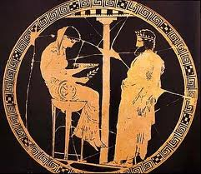
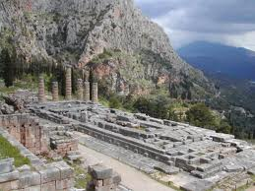
Pythia Detection, Localization, and Diagnosis of Performance Problems using perfSONAR
Constantine Dovrolis (PI),
Partha Kanuparthy, Sajjad Zarifzadeh, Madhwaraj GK
Warren Matthews, Danny Lee
Georgia Institute of Technology

Slide 2
Basics
Pythia is a data-analysis tool.
We will talk mostly about the implementation using perfSONAR data
Other active measurements could be used
Pythia does not use NetFlow, SNMP, syslogs or customer trouble tickets.
Our focus: performance problems.
Objectives: detection, localization, diagnosis.
Funded by DoE: started Sep/2011.

Slide 3
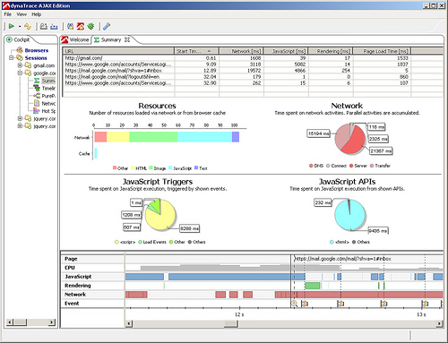
Goals
Short-term events
Major outages are easy
Near real time
troubleshoot problems
And plan upgrades.
Scalable
Configurable
Visualize useful summaries
Agent
Agent
Agent
Agent
Agent
Internet
Key: Lightweight agents!
Agent
Agent
Agent
One-way delays, loss, reordering
Detection
Diagnosis
Performance
Pathology
Definitions

Slide 4
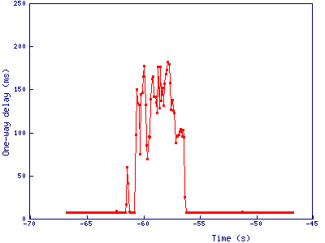
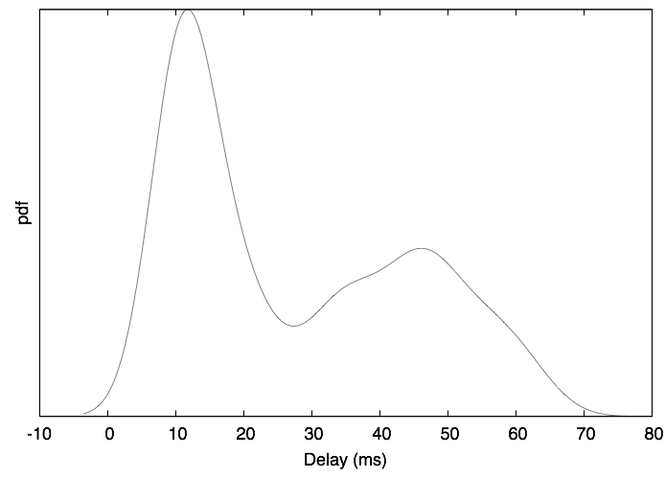
Detection
One-Way Delay Between Two PerfSONAR hosts.
Look for statistically significant deviations from baseline One-Way Delays
But, baseline can change abruptly
Scalability requirement: only a single pass through OWAMP time series is allowed
Baseline
Type | Baseline
Delay | Propagation + TX delay + noise
Loss | No loss
Reordering | No reordering
baseline
Deviation

Slide 5
Diagnosis
Pythia uses a model-based approach to associate each root-cause with an expected set of symptoms (signatures)
Which pathologies do we currently consider?
Various congestion types
Routing events and anomalies
Various loss-episode types
Reordering causes
Various end-host effects
Need to exclude problems with the end-host (monitor) itself to find network problems

Slide 6
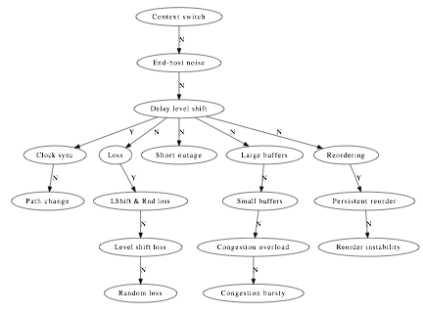
Pythia Diagnosis Tree
Input:
Detected Events
(delay, loss, reordering)
End-host
effects
Not shown:
Unknown type
NTP vs.
route events
Reordering
nature
Loss events
Congestion

Slide 7
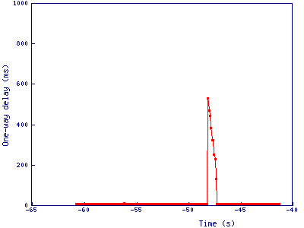
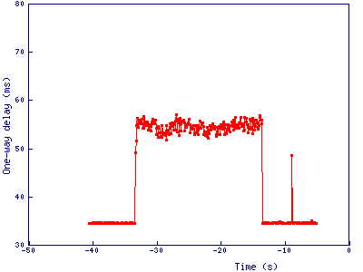
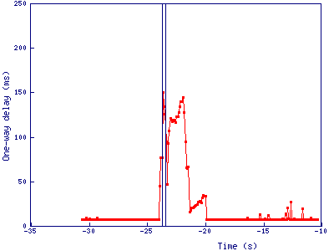
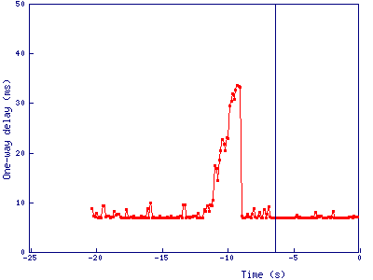
Common Pathologies
End-host effects
Congestion & buffers
significant backlog for long periods
Loss events
Routing changes
Reordering events
large triangles
Engineers know what congestion looks like
600ms rise!
Overload
Bursty
Delay-correlated losses
Random losses

Slide 8
Localization
Network Tomography: Localization of performance anomalies using active end-to-end measurements
Pythia is not able to localize each individual diagnosed event. It tries to identify links that are most likely the cause of problems.

Slide 9
Motivation for Range Tomography
Constantine used this example
S₂
2
S₁
1
4
5
S₅
3
S₃
Analog tomography models path/link performance as continuous random variables
Very sensitive to noise, needs long measurement
Binary (boolean) tomography models path/link performance as “good” vs “bad”
Limited resolution

Slide 10
Boolean Tomography
If we have several lossy links:
Measure 15% loss (1,5)
And 5% between (2,5)
And 7% between (3,5)
S₂
2
S₁
1
4
5
S₅
Boolean tomography would infer that (4,5) was the only lossy link because this is the only common hop for multiple measurements showing loss.
3
S₃

Slide 11
Range Tomography
Remember:
Measure 15% loss (1,5)
And 5% between (2,5)
And 7% between (3.5)
S₂
2
10
5
S₁
1
4
5
S₅
2
P(1,4)=10% (8-10%)
P(4,5)=5% (5-7%)
P(3,4)=2%
3
S₃
Range tomography gives best of analog and boolean.
To match a localization event with diagnosis events, look for significant overlaps in time.

Slide 12
Pythia – System Architecture
Pythia pulls data from perfSONAR (OWAMP, traceroute, ..)
Traceroute
MA
OWAMP
MA 3
Pythia
BWCTL
MA
OWAMP
MA 1
OWAMP
MA 2
...
MA
Bring it all together:
Localization
Preprocessing
Detection
Diagnosis

Slide 13
New Work
I joined the project last year because of my operational experience.
Partha also developed some initial visualization tools. Visualization remains under development.
Partha implemented the detection and diagnosis on live data. Previously he had used captured owp files.
Danny Lee joined the project too and implemented the localization on live data.
Danny has been working on scaling and optimizing the database. Now 2.8m entries.

Slide 14
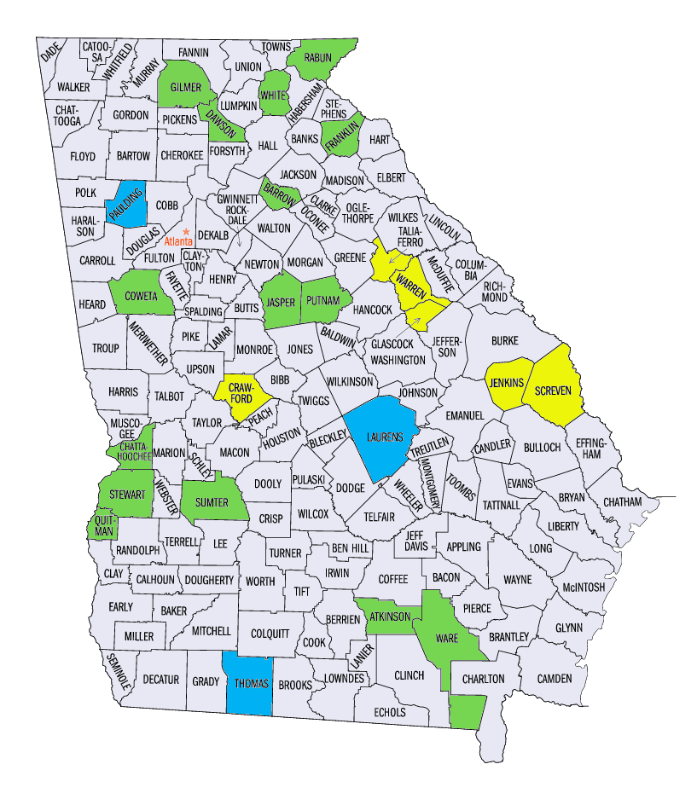
Our Testbed - GAMMON
We installed the Pythia agent code on hosts in the GAMMON project, 15 machines on multiple networks around Georgia.
Georgia does not have an education network serving schools. AT&T provide connectivity for most districts but GAMMON sites have 8 different service providers.
The Georgia Measurement and Monitoring (GAMMON) project studies network and application performance between K-12 school districts. Green represents districts with servers, blue are districts that have expressed willingness to host a server, and yellow is targeted for the next phase of deployment.

Slide 15
Front-End Visualization

Slide 16
Heatmap Table
Total of 1,380,318 events in February:
EndHostNoise 751,294 (54%)
does not seem to be related to hardware
DelayCorrelatedLoss 218,725 (16%)
RandomLoss 114,860 (8%)
Unknown 93,185 (7%)
Filter diagnosis type
time frame

Slide 17
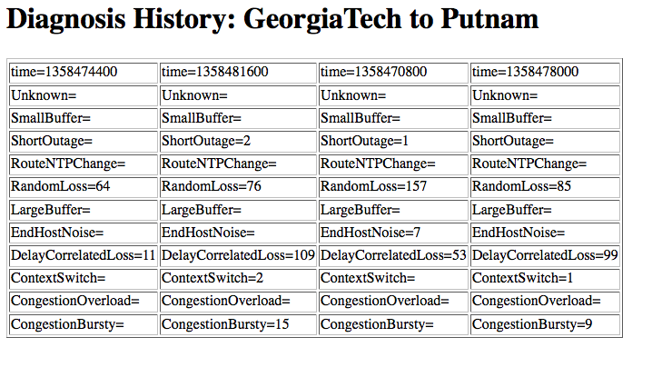
Diagnosis History
Intention was to track long-term trends, find issues that may otherwise disappear in the noise.

Slide 18
Localization
End host at Dawson
Brighter means more problems

Slide 19
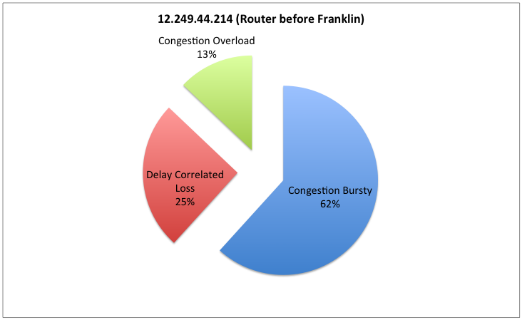
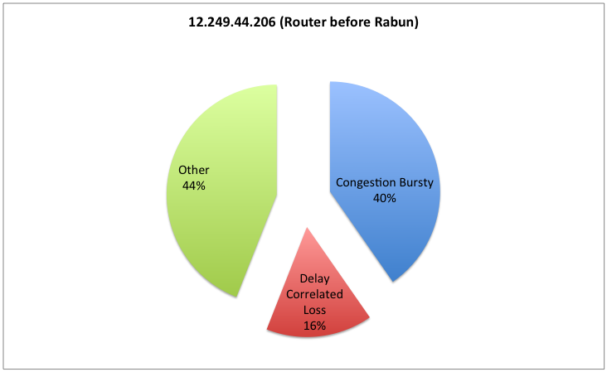
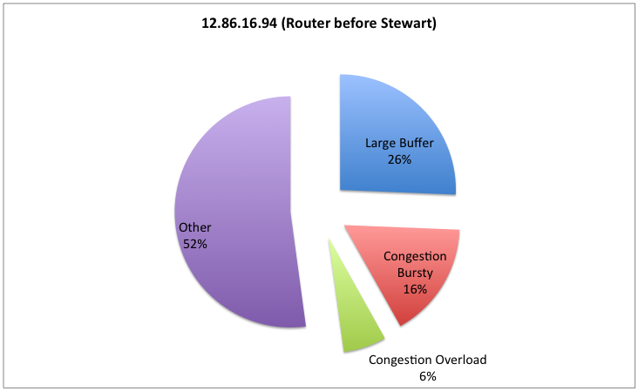
Root Cause

Slide 20
Summary: Work In Progress
Last year, Constantine reported that we would:
Diagnose more performance problems and improve existing tests ✔
Unsupervised clustering to identify unknown events ✗
Open-source system implementation of Detection, localization, diagnosis with a real-time data collection framework on ESnet, I2, PL-testbed, broadband networks ✔
Create front-end for users/operators ✔
The front-end is viewable at http://pythia.cc.gatech.edu
Other Achievements
Contributed to owamp source
Packaged pythia-agent for easy install

Slide 21
Further Work
Further Deployment
ESNET
Internet2
Others
Continue to improve near-real time analysis.
Continue to improve front-end performance.
We will continue to talk to IT directors, network administrators, upstream providers – Does Pythia help solve their problems?
}
We expect these to happen after the release of perfSONAR 3.3.

Slide 22
Project Publications
Sajjad Zarifzadeh, G. Madhwaraj, Constantine Dovrolis, “Range Tomography: Combining the Practicality of Boolean Tomography with the Resolution of Analog Tomography”. At the ACM IMC conference, 2012
Sajjad Zarifzadeh, Constantine Dovrolis, “Localization of Network Performance Problems with Multi-Level Discrete Tomography”. At the IEEE ICCCN conference, July 2012
Partha Kanuparthy, Constantine Dovrolis, “Pythia: End-to-End Diagnosis of Wide-area Performance Problems”. Under peer-review submission, 2013.

Slide 23
Any Questions?
constantine@gatech.edu

