Slide 1
Towards 100Gbps End-to-end Data Transfer: Zero-copy with RDMA vs TCP
Dantong Yu and Shudong Jin
Brookhaven National Laboratory
Stony Brook University
Notes:
Abstract
Providing high-speed data transfer is vital to various data-intensive applications, such as those in cloud computing, grid computing, and data centers. While remarkable advances in hardware technology have provided ultra-high-speed network bandwidth, the existing protocols and applications may not yet fully utilize the bare-metal bandwidth due to their inefficient design and expensive OS kernel processing. Remote Direct Memory Access (RDMA) offers a promising technology to offload software protocols to hardware devices, and directly can move bulk data from the source memory to the remote host memory with kernel-bypass and zero-copy operations. However, RDMA originally was designed for transferring data with low latency, and its benefits have not been fully exploited in remote data transfers due to the complex programming requirement to handle high latency while affording high performance. In this paper, we address this challenge and design an efficient RDMA data transfer protocol that is implemented as general communication middleware.
The protocol includes flow control and task synchronization, and maximizes the parallelism of RDMA operations between the data sources and destinations. The resulting middleware greatly simplifies RDMA-based data transfer, and is suitable for various data transfer applications. We demonstrate the benefit in performance of this protocol and middleware on various local and wide area testbeds, including that of the DOE's Advanced Networking Initiative (ANI) with both RoCE and InfiniBand links.
Hello everyone. I’m Yufei Ren from Stony Brook University. Today, I’m going to present a research paper published by some of my colleagues and me, including my adviser Dantong from BNL, Brian and Eric from LBL.

Slide 2
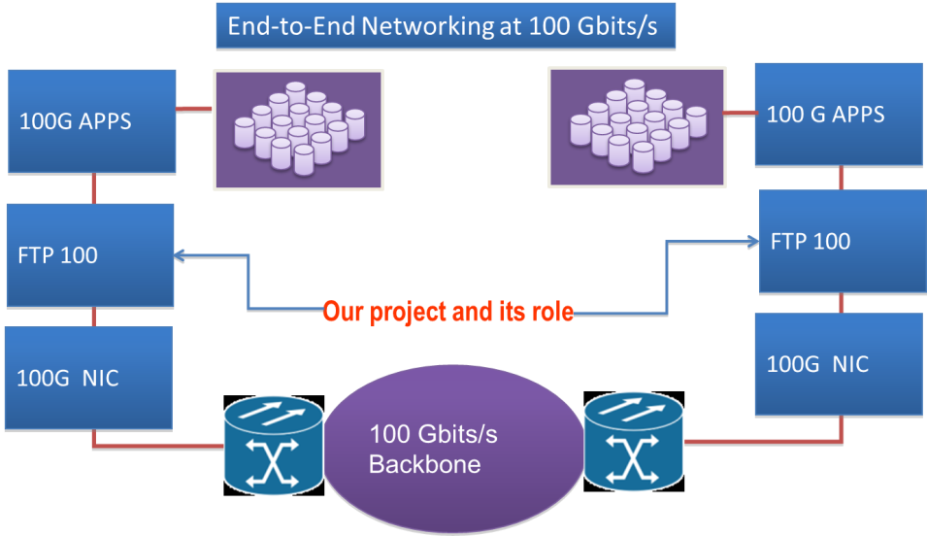
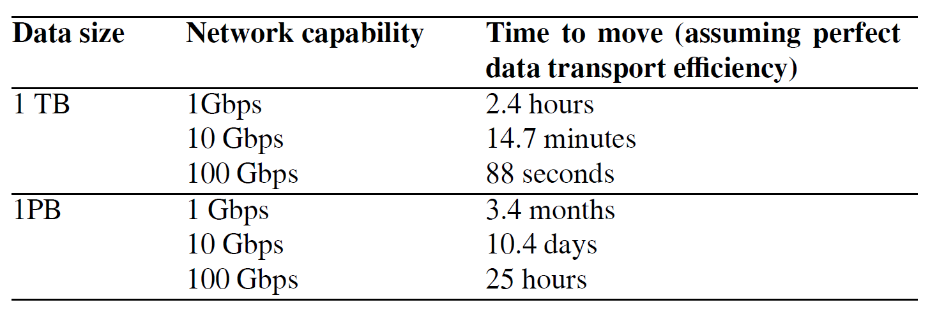
Project Background
Data Intensive Application
Explosion of data, and massive data processing
Ultra high speed network
QDR 40Gb/s, FDR 56Gb/s
100Gb/s InfiniBand and Ethernet
Our project goal
fully utilizes resources of HPC hardware
eliminate end-to-end data transfer bottlenecks
Design protocols and develop software to support high performance data transferring/synchronization in and between data centers

Slide 3
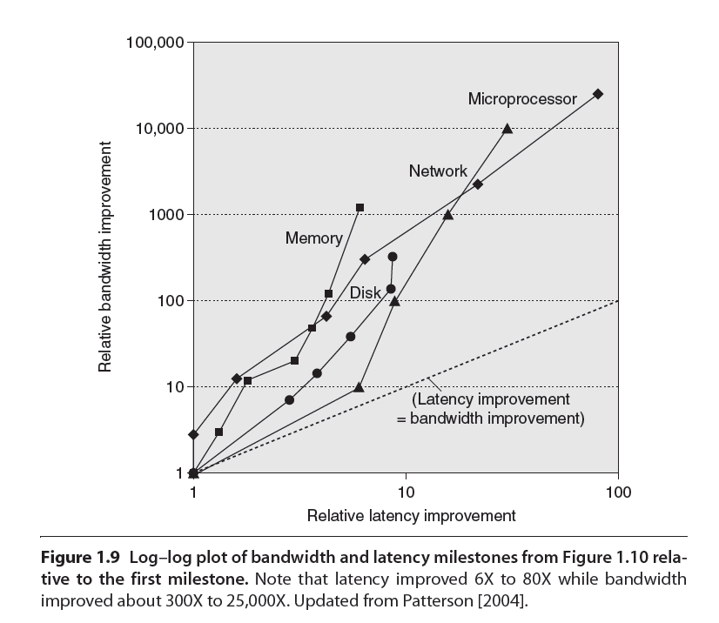
RDMA Challenge
Why not TCP?
Data copies
CPU intensive
Complex kernel tuning issues
Why RDMA?
Zero-copy
kernel bypass
InfiniBand, RoCE
RDMA challenge
Buffer management
Asynchronous, event based programming paradigm
Notes:
Kernel tuning includes kernel buffer, interrupt tuning

Slide 4
Outline
RFTP Protocol Design and Implementation
RFTP infrastructure for Performance and Scalability Test
Migration RFTP into Internet (Best Effort)
TCP kernel bypass – Sendfile and splice
TCP NUMA-aware tuning
Performance Results
Conclusion and Future Work

Slide 5
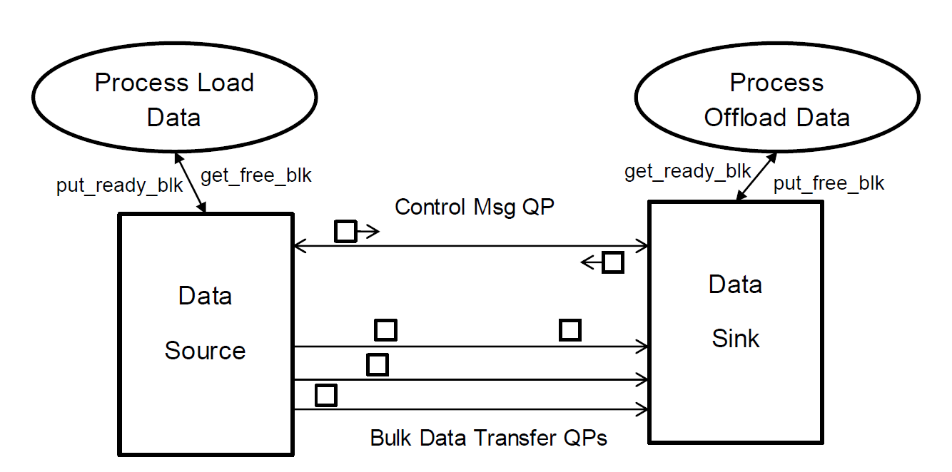
RFTP Protocol and Software
Protocol highlights
Design a dedicate Queue Pair (QP) to exchange control messages
Multiple data transfer QPs
Proactive buffer information feedback
RFTP: RDMA enabled FTP
New ‘rput’ and ‘rget’ command based on RDMA technology
Directory hierarchy
Integrate direct IO for file operation
Notes:
Kernel tuning includes kernel buffer, interrupt tuning

Slide 6
Our Design: Software Architecture
Data Structure
Threads
Data Block List
Sender
Our design includes a middleware layer, which is responsible for resource management, task scheduling and synchronization, and parallelism of RDMA operations.
Receive Control Message List
CE dispatcher
4
3
2
Send Control Message List
CE slave-1
CE slave-2
...
Remote MR Info List
CE slave-n
Queue Pair List
Logger
application
Memory
1
system
QP-1
QP-2
QP-n
CQ
Receive a Block of User Payload
Hardware
HCA
Notes:
Based on our protocol description, we show our software architecture.
Our software design includes two sections. The data structures section is used for resources abstraction, such as memory blocks, connections. Threads section includes a thread pool to handle various kinds of tasks and events. Our software is a combination of pipeline and master/worker model. That is useful to take advantage of multi-core environment. Let’s explain how this model works by an example about receiving a memory block.

Slide 7
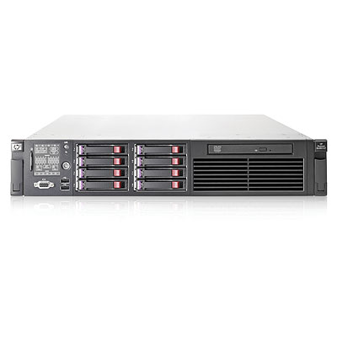
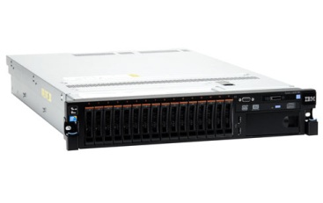
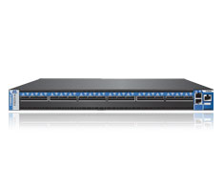
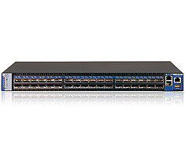
Local Test Environment Configuration setup
iSER
(iSCSI Extensions for RDMA)
RFTP
(RDMA enabled FTP service)
RDMA based end-to-end data transfer solution with iSER
Backend: SAN, InfiniBand, iSER, 56Gbps*2 FDR
Frontend: LAN, RoCE, RFTP, 40Gbps*3 QDR
HP DL380
IBM X3650
Mellanox FDR Switch
InfiniBand SX6018
Mellanox QDR Switch
Ethernet SX1036
HP DL380
IBM X3650
Mellanox ConnectX 3 VPI
56Gbps FDR
Mellanox
ConnectX 3 Ethernet
40Gbps QDR
Notes:
VPI: Virtual Protocol Interconnect
iSER: iSCSI Extensions for RDMA
NUMA aware tuning

Slide 8
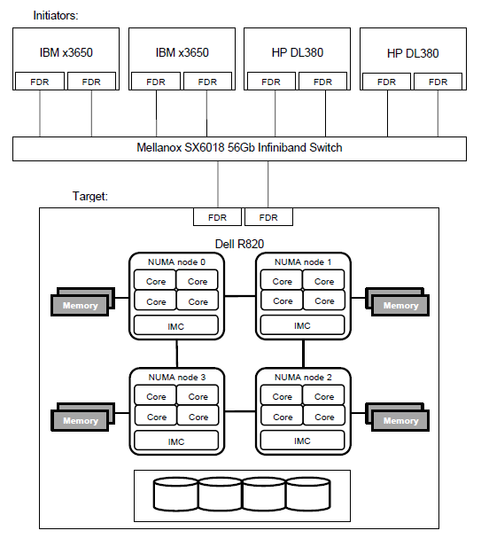
Tuning in state-of-the-art NUMA systems
Front End - RFTP
Use `numactl’ to bind RFTP to specified NUMA node
Load-balance between NUMA nodes with multiple network adapters.
Back End - iSCSI/iSER
Integrate libnuma into Linux SCSI Target Framework – tgtd.
Support RDMA driver (iSER). TCP driver integration is under-development.
Improve iSCSI throughput 80% in 4-nodes Dell system.
Notes:
Kernel tuning includes kernel buffer, interrupt tuning

Slide 9
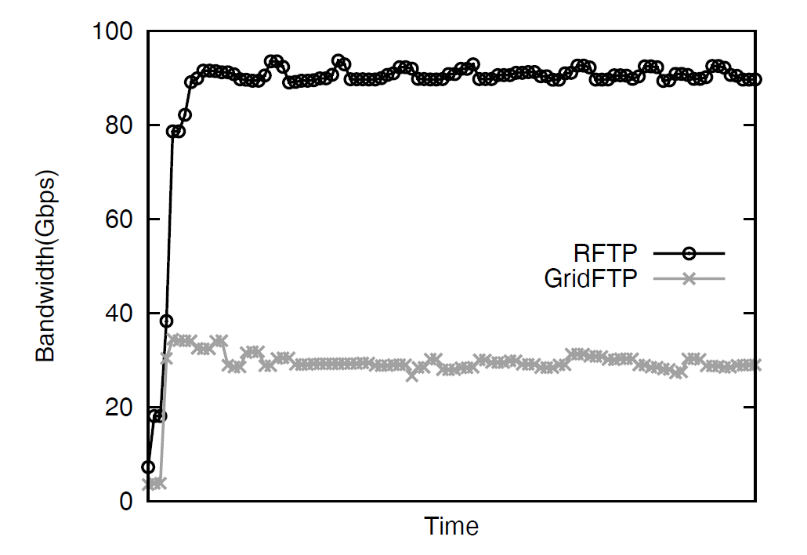
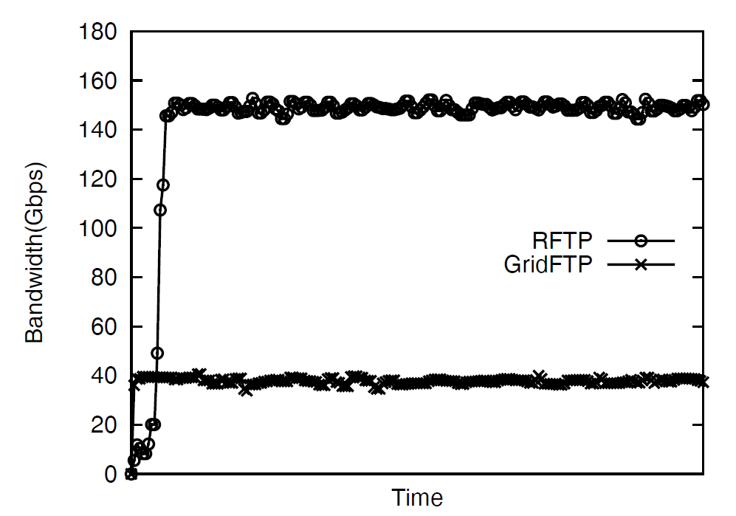
Live Demo in LAN
Single directional test result
Bi-directional test result
Notes:
http://ftp100.cewit.stonybrook.edu/ganglia/
Create a page to monitor traffic and CPU utilization of LAN
http://ftp100.cewit.stonybrook.edu/sc12/

Slide 10
Use RFTP IN WAN Internet

Slide 11
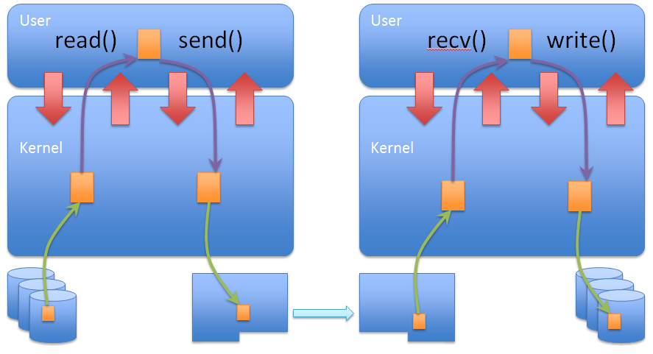
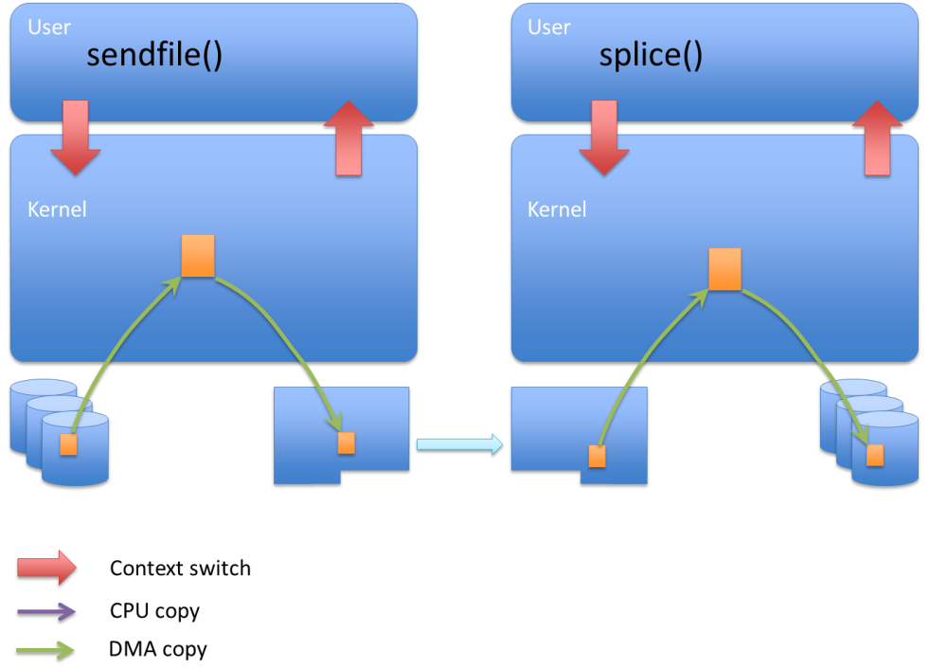
Sendfile/Splice based Approach
Sendfile/splice is a Linux TCP zero-copy interface.
Copy By Reference
Work out wire-speed on 10Gbps network environment (Intel, IBM, Broadcom) with extremely low CPU load
Can we scale this solution up to 40Gbps/100Gbps?
Notes:
Kernel tuning includes kernel buffer, interrupt tuning

Slide 12
splice tuning in Mellanox Adapters
splice bug report
Splice didn’t work in Mellanox 40 Gbps adapters configured with jumbo frames – 9000 bytes.
We did problem debugging, and benchmark with Mellanox supporters.
RFTP now works fine with read/write, sendfile and splice.
splice on sender side achieves comparable bandwidth as read/write did.
Configurable for end users.
Notes:
Kernel tuning includes kernel buffer, interrupt tuning

Slide 13
Mellanox splice bug illustration
As an Ethernet frame comes into a host, it generates an interrupt and the driver handles this frame.
In traditional data path, the driver copies data from hardware into kernel socket buffer, then kernel copies it to user space.
In splice case, the driver copy data from hardware into a Operating System page directly and kernel ``moves’’(re-direct) this page to a pre-defined pipe without data copy.
If previous page is not filled up with user payload, i.e. 1K is empty in a 4K page, existing Mellanox driver will take new coming data into that 1K empty buffer. This cause a read/write synchronization problem - the kernel takes it as 3K data but it filled up with 4K actually.
Mellanox fixed this problem by requesting new pages for every truck of new coming data.
Slow down the performance
Buggy, new problems were introduced
Notes:
Kernel tuning includes kernel buffer, interrupt tuning

Slide 14
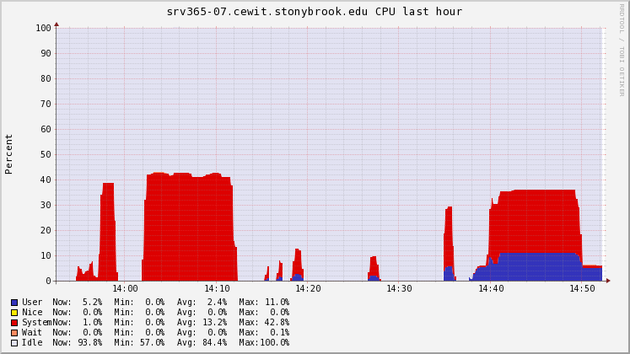
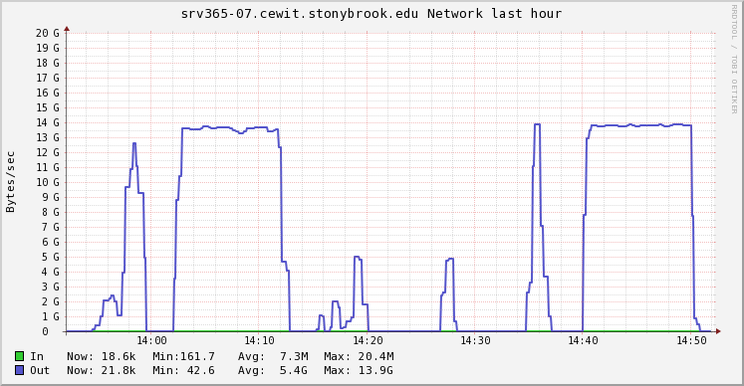
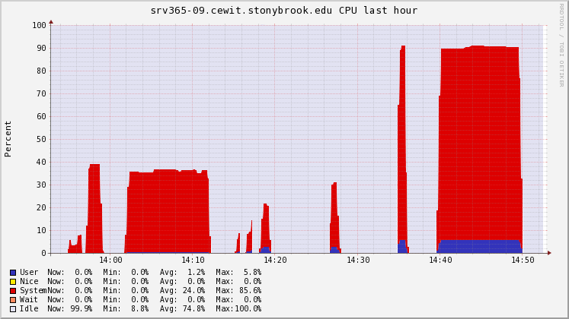
After splice bug fixing
Client’s CPU usage
Throughput
read/write
splice
read/write
120Gbps
splice
Read/write and splice achieve comparable bandwidth, while splice consumes much more higher CPU usage in server side.
We still need collaborate with Mellanox to improve the splice usage.
Server’s CPU usage

Slide 15
Can we scale up RFTP with standard TCP
IRQ binding
Restart the lldpad (link layer discovery protocol) script and turn on flow control using ethtool
/etc/init.d/lldpad stop and restart
ethtool –A ethX rx on tx on
numactl binding
TCP’s peak performance is about 110 Gbps, and stable performance is about 85Gbps.
NICs not stable sometimes with large block sizes

Slide 16
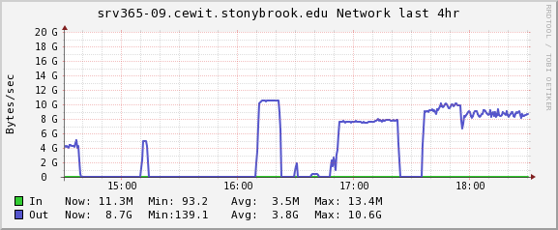
iperf
Rftp
end-to-end
r/w
Rftp
end-to-/dev/null

Slide 17
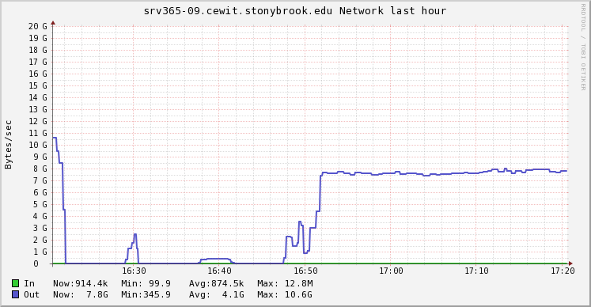
Scale-up to more NICs
2 NICs
3 NICs

Slide 18
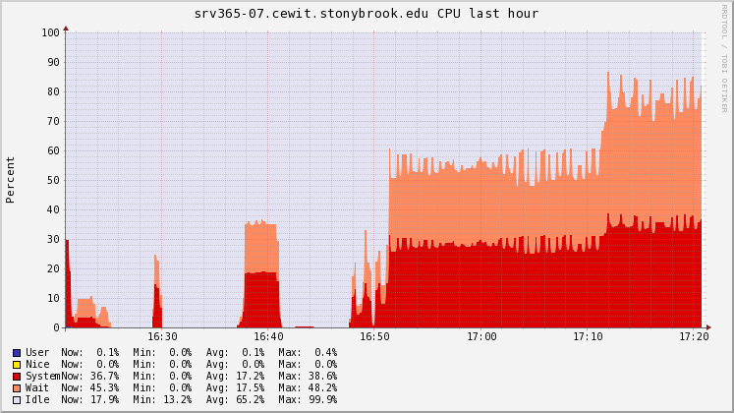
Possible reason: Node 1 is almost 100% busy
2 NICs
3 NICs

Slide 19
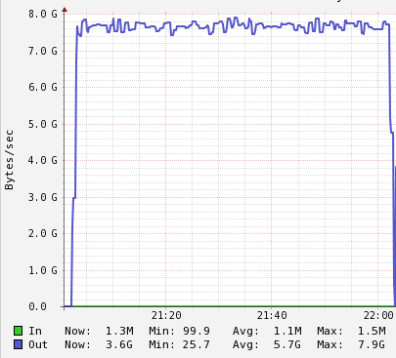
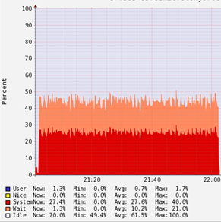
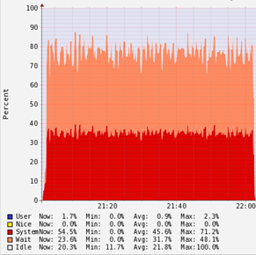
Performance
Throughput
Sender CPU
Receiver CPU

Slide 20
SC’2012 End-to-End, WAN
Our initial plan was to use the 40Gbps RoCE links between University of Michigan and BNL
Packet loss rate was high, and losses are bursty
RoCE doesn’t work well under heavy losses
Caltech’s 80Gbps RoCE links work for us!
2 clients, each with 40Gbps RoCE, loopback to a server with 2x 40Gbps RoCE
All hosts are equipped with Fusion IO SSDs
RTT close to 50ms

Slide 21
SC ‘12 Live Demo

Slide 22
80Gbps

Slide 23
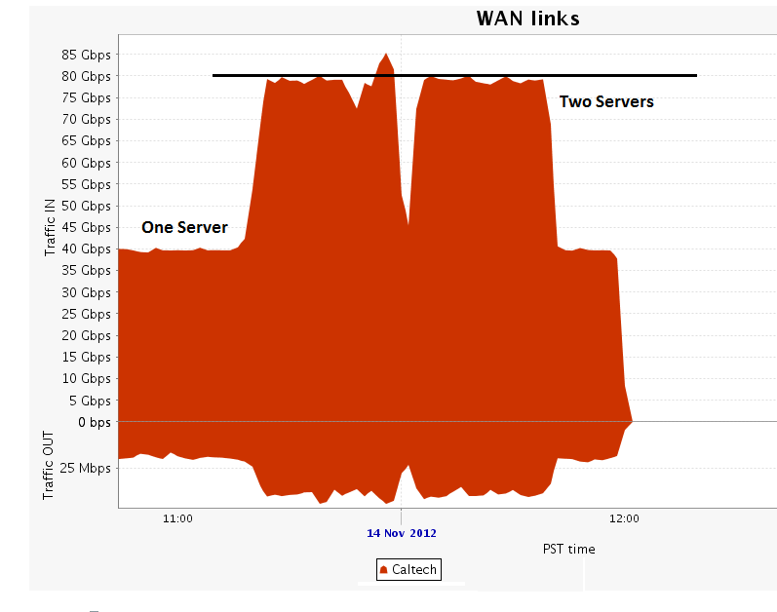
Additional Test of RFTP done by CalTech

Slide 24
ANI WAN Link, Summer 2012
National Energy Research Scientific Computing (NERSC) to Argonne National Laboratory (ANL)
2000 miles away
RTT: 90ms
40Gbps RoCE NIC
Notes:
BDP = 63MB

Slide 25
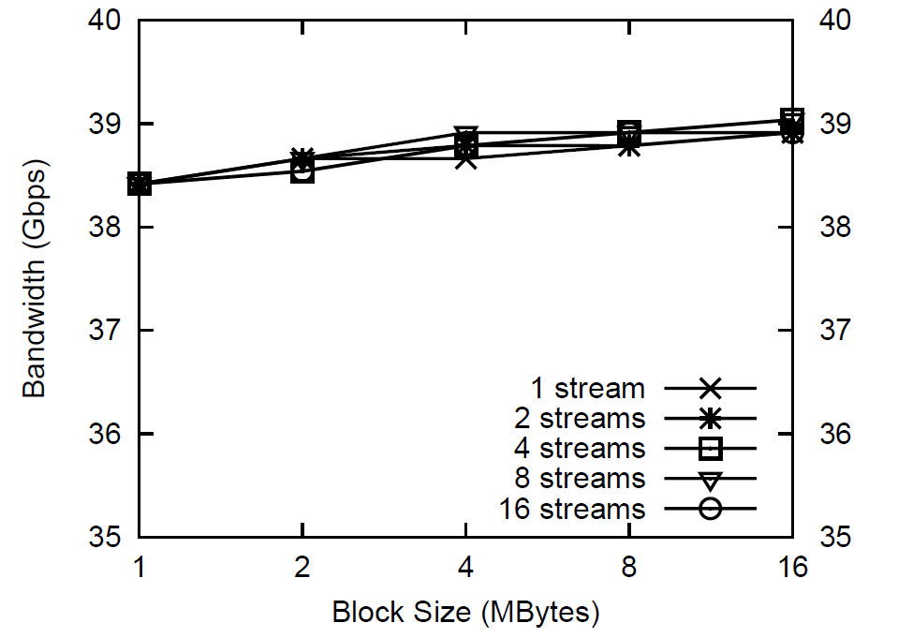
RFTP bandwidth with various block sizes and numbers of streams in WAN

Slide 26
Conclusions
Modern data centers urges modern interconnections with extremely high throughput and low latency.
Mellanox: 40Gbps RoCE, 56Gbps InfiniBand
RDMA is a promising technology
Zero-copy and kernel bypass
Software complexity: asynchronous programming mode, buffer management
Lack of generic protocol and interface for both LAN and WAN with long RTT
CCI integration
There is 30% performance difference between hardware bypass (RDMA) and software approach
End-to-end RDMA data transfer solution
High Performance Software Defined Network
Standard Best effort internet

Slide 27
Future Works in the next six months and more
Complete the RFTP with libnuma call
Supports reading NUMA/Memory/IRQ in /proc
Continue working with Mellanox to fix their TCP driver bugs
Looking into the splice problem that the size limitation in copy by reference (current limitation is 16KB)
Add CCI support with ORNL

Slide 28
Publications
Yufei Ren, Tan Li, Dantong Yu, Shudong Jin, and Thomas Robertazzi, Brian L. Tierney, Eric Pouyoul, "Protocols for Wide-Area Data-Intensive Applications: Design and Performance Issues", In Proceedings of the IEEE/ACM Conference on Supercomputing SC'12, Salt Lake City, Utah, November 2012.
Yufei Ren, Tan Li, Dantong Yu, Shudong Jin, Thomas Robertazzi, “Design and Testbed Evaluation of RDMA-based middleware for high-performance data transfer applications”, The Journal of Systems and Software (Elsevier), accepted, in press.
Yufei Ren, Tan Li, Dantong Yu, Shudong Jin, Thomas Robertazzi, "Middleware Support for RDMA-based Data Transfer in Cloud Computing", In Proceedings of the High-Performance Grid and Cloud Computing Workshop (held in conjunction with IPDPS 2012), Shanghai, China, May 2012.
RFTP: RDMA based FTP service
http://ftp100.cewit.stonybrook.edu/rftp/
rperf: RDMA performance evaluator
http://ftp100.cewit.stonybrook.edu/rperf/
Software

Slide 29
Thank You

