Slide 1
PMG Agenda
Status of the grant proposal for U Tennessee to purchase MVTX staves and RU’s
Plan to negotiate and sign agreements with LANL, LBNL, MIT for MVTX activities
MoU with C-AD
LLPs
Initiate the signature process for the PPMP
Status of new hires and succession plan
Status of the analysis of the impact of a FY21/FY22 RHIC run
Near Term sPHENIX Schedule including reviews

Slide 2
Status of Grant Proposal to Purchase ALICE Staves and RU’s
In December Univ of Tennessee submitted at Grant Proposal for $1.3M to fund the purchase of ALICE staves and RU’s.
At the time we expected UTK would have the funds in 4 weeks.
  CERN was informed to expect funds in January
1.5 weeks ago we heard from ONP that the proposal bounced
  A DOE internal review committee rejected the purchase as being too specific for the sPHENIX MVTX. They wanted a more generic proposal that described a variety of potential uses for the staves
The proposal was rewritten by BNL and is about to be resubmitted by UTK to DOE. Expect this to happen today.
Elizabeth Bartosz of DOE said that the process will take ~6 weeks to get funds to UTK.
Once we have confirmed that the proposal was submitted, we’ll inform CERN of the situation

Slide 3
Status of MVTX Budget Reduction
Based on DOE guidance the MVTX TPC can be no more than $5.0M
The MVTX TPC estimate as of December after the correct burdens and rates were applied was $5.6-5.7M
About 60% of the cost is labor at LANL, LBNL and MIT
We are currently doing a final adjustment on the labor due to task reassignments coming out of the December MVTX Workshop
Once this step is done we will approach all three institutions with a proposed labor number that puts us below the budget cap.
  Each institution has a unique situation. We will negotiate with them individually
Our goal is to hit $4.9M

Slide 4
Status of Final MoA w/ CAD
Final sPHENIX MoA w/ CAD covers conventional facilities
Jim Mills is handling this for the sPHENIX side and Joe Tuozzolo from the CAD side. Both are very busy with other responsibilities
We’re impacted due to the retirement of Don Lynch and Paul Giannotti
sPHENIX has a requirements document in draft form and nearly ready to submit to CAD.
  Water, power, grounding, HVAC, environmental controls, safety systems, etc.
We’d like to have a draft ready to sign by next week.

Slide 5
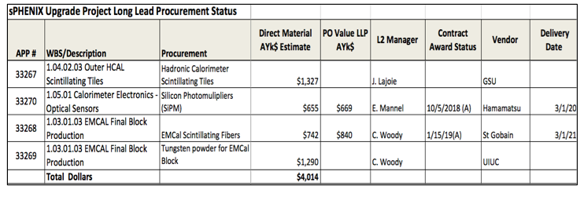
LLP Status
100k SiPMs has been placed. First parts in Feb 2019. Order complete Mar 2020
Scintillating fiber order placed. First parts in Apr 2019. Order complete Mar 2021
Working on the scintillating tile order. To be placed with Georgia State University
Tungsten powder LLP-4 order waits for additional preproduction work at UIUC. Expect to split the order 50% in FY19, 50% in FY20.

Slide 6
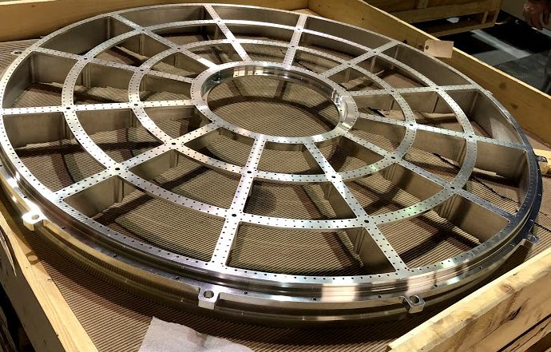
TPC Wagon Wheels at SBU
Both end cap for full-size TPC prototype have arrived at SBU. If prototype tests determine that no modifications are need then it would be part of the final detector

Slide 7
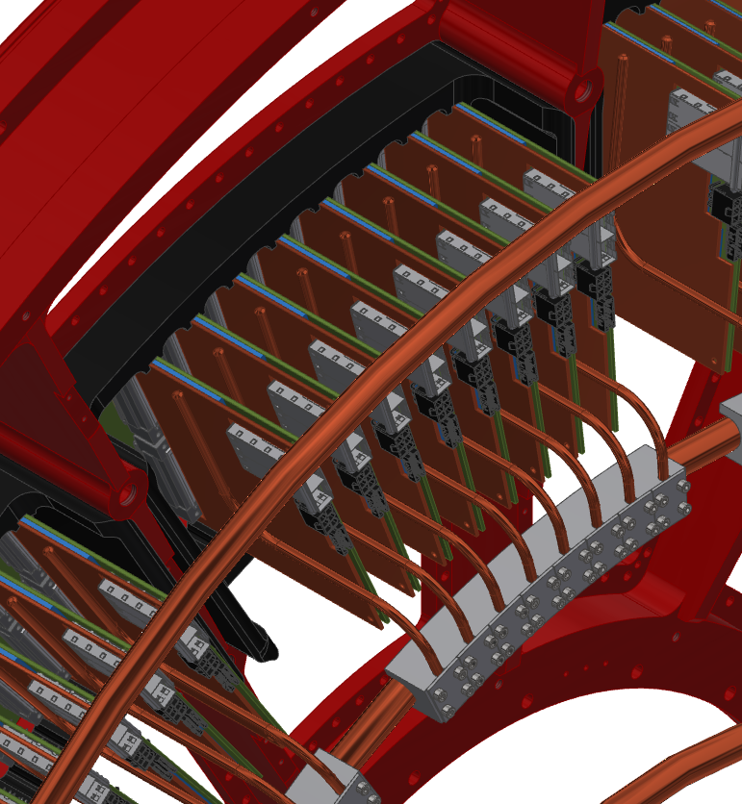
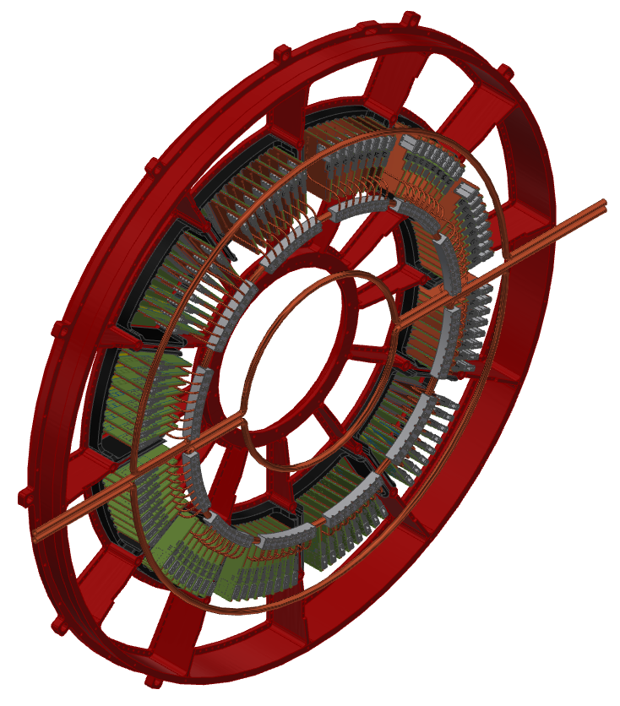
TPC Electronics Location and Cooling Design
Wagon wheel + Front End electronics + cooling distribution system
FEE cooling system

Slide 8
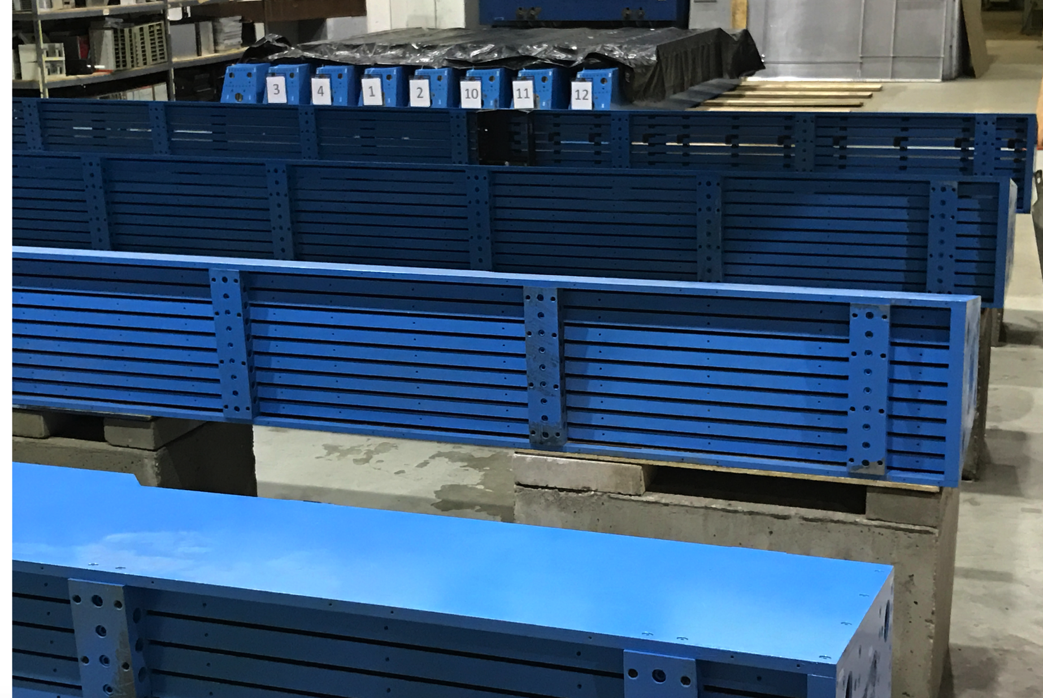
Barrel Magnet Steel Sectors

Slide 9
High Priority Issues
Finalize sPHENIX PPMP
  Incorporated changes into PPMP requested by ONP, BHSO and BNL
  Ready to passback to BNL ALD and Director’s Office prior to sending to BHSO and ONP
Prepare for February Budget Briefing
  Status of sPHENIX
  Describe approach of managing sPHENIX under new rules for MIE projects w/ TPC < $50M
  Describe potential schedule impact of a 16 week Run-22 (2022)
EV Preparation for PD-2/3
  Practice EVMS starting now. Have the process debugged by early CY2019.
  We will use change control on FY19 LLP orders.
  Incorporate EV calculations in monthly financial report to DOE

Slide 10
High Priority Issues -continues
Personnel issues
Replace two recently retired engineer: Chief Mechanical engineer and Engineer in charge of sPHENIX 1008 Infrastructure.
  Req for replacement of Chief Mechanical engineer in the system for 1.5 weeks. Interviews start next week.
  Req for replacement of Infrastructure Engineer to follow.
We supplemented the designer effort on the TPC

Slide 11
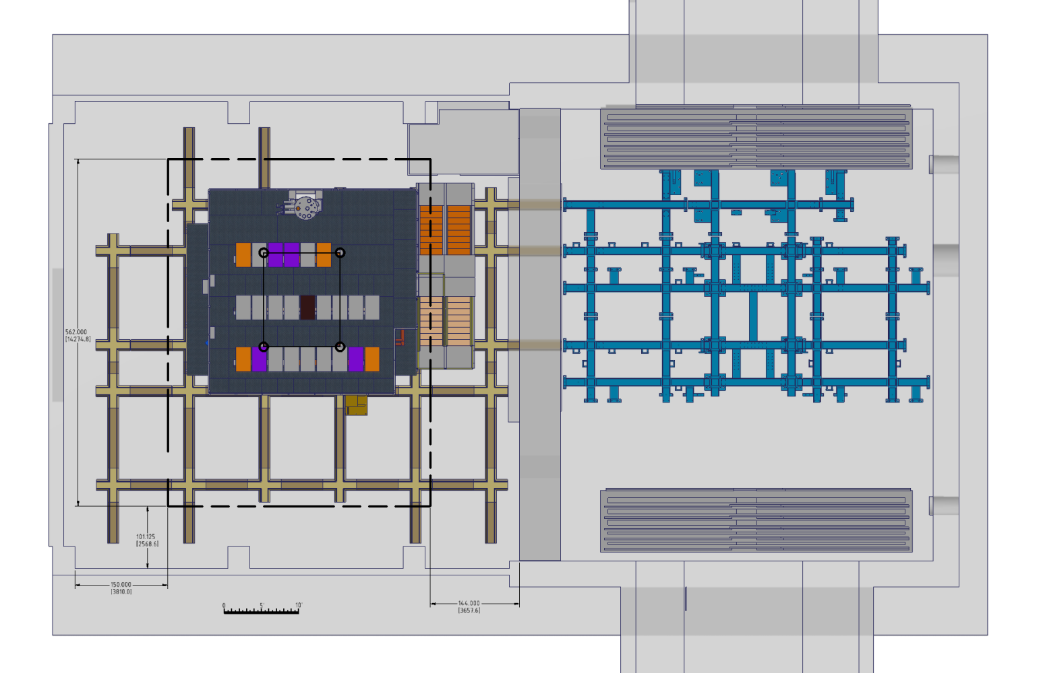
FY2022 Schedule Issues
A FY2022 run should have no impact on the MIE schedule
Assembly & disassembly of the 1008 shield wall looks feasible but requires a conclusive test this summer
Impact on cryo installation schedule for SC-Magnet needs further study
Plan View of the 1008 Hall

Slide 12
sPHENIX Calendar
NP Budget Briefing Feb 14, Germantown, MD
  sPHENIX Update at the meeting w/ DOE
sPHENIX in Asia meeting Mar 25-27, Taiwan
  sPHENIX has 21 collaborating institutions in Asia
Practice for Director’s Review Week of Apr 1, BNL
Director’s Review Week of Apr 8, BNL
  Covers MIE + Infrastructure and Facility + MVTX
Practice for the PD-2/3 Review Week of May 13, BNL
PD-2/3 Review (MIE only) May 28-30

Slide 13
How Will Future Reviews be Administered?
Under the new sub $50M Project BNL Management Scheme how will future reviews be administered?
What is the role of the Project in:
Preparing the charge?
Selecting the committee and managing their logistics at BNL?
Setting the review agenda?
Reserving meeting rooms, providing admin assistance, review dinner, etc.?

Slide 14
Back Up

Slide 15
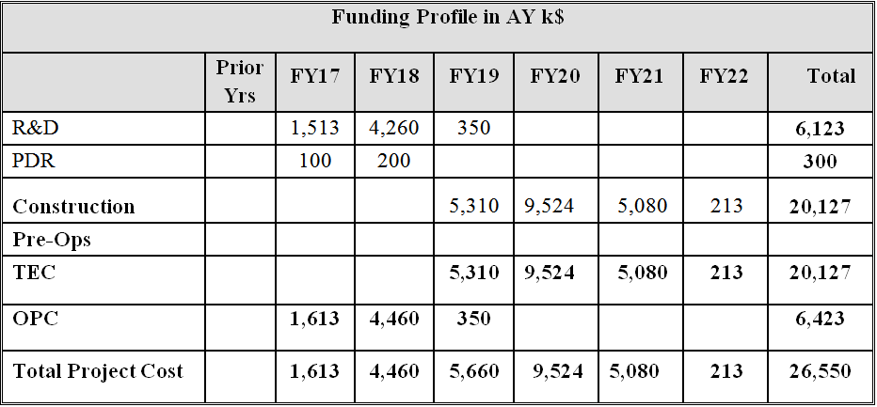
Budget at CD-1/3A
sPHENIX Budget Profile

Slide 16
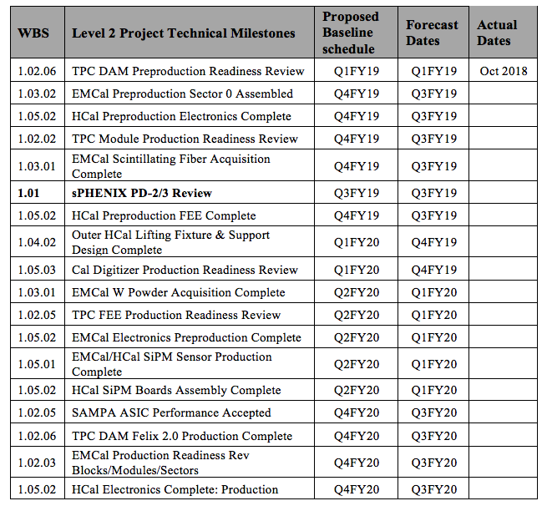
L1 and L2 Milestones

Slide 17
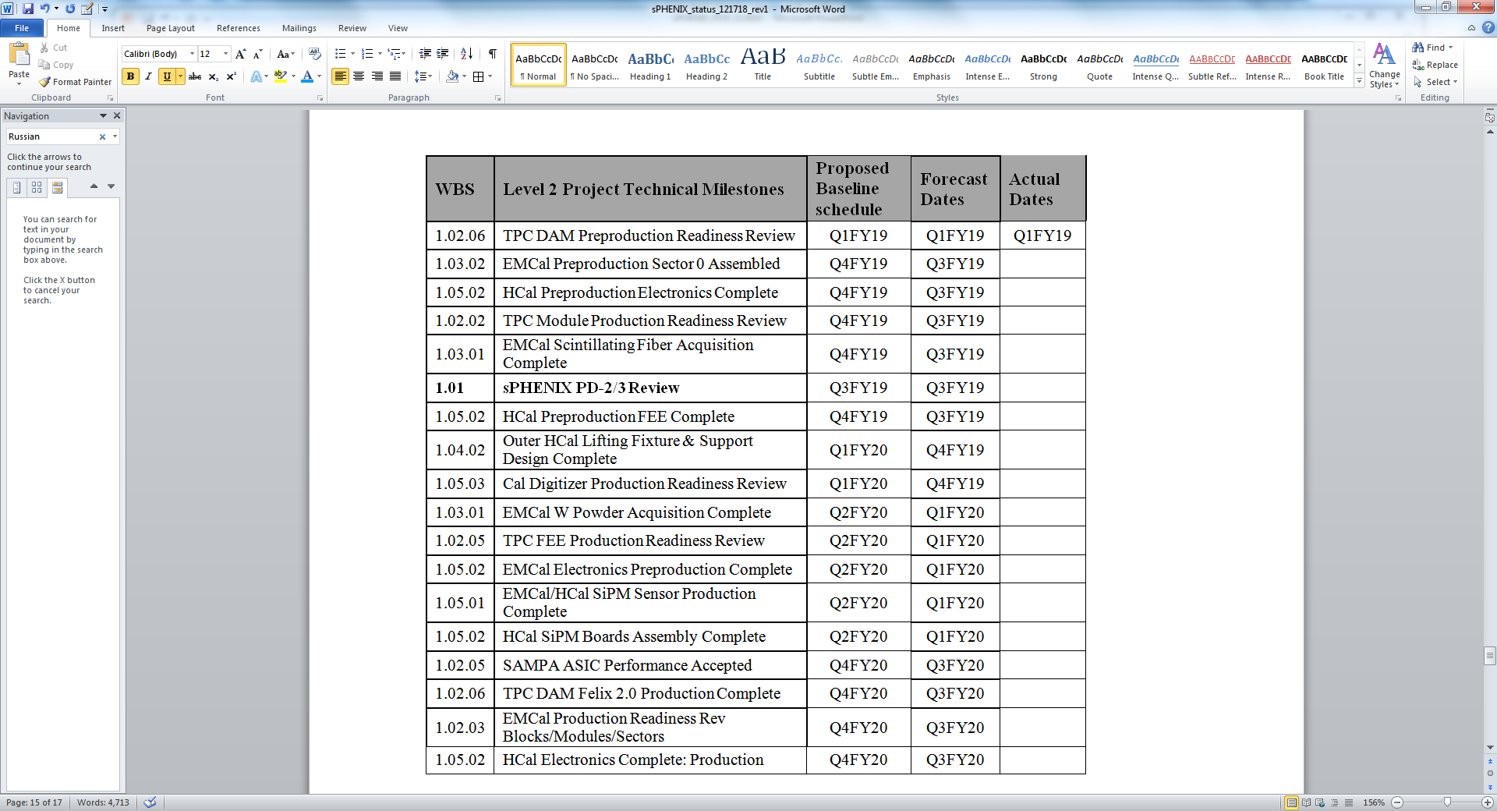
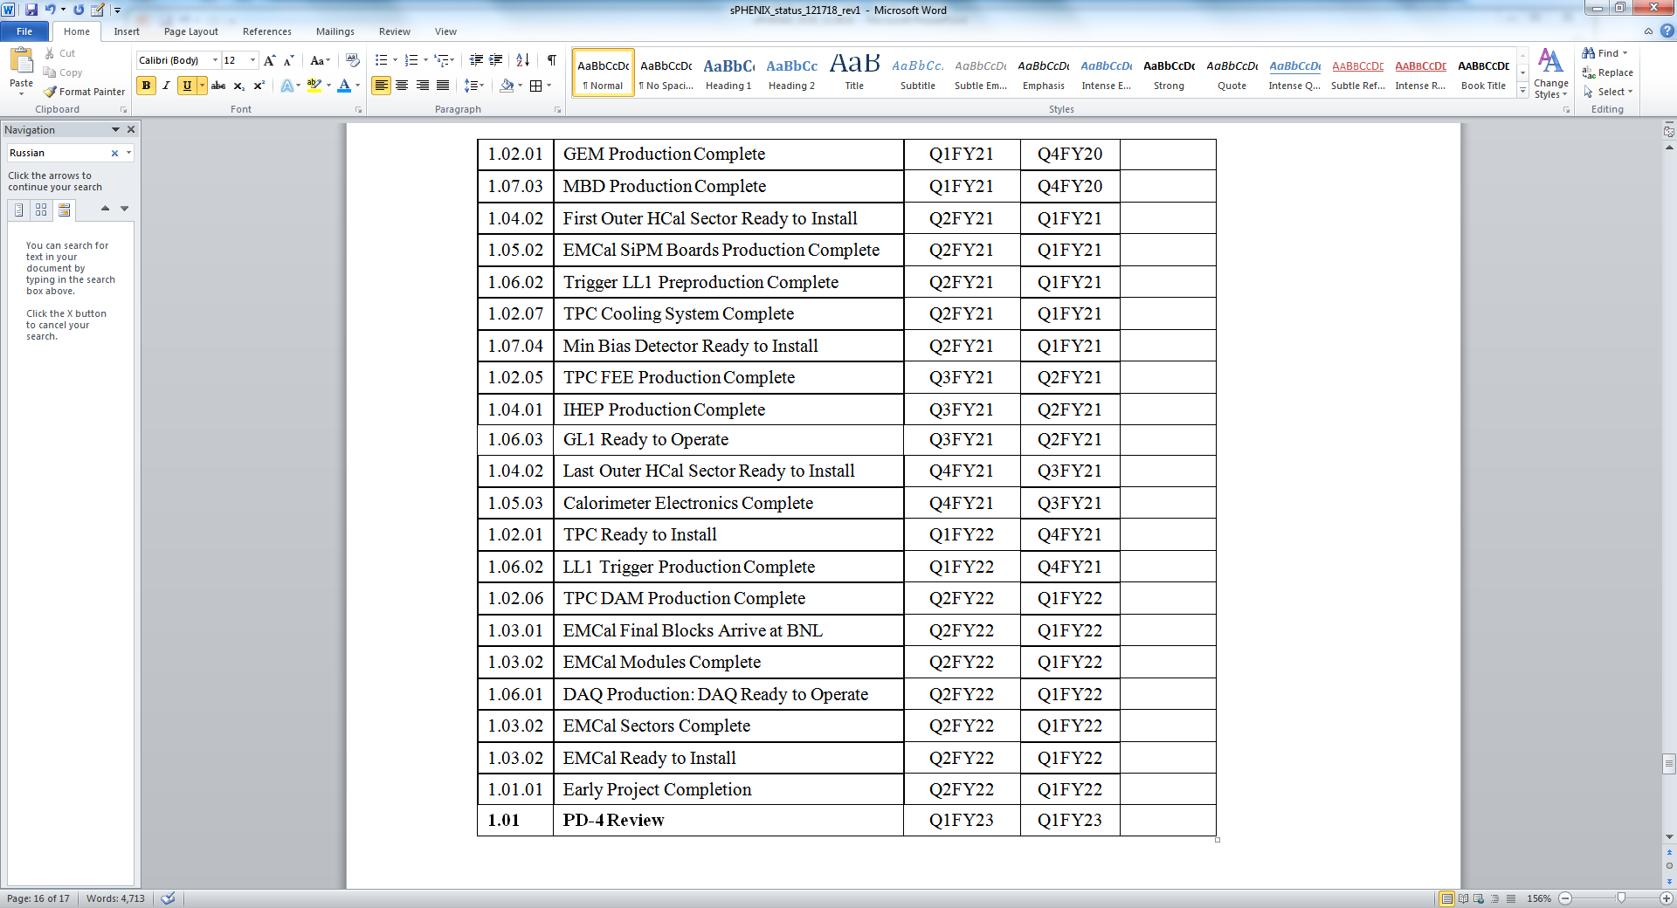
L1 and L2 Milestones

