Slide 1
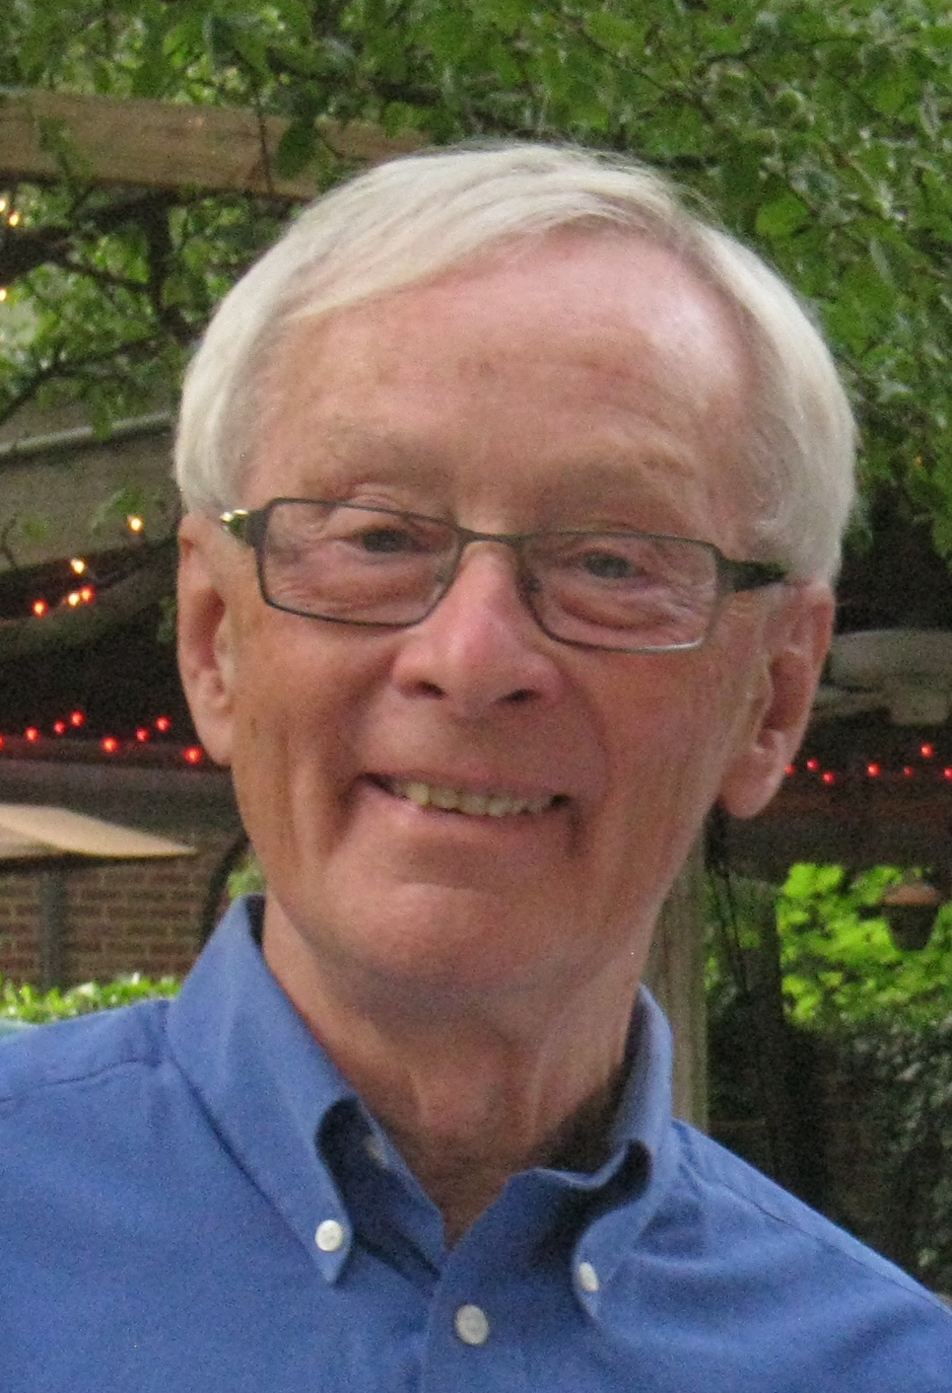
The Bill Willis CERN Years
Personal reminiscences of
Chris Fabjan’s Golden Years
Willis Symposium, BNL April 26th, 2013

Slide 2
Where it all began: the Impactometer
A new Vision in Physics
  search for and study charged leptons
  search for and study neutrinos
  emphasis on complete event information
Required a revolution in experimentation
Vision and revolution implemented at CERN from 1973 onwards

Slide 3
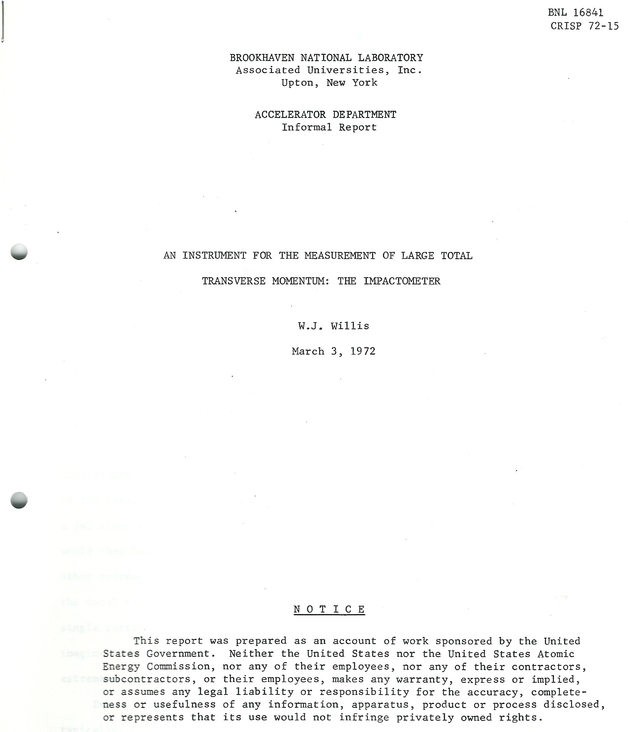
Impactometer

Slide 4
Revolution in Experimentation
Physics program required performance of the experimental techniques at the limit of the detector physics
  A new paradigm in experimental physics
Physics program required new experimental techniques
  full event information: hadron calorimetry
  Neutrinos: missing transverse energy
  Electron detection: Transition radiation
Bill arrived at CERN with his plans in his head…
Off to a flying start

Slide 5
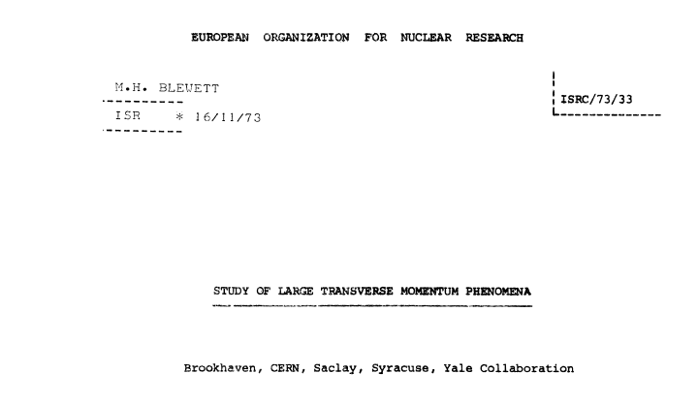
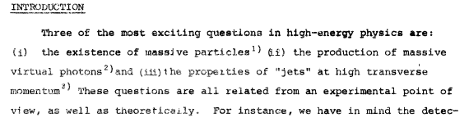
‘R806’

Slide 6
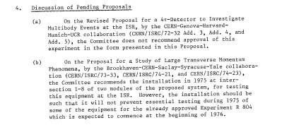
1973: Two proposals for 4π Facilities
The Competition is not approved
The Willis proposal is approved, albeit
  insights meets scepticism: is a ‘Test’: R806T…

Slide 7
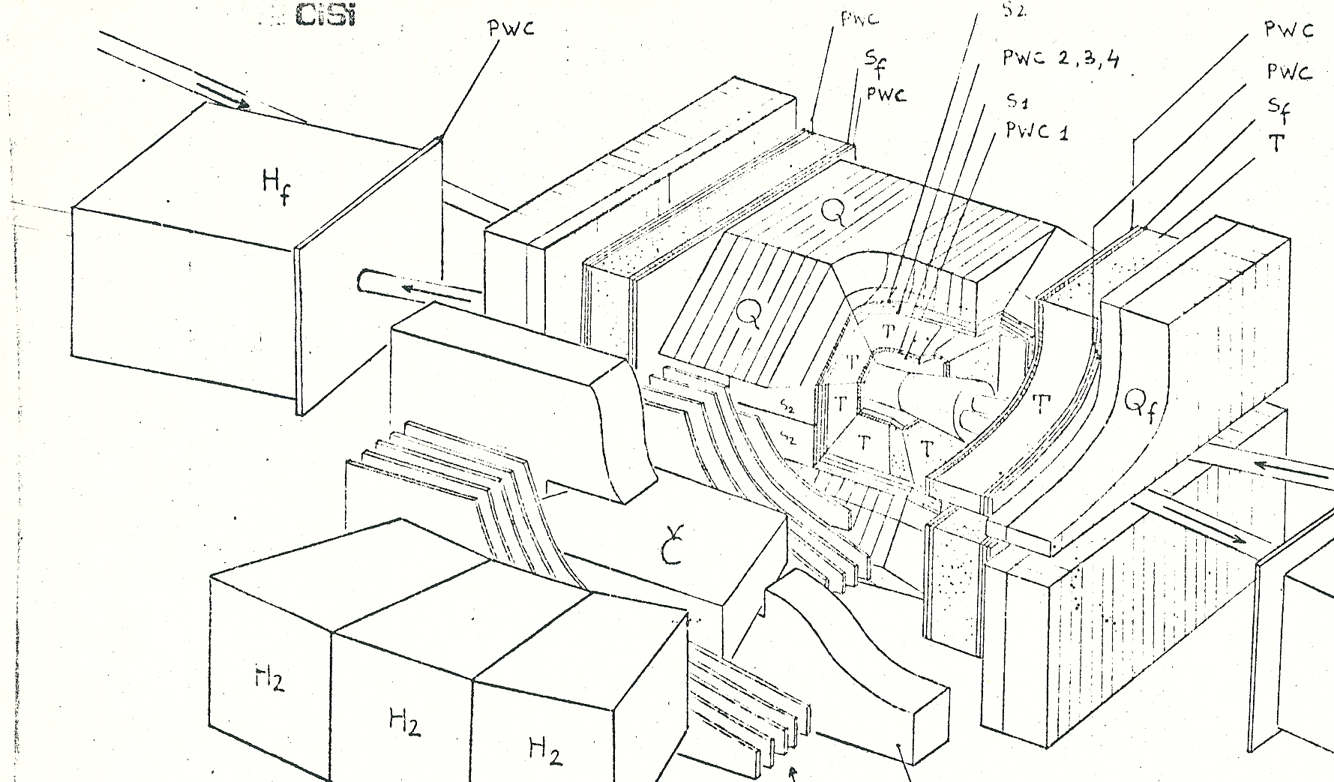
3D view of proposed experiment
(not included in proposal)

Slide 8
Start of a massives R&D program
Understanding the physics limitation of Hadron Calorimetry
  Distinguishing
    Instrumental effects, such as sampling fluctuations from
    Intrinsic effects
Construction of a fine-sampling Iron/ LAr hadron calorimeter
It’s not the sampling which limits performance
  Bill: we have overdone it…
Insight #1: what matters is the response difference to electrons and hadrons
Bill translates insight into reality: Uranium is the answer

Slide 9
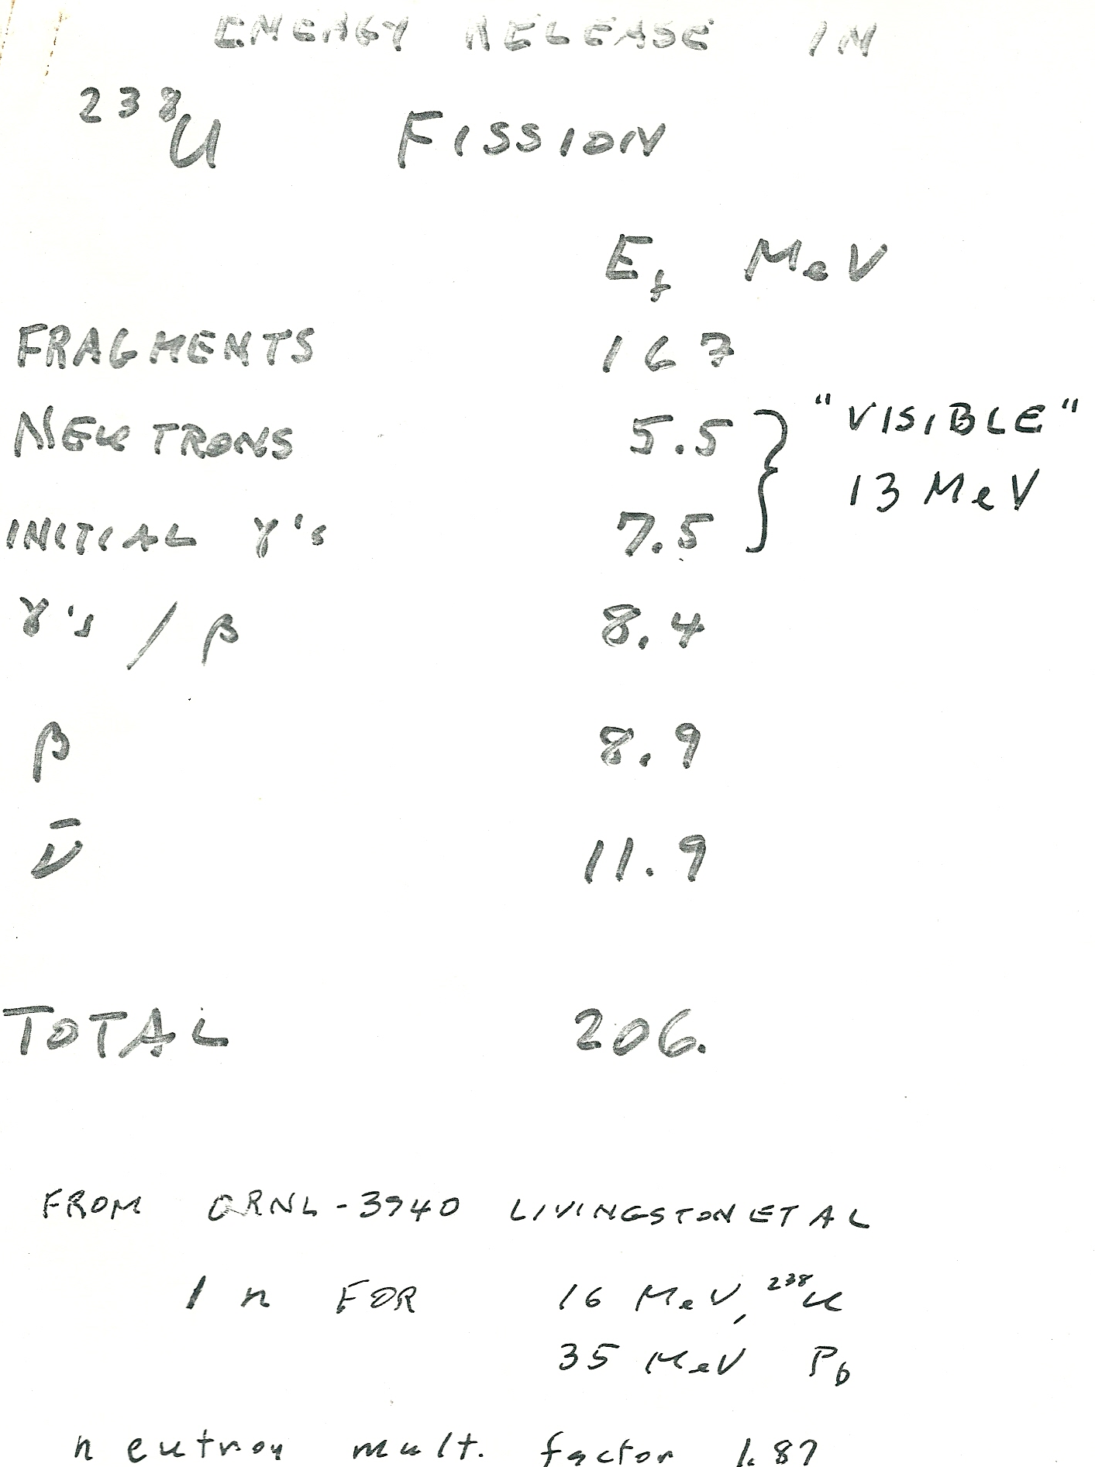
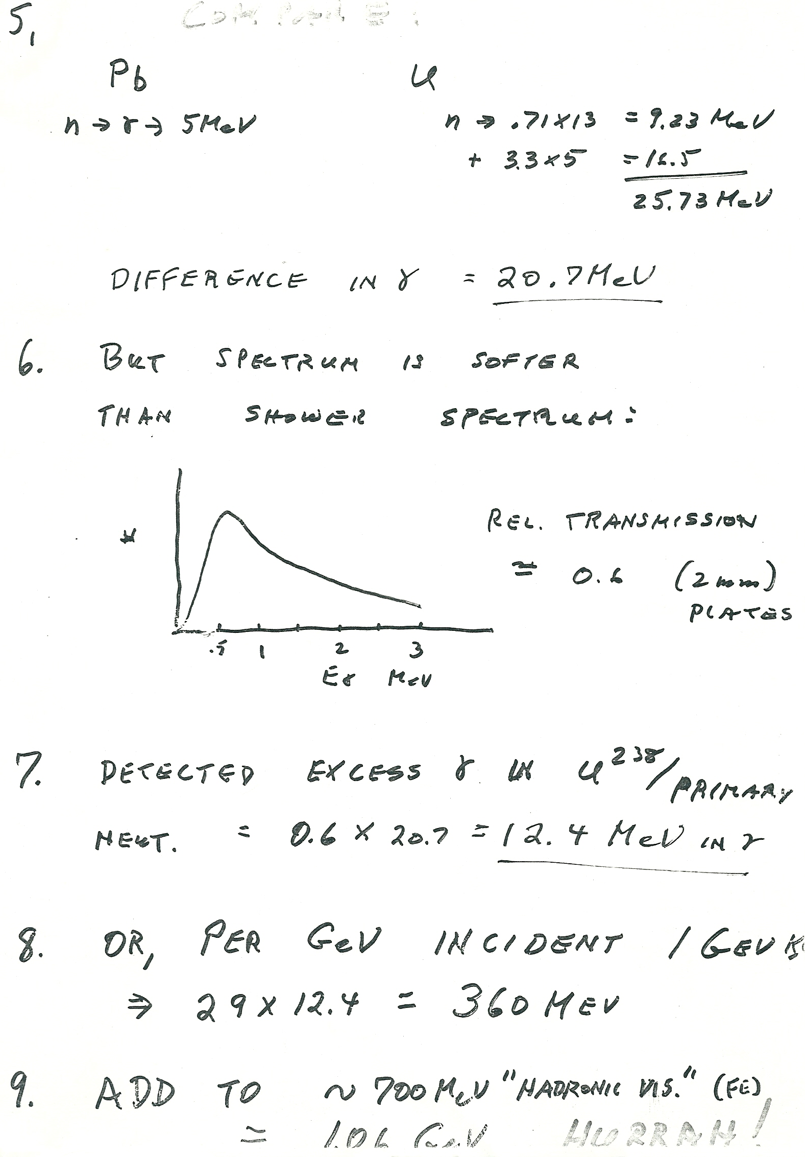
Willis’ notes on Uranium compensation

Slide 10
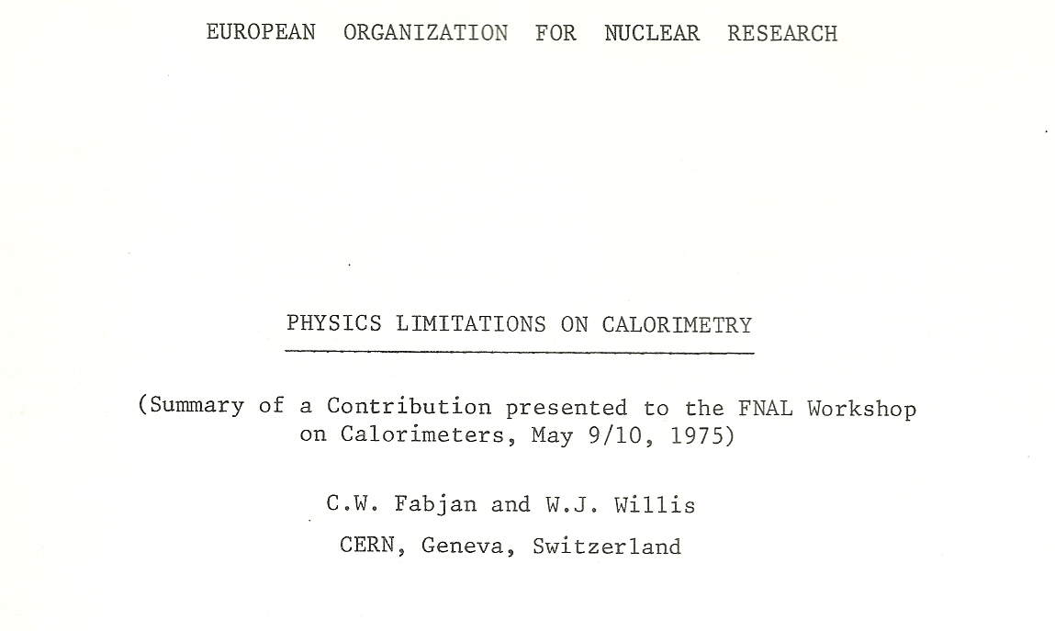
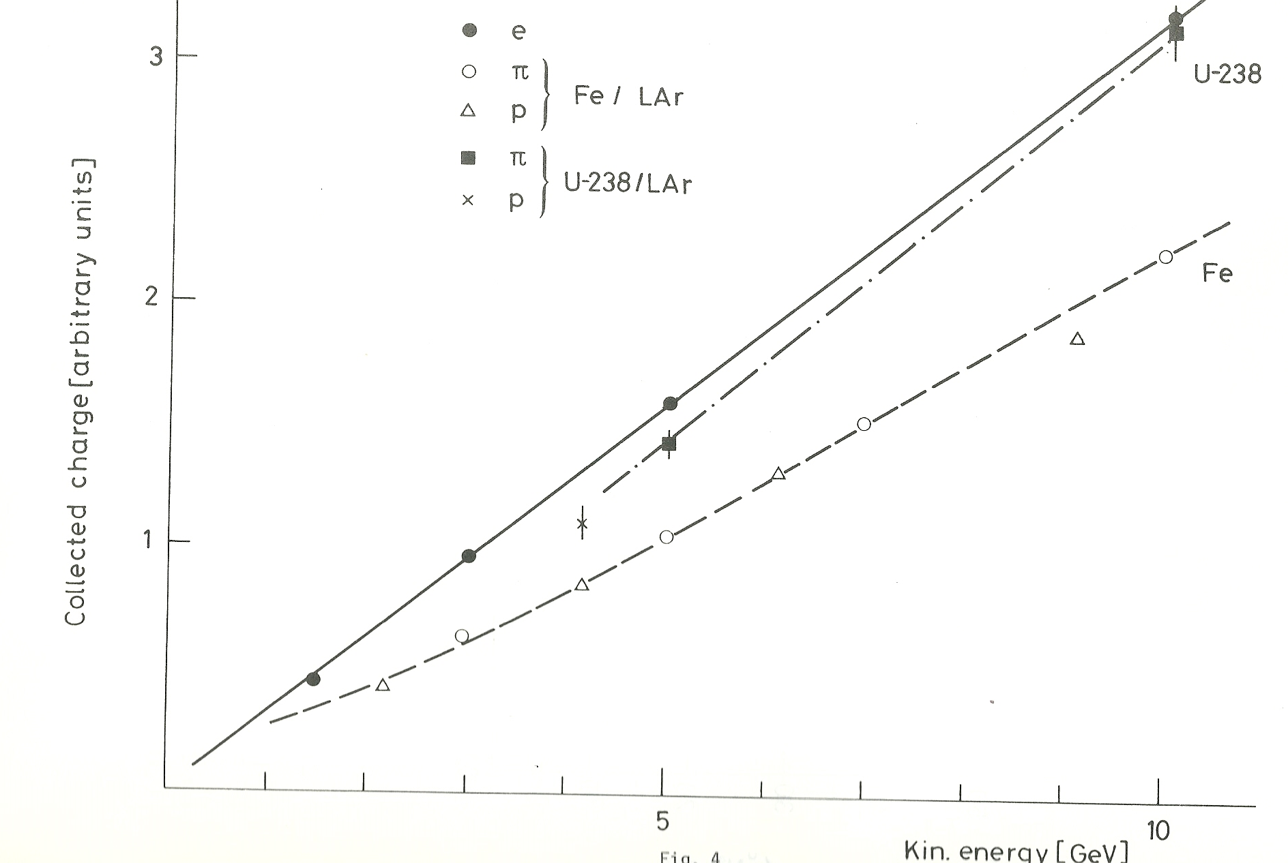

Slide 11
Next challenge: electron identification
At the time: a dramatic choice:
  Transition radiation detectors: only option for 4π coverage
    Experimentally barely established
    Never used in a particle physics experiment
Unperturbed, Bill concludes: this must work, provided
Insight #2:
  Use thin (1 mil thickness) Lithium foils as radiator
  Develop 2D readout chambers using Xenon gas as absorber
Required construction of a dry lab with 1 % humidity…
CERN Safety: what about health effects?
Dave Rahm provides the (unconventional) answer:
  According to the US Air Force: working in dry atmosphere increases productivity…

Slide 12
Revolution in Experimentation: constructing the Lithium foil TR radiators

Slide 13
Revolution in Experimentation
Guy Dubois-Dauphin constructed almost single-handedly the many radiator ‘bricks’

Slide 14
Revolution in Experimentation
Four bricks have just been fabricated and placed into
a TRD box, half-filled with the Lithium-bricks

Slide 15
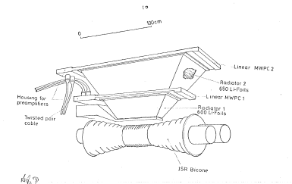
TRD: Li-Radiator + Xe- filled linear MWPC’s with Charge division readout (another Radeka first)

Slide 16
CWF learned a lesson
There is always a solution
Nature is subtle, but
kind to the thoughtful mind

Slide 17
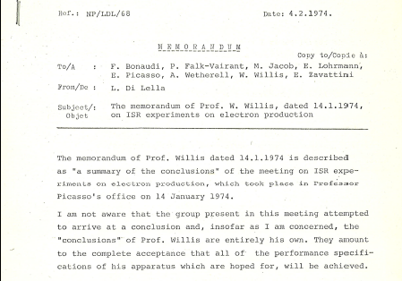
1974: Lepton pairs: emerging ISR frontier

Slide 18
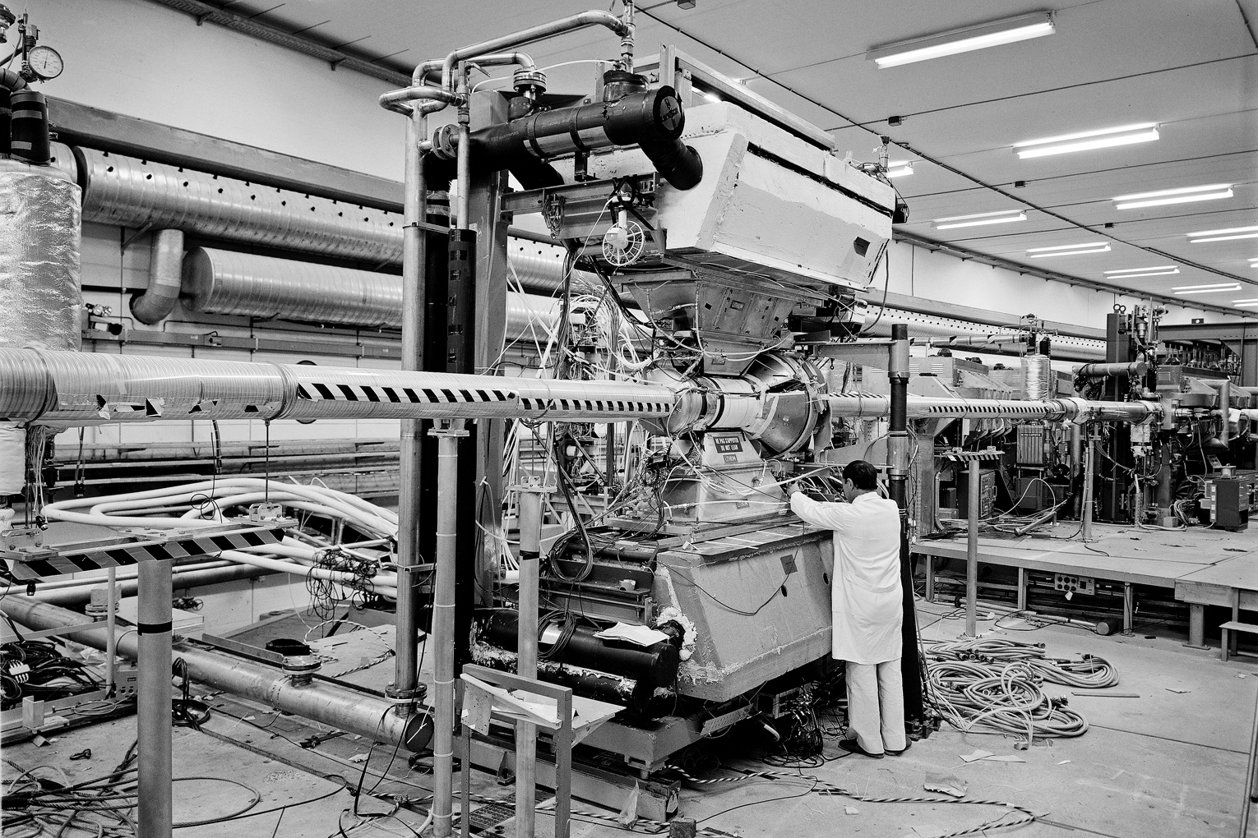
R806T: work in progress: early days

Slide 19
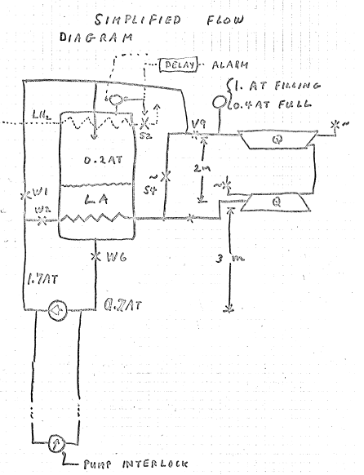
From Bill’s notes: its so simple…
Flow diagram of Liquid Nitrogen and Argon

Slide 20
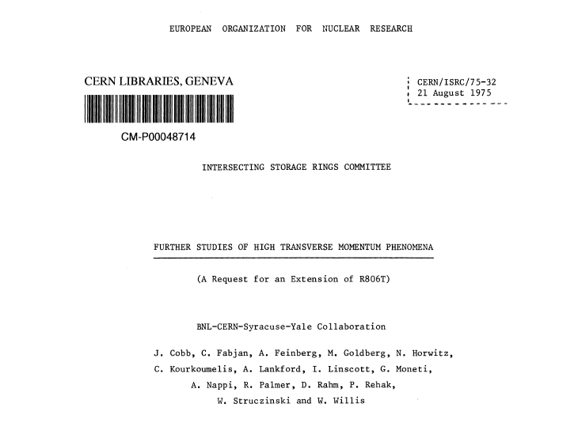
The first of several extensions of
R806 T ( T…Test)

Slide 21
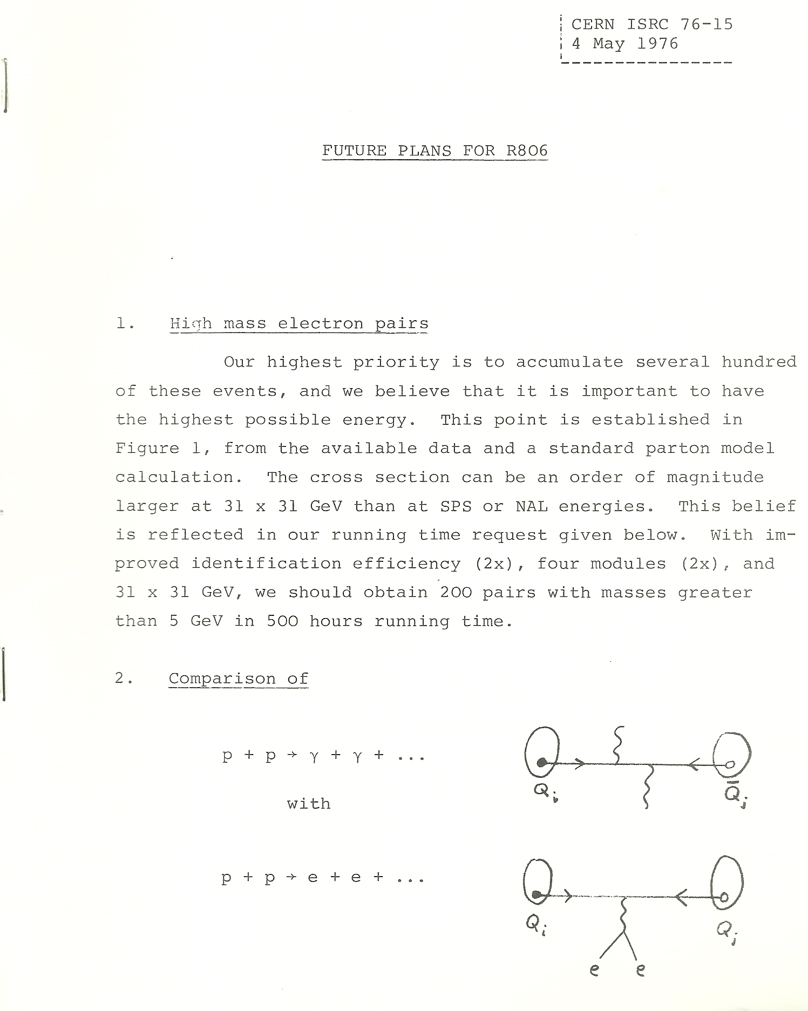
May 1976
The quest for
high statistics
lepton pairs…
It was in the air…

Slide 22
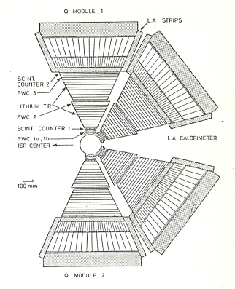
Four Octants:
Workhorse of R806
and in combination
with R807
(on the drawing
Board)
the flexibility of the modular construction proved invaluable
meeting the changing
physics priorities

Slide 23
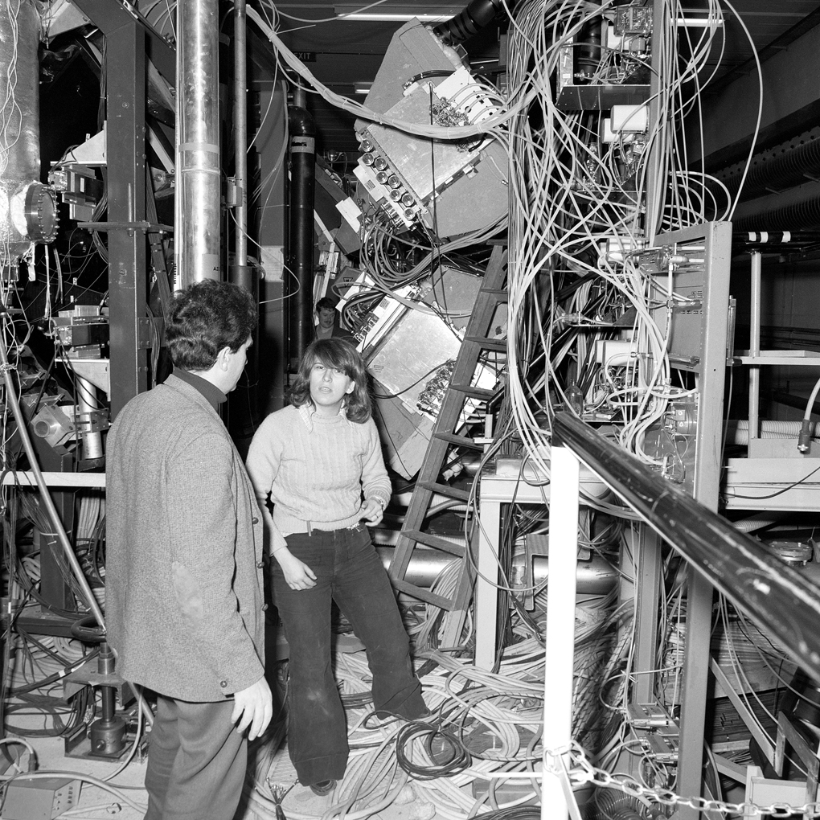
19761 1976
Italo Manelli
With Yale graduate
student Christina
Kourkoumelis, who
would become a
leader of Greek
particle physics.
The other Yale
student was
Andy Lankford,
now a leader in
ATLAS

Slide 24
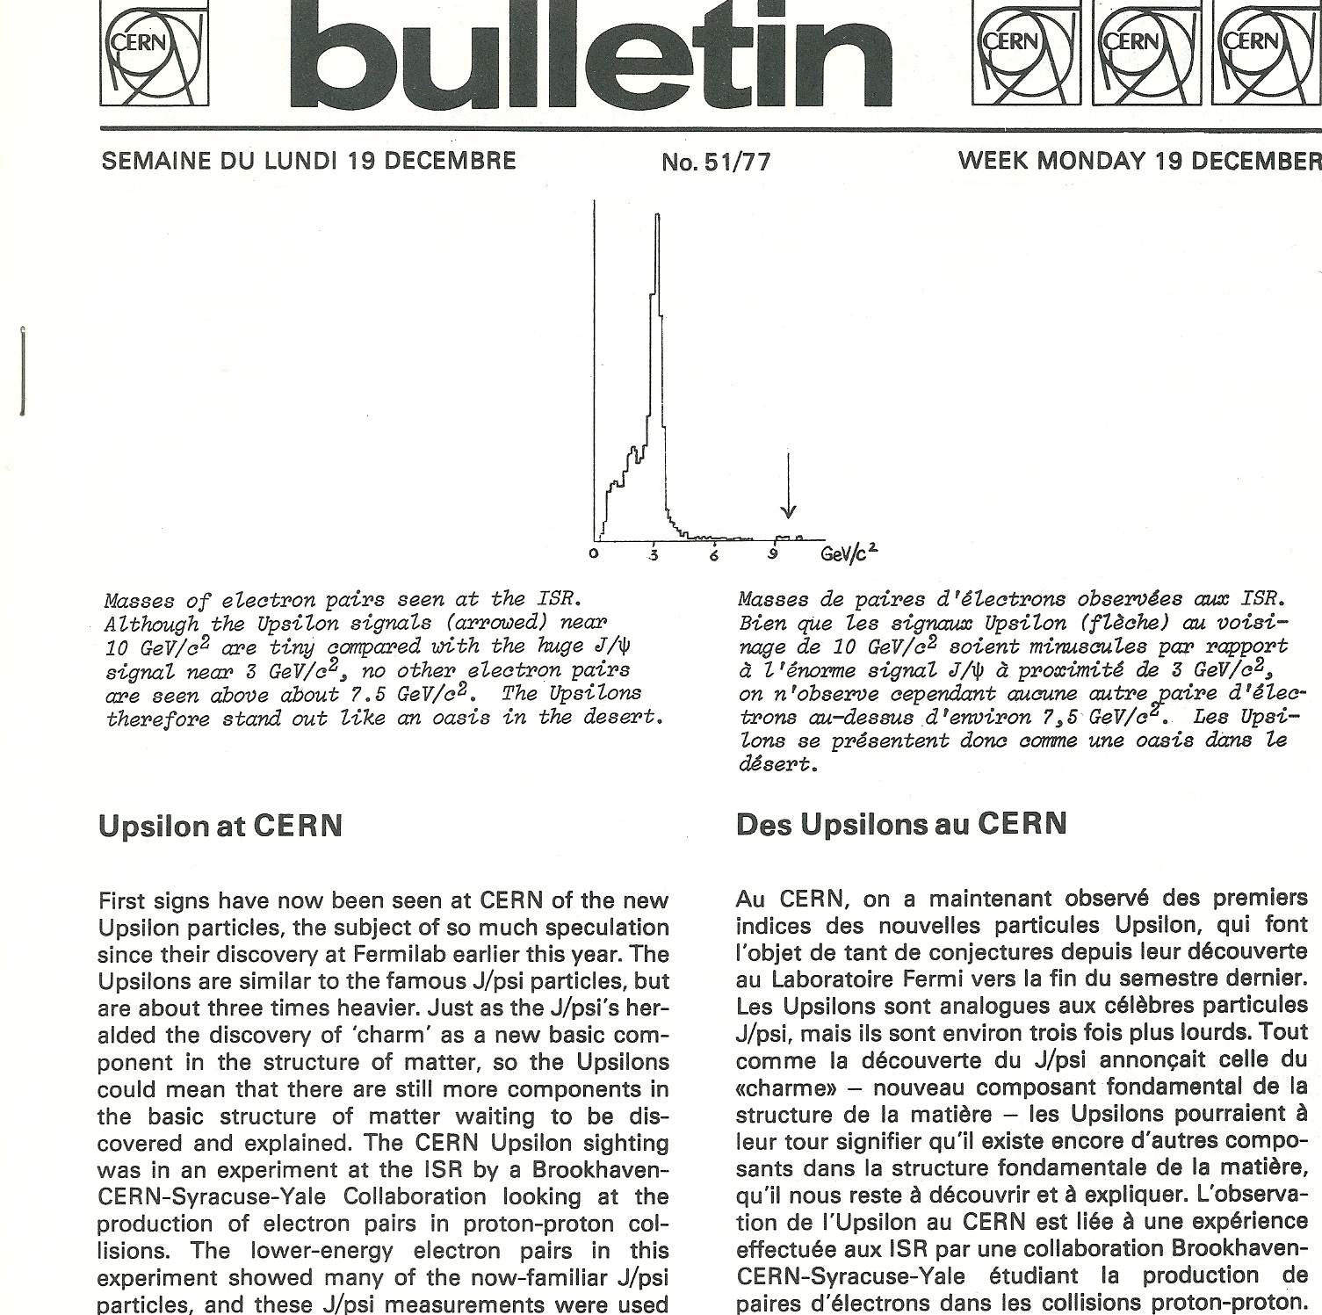
Five months after the FNAL discovery…

Slide 25
Meanwhile (1976): the quest for the ultimate ISR facility
At the time: two major facilities proposed
  Large superconducting aircore toroid magnet:
  led by A. Zichichi
  Large, thin superconducting solenoid: British-Scandinavian proposal
ISRC: What to do? Obvious: need a Committee

Slide 26
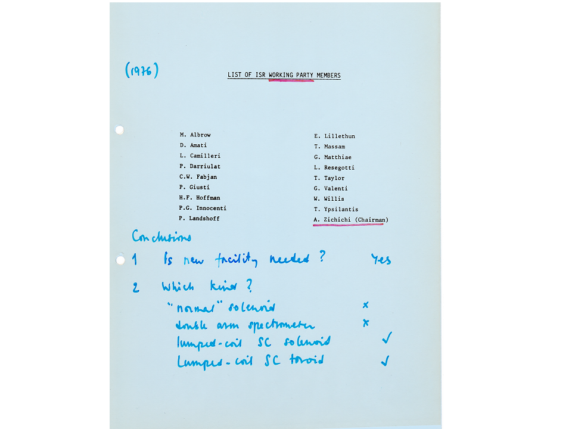
1976: ISR Working Party: Membership

Slide 27
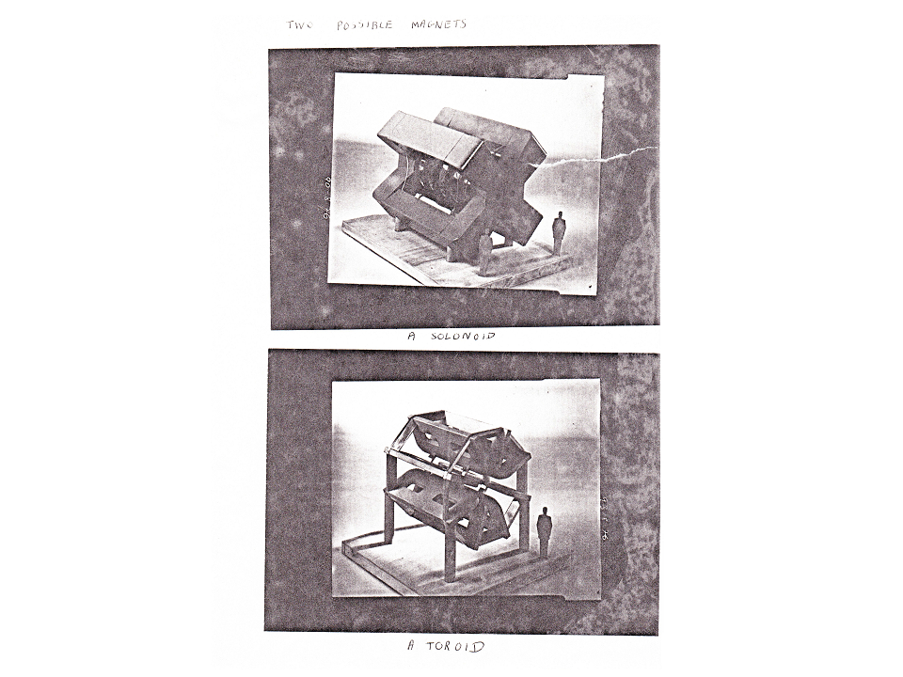
Committee considerations on magnets….

Slide 28
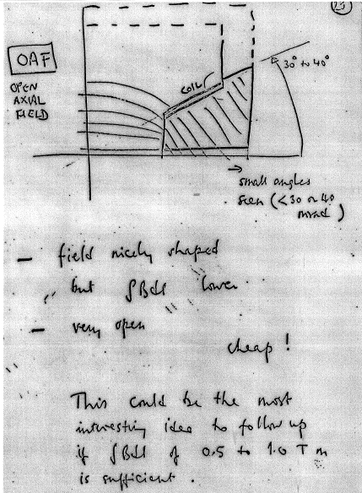
Tom Taylor gets into the act…

Slide 29
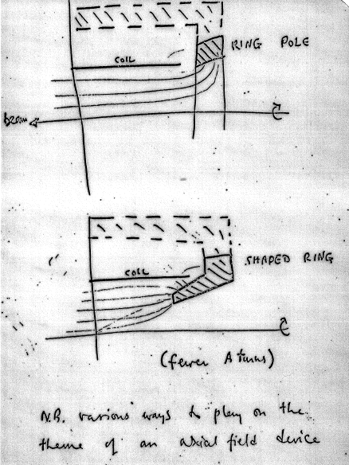
That’s it!
A novel, very attractive concept,
meeting many design targets

Slide 30
Conclusions (?) of the Working Group

Slide 31
Bill’s and Chris’ reaction
Tom Taylor’s design was the answer to magnet issue
  Openness and access, majors assets at the time
Drift chambers had advanced to a stage allowing high rate and high particle densities to be measured
We worked over the weekend, made some drawings and went to see the then Director of Research, Paul Falk-Vairant
He encouraged us to work out a proposal, knowing that it would be in competition with the ISR Working group conclusions

Slide 32
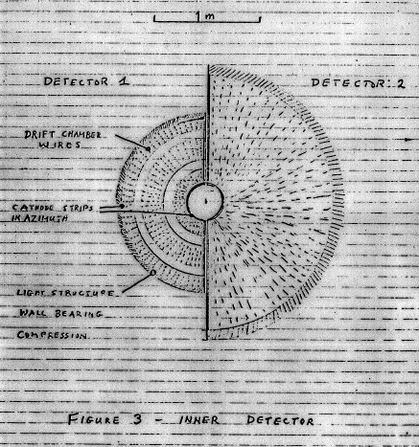
Bill’s rendering of the tracking options

Slide 33
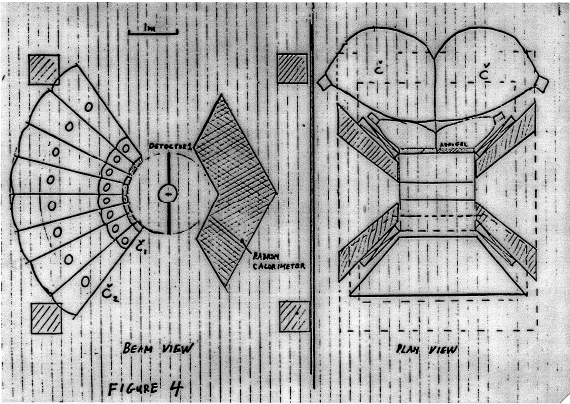
Towards the AFS Proposal: Bill’s hand drawing (Nov 76)

Slide 34
Axial Field Spectrometer (AFS) Proposal
The Danish (Boggild, Damgaard, Hansen et al) and Swedish colleagues (van Dardel, Jarlskog, Lörstadt et al) of the former British-Scandinavian Collaboration joined the effort
The British colleagues (Albrow and McCubbin et al) wanted to explore other options
Proposal submitted in January 1977 and approved by research board in April 1977
The Brits joined in April 1977
Start of a glorious time….

Slide 35
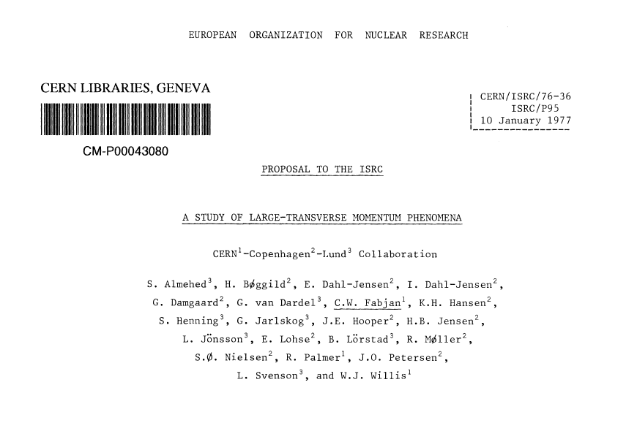
Productive Christmas recess: the AFS proposal is submitted on 10/1/1977

Slide 36
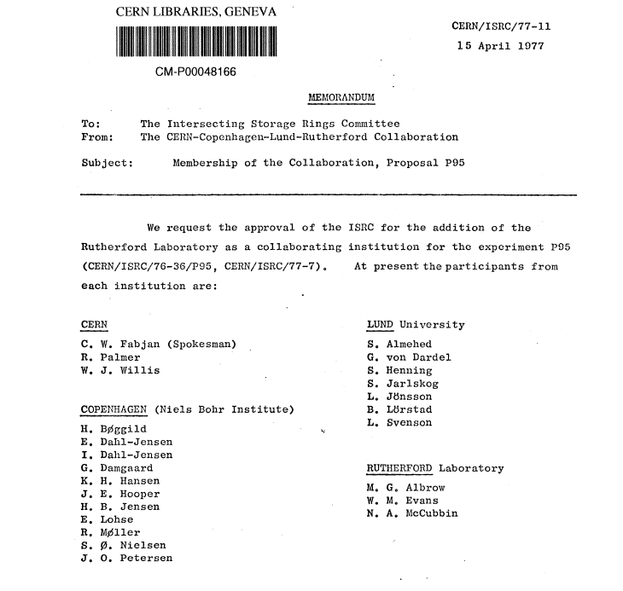
AFS-collaboration
is complete:
Rutherford has joined!

Slide 37
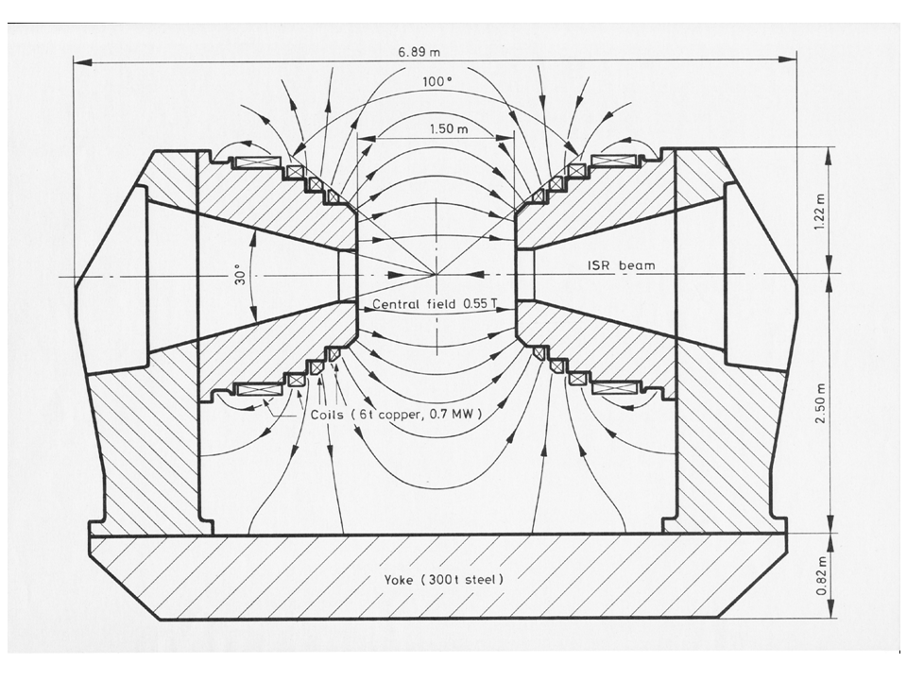

Slide 38
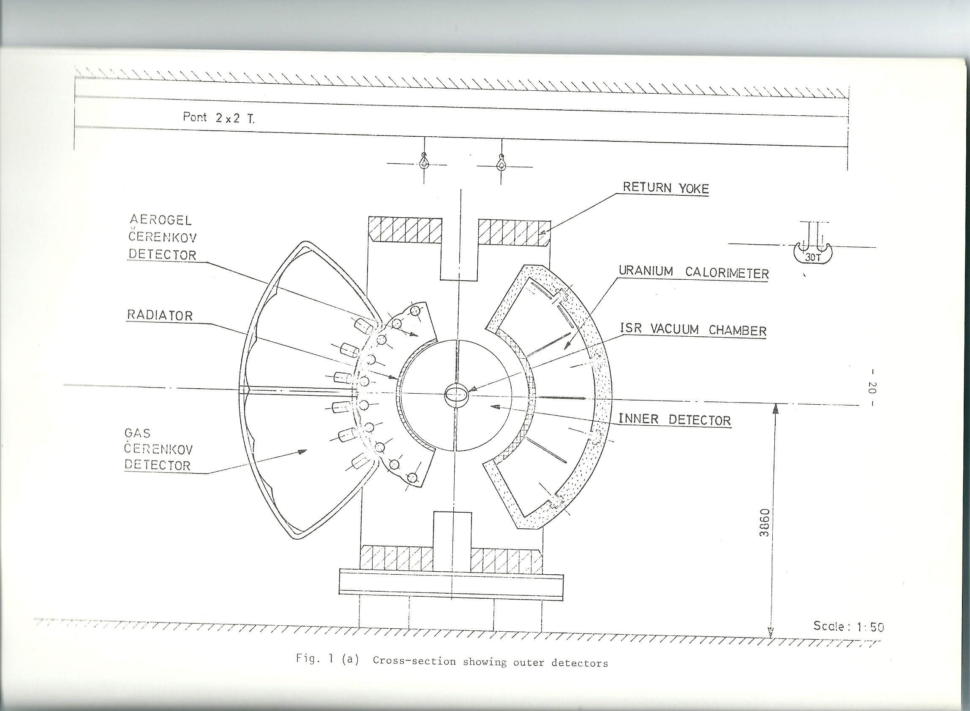
As seen in the proposal

Slide 39
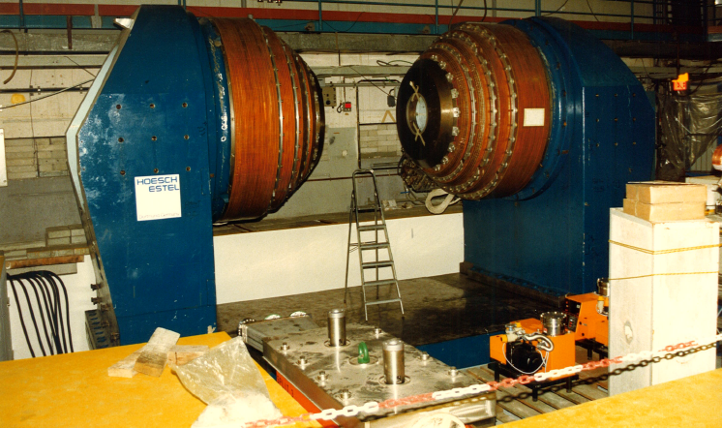
Open Axial Field Magnet: assembly (1978)

Slide 40
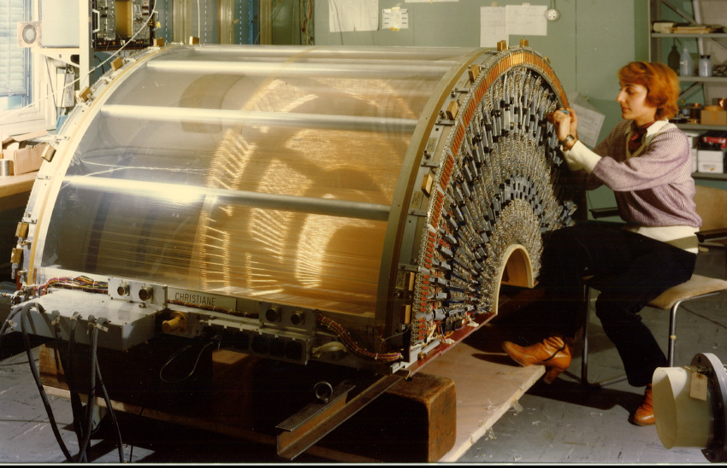
The drift chambers were designed in two halves to allow retractability

Slide 41
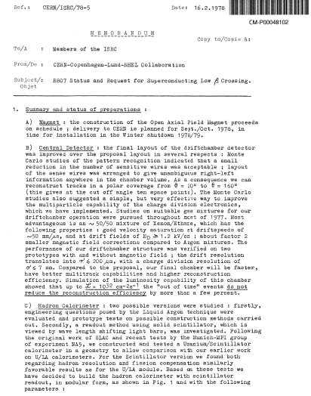
A little crisis
Typically Bill:
Make an audacious request (SC low-ß)
while
inconspicuously announcing a ‘dramatic’ change:
One of Bill’s famous ‘Volte-face’:
Switch from Liquid Argon technology to
Scintillator readout

Slide 42
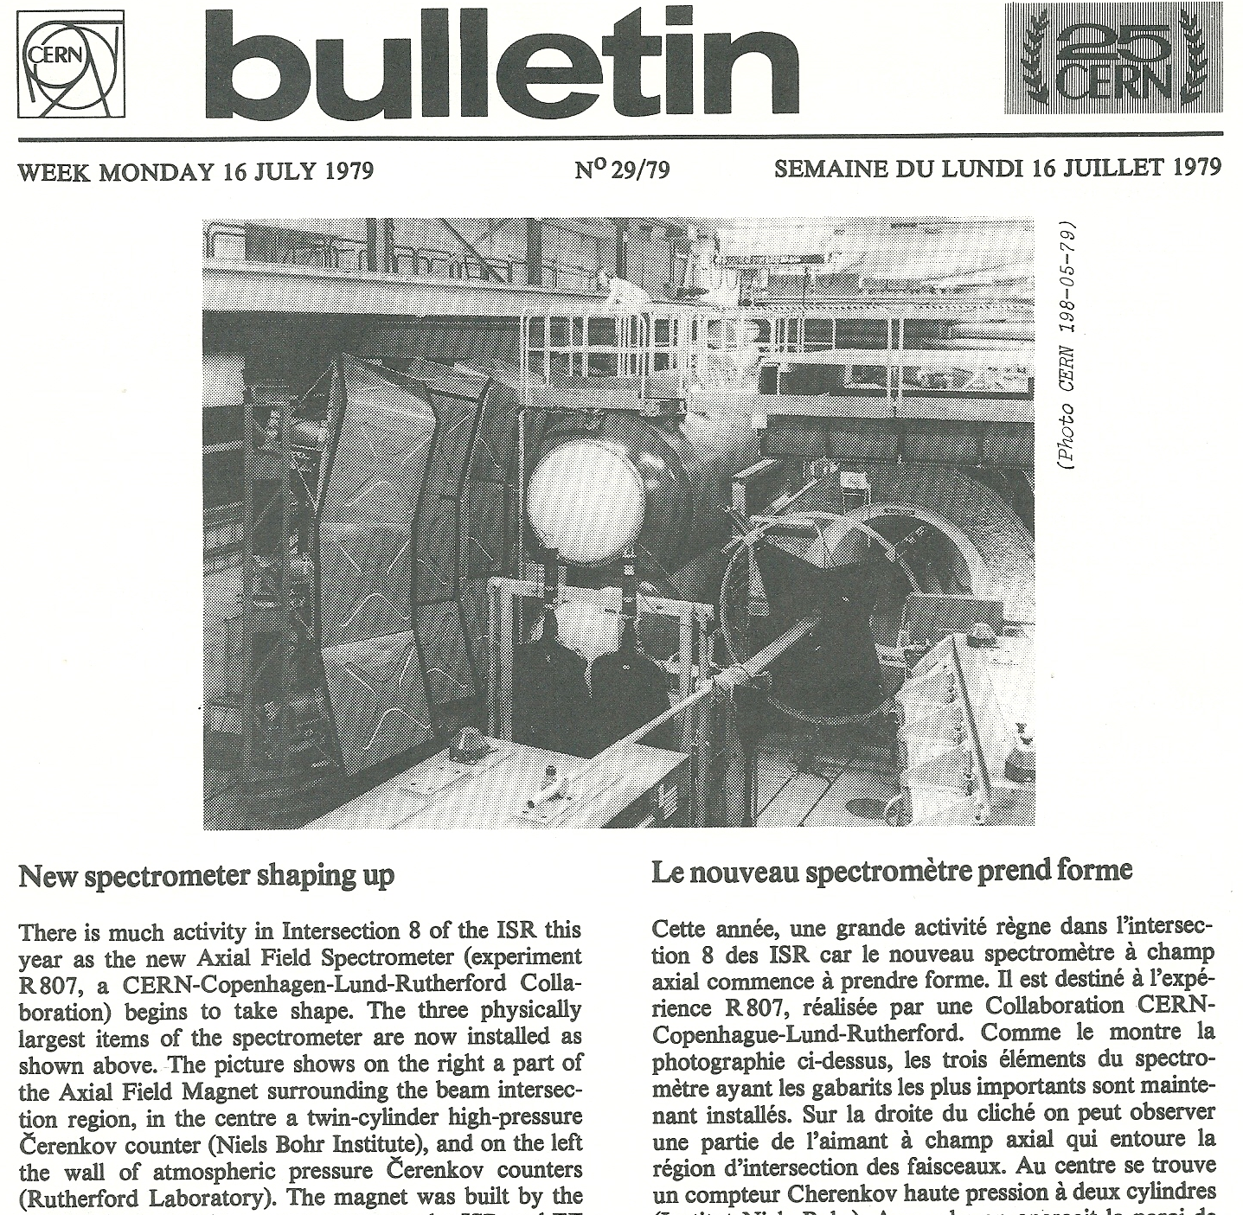
Mike Albrow in admiration of ‘his’ Cherenkov
Two years
after approval

Slide 43
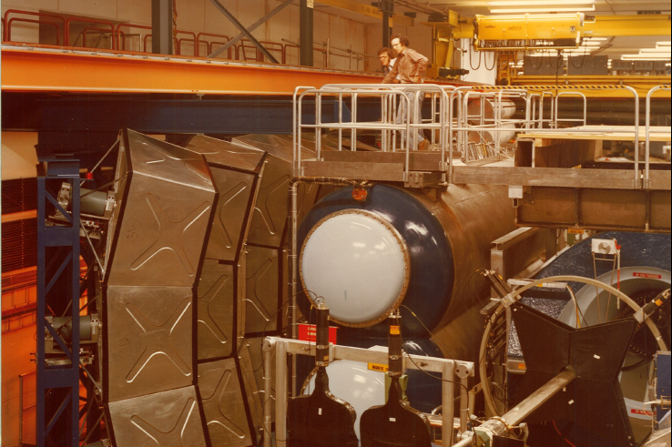
May 1979: Albrow’s + McCubbin’s opus

Slide 44
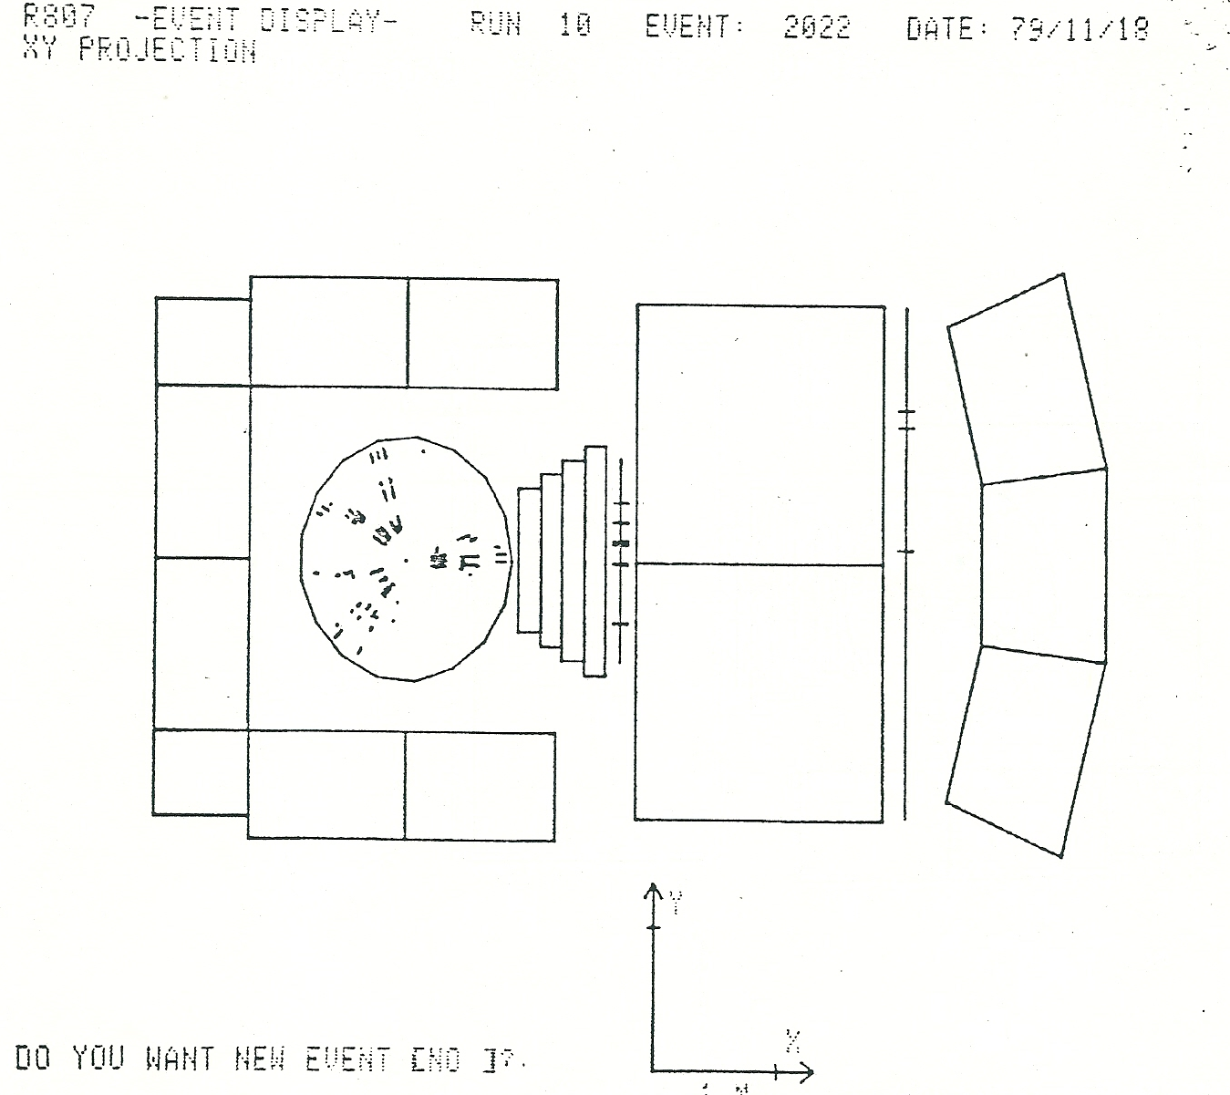
It works! One of the first event displays

Slide 45
Time for some fun away from CERN: summer parties at the Willis home alternated with skiing trips: Vallée Blanche, Feb. 1978

Slide 46
What is Bill thinking?

Slide 47
A very happy Italo Manelli

Slide 48
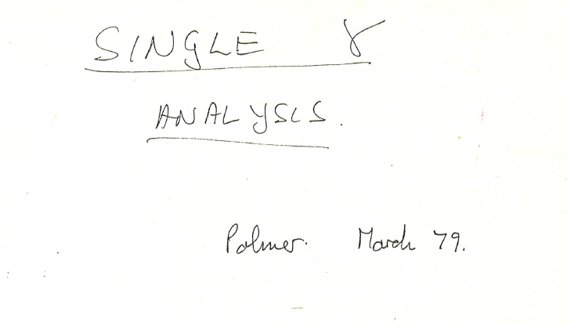
In parallel to AFS implementation: the finest hour of R806 and a major ISR-discovery
Front page of Bob Palmer’s analysis note

Slide 49
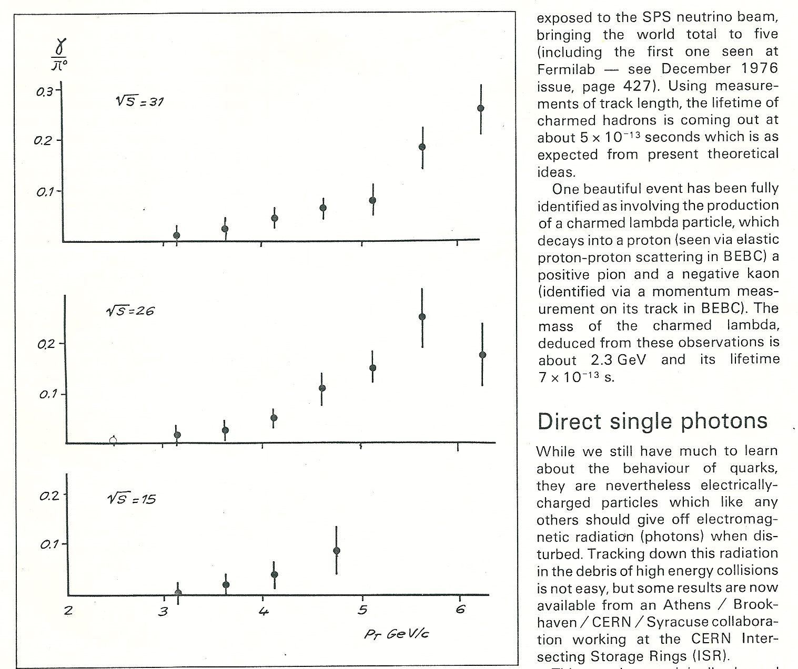
Major ISR Discovery: Prompt photons
Cern Weekly Bulletin, May 1979
CERN Courier
June 1979

Slide 50
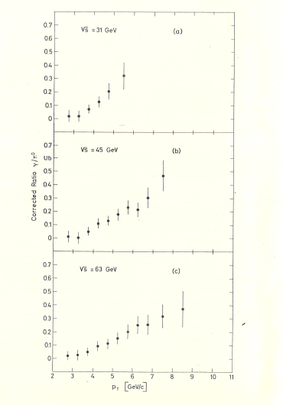
Direct Photon production
In pp-collisions
Invited presentation at
The EPS HEP Conference,
Geneva 1979

Slide 51
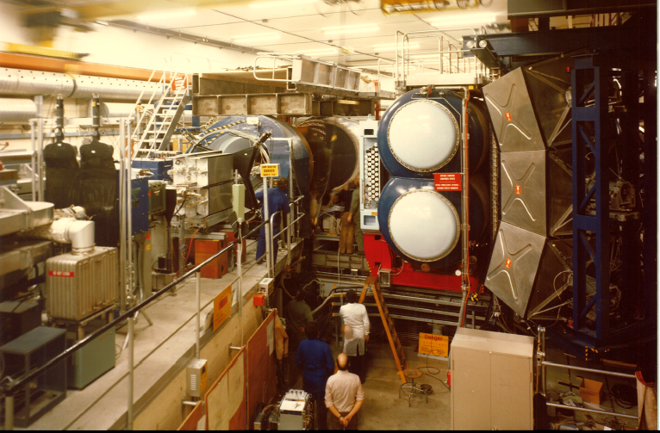
AFS: vintage 1980

Slide 52
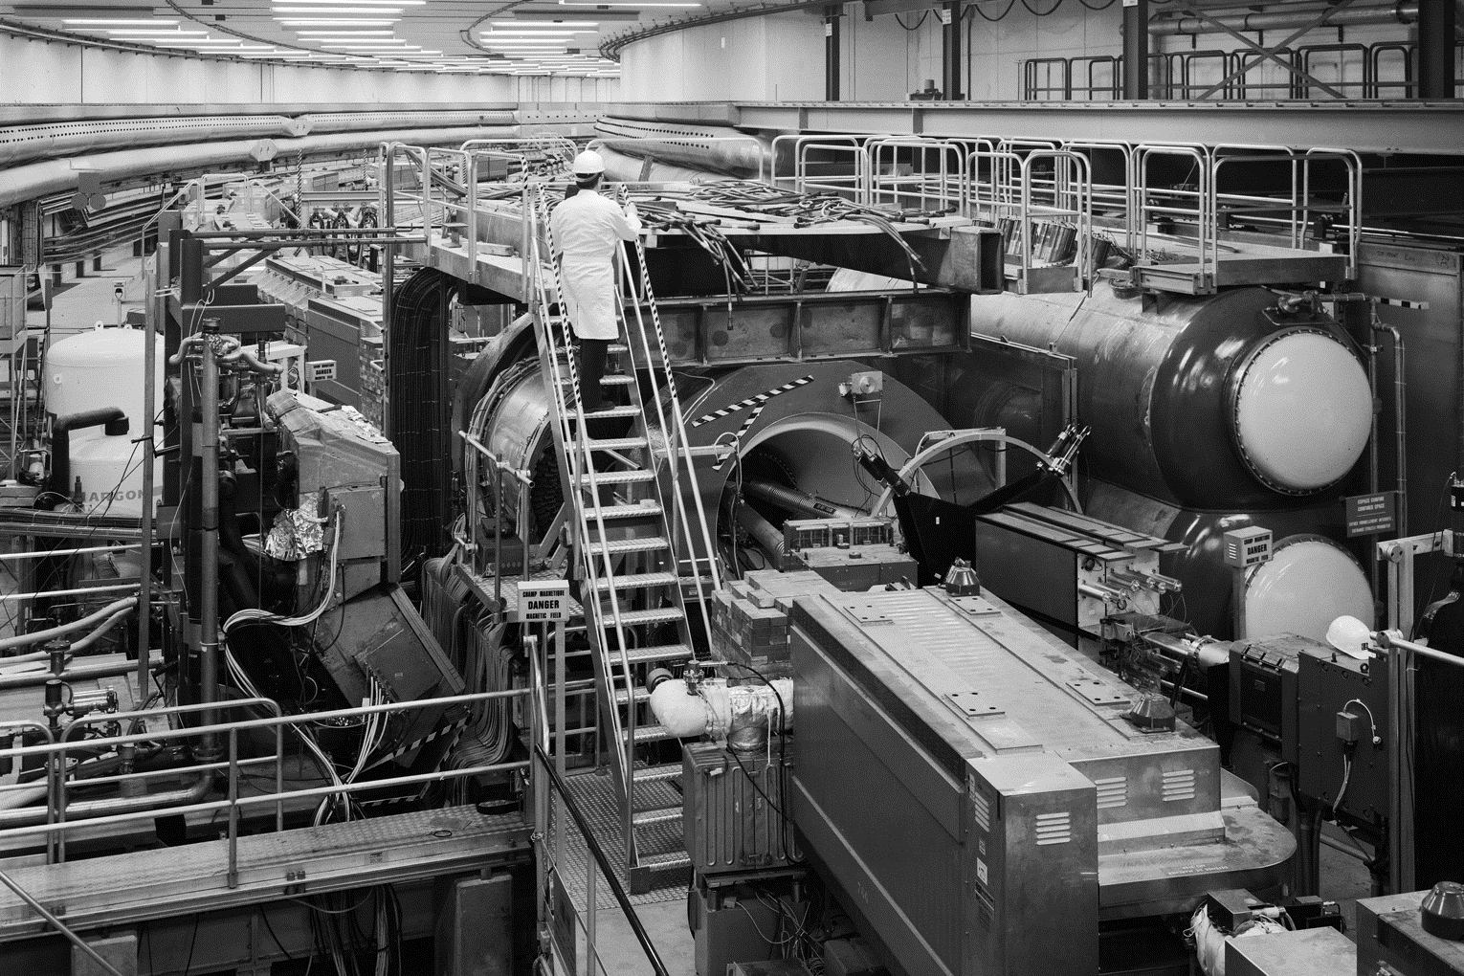
Layout of the AFS (1980)

Slide 53
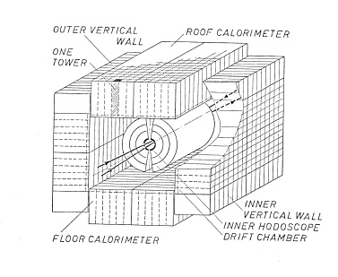
At last: 2π calorimeter coverage

Slide 54
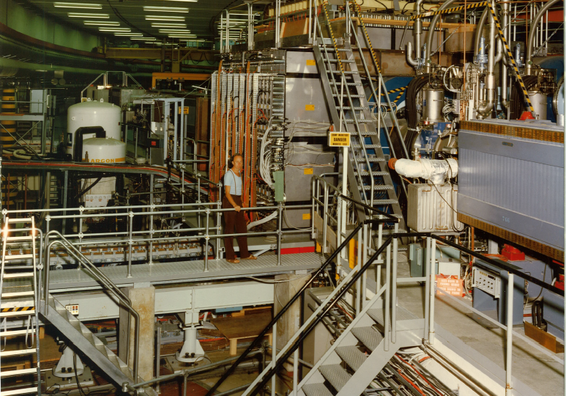
AFS (1982): full hadron calorimetry

Slide 55
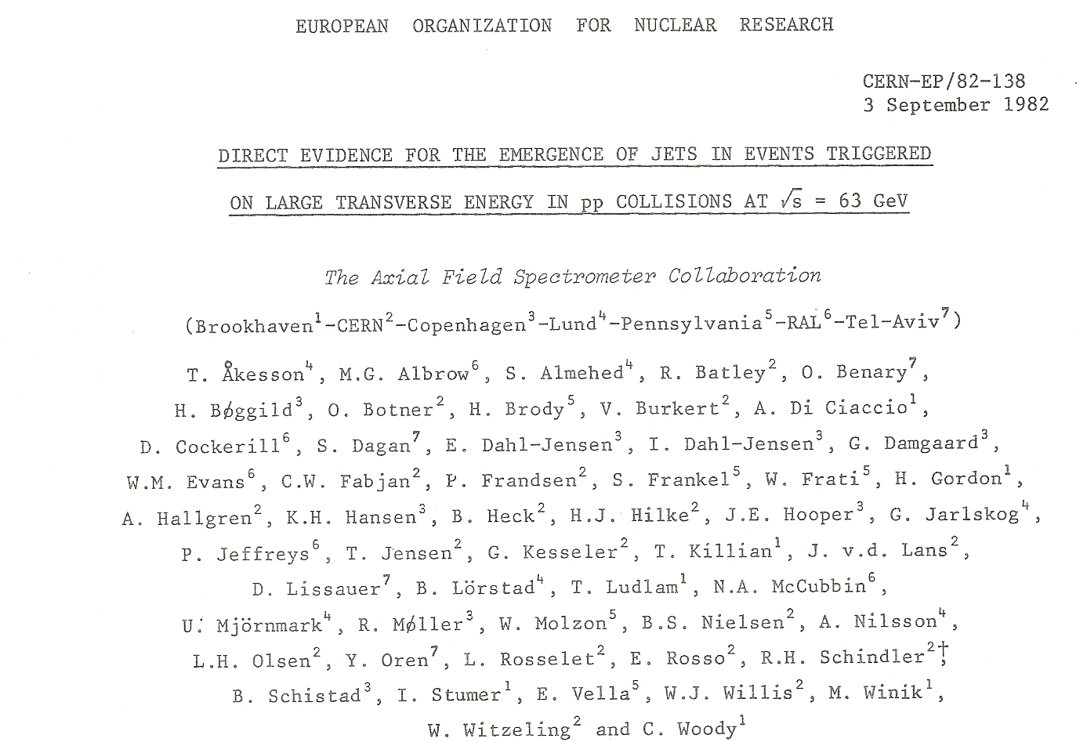
Co-Discovery of ‘Jets’ (with the UA expts.)

Slide 56
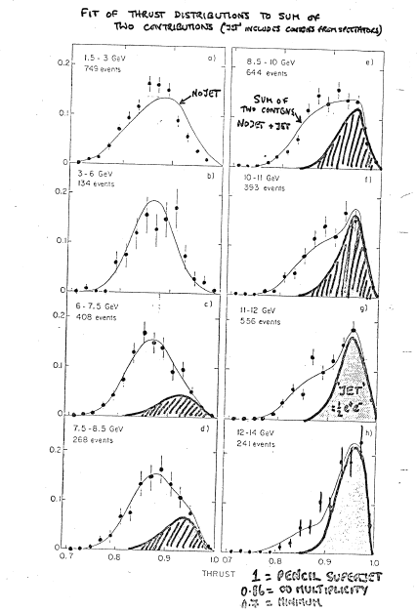
From a presentation of
M. Albrow
Jet component

Slide 57
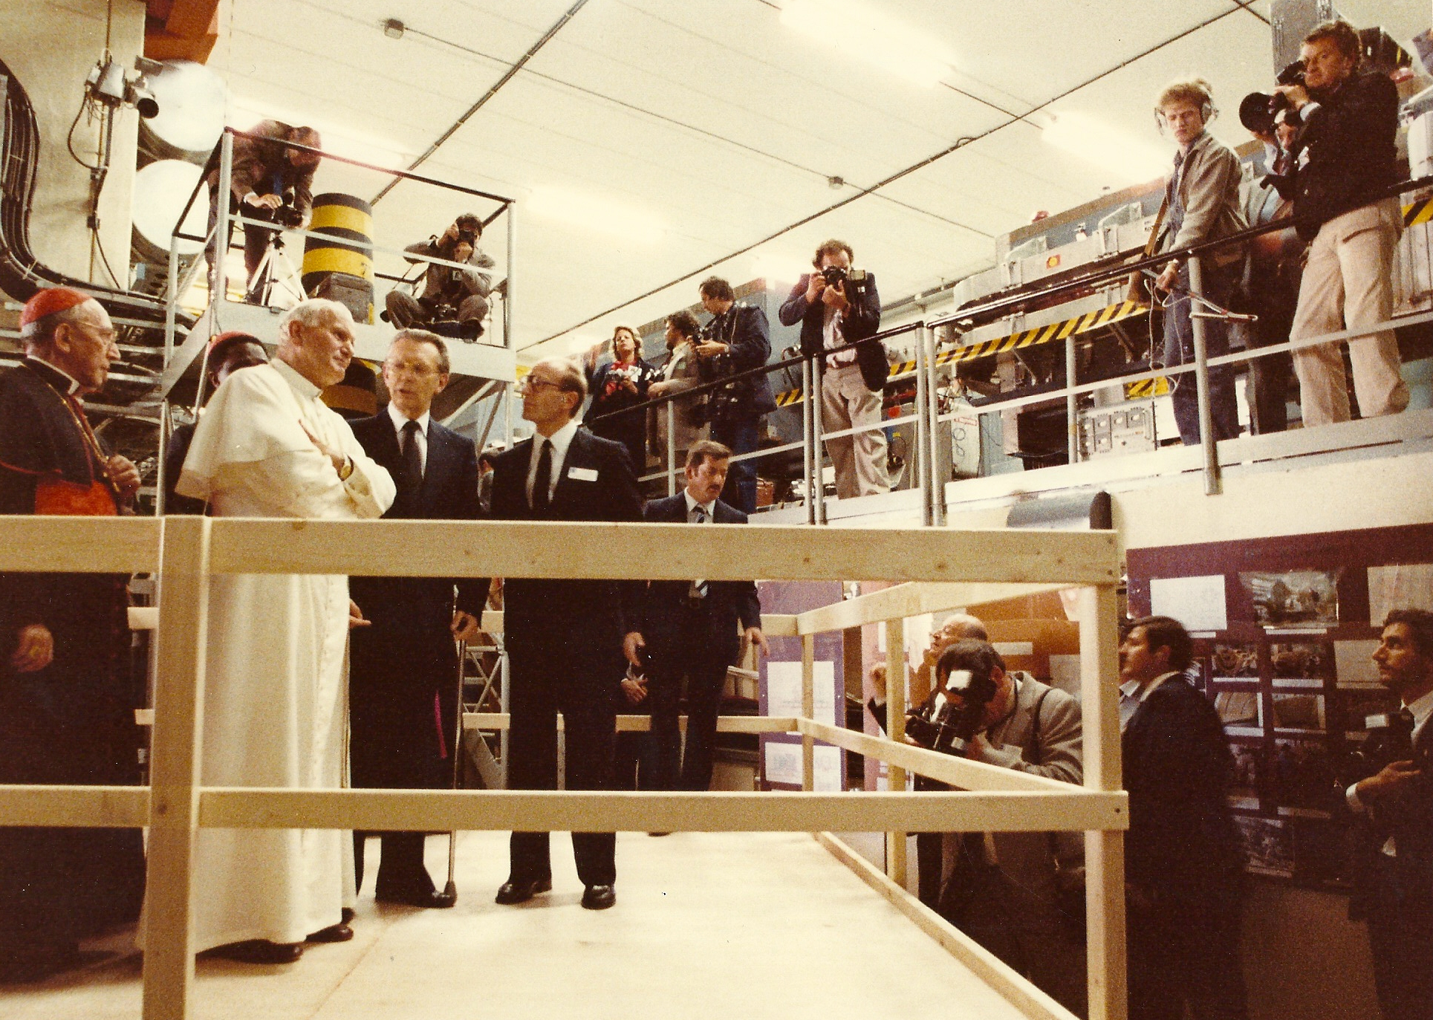
Pope John-Paul II at the AFS, June 1982

Slide 58
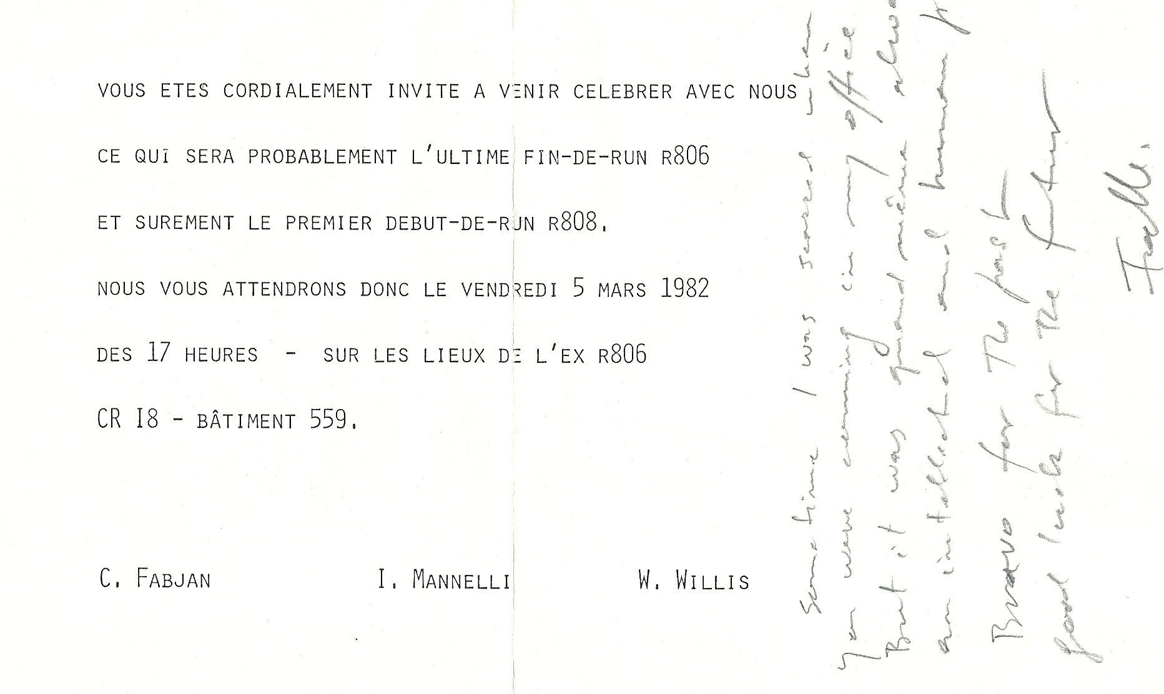
Another farewell to R806 and the first welcome to R808

Slide 59
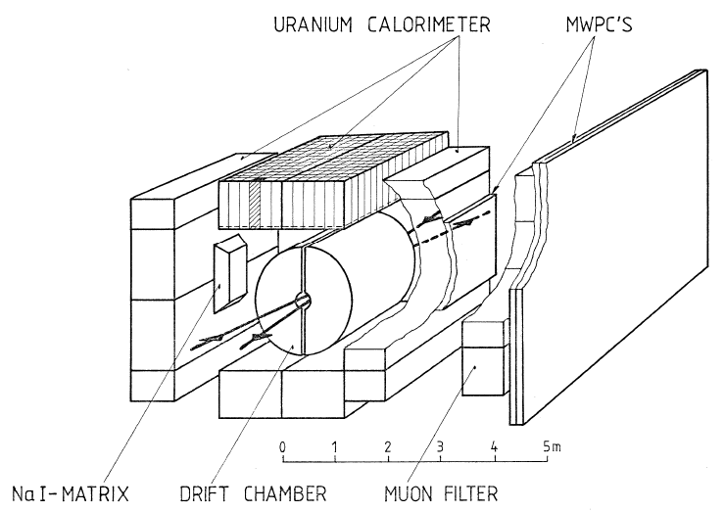
R808: NaI Photon Detector, Muon ID

Slide 60
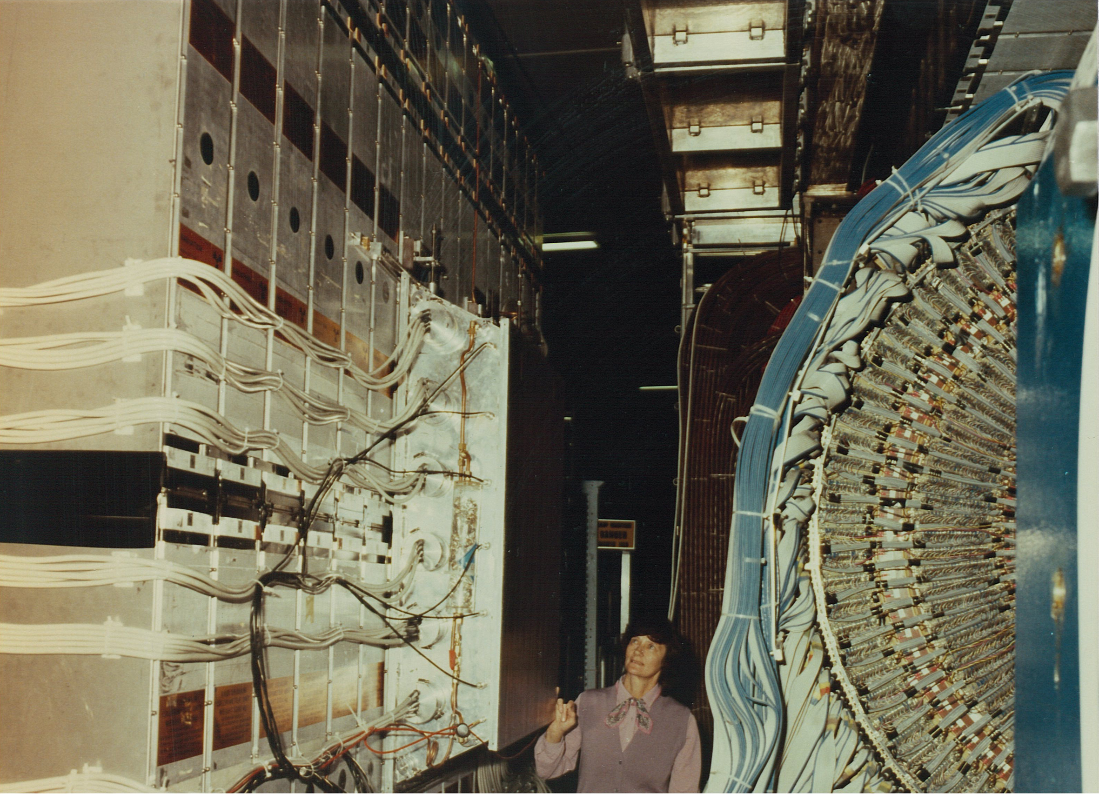
Alevtina Shmeleva in admiration of the R808 NaI crystal calorimeter: start of a fruitful Russian-CERN crystallographic collaboration (Feb.1980)

Slide 61
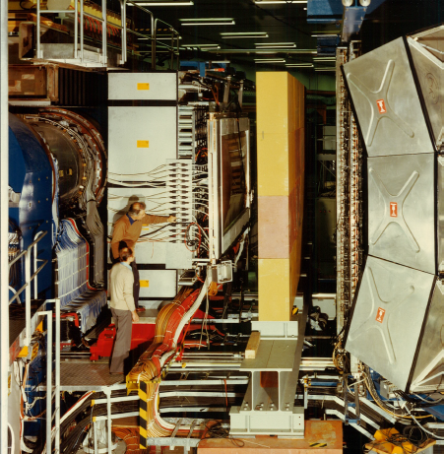
Bill Evans and Jean Renaud inspecting the Muon arm, 1982

Slide 62
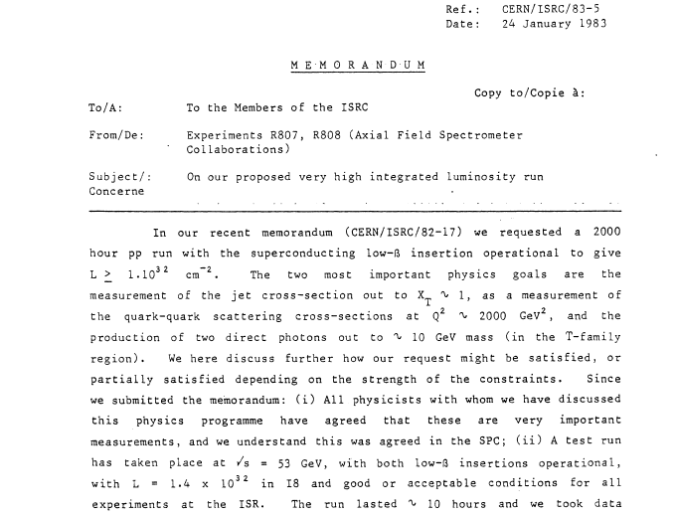
Fighting for precious pp collisions

Slide 63

Prime of its life: AFS in Oct. 1983

Slide 64

AFS Collaboration, 1983; Bill was late….

Slide 65
At its prime: the end of the ISR
300 ISR Physicists were fighting to extend the live of the ISR
Special ISR Workshop and ISRC:
  Albrow, Cronin, Fabjan, Willis et al speaking
Bill Willis: (I have never heard him speaking so directly…)
‘shutting down the ISR is an act of vandalism…’
However, the emerging LEP community would have the final say…

Slide 66

From Bill’s presentation at the ISR Workshop

Slide 67
From Mike Albrow’s diary
Diary on Jan 27 1984:
"13th anniversary of 1st ISR collisions and day of the final ISRC. Open session in auditorium (heavy snowfall
so few people at first).
I talked on jets at the end of the morning.
Afternoon: Kjell Johnson gave a very fine talk on the history and achievements of the machine, and
Maurice Jacob on some of the physics, quoting Shakespeare: "I come to bury Caesar, not to praise him". Schopper made some "closing remarks".
Ended at six. Nostalgic beer."

Slide 68


"There once was a great ISR,
It collided both p and pbar
We all said to Schopper
Don't be a beam stopper
We might find the Z-triple star“
H. Boggild; present by Mike Albrow to H. Schopper , who was not amused

Slide 69

To new horizons:
converting the SPS into an Ion-accelerator to study nuclear matter under extreme conditions

Slide 70

NA 34 – HELIOS
High Energy Lepton and Ion Spectrometer
Also an experiment in sociology: particle physicists meeting the nuclear physicists
BNL-CERN-Heidelberg-
Lund-McGill-Montreal-
Lebedev-Novosibirsk-
Pittsburgh-Saclay-
Syracuse-Tel Aviv

Slide 71

The power of modularity: AFS reconfigured

Slide 72

First task: solve a 20 year puzzle of prompt lepton production: Helios vindicates the ‘Standard Model’:
NO anomalous lepton production

Slide 73

The power of ion collision revealed in the first night of ion beams (during MD!)

Slide 74


Slide 75


Slide 76

HELIOS 3: with all the detectors in the books to study matter under extreme conditions

Slide 77

From Russia with love:
the Alumina Hadron absorber

Slide 78

Bill never stopped surprising us: from 4π facilities to a ‘classical’ spectrometer

Slide 79


Slide 80

NA 44 Focusing Spectrometer

Slide 81



Slide 82
The Bill Willis CERN Years
Were stimulating, adventurous, productive with enormous impact on the development of particle physics
We all, working with Bill, were immensely privileged to have known him and to have shared these years with Bill
Thank you.

