Slide 1
EICUG Working Group on the Interaction Region Video Conference on High Precision Luminosity Measurements 15 February 2019
Charles Hyde
chyde@odu.edu
Old Dominion University
EICUG IR working group co-convener

Slide 2
Purpose of Meeting
Review previous techniques / achievements / limitations for precision luminosity measurements.
Review luminosity precision requirements for EIC physics program
Stimulate necessary R&D efforts for EIC program

Slide 3
Techniques
Van der Meer Scans
Total Absorption Bremsstrahlung Calorimeter at 0°
Small angle (2-10 mrad) “QED Compton”
^{A}Z(e,e’ γ) ^{A}Z
Forward Pair spectrometer (thin convertor): γ → e⁺e–

Slide 4
Challenges
Absolution Precision < 2%
Relative Precision < 1%
Polarization dependence
100x → 1000x greater luminosity than HERA
Valid for ep to eU
Polarized p, d, ³He, Li
Bunch-by-Bunch measurements (time-averaged)
Emittance growth & polarization can be bunch specific

Slide 5
Program
Following (backup) slides review some previous methods, and give references

Slide 6
Van der Meer Scans
Absolute determination of Luminosity
$Monitor a physics rate as the colliding beams are scanned across each other in 2D$
$Requires precision measurement$ of beam currents and collision centroid stability (3-D)
Does not require a priori knowledge of cross section.
Interupts experimental data taking
Not a continuous monitor
V. Balagura, NIM A 654 (2011) 634–638
RHIC: (IPAC’10, Kyoto Japan, May 2010 proceedings)
K.A. Drees, S.M. White, Vernier scan results from the first RHIC proton run at 250 GeV,
LHC:
M. Ferro-Luzzi, Determination of the luminosity at the LHC experiments, in: Proceedings of ICHEP’10, Paris, July 2010, published in PoS (ICHEP 2010) 010:
S.M. White, et al., First luminosity scans in the LHC, in: Proceedings of IPAC’10, Kyoto, Japan, May 2010.

Slide 7
Bremsstrahlung
At L = 10³³ /cm²/sec:
Bremsstrahlung power ~ 0.04 Watt
Angular distribution dominated by rms angular spread of e– beam: Photon rms $≈$ 4 mm @ 20 m
Total Absorption ECal dose (10⁷ sec exposure per year)
0.4 MGray/year
Each photon absorbed in ~ 1 kg of high-Z material
Calorimeter options
Liquid Argon
Quantameter (SLAC 1960s): Alternating HV plates in vacuo
D. Yount, NIM 52 (1967) 1 –14
R. Anderson, NIM 65 (1968) 195–198
Calibrate with electron beam?
Pair Spectrometer (ZEUS method)
Rate is tunable (detector out of synchrotron and brem beam)

Slide 8
QED Compton: HERA experience
Challenges:
acceptance, alignment, absolute precision
E. Aaron (H1 collaboration) Eur. Phys. J. C (2012) 72:2163
DOI 10.1140/epjc/s10052-012-2163-2
Erratum DOI 10.1140/epjc/s10052-014-2733-6
Electron gamma detection at 10° to 25° from e– beam
Theory:
A. Courau, P. Kessler, Phys Rev D 46 (1992) p. 117
K. Gaemers, M. van der Horst, Nuclear Physics B 316 (1989) 269-288: (Small angle theory, simulation)
Compton22 Generator:
V. Lendermann, et al., Eur. Phys. J. C 31, 343 (2003). hep-ph/0307116

Slide 9
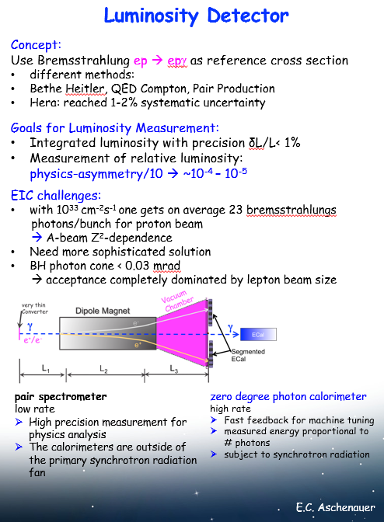
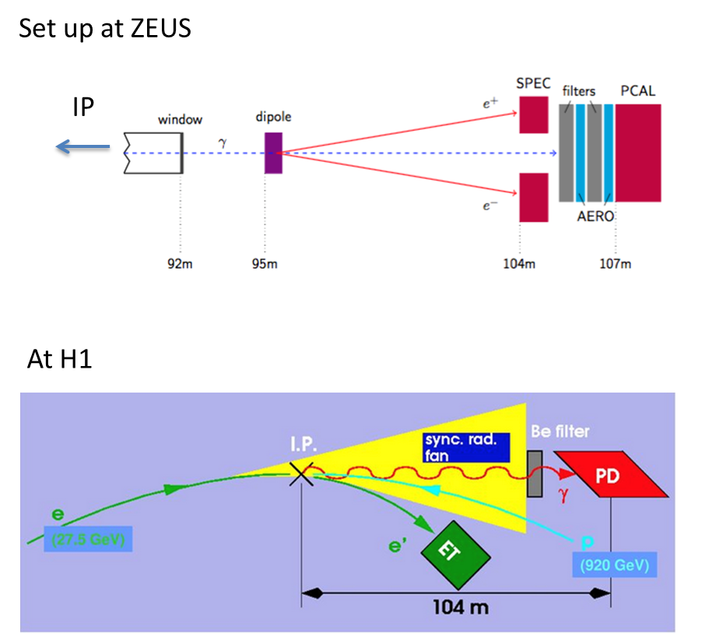
Luminosity Monitor: HERA Summary
R. Yoshida

