Slide 1
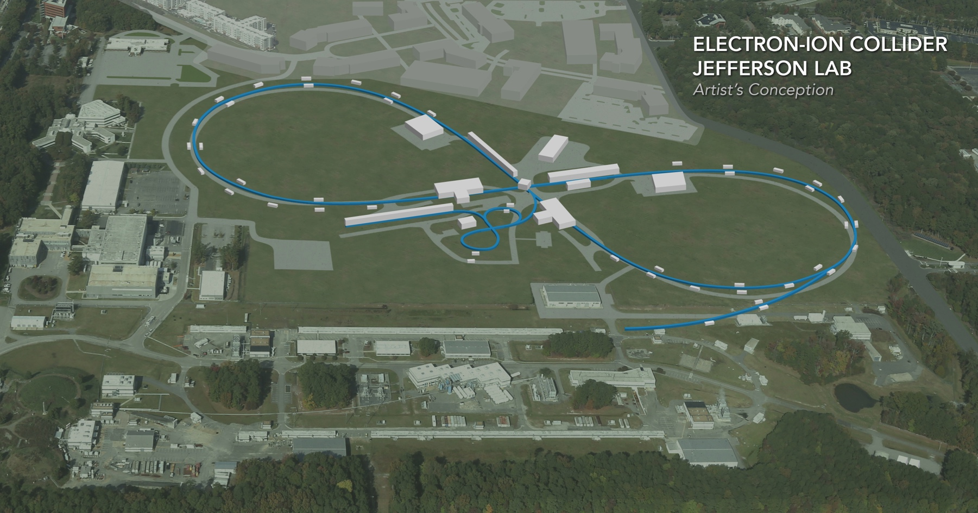
JLEIC IR Summary
Vasiliy Morozov
EICUG IR Working Group meeting on Luminosity Measurement February 15, 2019

Slide 2
Full Acceptance Detector Concept
Would like to get ~100% acceptance for the whole event
Central Detector/Solenoid
Ion beamline
Scattered Electron
Electron beamline
Dipole
Forward photon
Dipole
Forward (Ion) Detector
Particles Associated with struck parton
Particles Associated
with Initial Ion

Slide 3
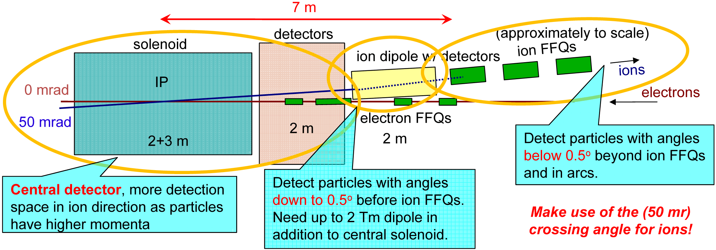
Schematic of Full-Acceptance Detector
50 mrad crossing angle
Forward hadron detection in three stages
Endcap
Small dipole covering angles up to ~2-3°
Far forward, up to ~10 mrad, for particles passing through accelerator quads
Low-Q2 tagger
Small-angle electron detection

Slide 4
JLEIC Interaction Region Layout
Most recent changes occurred in the ion IR due to redesign for 200 GeV/c ion momentum
Streamlined updates of GEMC and GEANT4 detector region models
Continued development of an engineering design of the detector region
IP
e
Compton polarimetry
forward ion detection
ions
forward e detection
spectrometers
dispersion suppressor/
geometric match
p
(top view in GEANT4)
e
low-Q² electron detection
and Compton polarimeter
Forward hadron spectrometer
ZDC

Slide 5
Modifying IR Design for 200 GeV/c
Constraints
Maximum pole-tip fields at 200 GeV/c of 4.6 T
Minimum impact on the forward hadron tagging performance compared to the 100 GeV/c design
Minimum impact on the luminosity performance compared to the 100 GeV/c design
Minimum impact on the beam dynamics compared to the 100 GeV/c design
Modification strategy
Increase the FFQ lengths to drop the pole-tip fields
Switch from a triplet to doublet final focusing configuration
First “quadrupole” in the doublet is two independent quadrupoles that can be run in a doublet mode up to 100 GeV/c

Slide 6
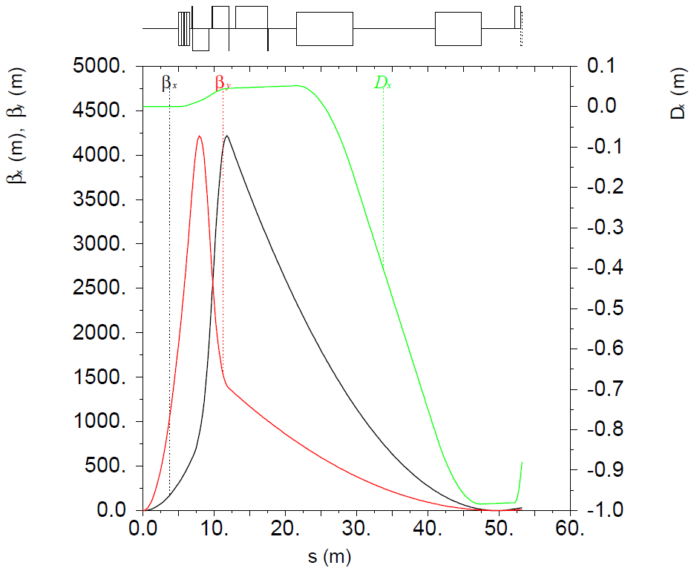
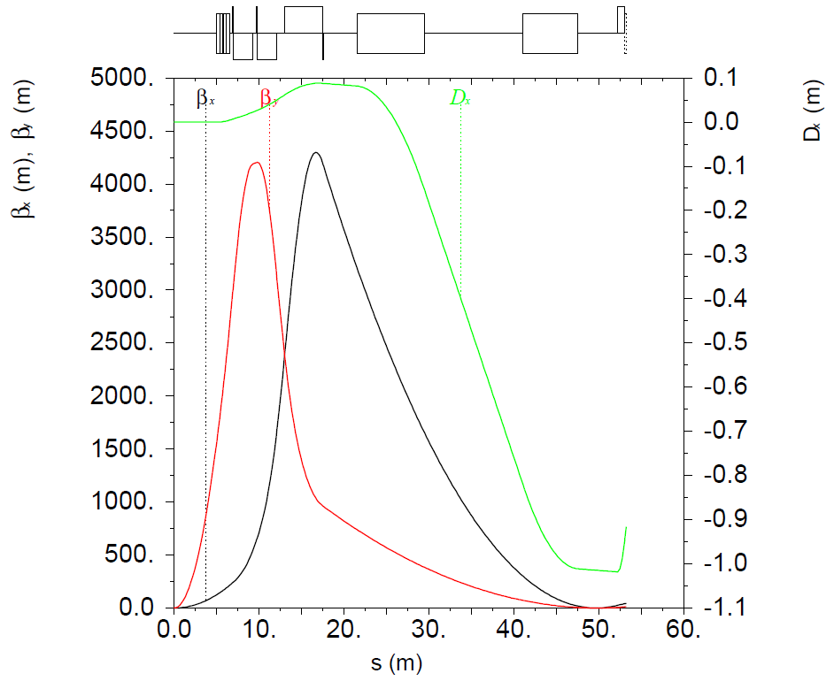
JLEIC Ion IR 100 GeV COM Design
±10 mrad angular aperture acceptance in the whole energy range up to 100 GeV COM with a secondary focus in combination with high dispersion point downstream of spectrometer dipole
Conventional Nb-Ti technology Final-Focusing Quadrupole technology
Same high luminosity and detection performance as the 65 GeV COM design
Shorter- and longer-focus configurations at lower and higher energies, respectively
65 GeV COM
100 GeV COM

Slide 7
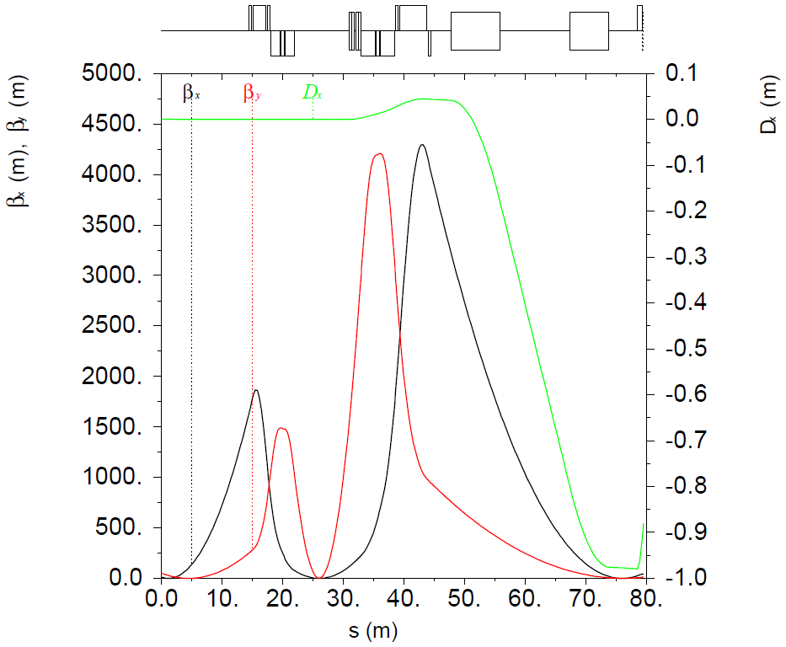
Ion IR Optics
Multipole and orbit correction spools
Multipole and orbit correction spools
x/y kickers
Secondary focus for Roman Pot
IP

Slide 8
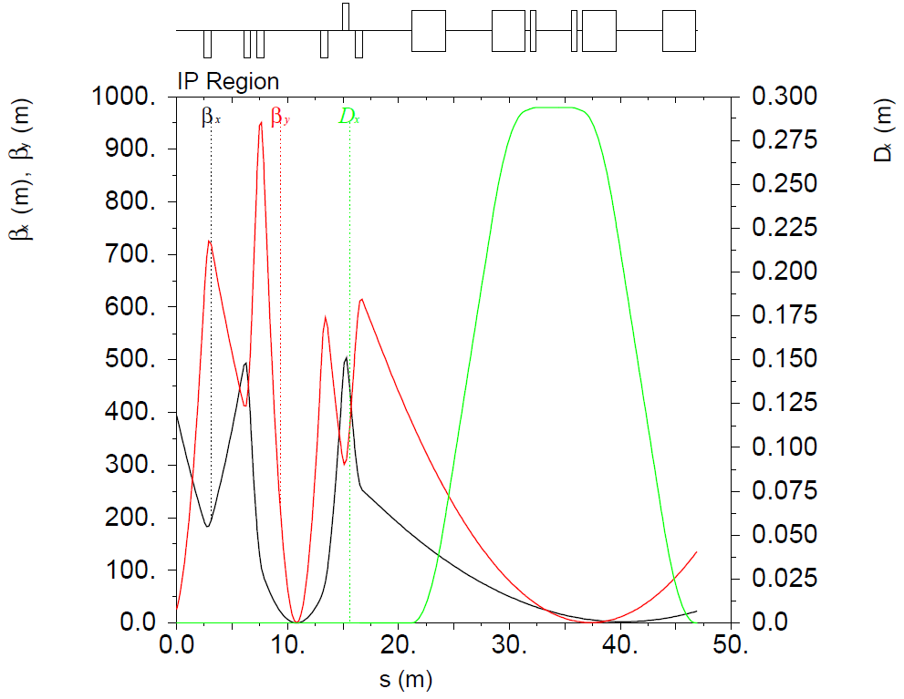
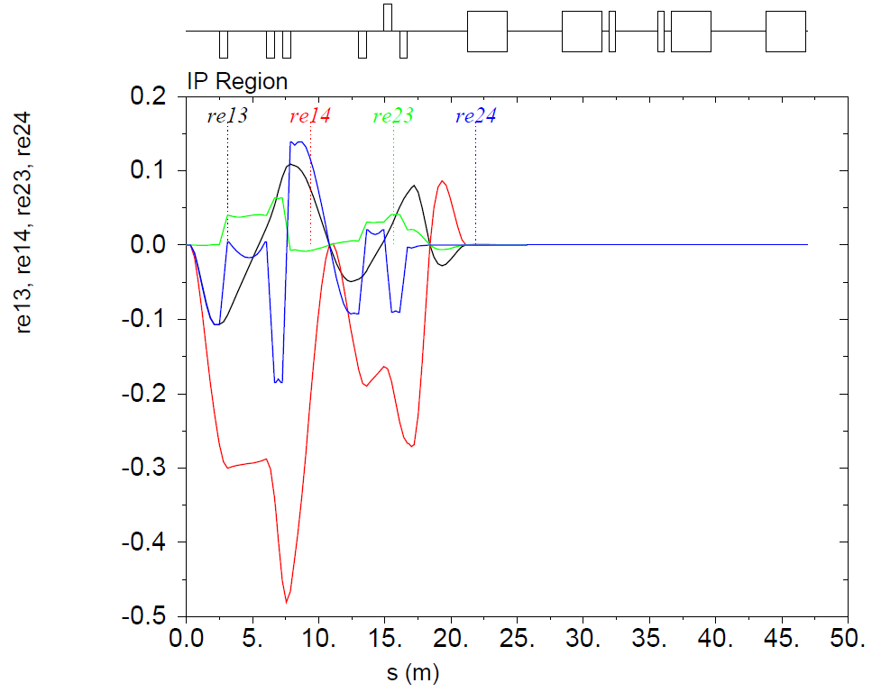
Electron IR Optics
IP
Compton polarimeter

Slide 9
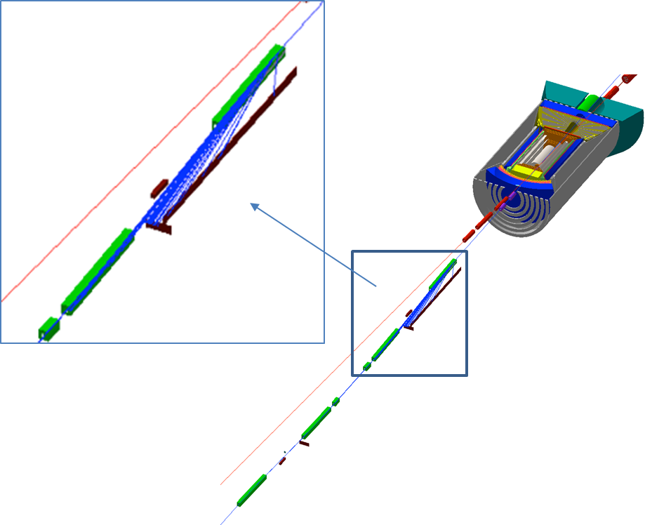
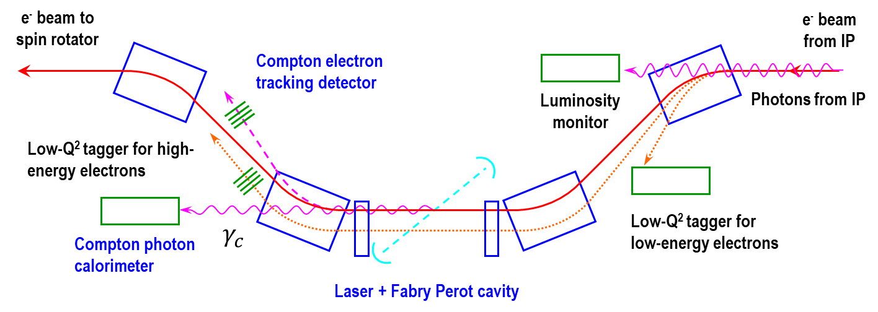
Low $Q^{2}$ Tagger in JLEIC
Dipole chicane for high-resolution detection of low-Q² electrons
Compton polarimetry has been integrated to the interaction region design
same polarization at laser as at IP due to zero net bend
non-invasive monitoring of electron polarization

Slide 10
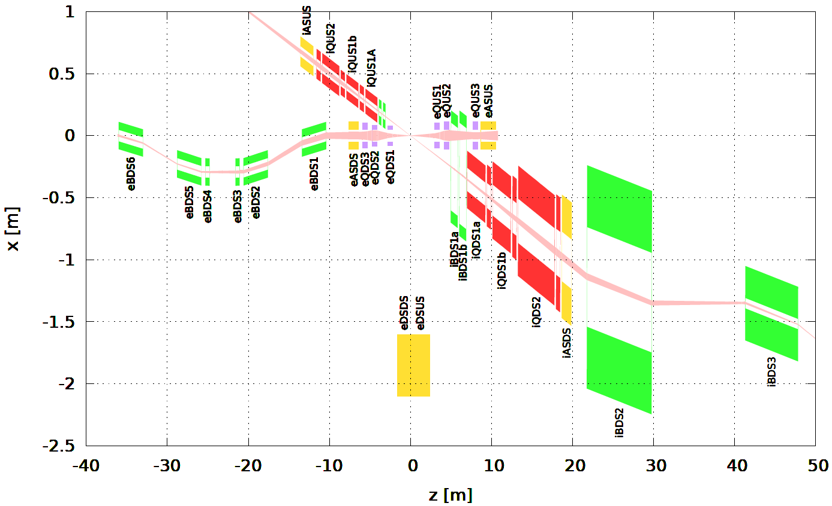
IR Layout

Slide 11
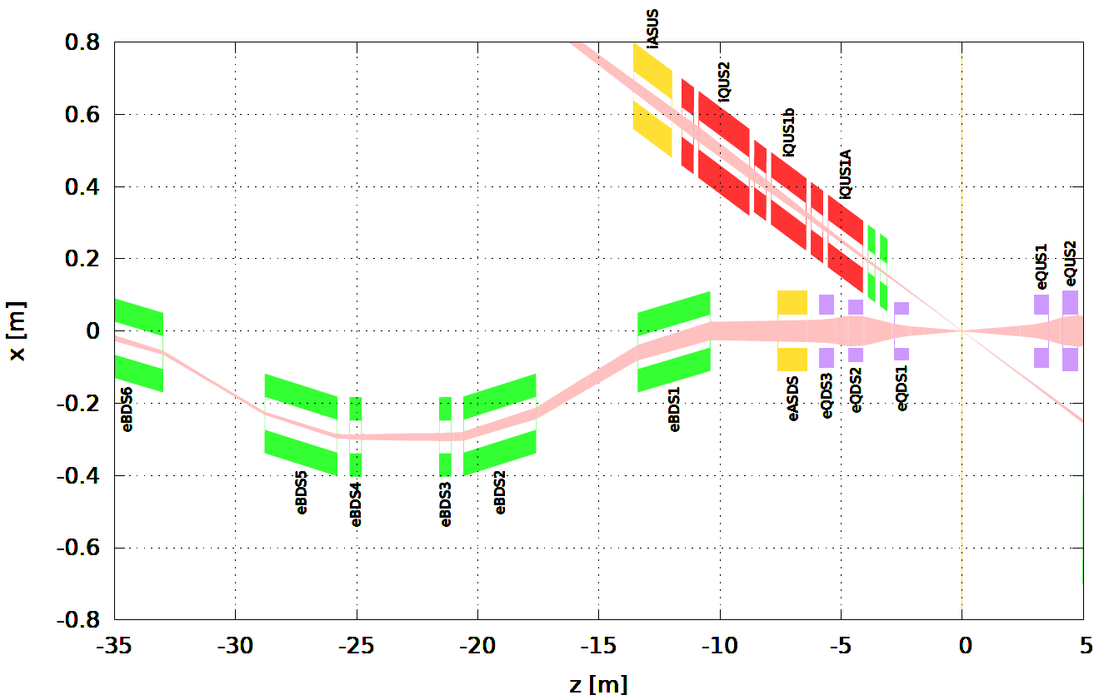
IR Layout
Compton polarimeter
+
Luminosity monitor
Need a hole in the dipole yoke for $0^{∘}$ photons

Slide 12
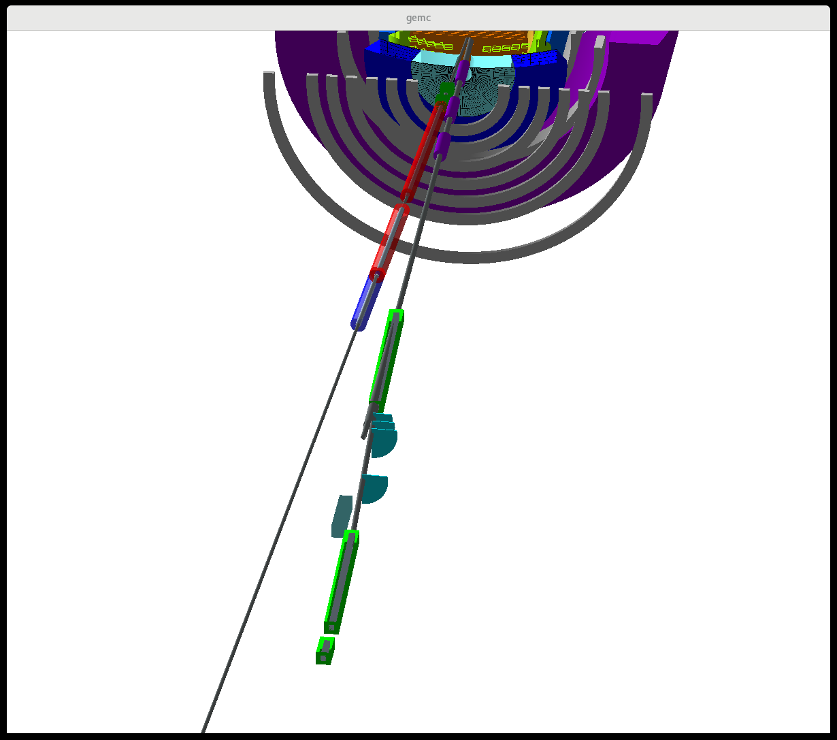
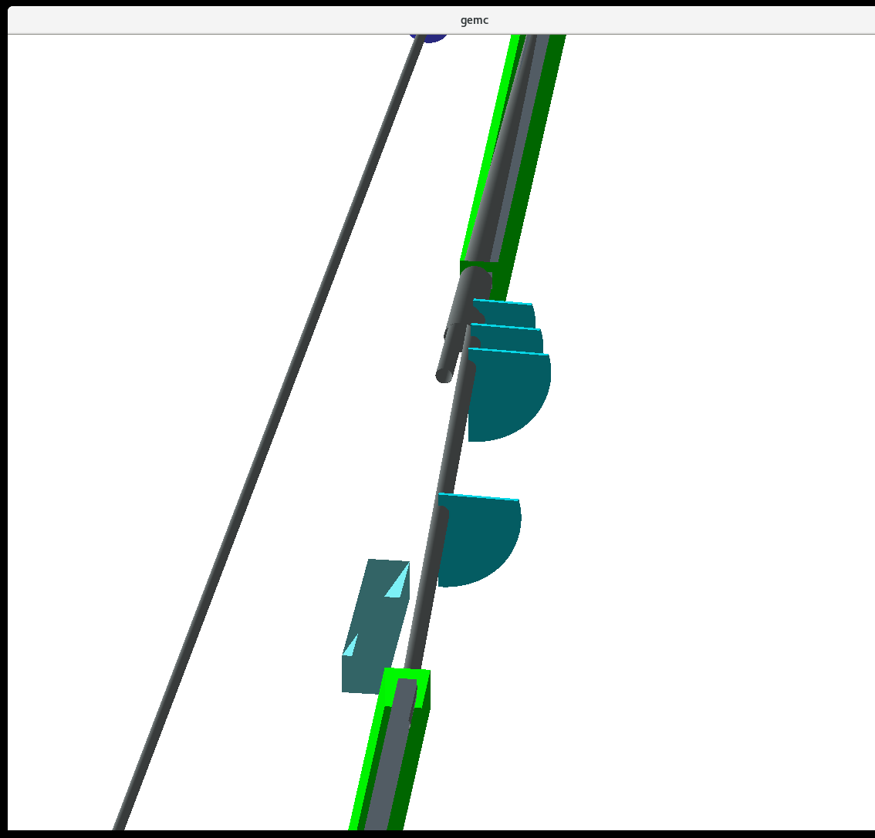
GEANT4 Model (Y. Furletova)

Slide 13
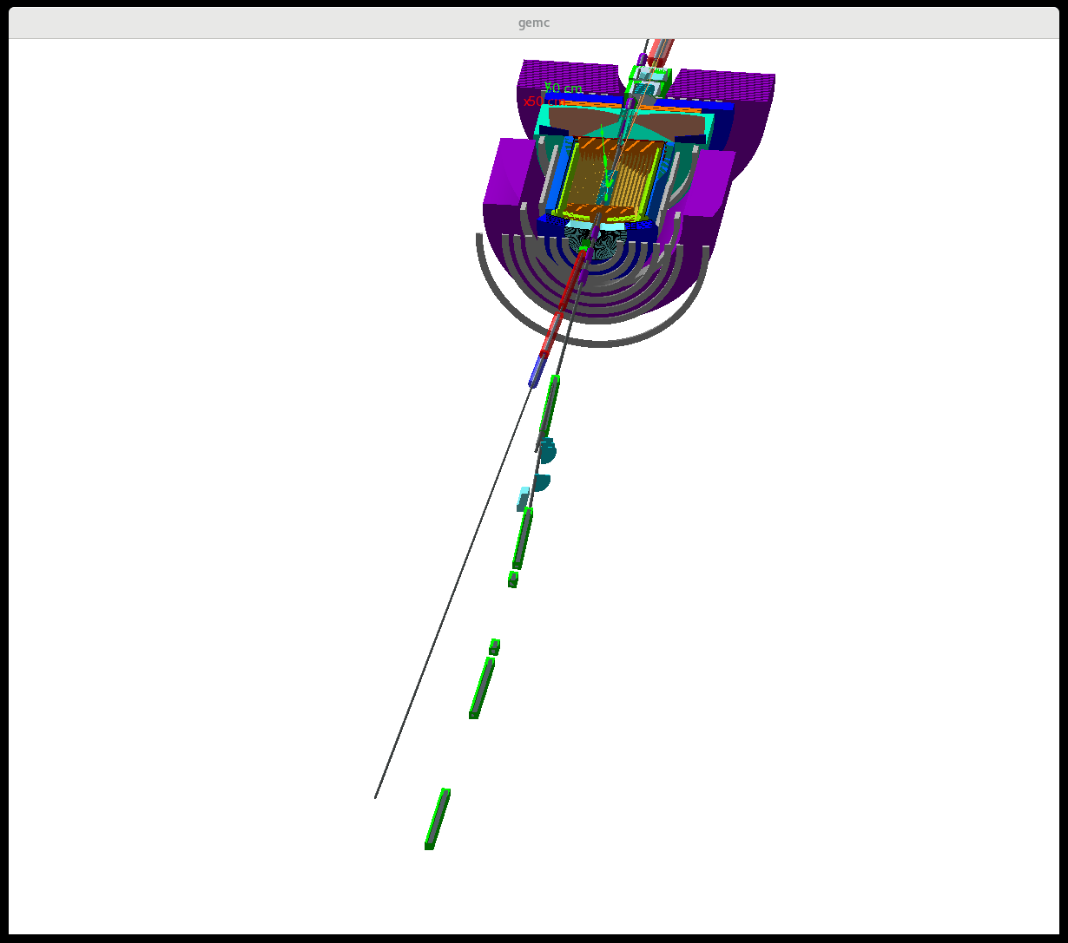
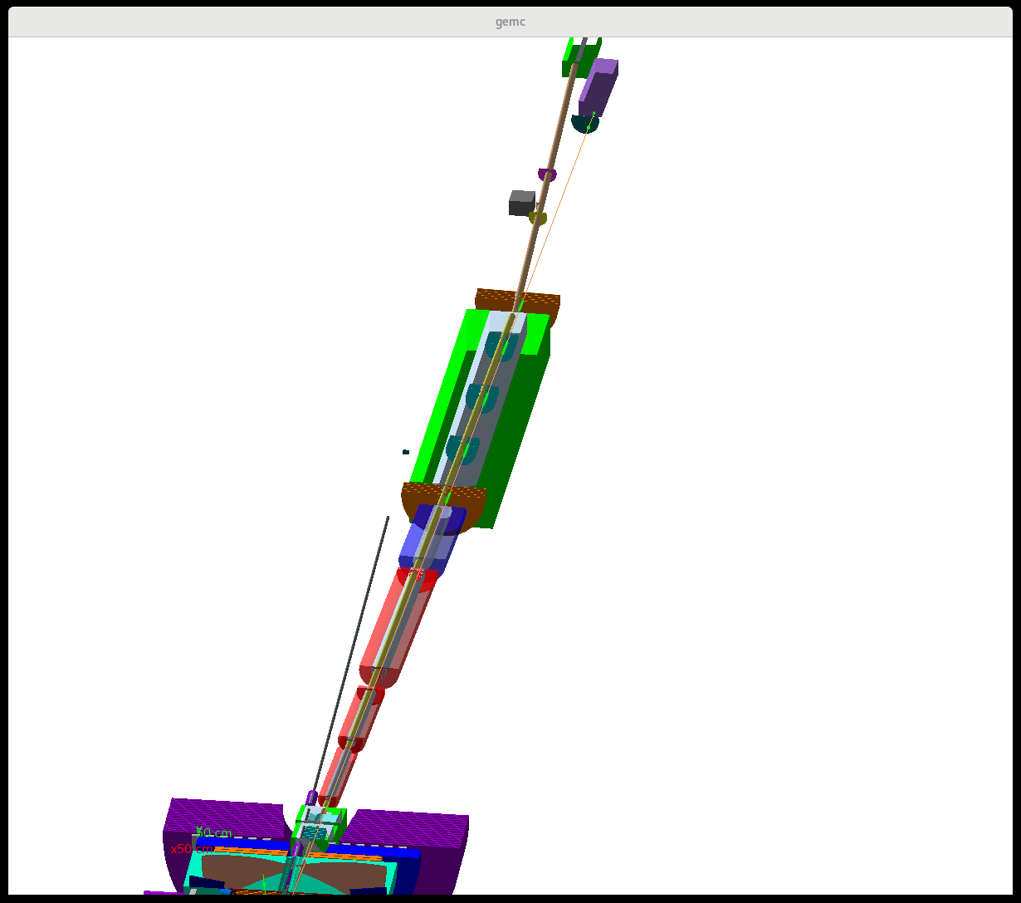
GEANT4 Model (Y. Furletova)

Slide 14
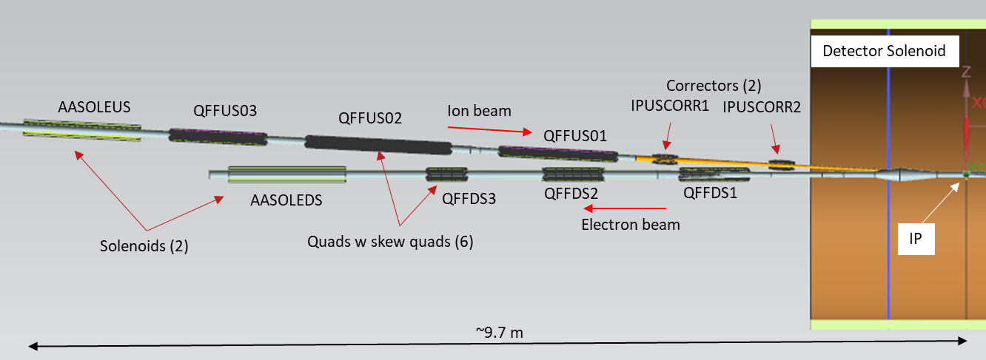
Development of IR Magnet Specifications
IR magnet engineering design/analysis
Design of the multipole correction scheme in the IR region, relate LARP experience
Identify limits in magnet parameters which directly affect the IR performance
Relate existing magnet data to the EIC performance requirements including scaling to the IR design
Heat and radiation loads on IR magnets
Perform magnetic analysis and initial optimization, considering LARP design, BNL EIC IR quadrupole prototype, and others
Mechanical and magnetic design of an optimized IR quadrupole
Incorporate optimized IR quadrupole lessons/features and finalize IR layout

