Slide 1
Report on the Design of PMT Read out board
Yasir Ali
PostDoctoral Researcher Instrumentation Development Lab University of Hawaii

Slide 2
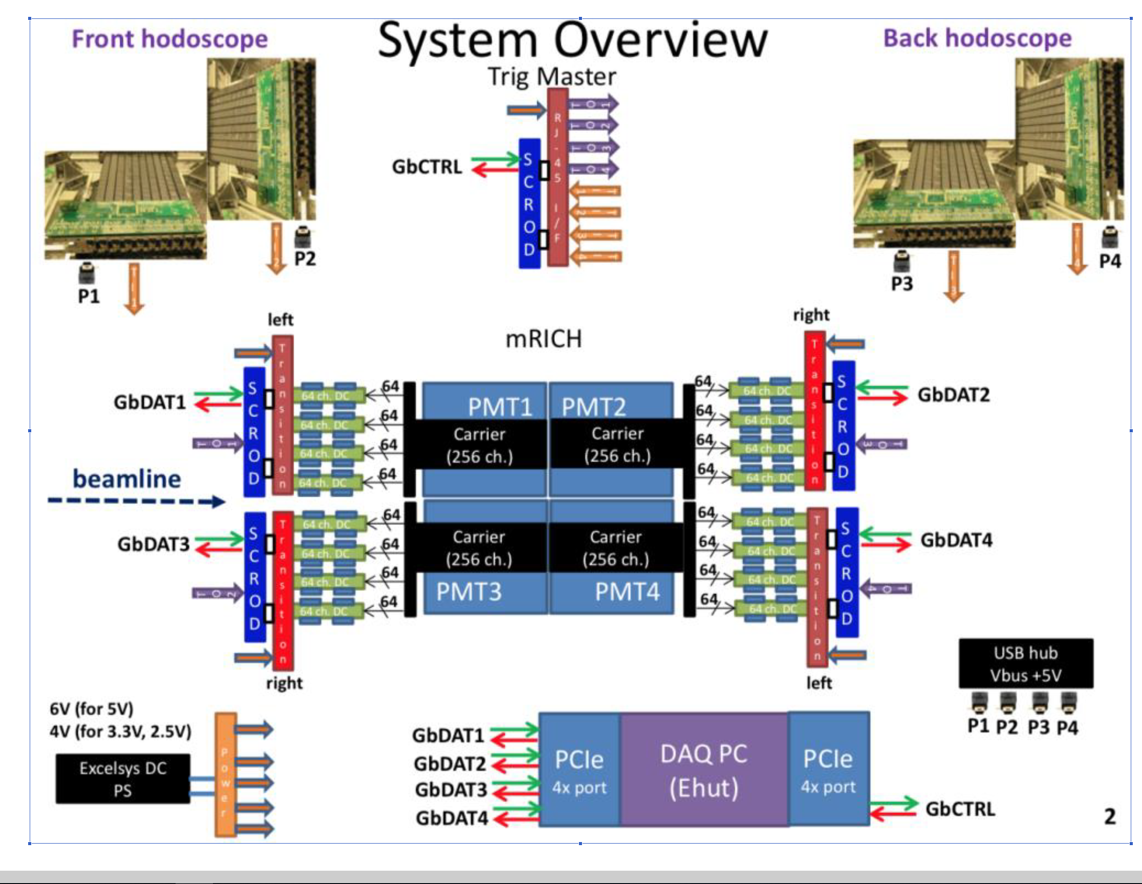
Modular Rich (mRICH) -> Key PID detectors →ring imaging Cherenkov technology (RICH). →Developed by the eRD14 collaboration →for kaon and pion identification in momentum range from 3 to 10 GeV/c

Slide 3
PMT Daughter card Integration:
Transition Board
Carrier
64
DC
SCROD
PMT
64
DC
Ethernet Connection
256
64
DC
64
DC

Slide 4
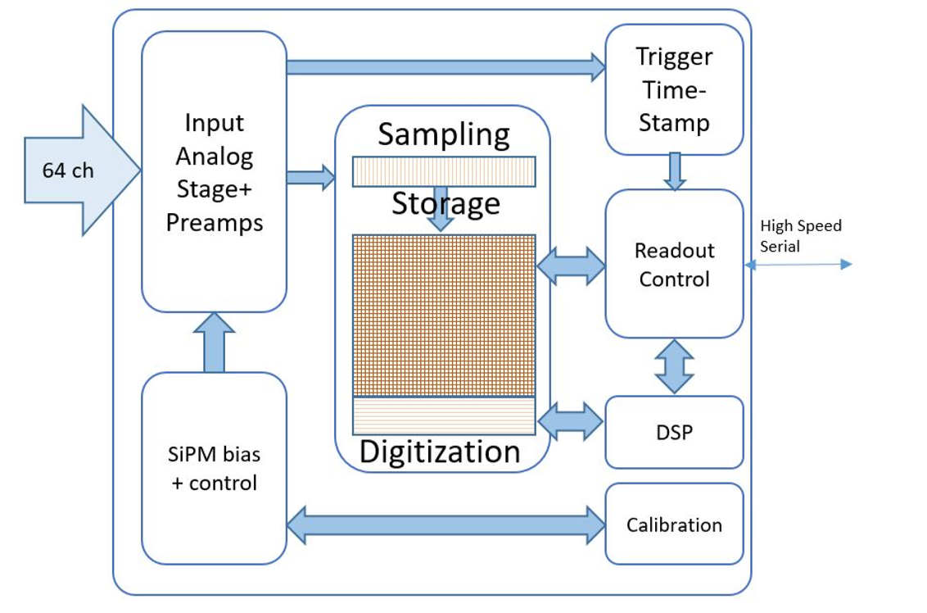
→ SiREAD waveform sampling ASIC (SiREAD), optimized for high density light detectors, such as Silicon Photomultiplier (SiPM) or MA-PMTs It has 32 Channels with Sampling Rate of 1 GSa/s.
SiREAD

Slide 5
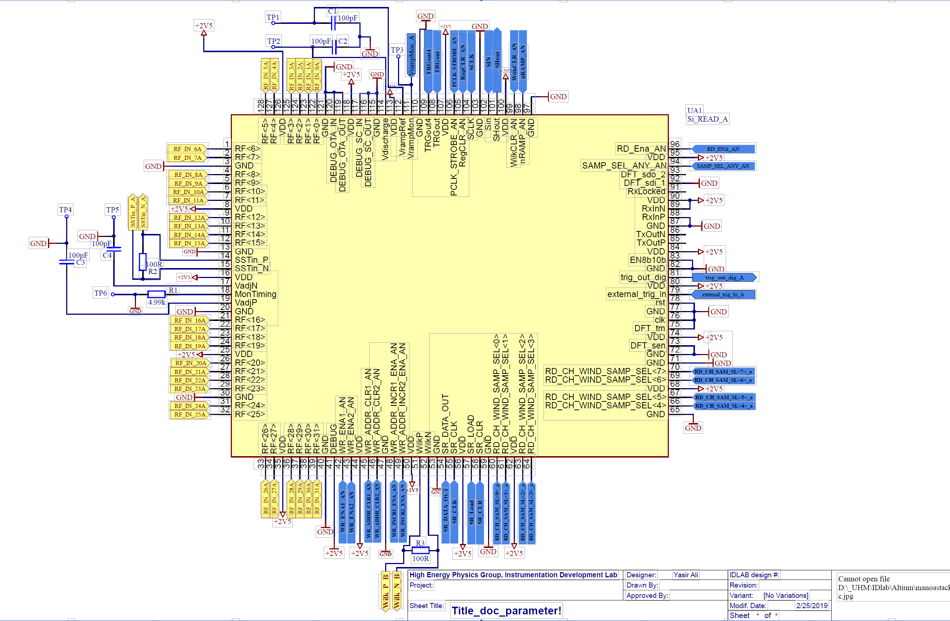
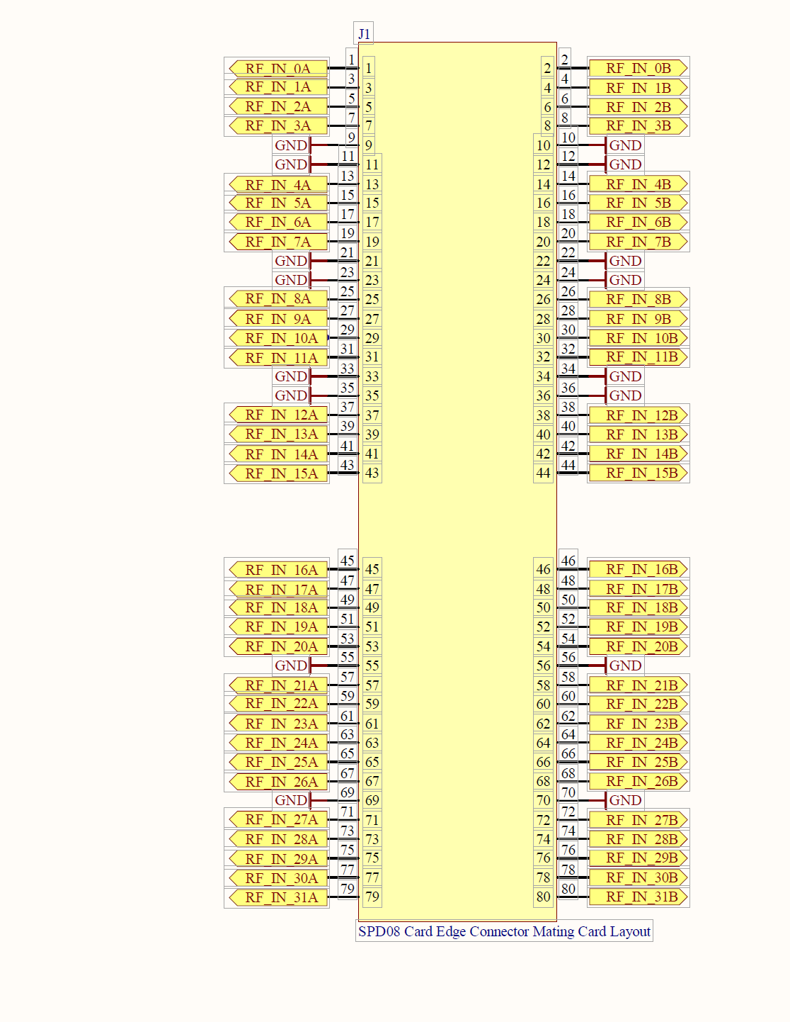
Schematic
J2 Connector
FPGA Spartan 6

Slide 6
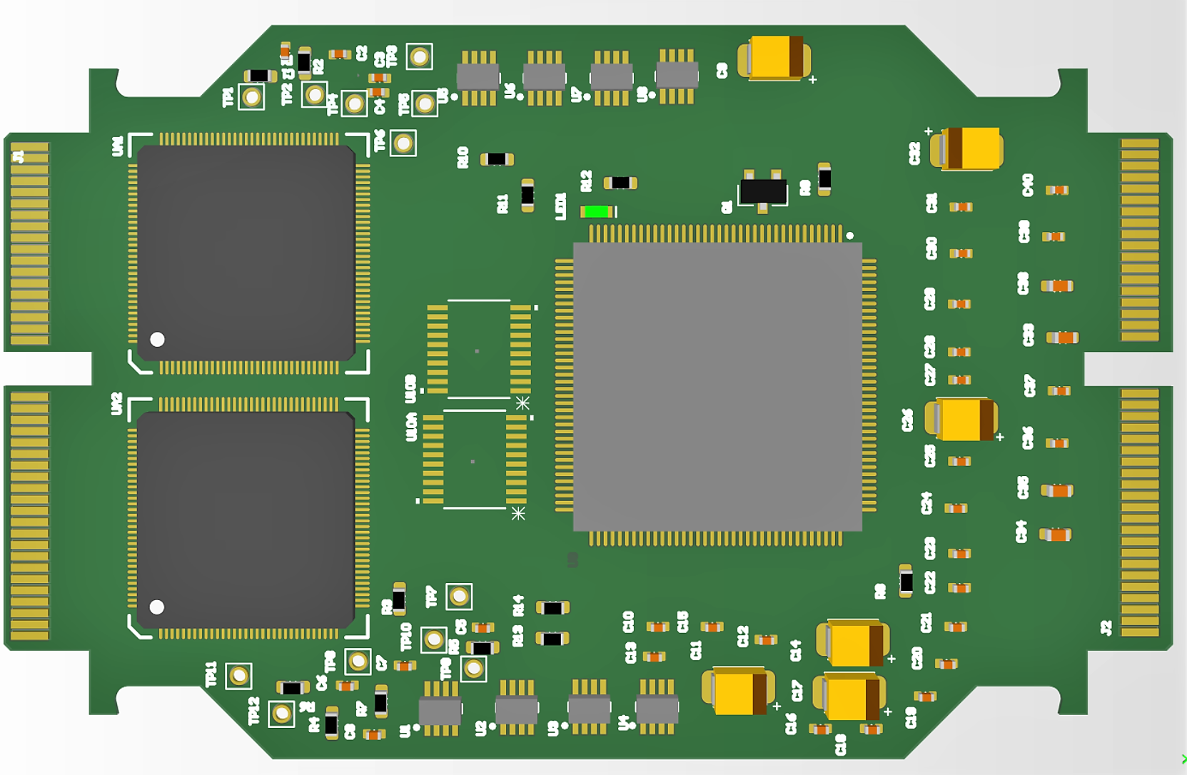
PCB with Placement Stepping towards Routing
SiREAD
FPGA-Spartan 6
SCROD
PMT

Slide 7
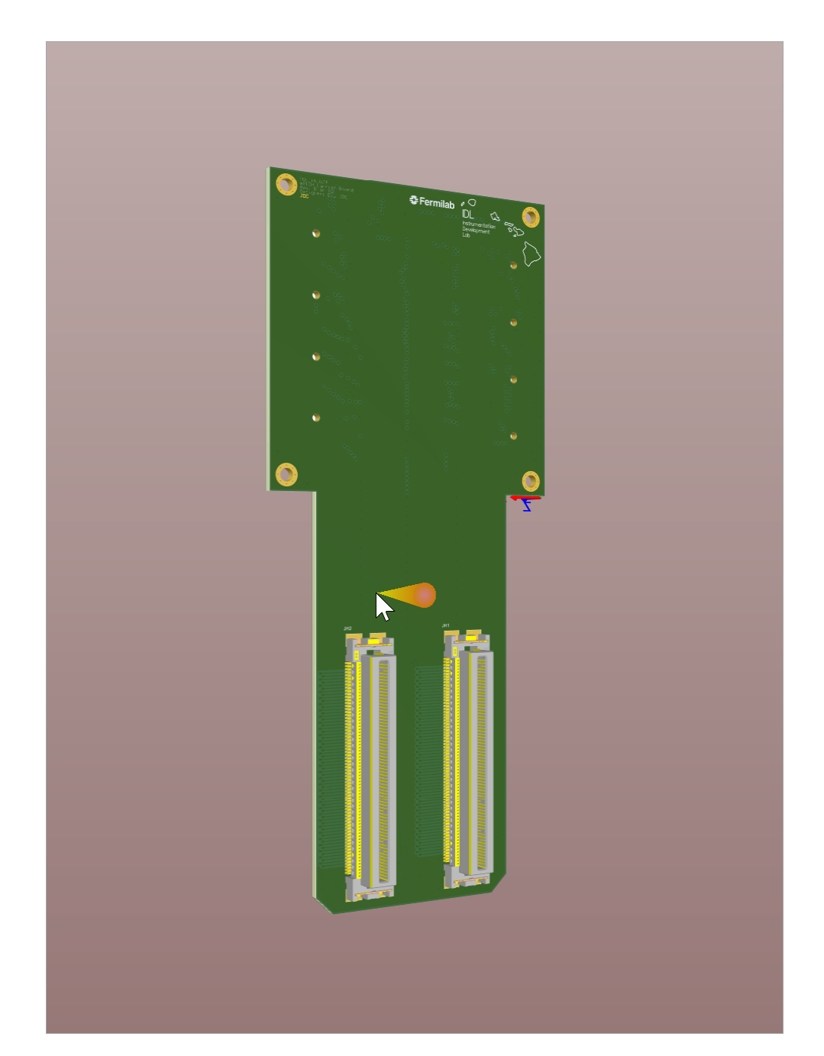
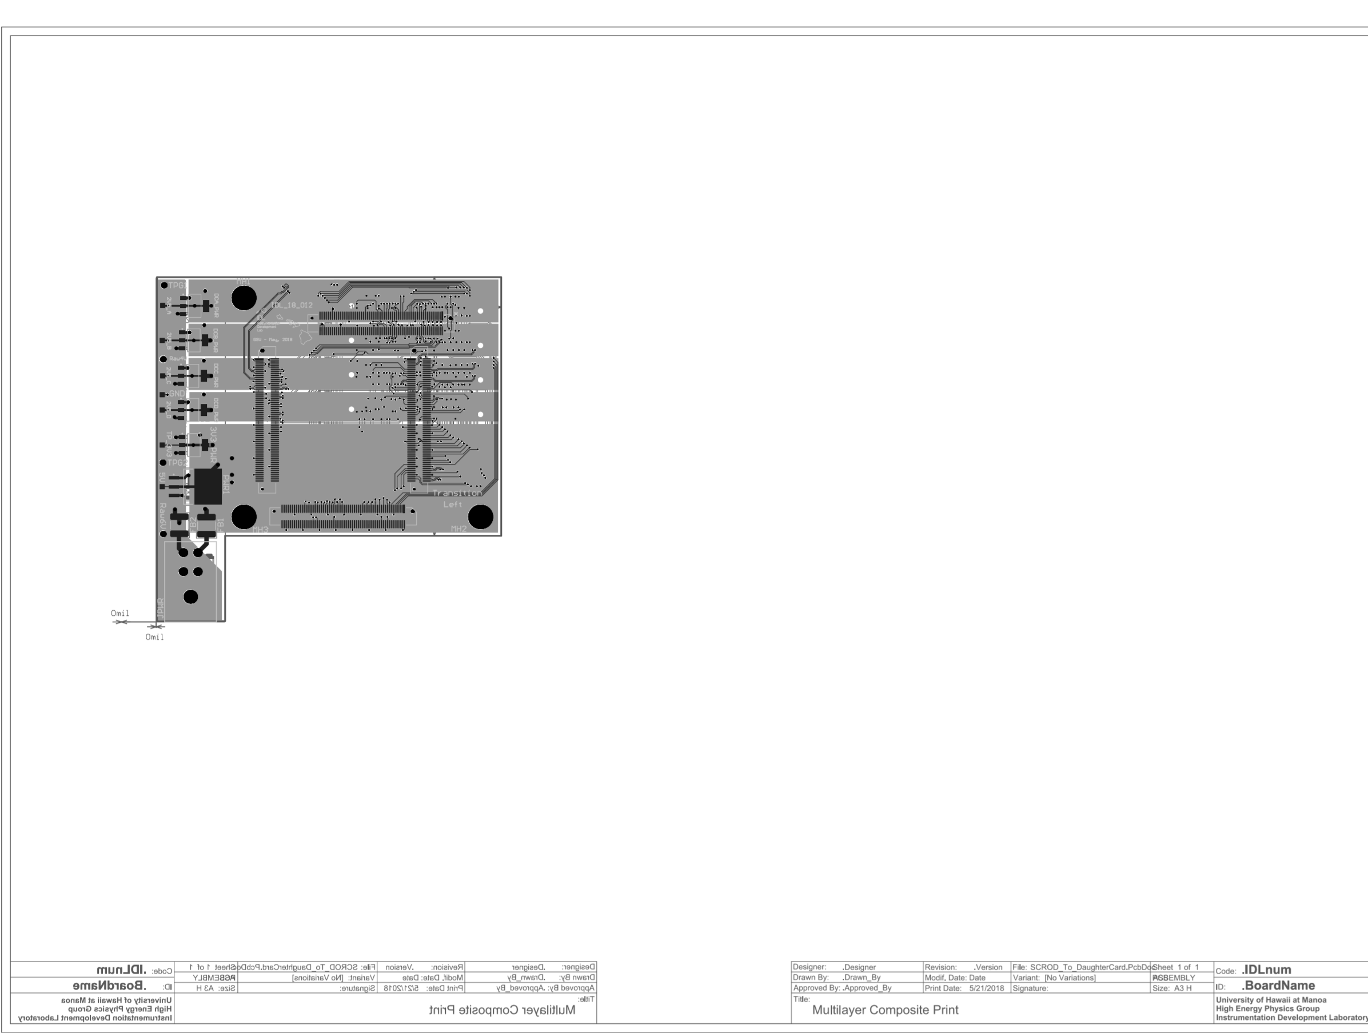
Carrier Board
SCROD to FMC Board

Slide 8
Estimated Schedule
Schematic is Finalized and Placement is almost there
Lay out completion and Final Design Review by: 03-20-2019
Fabrication by: 03-29-2019
Assembly: 04-07-2019
Initial bring up and first indication of working: 04-15-2019
Thanks for your Patience

