Slide 1
PMG Agenda
Short Update and Calendar
Major risks as the project evolves into construction
Status of the recommendations from past reviews concerning CD-2
Status of documentation needed for PD-2/PD-3 (TDR, EVMS reporting, etc…)
Status of UTK grant proposal (I’ll check)
AOB (GSU contract, LPPs, PPMP…)

Slide 2
sPHENIX MIE Overview
TPC Range | Total Budget w/ contingency | Total Baseline Cost | Actuals to Date | % Complete based on actuals | CPI | SPI
$24.2- 34.5M AY | $26.55 M AY | $20.53 M AY | $2.86 M AY | 13.9% | Pre-baseline | Pre-baseline
Scope
Detector systems produced, tested and ready for installation: Time Projection Chamber w/ electronics, Electromagnetic Calorimeter w/ electronics, Hadronic Calorimeter w/ electronics, DAQ/Trigger, Minimum Bias Detector, Project Management
Installation and system commissioning is not part of the scope
Schedule
CD-0 received Sept 2016
CD-1/3A received Aug 2018
PD-2/3 review May 2019
Early completion Oct 2021
PD-4 Dec 2022
Cost
$24.2 – 34.5M AY
$26.55M AY Point cost estimate including ~30% contingency

Slide 3
Recent News/Issues
The preliminary project baseline is set and EVMS practice has begun.
The first practice EVMS report has been generated.
We are meeting monthly with the L2 Managers to status the project
First partial delivery of LLP orders, 8500 SiPMs, will arrive at Univ. of Michigan next week.
First partial delivery of production scintillating fibers for the EMCal arrives at UIUC in April.
Both wagon wheels for the TPC full-size prototype were delivered to SBU
The 36 EMCal blocks that have been delivered to BNL have all been tested, reflectors and light guides have been attached . The SiPM readout boards are in the process of being installed.
An additional 21 EMCal blocks will be shipped from UIUC to BNL this week. We expect all of the block production for Sector 0 will be completed by the end of March.
An internal engineering review of the sPHENIX Carriage/Cradle was held at BNL Feb 11.
Good progress and positive feedback
Procurement readiness review for the cryogenics in 1008 scheduled for Mar 11.

Slide 4
sPHENIX Calendar
sPHENIX Cryo Procurement Readiness Review Mar 11
sPHENIX in Asia meeting Mar 25-27, Taiwan
21 sPHENIX institutions in Asia
Director’s review practice Week of Apr 1
Director’s Review (1.X,2.X,3.X) Apr 9-11
PD-2/3 Review Practice Week of May 13
PD-2/3 Review (MIE only) May 28(noon) - 30

Slide 5
Major Project Risks
Project management risks:
Multiple quarter federal budget delay
Vulnerability of all DOE projects. Being funded by re-directs rather than as a line item helps reduce risk
Loss of key personnel at critical time
Being part of a large directorate where it is possible to ‘borrow’ personnel temporarily helps mitigate this risk
Technical risks:
Unable to place scintillating tile order with Uniplast
We have alternate approaches to getting this order placed but all involve Uniplast as the primary vendor
SAMPA chip revision for TPC is a failure
Fall back to longer shaping time of 160 ns or
Use ~$500k in contingency and 9 months of schedule time to correct the chip problem and resubmit
UIUC can not get enough student help for block production.
No problems with student help for preproduction work. Good so far.

Slide 6
Open Action Items from Other Reviews
Two action items from the previous reviews both being addressed:
Update the schedule contingency following a re-evaluation of schedule risks
MC risk simulation will be done using a residual risk assessment. Our project people are taking care of this
Complete the MoA’s with other BNL departments and divisions.
CAD and sPHENIX are working on the remaining one: 1008 conventional services. sPHENIX wrote a requirements document and is waiting for CAD feedback prior to revising.

Slide 7
Preparing for PD-2/3 Review, May 2019
PD-2/3 Documentation:
Prepared for PD-2/3 review in May 2019.Need near final drafts by March in preparation for practice Director’s (ALD) Review
TDR (John H)
PMP (EO’B)
Revised BOE and WBS Dictionary (Glenn)
Hazard Analysis Plan (Jim)
Updated Risk Registry and RMP (Irina)
Cost Books, P6 reports (Cathy w/ Eric and Irina)

Slide 8
Status of Univ Tennessee Grant Proposal
Based on communication with Elizabeth Bartosz of DOE, UTK should have the funding to send to CERN by the beginning of April.
I’ll get a revised update this week

Slide 9
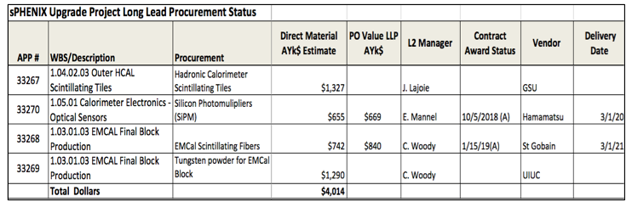
LLP Status
100k SiPMs has been placed. First parts in Feb 2019. Order complete Mar 2020
Scintillating fiber order placed. First parts in Apr 2019, Order complete Mar 2021
Scintillating tile order to be placed with Georgia State University
Tungsten powder LLP-4 order being prepared at UIUC. Will split between FY19 and FY20.

Slide 10
Upcoming Reviews
Director’s Review April 9-11
Covers 1.X (MIE), 2.X (Infrastructure &Facility Upgrade), 3.X (INTT and MVTX)
Chaired by Jim Yeck
Expanded committee from Mar 2018 Director’s review. Mix of BNL and outside committee members but most local.
Dominated by parallel sessions
PD-2/3 Review May 28 (noon) - 30
Outside chair TBD
Organized through BNL’s Project Oversight Board
Try to get the same committee as last years CD-1/3A review w/o OPA
MIE only
Review charge will be modeled on charges from recent OPA CD-2/3 reviews

Slide 11
High Priority Issues
Monthly EV calculations
Practice EVMS starting now. Have the process debugged by early CY2019.
February status meetings with L2 managers are going on this week.
We will use change control on FY19 LLP orders and any changes to the preliminary baseline.
Incorporate EV calculations in future monthly financial report to DOE.
Get final approval of PPMP
BNL Physics and ALD have signed the PPMP. It is with BHSO for Bob Gordon’s signature. After that it goes to Germantown for concurrence and finally to Doon
Revise the RLS for 3.1 (INTT), 3.2 (MVTX)
Need to bring the project files for the silicon detectors to the same state as the MIE and Infrastructure and Facility upgrade.

Slide 12
Back Up

Slide 13
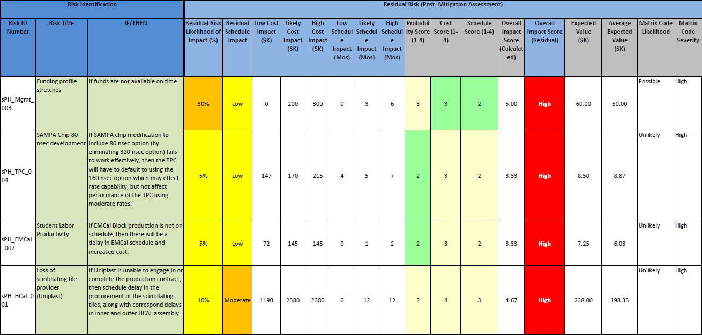
Major Project Risks

Slide 14
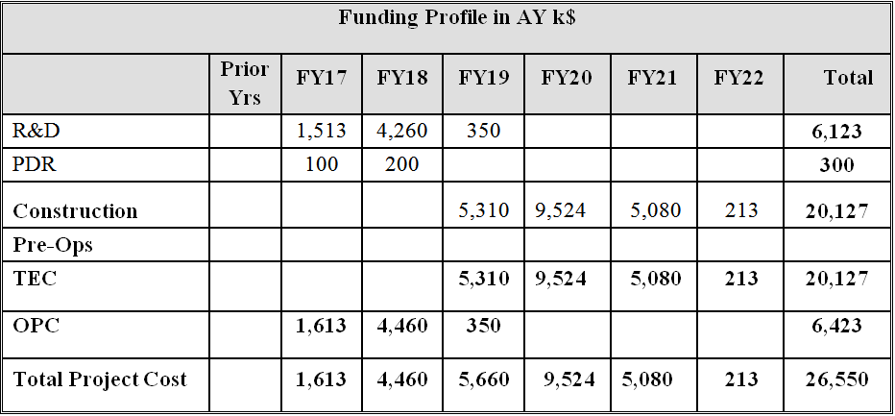
Budget at CD-1/3A
sPHENIX Budget Profile

Slide 15
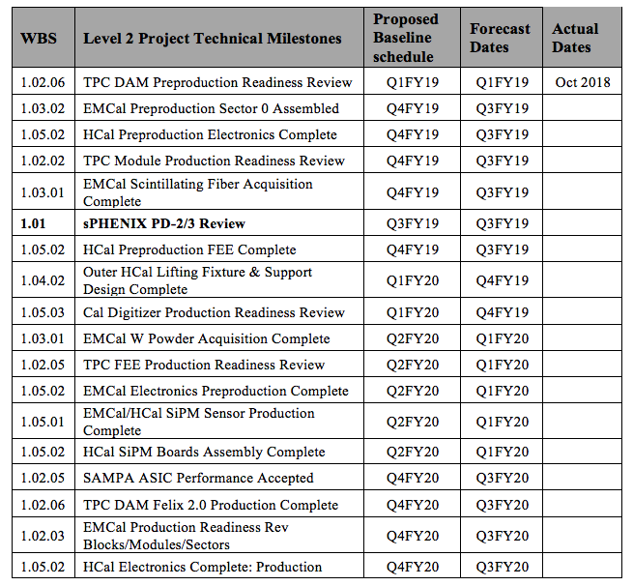
L1 and L2 Milestones

Slide 16
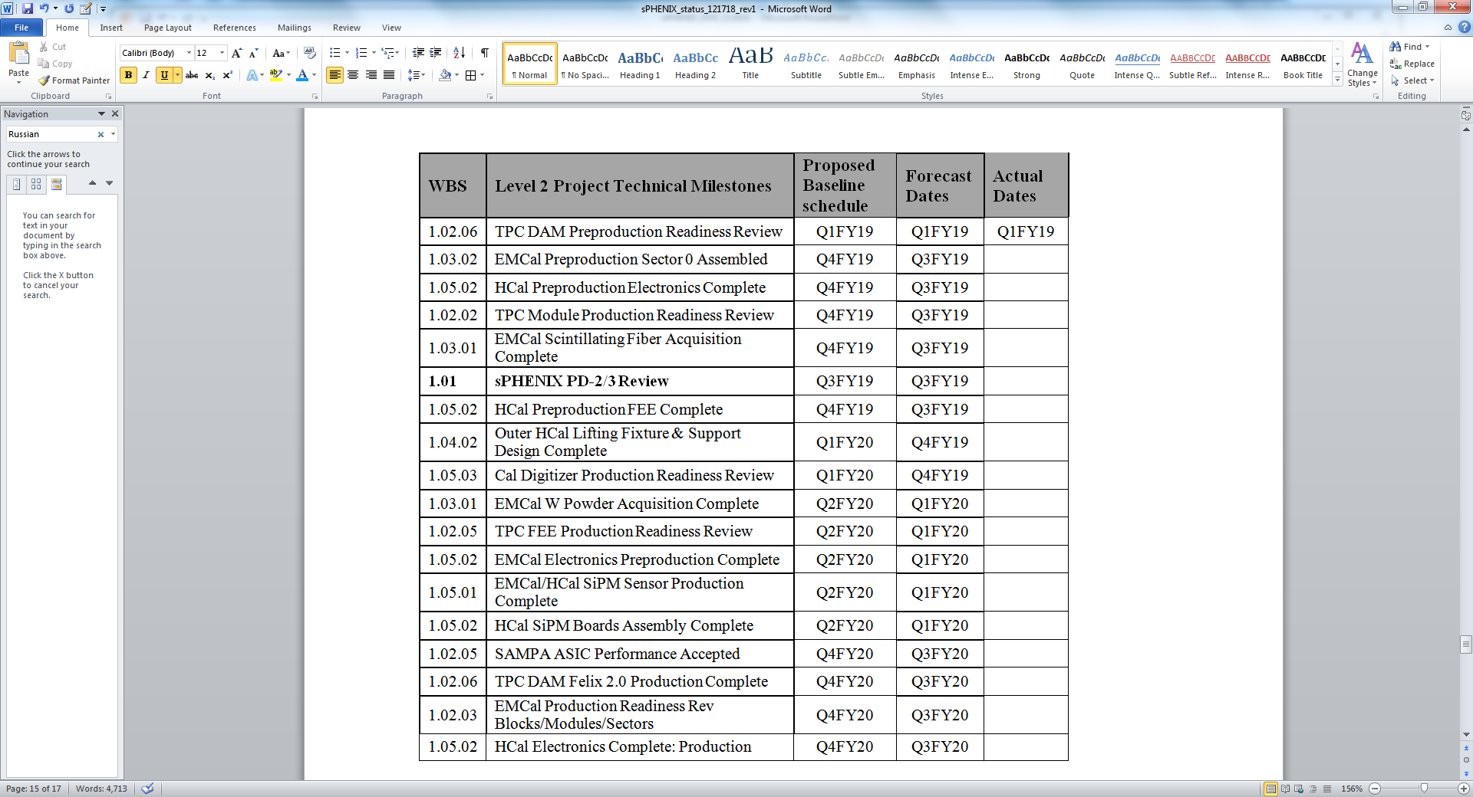
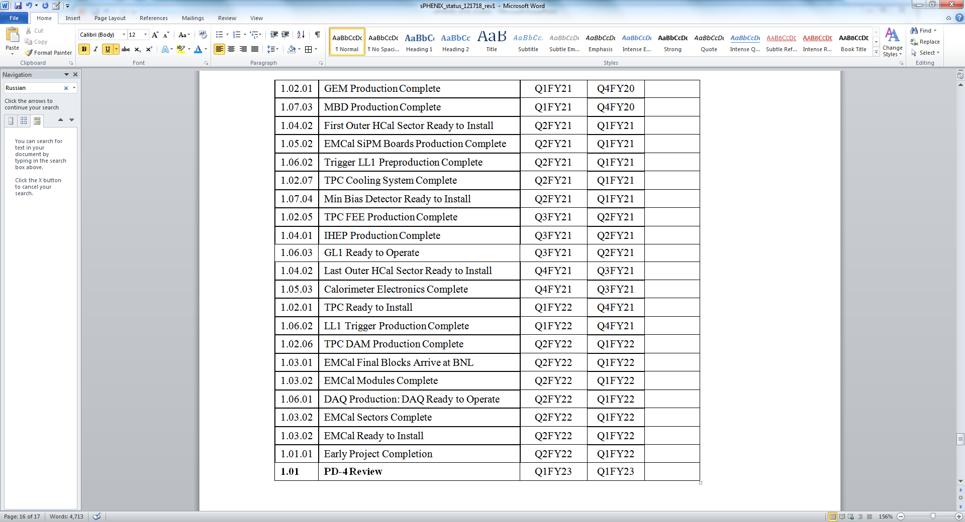
L1 and L2 Milestones

