Slide 1
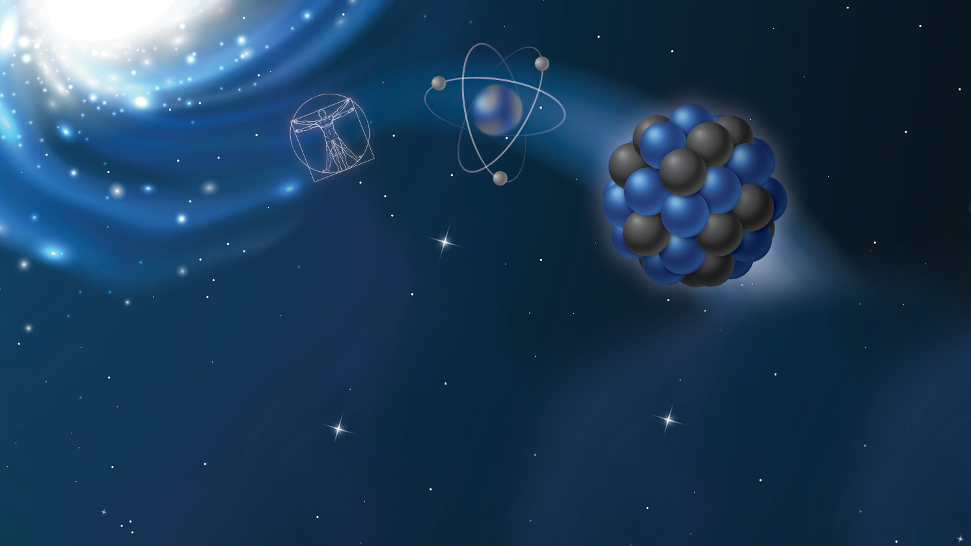
Data rates for current EIC Detector concepts
Outline: ● Uniqueness of EIC ● Data rate estimation ● Comments on DAQ strategy
Jin Huang (BNL)
Many thanks to the inputs from
Elke Aschenauer, Kai Chen, Abhay Deshpande, Alexander Kiselev,
Tonko Ljubicic, David Morrison, Christopher Pinkenburg, Martin Purschke

Slide 2
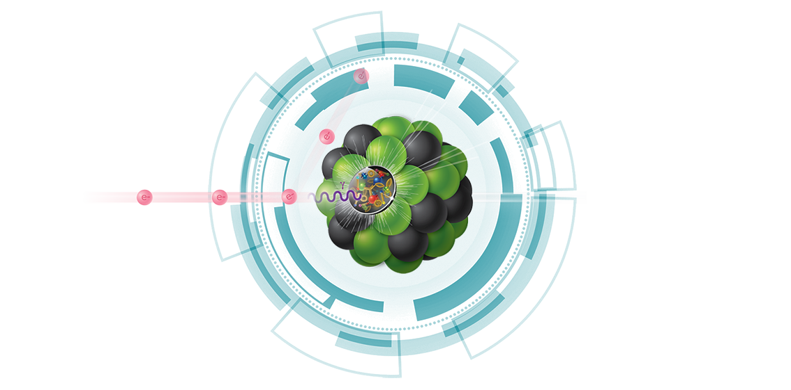
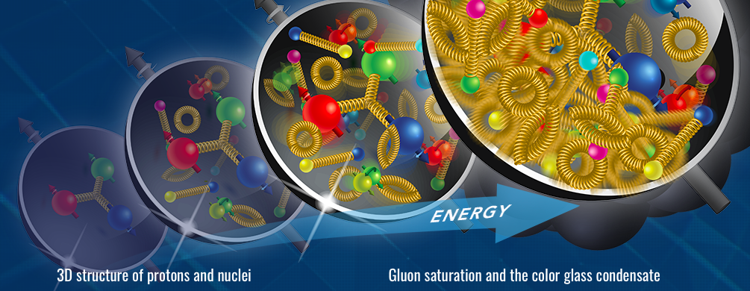
EIC: Electron ion collider
Precisely image gluons in nucleons and nuclei, explore QCD frontier of ultra-dense gluon fields, reveal origins of nucleon spin

Slide 3
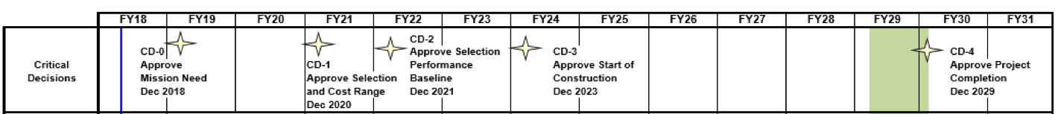
EIC: Electron ion collider
Precisely image gluons in nucleons and nuclei, explore QCD frontier of ultra-dense gluon fields, reveal origins of nucleon spin
BNL’s concept for timeline to EIC
RHIC Science Program
eRHIC

Slide 4
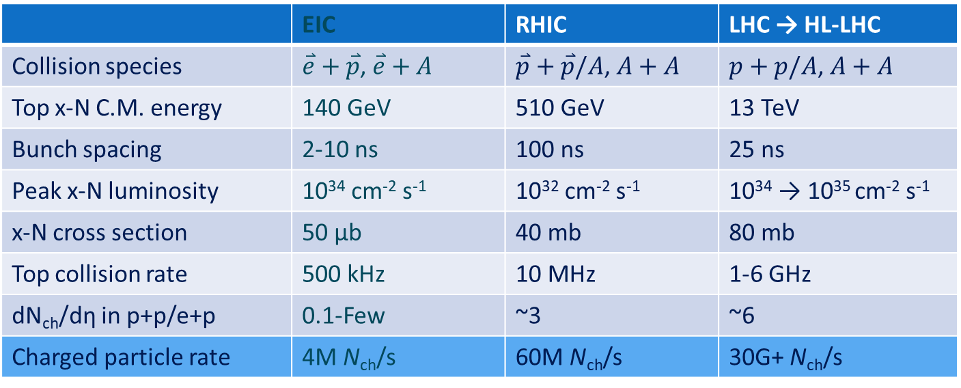
EIC: unique collider
→ unique real-time challenges
 | EIC | RHIC | LHC → HL-LHC
Collision species | $\overset{⃑}{e}+\overset{⃑}{p}$, $\overset{⃑}{e}+A$ | $\overset{⃑}{p}+\overset{⃑}{p}/A$, $A+A$ | $p+p/A$, $A+A$
Top x-N C.M. energy | 140 GeV | 510 GeV | 13 TeV
Bunch spacing | 2-10 ns | 100 ns | 25 ns
Peak x-N luminosity | 10³⁴ cm⁻² s⁻¹ | 10³² cm⁻² s⁻¹ | 10³⁴ → 10³⁵ cm⁻² s⁻¹
x-N cross section | 50 μb | 40 mb | 80 mb
Top collision rate | 500 kHz | 10 MHz | 1-6 GHz
dN_{ch}/dη in p+p/e+p | 0.1-Few | ~3 | ~6
Charged particle rate | 4M N_{ch}/s | 60M N_{ch}/s | 30G+ N_{ch}/s
EIC has lower collision rate and event size is small → signal data rate is low
But events are precious and have diverse topology
EIC luminosity is high, so background and systematic control is key

Slide 5
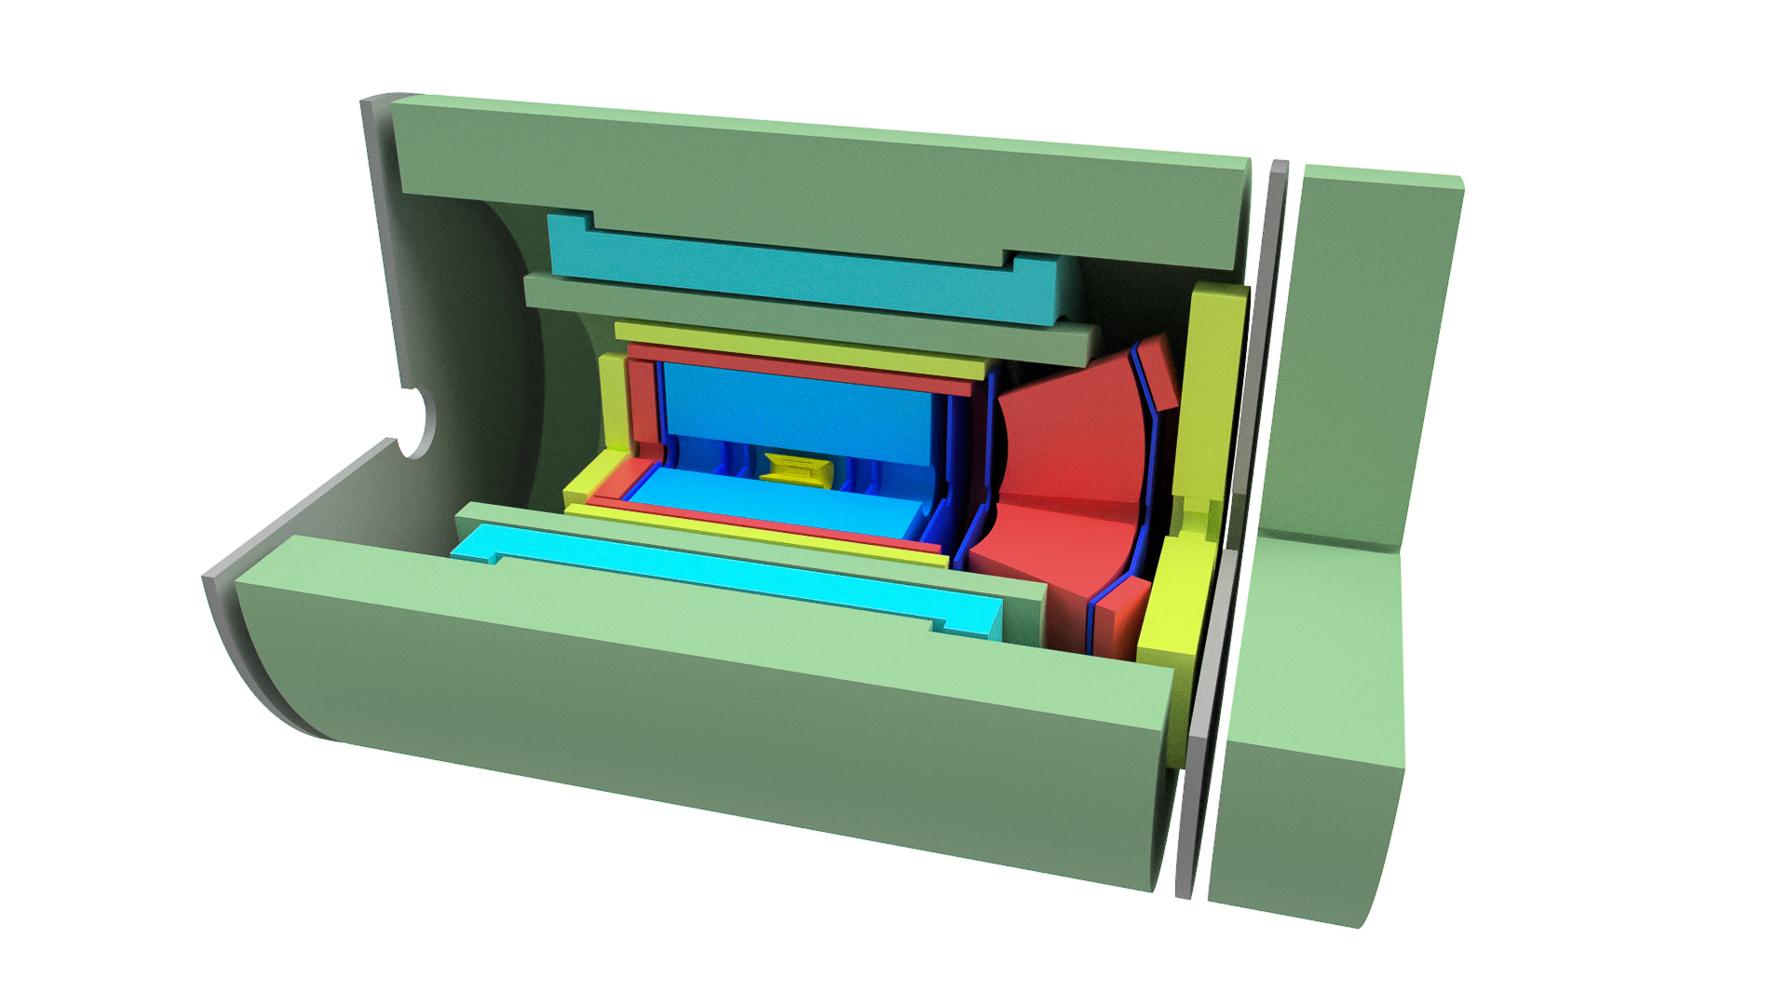
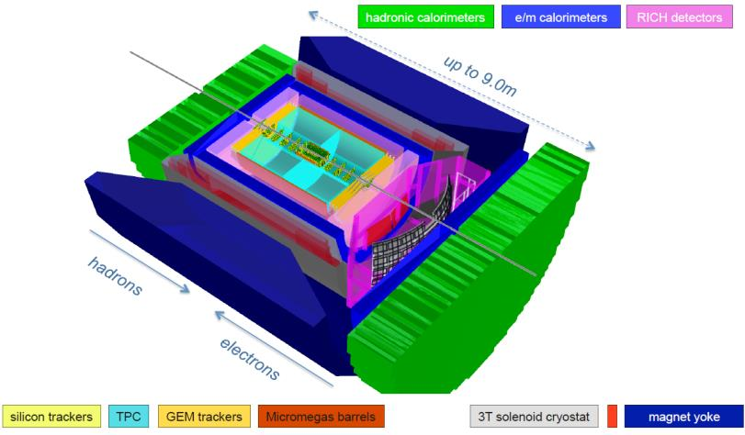
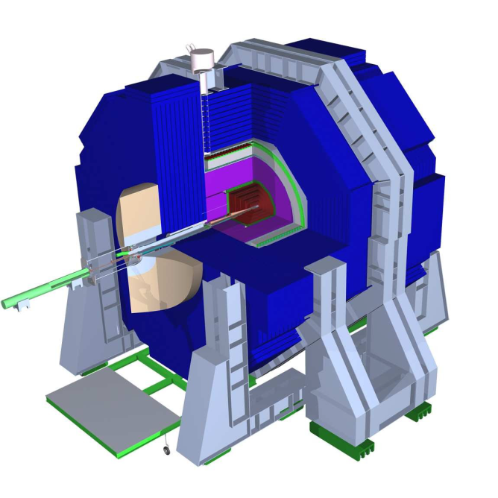
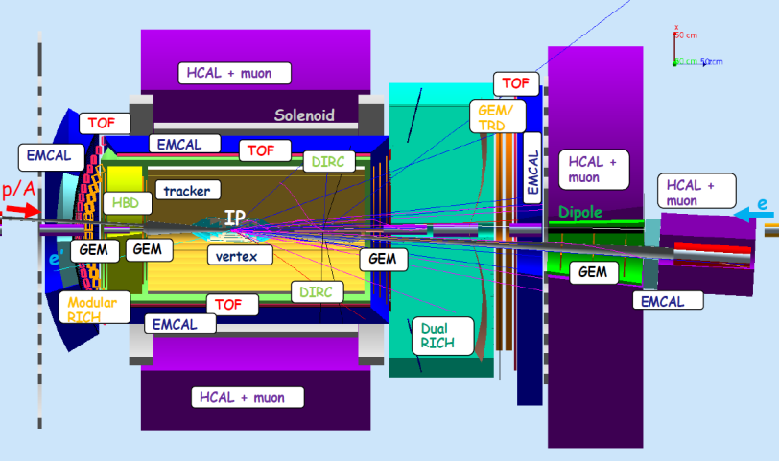
Detector concepts
BeAST concept
sPHENIX-based concept
JLEIC concept
TOPsiDE concept
References reports :
ePHENIX LOI: arXiv:1402.1209
eRHIC design report, preCDR: arXiv:1409.1633
MEIC (JLEIC) design summary: arXiv:1504.07961
On-going development and updates

Slide 6
Strategy of the estimation
Among these four concepts, three are similar: BeAST/sPHENIX/JLEIC
  Next two sections: data rate and beam gas background estimation based on an assumptions sPHENIX digitizer data format
TOPsiDE has much larger channel count in calorimeter (pixelated digital calorimeter) and short integration time in trackers (10-ps LGAD tracker)
  R&D are still early (e.g. 10-ps LGAD noise rate),
  Readout cost is quite undefined too IMHO
  Comments on its data rate and strategy at the end of rate estimation

Slide 7
Collision-related data rate estimation

Slide 8
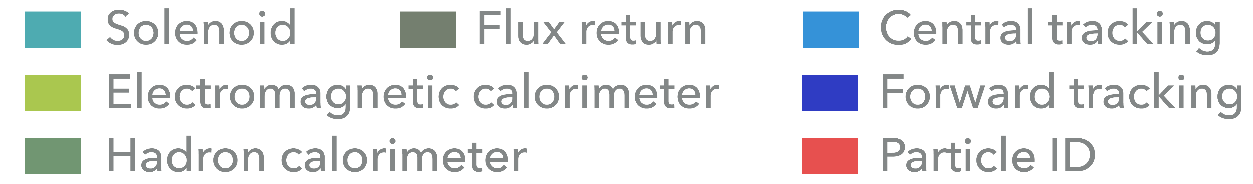
Example: sPHENIX-based EIC detector
Proton 275 GeV/c
Polarized
Ion 100 GeV/c/nucleon
e⁻ 10 GeV/c
Polarized

Slide 9
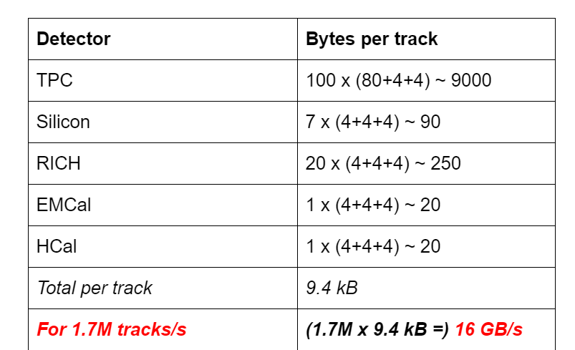
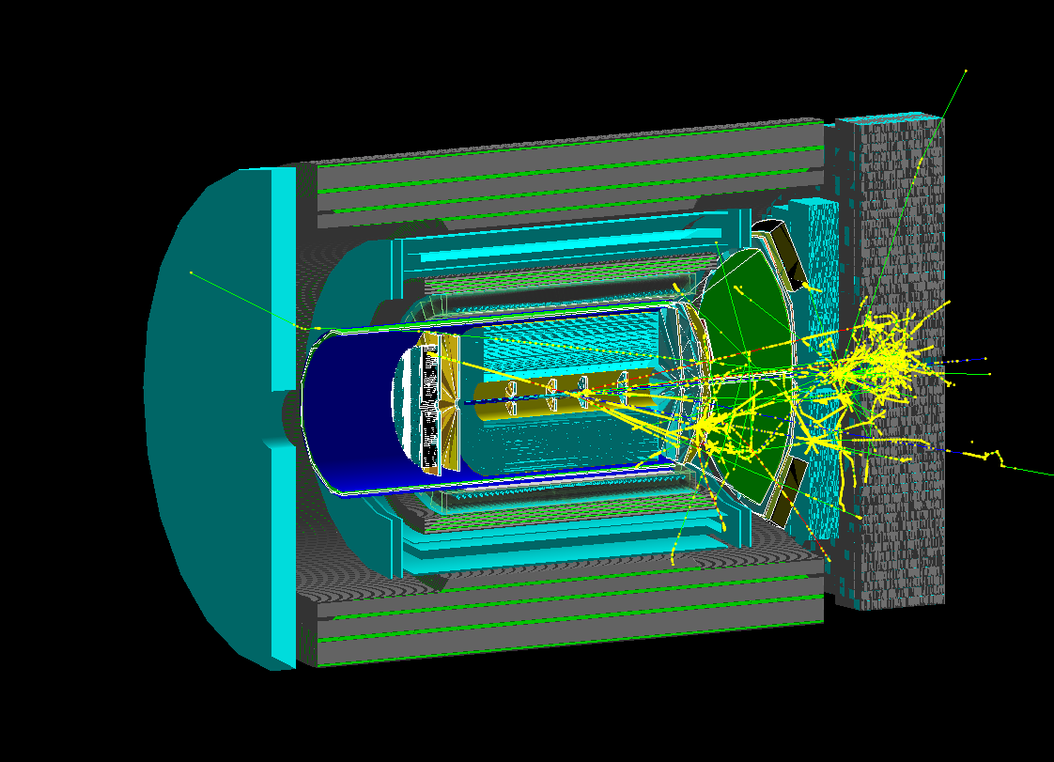
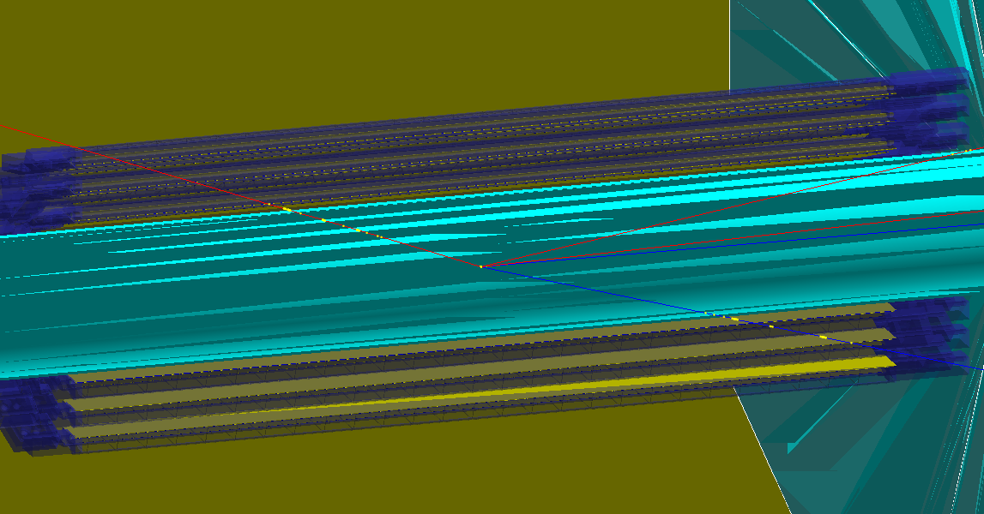
Tonko’s estimation:
Signal rate = 16*8 Gbps ~ 100 Gbps
@ 10³³ cm⁻² s^{-1,} 200kHz collision
How about in G4:
Tonko’s estimation (2015)
The eRHIC Detector (“BeAST”) Readout Scheme
e+p collision 18+275 GeV/c
DIS @ Q² ~ 100 (GeV/c)²

Slide 10
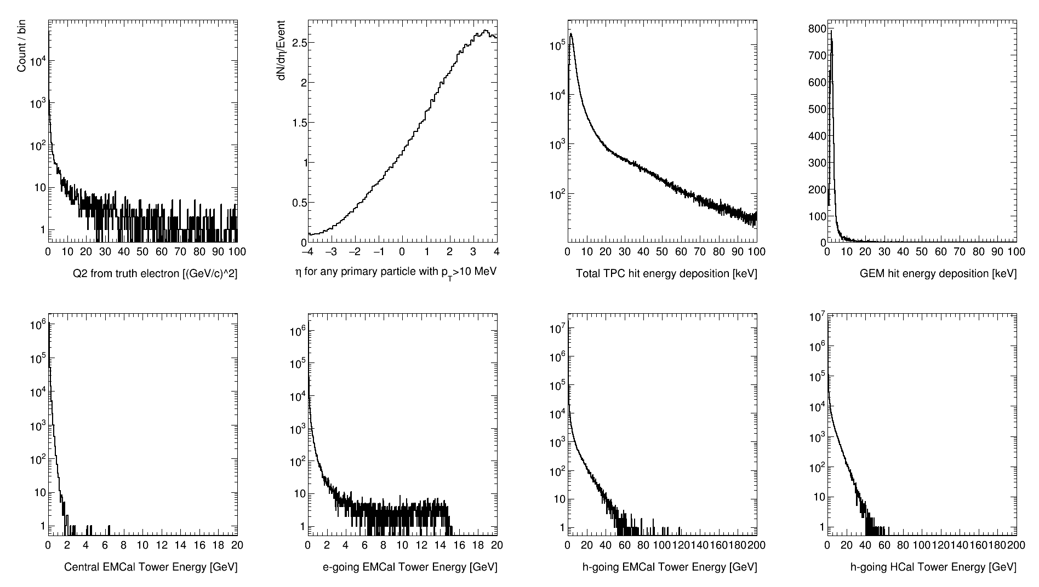
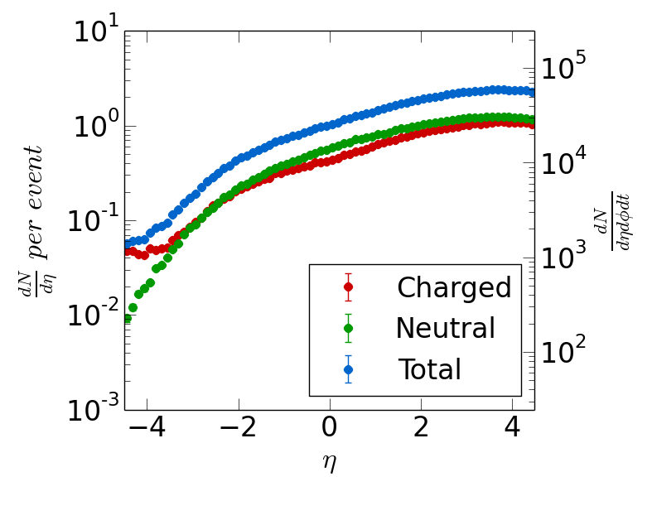
Full detector “Minimal bias” EIC events in sPHENIX framework: quick first look
Multiplicity check for all particles
Minimal bias Pythia6 e+p 20 GeV + 250 GeV
53 µb cross section
BNL EIC taskforce studies
https://wiki.bnl.gov/eic/index.php/Detector_Design_Requirements
  Based on BNL EIC task-force eRHIC-pythia6 55ub sample
  pythia.ep.20x250.1Mevents.RadCor=0.root
  CKIN(3) changed from 0.00000 to 0.00000
  CKIN(4) changed from -1.00000 to -1.00000
Notes:
==============================================================================
I I I I
I Subprocess I Number of points I Sigma I
I I I I
I----------------------------------I----------------------------I (mb) I
I I I I
I N:o Type I Generated Tried I I
I I I I
==============================================================================
I I I I
I 0 All included subprocesses I 1000000 30948998 I 5.488D-02 I
I 11 f + f' -> f + f' (QCD) I 24353 0 I 1.372D-03 I
I 12 f + fbar -> f' + fbar' I 463 0 I 2.614D-05 I
I 13 f + fbar -> g + g I 639 0 I 3.590D-05 I
I 28 f + g -> f + g I 78052 0 I 4.357D-03 I
I 53 g + g -> f + fbar I 1028 0 I 5.602D-05 I
I 68 g + g -> g + g I 44936 0 I 2.447D-03 I
I 91 Elastic scattering I 77227 528788 I 3.748D-03 I
I 92 Single diffractive (XB) I 47309 366999 I 2.283D-03 I
I 93 Single diffractive (AX) I 39423 293957 I 1.911D-03 I
I 94 Double diffractive I 25055 320355 I 1.203D-03 I
I 95 Low-pT scattering I 188196 1177397 I 1.308D-02 I
I 99 q + gamma* -> q I 442894 2100211 I 2.280D-02 I
I 131 f + gamma*_T -> f + g I 8246 154010 I 4.183D-04 I
I 132 f + gamma*_L -> f + g I 30 8008 I 1.918D-06 I
I 135 g + gamma*_T -> f + fbar I 21785 827047 I 1.124D-03 I
I 136 g + gamma*_L -> f + fbar I 364 155067 I 1.999D-05 I
I I I I
==============================================================================
I I I I
I 1 VMD * hadron I 428001 12492304 I 2.497D-02 I
I 2 direct * hadron I 30425 1144132 I 1.564D-03 I
I 3 anomalous * hadron I 98680 15212351 I 5.550D-03 I
I 4 DIS * hadron I 442894 2100211 I 2.280D-02 I
I I I I
==============================================================================
********* Total number of errors, excluding junctions = 0 *************
********* Total number of errors, including junctions = 0 *************
********* Total number of warnings = 0 *************
********* Fraction of events that fail fragmentation cuts = 0.07767 *********
1************ PYSTAT: User-Defined Limits on Kinematical Variables ************
==============================================================================
I I
I 0.000D+00 < m_hard (GeV/c^2) < 2.900D+00 I
I 0.000D+00 ( 1.000D+00) < p_T_hard (GeV/c) < 1.450D+00 I
I m_finite (GeV/c^2) = 1.000D+00 I
I -1.000D+01 < y*_subsystem < 1.000D+01 I
I -4.000D+01 < y*_large < 4.000D+01 I
I -4.000D+01 < y*_small < 4.000D+01 I
I -4.000D+01 < eta*_large < 4.000D+01 I
I -4.000D+01 < eta*_small < 4.000D+01 I
I -1.000D+00 < cos(theta*)_large < 1.000D+00 I
I -1.000D+00 < cos(theta*)_small < 1.000D+00 I
I 0.000D+00 < x_1 < 1.000D+00 I
I 0.000D+00 < x_2 < 1.000D+00 I
I -1.000D+00 < x_F < 1.000D+00 I
I -1.000D+00 < cos(theta_hard) < 1.000D+00 I
I 2.000D+00 < m'_hard (GeV/c^2) < 2.900D+00 I
I I
==============================================================================

Slide 11
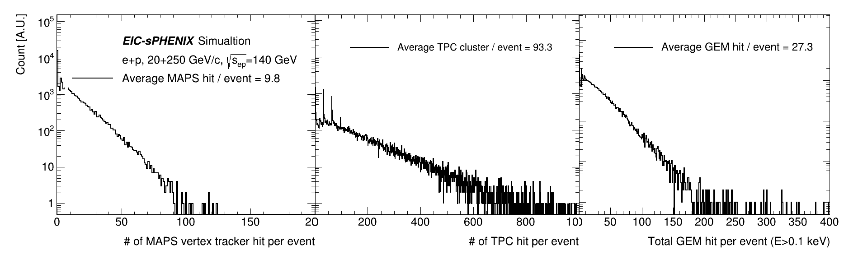
GEANT4-based detector simulation for DAQ simulation: tracker
sPH-cQCD-2018-001, https://indico.bnl.gov/event/5283/
Extract mean value/collision that produces average signal data rate
and tails that produce the buffer depth and latency requirements
Raw data: 16 bit / MAPS hit
Raw data: 3x5 10 bit / TPC hit
+ headers (60 bits)
3x10 signal hit / collision → 0.2 Gbps @10³⁴ cm⁻²s⁻¹
MAPS is vulnerable to beam background see later slides
ALPIDE MAPS noise are low,
expect 10⁻⁶ /pixel/strobe, 200M pixel, 3us strobe → ~1Gbps
Raw data: 3x5 10 bit / GEM hit
+ headers (60 bits)
Notes:
MAPS noise rate = 1e-6 noise hit / pixel / strobe * 200M pixel * 300kHz strobe * 16bi / hit = 1Gbps

Slide 12
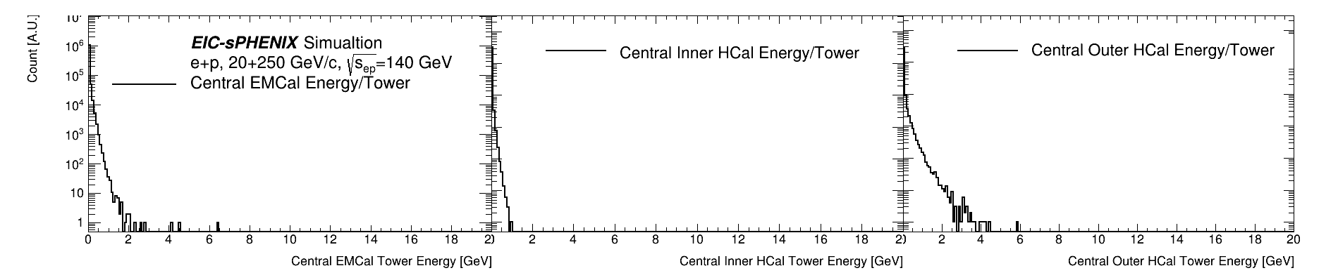
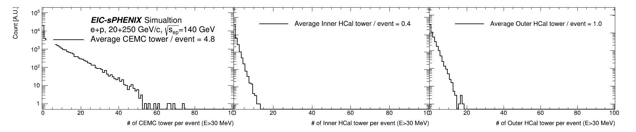
GEANT4-based detector simulation for DAQ simulation: central calorimeters
Raw data: 31x 14 bit / active tower +padding + headers ~ 512 bits / active tower
sPH-cQCD-2018-001, https://indico.bnl.gov/event/5283/

Slide 13
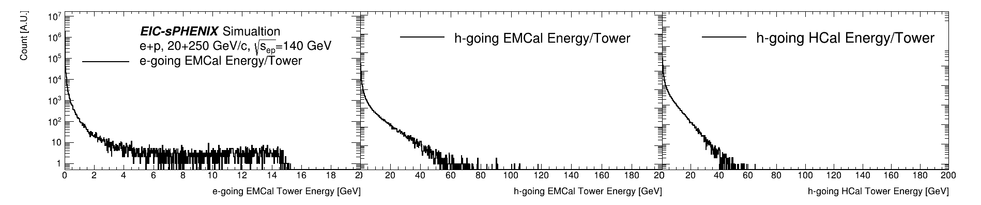
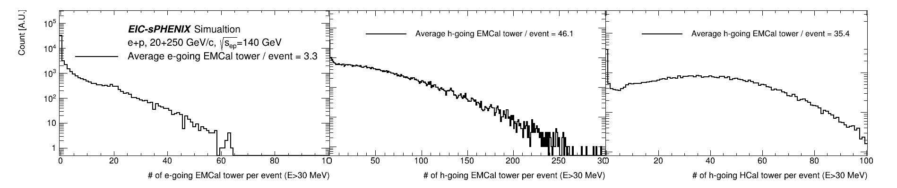
GEANT4-based detector simulation for DAQ simulation: forward calorimeters
Raw data: 31x 14 bit / active tower +padding + headers ~ 512 bits / active tower
sPH-cQCD-2018-001, https://indico.bnl.gov/event/5283/

Slide 14
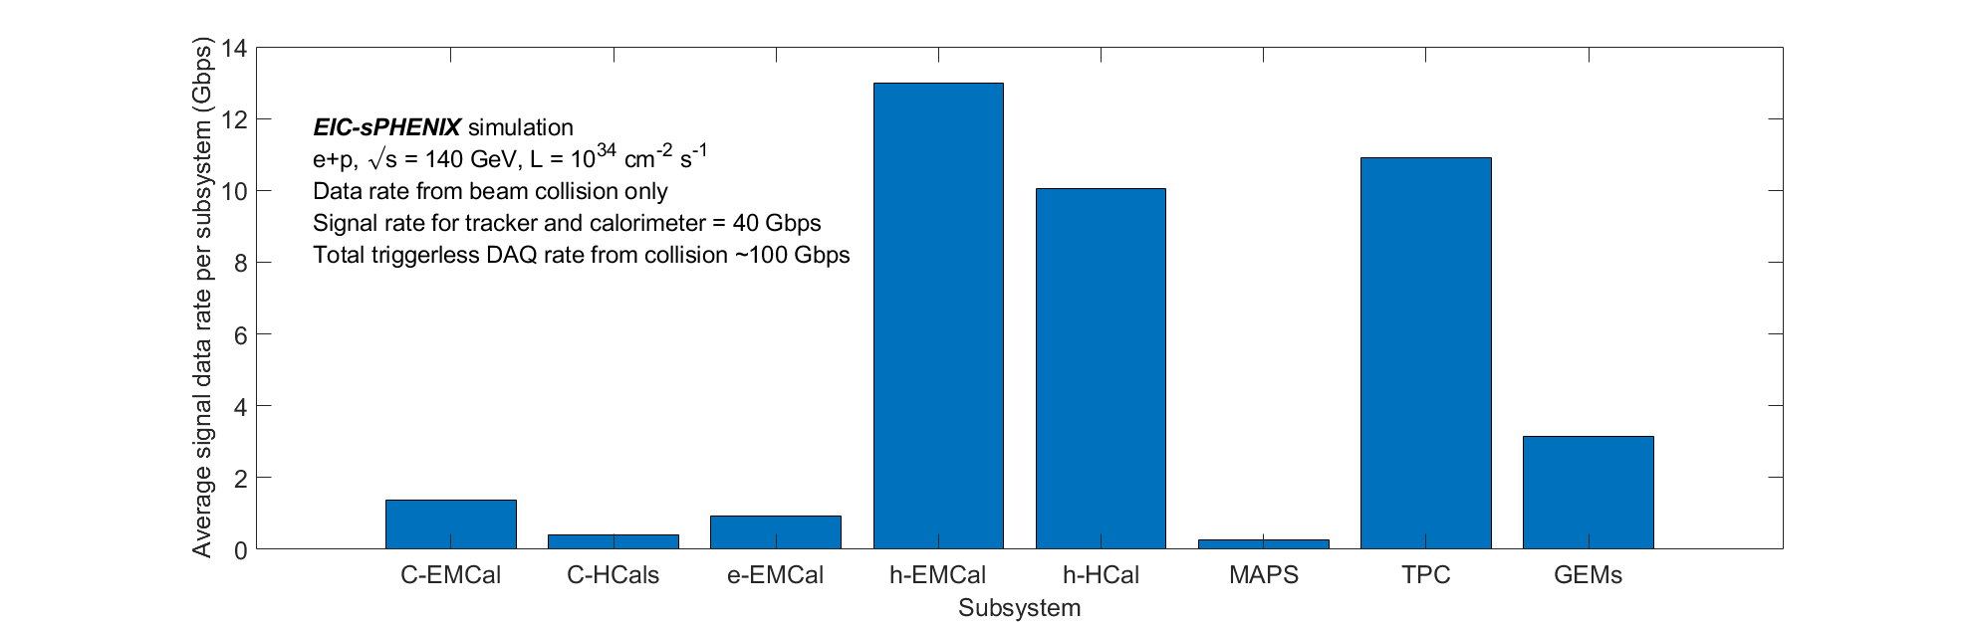
EIC preliminary data rate summary
sPH-cQCD-2018-001, https://indico.bnl.gov/event/5283/
Tracker + calorimeter ~ 40 Gbps
+ PID detector + 2x for noise ~ 100 Gbps
Signal-collision data rate of 100 Gbps seems quite manageable,
  < sPHENIX TPC peak disk rate of 200 Gbps (See Martin’s talk)
Machine background and noise would be critical in finalizing the total data rate
  From on-going EIC/sPHENIX R&D prototyping will show noise level from state-of-art MAPS and SAMPA ASICs, e.g. ALPIDE MAPS noise rate ~ 1 Gbps
  Enough FPGA/CPU resource with prevision for noise filtering in EIC online system
MAPS noise
Notes:
MAPS noise rate = 1e-6 noise hit / pixel / strobe * 200M pixel * 300kHz strobe * 16bi / hit = 1Gbps

Slide 15
Beam gas estimation for eRHIC detectors
Assuming flat 10e-9 mbar vac in experimental region

Slide 16
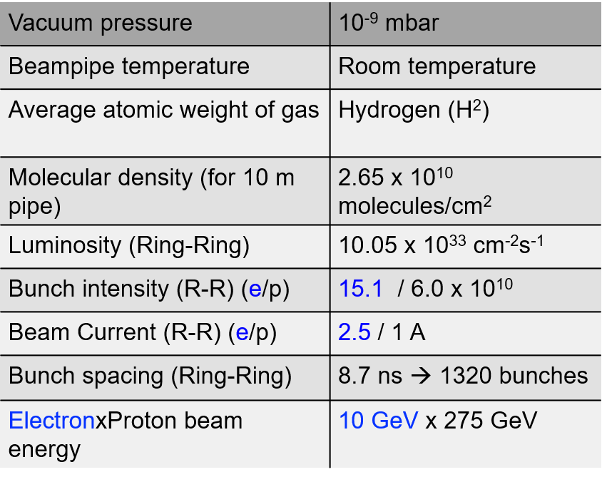
Beam-gas interactions
p + p (beam gas) cross section ~ 40 mb @ 250 GeV
Beam gas interaction rate = 2.65e10(H₂/cm²/10m) * 2(proton/H₂) * 40e-27(40mb→cm²) * 1(A) / 1.6e-19(C/proton)
= 13kHz / 10m beam line < 10% EIC collision rate
The following estimation assumes
  HERA inspired flat 10e-9 mbar vac in
  experimental region of |z|<450 cm
  2M M.B. Pythia-8 beam gas events
  simulated in Geant4 full detector
Courtesy: E.C. Aschenauer
eRHIC pre-CDR review

Slide 17
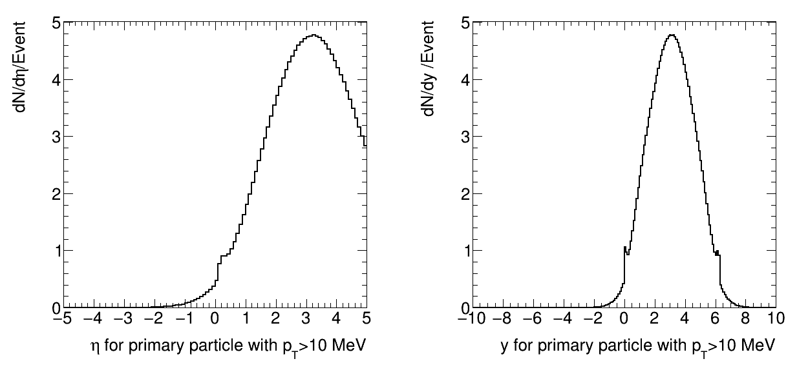
Beam gas multiplicity
250 GeV/c proton beam on H₂ gas target
C.M. rapidity~3.1, sqrt[s] ~ 22 GeV, cross section~40 mb
Lab per-pseudorapidity multiplicity is higher than e+p,
but not orders of magnitude higher
e+p, 20 + 250 GeV/c
p+p (beam gas), 250 GeV/c
y_{cm}~3.1
y_{proj.}~6.3

Slide 18
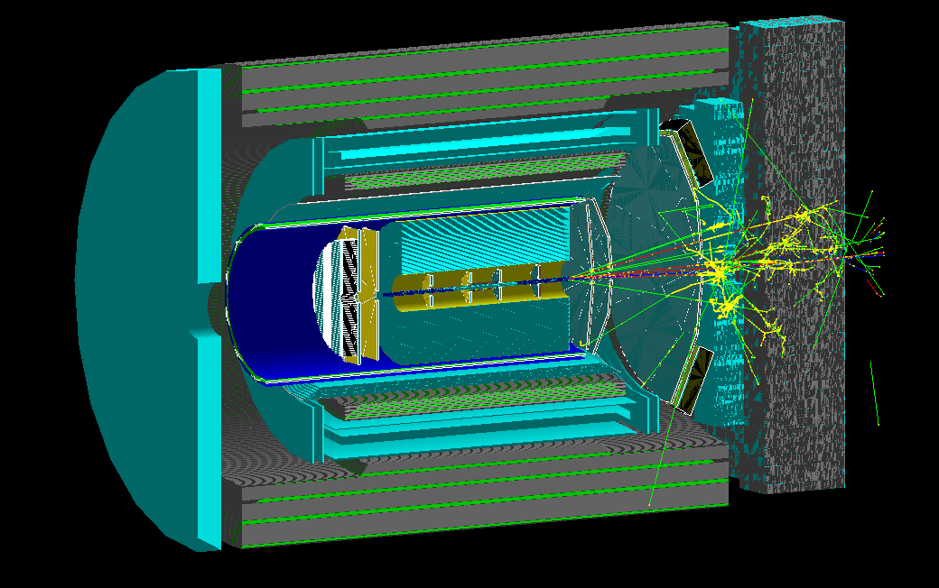
Beam gas event in a detector
250 GeV proton beam on proton beam gas, sqrt[s] ~ 22 GeV
For this illustration, use pythia-8 very-hard interaction event (q^hat > 5 GeV/c)
z = +100 cm, 100 MeV suppression
Gas event at z=1 m
Most multiplicity goes to forward calo.

Slide 19
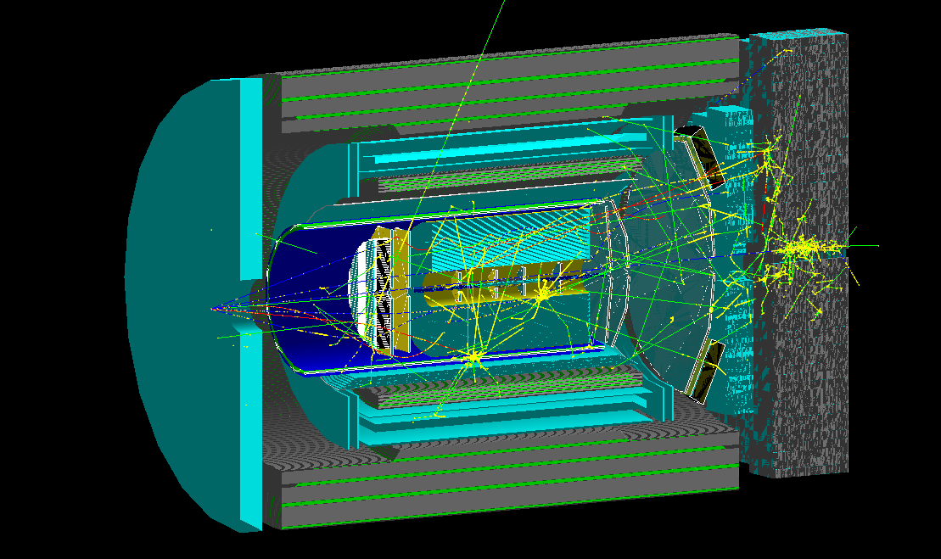
Beam gas event in a detector
250 GeV proton beam on proton beam gas, sqrt[s] ~ 22 GeV
For this illustration, use pythia-8 very-hard interaction event (q^hat > 5 GeV/c)
z = -400 cm, 100 MeV suppression
Gas event at z=-4 m
Shower starts in e-going calorimeter
Induce multiplicity in trackers and forward calo

Slide 20
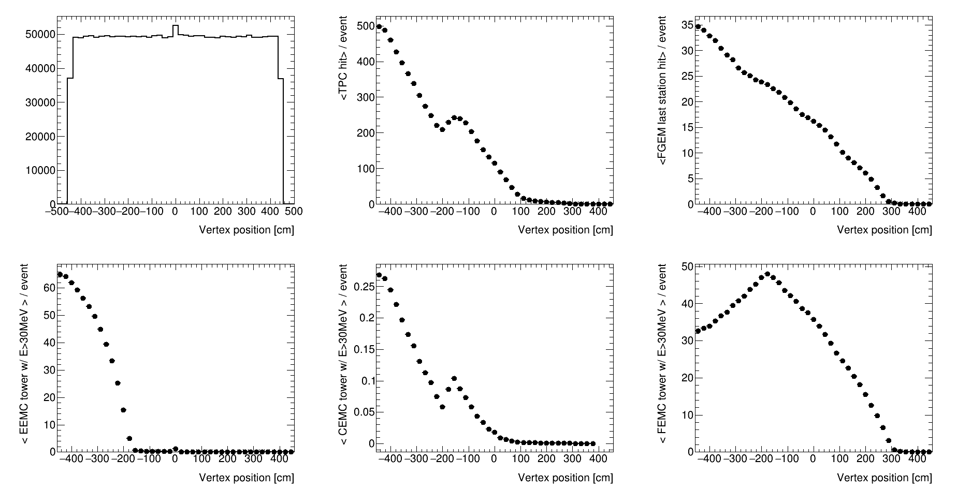
Beam gas vertex sensitivity - tracker
Average active hit for each beam gas vertex bin
250 GeV proton beam on proton beam gas, Pythia-8 M.B.
TPC volume
Last h-going tracker
Showers in
e-going calorimeter
z = -400 cm
z = +1 00 cm

Slide 21
Beam gas vertex sensitivity – calo.
Average active hit for each beam gas vertex bin
250 GeV proton beam on proton beam gas, Pythia-8 M.B.
e-going EMCal
Barrel EMCal
(very low activity)
h-going EMCal
z = -400 cm
z = +1 00 cm

Slide 22
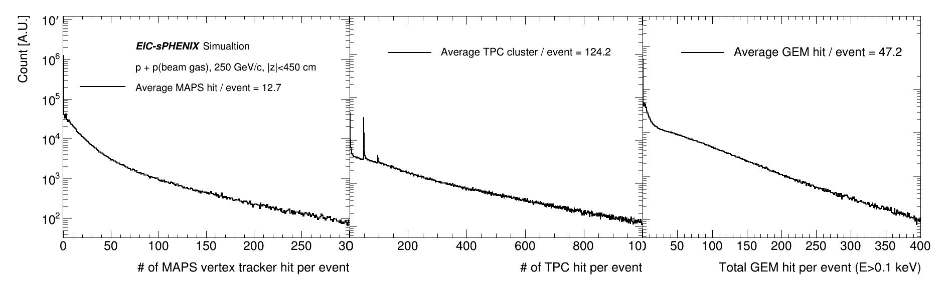
GEANT4-based detector simulation: beam gas event on tracker
Extract mean value/collision (signal data rate) and tails (relates to buffer depth requirement)
Very long tails to 1000 hits at P=10⁻⁶
Raw data:
3 pixel x 16 bit / MAPS hit
Raw data:
3 (strip) x5(time)x 10 bit / TPC hit
+ headers (60 bits)
Raw data:
3 (strip) x5(time)x 10 bit / GEM hit
+ headers (60 bits)

Slide 23
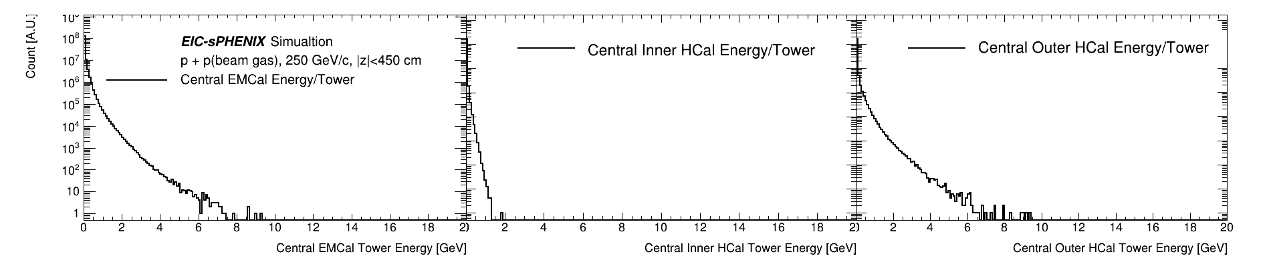
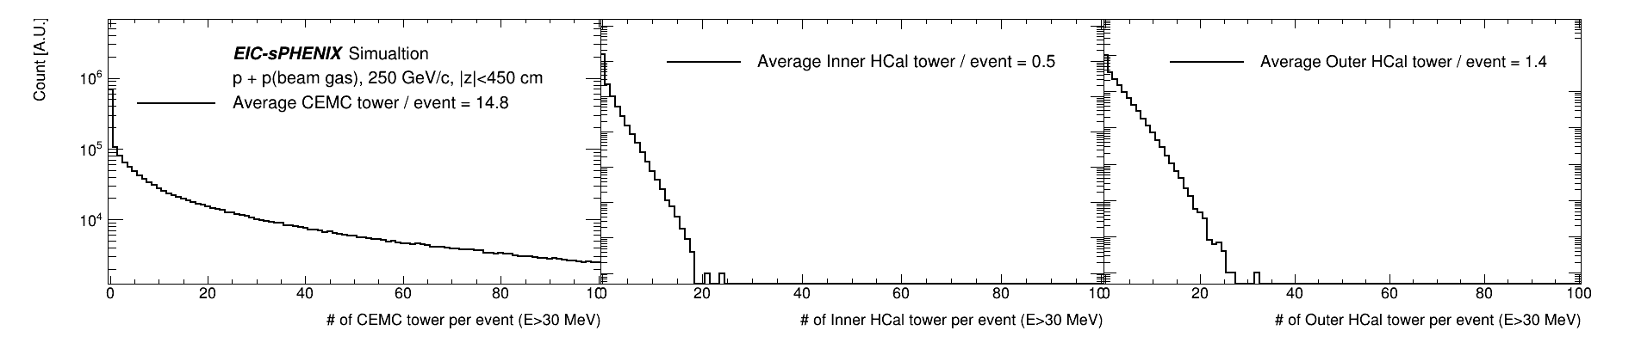
GEANT4-based detector simulation: beam gas event on central calorimeters
Raw data: 31x 14 bit / active tower +padding + headers ~ 512 bits / active tower

Slide 24
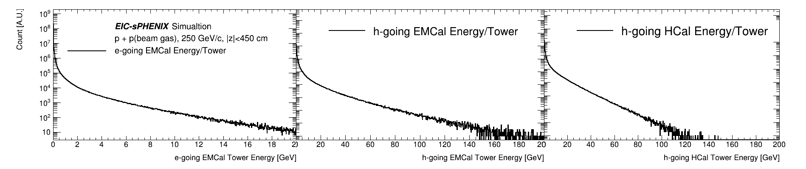
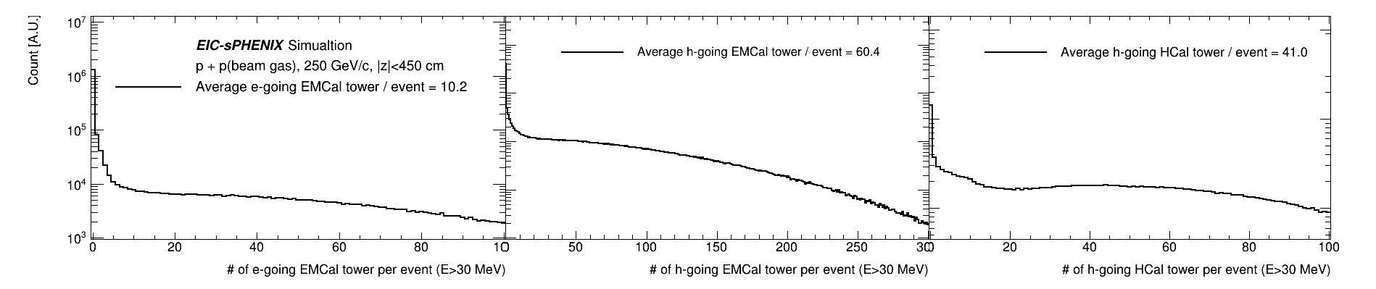
GEANT4-based detector simulation: beam gas event on forward calorimeters
Raw data: 31x 14 bit / active tower +padding + headers ~ 512 bits / active tower

Slide 25
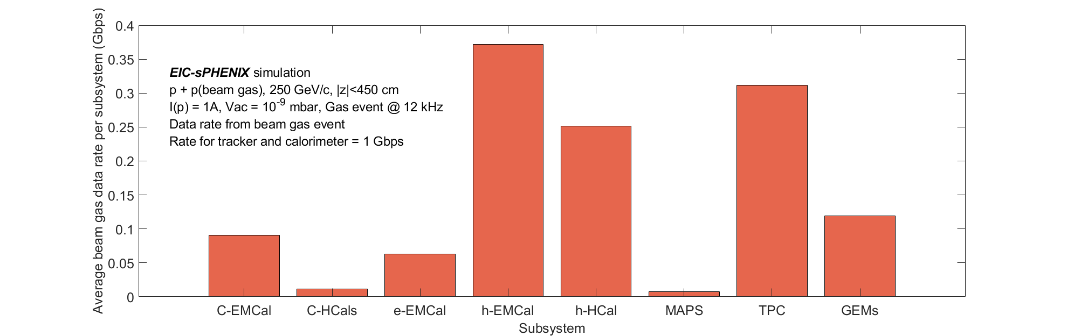
Rate summary for beam gas
Very similar rate distribution among subsystems when compared with EIC collisions
With an assumed vacuum profile (10⁻⁹ mbar flat within experiment region):
  Overall ~ 1 Gbps @ 12kHz beam gas at 10⁻⁹ mbar in |z|<450 cm (detector region)
  << EIC collision signal data rate
Further investigation needed:
  In the experimental region : Dynamic vac profile
  Beyond experiment region: beam gas profile, possible passive shielding and active veto

Slide 26
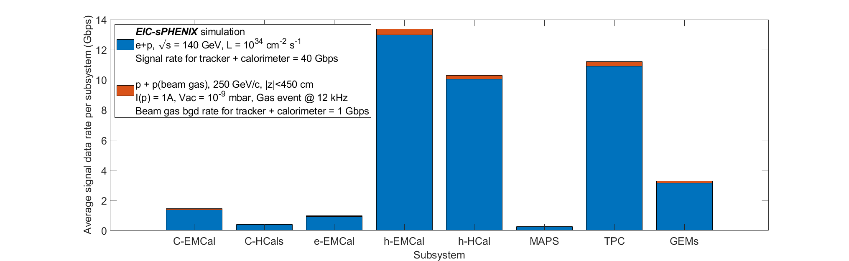
Rate summary
Sum collision + beam gas
Total ~ 100 Gbps @ 10³² cm⁻² s⁻¹
  < sPHENIX peak disk rate
  Beam gas data rate << collision data rate
Further to be evaluated with more concrete detector and accelerator development:
Beam gas profile, synchrotron radiation, detector noise
MAPS noise

Slide 27
Highly segmented detectors/ TOPsiDE
Highly spatial and/or time segmented detectors would induce higher event size
TOPSIDE would use pixelated calorimeter and produce x O(100-1000) calorimeter data rate depending on segmentation and digitizer assumptions
TOPSIDE propose to use LGAD tracker
  Low Gain Amplifying Detectors (LGAD) + MAPS to enhance charge collection and timing
  The signal data rate would not change in the leading order (e.g. 3-hit x 16bit/cluster)
  Depending on LGAD R&D, the noise rate could be higher (i.e. higher noise/pixel, shorter integration)
TOPSIDE may start with full streaming at 10³³ cm⁻² s⁻¹.
However, assuming same data log rate (say 100Gbps), at full EIC lumi it may require global triggering to record a subset of collisions and/or real-time feature building (e.g. cluster fitting/tracking, See talk JD/TU/SY).
More noise?

Slide 28
Discussion on real-time system for EIC

Slide 29
Strategy for an EIC real-time system
Exp. Hall
DAQ room
sPHENIX capable to O(20 Tbps).
Using about 10% b.w.
sPHENIX capable to
O(100 Gbps)
EIC
Detector
FEE, Buffer Δt ~ us
DAQ , Buffer Δt ~ s
Storage
Digitizer
ASIC/FPGA
DAQ Interface
Servers
Disk→Tape
O(100 Tbps)
Trigger ?
Timing
Analog
Digital
Clock/Sync, Slow control
In a digital pipelined real-time system, all channels are digitized at all times. Data reduction in real-time to fit within bandwidth + buffer constraints
  A commonly used strategy in data reduction is global triggering to selectively record a small fraction of collisions.
  However, global triggering is not required if [system throughput > rate from all collisions]
  Data reduction beyond global triggering : e.g. zero-suppression (in ASIC/FPGA), feature building (e.g. clustering), online analysis (e.g. online tracking)
For the signal data rate from EIC (100 Gbps), we can aim for filtering-out and streaming all collision in raw data without a hardware-based global triggering
  One may also consider a trigger-streaming hybrid system (e.g. STAR eTOF DAQ, sPHENIX hybrid-DAQ in Martin’s talk), which can quantify efficiency/bias in streaming data reduction and be resilient at high background rate

Slide 30

One DAQ strategy
Exp. Hall
DAQ room
FEE
Server
COST Network
&
Storage
FEE
Server
sPH-cQCD-2018-001
https://indico.bnl.gov/event/5283/
FEE
Server
FEE
....
Server
48x 10-Gbps bi-directional
optical links per FELIX
....
10/100 Gbps
Network
Timing
Full streaming readout front-end (buffer length : μs)
→ DAQ interface to commodity computing via PCIe-based FPGA cards (e.g. FELIX)
→ Disk/tape storage of streaming time-framed zero-suppressed raw data (buffer length : s)
→ Collision event tagging in offline production (latency : days)
Why time-framed streaming readout?
  Diversity of EIC event topology. Streaming minimizing systematics by avoiding hardware trigger decision, keeping background and history
  At 500kHz event rate, multi-μs-integration detectors would require streaming, e.g. TPC, MAPS
Why FELIX-like DAQ interface?
  0.5 Tbps x bi-direction IO, bridging μs-level FEE buffer length with miliseconds + DAQ network time scale
  Interface with commodity computing via PCIe @ ~100Gbps
  Distribute experiment timing and synchronization cross large system
Why keep raw data?
  At 100 Gbps < sPHENIX rate, it is affordable to disk-write all raw signal data: If you can, always keep raw data
  Allow time + special run needed for final calibration, followed by prompt reconstruction
See Martin’s talk on sPHENIX adaption and implementation in with sPHENIX/EIC tracker test stands

Slide 31
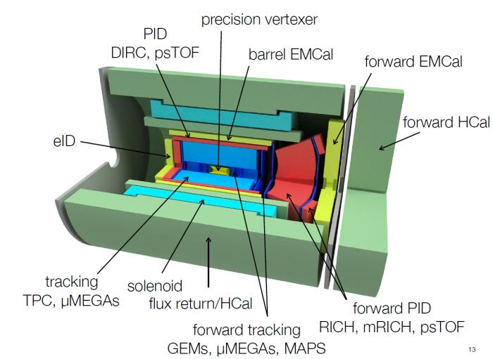
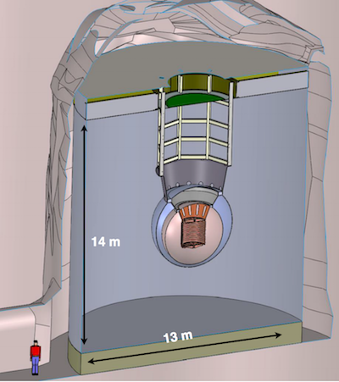
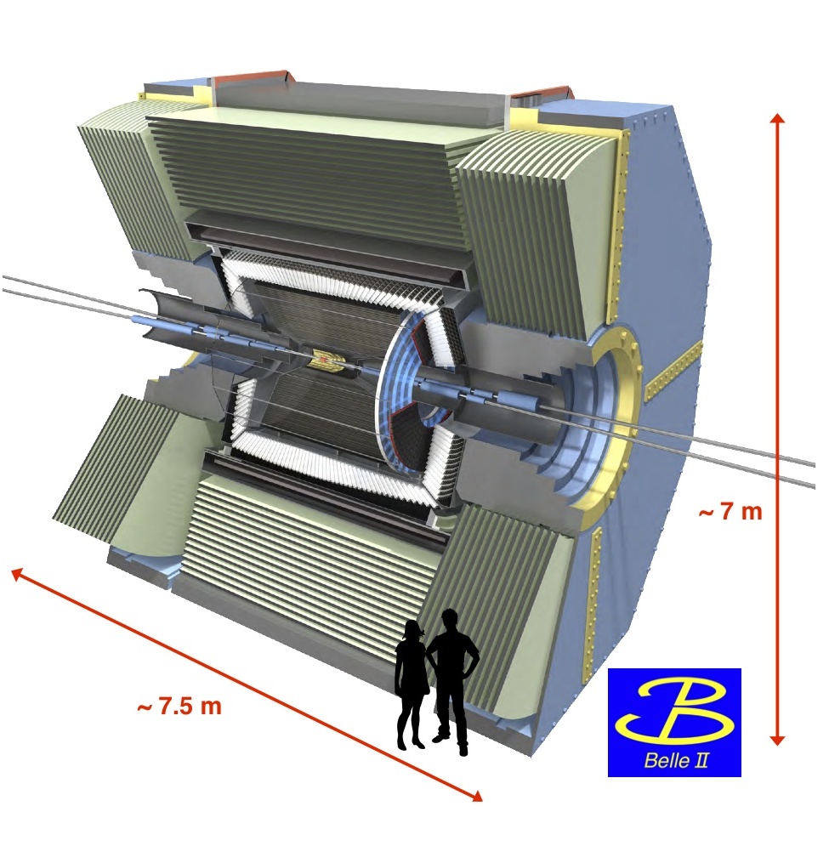
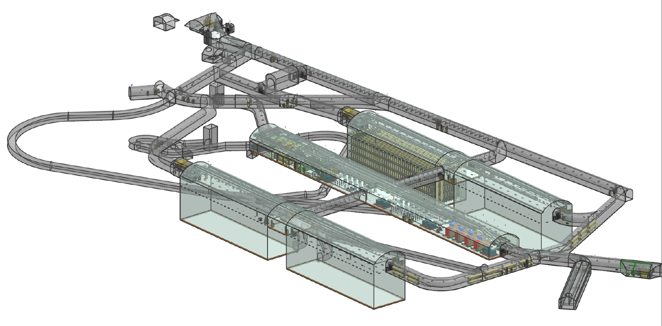
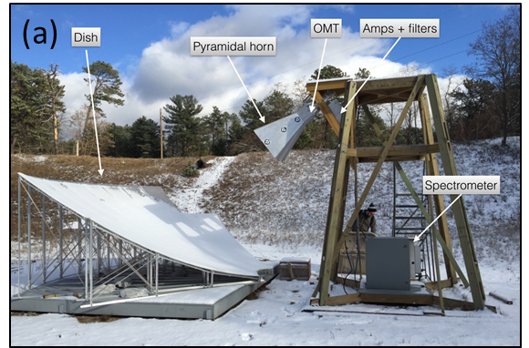
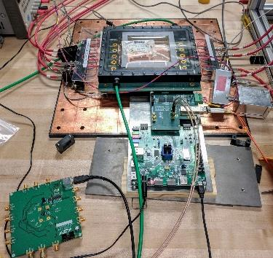
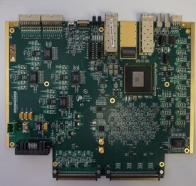
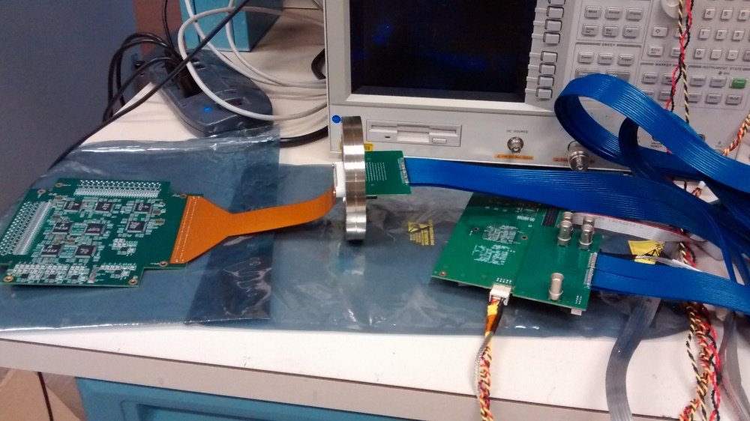
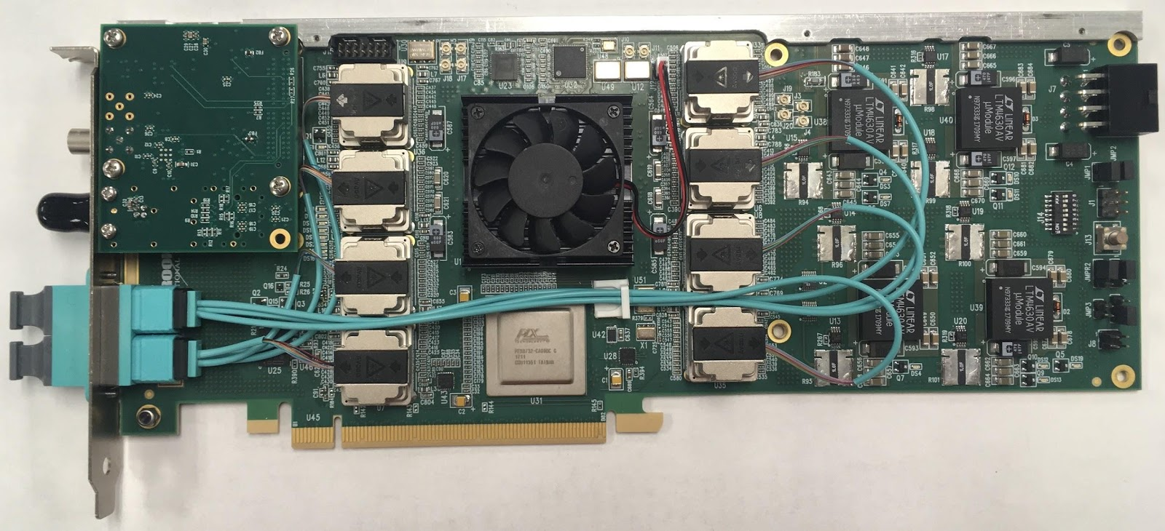
Ongoing R&D, BNL LDRD 19-026:
Common development for Advanced DAQ
EIC detectors
DUNE far detector
nEXO
BELLE-II
21-cm digital interferometer
Common challenge cross multi-discipline of BNL:
Advanced DAQ with high throughput @ 100+ Gbps
Solution: FELIX-based DAQ, the architecture used
in the LHC upgrades in the 2020s
Deliverable: test stand & firmware for each case
Co-PIs: Kai Chen (BNL/ATLAS),
Jin Huang (BNL/sPHENIX)
BNL 712 – series PCIe Card
Commodity Computing

Slide 32
Summary
EIC is a unique collider combining high luminosity and low collision cross section, diverse event topologies and vital in systematics control
The total collision raw data rate → 100 Gbps
  Affordable to write all to disk
  Can be higher for highly segmented or noisy detectors (intrinsic or accelerator)
Instead of global triggering that selects subset of event,
we can choose to stream-record all collisions signals
  Requiring all front-end to continuously digitize data or self-triggering
  e.g. PHENIX FVTX, STAR eTOF, all sPHENIX trackers
  Reliably synchronize all front-ends and identify faults
  Recording all collision data (100 Gbps if raw)
  If needed, filtering out background with low signal loss (10⁻⁴?)
  Requiring reliable data flow → control systematics:
  Low data loss rate < 10⁻⁴(?) and/or loss in a deterministic manor (e.g. via real-time busy signal tree to avoid correlation between event type and loss rate)
A strategy for EIC DAQ based on sPHENIX DAQ investments: FPGA-PCIe DAQ interface, streaming all signal data to disk/tape, prompt off-line reconstruction

Slide 33
Extra information

Slide 34
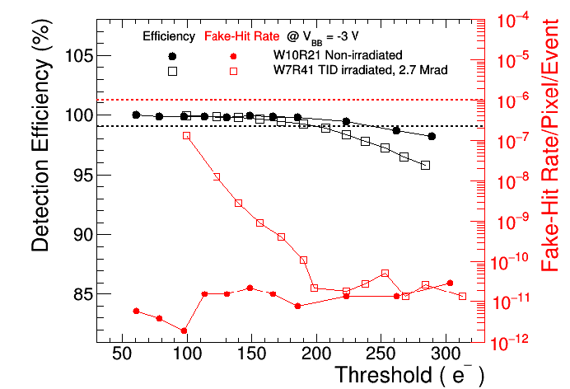
Per-strobe ALPIDE multiplicity
Four factor contributes in a MC simulation:
Per-collision multiplicity, PDF as in last page
Number of pile up collision, Poisson distributed
The triggered collision, |z|<10 cm (trigger mode only)
Number of noise, Poisson distributed
Comments received:
Duplicated hits between strobes are not included yet (Thanks to Jo)
UPC electron background not included (Thanks to Xin)
Aiming for 10⁻⁶ noise in final detector (Many)
Bottom line: 10⁻⁴
Also studied: 10⁻⁵
Likely in operation: 10⁻⁶

Slide 35
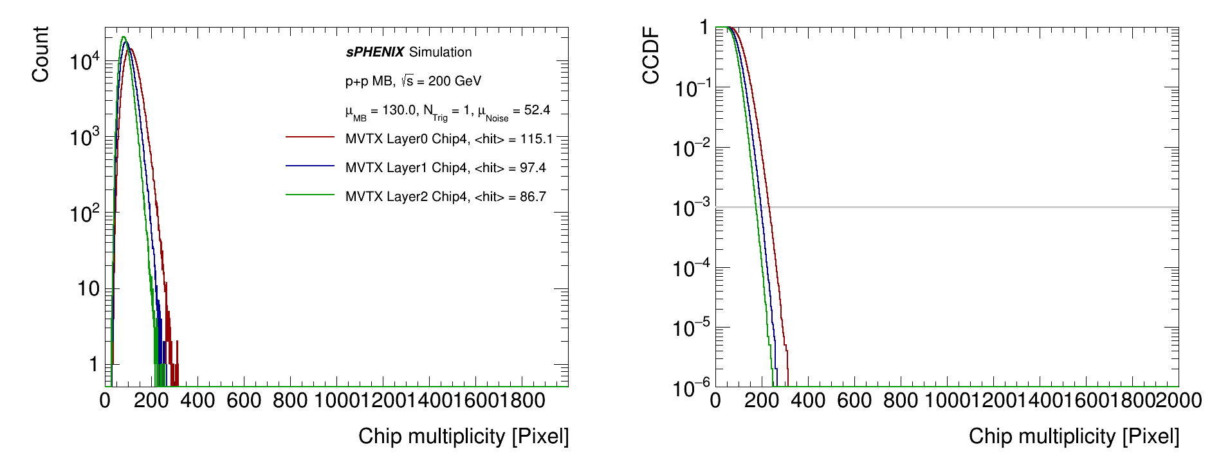
p+p multiplicity, per-strobe, chip-4
p+p collision related data is completely dominated by pile-ups
Central limit theorem: High number of pile up → low non-Gauss high tails
Continuous-mode is quite safe @ 10-us strobe window
13 MHz p+p collision, 10-us strobe width+integration, 1 trigger, 10⁻⁴ noise per strobe
10-us readout

Slide 36
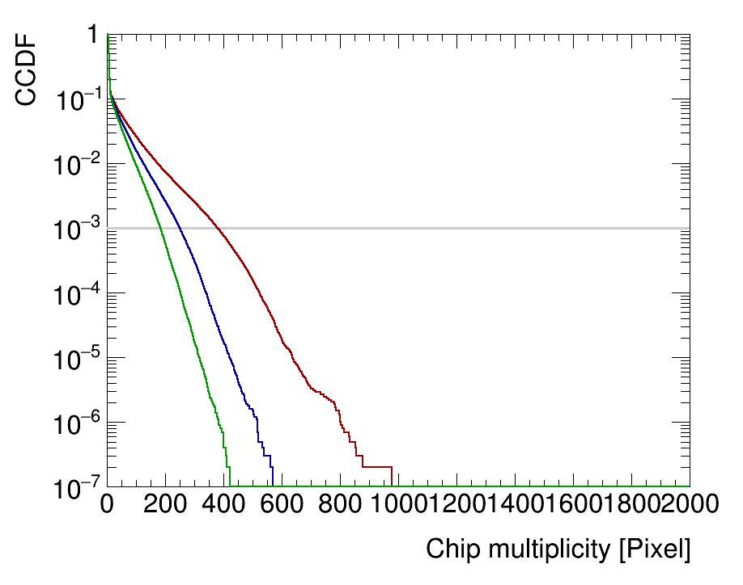
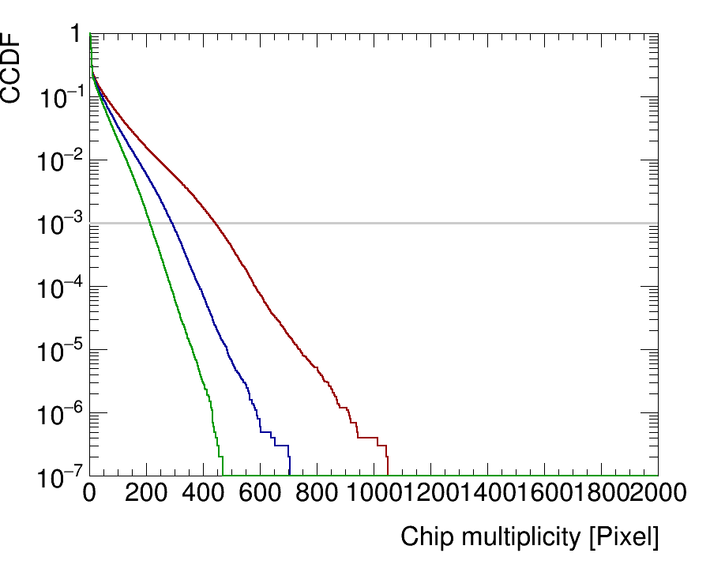
Au+Au multiplicity, per-strobe, chip-4
Can we do better?
  Further reducing collision rate to 50kHz by introducing a beam crossing angle
  Reducing noise by 1/10 to 10⁻⁵ noise per strobe
Still challenging for continuous , but plausible to have overflow dead-time < 0.1% further using multi-hit buffer on chip (eating the safety factor)
50 kHz Au+Au collision, periodic strobe, 10⁻⁵ noise per strobe
5-us strobe width+ integration
10-us strobe width+ integration
5-us readout
10-us readout

Slide 37
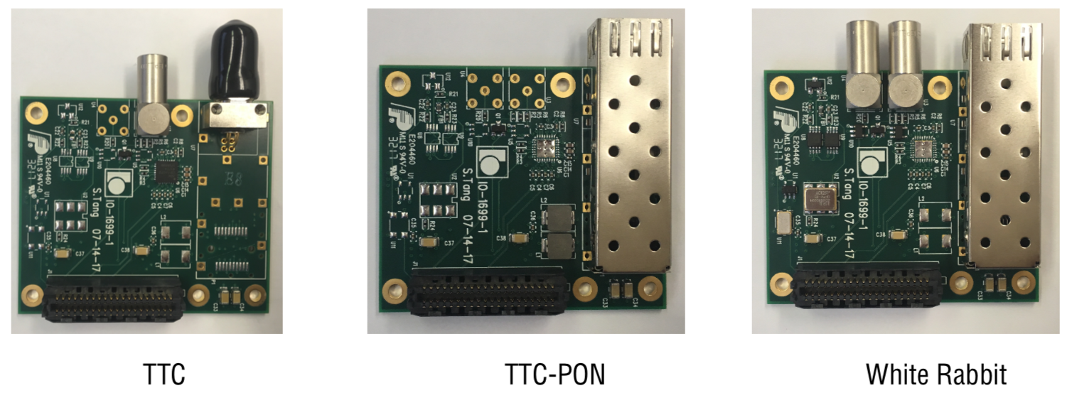
Timing distributions
All PHENIX/sPHENIX FEE are synced to beam clock/counter. Expecting similar for EIC detector
BNL-712/FELIX can receive clock of multiple protocols (SPF+, White Rabbit, TTC, …) via a timing mezzanine card
SI5345 jitter cleaner control jitter to <0.1 ps
BNL-712/FELIX carries 48x 10 Gbps downlink fiber for control data to FEE. Beam clock and sync word can be encoded on fiber (e.g. 8b10b encoding)
For EIC hadron beam RF, extra cautious need to be taken for hadron machine ramp from low gamma to high gamma, which leads to clock frequency variation [next slide].
Exp. Hall
DAQ room
FEE
Server
COST Network
&
Online Computing
FEE
Server
FEE
Server
FEE
....
Server
48x 10-Gbps
fibers per FELIX
....
10-100 Gbps
Network
EIC Timing
timing mezzanine cards
Courtesy of Kai Chen (BNL)

Slide 38
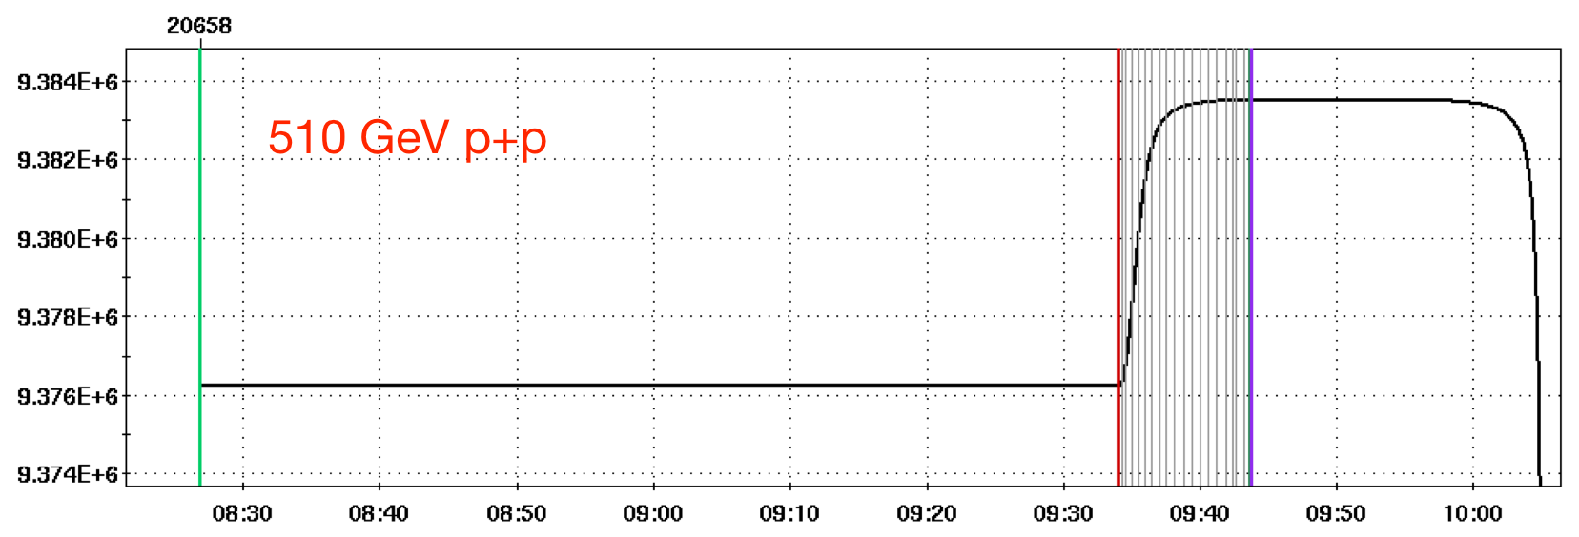
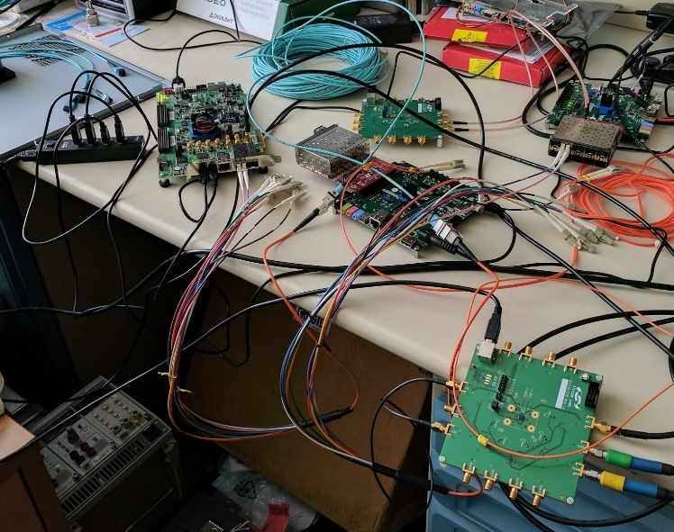
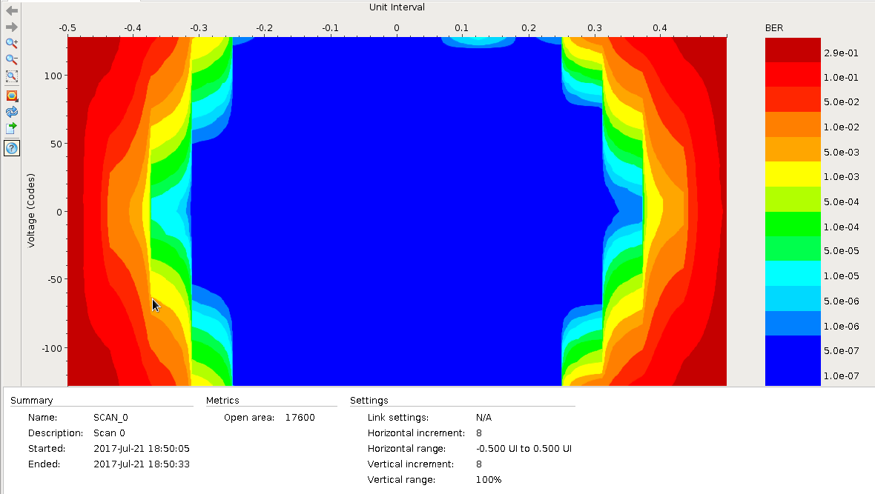


Embedded clock demo with variable beam clock frequency
RHIC frequency spread (due to ramp) is large, 9.362 MHz ±22 kHz
Function generator mimic repeated RHIC clock ramping (triangle pattern)
Demo FELIX
Kintex-7 Ultrascale
Downlink: 4.8 Gb/s
Multiples of RHIC clock (9.4 MHz)
Recover clock from 8b/10b
Optical Links
Demo FEE
Atrix-7
Uplink: 4.8 Gb/s, fixed clock
Uplink iBERT @ DAM: 1.46e-13
Downlink iBERT @ FEE: 1. 023e-13
Test recovered “RHIC” clock
Kintex 7 (eval board for now) -> Atrix 7 (eval board)

Slide 39

TOPSiDE: Concept of an EIC Detector
José Repond
TOPSiDE
5D Concept
Energy E
Position x,y,z
Time t
Salient features
4π detector (hermetic coverage)
Multi-purpose detector (don’t need another specialized detector)
Mostly based on silicon sensors (tracker, electromagnetic calorimeter)
Each particle measured individually (optimized for Particle Flow Algorithms)
Particle identification (pion-kaon separation) performed by TOF (tracker and calorimeter)
Imaging calorimetry (tens of millions of readout channels)
Coil on the outside (not to disturb calorimetric measurements)
Dipole/Toroid in the forward direction (to obtain a momentum measurement)
Special detectors in the forward direction (Ring Imaging Cerenkov for Particle ID, debris taggers)
No need for additional TOFs, TRDs, Čerenkovs (in front of calorimeters), muon chambers

Slide 40

Low-Gain Avalanche Diode (LGAD) Sensors
José Repond
Additional thin p-layer
Through Boron/Gallium implantation
Increases E-field
Charge multiplication with moderate gain 10 – 50
Amplification of electrons close to pixel (minimal drift)
→ Improved time resolution
Four manufacturers
CNM Barcelona (RD50, ATLAS HGTD)
HPK Hamamatsu
FBK Trento (Italy)

Slide 41

Time Resolution versus Time
José Repond
H Sadrozinski at the Pico-second Timing Workshop, Torino, Italy, 2018
https://agenda.infn.it/conferenceTimeTable.py?confId=15031
Smaller C
Low noise
Thin sensors
2018
To date best results ~18 picosecond with 35 μm sensors
→ Results with 20 μm sensors imminent

Slide 42





RHIC @ mid-2020s
See last three talks
Φ 1.2km

Slide 43
Proposed eRHIC @ end of 2020s
eRHIC pre-CDR

Slide 44

Potential areas of collaboration on real-time analysis
Real-time data reduction
Real-time feature building
Real-time/fast off-line event reconstruction
Large simulation sample generation that match or exceed real data event statistics
Data/theory-driven visualization
https://www.bnl.gov/compsci/

Slide 45

1. Suppression noise/beam background
Considering that all tracker data is continuously recorded after zero suppression
Half of collision-originated hits in tracker do not belong to a reconstructable particle trajectory (track)
Electronic detector noise and collider backgrounds contribute more “noise” hits
We could have a ML algorithm, e.g. DNN, to run in real-time on DAQ FPGA (e.g. Kintex Ultrascale) to filter out obvious hits that do not belong to a track
  Unlike real-time triggering, this algorithm operate at low rejection, high efficiency ROC working point
By filtering out noise hits, we could save on data storage volume, more resilient to high background operation
Notes:
(4k LTO10 tape -> 2k?)

Slide 46

Publicly available dataset for ML/AI
Already have 4M simulated events in sPHENIX silicon tracking detector
  https://github.com/sPHENIX-Collaboration/HFMLTrigger
  JSON formatted data, self explanatory fields
Can generate files for EIC collision + detector noise + background stream for algorithm development and performance evaluation

Slide 47


Open data used in DCNN learning
Courtesy of, Dantong Yu (NJIT), Yu Sun, Jason Chen (SBU)
Conversion of vertex tracker data (3D hits) into 2D image with color coding of layers
sPHENIX MVTX hits in a event → image
Simulated raw data. Composited picture of hits from six half layers.
sPHENIX MVTX hits in a event → image
Simulated ground truth. Hits belong to good truth track
Z-index
Z-index
Azimuthal index
Azimuthal index
All MAPS hits
pp 200 GeV, EIC event would be similar
Reconstruct-able MVTX hits for tracks, same event

Slide 48



Open data used in DCNN learning
Collaboration with computer scientists at NJ Inst. Tech and StonyBrook U.
Exploring FPGA-HLS of Deep Convolutional Neural Network (DCNN) with capabilities of unsupervised-learning on data based on auto-encoder network
Output of network can be used to filter out non-track hits
“Code” level in the autoencoder may be used in another ML classifier for event tagging and event classification
sPHENIX MVTX
Simulated raw data
sPHENIX MVTX
Simulated ground truth
Input Track Images
Event classifier
Predicted Track
Ground Truth
Stub Features
Courtesy of
Dantong Yu (NJIT)
Yu Sun, Jason Chen (SBU)
Stub Filters
Encoder
Decoder

Slide 49
2. Real-time feature building
Real-time data reduction; improved zero-suppression
Examples :
Calorimeter
  Multi-time sample fit → energy, shower features
  Local clustering/triggering for improved zero-suppression. E.g. ALICE TPC: 10.1088/1742-6596/396/1/012043
Time projection chamber
  See detailed discussion in Martin’s talk [sPHENIX]
  Cluster building (1/2 reduction, see last talk)
  Cluster – track matching (1/10 reduction, unlikely needed)

Slide 50
3. Real-time reconstruction needs
Prompt reconstruction
  Process data at same speed as data taking, but allow O(days) latency for final calibration
Perform in commodity computing (CPU, GPU farms @ RCF-like facilities)
Not a true “real-time” topic, but could use CSI’s expertise. Examples:
  Event tagging in time-framed continuous stream, event categorization
  Pattern recognition (string hits to tracks, string track+PID+calorimeter to particle candidates)

Slide 51
4. Fast simulation
Need high statistics simulations for multi-dimensional unfolding
→ Simulation speed needs to ~match data taking speed
Detailed detector simulation currently take ~1 CPU-minute/event
Use ML to generate event response in EIC detector
Hot topic for ML in LHC analysis, e.g. caloGAN 10.1103/PhysRevD.97.014021
e+p collision 18+275 GeV/c
DIS @ Q² ~ 100 (GeV/c)²
Notes:
DOI:10.1146/annurev-nucl-101917-021019

Slide 52




5. Visualization of EIC process @ Δt = 10⁻²⁴s
E.g. data/theory driven 3-D movie of EIC collision
Static visualization of DIS collision
[PhD thesis, Jin Huang]
Example 3D visualization
Fluctuation of gluon field [US QCD]
Global fit on quark
distribution in proton
[u-quark Sieves function,
EIC white paper]

Slide 53
Summary
EIC is a unique collider combining high luminosity and low collision cross section, versatile events
  The total collision signal is about 100 Gbps, plausible to write all to disk. However, background estimate is still early.
  A real-time strategy for EIC: stream all signal data to disk/tape, real-time background hit filter, prompt off-line reconstruction
Many areas for collaboration with CSI:
  Real-time background reduction, feature building; fast event reconstruction and simulations; Visualization
  We can provide open dataset extracted from EIC simulation for algorithm development and evaluation
  .e.g https://github.com/sPHENIX-Collaboration/HFMLTrigger

Slide 54
Strategy discussion
sPHENIX capable to
O(20 Tbps). Using about 10% b.w.
sPHENIX capable to
O(100 Gbps)
Detector
FEE
DAQ Interface
Servers
Disk/Tape
Trigger
Timing
Analog
Digital
Clock/Sync, Slow control
Strategy depends on the detector, data rate and physics goals.
I feel it factorizes into two choices:
Front-end electronic (FEE) choice: digitizer + on-FEE FPGA
  Real-time (<10us) triggered, e.g. STAR, sPHENIX calorimeter, ATLAS, CMS
  Zero-suppressed/self triggered streaming , e.g. PHENIX FVTX, sPHENIX trackers, STAR eTOF
  None-zero suppressed streaming , e.g. ALICE TPC, ePHENIX calorimeter?
DAQ choice: reducing data O(<100 Tbps) -> O(~100Gbps)
  Passthrough w/ lossless compression (PHENIX, sPHENIX)
  Further event building and selection (HLTs)
  Feature building in time-slices (LHCb, CBM)

Slide 55
PHENIX and sPHENIX Mixed-Mode DAQ, LDRD 19-026
Also in communication with CBM group as they install streaming eTOF in STAR

Slide 56


Selection of streaming and triggered front end
For calorimeter triggered FEE,
(signal collision rate 15kHz x signal span 200ns) << 1:
No need for streaming readout which significantly reduce front-end transmission rate
For TPC and MVTX tracker FEE supports full streaming:
(signal collision rate 15kHz x integration time 10-20us) ~ 1:
Streaming readout fits this scenario. Consider late stage data reduction by trigger-based filtering
FEM
10+ Gigabit
Network
Switch
DCM
DCM2
Buffer Box
DCM
DCM
DCM
DCM
ATP
FEM
DCM
SEB
DCM
ATP
Buffer Box
DCM
DCM2
DCM
DCM
ATP
DCM
FEM
DCM
SEB
DCM
ATP
Buffer Box
DCM
DCM
DCM2
ATP
DCM
SEB
DCM
DCM
ATP
Buffer Box
FEE
ATP
DCM
TPC
DCM
DAM
EBDC
ATP
DCM
Buffer Box
FEE
ATP
DCM
DCM
DAM
EBDC
ATP
Buffer Box
DCM
FEE
ATP
MVTX
DCM
DAM
EBDC
DCM
ATP
Buffer Box
DCM
Data Concentration
Computing
Facility
Interaction Region
Rack Room
Rack Room
Rack Room
O(1000) SFP(+) fiber links
Multi-Tbps to DAQ room
Commodity network
~200 Gbps to disk

Slide 57

TPC DAQ in streaming mode
600 Fibers @ 600x 6 Gbps
Commodity networking @ 200 Gbps

Slide 58

Productions for BNL-712v2/FELIXv2
Ongoing FY19 BNL-712v2/FELIXv2 card production from BNL covering sPHENIX advanced R&D
  CBM working on joining this production and adopting this architecture for 2020 campaign too.
  2nd sPHENIX production planned after sPHENIX CD-3B (FY20?)
  BNL produced 40x cards in various versions of FELIX in ATLAS pre-productions, which will continue too.
Synergies from further EIC stream readout R&D welcomed too
Courtesy of C. Stum, D. Emschermann (GSI)

Slide 59
Upgrade for HL-LHC
From Kai Chen (BNL)
Custom electronic
components
including
FELIX cards
GBT, LpGBT* or FULL mode links
FE
FE
FE
FE
FE
Frontend
~20,000 links
COTS network technology
less than 10 TB/s
HPC Network
Data
Handler
Data
Handler
Data
Handler
Data
Handler
Data
Handler
HPC Network
PCs
(COTs)
HLTPU
HLTPU
HLTPU
HLTPU
HLTPU
HLTPU
HLTPU
HLTPU
HLTPU
HLTPU
HLTPU
HLTPU
HLTPU
HLTPU
HLTPU
HLTPU
HLTPU
HLTPU
HLTPU
HLTPU
*LpGBT: Low power GBT
High-Level Trigger Farm
* COTs: Commercial
off-the-shelf
2024
Run 2
Run 3
Run 4
2015
2017
2019
2021
2023
2025

Slide 61

sPHENIX rate VS EIC charge track rate
Charged multiplicity, Au+Au, 100 + 100 GeV/c
HIJING event generator
Multiplicity, e+p 20+250 GeV/c, 50μb
https://wiki.bnl.gov/eic/index.php/Detector_Design_Requirements
sPHENIX AuAu dN_{ch}/dη ~200, |η|<1
Streaming readout @ 200 kHz collision : 80 M N_{ch}/s
DAQ throughput @ trigger rate 15 kHz:
6 M N_{ch}/s + pile up
EIC 20+250 GeV/c dN_{ch}/dη ~1, |η|<4
Streaming readout @ 500kHz collision (10³⁴ cm⁻² s⁻¹) :
4 M N_{ch}/s << sPHENIX
DAQ throughput, full stream:
4 M N_{ch}/s <~ sPHENIX

Slide 62

TPC data rate
TPC is the dominating data contributor to sPHENIX event
Using past <dNch/deta>x2 estimation, expect event size is
  Single MB collision, no pile up:
    1.05 MB/event (before compression)
  Year-5 average, MB + 170kHz AuAu (plots below):
    3.3 MB /event (before compression)
    240 Gbps (15kHz trigger, LZO compression)
Now simulating the event size and data rate in Geant4 simulation.

Slide 63


Buffer Box hardware
We don’t have to buy the off-the-shelf PCs until 2022
If we would buy today, this would be the candidate for a buffer box:
$34,000 fully equipped
84 disk slots x 8TB = 672TB raw size
Other PCs (SEB, EBDC, ATP) are standard rack-mounted PCs, too

Slide 64


Total Data volumes
Au + Au
Year 1: 47 billion events * 1.7 MB = 75 PB
LTO-9: 75 * 1024 TB / 20TB = 3840 tape cartridges
LTO-10: 75 * 1024 TB / 48TB = 1600 cartridges
Year 2,4: 96 billion events * 1.6 MB = 143 PB
LTO-9: 143 * 1024 TB / 20TB = 7300 tape cartridges
LTO-10: 143 * 1024 TB / 48TB = 3500 cartridges
Year 3, 5: 96 billion events * 2.3 MB = 205 PB
LTO-10: 205 * 1024 TB / 48TB = 4400 cartridges
The 2023-era tape drives (“LTO-9”) can sustain about 4.5GBit/s real-world throughput (20TB capacity)
Next-gen LTO-10 has 8GBit/s throughput (48TB)
p + p
Au + Au
Current-generation LTO-8

Slide 65
Peak Data rates
Peak data rates determine how many tape drives will be needed
Based on a “high performance week” with 75% * 75% combined uptime in Year-1
75% * 80% combined uptime in year-2,3,5 (instead of 60% * 80%)
Year 1: 5 billion events * 1.7 MB * 8 / (7*24*3600) = 109 Gbit/s peak (14.5 weeks)
Year 2,4: 5.5 billion events * 1.6 MB * 8 / (7*24*3600) = 113 Gbit/s peak (22 weeks)
Year 3,5: 6 billion events * 2.3 MB * 8 / (7*24*3600) = 178 Gbit/s peak (22 weeks)
Year 1, 2, 4
LTO-9: 4.5 Gbit/s → 25 tape drives
LTO-10: 8 Gbit/s → 14 Tape drives
Year 3,5
LTO-10: 8 Gbit/s → 23 Tape drives

Slide 66


Evolution of the RHIC 1008 Interaction region
PHENIX experiment
An EIC detector
16y+ operation
Broad spectrum of physics 180+ physics papers with 25k citations
1.4-M channel streaming
Comprehensive central upgrade base on previous BaBar magnet
Rich jet and HF physics program
→ Microscopic nature of QGP
Path of PHENIX upgrade leads to a capable EIC detector
Large coverage of tracking, calorimetry and PID
Full streaming DAQ based on sPHENIX
arXiv:1501.06197 [nucl-ex]
arXiv:1402.1209 [nucl-ex]
Update: sPH-cQCD-2018-001
~2000
2017→2023, CD-1/3A Approved
>2025
Time
RHIC: A+A, spin-polarized p+p, spin-polarized p+A
EIC: e+p, e+A

Slide 67





PHENIX/FVTX Streaming FEE
Streaming data processing on FPGA for b-by-b luminosity & Transverse SSA (A_{N})
384 Wedges
1.4M channel 3-bit flash ADC
IR
DAQ Room
HDI
FPHX Chip
17k LVDS
3.2 Tb/s
768 fibers
1.9 Tb/s
Ionizing Hit
Sensor
24 Readout cards (ROC)
Flash ADC & free streaming
48 FEM
PHENIX event builder
/ Data storage
Triggered data
to disks
Online display
8 fibers
Standalone data
(calibration, etc.)
6 DCM II
5x PCIe cards on
5 SEB Servers
Data cable/bandwidth shown on this slide only
Notes:
SEB – sub-event builder

Slide 68



PHENIX Data validation & data processing in near-real-time
PHENIX validate data and perform majority calibration in near-real-time via online system using a subset of raw data prior to disk write
PHENIX has enough CPU to final process all data in real-time, but the limitation is usually special data need and manpower for calibration
J/Psi spectrum in Cu+Au @ sqrtS = 200 GeV via run-time data production & analysis,
Run 12 weekly report : https://www.c-ad.bnl.gov/esfd/Scheduling_Physicist/Time_Meetings/2012/tm120619/tm120619.htm
0 – 5% Most Central
0 – 10% Most Central
0 – 20% Most Central

Slide 69

Outer HCal
SC Magnet
Inner HCal
EMCal
TPC
INTT
MVTX
Φ ~ 5m
15 kHz trigger
>10 GB/s data
Detector
2016: Scientific review and DOE mission need Status (CD-0)
2018: Cost/schedule review and DOE approval for production start of long lead-time items (CD-1/3A)
2022: installation in RHIC 1008 Hall; 2023: First data
All tracker front end support streaming readout.
DAQ disk throughput for 9M particle/s + pile ups (> EIC ~4M particle/s)
Notes:
15kHz matched to collision rate.

Slide 70




sPHENIX Time projection chamber (TPC)
MVTX
Diameter ~ 1.6 m
INTT
TPC
Next-gen TPC w/ gateless and continuous readout: δp/p < 2% for p_{T}<10 GeV/c
Ne-based gas for fast drift (13us). qGEM amplification and zigzag mini-pads.
160k channels 10b flash ADC @ 20MHz with SAMPA ASIC -> 2 Tbps stream rate.
MTP <-> LC Breakout
(To be built into TPC)
Server
FEE Prototype
BNL-712 v2 (FELIX2)
FELIX in server

Slide 71






sPHENIX MVTX
200M pixel monolithic active pixel sensors (MAPS) vertex tracker (MVTX)
→ 5μm position resolution, 0.3% X0 / layer → <50 μ m DCA @ 1 GeV/c
In close collaboration with ALICE & ATLAS phase-1 upgrades
Active length
~ 30 cm
MVTX
INTT
Diameter
~ 8 cm
TPC
Thickness ~ 50 μm, 30x30 μm pixels
Sensor test with sPHENIX extension
Readout Unit v2
BNL-712 v2 (FELIX2)
192 GBT fiber links
Exp. Hall DAQ room
Notes:
48 staves + 100% spares
30-um-pitch, 200 M pixel, 0.3% X0/layer, 4-10 us integration time

Slide 72




Highlight of sPHENIX prototypes in action
INTT
MVTX EMCal HCal
TPC
Feb-July 2018 FermiLab Test beam facility, test of each sPHENIX detector subsystem
4x MVTX sensor in beam sPHENIX DAQ
MVTX Hit Spatial Resolution: < 5 um

Slide 73
eRHIC and JLEIC key parameters at max Lumi points

Slide 74



FEE data rate
100kHz collision in continuous DAQ trigger
In TPC DAQ simulation
All collisions
Triggered collisions
FEE -> DAM limit : 6 Gbps x 8b/10b per FEE
Reference design rate: 1.9 Gbps, far lower than limit
Max rate: 200kHz + 48 rings → max 7.2 Gbps @ module 1

Slide 75

Radiation map

Slide 76



