Slide 1
Three-dimensional structure of the nucleon
CFNS Summer School 2019
August 1 - 9, 2019

Slide 2
Outline
Lecture 1: Overview
  What are TMDs? How many are there?
  TMD global analysis, TMD factorization and evolution
  Key: you do not need to know all details
Lecture 2: TMD physics (I)
  Basic ideas, TMD operator analysis
  Key: I hope you can follow the derivations
Lecture 3: TMD physics (II)
  TMD factorization and evolution
  Key: I hope you understand all the concepts

Slide 3
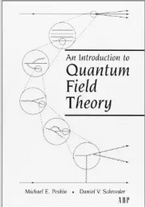
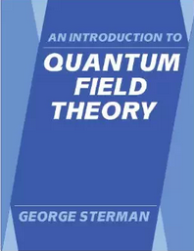
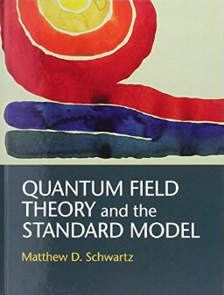

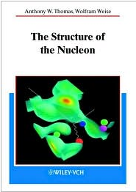
Selected references on QCD
Textbooks on QCD
  QCD and Collider Physics – Ellis, Stirling, Webber
  Foundations of Perturbative QCD: J. Collins
  Applications of Perturbative QCD: R. Field
Textbooks on Quantum Field Theory
  An Introduction to Quantum Field Theory: Peksin & Schroeder, Sterman
  Quantum Field Theory and the Standard Model: M. Schwartz
  Quantum Field Theory in a Nutshell: A. Zee
The structure of the Nucleon: Thomas & Weise
CTEQ collaboration http://www.phys.psu.edu/~cteq
P. J. Mulders http://www.nat.vu.nl/~mulders/correlations-0new.pdf

Slide 4
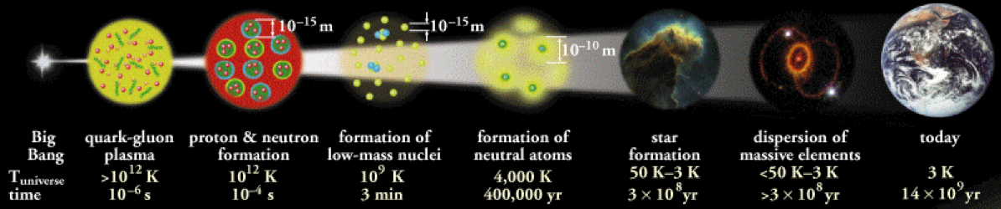
Structure of matter
Central goal of nuclear science
  To discover, explore, and understand nuclear matter in its all forms
    Quark gluon plasma
    Protons and neutrons (nucleons)
    Atomic nuclei
    Neutron stars
    …
Today’s topic: structure of the nucleons
  Quantum tomography of the nucleons
  3D imagining of the nucleons in terms of their most fundamental constituents (quarks and gluons)

Slide 5

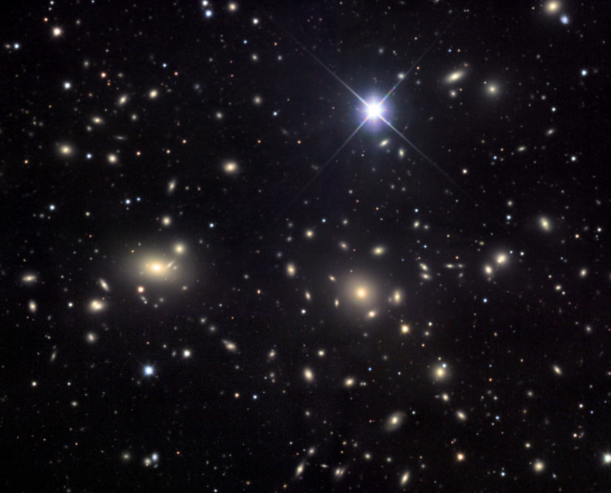
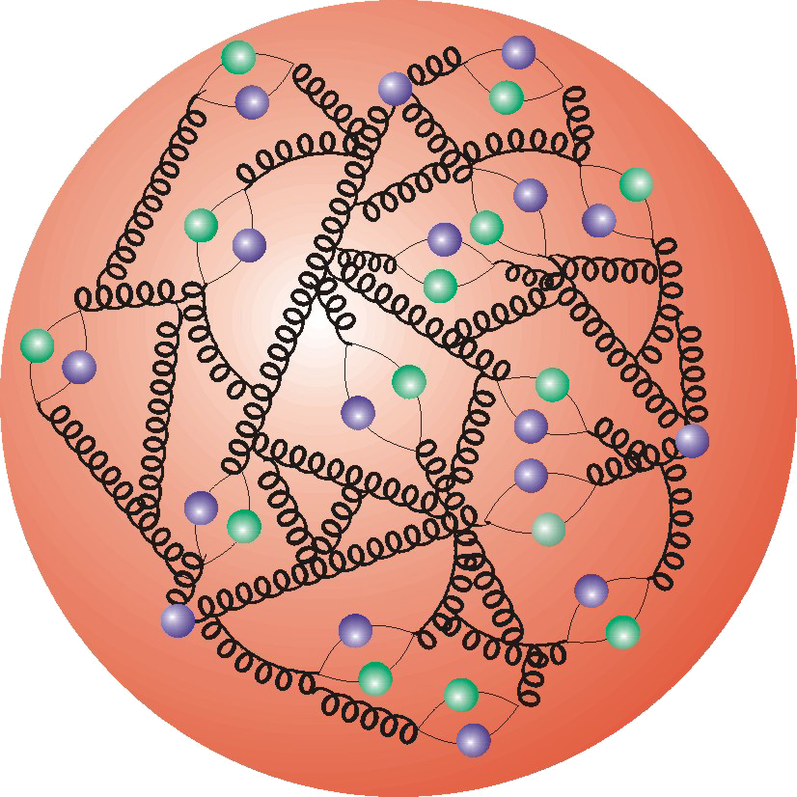
Exploring the nucleon: fundamental importance in science
The most abundant particles around us
  Our human body is almost entirely made of nucleons
  The sun, all the other stars
  Atomic nuclei, …
Tool for discovery
  Colliding high energy nucleons to look for Higgs particle, new physics beyond Standard Model

Slide 6

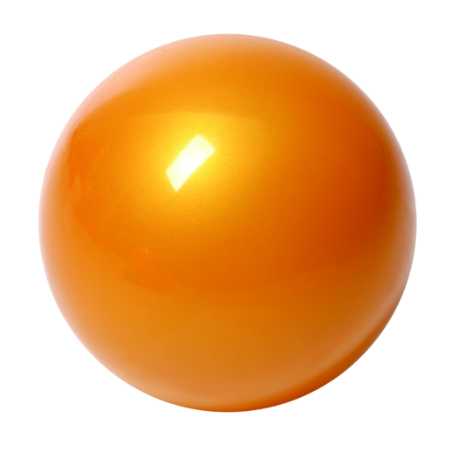
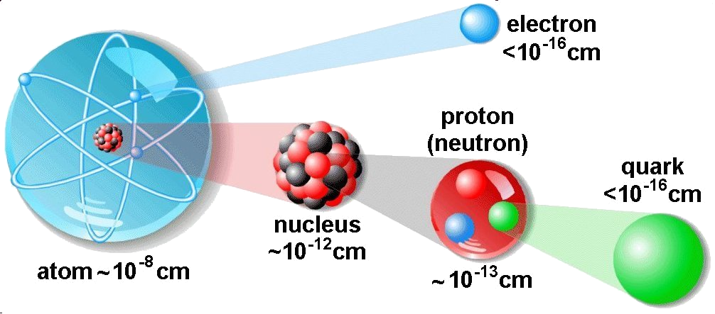
Exploration of the nucleons: history
Exploration of the nucleon structure started a century ago
  1911, Rutherford scattering: atomic nucleus
  1955, electron scattering from Hydrogen: Hofstadter
    Proton has size around 1 fm ~ 10⁻¹⁵ m
  1969, deep inelastic scattering at SLAC: Friedman, Kendall, Taylor
    Feynman’s parton model
    Quarks and gluons
electron
p

Slide 7
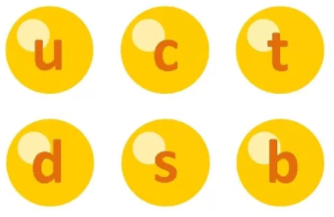

Quantum Chromodynamics (QCD)
QCD: underlying theory for strong interactions
  Building blocks
    Quarks: spin-1/2
    Gluons: spin-1, mediate interactions
  Both quarks and gluons carry “color” charge
Proton: 2 up quarks + 1 down quark

Slide 8
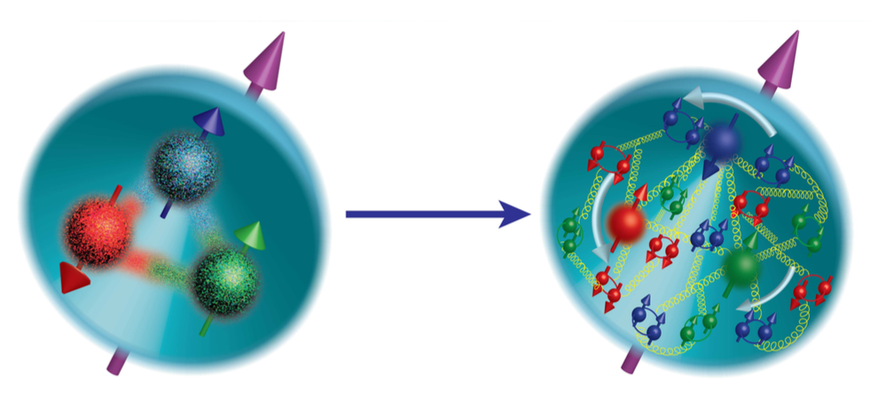
The proton in QCD
Proton is made of
  2 up quarks + 1 down quarks
  + any number of quark-antiquark pairs
  + any number of gluons
valence quarks
sea quarks
Infinite many body system
Fluctuating number of elementary quark/gluon constituents
Rich structure of the nucleon

Slide 9
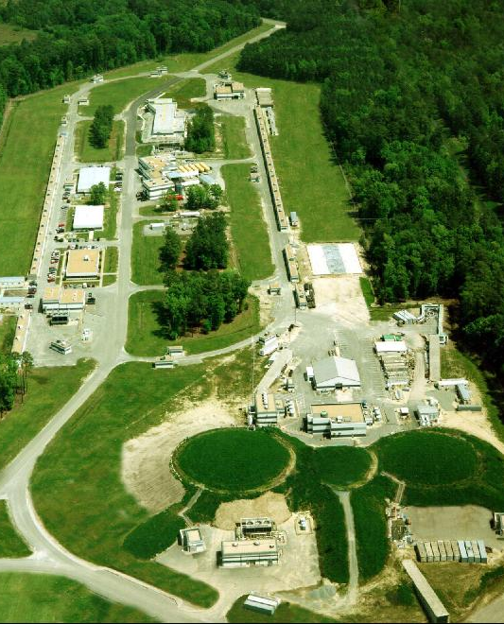
Active experimental programs in US: JLab
Jefferson Lab 12 GeV program: $380 million, started running in late 2015
CEBAF: Continuous Electron Beam Accelerator Facility
Electron-nucleon scattering
A
B
C

Slide 10
Active experimental programs in US: BNL
Relativistic Heavy Ion Collider (RHIC) through RHIC spin program
Proton-proton scattering

Slide 11

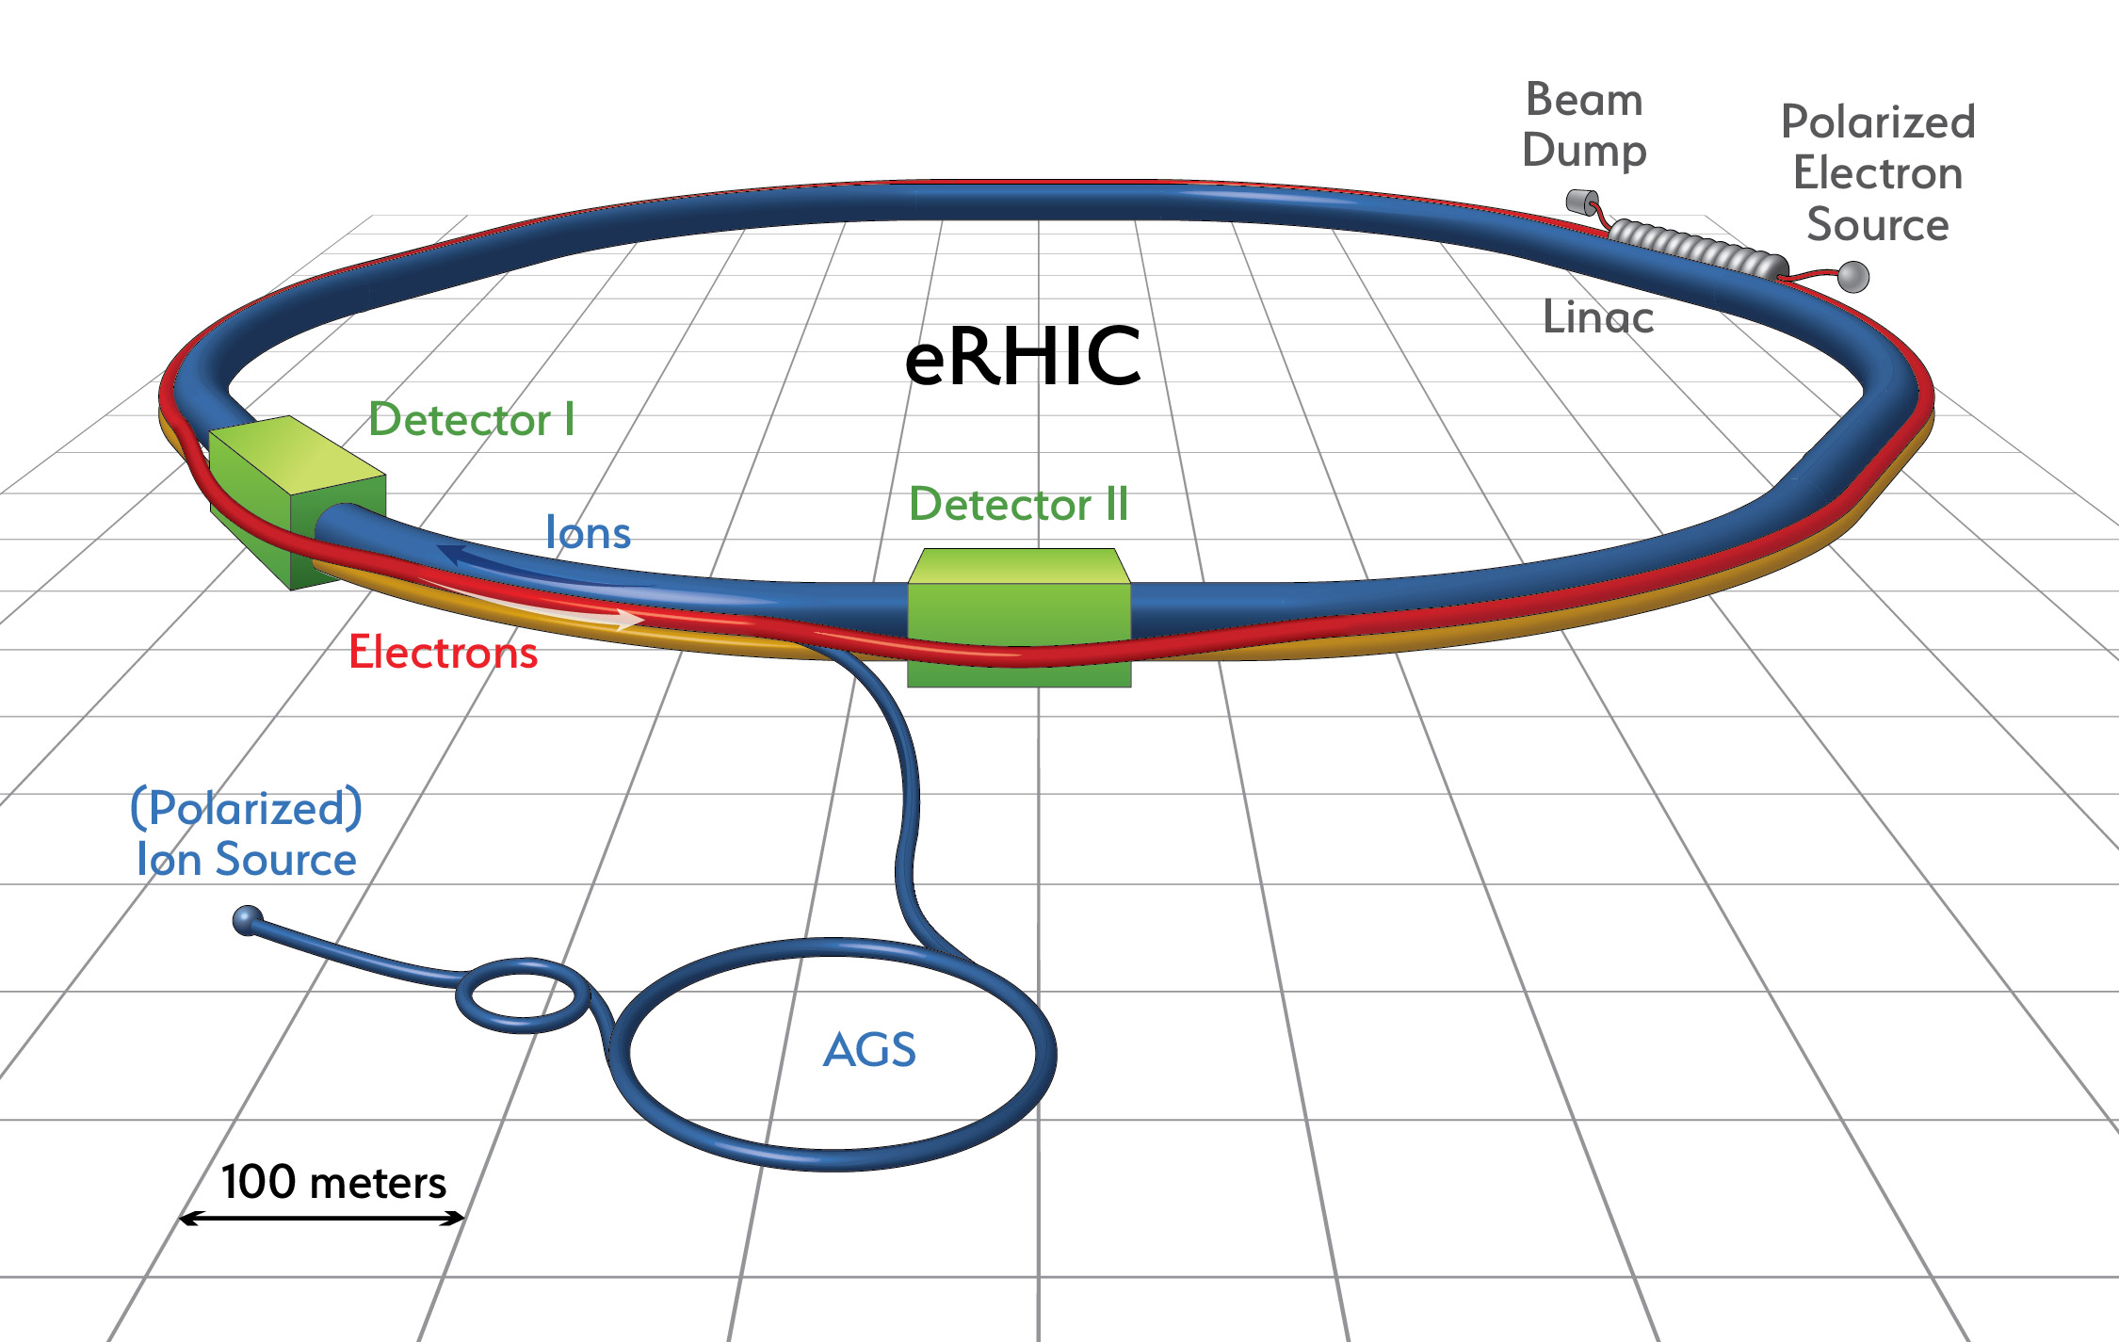
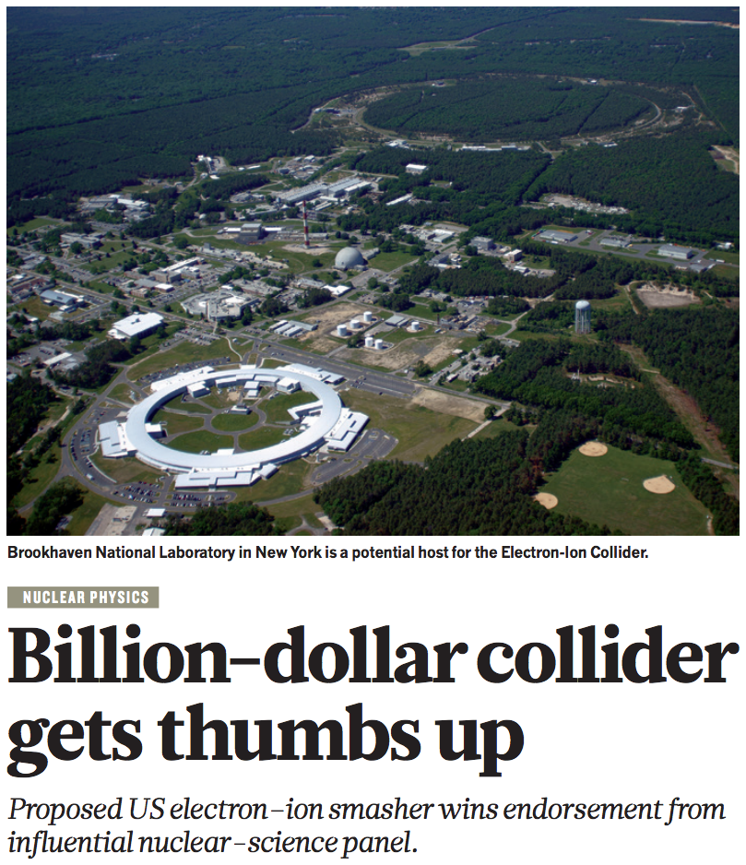

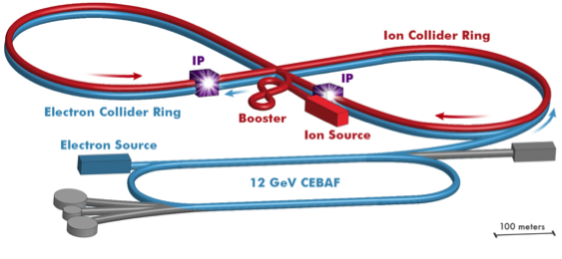
Electron Ion Collider
BNL
JLab

Slide 12
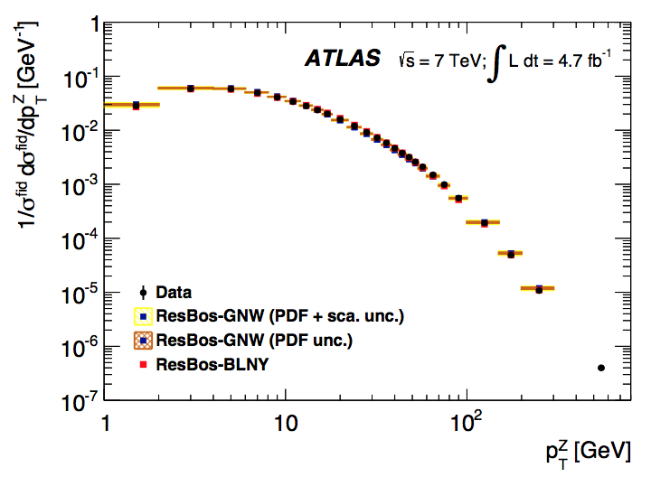
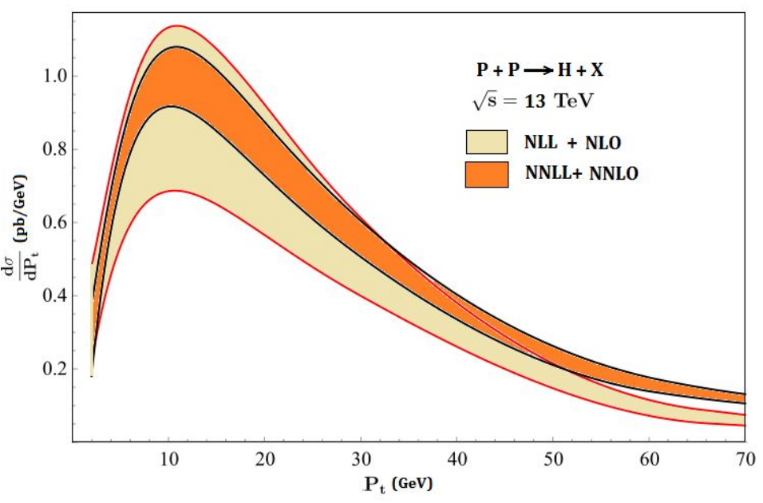
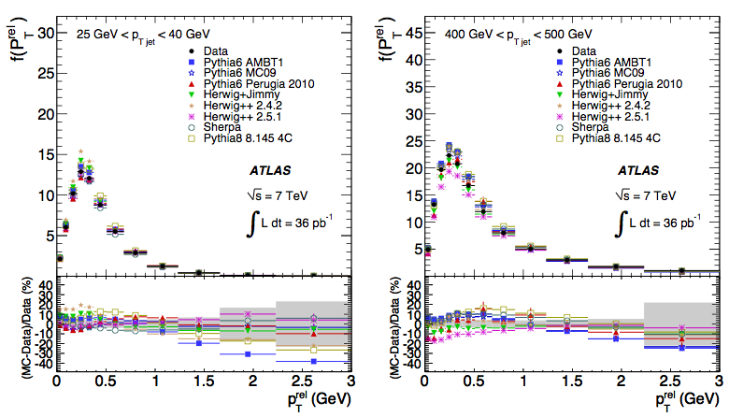
What is TMD?
Three-dimensional structure is encoded in quark/gluon TMDs
TMDs = Transverse Momentum Dependent Parton Distribution or Fragmentation Functions
Hadron in a jet
h
jet
Z boson
Higgs

Slide 13


QCD: Two faces
Asymptotic freedom
Confinement
No one has ever seen a free quark
2004
High energy scale
Weak coupling
Low energy scale, strong coupling
Low energy scale: at the size of the proton

Slide 14
Experimental tool: high energy scattering
To study SM and BSM physics, we rely on high energy scattering
To compute cross sections, we need QCD factorization
electron
p
p
p
Deep Inelastic Scattering (DIS)
Z production Proton-Proton collisions

Slide 15
QCD factorization
Take deep inelastic scattering as an example
Proton structure: encoded in PDFs
QCD dynamics at high-energy scale Q
quark
Parton Distribution Functions (PDFs):
Probability for finding a parton in a proton with momentum fraction x
measured
extracted
calculable

Slide 16
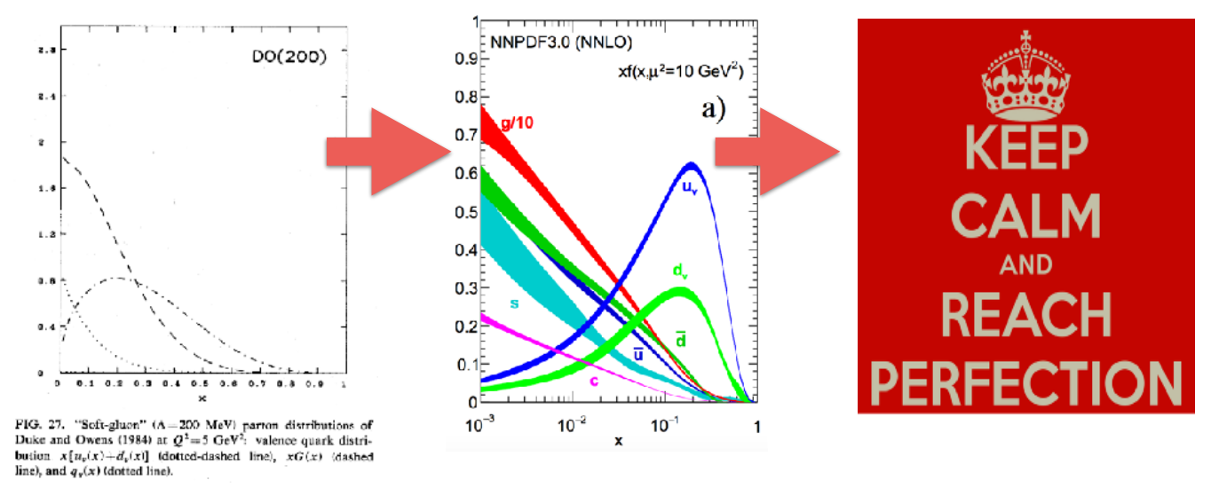
Parton distribution functions

Slide 17

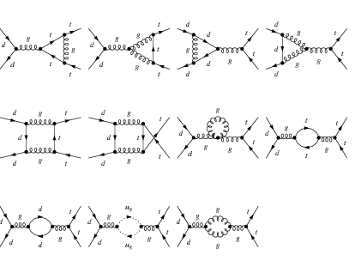

Direction 1: deep in purturbative direction
Dave Soper
Jets, Jet substructure, W/Z/H+Jet, …
NLO, NNLO, Resummation, multi-loops/legs, …

Slide 18

Moving forward
30+ years’ study, good knowledge about parton’s longitudinal motion: 1D
Nucleon 3D structure: both longitudinal + transverse momentum dependent structure
  Transverse Momentum Dependent parton distributions (TMDs)
Longitudinal motion only
Longitudinal + transverse motion

Slide 19

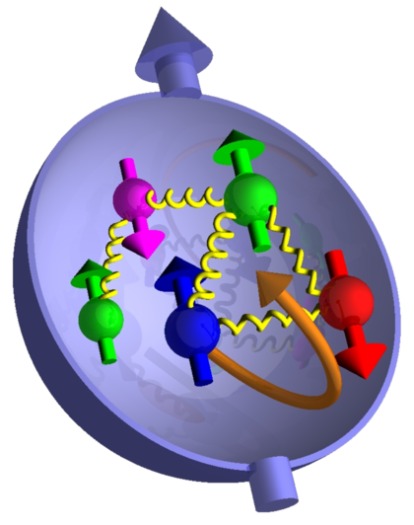
Direction 2: quantum tomography of nucleons

Slide 20
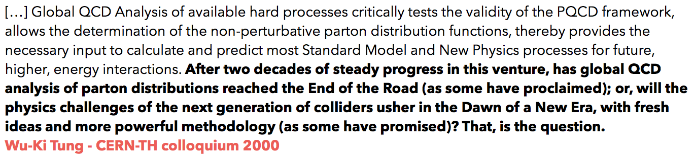
Follow the wisdom of pioneers
From Maria Ubiali, DIS2017 talk

Slide 21
Quark and gluon structure of the nucleon
Goal: quantum tomography/3D imaging in terms of quarks and gluons
  Momentum: how do the quarks, antiquarks, gluons move inside?
  Position: where are they located?
  Orbit: do they orbit, carry orbital angular momentum?
  Correlation: quantum correlations between motion and overall nucleon properties, e.g., spin? How do they respond to the external probes?
Internal landscape of the nucleon
Such information are defined as a set of
parton distribution functions

Slide 22
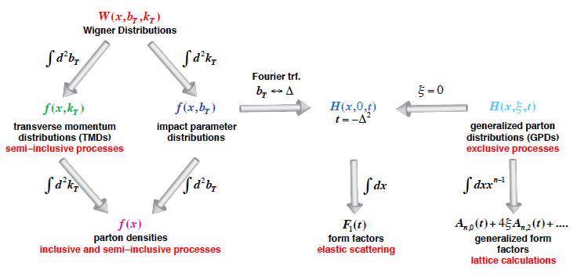
Unified view: internal landscape
Wigner distributions: a quantum version of phase-space distribution
5D
3D
1D

Slide 23
3D imaging of nucleons: how?
For a fast moving proton
how do we probe the parton’s transverse motion?
Experimental advance: use transverse spin as a probe, as it can correlate with parton’s transverse momentum
Transverse spin physics

Slide 24
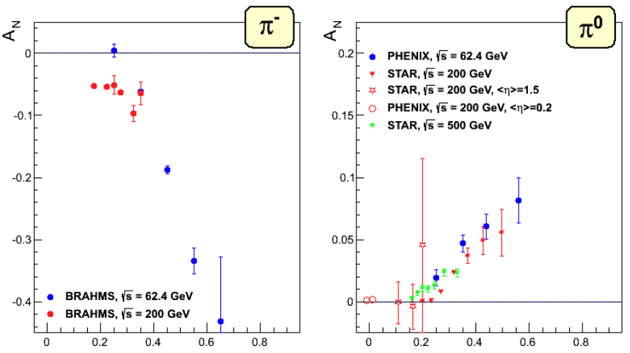
Single transverse spin asymmetry (SSA)
Consider a transversely polarized proton scatter off an unpolarized proton or electron
scaled longitudinal momentum

Slide 25
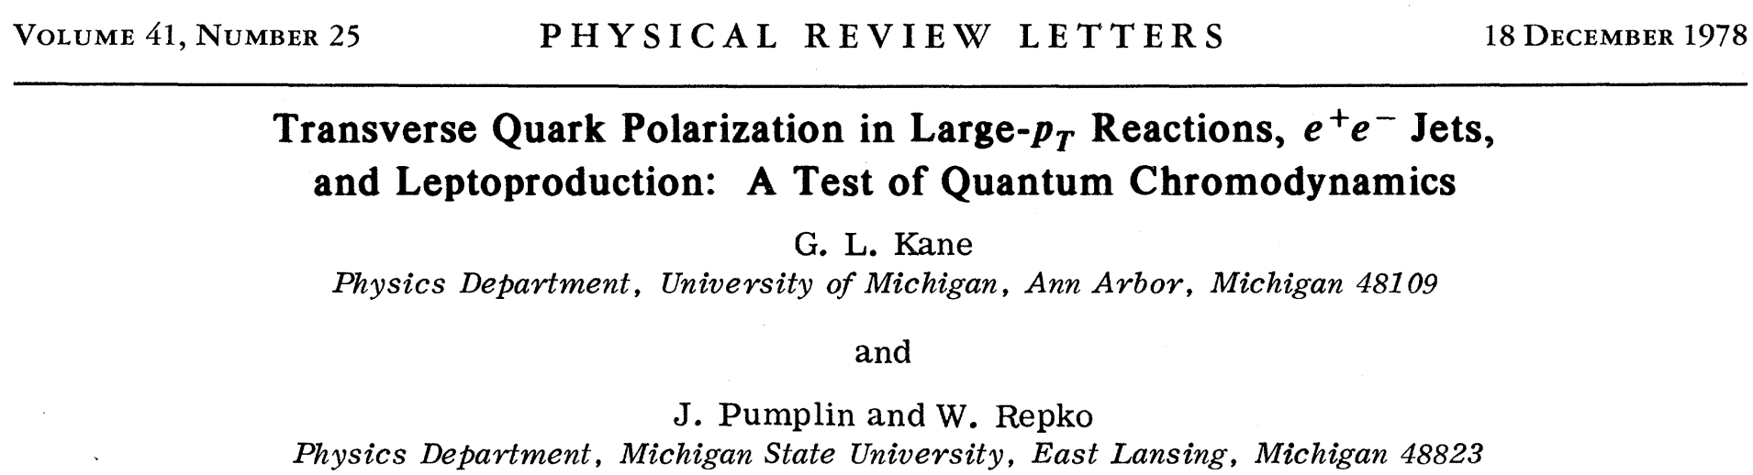
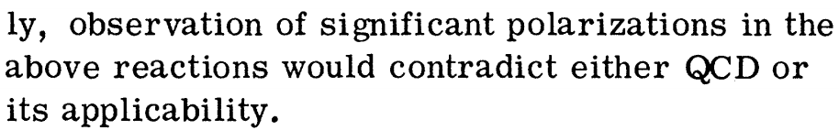
Early theory prediction
If partons have only longitudinal momentum, SSA would vanish
Transverse motion is the key
1D
3D

Slide 26
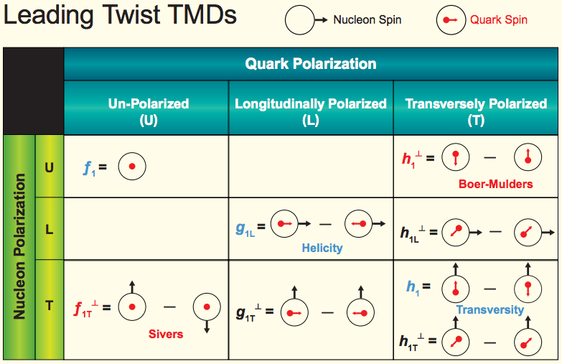
TMDs: rich quantum correlations
TMD parton distribution
Transversal Helicity
Quark Polarization
U L T
TMD fragmentation function
Pion
Collins

Slide 27
Novel insights from TMDs
Quantum correlation: spin-spin, spin-momentum (orbit) correlations
  Akin to those in hydrogen atoms and topological insulators
3D imagining
  Both longitudinal and transverse motion
Orbital motion
  Most TMDs would vanish in the absence of parton orbital angular momentum
Color gauge invariance at a very deep level
  Akin to Aharonov-Bohm Effect
Using the nucleon as
a QCD “laboratory”

Slide 28
Sivers function: a spin-momentum correlation
Sivers function: unpolarized quark distribution inside a transversely polarized proton
Sivers function
Look closer
Naïve time-reversal-odd: recall momentum and spin change sign under T
Forbidden?: such a correlation is forbidden in QCD, unless there is a phase
Sivers effect
left-right asymmetry
Recall:

Slide 29
Quantum mechanical phase
Quark passes through a color gauge field, generated by the remnant of the nucleon, it will accumulate a phase
electron
proton
anti-quark
quark
quark
quark
remnant
remnant
DIS: after the interaction
final state
Drell-Yan: before the interaction
initial state
Phase can be computed:
they are different for different processes
(key: track the path of the color flow)

Slide 30
Surprising consequence
The phase leads to a sign change in Sivers function
  Parity and time reversal operation
Collins 02, Boer-Mulders-Pijlman 03, Collins-Metz 04, Kang, Qiu, PRL 09, …
Nuclear Science Advisory Committee milestone: most important property of the Sivers function, need to be tested

Slide 31
Sivers function: history
1990: introduced by D. Sivers, to describe the large single spin asymmetry measured in inclusive hadron production in p+p collisions at Fermilab
1993: J. Collins shows Sivers function has to vanish due to time-reversal invariance
2002: Brodsky, Hwang, Schmidt performed an explicit model calculation, showed the existence of the Sivers function
2002: Original proof missed the gauge link (needed to properly define gauge invariant distribution), once added, found Sivers function in SIDIS is opposite to that in Drell-Yan
2016/17: sign change has been observed/hinted

Slide 32
Sivers effect: QCD version of Aharonov-Bohm effect
Pure quantum effect: different paths lead to interference
Physics today, September 2009

Slide 33
TMD factorization in a nut-shell
Drell-Yan:
Factorized form and mimic “parton model”
Factorization of regions:
(1) k//P₁, (2) k//P₂, (3) k soft, (4) k hard
mimic “parton model”

Slide 34
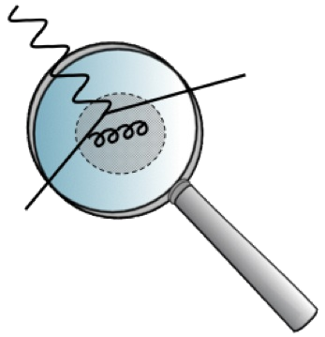
TMD evolves
Just like collinear PDFs, TMDs also depend on the scale of the probe = evolution
Collinear PDFs
TMDs
DGLAP evolution
Resum
Kernel: purely perturbative
Collins-Soper/rapidity evolution equation
Resum
Kernel: can be non-perturbative when

Slide 35
TMD evolution in b-space
We have a TMD above measured at a scale Q. So far the evolution is written down in the Fourier transformed space (convolution → product)
In the small b region (1/b >> Λ_{QCD}), one can then compute the evolution to this TMD, which goes like
calculable for small b with pQCD
Collins-Sopoer-Sterman papers
Kang, Xiao, Yuan, PRL 11, Echevarria, Idilbi, Kang, Vitev, 14, Kang, Prokudin, Sun, Yuan, 15, 16,
Aybat, Rogers, Collins, Qiu, 12,
Aybat, Prokudin, Rogers, 12, Sun, Yuan, 13, Echevarria, Idilbi, Schafer, Scimemi, 13, …

Slide 36
TMD evolution contains non-perturbative component
Fourier transform back to the momentum space, one needs the whole b region (large b): need some non-perturbative extrapolation
  Many different methods/proposals to model this non-perturbative part
Eventually evolved TMDs in b-space
longitudinal/collinear part
transverse part
Non-perturbative: fitted from data
The key ingredient – ln(Q) piece is spin-independent
Since the polarized scattering data is still limited kinematics, we can use unpolarized data to constrain/extract the key ingredient for the non-perturbative part

Slide 37
TMD global analysis
Outline of a TMD global analysis: numerically more heavy
Model ansatz for TMDs
with initial set of parameters
Model ansatz for non-perturbative evolution kernel
Evolve TMDs to relevant scale with TMD evolution
Fourier transform back to momentum space
adjust parameters
all data points
calculate the cross section/asymmetry as well as χ²
χ² minimum?
no
yes

Slide 38
Standard processes to extract TMDs
SIDIS, Drell-Yan, dihadron in e⁺e⁻
They have a well-established TMD factorization formalism
h₁
electron
p
p
p
h
h₂

Slide 39
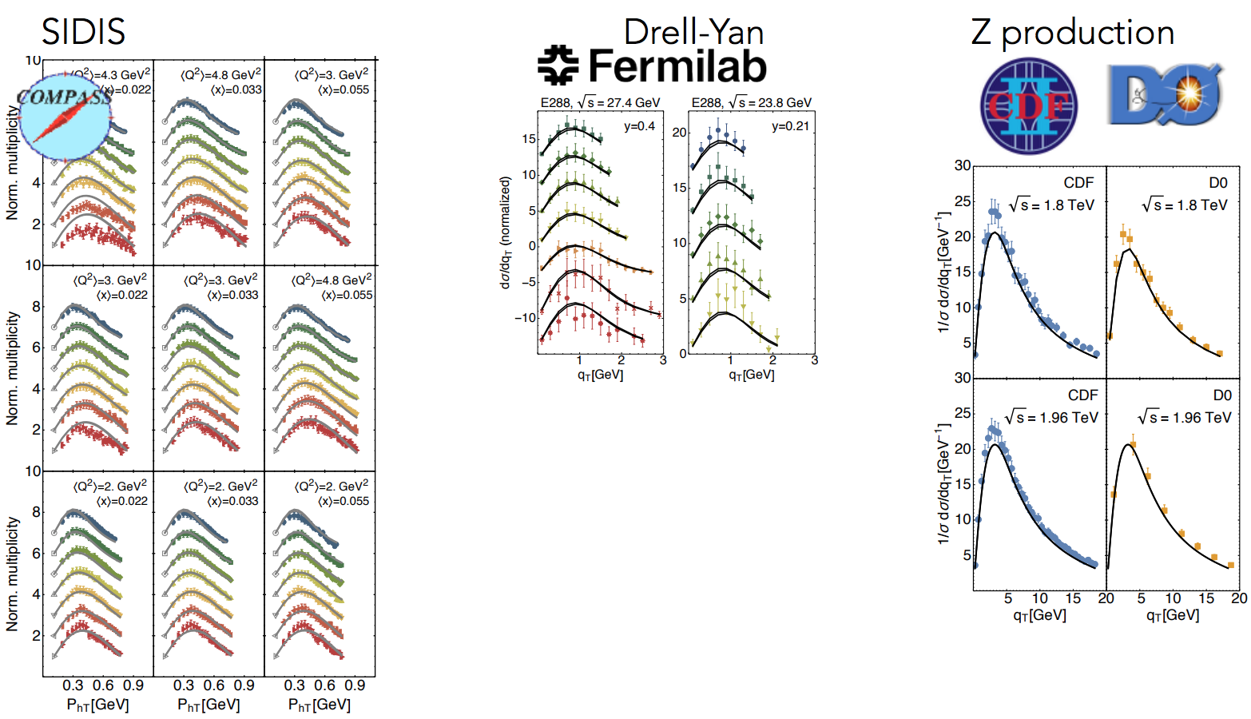
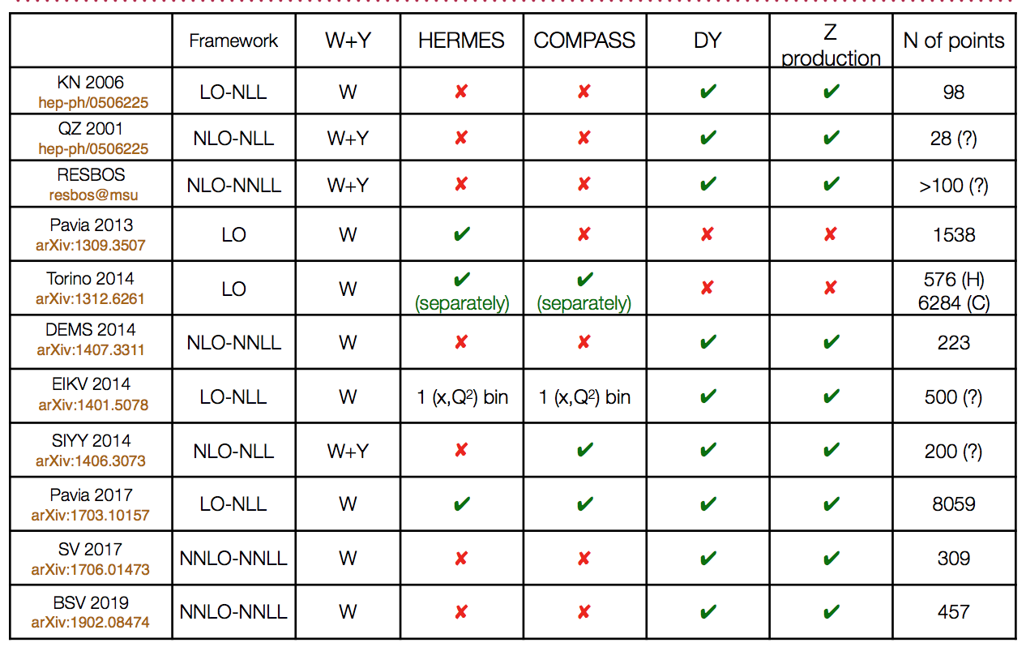
Extremely active phenomenology
Examples: Pavia, Torino, EIKV, KSPY, DEMS, SV…

Slide 40
Unpolarized TMDs: SIDIS
Comparison to COMPASS data
Echevarria, Idilbi, Kang, Vitev, 14

Slide 41
Drell-Yan and W/Z production
Comparison with DY, W/Z pt distribution
DY
W
Z
Works for SIDIS, DY, and W/Z in all the energy ranges
Note: same method works for Higgs production

Slide 42
QCD evolved unpolarized TMD
What evolution does
  Spread out the distribution to much larger kt
  At low kt, the distribution decreases due to this spread
Based on Echevarria, Idilbi, Kang, Vitev, 14

Slide 43
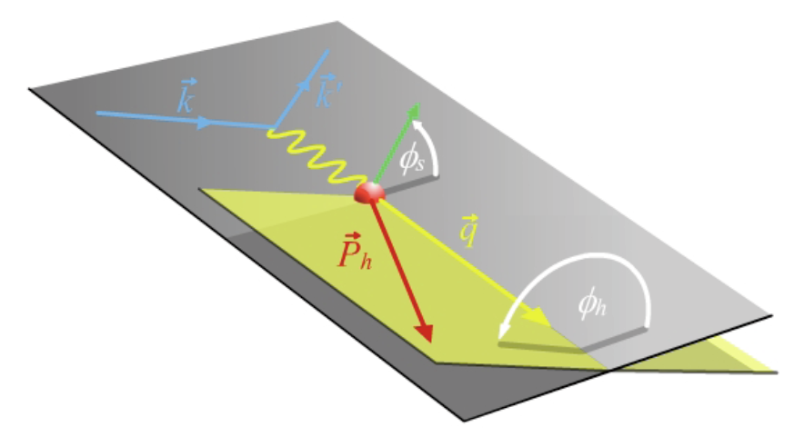
Sivers asymmetry from SIDIS
Sivers asymmetry has been measured in SIDIS process: HERMES, COMPASS, JLab
Sivers function

Slide 44
Sivers function with energy evolution
Example of the fit: JLab, HERMES, COMPASS
Echevarria, Idilbi, Kang, Vitev, 14

Slide 45

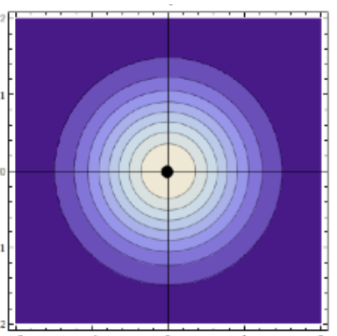
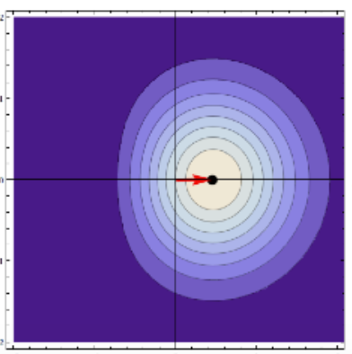
Extracted Sivers functions and meaning
Gamberg, Kang, Prokudin, PRL 2013
u
Sivers function
Distortion from Sivers effect
negative = right preference
d
2
0
–2
–2
0
2
unpolarized
Transversely polarized

Slide 46
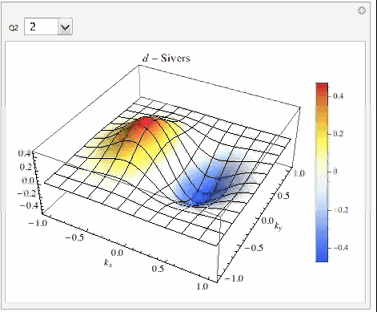

3D view: d quark
Q² = 2 – 100 GeV²
x=0.1
: along y direction
Echevarria, Idilbi, Kang, Vitev, 14

Slide 47
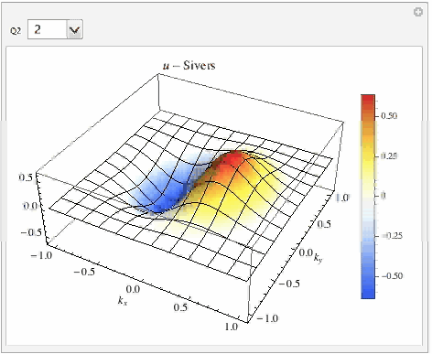
3D view: u quark
Q² = 2 – 100 GeV²
x=0.1
: along y direction
Echevarria, Idilbi, Kang, Vitev, 14

Slide 48
Sign change and predictions for W/Z
Still need DY to verify the sign change, thus fully understand the Sivers mechanism
Reverse the sign from DIS, make predictions for W/Z at RHIC
Kang, Qiu 09, Kang 15
Huang, Kang, Vitev, Xing, 15
p
p
rapidity

Slide 49
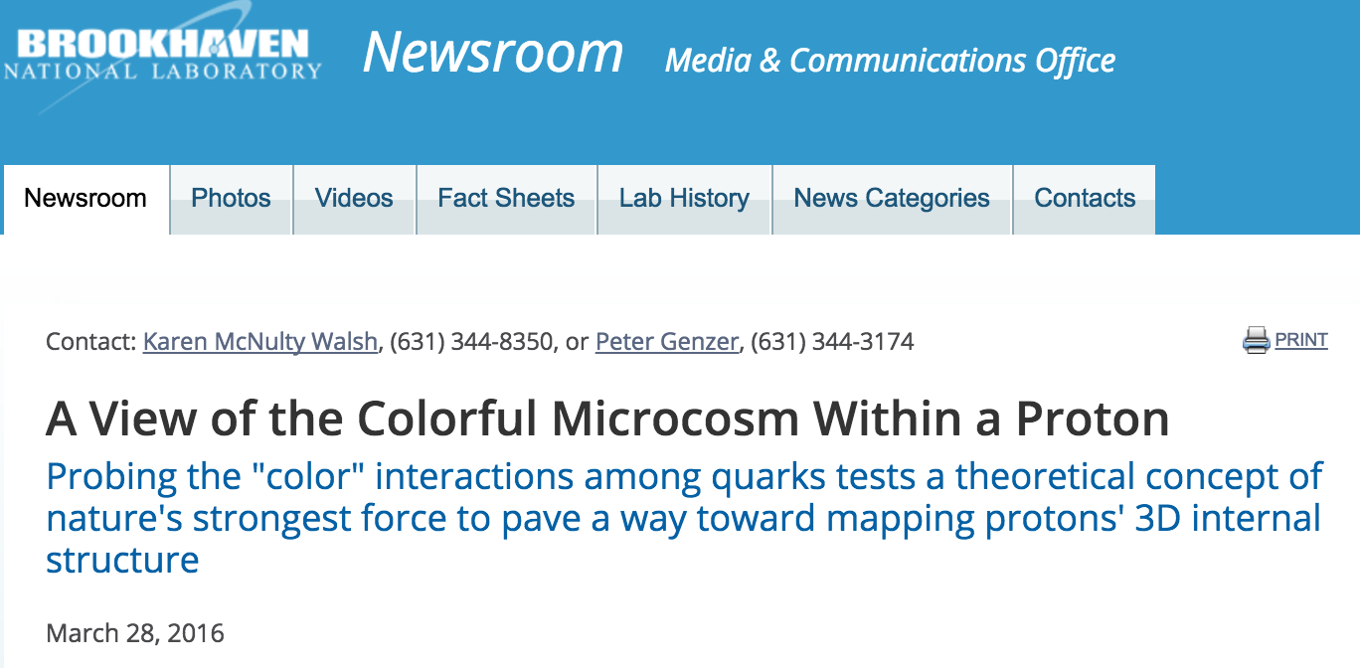
Experimental evidence of sign change
STAR measurements: the data favors sign change
Both theory and experiment has large uncertainty: will be improved in 2017 run
KQ = Kang, Qiu
STAR, arXiv:1511.06003, PRL

Slide 50
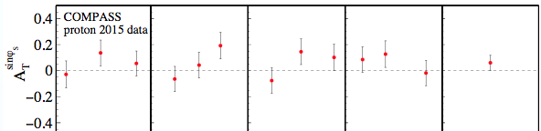
Drell-Yan process
First experimental hint on the sign change in Drell-Yan
COMPASS, 1704.00488
With sign change
Without sign change

Slide 51

Other predictions
One can also study the consequences for real photon production, jet production, and etc
  Color interaction in both initial and final states
Have been planned by RHIC
p
p

Slide 52
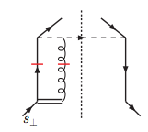
Collins function: universal
Collins function: unpolarized hadron from a transversely polarized quark
Spin-independent
Spin-dependent
2002: A. Metz studied the universality property of Collins function in a model-dependent way – very subtle – finally found it is universal between SIDIS and e+e-
2004: Collins and Metz have general arguments
2008: Yuan generalizes to pp
2010: Boer, Kang, Vogelsang, and Yuan perform perturbative tail calculation, demonstrate the gauge link does not contribute
h
Metz 02, Collins, Metz 04, Yuan 08,
Boer, Kang, Vogelsang, Yuan, PRL 10, …

Slide 53
Collins asymmetry from SIDIS and e+e-
SIDIS and e+e-: combined global analysis
transversity
Collins function
Collins function

Slide 54
Collins asymmetry in SIDIS
Fitting of SIDIS data
Kang, Prokudin, Sun, Yuan, PRD 15 & 16
HERMES
COMPASS
JLab

Slide 55
Collins asymmetry in e+e-
Fitting of e+e- data from BaBar, Belle, BES
BaBar
Belle

Slide 56
Fitted TMDs
Fitted quark transversity and Collins function: x (z) -dependence
Collins function: pt-dependence

Slide 57
Active experimental programs in US: JLab
Jefferson Lab 12 GeV program: $380 million, started running in late 2015
CEBAF: Continuous Electron Beam Accelerator Facility
Electron-nucleon scattering
A
B
C

Slide 58
Active experimental programs in US: BNL
Relativistic Heavy Ion Collider (RHIC) through RHIC spin program
Proton-proton scattering

Slide 59
Electron Ion Collider
BNL
JLab

Slide 60
Looking into the future
Experimental activities worldwide

Slide 61
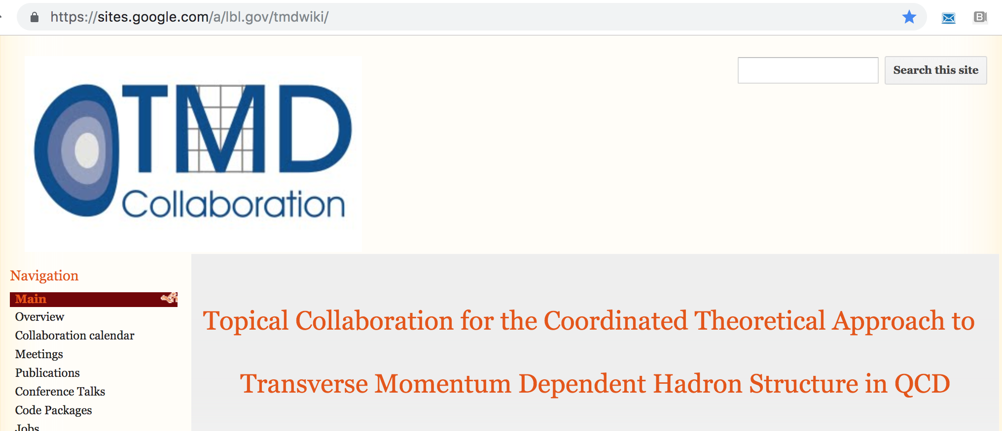
Very active theoretical research
DOE TMD Collaboration

Slide 62
Summary
Nucleon as a QCD “laboratory”: in particular topics/ideas that are similar to those in AMO/Condensed Matter Physics
  Quantum correlation: spin-spin correlation, spin-orbit correlation, orbital motion, quantum phase interference effects …
  3D imaging of the nucleon at the most fundamental level
Exciting opportunities: lots of experiments activities/measurements being/to be performed/planned in current and future experimental facilities
Thank you!

