Slide 1
Three-dimensional structure of the nucleon
CFNS Summer School 2019
August 1 - 9, 2019

Slide 2
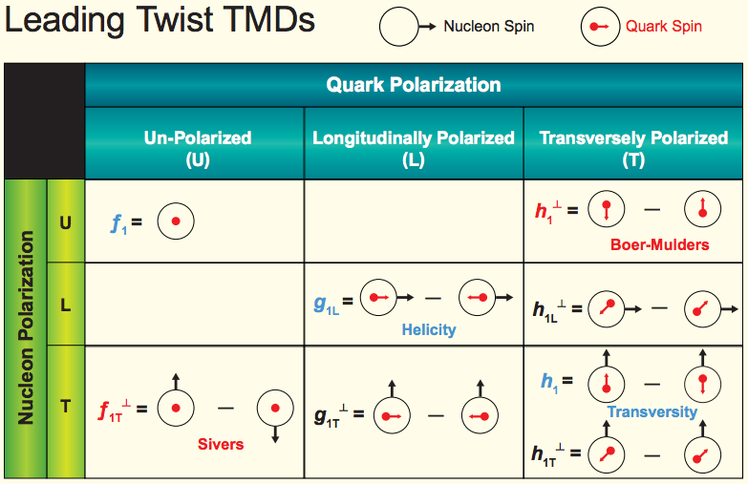
TMDs: rich quantum correlations
TMD parton distribution
Transversal Helicity
Quark Polarization
U L T
TMD fragmentation function
Pion
Collins

Slide 3
How many distributions are needed
In order to fully characterize the proton structure, how many parton distribution functions and fragmentation functions are actually needed?
To answer this question, we need to perform some operator analysis

Slide 4
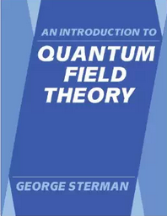
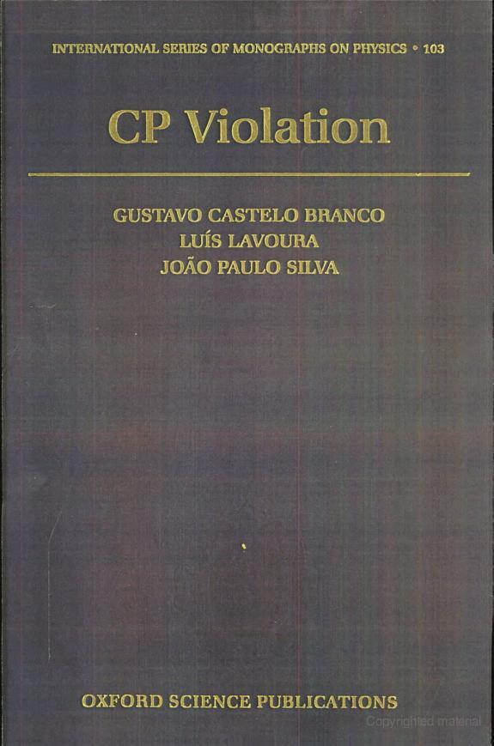
Good textbooks
Understand C, P, T discrete symmetry properties of the correlation function
  Most textbooks on quantum field theory will give discussion on this topic, such as Peskin, Sterman: appendix of Sterman’s book
  If you want extensive discussion, see this book

Slide 5
One example: Sivers function
Sivers function: an asymmetric parton distribution in a transversely polarized nucleon (kt correlated with the spin of the nucleon)
Naïve time-reversal-odd, and its existence requires a phase (generate through interactions)
Spin-independent
Spin-dependent

Slide 6
Sivers function: history
1990: introduced by D. Sivers, to describe the large single spin asymmetry measured in inclusive hadron production in p+p collisions at Fermilab
1993: J. Collins shows Sivers function has to vanish due to time-reversal invariance
2002: Brodsky, Hwang, Schmidt performed an explicit model calculation, showed the existence of the Sivers function
2002: Original proof missed the gauge link (needed to properly define gauge invariant distribution), once added, found Sivers function in SIDIS is opposite to that in Drell-Yan
2016/17: sign change has been observed/hinted

Slide 7
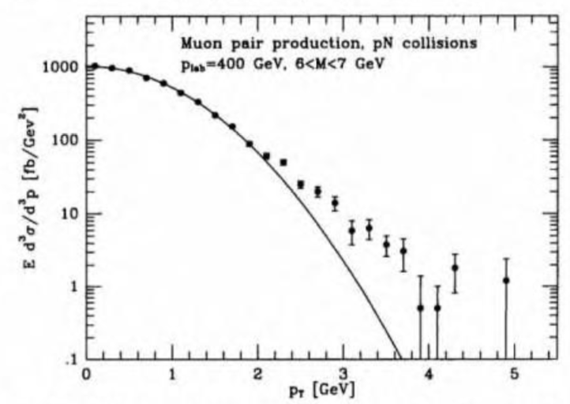
Parton model for TMDs
At low pT, the distribution is described by a Gaussian form

