Slide 1
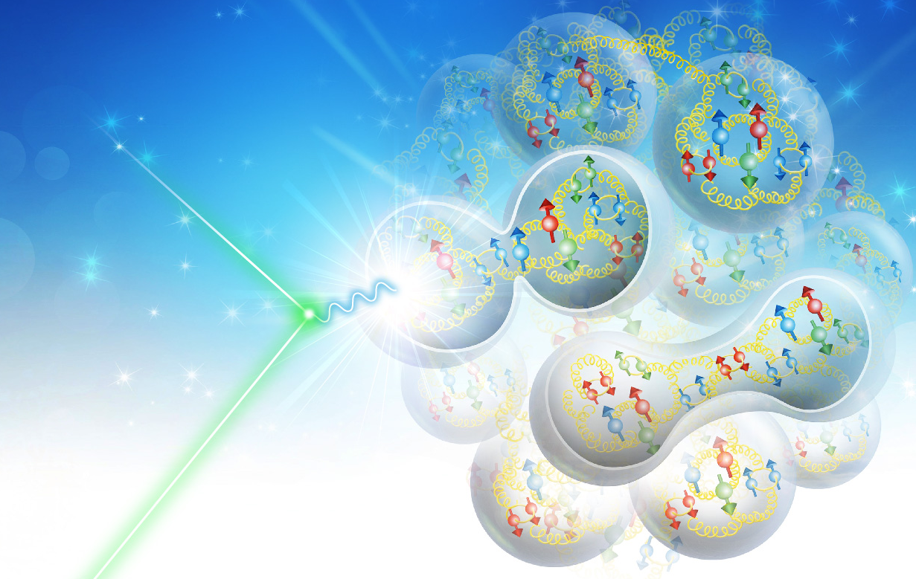
EIC Physics and IR Design II
Vasiliy Morozov
on behalf of JLEIC design team
CFNS Summer School 2019
August 3, 2019

Slide 2
Outline
Full acceptance detector concept
Magnetic optics of the interaction region
Engineering design of the interaction region magnets
Detector background
Detector acceptance
Tagging for heavy ions
Coherent diffraction
quark propagation and hadronization
EIC software highlights

Slide 3
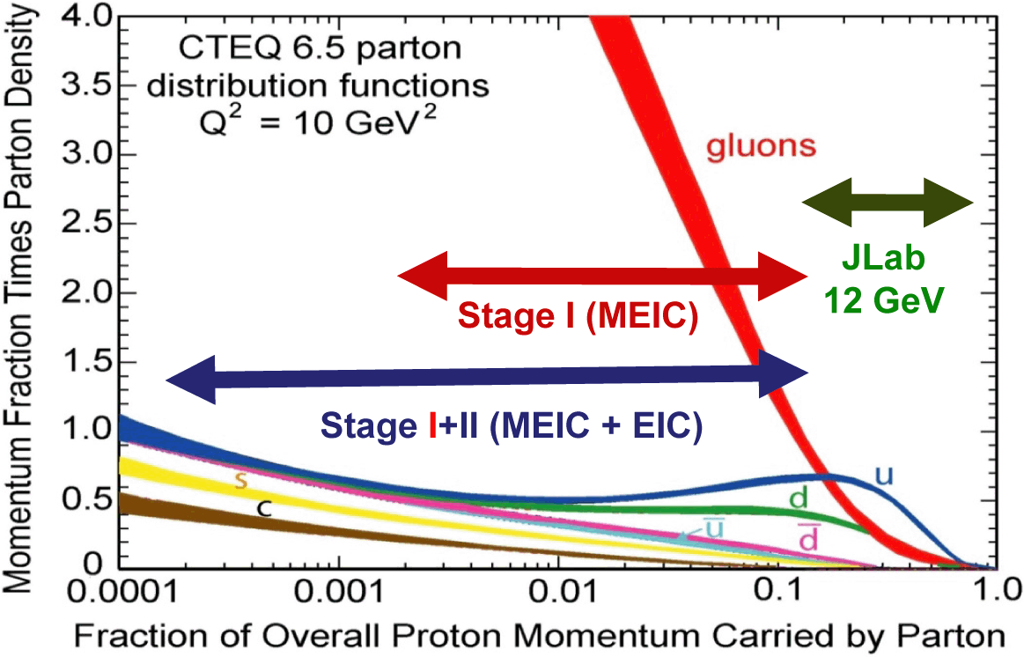
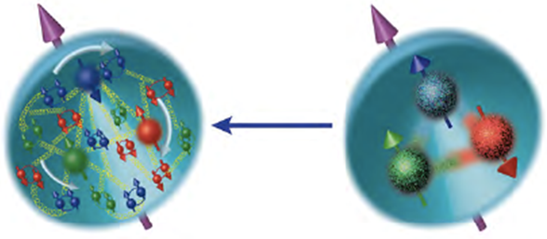
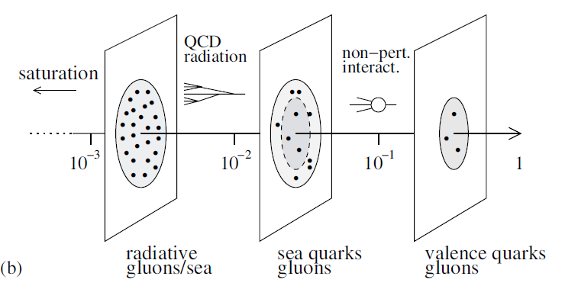
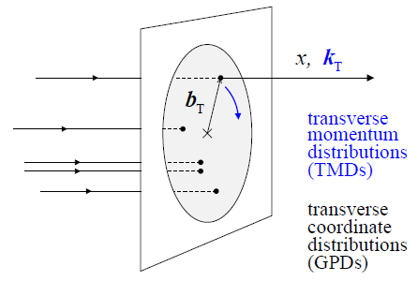
EIC Physics Highlights
An EIC aims to study the sea quark and gluon-dominated matter
3D structure of nucleons
How do gluons and quarks bind into 3D hadrons?
How does the mass of a nucleon emerges?
Role of orbital motion and gluon dynamics in the proton spin
Why do quarks contribute only ~30%?
Gluons in nuclei (splitting/recombining)
Does the gluon density saturate at small x?
Need luminosity, polarization and good acceptance to detect spectator & fragments

Slide 4
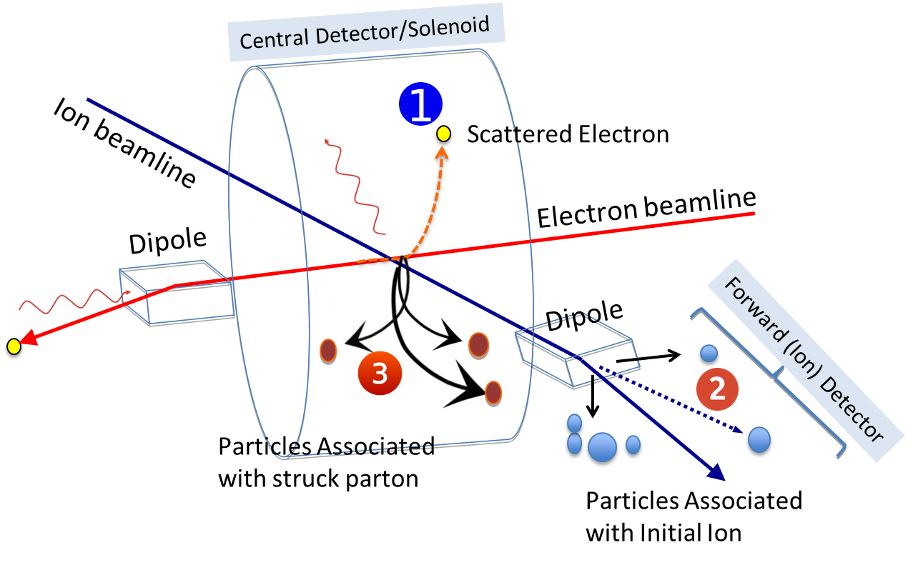
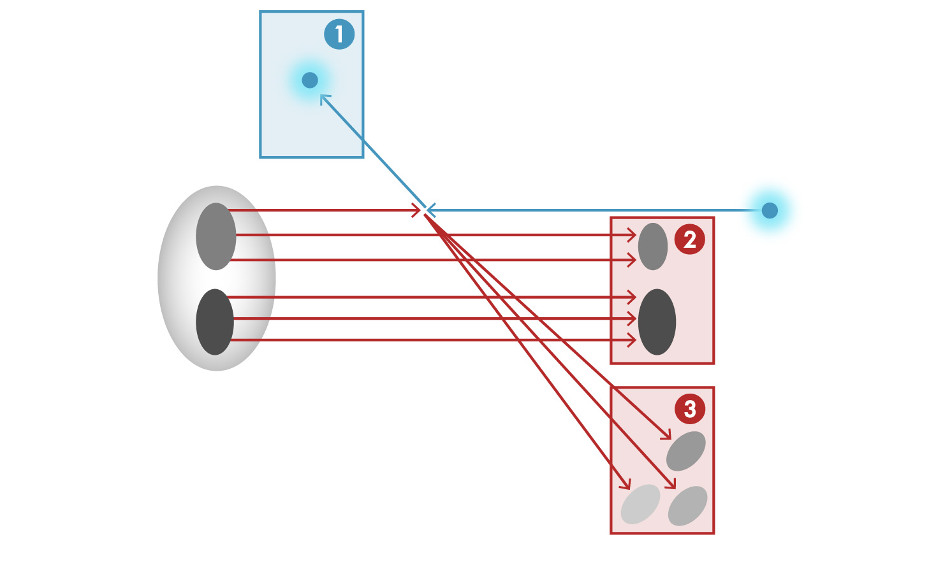
Full Acceptance Detector Concept
For typical collider experiments, measurements are performed mainly in central region
Would like to get ~100% acceptance for the whole event
e’
e
p/A

Slide 5
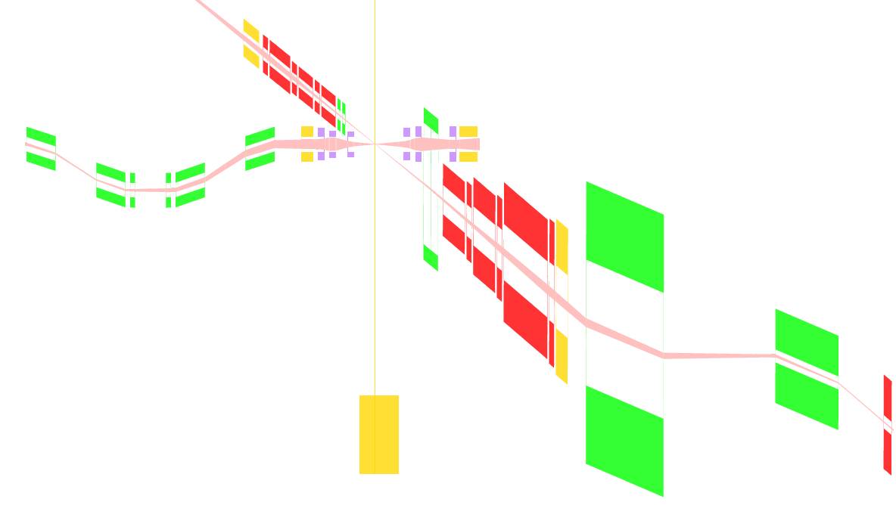
Schematic of Full-Acceptance Detector
50 mrad crossing angle
Forward hadron detection in three stages
Endcap
Small dipole covering angles up to ~3°
Far forward, ~10 mrad, for particles passing through accelerator quads
Low-Q2 tagger
Small-angle electron detection
End caps
Roman pots
$±50$ mrad
Secondary
focus
Low $Q^{2}$ tagger
Central detector
$±10$ mrad

Slide 6
Streamlining IR Updates
With many parties involved, need to find a way to reliably synchronize the IR models between accelerator, detector and engineering groups.
Accelerator Lattice
MAD-X
Largely
automated
Detector Model
GEMC
Engineering Design
CAD
Largely
automated

Slide 7
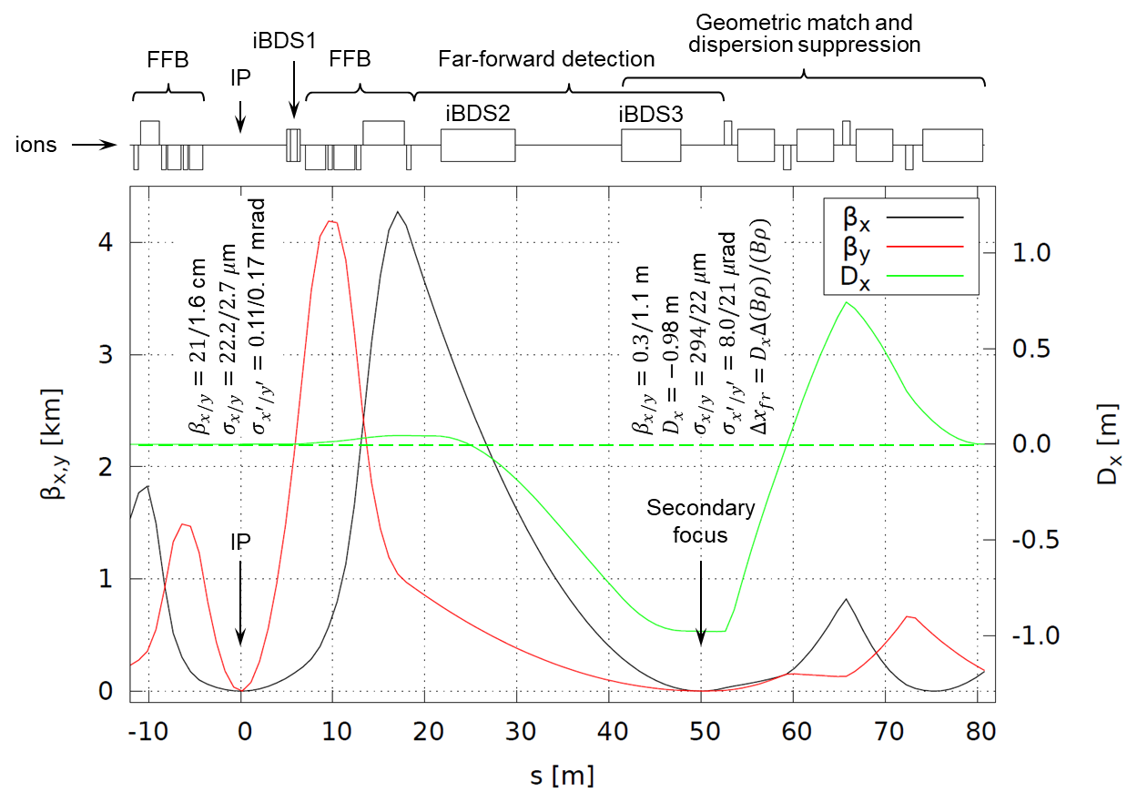
Ion Interaction Region
High luminosity and acceptance performance in the whole energy range
Conventional NbTi technology
Secondary focus with high dispersion

Slide 8
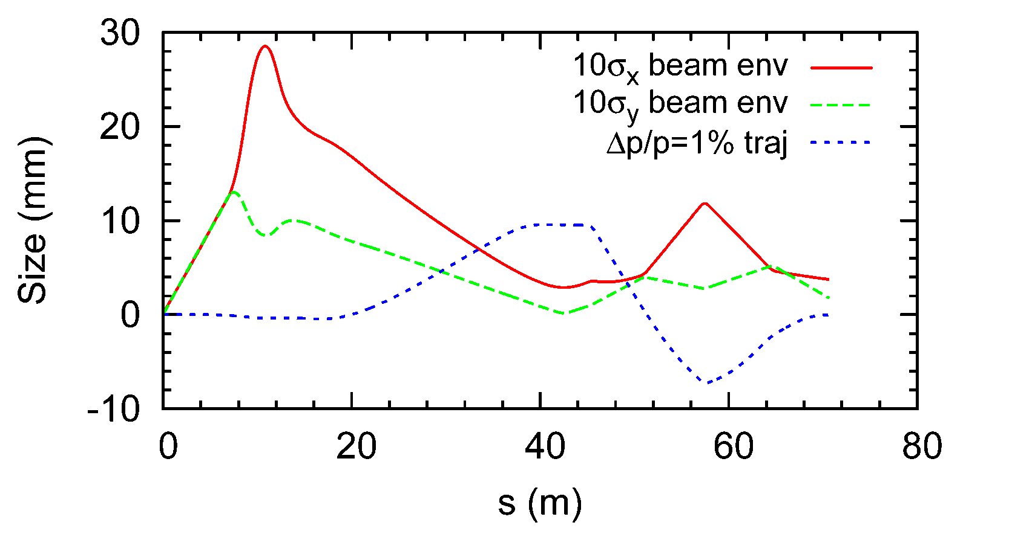
Ion Beam Envelope & 99%p Trajectory
Assuming beam momentum of 100 GeV/c, ultimate normalized x/y emittances $xN/yN$ of 0.35/0.07 μm, and ultimate momentum spread $p/p$ of 3×10⁻⁴
The horizontal size includes both betatron and dispersive components
Ignoring effect of the crab tilt

Slide 9
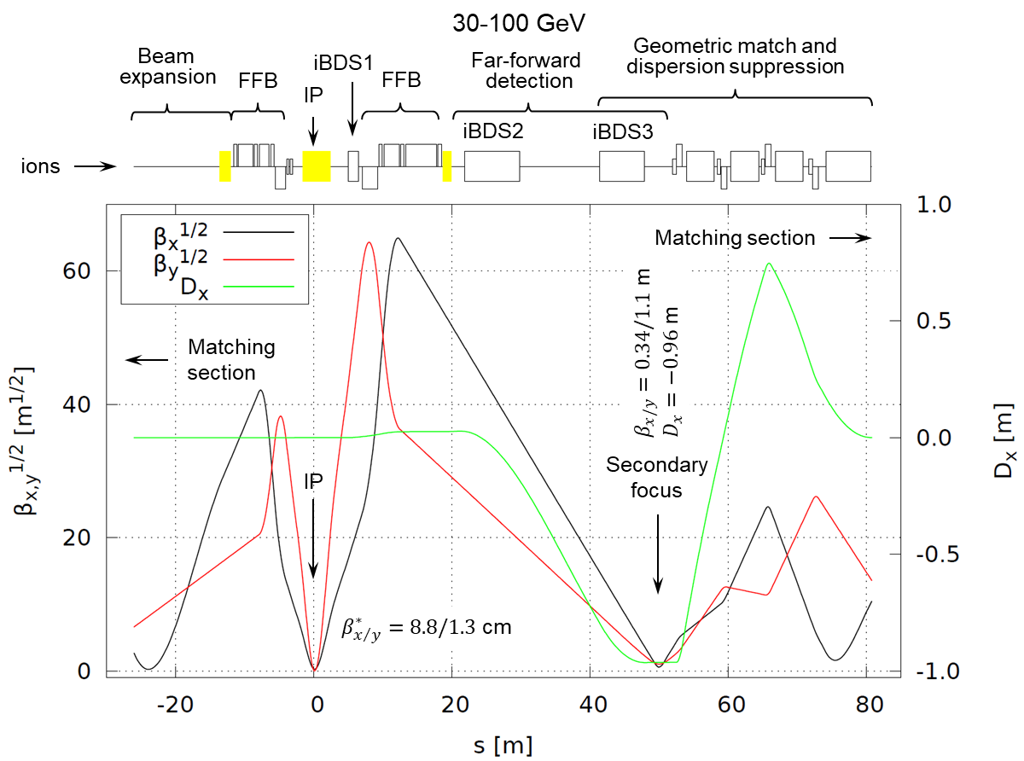
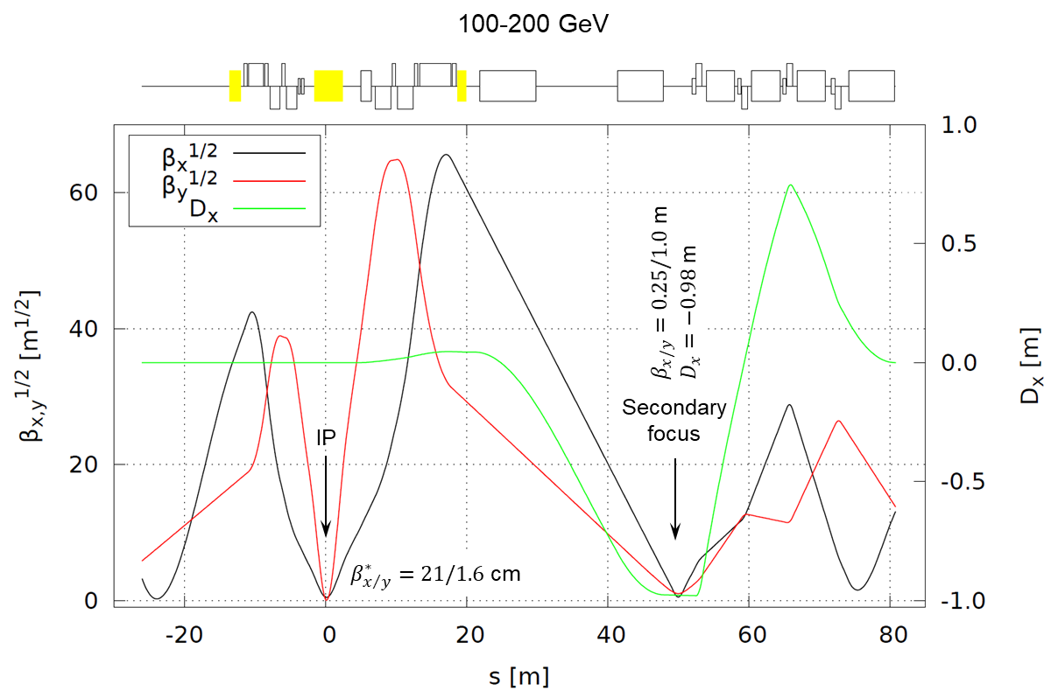
JLEIC Ion IR 100 GeV COM Design
±10 mrad angular aperture acceptance in the whole energy range up to 100 GeV COM with a secondary focus in combination with high dispersion point downstream of spectrometer dipole
Conventional Nb-Ti technology Final-Focusing Quadrupole technology
Same high luminosity and detection performance as the 65 GeV COM design
Shorter- and longer-focus configurations at lower and higher energies, respectively

Slide 10
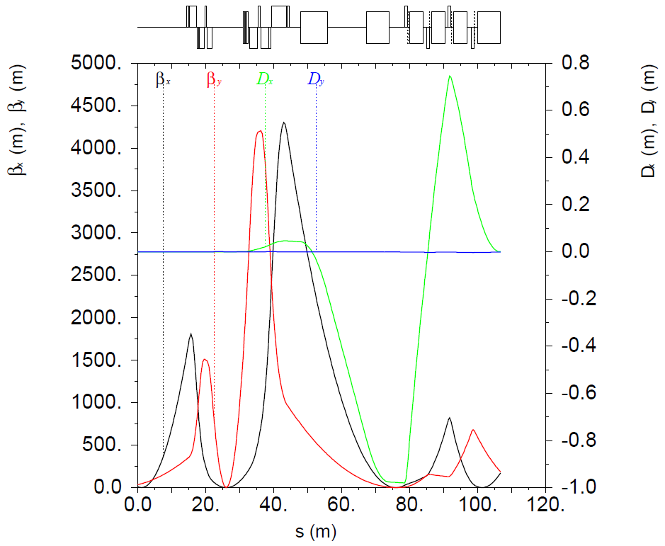
Ion IR Optics
Space reserved for multipole and orbit correctors
Correction of solenoid orbital effect consistent with full acceptance requirement
Multipole and orbit correction spools
x/y kickers
Multipole and orbit correction spools
x kickers
IP

Slide 11
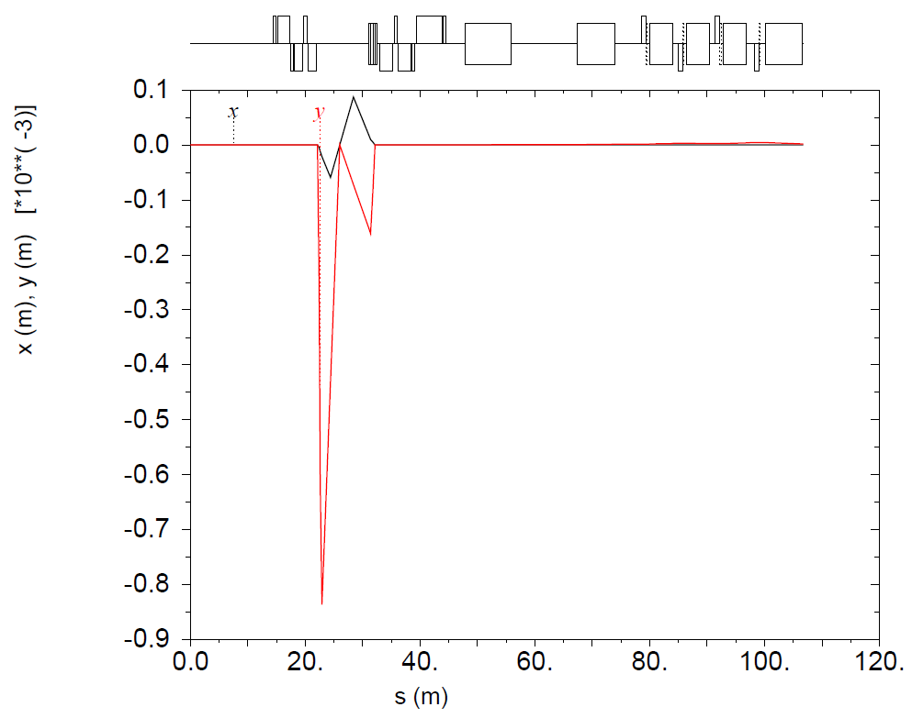
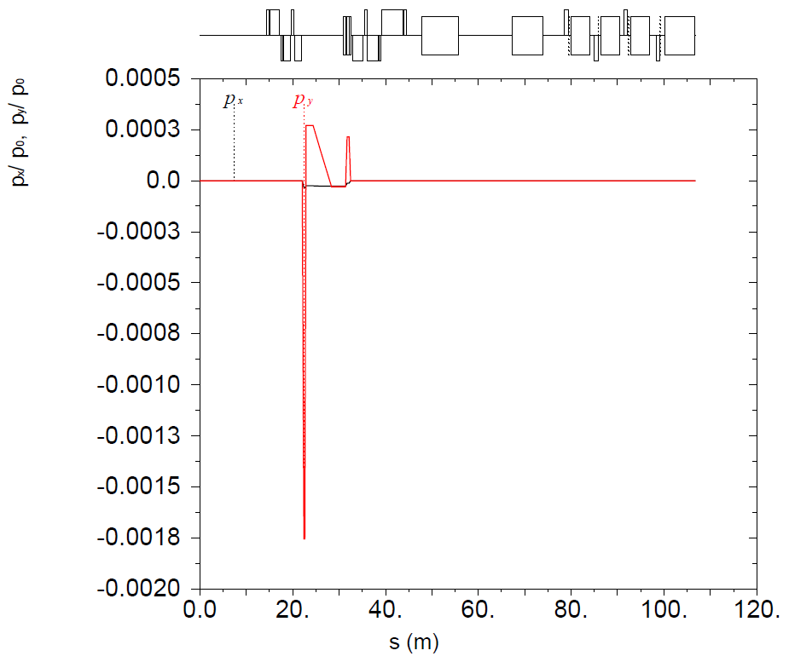
Orbit Correction
Orbit is centered inside the FFQs
The ion orbit has a vertical angle of 0.15 mrad to minimize the downstream corrector fields
IP
IP

Slide 12
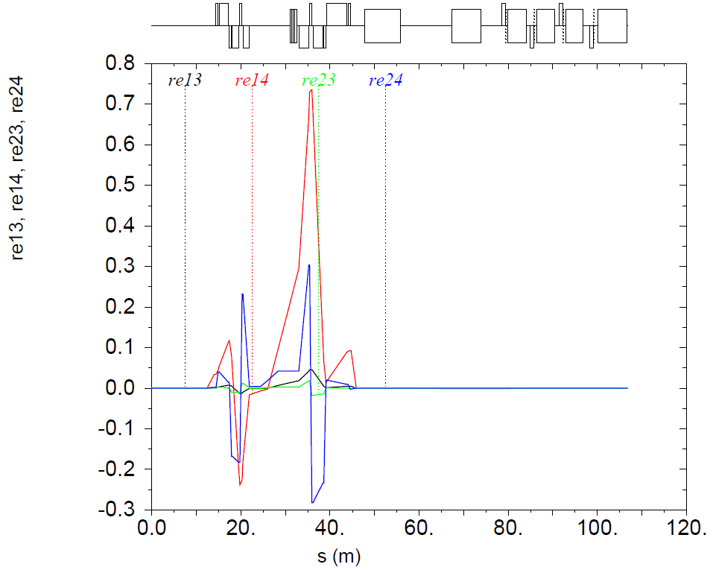
Coupling Compensation
Rotated frame technique: skew quads of the correction packages provide rotation effect
Interaction plane is rotated to account for the vertical angle of the ion orbit
Global coupling compensation
IP
Detector solenoid
Anti-solenoids

Slide 13
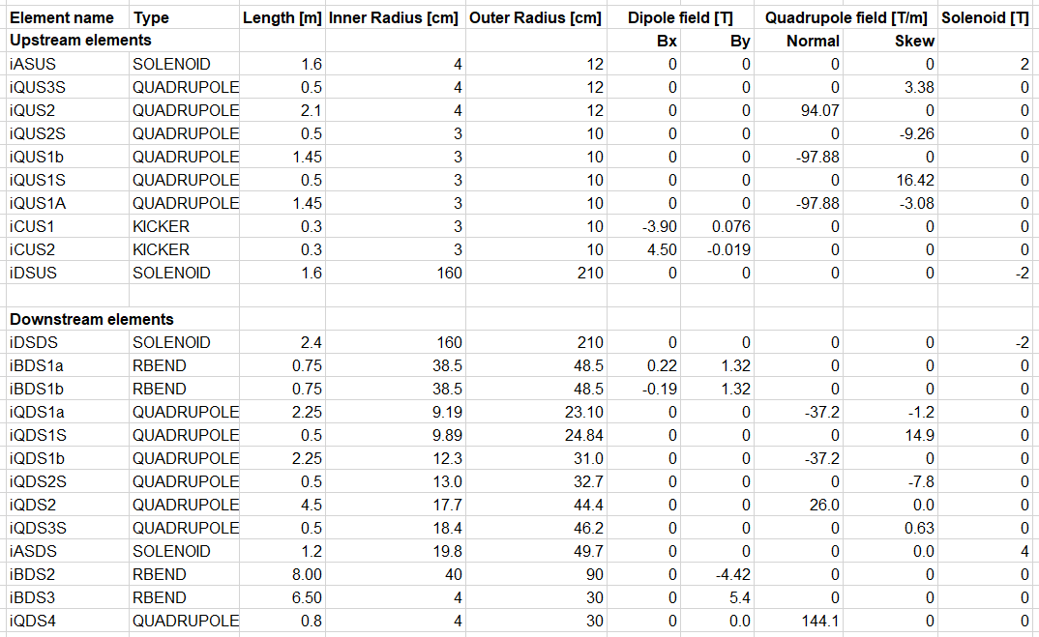
Ion IR Element Parameters

Slide 14
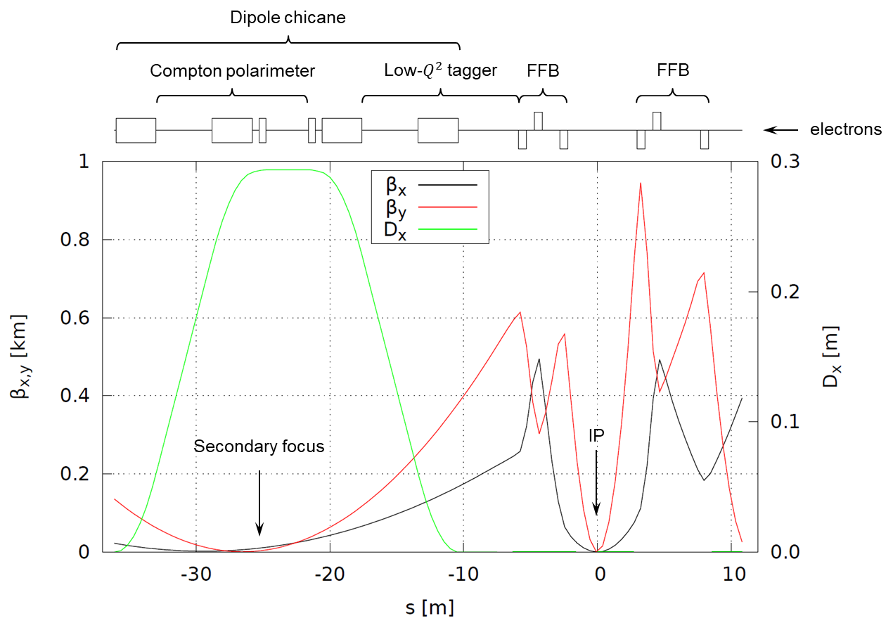
Electron Interaction Region
Downstream chicane for low-$Q^{2}$ tagging and polarimetry

Slide 15
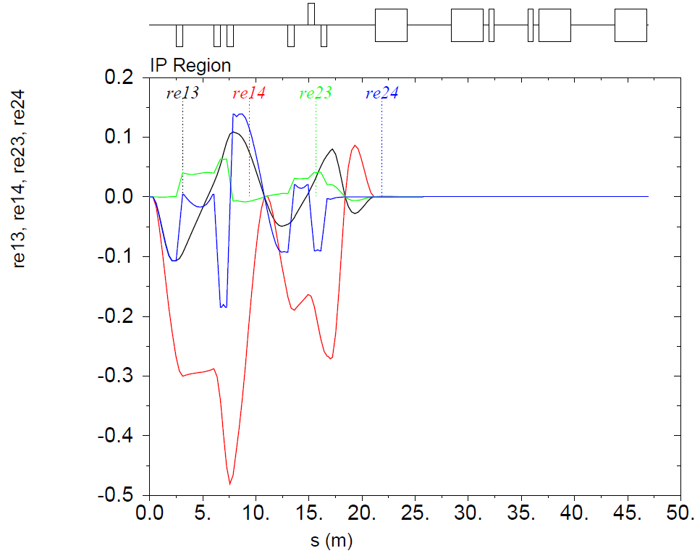
Electron Coupling Compensation
Rotated frame technique
Global decoupling and local decoupling at the IP to simplify matching crab planes
Nested skew quads providing rotation effect
Detector solenoid
Anti-solenoids

Slide 16
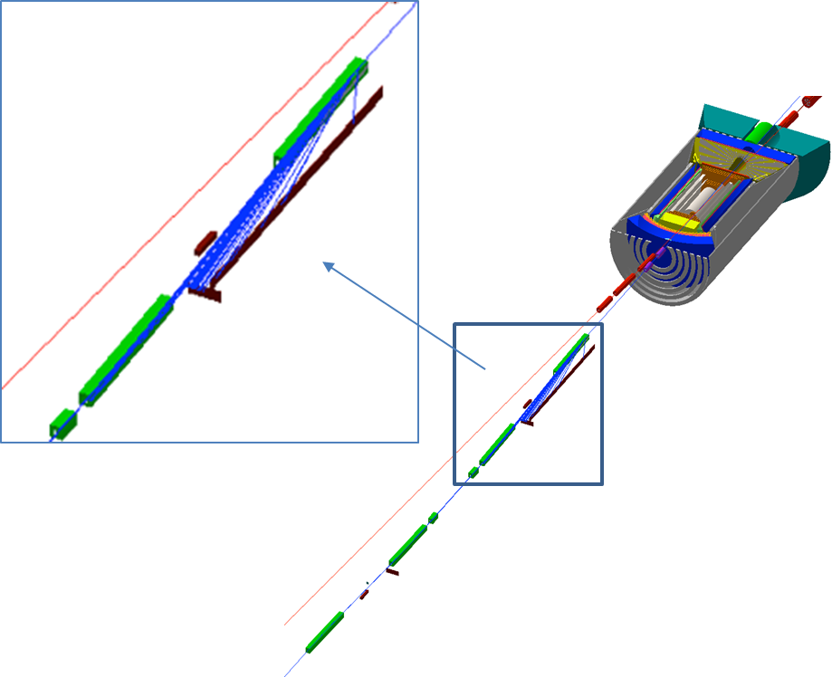
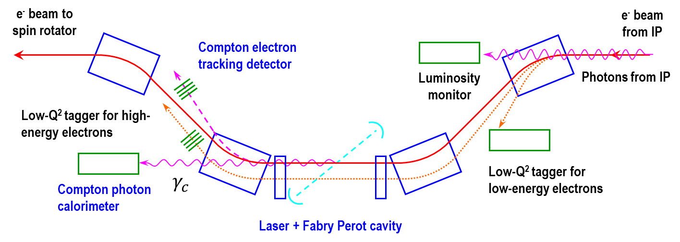
Low $Q^{2}$ Tagger in JLEIC
Dipole chicane for high-resolution detection of low-Q² electrons
Compton polarimetry has been integrated to the interaction region design
same polarization at laser as at IP due to zero net bend
non-invasive monitoring of electron polarization

Slide 17
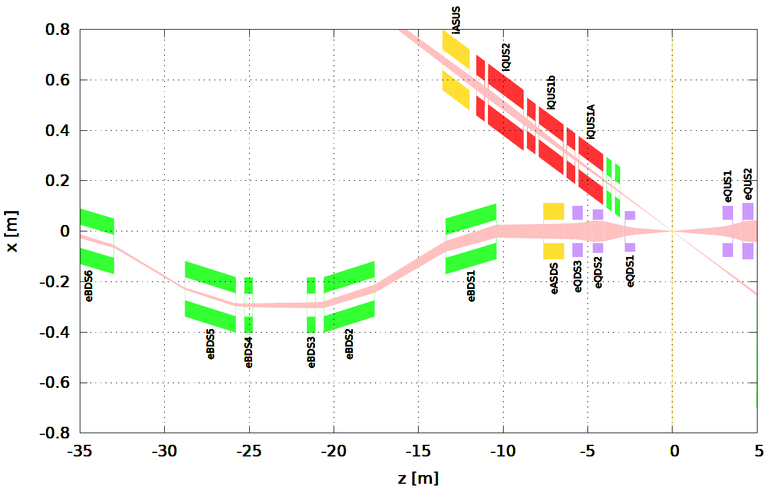
IR Layout
Compton polarimeter
+
Luminosity monitor
Need a hole in the dipole yoke for $0^{∘}$ photons

Slide 18
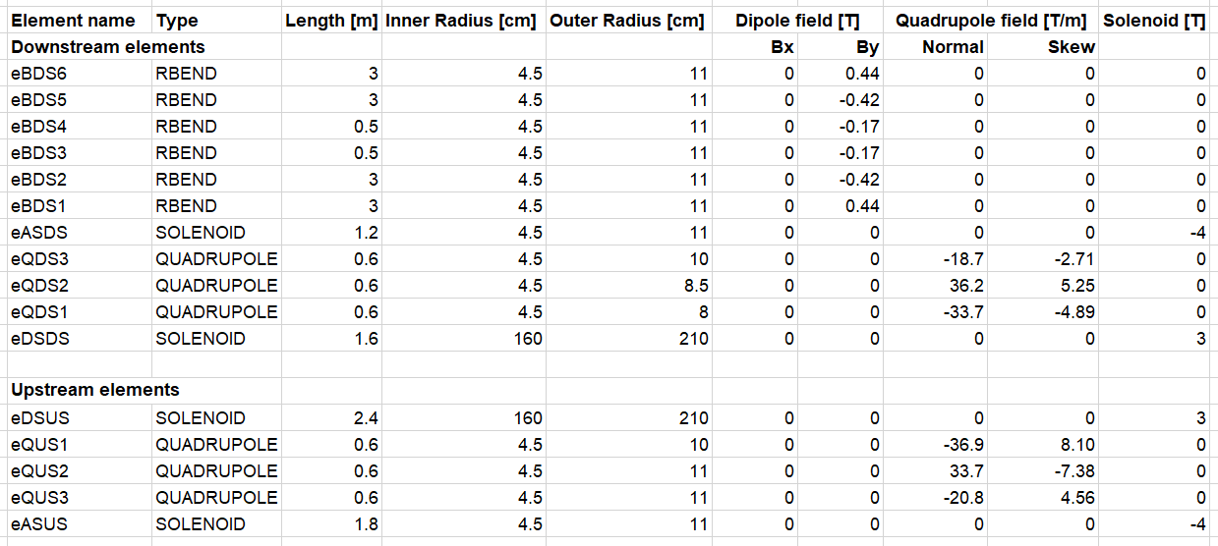
Electron IR Element Parameters

Slide 19
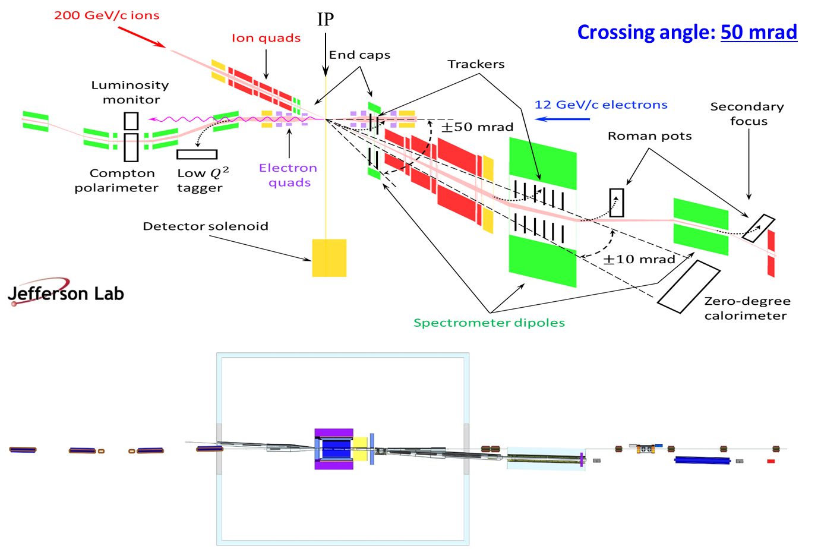
JLEIC Interaction Region Layout
Streamlined updates of GEMC and GEANT4 detector region models
Continued development of an engineering design of the detector region

Slide 20
Development of IR Magnet Specifications
IR magnet engineering design/analysis
Design of the multipole correction scheme in the IR region, relate LARP experience
Identify limits in magnet parameters which directly affect the IR performance
Relate existing magnet data to the EIC performance requirements including scaling to the IR design
Heat and radiation loads on IR magnets
Perform magnetic analysis and initial optimization, considering LARP design, BNL EIC IR quadrupole prototype, and others
Mechanical and magnetic design of an optimized IR quadrupole
Incorporate optimized IR quadrupole lessons/features and finalize IR layout

Slide 21
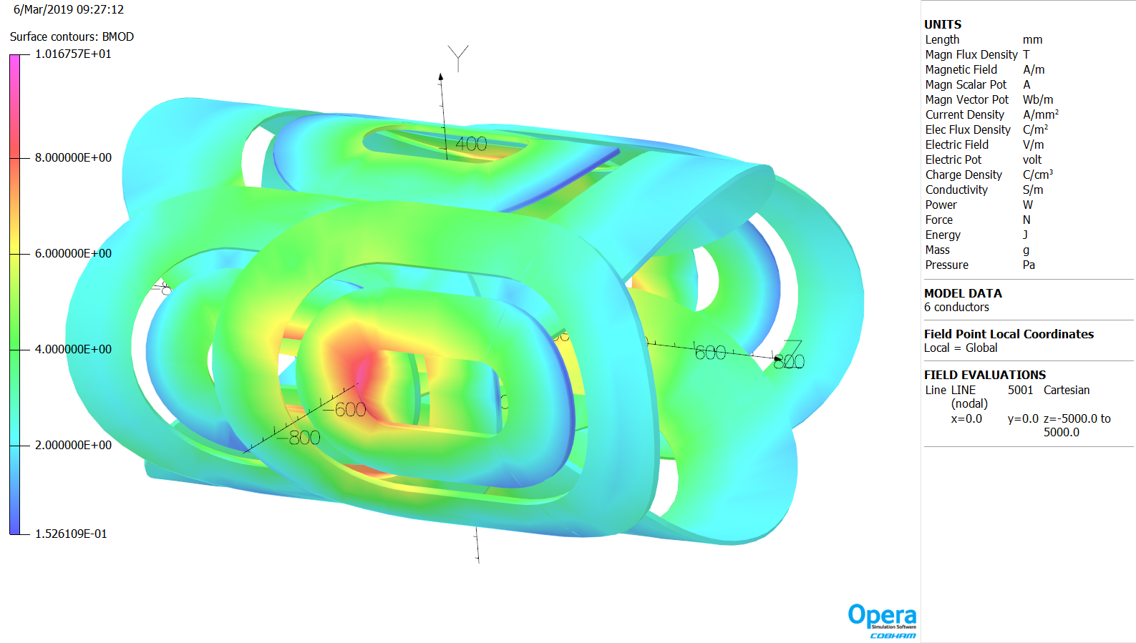
First Ion Spectrometer Dipole
By: 1.32 T x 1.5 m
Bx: 0.22 T x 0.75 m and –0.19 T x 0.75 m

Slide 22
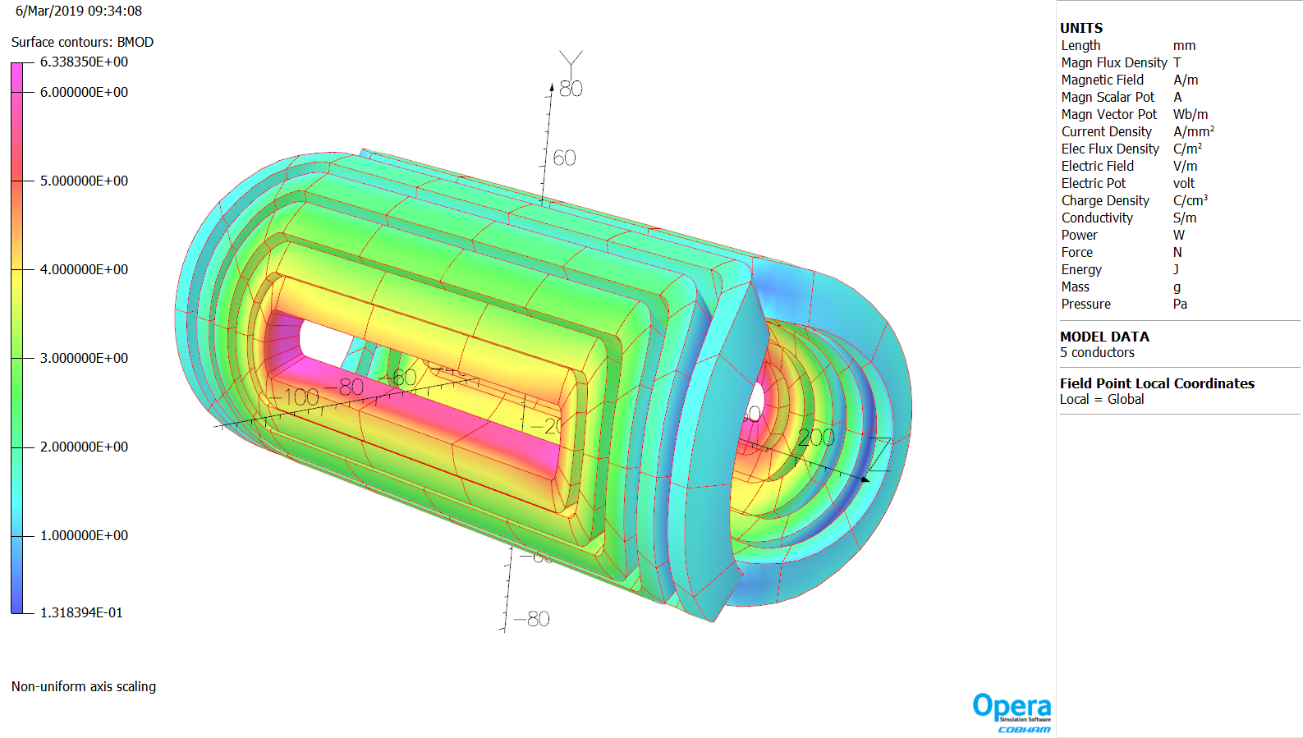
Upstream Ion Corrector
By: –0.019 T x 0.3 m
Bx: 4.5 T x 0.3 m

Slide 23
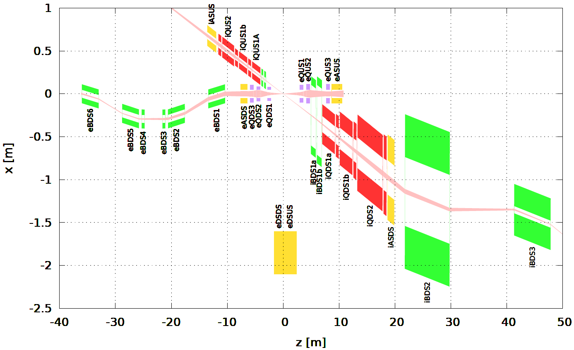
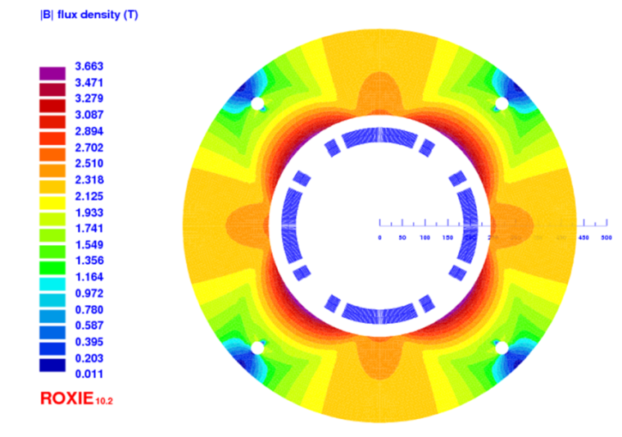
Downstream Hadron Quadrupoles
Parameter | Unit | iQDS1a | iQDS1b | iQDS2
L_{magnetic} | m | 2.25 | 2.25 | 4.5
R_{clearbore} | mm | 92 | 123 | 177
R_{outer} | mm | 231 | 310 | 444
R_{goodfield} | mm | 40 | 40 | 40
G_{normal} | T/m | -37.2 | -37.2 | 26.0
G_{skew} | T/m | -1.23 | 0.0 | 0.0
G x R_{inner} | T | 3.4 | 4.6 | 4.6
10 GeV/c electrons
200 GeV/c
protons
$±10$ mrad
Main design requirements and features:
Provide neutron cone acceptance of ± 10 mrad
Clear bore up to 177 mm, add ~8 mm for coil radius
Design is based on collared cos2θ NbTi coil: very large magnets but experience with CEBAF Hall C SHMS-Q2
50 mrad crossing angle allows more transverse space for shielding: no shift/tilt, separate electron magnets
iQDS2

Slide 24
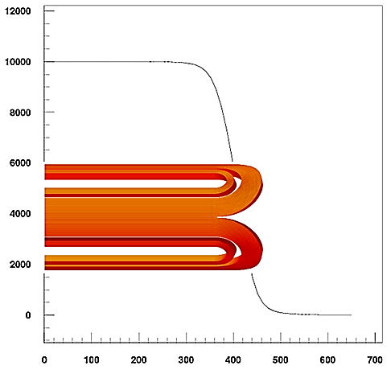
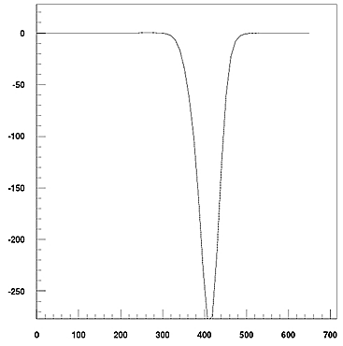
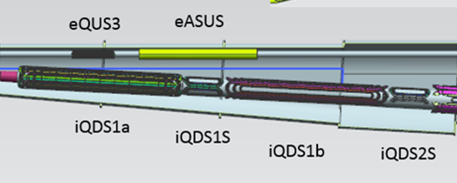
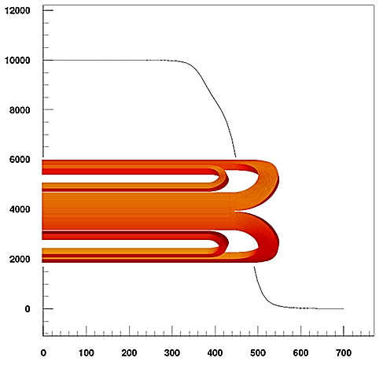
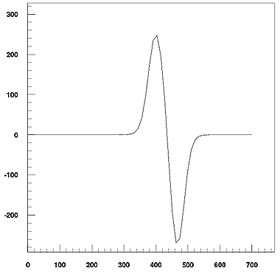
Magnet Length Optimization
Longitudinal space allocation is very tight:
Coil end geometry has to be optimized for winding the Rutherford cable
Spacers to control peak field and field quality make the coil end less compact
Include space for engineering features: leads, axial force support, cryostat
Estimate field quality and allocate space for correctors based on DA calculations
Option to increase operating gradient is limited by NbTi properties
Example: iQDS1a (JLEIC) end field quality
Baseline (compact) end
Integrated b₆:
-43.3 units
over 406.3 mm
With additional spacer
+17mm
Integrated b₆
is zero

Slide 25
Detector Beam Pipe
Detector beam pipe may serve a resonator excited by the beams. One must absorb the energy of excited resonances to prevent their build up.
One must minimize the impact of multiple scattering on particles existing the beam pipe.
Focusing by the electron quadrupoles causes synchrotron radiation, which may cause detector background and increase vacuum pressure in the beam pipe. The synchrotron radiation must be properly masked.
Ion beam
64.4 mm ID
Synchrotron mask
e beam
60 mm ID x2
200 mm
22.4 mm ID x2
1924 mm

Slide 26
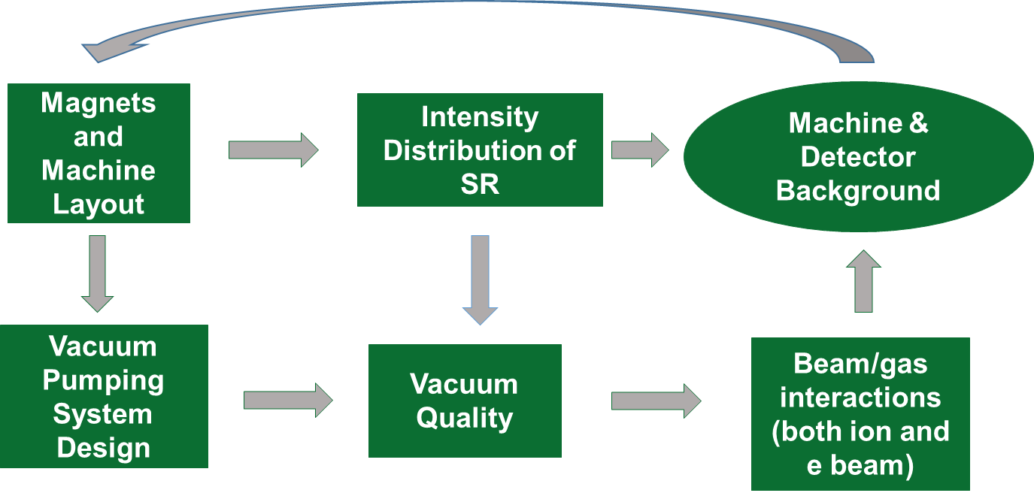
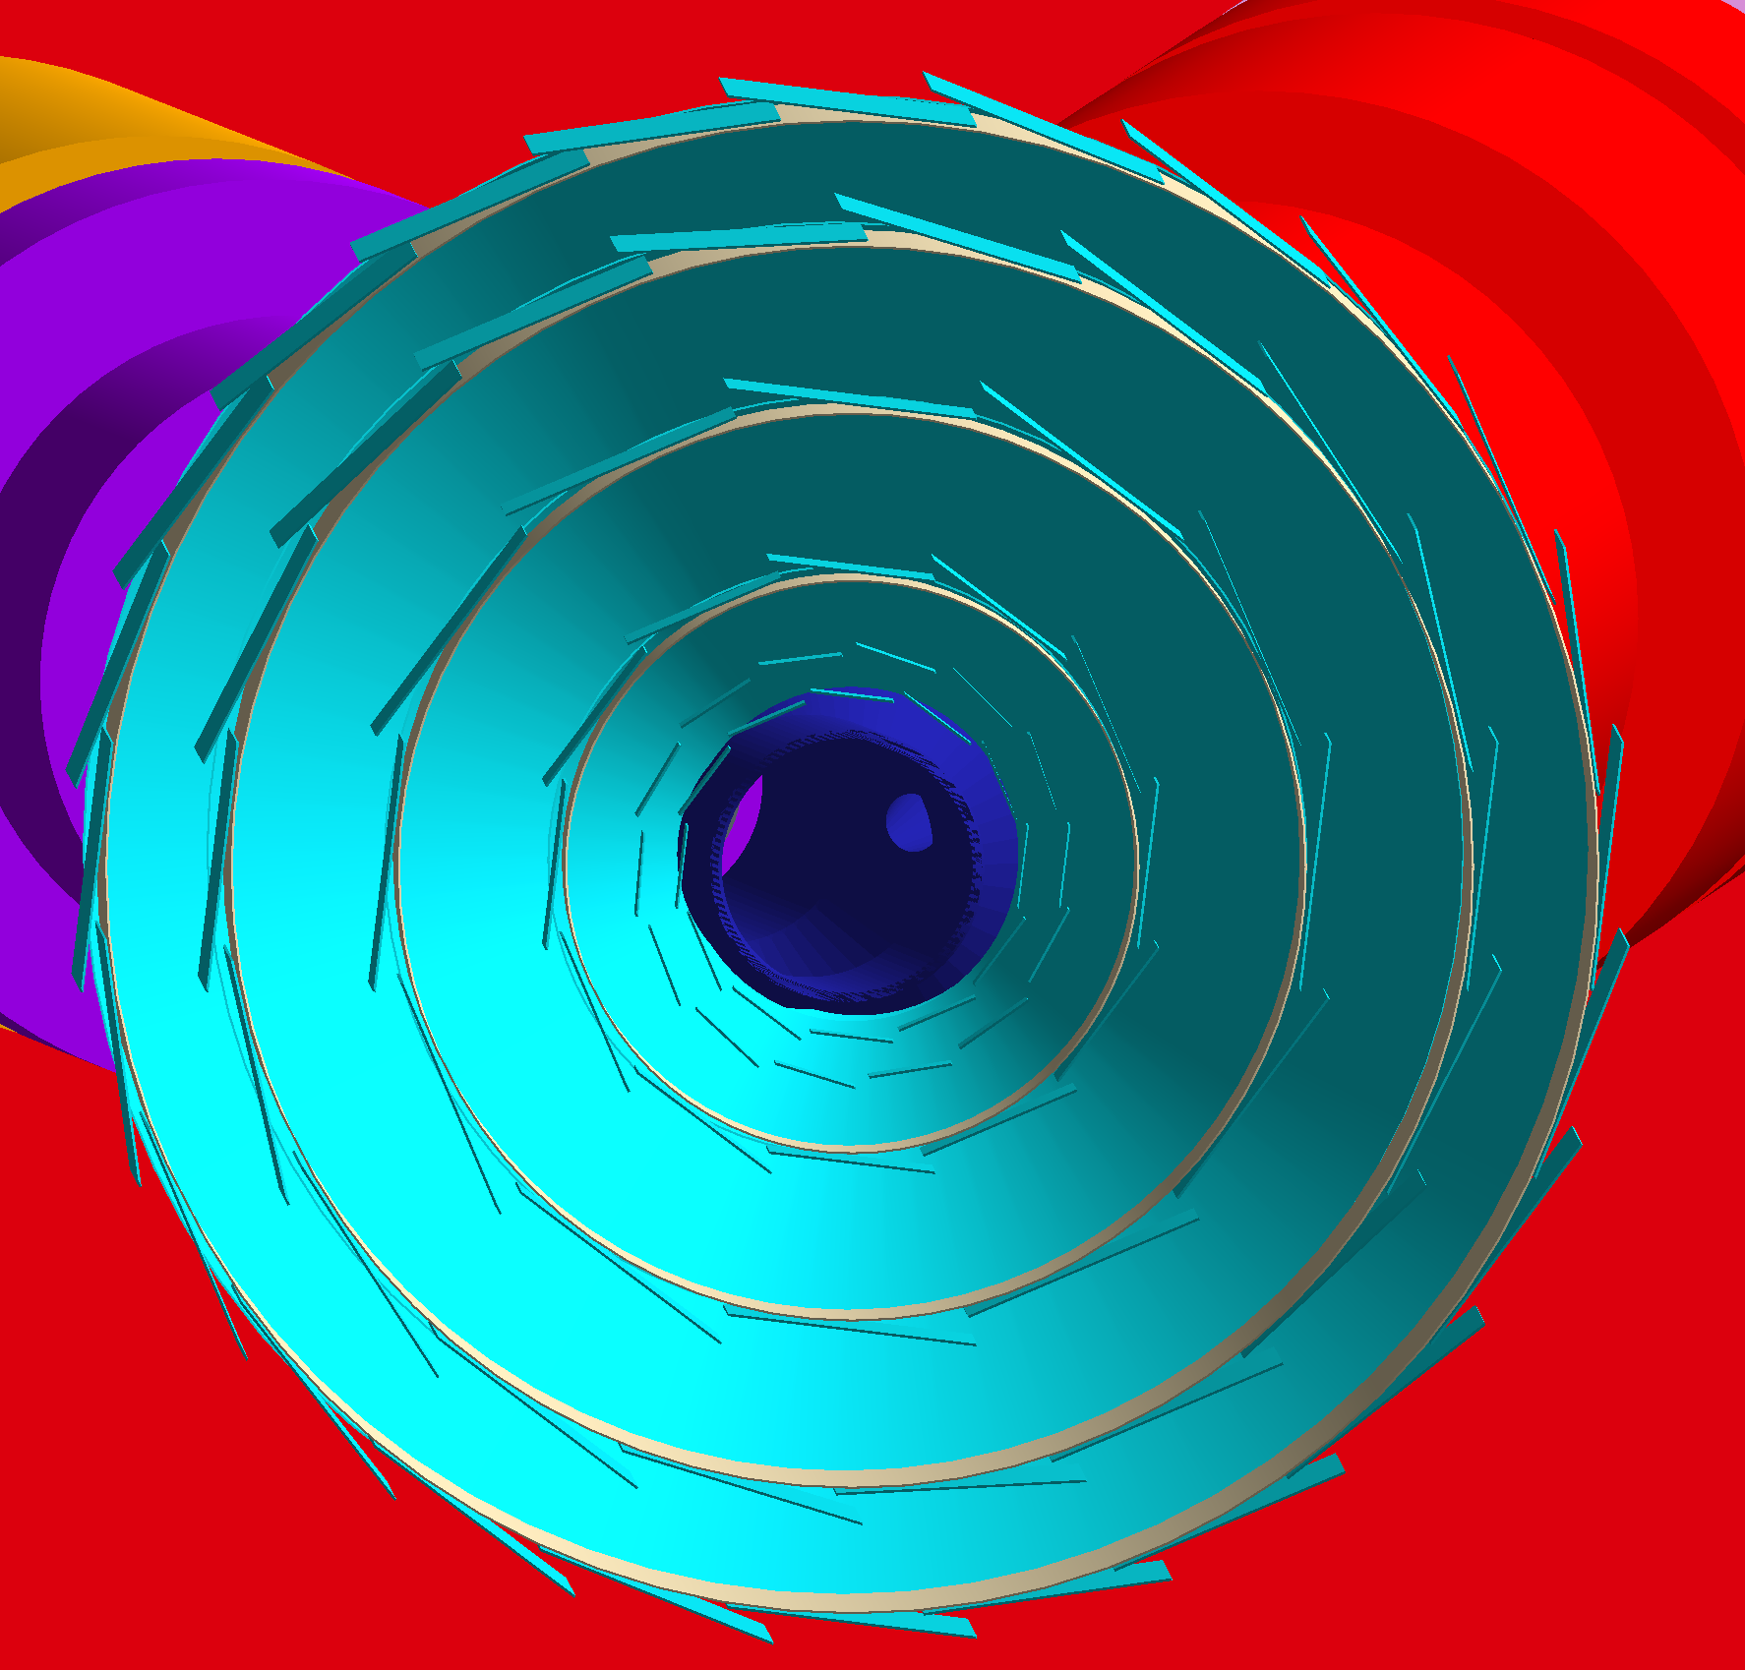
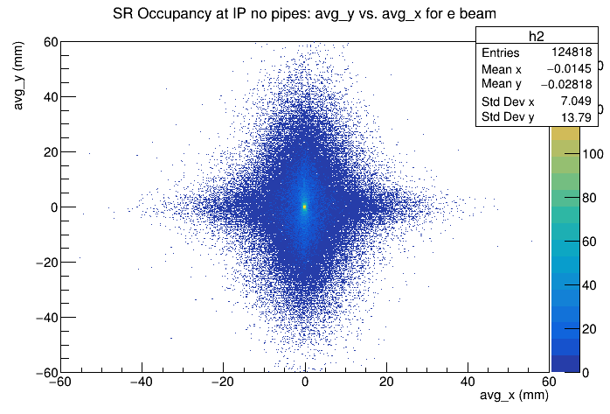
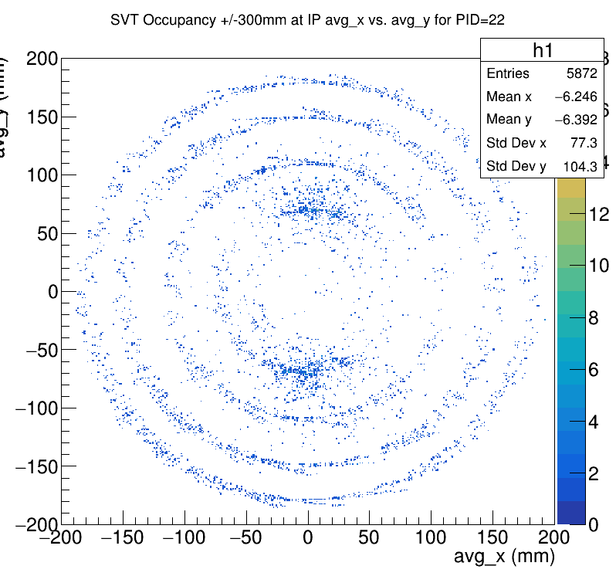
Background Studies
Project leads: Latifa Elouadrhiri and Charles Hyde

Slide 27
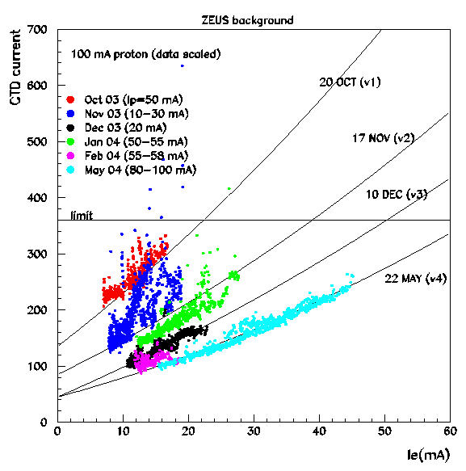
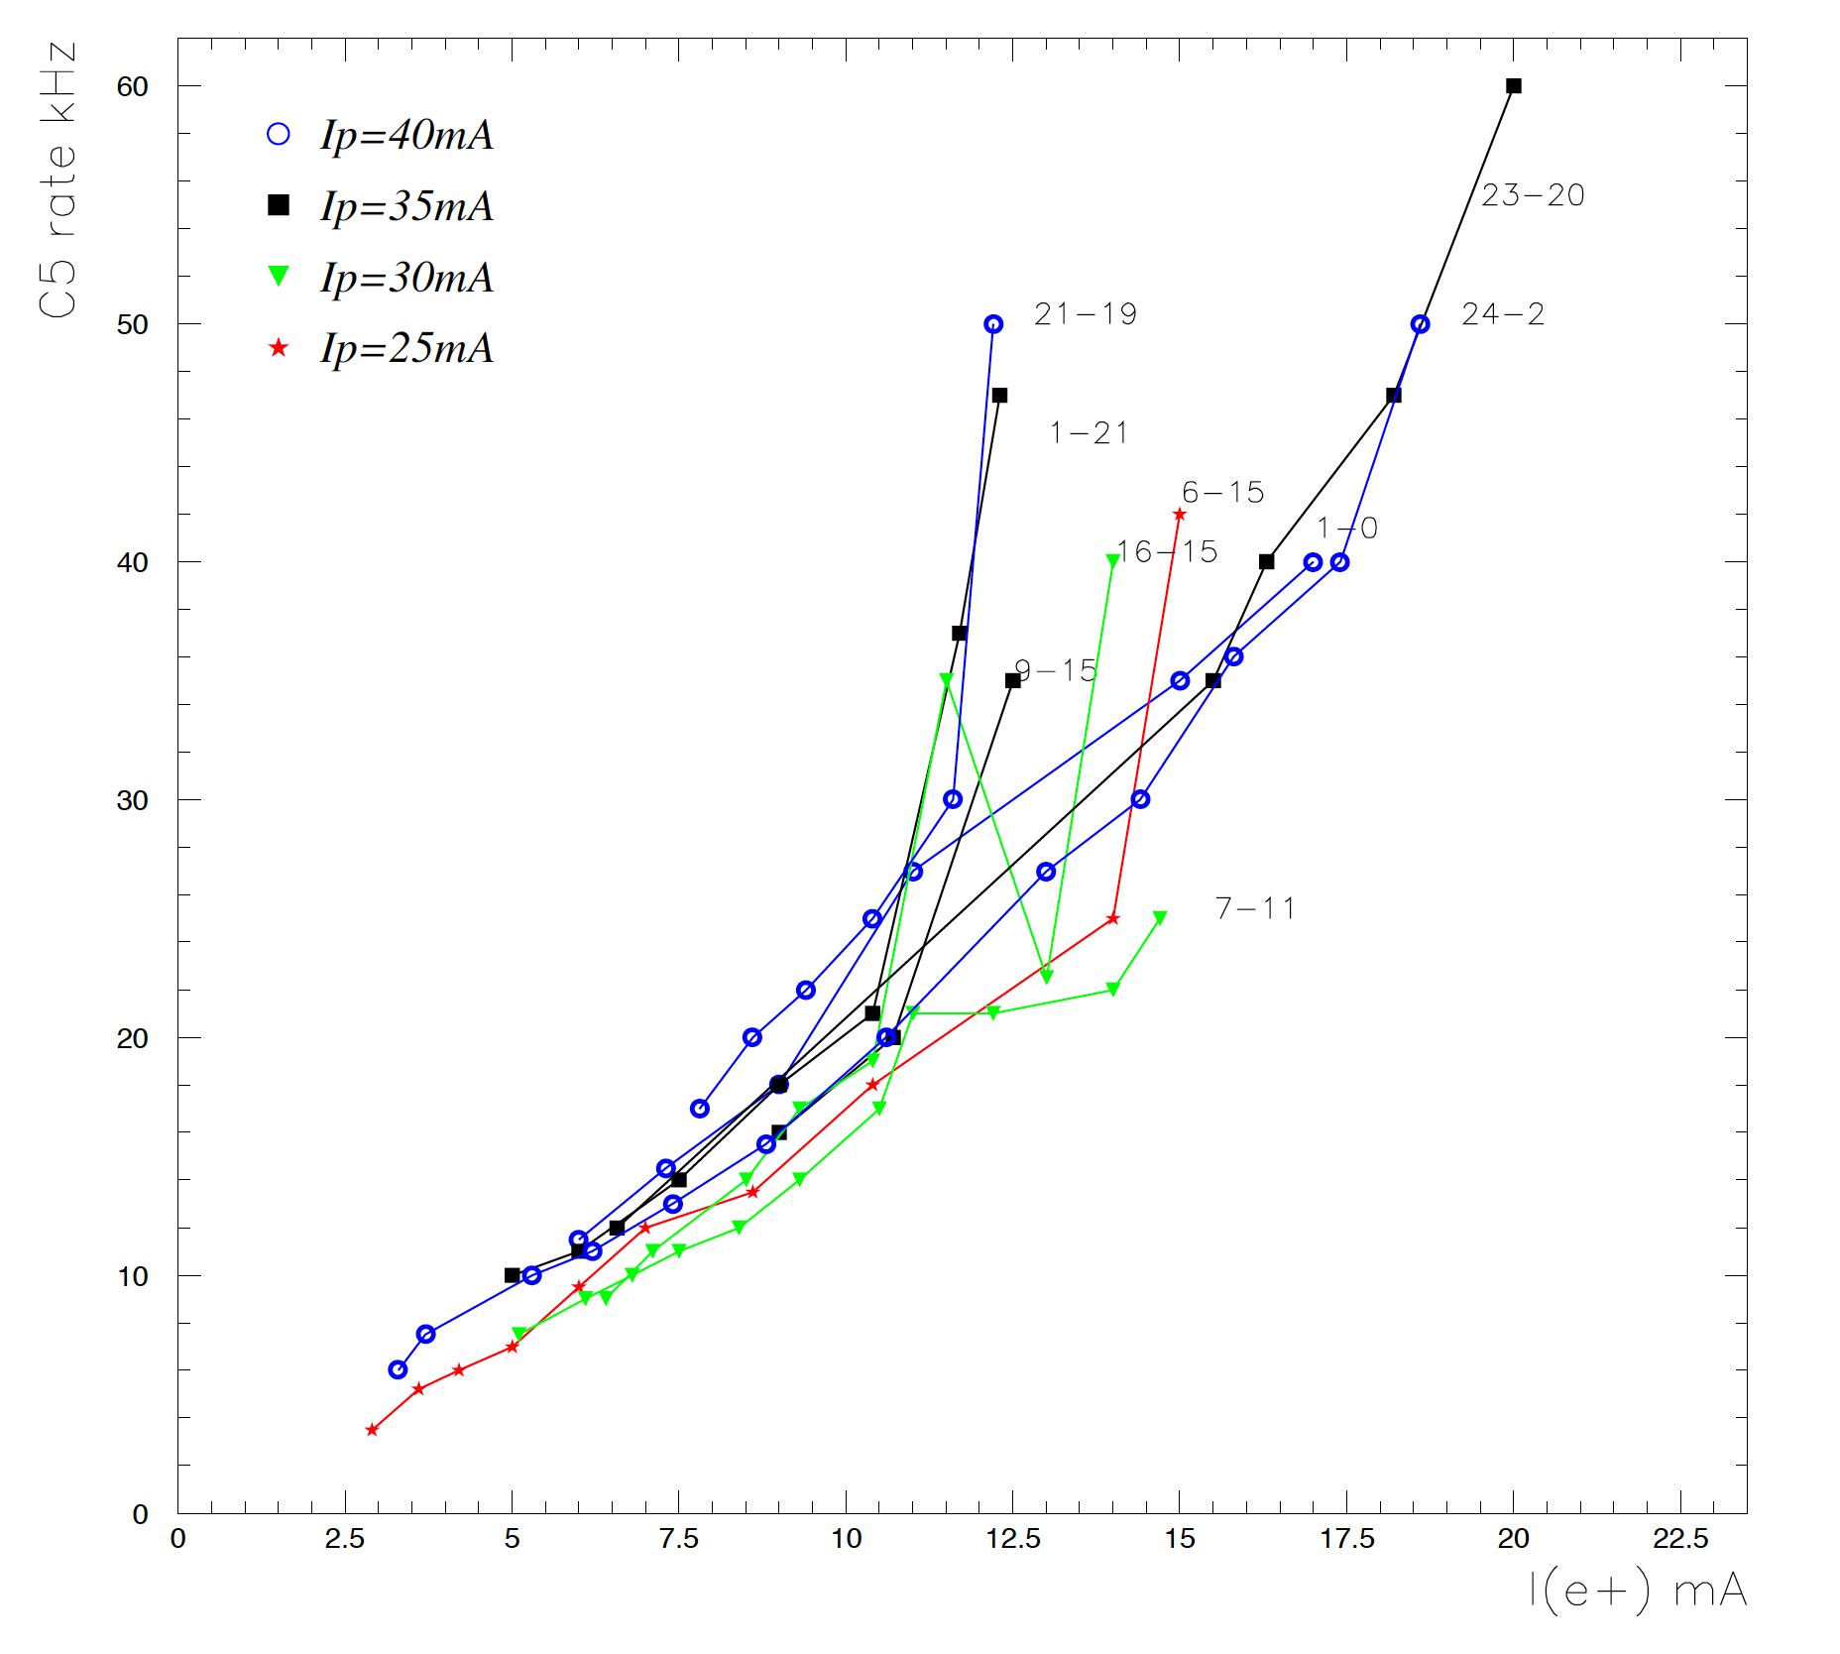
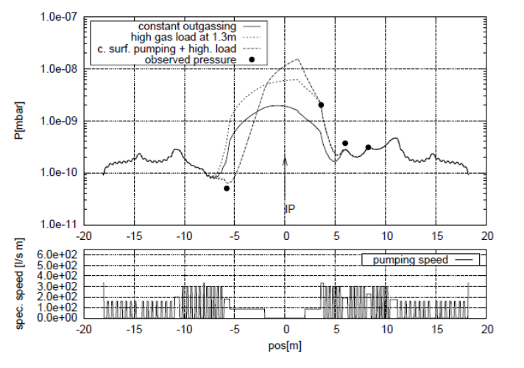
Detector Background
Performance of ZEUS at HERA was limited by background in the Central Tracking Detector (CTD)
No careful background simulations prior to running
Background was generated by ion beam scattering on residual gas generated by electron beam’s synchrotron radiation
Background was monitored using a small scintillator counter C5
Simulation tools and procedures validated using HERA data (L. Elouadrhiri et al.)
Be (65%), Al (35%)
10⁻¹⁰ mbar
10⁻⁸ mbar
10⁻¹⁰ mbar
Results of our simulations
C5 rate as a function of HERA e beam current for different p beam current

Slide 28
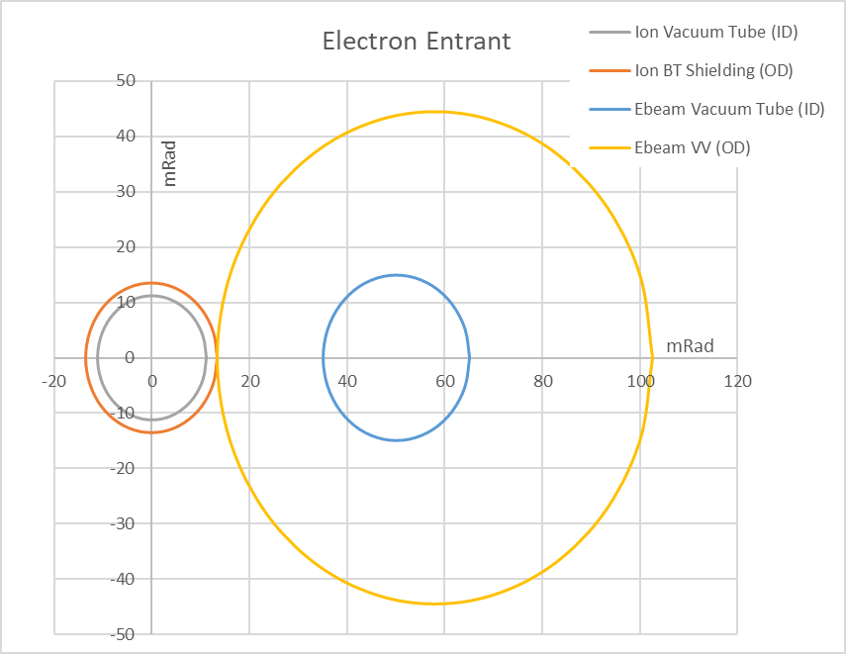
Shadow Diagram
Ion beam tube

Slide 29
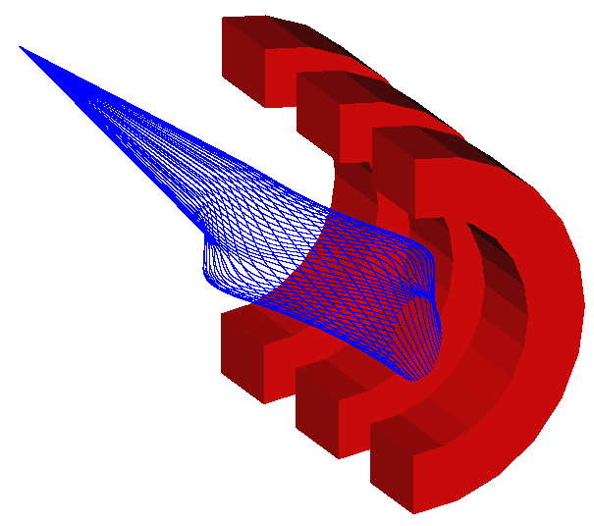
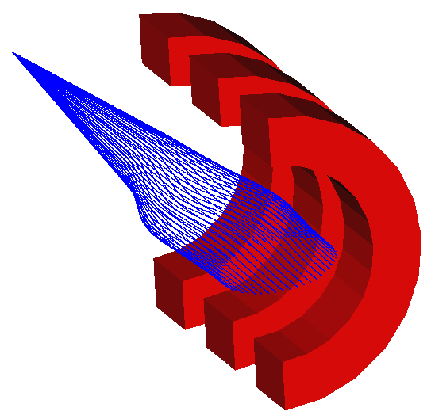
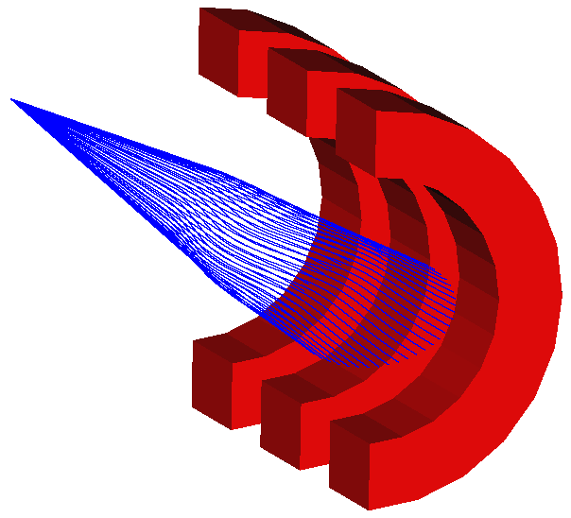
Far-Forward Acceptance for Charged Fragments
(protons rich fragments)
(neutron rich fragments)
Δp/p = -0.5
Δp/p = 0.0
Δp/p = 0.5
(spectator protons from deuterium)
(exclusive / diffractive recoil protons)
(tritons from N=Z nuclei)

Slide 30
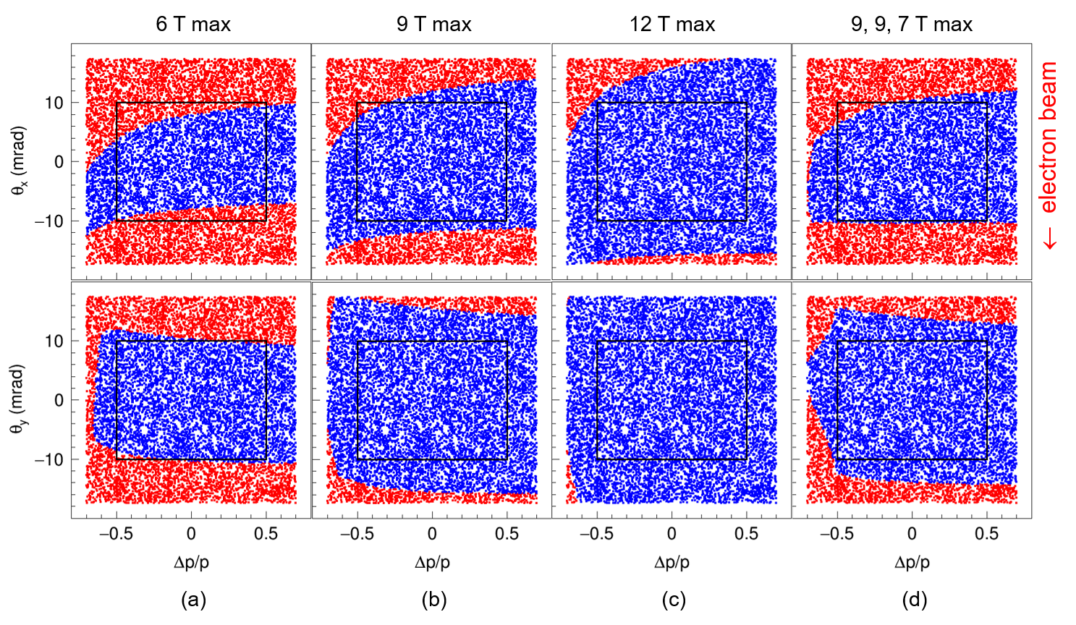
Far-Forward Angular & Momentum Acceptance
Transmission of particles with initial angular and Δp/p spread
Quad apertures = B max / (fixed field gradient @ 100 GeV/c)
Uniform particle distribution of ±0.7 in Δp/p and ±1° in horizontal angle originating at IP
Transmitted particles are indicated in blue (the box outlines acceptance of interest)

Slide 31
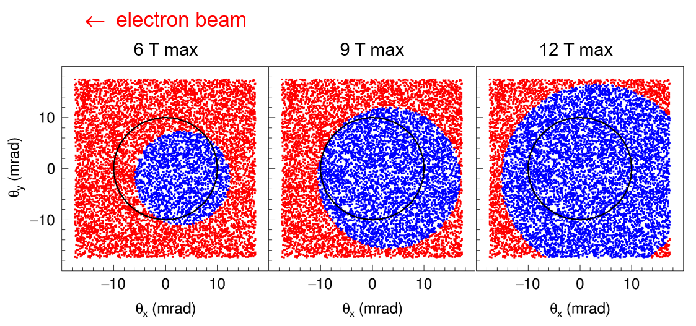
Far-Forward Acceptance to Neutrals
Transmission of neutrals with initial x and y angular spread
Quad apertures = B max / (fixed field gradient @ 100 GeV/c)
Uniform neutral particle distribution of ±1° in x and y angles around proton beam at IP
Transmitted particles are indicated in blue (the circle outlines ±0.5° cone)

Slide 32
Far-Forward Angular Acceptance
Quad apertures = 9, 9, 7 T / (∂By /∂x @ 100 GeV/c), dipole aperture = -30/+50 × ±40 cm
Uniform distribution of ±1° in x and y angles around proton beam at IP for a set of Δp/p
The circle indicates neutrals’ cone

Slide 33
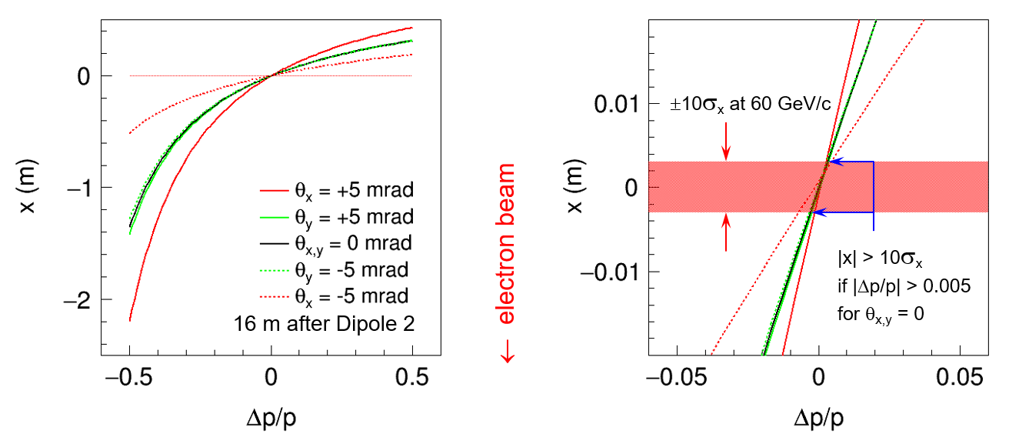
Momentum & Angular Resolution
Protons with Δp/p spread are launched at different angles to nominal trajectory
Resulting deflection is observed at the second focal point
Particles with large deflections can be detected closer to the dipole

Slide 34
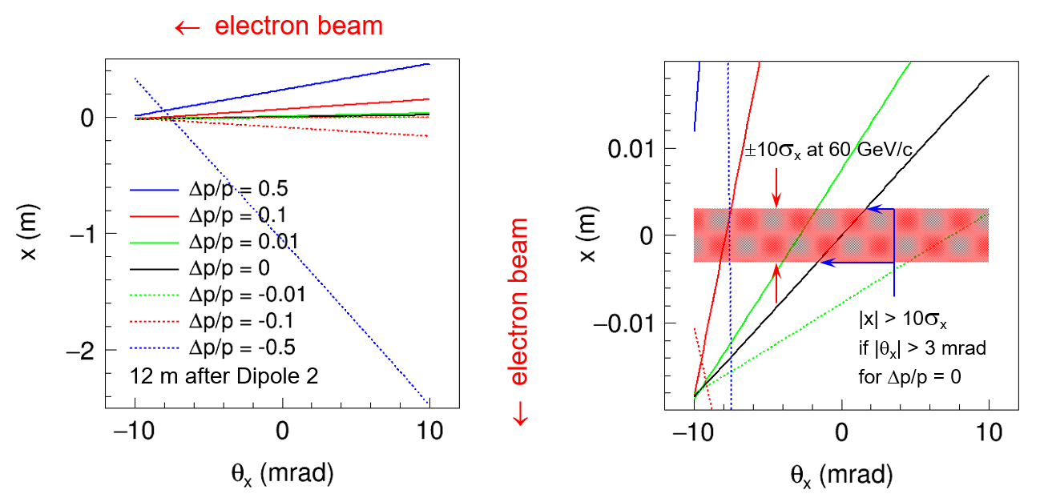
Momentum & Angular Resolution
Protons with different Δp/p launched with θ_{x} spread around nominal trajectory
Resulting deflection is observed 12 m downstream of the dipole
Particles with large deflections can be detected closer to the dipole

Slide 35
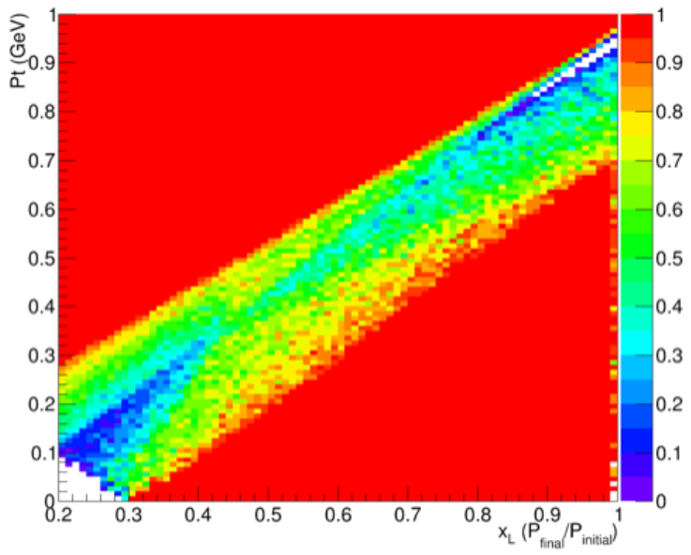
Acceptance for Protons from Diffractive Processes
Simulated acceptance for protons generated at the interaction point having energies of $x_{L}⋅100 GeV$and having $P_{t}$ up to $1 GeV$

Slide 36
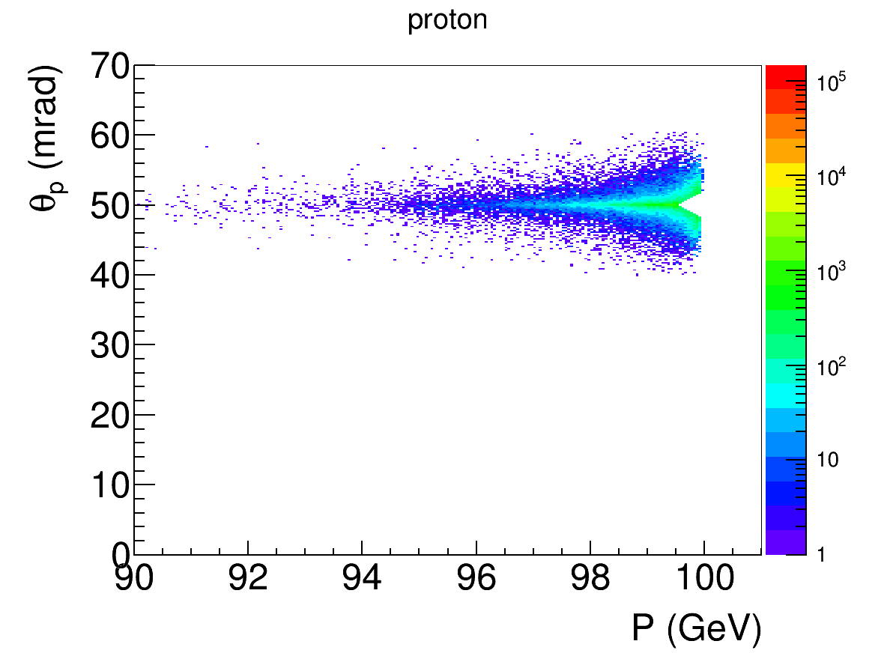
Example: DVCS Recoil Proton
Kinematics: 5 GeV e⁻ on 100 GeV p at a crossing angle of 50 mrad.
Cuts: Q² > 1 GeV², x < 0.1, E’_{e} > 1 GeV, recoil proton 10σ outside of beam
DVCS generator: MILOU (from HERA, courtesy of BNL)
GEANT4 simulation: tracking through all magnets done using the JLab GEMC package
low-t acceptance
high-t acceptance
p beam at 50 mrad
High-t acceptance limited by magnet apertures
10σ beam size cut:
p < 99.5% of beam for all angles
θ > 2 mrad for all momenta
-t = 1.9 GeV² ±14 mrad
Proton angle at IP
e⁻ beam at 0 mrad

Slide 37
Key EIC Measurements with Heavy Nuclei
Coherence and gluon saturation
At low $x$ and $Q^{2}$, the probe interacts coherently with all gluons in its path
The gluon density can be increased by going to lower x (higher cm energy), or increasing the nuclear thickness
Heavy nuclei + selection of large path lengths through geometry tagging
Extra boost from non-spherical nuclei?
Quark propagation and hadronization
Knowing the path length will greatly improve our understanding of what happens when a quark propagates through nuclear matter.
Energy loss, $p_{T}$ broadening, etc.
h
e'
γ*
p_{T}
q
e

Slide 38
Coherent diffraction can reveal the spatial gluon distribution
Coherent diffraction may be the only way to image the transverse gluon distribution in nuclei, but the incoherent background is large
Efficient veto is needed
Momentum transfer t is conjugate to transverse coordinate b T. Toll and T. Ullrich, Phys. Rev. C 87, 024913 (2013)
Notes:
Coherent distributions can be used to obtain info about gluon distribution in impact parameter space by taking fourier transform of cross-section

Slide 39
Coherent diffraction is also sensitive to gluon saturation
(Smaller) $J/ψ$ shows little sensitivity and can serve as a reference for (Larger) $φ$, which shows significant sensitivity to saturation (at moderate Q²) T. Toll and T. Ullrich, Phys. Rev. C 87, 024913 (2013)

Slide 40
Incoherent diffraction cross-section dominates
The challenge for coherent diffraction is to suppress the much larger incoherent background; requires a combination of detection methods
Signal-to-noise ratio of 2:1 at the 3rd dip requires a veto efficiency of 99.9% (M. Baker, 2017)

Slide 41
How Far in 𝒕 do we need to measure?
T. Ullrich and T. Toll
Fourier: large $t$ ⬄ small $b$
BAD
GOOD

Slide 42
Event generators
We also want to thank M. Ungaro for adding support for the event generator formats in the GEMC (Geant4) package

Slide 43
BeAGLE
Feynman diagram and structure of BeAGLE

Slide 44
Simulation process flow
Coherent events and their relative contribution from Sartre
Incoherent events from BeAGLE
GEMC for simulation of background suppression efficiency

Slide 45
Tracking generated events in detector
BeAGLE and Sartre event generators interfaced to a GEMC detector model
e+Pb²⁰⁸ collisions at 10 x 40 GeV/u
10 mrad acceptance through FFQs
20 mrad acceptance through first spectrometer dipole
Cyan: electrons
Blue: neutrons
Black: photons
Red: protons
Grey: residual ion

Slide 46
Vetoing incoherent diffractive events
Exclusive vector meson incoherent diffraction for 10 x 40 GeV e+Pb in BeAGLE
Sample includes any vector meson: $J/ψ$, $φ$, $ρ$, $ω$
$τ_{0}$ = 9 fm
$σ_{dipole}=\left\langle σ\left(J/ψ\right)\right\rangle =$ 5.7 mb
Significant fraction of the incoherent background events have no evaporation neutron: P(N_{n} = 0) = 11.3%
Rejection factor using a ZDC alone is two orders of magnitude too low

Slide 47
Vetoing inefficiency
Central veto: any of $γ$ ($E_{γ}>500$ MeV), $π^{+/−}$, $K^{+/−}$, $p/\overline{p}$, or $n/\overline{n}$ at $θ>100$ mrad
ZDC: any of $γ$ ($E_{γ}>40$ MeV), $π^{+/−}$, $K^{+/−}$, $p/\overline{p}$, or $n/\overline{n}$ through FFQs
Full veto: Central + ZDC + any of $π^{+/−}$, $K^{+/−}$, or $p/\overline{p}$ after the first dipole
Full + photons: Full + $γ$ ($E_{γ}>40$ MeV) through the first dipole
$τ_{0}=7$ fm
$τ_{0}=2$ fm

Slide 48
Applying the veto
$τ_{0}=7$ fm
$τ_{0}=2$ fm

Slide 49
Gluon spatial distribution
Full veto + photons reproduces model distribution fairly well
Detection of A-1 nuclei, photons can also improve the veto efficiency
Notes:
Magenta: reference input distribution; black: bSat model with including errors in t measurement; blue: full veto + photons with geometry tagging

Slide 50
Collision geometry can be reconstructed from final state
Geometry tagging is the use of information from the nuclear breakup to categorize the geometry of the collision
By detecting nuclear fragments and particles in the ion direction, we can:
Determine the impact parameter b and the effective nuclear thickness T(b) at lower x
Determine the path length d in the nucleus after the primary interaction
Tagging allows us to select events for which the average T(b) and d are very different from their averages over the entire nucleus
Intra-nuclear cascading increases with d (forward)
Evaporation of neutrons from excited nucleus (very forward)
Without tagging, average d in a nucleus scales as the radius (A^{1/3})

Slide 51
Tagging in b and T(b)
Geometry tagging using only evaporation neutrons: can select events with larger average nuclear thickness, at cost of lower statistics
Selecting 1.1% of events with largest average nuclear thickness (measured by evaporation neutrons only) equivalent to increasing the accelerator energy by a factor 3.2
e+Pb²⁰⁸ collisions at 10 x 40 GeV, Q² > 1 GeV², y < 0.95, x < 0.002
Notes:
Plot on left shows saturation scale Q^2 as a function of x for ep, eCa, eAu for min bias and central (eAu only). For fixed Q2, eAu collision has similar saturation reach as ep collision but with 300x larger energy. At fixed x, geometry tagging to isolate central events from min bias events enhances saturation reach -

Slide 52
What if we also detect the charged particles?
Detecting protons and light ions (d and ⁴He) in addition to neutrons increases the selectivity in b and the effective nuclear thickness T(b)
For a 1% yield cut, the increase in equivalent collision energy is about 40% (magenta curve on right) compared with using evaporation neutrons only
n, p, d, $α$ multiplicities

Slide 53
What if we identify the residual ion?
Kinematic reach can be extended by detecting the residual ion together with charged particles
Best result: measurement of Z in addition to A/Z (inferring A) – this would require a PID system for the ion (e.g. additional dE/dx if the dE/dx from the tracker is insufficient)
Compared to no geometry tagging, the total energy increase factor is 4.8
A, Z and d and $α$ multiplicities

Slide 54
Detection requirements
Best results obtained by detecting the residual ion (tracking + dE/dx) and light ions (easy for all except Z = N nuclei)
A neutron ZDC can provide additional information or a useful measurement on its own
Also beneficial to detect protons – requires larger magnet apertures but is also needed for spectator tagging with light nuclei
A, Z and d and $α$ multiplicities

Slide 55
Further increasing the effective thickness: ${}_{ }^{208}{Pb}$ vs ${}_{ }^{238}U$
Further energy boost is possible with using Uranium ions
Additional 1.4x factor gives total effective energy increase of 6.7
$e$ on $U$ is easier than $U$ on $U$ since only one axis needs to be aligned
M. Baker, 2017
8% in the tail
JLEIC

Slide 56
Tagging in $d$
$e$+$Pb$²⁰⁸ collisions at 10 x 40 GeV
 | IP | 2nd dipole
Evaporation Neutrons | 330216 | 330216 | 100.0%
Cascading Neutrons | 66968 | 39438 | 58.9%
Hard collision Neutrons | 40314 | 8199 | 20.3%
Total | 437498 | 377853 | 86.4%

Slide 57
Tagging in $d$ at higher $x$
For quark propagation and hadronization studies, it is more important to know d than to maximize it
Plots below illustrate $d$ sensitivity with yield. Binning for different values of average $d$ is straightforward.
Same detection criteria apply.
A, Z and d and $α$ multiplicities

Slide 58
Software chain
MC generators
Fast
detector
simulation
Full
detector
simulation
Reconstruction and analysis

Slide 59
Software chain
Database with various MC samples
Generators Database
Generators
Pythia
Beagle
Herwig
…
Fast simulation
Full simulation
g4e = Geant 4 EIC
C++ genue GEANT4 with JLEIC detector in it
BNL & Jlab effort on
Fast detector prototyping
Eic smear
Geant4 Fast mode
g4e JLEIC in Geant4
Reconstruction & analysis
ejana = EIC Jana
Community reference reconstruction
ejana – EIC JANA(2)

Slide 60
Software for detector simulation and reconstruction
Plain Geant 4 C++ for √s 100 GeV design (Driven by the community request)
GEMC Geant 4 based simulation
For those who prefer scripting over compilation
Geant 4 python can be used

Slide 61
Geant 4 EIC
The codename g4e – stands for Geant 4 EIC
Beta stage
√s 100 GeV design is implemented
Imports CAD, accelerator group data
Exports final Geometry in various formats
Plain flattened analysis ready ROOT files
For those who prefer scripting over compilation
Geant 4 python can be used

Slide 62
Entry Point for EIC = EPIC
Workflow oriented interactive environment based on Jupyter
Contact:
Dmitry Romanov
romanov@jlab.org

