Slide 1


EIC Detector Design
Alexander Kiselev
CFNS Summer School
Stony Brook University August,1-9 2019

Slide 2
Outline
Introduction
EIC detector concepts
Tracking
Calorimetry
Particle identification
Summary
Wednesday
Thursday
*Input from E.Aschenauer, M.Chiu, R.Erbacher, Y.Furletova, K.Gnanvo, T.Horn,
U.Langenegger, V.Manzari, P.Nadel-Turonski, B.Page, D.Pitzl, J.Repond, L.Ruan,
F.Sefkow, M.Stanitzki, B.Surrow, M.Vandenbroucke, H.Wennloef, P.Wintz, C.Woody,
R.Yoshida and other colleagues used in this lecture

Slide 3
Introduction

Slide 4
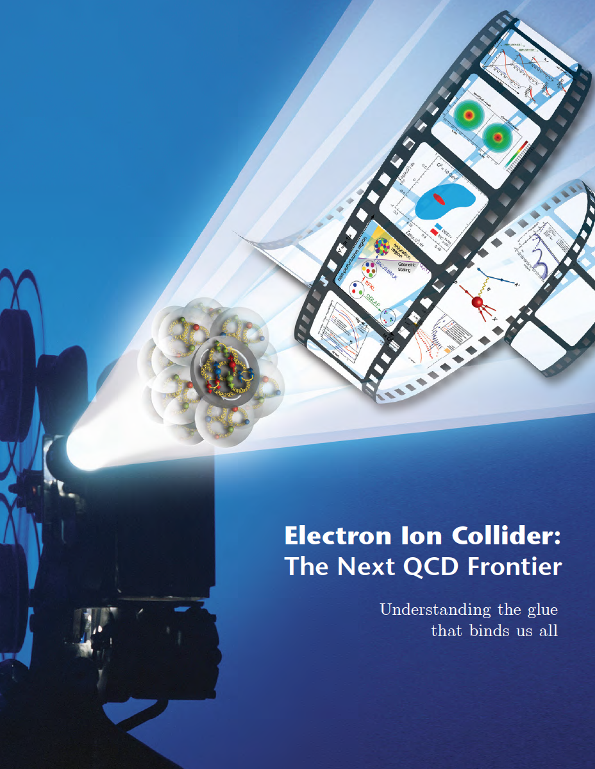
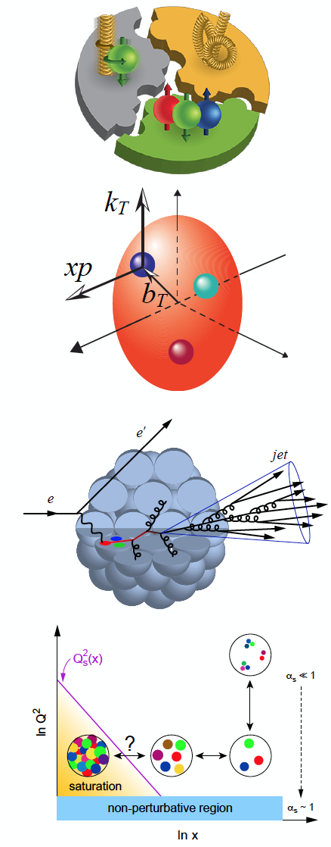
EIC Physics
Precision study of quark and gluon dynamics inside nucleon and nuclei
Key questions:
How are the sea quarks and gluons, and their spins, distributed in space and momentum inside the nucleon?
How does the nuclear environment affect the distribution of quarks and gluons and their interactions in nuclei?
Where does the saturation of gluon densities set in? Does this saturation produce matter with universal properties?
A.Acardi et al, EPJ A 52 9 (2016)

Slide 5


Typical EIC experimental measurements
(A) Inclusive Reactions in ep/eA:
Structure Functions: g₁, F₂, F_{L}
(B) Semi-inclusive Reactions in ep/eA:
TMDs, Helicity PDFs, FFs (with flavor separation); di-hadron correlations; Kaon asymmetries, cross sections
e’
(C) Exclusive Reactions in ep/eA:
DVCS, exclusive VM production (GPDs; parton imaging)
γ, π,J/Ψ
e
γ_{L}*
(Q²)
x+ξ
x-ξ
~
~
H, H, E, E (x,ξ,t)
p
p’
t

Slide 6
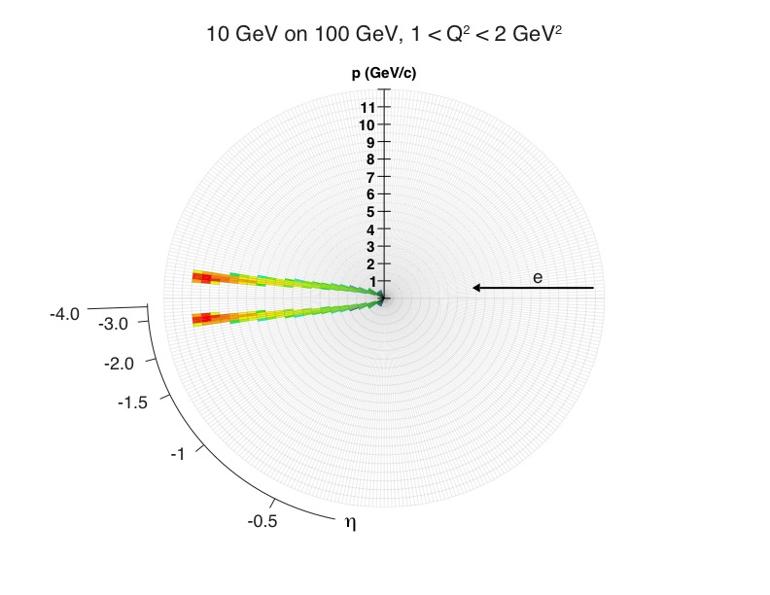
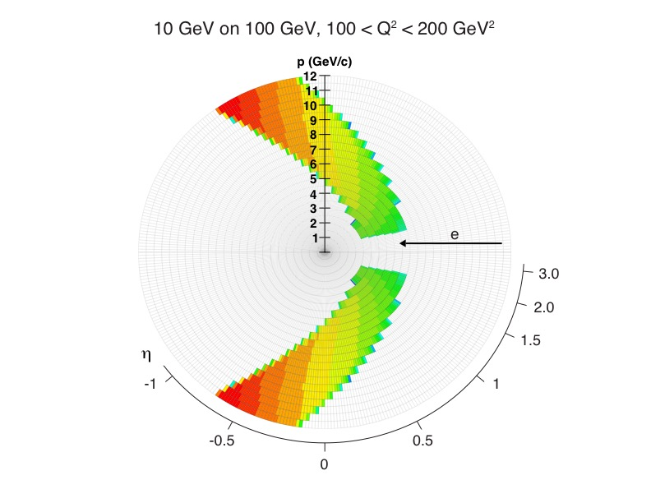
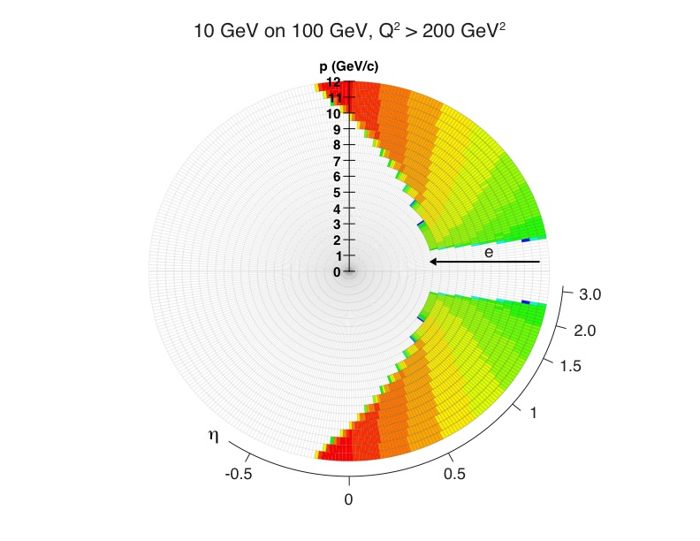
Example (A): scattered e⁻ acceptance
η=4 ~ 2⁰
η=0 ~ 90⁰
Typically use pseudo-rapidity η = -ln(tan(θ/2)) rather than θ
Scattered electron {η,p} for various Q² ranges at the same set of beam energies
In principle need to cover at least -4 < η < 2 range with appropriate tracking and e/m calorimetry

Slide 7
Example (B): kinematics of SIDIS pions
Cuts: Q²>1 GeV², 0.01<y<0.95, p>1GeV
(no difference between π±, K±, p±)
-> -3.5 < η < 3.5 covers entire kinematic region in hadron p_{t} (transverse momentum) and z (virtual photon energy fraction), which are important for physics

Slide 8
Example (C): DVCS photons & protons
DVCS photon {η,E} for 10 GeV electrons and various proton beam energies
e’
e
γ
γ_{L}*
(Q²)
x+ξ
x-ξ
~
~
H, H, E, E (x,ξ,t)
p
p’
t
Need e/m calorimetry coverage in -4 < η < 2 range
DVCS proton P_{t} (by far forward spectrometers B0/RP ); range up to ~1.3 GeV/c required by physics
275 x 18 GeV
100 x 10 GeV
41 x 5 GeV
~10σ away from beam line
first quad aperture & beam pipe
vacuum system ~20mrad cone
RP
B0
20mrad vacuum system cone opening from IP to B0 magnet suffices, except for the lowest energy combination

Slide 9
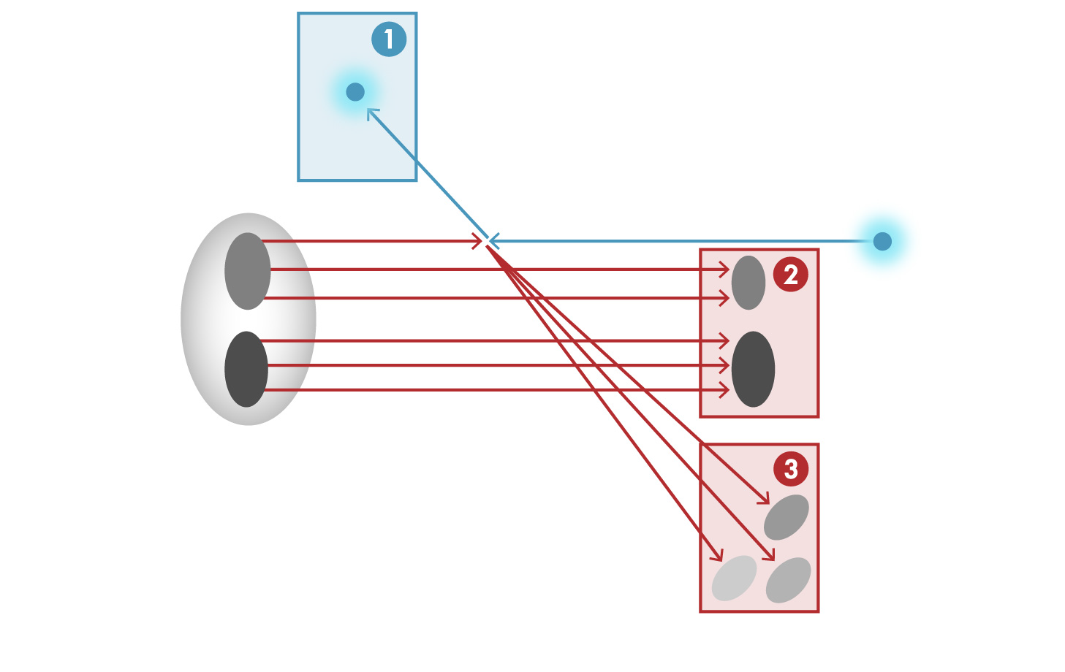
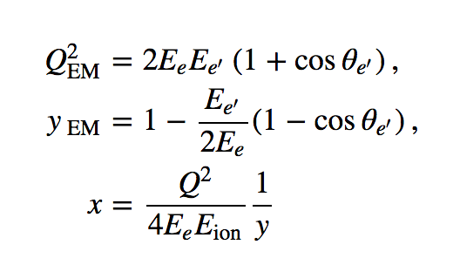
DIS kinematics reconstruction basics
e'
θ_{e’}
Electron method
e
-> only scattered electron
information is used
p/A
Scattered electron
Proton (ion) remnants
Struck quark fragmentation products
“Classic” way to determine {x,Q²}
Obviously diverges at small y

Slide 10
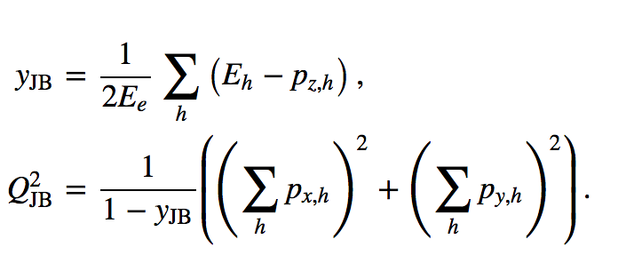
DIS kinematics reconstruction basics
e'
Jacquet-Blondel method
e
-> only hadronic final state
information is used
p/A
Scattered electron
Proton (ion) remnants
Struck quark fragmentation products
Relatively poor resolution (yet better than nothing)
The only way to reconstruct {x,Q²} for charged current
events (since neutrino in the final state can not be detected)
-> FYI: “mixed” reconstruction methods exist as well (see e.g. next slide)

Slide 11
DIS kinematics reconstruction example
Describes migration between kinematic bins
Important to keep it close to 1.0 for successful unfolding
{PYTHIA events 20x250 GeV} -> {BeAST detector; full GEANT simulation} -> {Kalman filter track fit}
Bremsstrahlung turned on here (and it matters even for detector with ~5% X/X ₀!)
Lepton tracking only
Double-angle method
“Straightforward” lepton tracking can hardly help at Y<0.1
Hadronic final state accounting allows to recover part of the high Q² range

Slide 12
EIC detector concepts

Slide 13
Detector requirements: ideal vs real life
The “ideal” detector (for a given process):
Detect all final state particles of interest with 100% efficiency
Determine their type (PDG) with high confidence level
Measure all 4-momenta precisely
Real life:
Only 13 particle species have cτ > 500μm -> have to deal with the decay products, secondary vertices, invariant mass peaks
Never get 100% efficient acceptance (cracks, support system, beam pipe, sub-detector frames, ...)
Never get 100% detection efficiency (detector imperfectness, reconstruction algorithms, DAQ limitations, ...)
Particle identification is never perfect
Have to deal with the finite detector resolutions (detector size and technology limitations, costs, ...)
Background processes spoil the picture

Slide 14
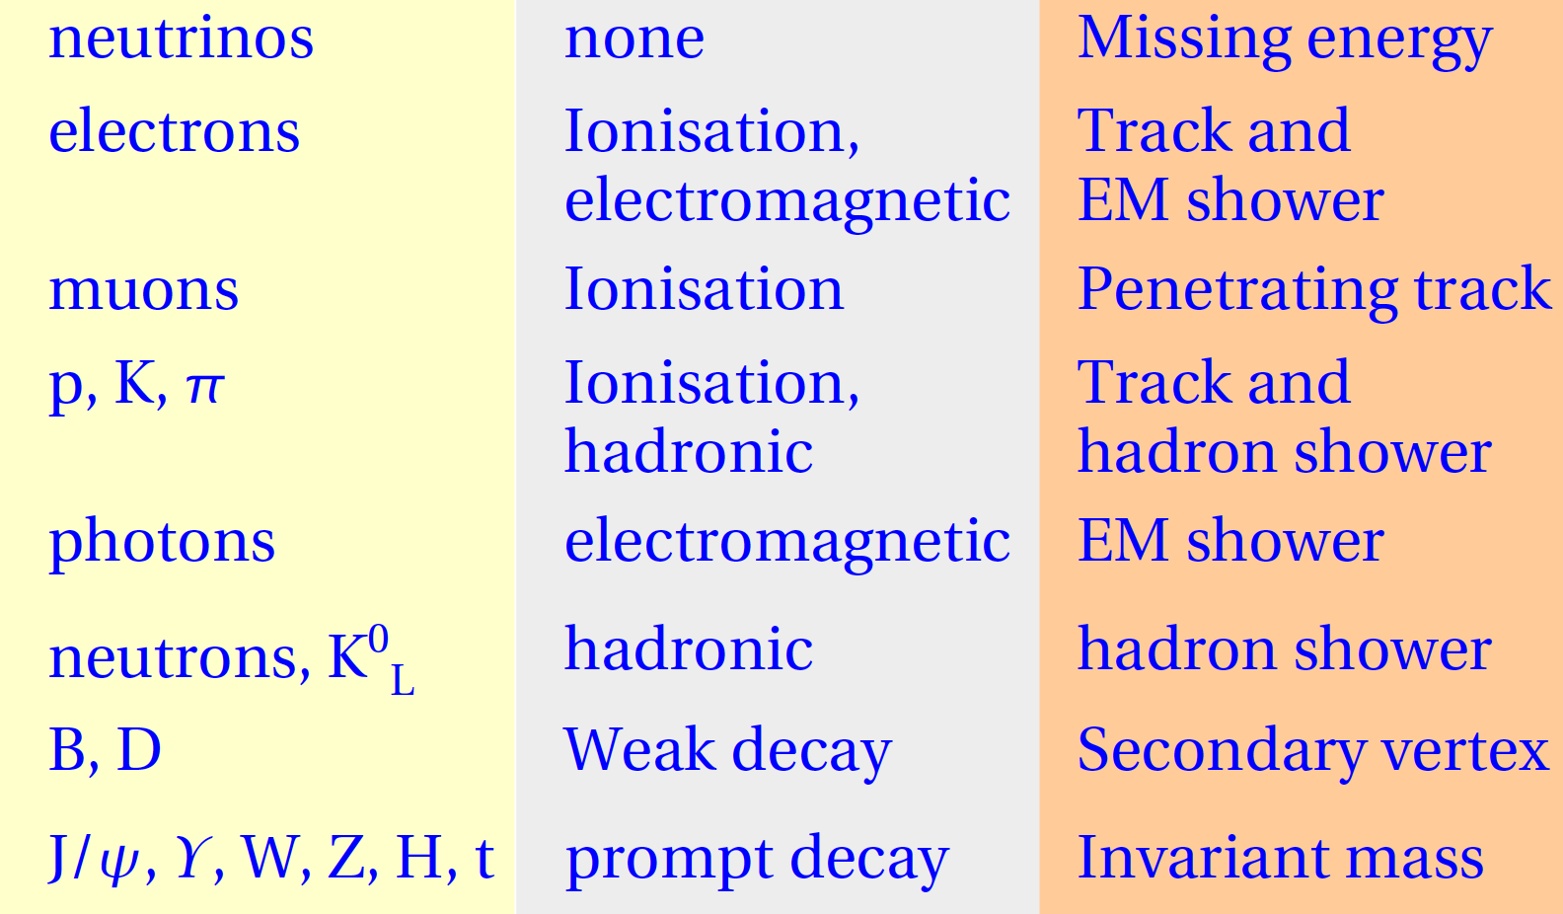
How do we detect particles?
Long-lived: through their interaction with the detector material
Tracking (“gentle” measurement)
Calorimetry (destructive measurement)
& PID detectors
Short-lived: through measuring their decay products

Slide 15
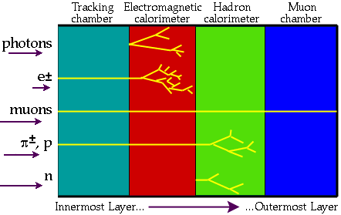
Emerging practical implementation
Caveats:
Calorimetry measurement is destructive, therefore tracking system should be the closest to the IP
EIC physics also requires hadron species π/K/p identification!

Slide 16
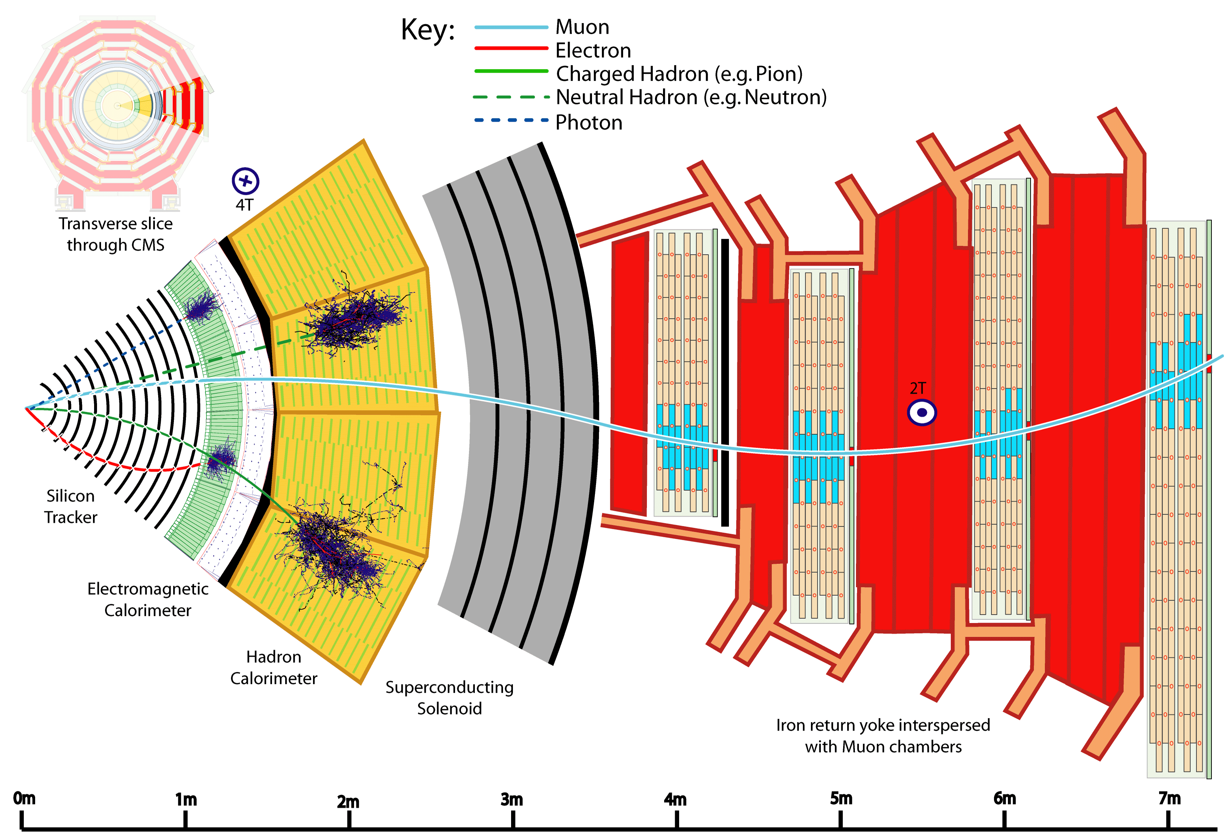
Illustration: CMS detector at LHC

Slide 17
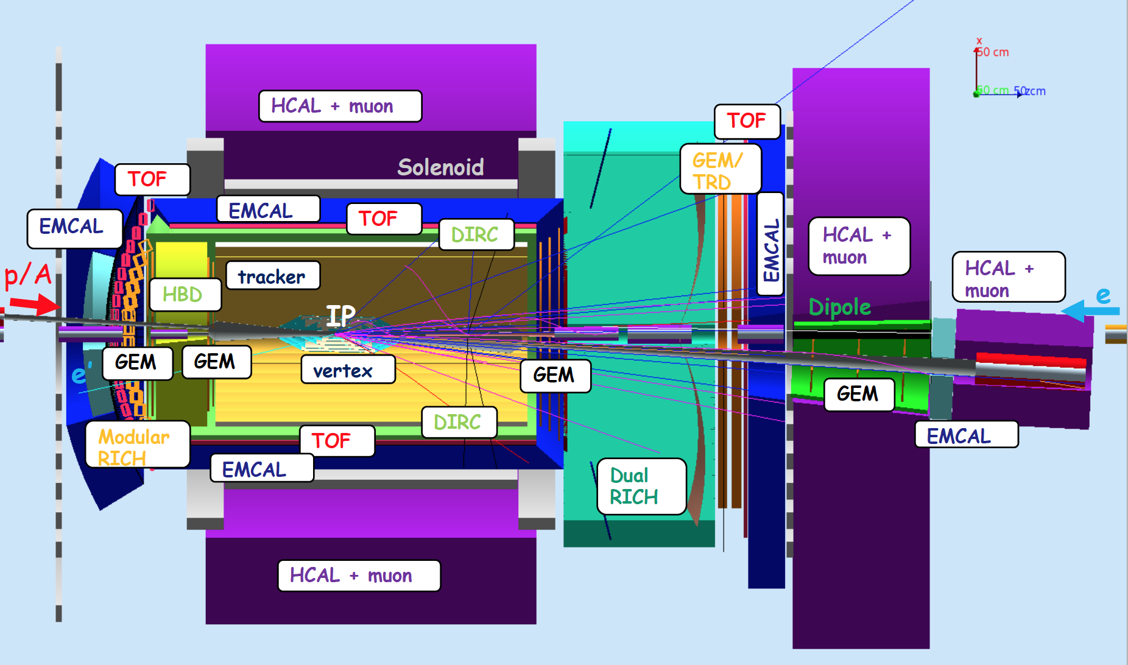
EIC detector concept: JLEIC
Jefferson Laboratory (JLab) “green field” detector

Slide 18
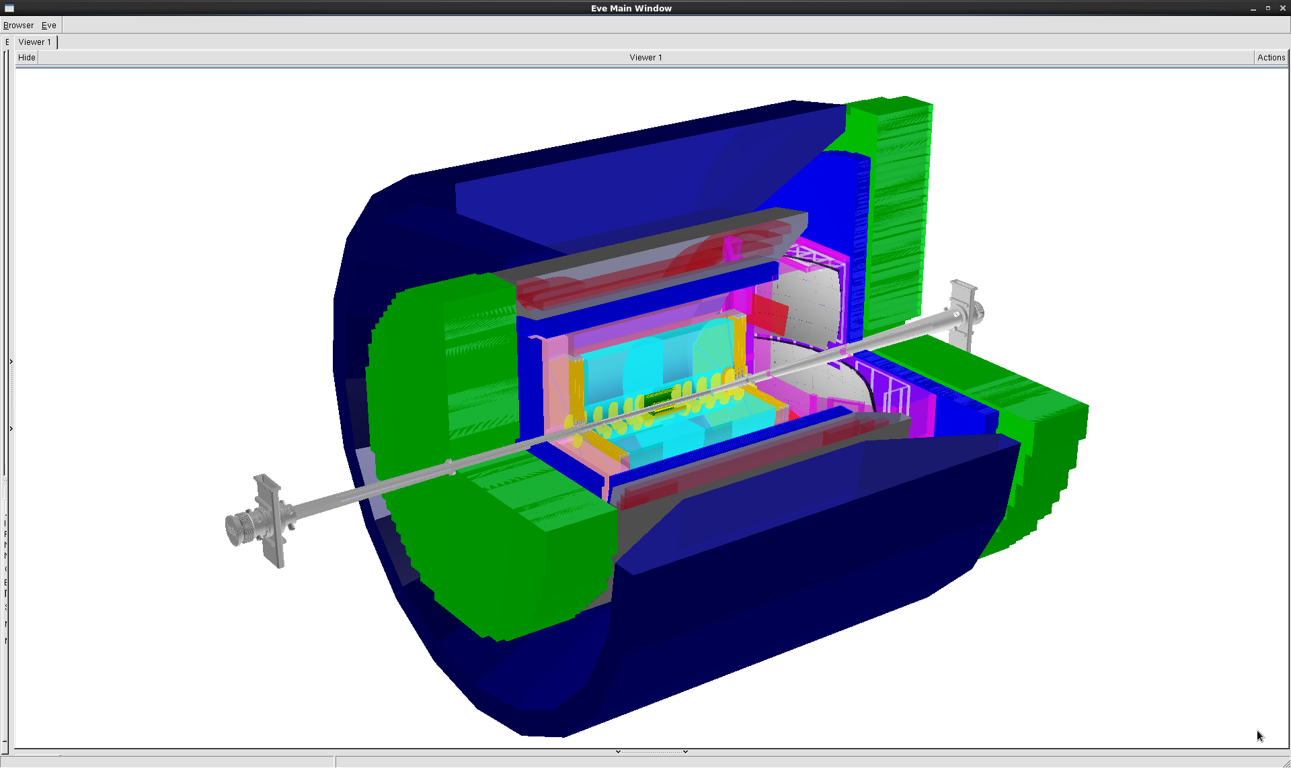
EIC detector concept: BeAST
3T solenoid cryostat
coils
iron yoke
electrons
hadrons
up to 9.0m
hadronic calorimeters
e/m calorimeters
RICH detectors
silicon trackers
trackers
GEM trackers
TPC
Brookhaven Laboratory (BNL) “green field” detector

Slide 19
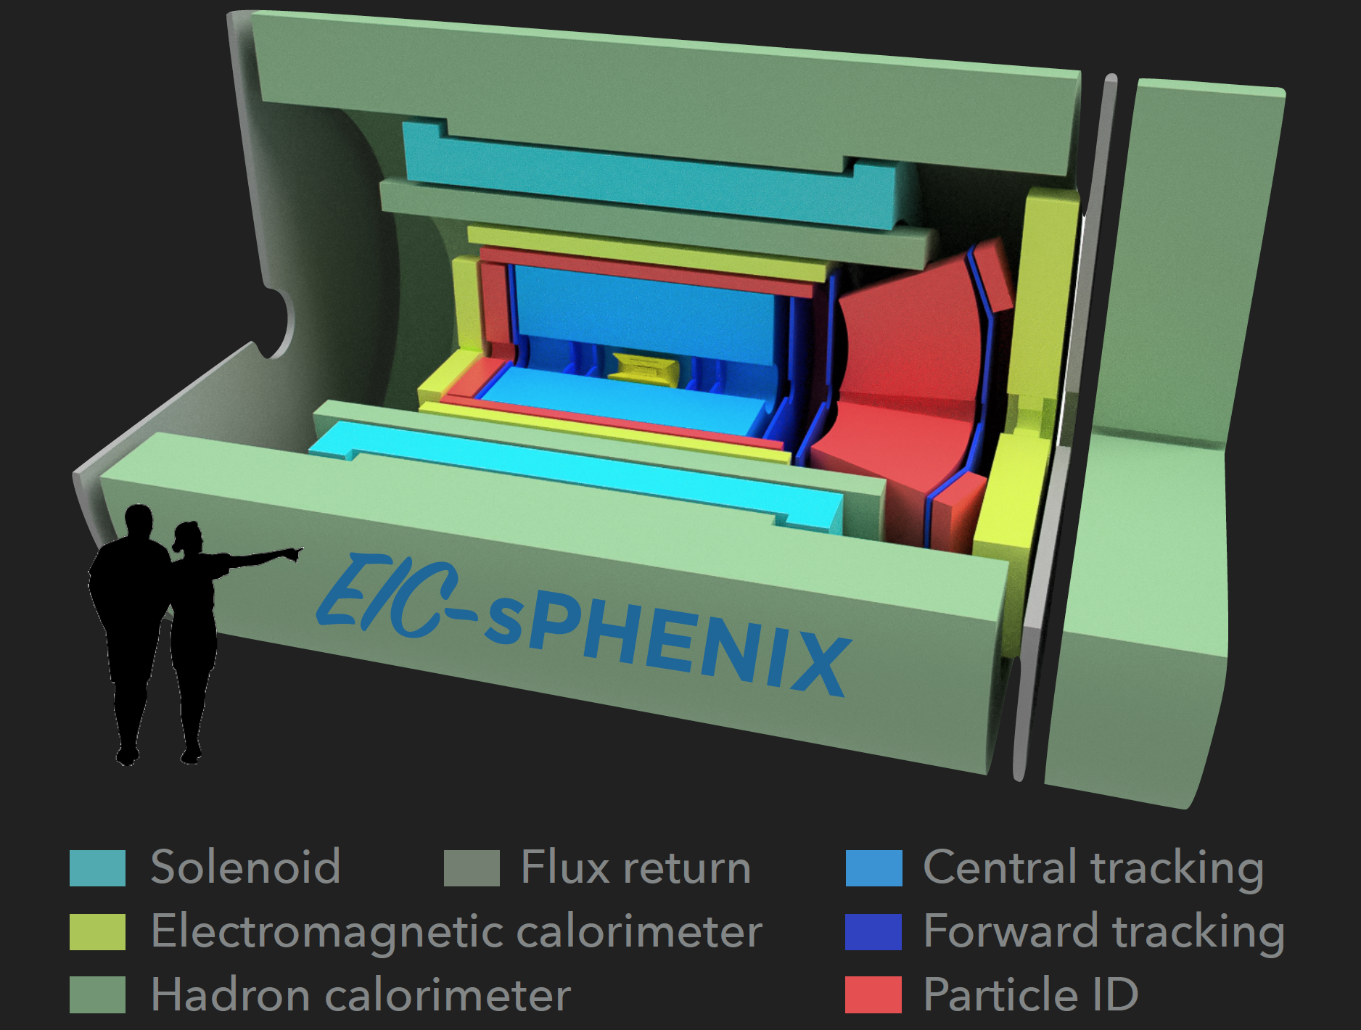
EIC detector concept: ePHENIX
Brookhaven Laboratory sPHENIX-based implementation

Slide 20
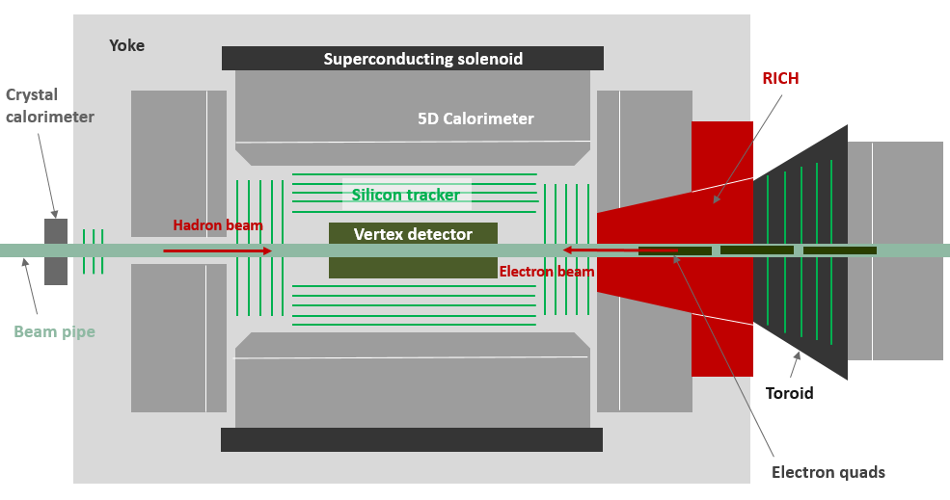
EIC detector concept: TOPSiDE
Argonne Laboratory (ANL) all-silicon implementation

Slide 21
EIC Detector Concepts
Common features:
  Compact design
  (Almost) 4π hermetic acceptance in tracking/calorimetry/PID
  Vertex + central + forward/backward + far forward tracker layout
  Low material budget in the tracker volume
  Strong central solenoid field
  Moderate momentum resolution (~1% level)
  Moderate EmCal and HCal energy resolution
Note:
  Community wants two general-purpose detectors

Slide 22
Tracking

Slide 23

Tracking basics: idea
Charged particles lose energy via ionization when passing through media (a gas volume, a silicon layer, …):
Tracking detector:
  Amplify this “electron signal” if needed
  Discretize it according to the detector design
Track fitting algorithm:
  Use the resulting N discrete “space points”, their respective covariance matrices (error estimates) and knowledge about the underlying dynamics (magnetic field, material distribution) in order to estimate track parameters at the detector location
  Extrapolate to the interaction point and build vertices
Bethe-Bloch formula

Slide 24
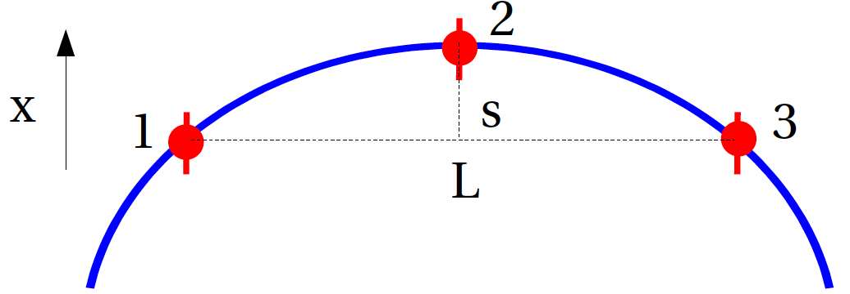
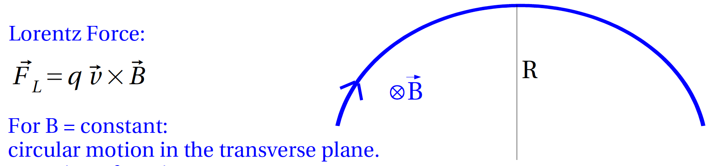
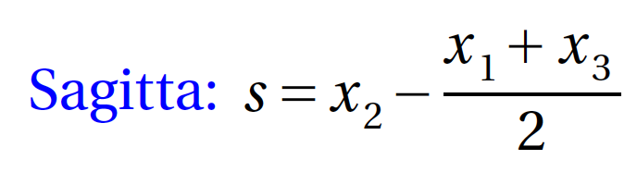
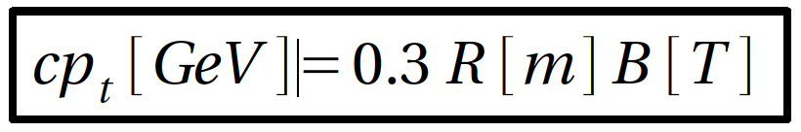
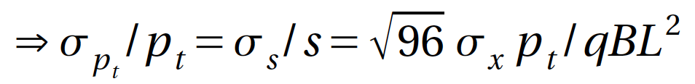
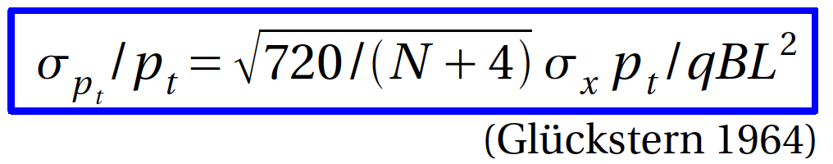
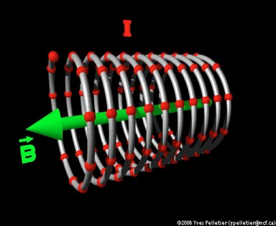

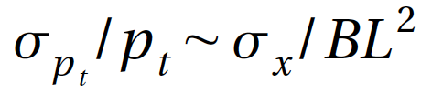
Tracking basics: momentum measurement
add 3 measurements
- 3 points
- N equidistant points
solenoidal field
Important observations:
-> resolution becomes worse
with increasing momentum
-> want high single point
resolution, large field
and large size

Slide 25
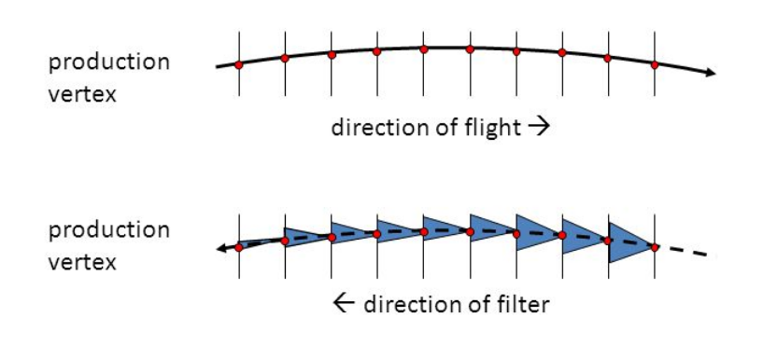
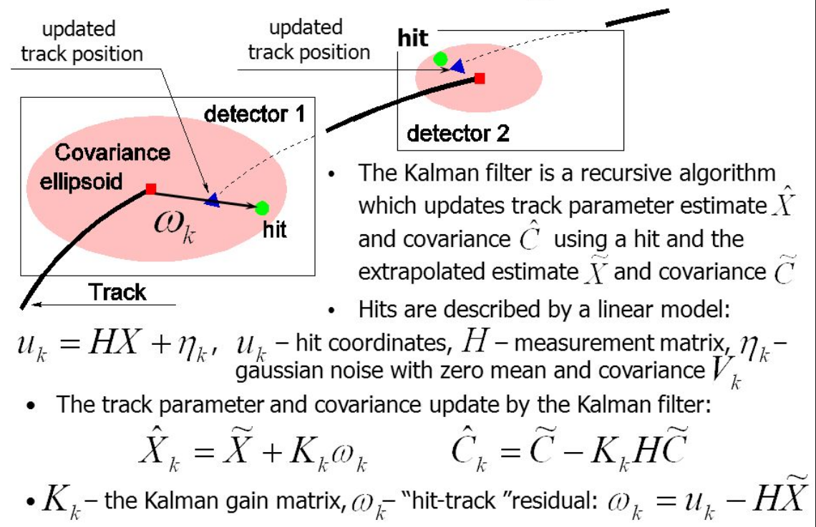
Tracking basics: Kalman filter algorithm
  Originally developed by R.Kalman in 1960 for spacecraft radar applications
  Formulated for charged particle tracking and vertex fitting by R.Fruehwirth in 1987

Slide 26
EIC detector tracking: systems & options
Vertex detector
  MAPS
Central tracker
  TPC (+ MM)
  All-silicon tracker
  A set of MM cylinders
  Drift chamber
  Straw tube tracker
Endcap trackers
  Large-area GEMs (MM, μRWELL, GEM-TRD, sTGC)
Forward & backward trackers
  MAPS
  (Very) high resolution GEMs
Close-to-beamline instrumentation
  Roman Pots, B0 magnet tracker, low-Q² tagger, …

Slide 27
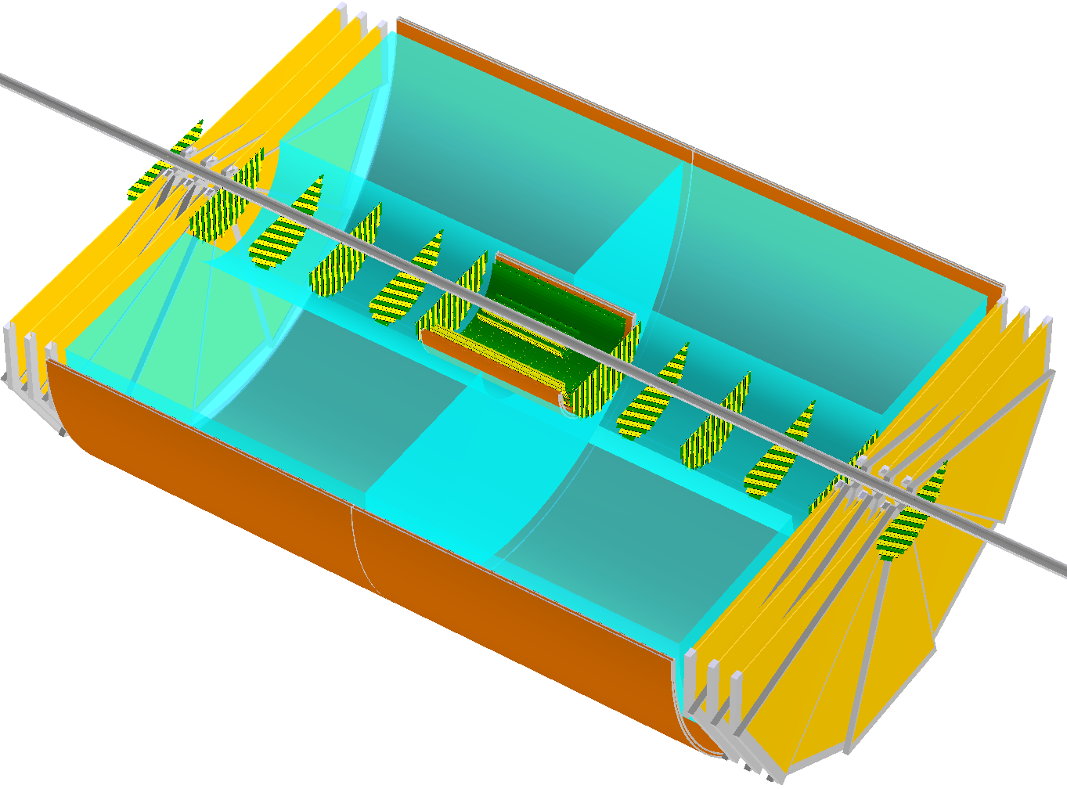
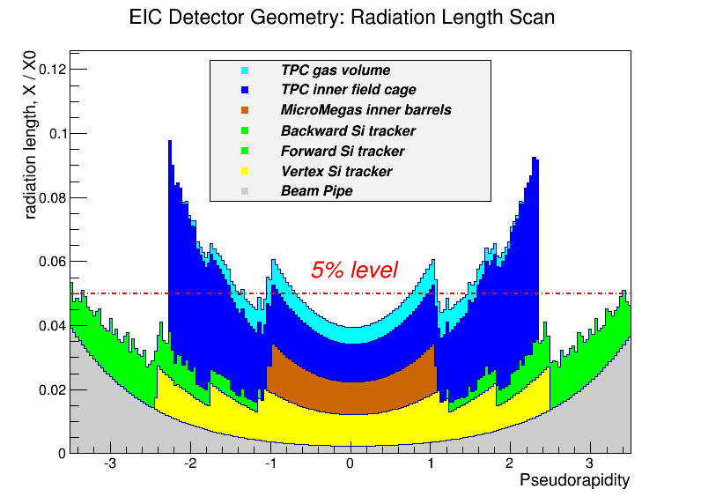
Expected “typical” EIC tracker performance
Radiation length scan
~2.0m
Momentum resolution
H1 : 0.6%*P_{t} + 1.5%
ZEUS : 0.5%*P_{t} + 1.5%

Slide 28
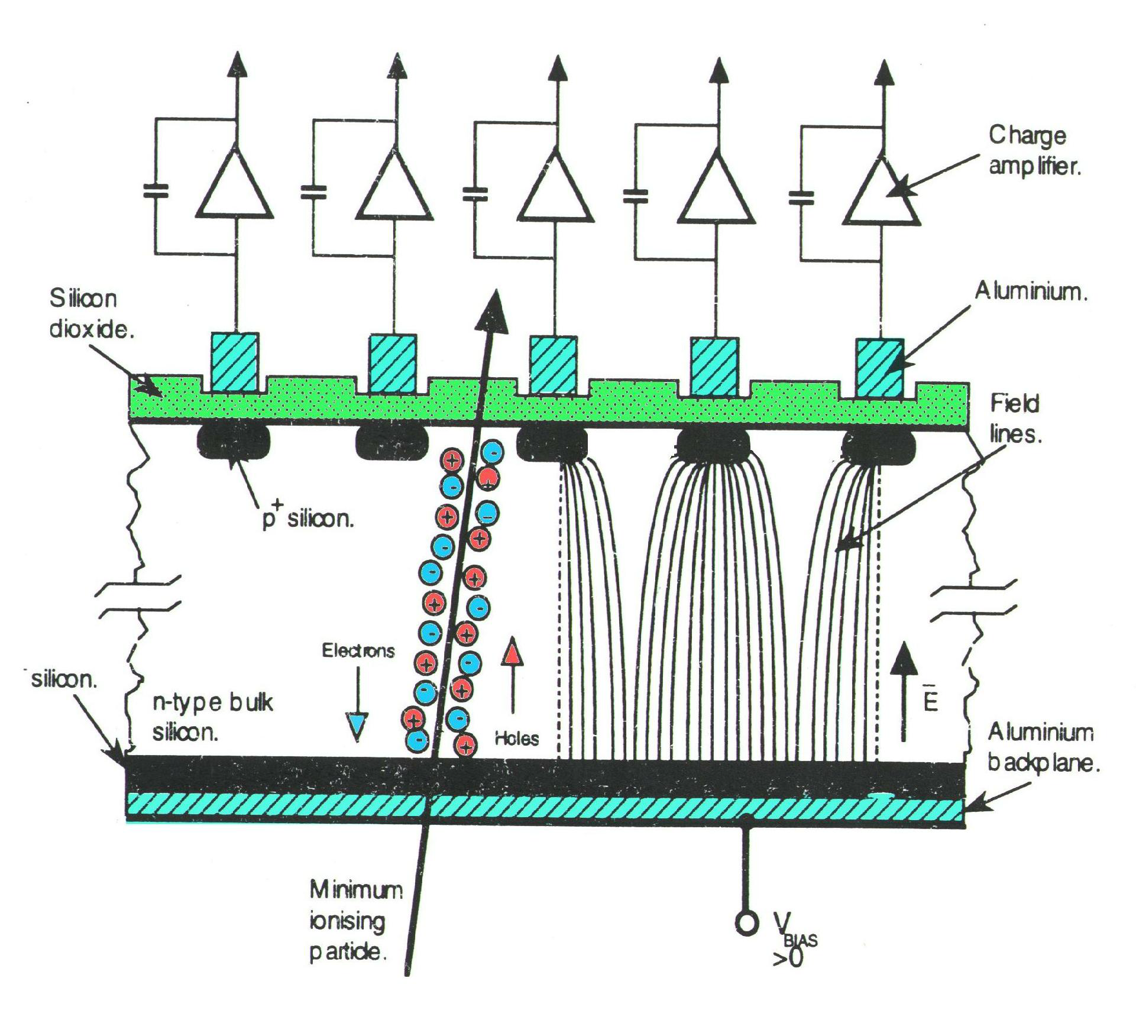
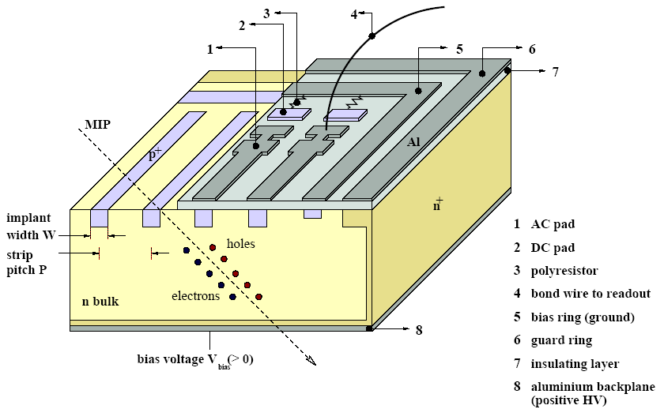
“Traditional” Si detectors (here: CMS strips)
Planar sensor from a high purity silicon wafer (here n-type).
Segmented into strips by implants forming pn junctions.
Strip pitch 20 to 200 μm, high precision photolithography.
Bulk is fully depleted by a reverse bias voltage (25-500V).
Ionizing particle creates electron-hole pairs (25k in 300 μm; 3.6eV/pair).
Electrons and holes are separated by the electric field and collected on the implanted strips
High spatial resolution (dozens of microns, pitch-dependent)
Fast (~10ns collection time)

Slide 29
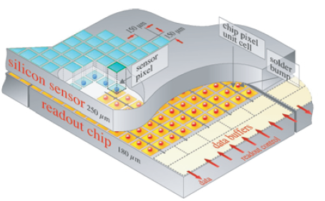
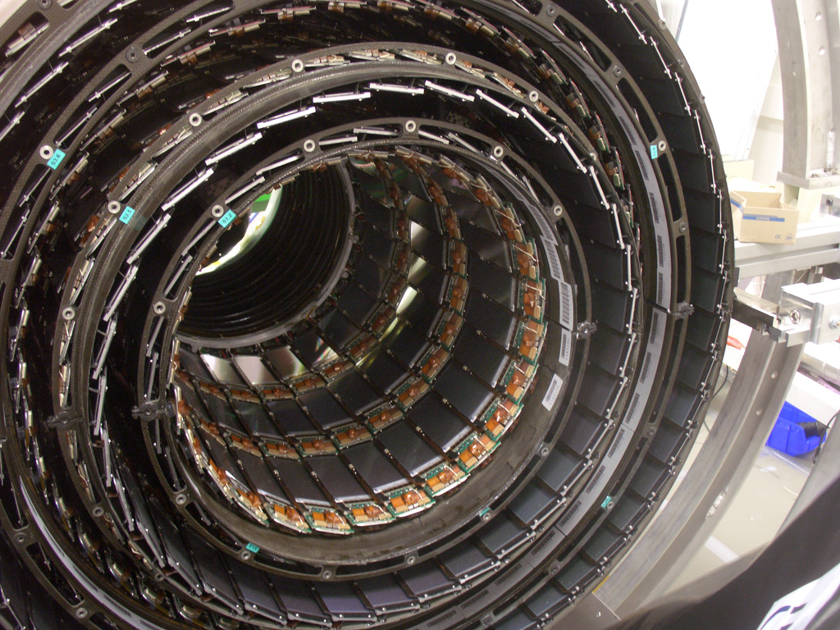
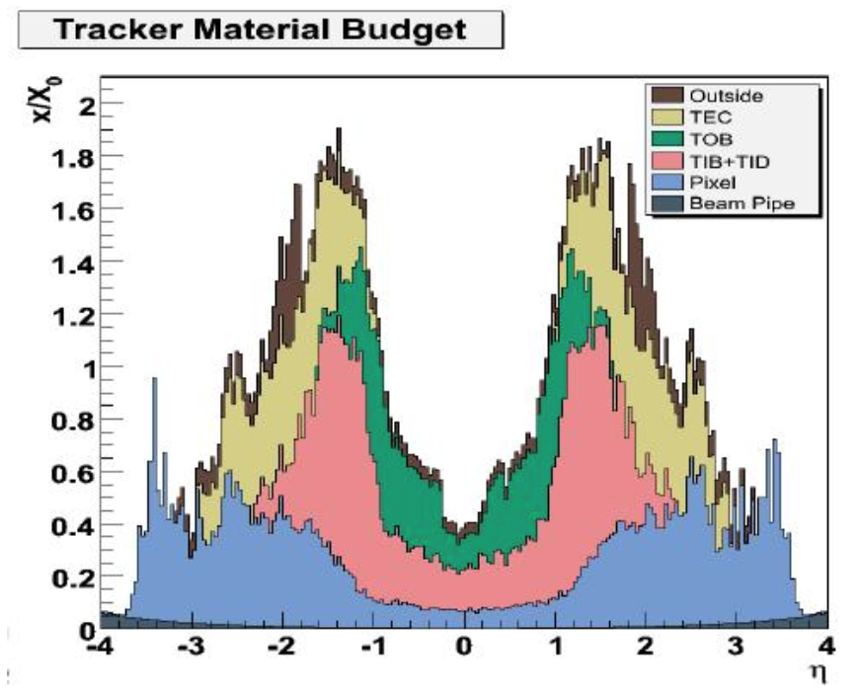
“Traditional” Si detectors (CMS)
Bump-bonding to a (separate
from sensor) readout chip …
Impressive system: 10⁷ channels; 200 m²!
  … this blows up the material budget (no good for EIC)!

Slide 30
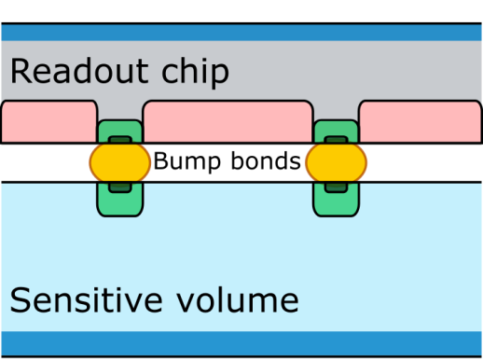
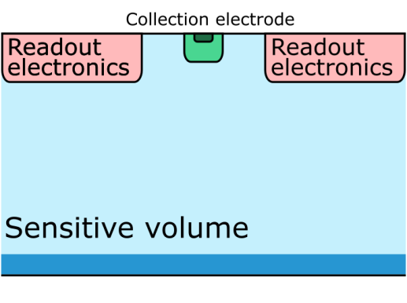
Monolithic active pixel sensors
Hybrids
Sensitive volume and readout electronics on separate chips
Most commonly used in silicon vertex trackers
Radiation tolerant and fast
Monolithic Active Pixel Sensors (MAPS)
Sensitive volume and readout electronics on same chip
Made using commercial CMOS technology
Thin and fine granularity
Slow (charge collection partly via diffusion)

Slide 31
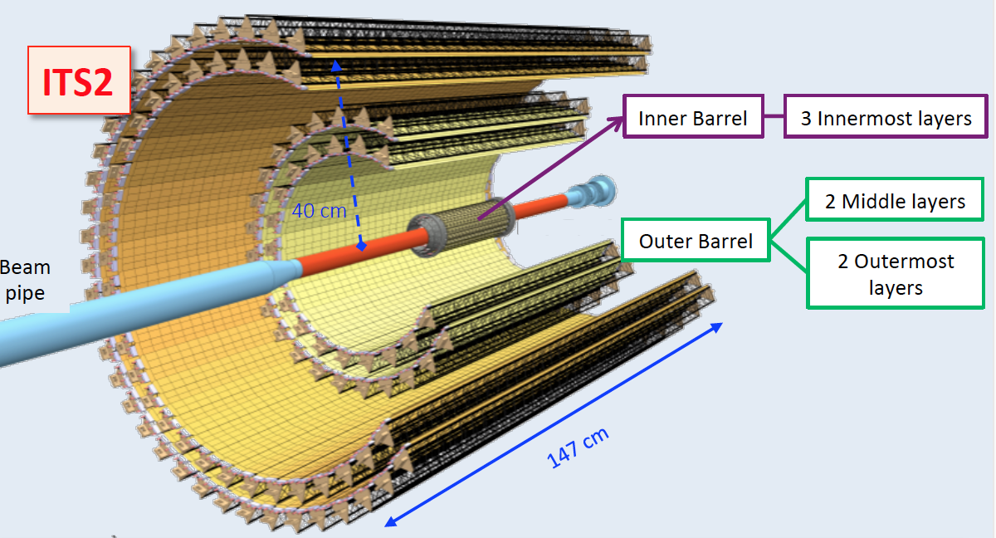
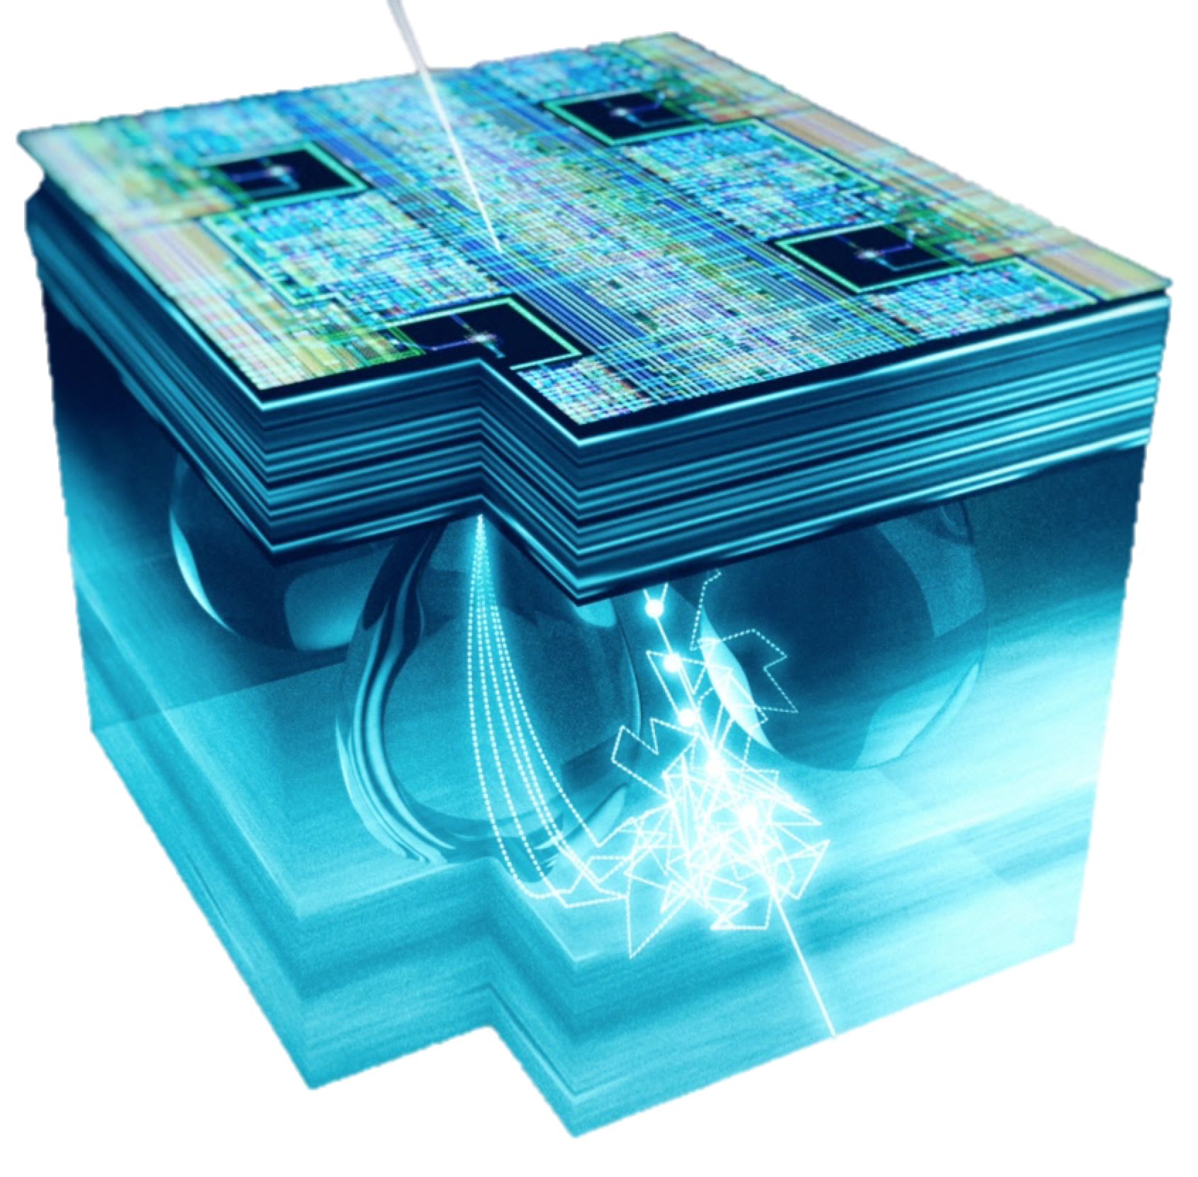
Monolithic active pixel sensors (ALICE)
Upgraded ALICE Inner Tracker System (ITS2)
artistic view of charge
collection process
Based on novel MAPS ALPIDE (vs ITS1)
10 m² active silicon area, 12.5 G-pixels
Smaller pixels: ~5 μm in rφ and z directions (vs 12 μm and 100 μm)
Power density < 40mW / cm2
Less material: ~0.3% X0 for Inner Barrel (vs 1.1% X0)
Faster readout: 100 kHz Pb-Pb (vs 1 kHz)

Slide 32
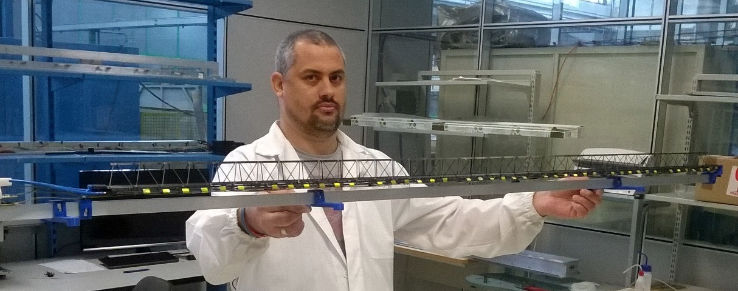
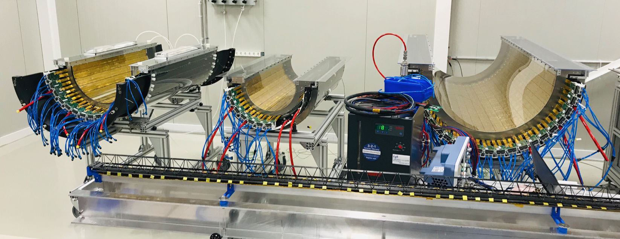
Monolithic active pixel sensors (ALICE)
Outer barrel stave, 102 million pixels
Upgraded ALICE Inner Tracker System (ITS2)
Layers 4,3 & 5

Slide 33
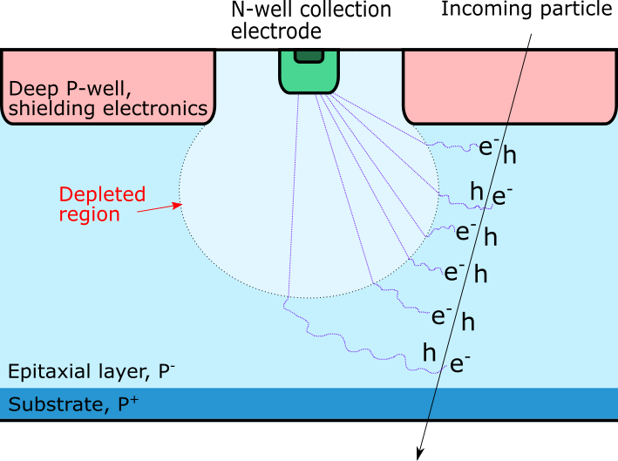
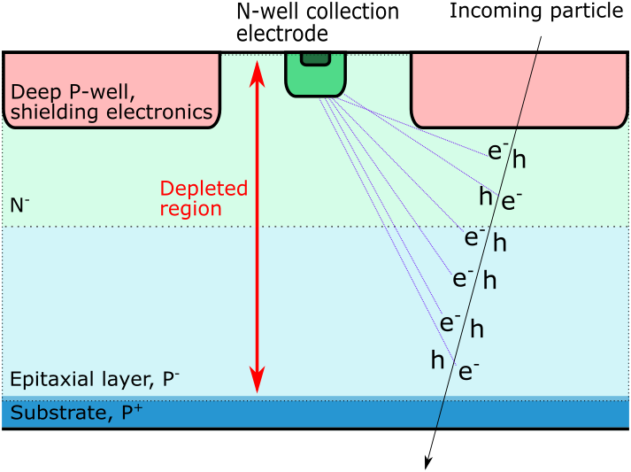
Depleted monolithic active pixel sensors
Depleted Monolithic Active Pixel Sensors (DMAPS)
Utilizing high voltage/high resistivity CMOS technology
Depleted volume intended to be as large as possible
Depletion gives faster (drift mode) and more uniform charge collection compared to standard MAPS
Standard process (MAPS)
Modified process (DMAPS)

Slide 34
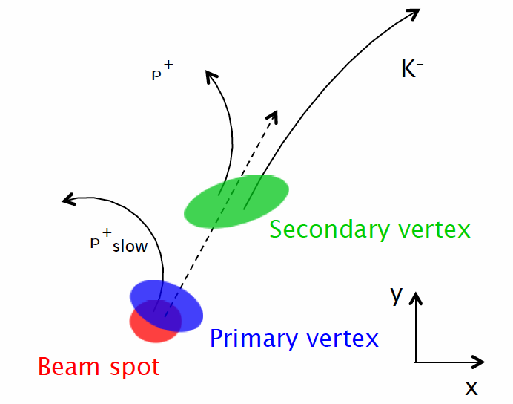
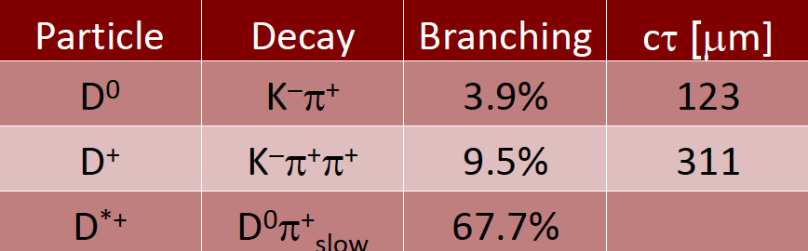
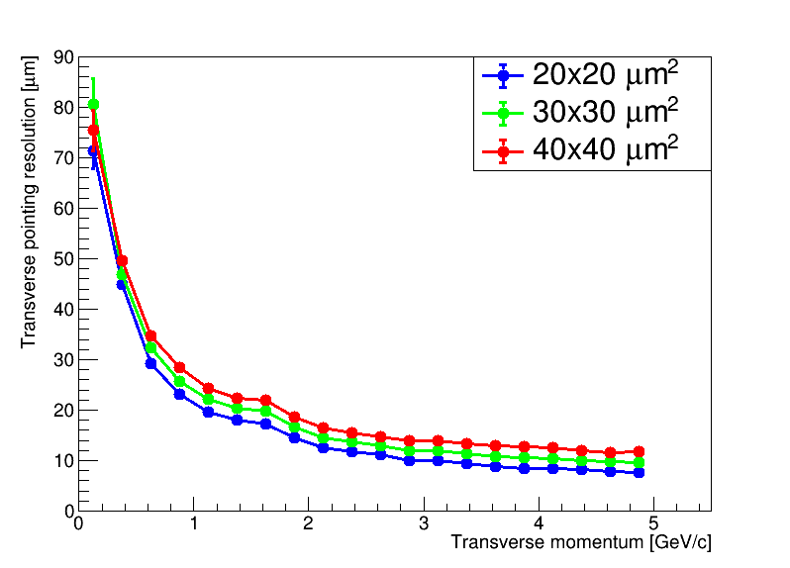
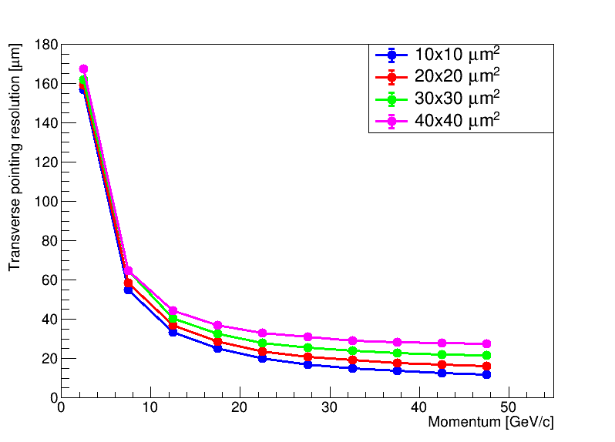
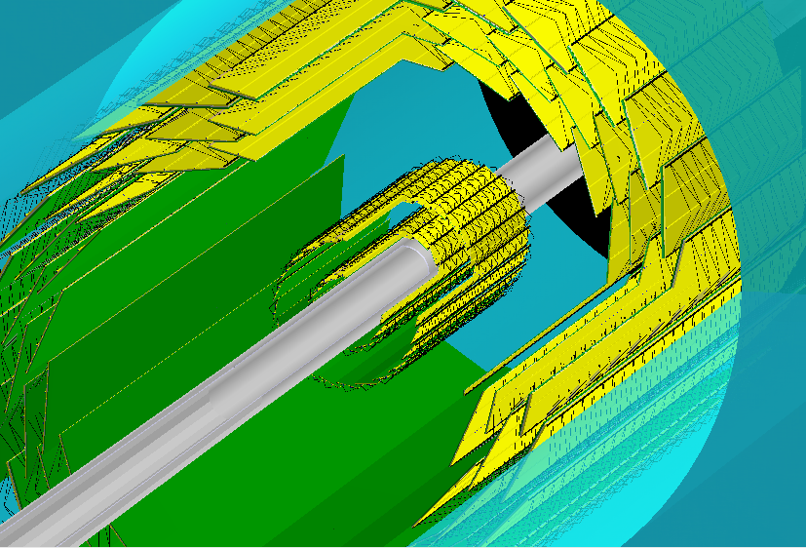
Why small pixels are required?
Open charm reconstruction
Signature: displaced Kπ vertex
Pointing resolution plots
Simulated vertex tracker
|η| < 0.5 (barrel region)
η = 3 (forward region)
  Smaller pixels provide better pointing resolution …

Slide 35
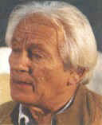
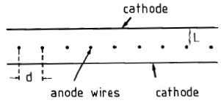
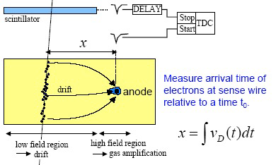
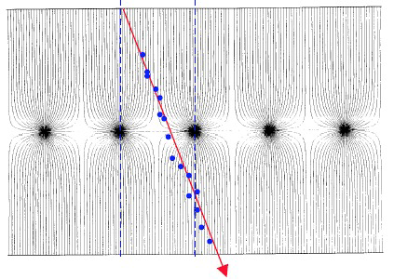
Central tracker: Drift Chamber
Multi Wire Proportional Chamber (MWPC)
G.Charpak 1968, Nobel prize 1992
Typical parameters: L=5~8 mm,
d=2mm, anode wire diameter =20 μm.
MWPC: address of fired wire(s) give one dimensional information and σ_{x} ≈ d/√12
Drift chamber: use drift length time information, typical resolution ~200 μm
Resolution limits: drift and diffusion effects

Slide 36
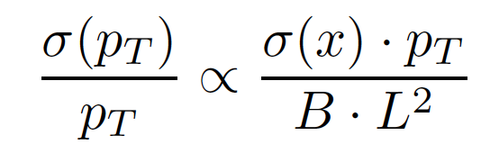
Central tracker: Drift Chamber (issues)
Remember, error of momentum measurement:
⇒ L has to be large ⇒ detector has to be wide (small Rin, large Rout)
Also: want large η coverage ⇒ z dimension has to be large ⇒ detector has to be long
-> a drift chamber with several thousand long wires
-> problems with both construction and maintenance
Solution#1: encapsulate each anode wire in a separate cylindrical volume ⇒ straw tracker
Solution#2: let the electrons drift over long distances
⇒ TPC: essentially a huge gas filled box

Slide 37


Central tracker: Straw Tubes (PANDA)
4636 straw tubes in 2 separated semi-barrels
23-27 radial layers in 6 hexagonal sectors
  15-19 axial layers (green) in beam direction
  4 stereo double-layers: ±3° skew angle (blue/red)
Volume: R_{in} / R_{outr}= 150 / 418 mm, L~ 1650 mm
  Inner / outer protection skins (~ 1mm Rohacell/CF)
Ar/CO₂ (10%), 2 bar, ~ 200ns drift time (2 T field)
Time & amplitude readout
  σ_{rϕ} ~ 150 µm, σ_{z} ~ 2-3 mm (isochrone)
  σ(dE/dx) < 10% for PID (p/K/π < 1 GeV/c)
σ_{p} /p ~ 1-2% at B=2 Tesla (STT + MVD)
X/X₀ ~ 1.25% (~ ²/₃ tube wall + ¹/₃ gas)

Slide 38



Central tracker: Straw Tubes (PANDA)
Material budget at lowest limit (2.5 g per assembled straw)
thinnest Al-mylar film, d=27µm, ∅=10mm, L=1400mm
thin wall endcaps, wire fixation (crimp pins), radiation-hard
self-supporting modules of pressurized straws (Δp=1bar)
  close-packed (~20 µm gaps) and glued to planar multi-layers
  replacement of single straws in module possible (glue dots)
strong stretching (230kg wires, 3.2tons tubes)*, but no reinforcement needed

Slide 39


Central tracker: Time Projection Chamber
STAR TPC
140,000 electronics channels (pads)
512 time bins
140,000 x 512 = 72 million 3D “pixels”
Inner sectors were instrumented in 2019
Gating Grid concept:
Designed to reduce Ion Back Flow (IBF) from the amplification stage, and respective space charge of positive ions in the TPC volume (gate open by trigger only for the time needed to collect all electrons – several μs only)

Slide 40





STAR TPC, legacy pictures
STAR event display, {r,φ} view
STAR event display, side view

Slide 41





“New generation” TPCs: attack IBF problem
MWPC-based TPC drawbacks
No other means to suppress IBF other than gating grid
This in particular excludes TPC usage in a continuous readout mode (and in a high luminosity environment)
IBF vs uMegas mesh voltage
Solution: replace MWPC amplification stage
by either quadruple GEM (ALICE upgrade &
sPHENIX TPC) or a GEM+μMegas hybrid; carefully tune gas mixture, GEM foil configuration & HV
dE/dx resolution vs IBF
sPHENIX TPC: ALICE approach

Slide 42





Large (here 2D) planar detectors: GEM
EIC Detector R&D program
U-V strips charge sharing
GEM: Gas Electron Multiplier
Primary ionization in a short (few mm) drift gap
Multi-stage (3-5 50μm thick foils) amplification in a high field
Direct coupling to readout strips (or pads)

Slide 43




Large (1D) planar detectors: GEM
EIC Detector R&D Program
via
  Low mass, stretched carbon fiber frames
  High spatial resolution & low channel count zigzag charge sharing readout

Slide 44



Large planar detectors: μMegas
ATLAS New Small Wheel
4 Types of detectors => 4 constructions sites
Technology: 1200 m² of resistive Micromegas
2M channels
Primary ionization in a short (few mm) drift gap
Single-stage amplification in a high field 128μm gap
Capacitive coupling to readout strips through the resistive layer

Slide 45





Medium-size cylindrical tracker: μMegas
CLAS12 vertex tracker upgrade
Same technology: 4 m² of μMegas detectors
Light-Weight Detectors (~0.5% of X₀ per layer)
Limited space (~10 cm for 6 layers)
High magnetic field (5T)
Variable geometry (6 Layers with different R)
High enough spatial resolution (~100μm)
Silicon
MM
TOF
Neutron Det.

Slide 46



μRWELL trackers
Modern technology, competing with GEM & μMegas:
  Simple, low mass, no stretching, low cost
  1D & 2D configurations, flat & cylindrical
µRWELL with 2D X-Y readout
µRWELL in FNAL Test Beam
Primary ionization in a short (few mm) drift gap
Single-stage amplification in a high field 50μm gap (foil)
Capacitive coupling to readout strips through the resistive layer
µRWELL

Slide 47
End of day one!

