Slide 1
PMG Agenda
Preparation for the Director’s Review
LLP status
MVTX
cost and schedule status
UTK grant proposal status
Discussions with LANL, LBNL and MIT for getting within budget constraints
Status of positions to be filled
AoB relevant for the PMG including issues/concerns

Slide 2
sPHENIX MIE Overview
TPC Range | Total Budget w/ contingency | Total Baseline Cost | Actuals to Date | % Complete based on actuals | CPI | SPI
$24.2- 34.5M AY | $26.55 M AY | $20.53 M AY | $2.94 M AY | 14.3% | Pre-baseline | Pre-baseline
Scope
Detector systems produced, tested and ready for installation: Time Projection Chamber w/ electronics, Electromagnetic Calorimeter w/ electronics, Hadronic Calorimeter w/ electronics, DAQ/Trigger, Minimum Bias Detector, Project Management
Installation and system commissioning is not part of the scope
Schedule
CD-0 received Sept 2016
CD-1/3A received Aug 2018
PD-2/3 review May 2019
Early completion Oct 2021
PD-4 Dec 2022
Cost
$24.2 – 34.5M AY
$26.55M AY Point cost estimate including ~30% contingency

Slide 3
Recent News/Issues
First partial delivery of LLP orders, 8500 SiPMs, arrived at Univ. of Michigan Mar 8.
The preliminary project baseline is set and EVMS practice has begun.
The first practice EVMS report has been generated.
We are meeting monthly with the L2 Managers to status the project
First partial delivery of production scintillating fibers for the EMCal arrives at UIUC in April.
SAMPA v5 chip components from MWR delivered to U Sao Paulo
84/96 EMCal blocks for Sector 0 are complete. Attachment of reflectors, light guides and SiPM daughter cards underway. Balance of Sector 0 blocks to be completed by 1st week of April.
Approximately 600 preprod scintillating tiles for HCal at GSU for testing. First 200 tested at GSU had ~95% within good performance range. Tests on remainder 2/3 continuing.
Hired Chief Mechanical engineer to replace Don Lynch. The new person starts April 15.
Barrel Magnet steel sector 18 arrived at BNL Mar 15. Over 50% delivered (non-MIE)

Slide 4
sPHENIX Project Calendar
1008 Cryogenic procurement readiness review March 11 (non-MIE)
sPHENIX in Asia meeting March 25-27, Taiwan
Director’s review practice April 3-4
Director’s Review (1.X,2.X,3.X) April 9-11
PD-2/3 Review Practice May 15-16
PD-2/3 Review (MIE only) May 28 (1:00 pm)-May 30

Slide 5
High Priority Issues
Preparation for the PD-2/3 review is our top priority
Passing the review gives us authorization to spend TEC funds
In preparation for the review we are also preparing for the Director’s Review.
Complete documentation
Get EVMS running smoothly
Schedule practices
Monthly EV calculations.
Continue practicing EVMS process.
Using Change Control on the LLPs and Preliminary project baseline
Incorporate EV calculations in monthly financial report to DOE.
Get PPMP signed by the BNL Lab Director

Slide 6
Upcoming Reviews
Director’s Review April 9-11
Covers 1.X (MIE), 2.X (Infrastructure &Facility Upgrade), 3.X (INTT and MVTX)
Chaired by Jim Yeck
Expanded committee from Mar 2018 Director’s review. Mix of BNL and outside committee members but most local.
Dominated by parallel sessions
PD-2/3 Review May 28 (Noon)-30
MIE only. Similar to an OPA CD-2/3 review
Chaired by Tom Cormier
Trying to get the same committee as last years CD-1/3A review w/o OPA
Review charge will be modeled on charges from recent OPA CD-2/3 reviews

Slide 7
Preparing for PD-2/3 Review, May 2019
PD-2/3 Documentation:
Prepared for PD-2/3 review in May 2019.Need near final drafts by March in preparation for practice Director’s (ALD) Review
TDR (John H)
PMP (EO’B)
Revised Assumptions document (Cathy)
Revised BOE and WBS Dictionary (Glenn)
Hazard Analysis Plan (Jim)
Updated Risk Registry and RMP (Irina)
Cost Books, P6 reports (Cathy w/ Eric and Irina)

Slide 8
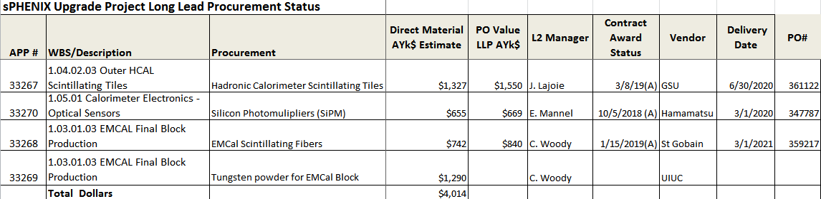
LLP Status
100k SiPMs has been placed. First parts have arrived at U Michigan. Order complete Mar 2020
Scintillating fiber order placed. First parts in Apr 2019. Order complete Mar 2021
Scintillating tile order placed. Working on date for first delivery. Order complete Jun 2020.
Tungsten powder order LLP-4. Working on the procurement documents.

Slide 9
MVTX Status
Cost and Schedule
P6 RLS exists. Schedule has the MVTX ready to install spring 2022. TPC including 30% contingency = $5.6M. Goal $4.9M.
Had informal discussions with MIT, LANL and LBNL on cost cutting but no agreement yet.
Need to update schedule once we learn actual stave delivery schedule
UTK Proposal
Internal review nearly complete. Elizabeth Bartosz will ask for Tim and Jehanne sign-off next week.
After that Elizabeth expects 3-4 weeks in the Chicago Office before funds reach UTK

Slide 10
Status of Positions to be Filled
We have hired a Chief Mechanical Engineer, Russ Feder from PPPL. He starts Apr 15.
Next task is to advertise the position of Infrastructure/Safety Engineer.

Slide 11
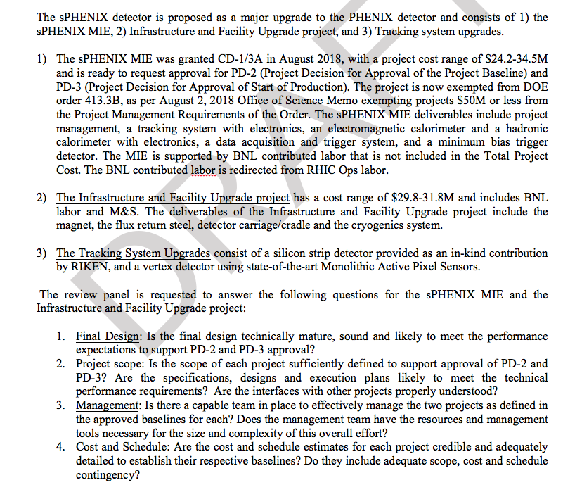
Any Other Business: Charge for Director’s Review

Slide 12
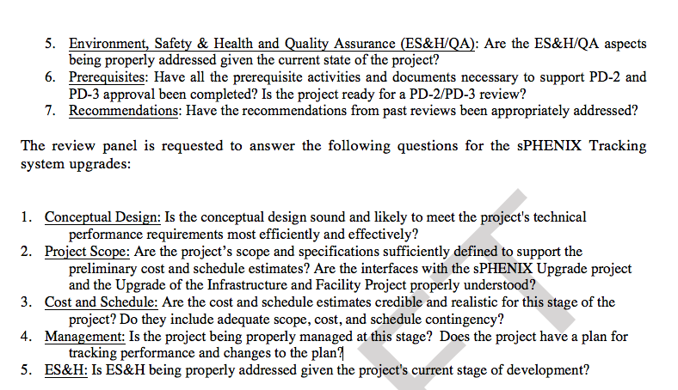
Charge for Director’s Review - cont

Slide 13
Summary
We continue to make good technical progress.
Need to continue pace of OPC and LLP procurements
Preparation for the Director’s and PD-2/3 Review are highest priority
Complete or update documentation. Demonstrate EVMS
Filled Chief Mech Engineer position on the Project team and will soon open req for Infrastructure/Safety engineer

Slide 14
Back Up

Slide 15
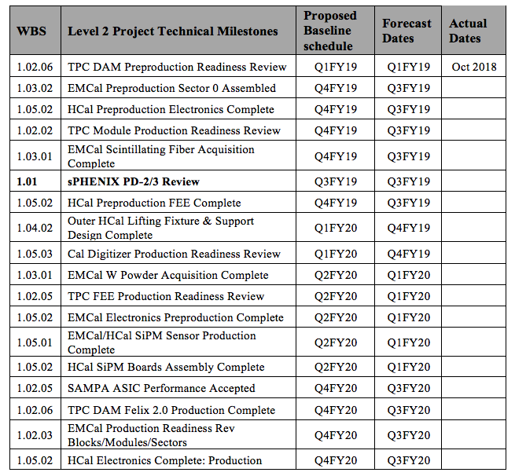
L1 and L2 Milestones

Slide 16
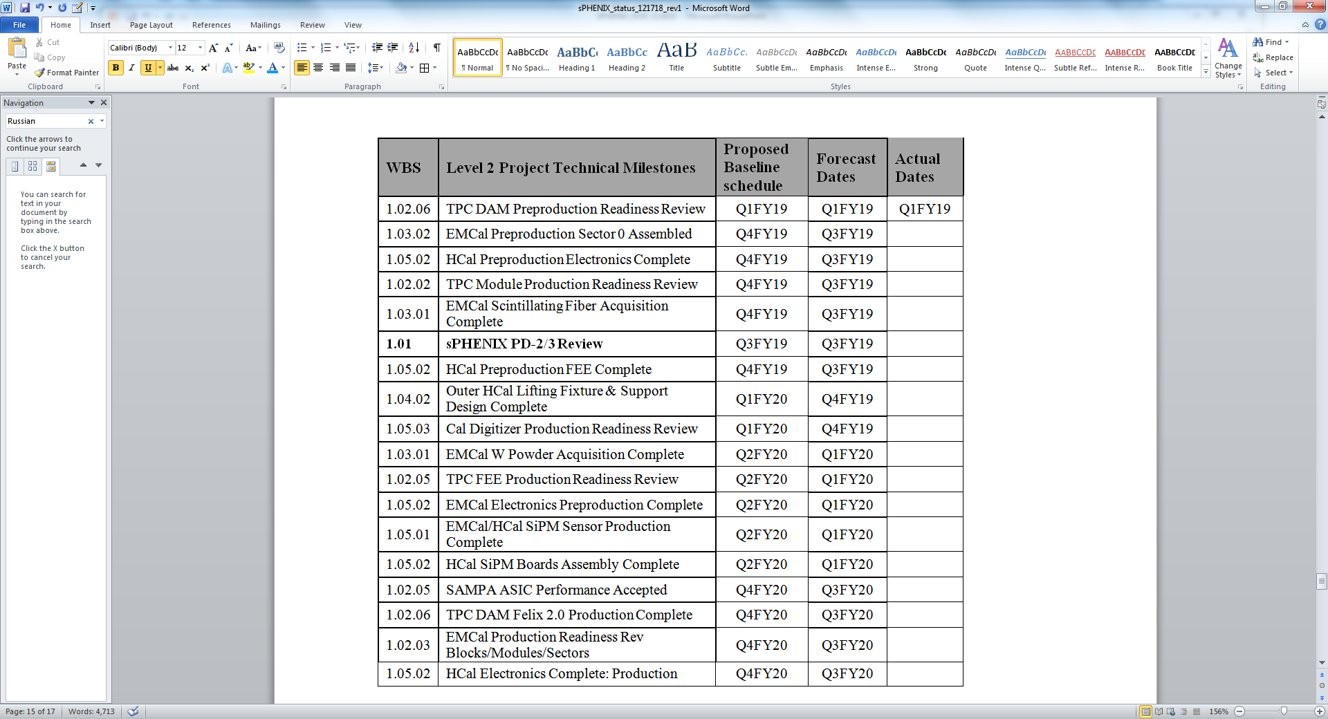
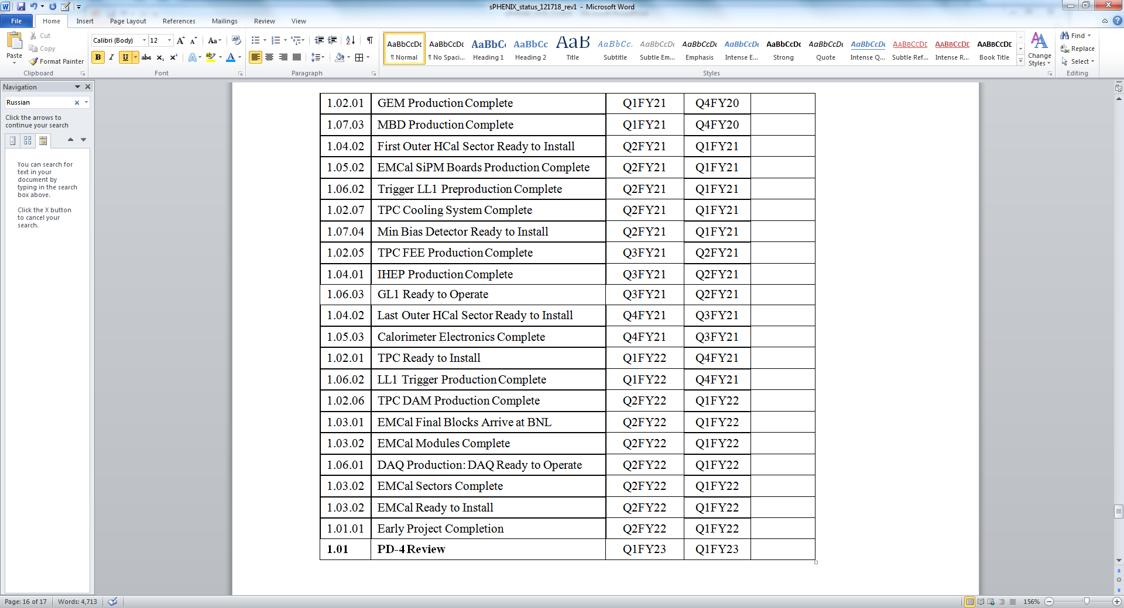
L1 and L2 Milestones

Slide 17
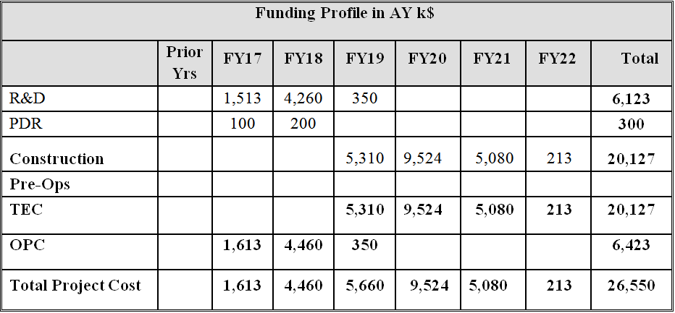
Budget Profile
sPHENIX Budget Profile

Slide 18
Project Management Update
Preliminary project baseline is set.
First EVMS reports have been generated.
P6 Data Date will be moved from Jan 1 to Mar 1 2019 after P6 Status updates on the last week of February.
CAMs will do monthly accruals along with monthly P6 status updates.
Project started analyzing EVMS reports.
All “practice” baseline changes will be incorporated via Change Control.
The first 2 Project Change Requests have been generated and is approved by the Change Control Board.
Preparations for Director’s Review are underway.

