Slide 1
sPHENIX Director’s Review Review
Project Overview
Edward O’Brien
April 9-11, 2019
BNL

Slide 2
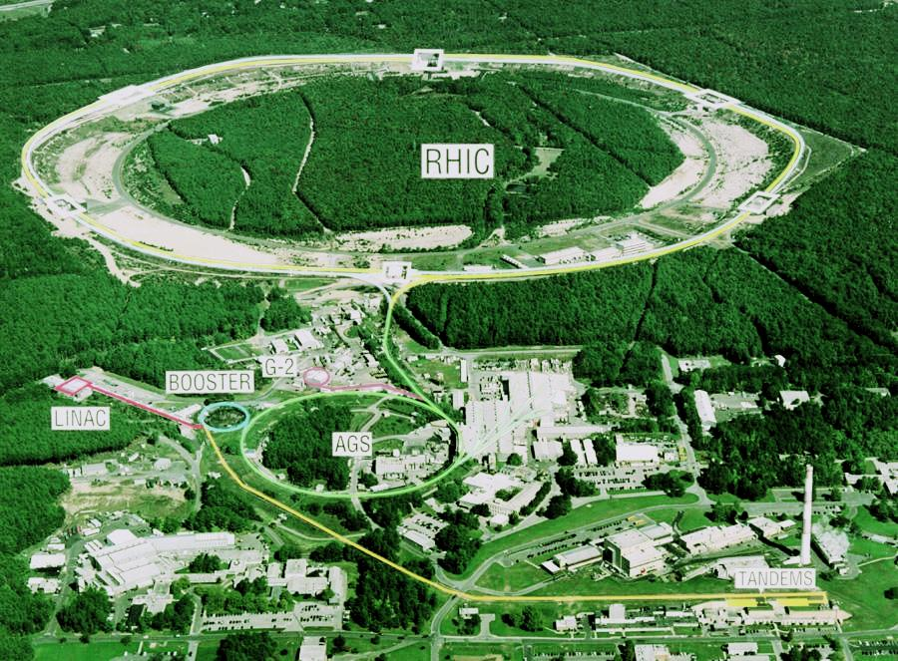
What is sPHENIX?
sPHENIX is a major upgrade to the PHENIX detector. It is a large-acceptance, high-rate detector for Heavy Ion physics that repurposes >$20M in existing PHENIX equipment, infrastructure and support facilities.
The detector is optimized to measure jet and heavy quark physics by incorporating a Time Projection Chamber, Electromagnetic and Hadronic Calorimeter with a high rate DAQ/Trigger and a 1.4 T solenoidal magnetic field.

Slide 3
sPHENIX MIE Overview
TPC | Project Leader | Last CD Achieved | % Complete | CPI | SPI
$24.2- 34.5M AY | Edward O’Brien | CD-1/3A | 14.3% based on actuals as of 2/2019 | Pre-baseline | Pre-baseline
Scope
Detector systems produced, tested and ready for installation: Time Projection Chamber w/ electronics, Electromagnetic Calorimeter w/ electronics, Hadronic Calorimeter w/ electronics, DAQ/Trigger, Minimum Bias Detector, Project Management
Installation and system commissioning is not part of the scope
Schedule
CD-0 received Sept 2016
CD-1/3A received Aug 2018
PD-2/3 review May 2019
Early completion Oct 2021
PD-4 Dec 2022
Cost
$24.2 – 34.5M AY
$27.0M AY Point cost estimate including ~25% contingency

Slide 4
sPHENIX MIE(1.X)+Infrastructure & Facility(2.X)+Silicon Dets(3.X)
TPC | Project Leader | Last CD Achieved | % Complete | CPI | SPI
$74.2- 86.0M AY | Edward O’Brien | CD-1/3A | 21.4% based on actuals as of 2/2019 | Pre-baseline | Pre-baseline
Scope
sPHENIX MIE+ Magnet Barrel Steel + BNL Contributed Labor + Infrastructure & Facility Upgrade
Installation and system commissioning is part of the scope
A $4.9M silicon vertex detector (MVTX) will be added to the upgrade portfolio. Finalizing the cost estimate this month.
Baseline RLS for 1008 Infrastructure and Facility. Revised Bottom-up contributed labor estimate MIE
Complete Revision of MVTX RLS is one of the main projects this month
Schedule
MIE PD-4 1QFY23
sPHENIX Upgrade Completion (ready for beam) 2QFY23

Slide 5
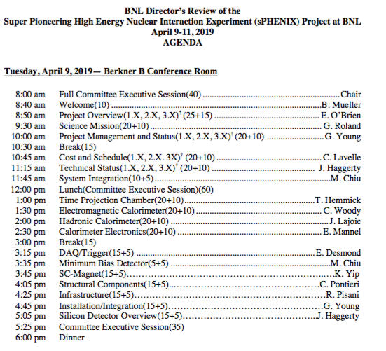
Director’s Review Organization
Features of the agenda:
Day-1 is all plenary talks
Day-2, Four breakout sessions
MIE
Infrastructure and Facility
Project Management
Silicon Detectors
One common drill down session in the Project Management breakout sessions
Time reserved Thursday morning for additional breakout session time if needed.

Slide 6
Director’s Review Draft Agenda

Slide 7
Director’s Review Charge
Is the sPHENIX final design technically mature, sound and likely to meet the performance expectations to support EO’B, D. Morrison, J. Haggerty, L2 talks and technical breakout sessions
Is the scope of each project sufficiently defined to support approval of PD-2 and PD-3? Are the specifications, designs, and execution plans likely to meet the technical performance requirements? Are the interfaces with other projects properly understood? EO’B, G. Young, J. Haggerty, L2 talks and technical breakout sessions
Are the project risks properly identified and are appropriate mitigation strategies in place? I. Sourikova
Is there a capable team in place to effectively manage the two projects as defined in the approved baseline for each? Does the management team have the resources and management tools necessary for the size and complexity of the overall effort? EO’B, G. Young, C. Lavelle

Slide 8
Director’s Review Charge
Are the cost and schedule estimates credible and adequately detailed to establish their respective baselines? Do they include adequate scope, cost, and schedule contingency? EO’B, C. Lavelle, G. Young, L2 Managers
Is the environment, safety and health (ES&H) and quality being properly addressed given the current state of the project? L. Stiegler, C. Gortakowski
Is the project being properly managed for this stage of the project? Are risks being effectively managed? Is the management team in place to successfully execute the CD-3A scope? EO’B, G. Young, C. Lavelle, project management breakout sessions
Have the recommendations from past reviews been appropriately addressed? EO’B

Slide 9
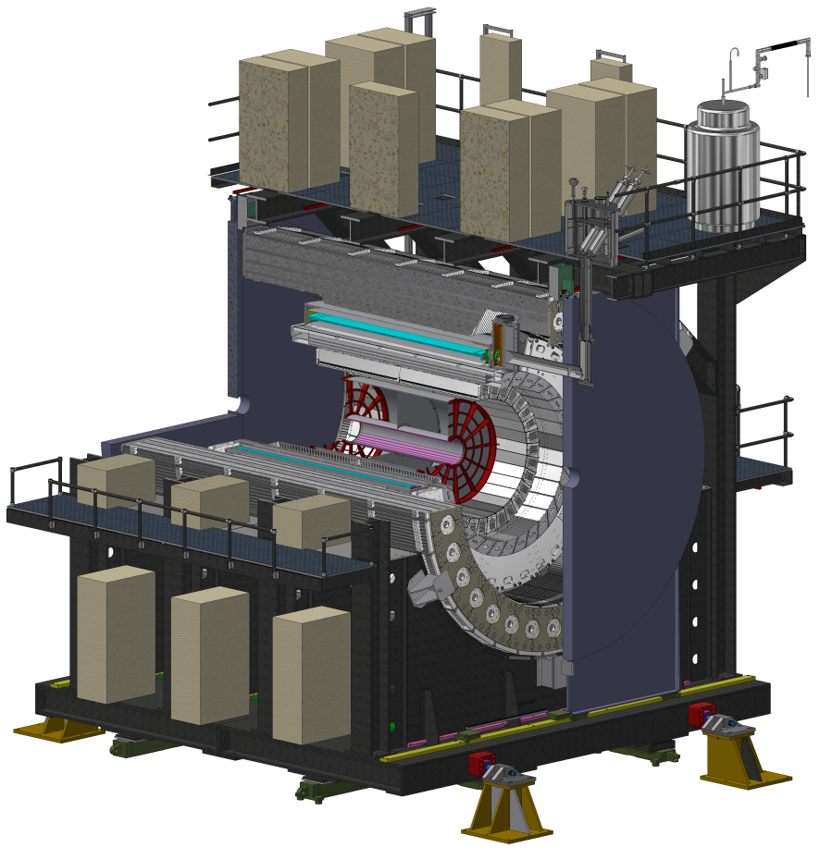
sPHENIX MIE (1.X)
To counting house
The final design of sPHENIX is driven by 3 principles:
Design a detector to meet the Science Mission of measurements of Jets and Upsilons in RHIC environment
Maximize cost effectiveness and utilize modern technologies where appropriate (SiPM, fast TPC readout)
Build on existing $20M+ PHENIX infrastructure

Slide 10
sPHENIX Infrastructure and Facility Upgrade(2.X)
WBS I&F Upgrade
2.1 I&F Management
2.2 SC Magnet
2.3 Carriage & Structural Components
2.4 Infrastructure
2.5 Installation & Integration

Slide 11
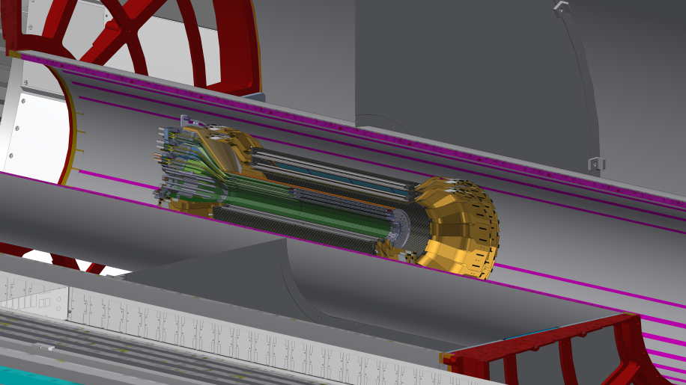
sPHENIX Silicon Detectors (3.X)
WBS Silicon Detectors
3.1 INTT
3.2 MVTX

Slide 12
Baseline Scope
MIE:
A Time Projection Chamber (TPC), Electromagnetic Calorimeter (EMCal), and a Hadronic Calorimeter (HCal) all covering 2p in azimuth. The TPC and HCal have pseudorapidity coverage of -1.1 ≤ h ≤ 1.1. The EMCal has pseudorapidity coverage of ‑0.85 ≤ h ≤ 0.85.
A Minimum Bias Trigger Detector (MBD).
Readout electronics to fully instrument the TPC, EMCal, HCal and MBD.
A data acquisition (DAQ) system with the capability to readout the TPC, EMCal, HCal and MBD with an event rate and data-logging rate commensurate with the sPHENIX physics goals.
A DAQ/Trigger system that can provide minimum bias and energy cluster triggers at a rate necessary to carry out the sPHENIX physics program in AA, pA and pp collisions at RHIC.
Project Management to carry the project scope through to a successful on time and on budget completion.

Slide 13
Baseline Scope
Infrastructure and Facility Upgrade:
SC-Magnet (formerly of BaBar) installed, mapped, commissioned and ready to operate
Includes cryogenics, power supplies and controls supporting SC-Magnet operation
Carriage/Cradle and mechanical structures supporting the detector
Includes magnet barrel flux return, pole tips, support platforms, access
Infrastructure in Building 1008 to support the detectors operation
Includes, HVAC, PS, water, gas systems, smoke detection/fire protection, safety systems including ODH
Integration and Installation of sPHENIX

Slide 14
Available Resources & External Dependencies
Complete
BNL has granted the sPHENIX MIE the Extraordinary Project Rate (Overhead)
Approved by BNL CFO 4/2017
Reuse of >$20M of existing infrastructure and equipment from the PHENIX experiment including use of the Building 1008 (PHENIX) complex
BNL-funded Infrastructure and Facility Upgrade (~$27M) to 1008 complex including bringing cryogenics for the SC-Magnet into the sPHENIX IR, upgrading safety, power, environmental controls, cooling systems, providing steel flux return for the magnet.
Former BaBar SC-magnet received from SLAC spring 2015. Tested to full current at BNL.
Si strip detector funded by RIKEN Lab –Japan
BNL and Collaborator contributed labor
Addition of MVTX silicon pixel detector.
Extended (in eta) EMCal coverage to (-1.1< eta < 1.1) from international sources
Potential NSF-funded instrumentation of an Inner HCal

Slide 15
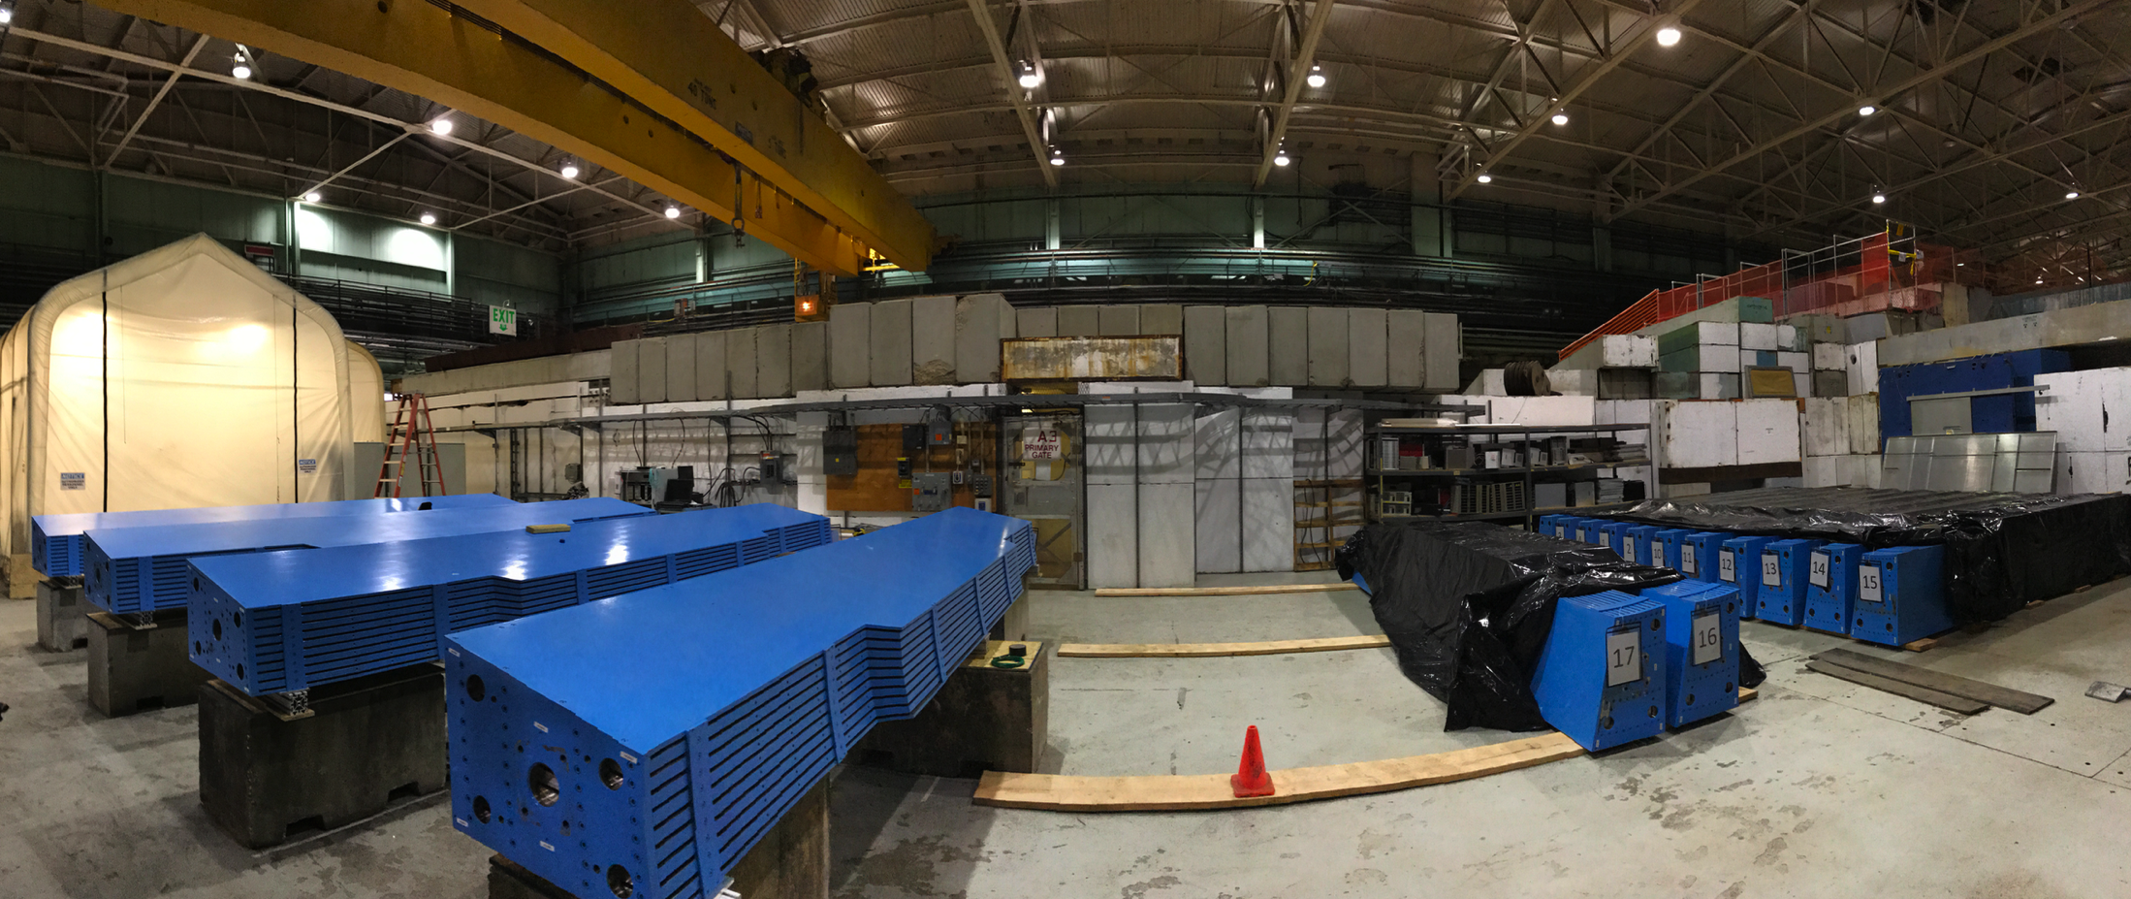
18 Barrel Magnet Steel Sectors at BNL
HCal assembly factory on the BNL AGS floor

Slide 16
sPHENIX Technical Progress Since CD-1/3A Approval
Three of four LLP’s approved at CD-3A have been ordered with then 4th submitted to BNL for approval. They are: 100k SiPMs, Scin fiber for EMCal, Scin tiles for HCal, tungsten powder for EMCal
The preliminary project baseline is set and EVMS practice gone on since start of January.
First partial delivery of LLP-1 orders, 8500 SiPMs, arrived at Univ. of Michigan Mar 8. First partial deliver of scin fibers expected at UIUC in April.
Magnet Barrel steel sectors continue to arrive at BNL at a rate of ~ one/week.
As of April 5, 21 out of 32 sectors at BNL
EMCal preproduction Sector 0 construction underway.
Approximately 900 preproduction scintillating tiles for HCal fabbed with testing at GSU started. First 200 tested at GSU had 95% within good performance range. Tests continuing.
Held Procurement Readiness Review for 1008 cryo component order. Prepping for issuing the RFP later this spring.
R&D work progressing on all sPHENIX detector components.

Slide 17
sPHENIX Management Organization
We have an established and experienced project organization. The majority of the Project Office and L2 Managers have been working together on sPHENIX for over three years. Many in the organization have been collaborating for over twenty years, since the days of PHENIX construction.

Slide 18
Project Team Experience
Edward O’Brien
Project Director
Senior Scientist, Physics Department, BNL
Relevant Experience
Three years as sPHENIX Project Director. Thirteen years as PHENIX Operations Director during which time he coordinated the addition of $25M in upgrade detectors to PHENIX and managed a staff of 25-30 FTEs. Four years as project manager of the $10M PHENIX Central Tracking system. Eight years as head of the PHENIX Central Tracking group and Project Manager of the $4M Time Expansion Chamber. Designed and built major components of the E814/E877 Tracking System, a BNL AGS fixed-target HI experiment.
John Haggerty
Project Scientist
Senior Scientist, Physics Department, BNL
Relevant Experience BNL AGS/E-787 1986-1996, DAQ and 500 MHz waveform digitizers; PHENIX Deputy Project Manager, 1997-2001; PHENIX Data Acquisition Coordinator, 2001-2007; PHENIX Deputy Operations Director, 2008-2016; PHENIX Run Coordinator 2009-2010; sPHENIX management 2012-present. Design, construction, implementation, and software support for PHENIX timing system, slow controls of front end electronics, high speed PCI interface to DAQ. Managed BaBar solenoid move to BNL. Lead Scientist for Fermilab T1044, the prototype sPHENIX Calorimeter test, 2014-2018.
Glenn Young
Project Manager
Senior Scientist, Physics Department, BNL
Relevant Experience
Glenn Young was at Oak Ridge National Laboratory from 1978 until 2009, serving in many capacities, including Physics Division Director. He led ORNL’s work on a series of heavy ion experiments at CERN (WA80, WA93, WA98). He was one of the founders of the PHENIX experiment in 1991 and led contributions by the Oak Ridge group to many PHENIX systems, and served as the experiment’s Deputy Spokesperson. He went to Thomas Jefferson National Accelerator Facility in 2009, and led the experimental program for the 12 GeV upgrade. He joined sPHENIX as Project Manager in 2017.
Cathy Lavelle, PMP
Resource Coordinator
Manager of the BNL Project Management Center
Relevant Experience
She obtained BNL Earned Value Management Systems (EVMS) Certification in 2008 and maintained certification to present day through DOE and Internal Surveillance Reviews and Implementation. She worked as NSLS-II Project Controls Manager from Project Inception February 2006 through completion March 2015, CFN, BGRR, HFBR and INSP Project Controls Specialist from 1994 through 2006. She worked for EG&G on the Superconducting Super Collider Project from 1990 through 1994 as the Cost Performance Manager and has worked for DOD contractors (Lockheed Sanders/GE Joint Venture, Honeywell, and Northrop Corporation) from 1980 through 1990 as a Project Scheduler and Project Controls Supervisor.

Slide 19
Project Team Experience
James Mills, P.E.
Project Engineer
Senior Project Engineer, Collider-Accelerator Department, BNL
Relevant Experience Over 37 years of Engineering and Project Management experience at Brookhaven National Laboratory. 8 years as Manager of the Modernization Project Office Engineering and Design Group (2006-2014) with overall responsibility for the successful completion of a portfolio of projects in excess of $15 million annually; 6 years as Project Engineer for conventional construction in support of facility operations at Brookhaven (2000-2006); managing projects up to $6 million in total scope. 4 years of experience as Head of the Facility and Experimental Support Group, RHIC Project (1996-2000). Responsible for approximately $13 million dollars of conventional construction in support of experiments at RHIC. 6 years as Project Engineer for the STAR Magnet (1990-1996), providing engineering analysis and design of the 0.5 Tesla solenoidal magnet.
Irina Sourikova, PMP
Project Controls
Physics Department, BNL
Advanced Applications Engineer
Relevant Experience Sixteen years as PHENIX software Engineer, database developer and database administrator. Designed, implemented and supported PHENIX calibrations and collaboration databases providing legacy data migration, data archival and replication. Two years as sPHENIX Project Controls. Certified Project Management Professional.
The sPHENIX Project team has decades of experience managing DOE (NP, BES and HEP) projects, including sPHENIX, PHENIX, NSLS-II, JLab 12 GeV, STAR, NSLS, BNL F&O…
Russ Feder
Chief Mechanical Engineer
Mechanical Engineer, Physics Department, BNL
Relevant Experience

Slide 20
Revise to show 1.X, 2.X, 3.X
1.01 sPHENIX Project Management I. Sourikova
1.02 sPHENIX TPC T. Hemmick
1.02.01 TPC Mechanics K. Dehmelt
1.02.02 TPC R1 Modules W. Llope
1.02.03 TPC R2 Modules V. Green
1.02.04 TPC R3 Modules S. Milov, B. Surrow
1.02.05 TPC FEE T. Sakaguchi
1.02.06 TPC DAM J. Huang
1.02.07 TPC Support Systems R. Pisani
1.03 sPHENIX EMCal C. Woody
1.03.01 EMCAL Block Production A. Sickles
1.03.02 EMCAL Module Production and Sector Assembly S. Stoll
1.04 sPHENIX HCal J. Lajoie
1.04.01 Inner HCal Frame J. Lajoie
1.04.02 Outer HCal M. Connors*, C. Pontieri*, S. Bathe*
1.05 sPHENIX Cal Electronics E. Mannel
1.05.01 Optical Sensors C. Aidala
1.05.02 Calorimeter Front End Electronics S. Boose
1.05.03 Calorimeter Digitizer System CY Chi
1.06 sPHENIX DAQ & Trigger M. Purschke
1.06.01 DAQ E. Desmond
1.06.02 Trigger J. Nagle
1.06.03 Global Level 1 (GL1) E. Desmond
1.06.04 Timing System M. Purschke
1.07 sPHENIX MinBias Trigger Detector M. Chiu
All Control Account Managers are at L2
*Managed at L4
Key:
Level 2: Level 3:
WBS Code WBS Name Owner
WBS Code WBS Name Owner

Slide 21
sPHENIX Key Dates in the RLS
sPHENIX CD-0 Sept 2016
Initial Project funding release 2QFY17
CD-1/CD-3a approval 4QFY18
CD3a Budget Appropriation 1QFY19
CD-2/CD-3 approval 4QFY19
MIE early completion date 1QFY22
CD-4 1QFY23
Ready for potential RHIC run CY 2023
RLS has 14 months of schedule contingency to CD-4

Slide 22
MIE Summary Schedule
Critical Path runs through:
- EMCal Prototype Procure
- Cal. Elec. Fab/Assy
- Calorimeter Elec. Procure
- Cal. Elec. Fab/Assy
(SiPMs) Production
- EMCal Module/Sector
Prod. Fab/Assy
- EMCal Sector Testing
- Early Completion
14 months schedule contingency

Slide 23
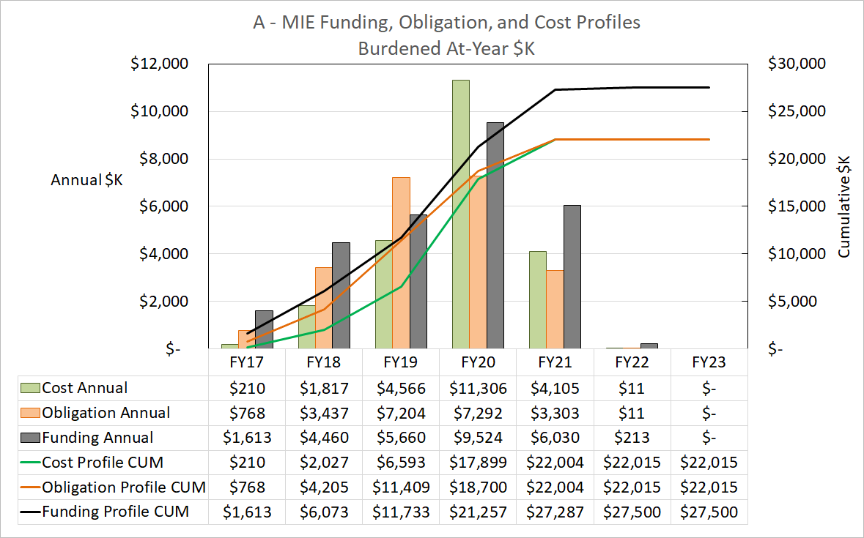
MIE Funding, Obligation, and Cost Profiles

Slide 24
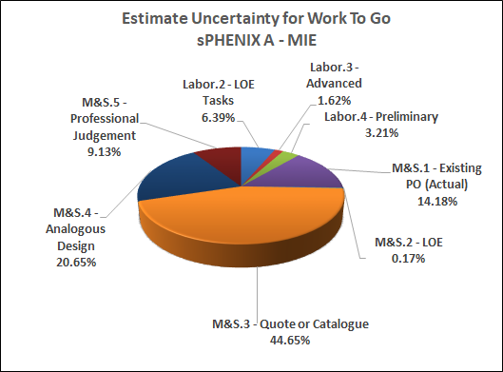
MIE Basis of Estimate Breakdown
We have a mature estimate for a project approaching CD-1.
Quotes +Catalog Prices + Actuals compose ~65% of the Work To Go

Slide 25
Budget Profile as of CD-1/3A
sPHENIX Budget Profile

Slide 26
Budget Profile to be Presented at PD-2/3 Review
sPHENIX Budget Profile

Slide 27
MIE Labor Summary by Labor Source
MIE Costed Labor +
BNL Contributed Labor + Collaborator Labor (Paid & Contributed)

Slide 28
Risk Registry and Risk Management Plan
The Project team together with the L2, L3 Managers and engineers have developed a detailed Risk Registry and Risk Management plan for the MIE.
Risk Cost and Schedule impacts have been calculated and are major inputs into our contingency calculations.
The RMP and RR were reviewed in Jan 2018 by Project experts from NSLS-II
We’ve started to hold Risk meetings with the Project Team and L2 Managers. Plan is to meet once/month to discuss risks.
See breakout talk by Irina Sourikova

Slide 29
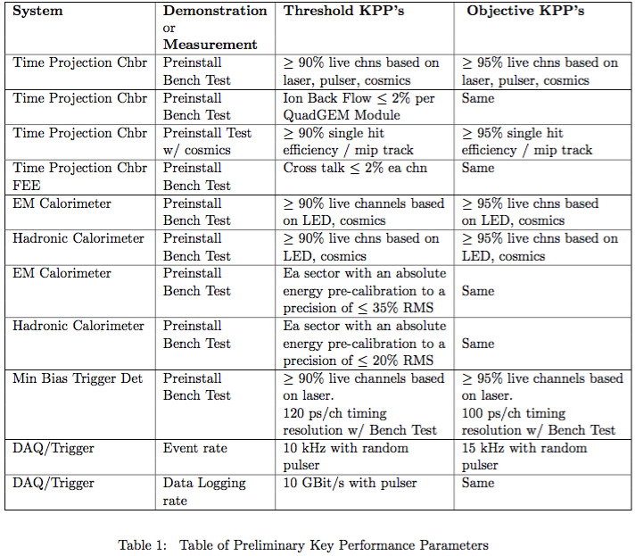
Threshold & Objective KPP’s
The individual L2 components of sPHENIX are the MIE deliverables.
Installation is NOT part of the MIE and not a deliverable.
Beam collisions are not needed to satisfy the KPP’s.

Slide 30
ES&H and QA
The sPHENIX MIE has ES&H and QA experts embedded by BNL in the project.
The ES&H and QA reps have led the effort to develop sPHENIX specific Safety and quality documents: Preliminary Hazard Analysis Report, Quality Assurance Plan.
The QA rep developed QA procedures and criteria for work on preproduction prototypes at collaborating universities, and R&D contracts with vendors .
ES&H experts are being used to develop plans for sPHENIX detector component fabrication areas at BNL.
https://indico.bnl.gov/event/4625/attachments/18449/23122/PHAR_050918.pdf
https://indico.bnl.gov/event/4625/attachments/18441/23130/QA_Plan_sPHENIX_Project.pdf
See:
ES&H breakout talk by Lori Stiegler
QA breakout talk by Chuck Gortakowski

Slide 31
Issues and Concerns

Slide 32
Summary
).
sPHENIX is ready for PD-2/3

Slide 33
Back Up

