Slide 1
sPHENIX Director’s Review Review
Project Overview
Edward O’Brien
April 9-11, 2019
BNL

Slide 2
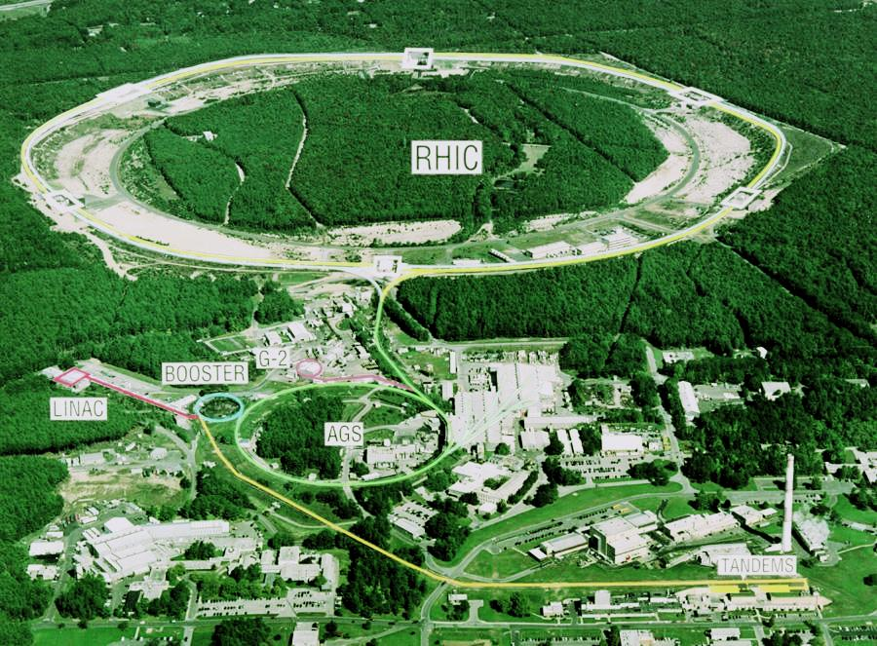
What is sPHENIX?
sPHENIX is a major upgrade to the PHENIX detector. It is a large-acceptance, high-rate detector for Heavy Ion physics that repurposes >$20M in existing PHENIX equipment, infrastructure and support facilities.
The detector is optimized to measure jet and heavy quark physics by incorporating a Time Projection Chamber, Electromagnetic and Hadronic Calorimeter with a high rate DAQ/Trigger and a 1.4 T solenoidal magnetic field.

Slide 3
sPHENIX MIE Overview
TPC | Project Director | Last CD Achieved | % Complete | CPI | SPI
$24.2- 34.5M AY | Edward O’Brien | CD-1/3A | 15.2% based on actuals as of 3/2019 | Pre-baseline | Pre-baseline
Scope
Detector systems produced, tested and ready for installation: Time Projection Chamber w/ electronics, Electromagnetic Calorimeter w/ electronics, Hadronic Calorimeter w/ electronics, DAQ/Trigger, Minimum Bias Detector, Project Management
Installation and system commissioning is not part of the scope
Schedule
CD-0 received Sept 2016
CD-1/3A received Aug 2018
PD-2/3 review May 2019
Early completion Oct 2021
PD-4 Dec 2022
Cost
$24.2 – 34.5M AY
$27.0M AY Point cost estimate including ~25% contingency

Slide 4
MIE(1.X)+Infrastructure & Facility(2.X) + BNL Contributed Labor
TPC | Project Director | Last CD Achieved | % Complete | CPI | SPI
$74.2- 87.0M AY | Edward O’Brien | CD-1/3A | 23.1% based on actuals as of 3/2019 | Pre-baseline | Pre-baseline
Scope
sPHENIX MIE + Infrastructure & Facility Upgrade + BNL Contributed Labor
Installation, integration and system commissioning is part of the scope
A $4.9M silicon vertex detector (MVTX) will be added to the upgrade portfolio.
Baseline-ready RLS for 1008 Infrastructure and Facility. Revised Bottom-up contributed labor estimate MIE
Complete Revision of MVTX RLS is needs to be completed to incorporate information from recent scrubbing exercise.
Schedule
sPHENIX Upgrade Completion (ready for beam) 2QFY23

Slide 5
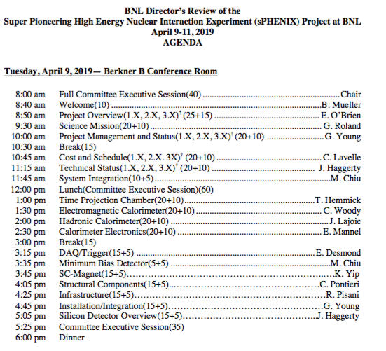
Director’s Review Organization
Features of the agenda:
Day-1 is all plenary talks
Day-2, Four breakout sessions
MIE
Infrastructure and Facility
Project Management
Silicon Detectors
One common drill down session in the Project Management breakout sessions
Time reserved Thursday morning for additional breakout session time if needed.

Slide 6
Director’s Review Draft Agenda

Slide 7
Director’s Review Charge
Is the sPHENIX final design technically mature, sound and likely to meet the performance expectations to support EO’B, G. Young, J. Haggerty, L2 talks and technical breakout sessions
Is the scope of each project sufficiently defined to support approval of PD-2 and PD-3? Are the specifications, designs, and execution plans likely to meet the technical performance requirements? Are the interfaces with other projects properly understood and documented? EO’B, G. Young, J. Haggerty, M. Chiu, L2 talks and technical breakout sessions
Are the project risks properly identified and are appropriate mitigation strategies in place? I. Sourikova
Is there a capable team in place to effectively manage the two projects as defined in the approved baseline for each? Does the management team have the resources and management tools necessary for the size and complexity of the overall effort? EO’B, G. Young, C. Lavelle

Slide 8
Director’s Review Charge
Are the cost and schedule estimates credible and adequately detailed to establish their respective baselines? Do they include adequate scope, cost, and schedule contingency? EO’B, C. Lavelle, G. Young, I. Sourikova, L2/L3 Managers
Is the environment, safety and health (ES&H) and quality being properly addressed given the current state of the project? L. Stiegler, C. Gortakowski
Have all the prerequisite activities and documents necessary to support PD-2 and PD-3 approval been completed? Is the project ready for a PD-2/PD-3? EO’B, G. Young, C. Lavelle, project management breakout sessions
Have the recommendations from past reviews been appropriately addressed? EO’B (breakout session)

Slide 9
Director’s Review Charge
sPHENIX Tracking System Upgrades (Silicon Detectors)
Is the conceptual design sound and likely to meet the project’s technical performance requirements most efficiently and effectively? J. Haggerty, M. Liu, R. Nouicer, MVTX and INTT L3 Managers
Are the project’s scope and specifications sufficiently defined to support the preliminary cost and schedule estimate? Are the interfaces with the sPHENIX MIE project and Infrastructure and Facility Upgrade project properly understood and documented? J. Haggerty, M. Liu, R. Nouicer, MVTX and INTT L3 Managers
Are the project risks properly identified and appropriate mitigation strategies in place? M. Liu, R. Nouicer, MVTX and INTT L3 Managers
Are the cost and schedule estimates credible and realistic for this stage of the project? Do they include adequate scope, cost and schedule contingency? C. Lavelle, M. Liu, R. Nouicer, MVTX and INTT L3 Managers
Is the project being properly managed at the stage? Is the documentation appropriate at this stage of the project? M. Liu, R. Nouicer
Is the environment, safety and health (ES&H) and quality being properly addressed given the current state of the project? L. Stiegler, C. Gortakowski

Slide 10
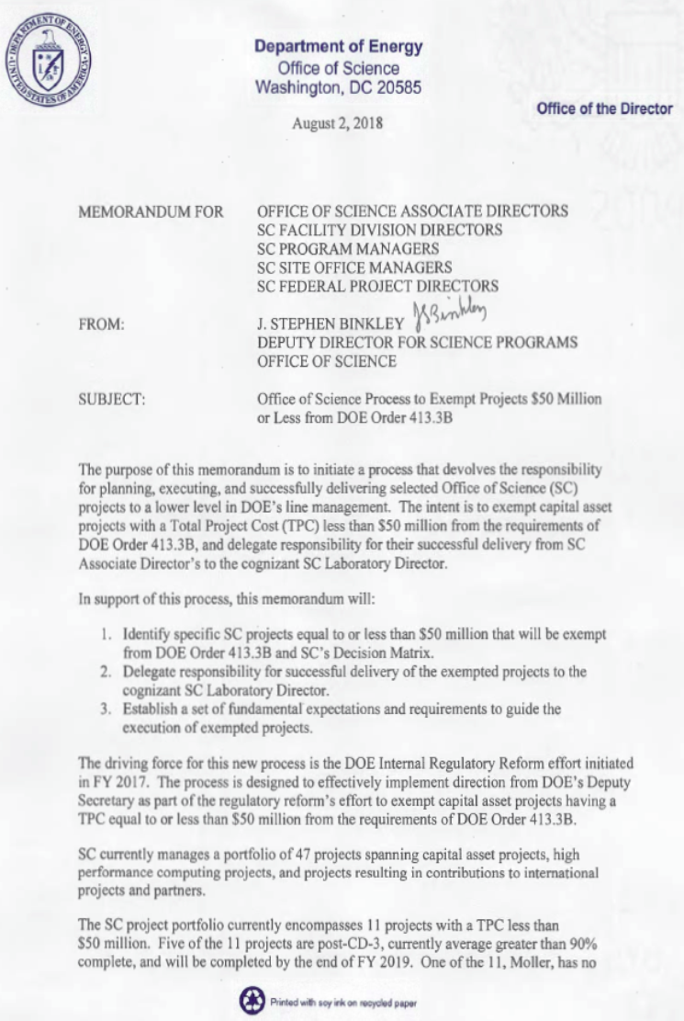
Change in DOE-SC Rules for MIE’s with TPC’s ≤ $50M
DOE SC Memo on Project Management dated August 2, 2018
Raised threshold for application of DOE Order 413.3B from $10M to $50M for SC projects.
sPHENIX was on the DOE SC list of projects impacted by the change.
Delegation for managing these projects now the responsibility of Laboratory Director
DOE-OPA no longer responsible for managing these projects.
ONP prepared guidance document for NP Oversight
BNL has generated a procedure to address the management of sub $50M MIE’s. (Cathy Lavelle)
BNL Procedure in process of being added to SBMS Project Management – Management System.
DOE will assign a PEMP goal to BNL to hold them accountable for the successful execution of the project.
sPHENIX must produce a PMP approved by BNL w/ concurrence by DOE.
sPHENIX has produced a preliminary PMP signed by BNL & DOE

Slide 11
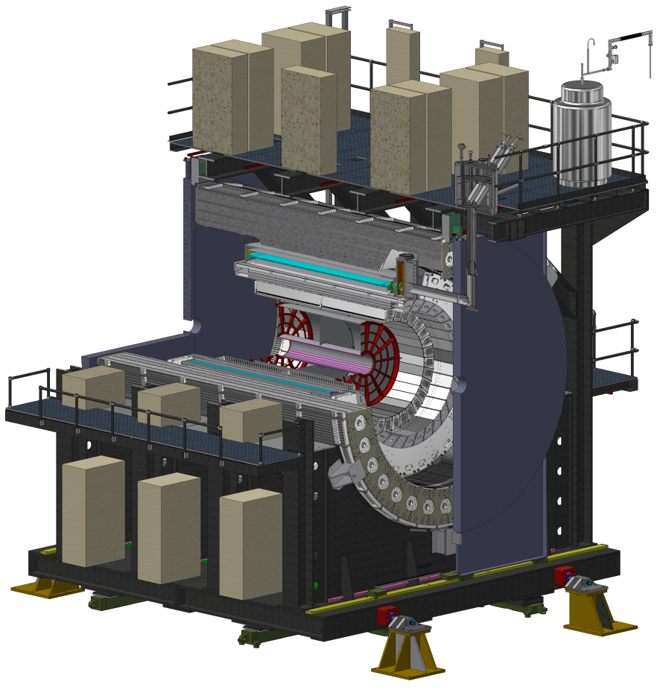
sPHENIX MIE (1.X)
WBS MIE
1.1 Project Management
1.2 Time Projection Chamber
1.3 EM Calorimeter
1.4 Hadronic Calorimeter
1.5 Calorimeter Electronics
1.6 DAQ/Trigger
1.7 Minimum Bias Detector
To counting house
The final design of sPHENIX is driven by 3 principles:
Design a detector to meet the Science Mission of measurements of Jets and Upsilons in RHIC environment
Maximize cost effectiveness and utilize modern technologies where appropriate (SiPM, fast TPC readout)
Build on existing $20M+ PHENIX infrastructure

Slide 12
sPHENIX Infrastructure and Facility Upgrade(2.X)
WBS I&F Upgrade
2.1 I&F Management
2.2 SC Magnet
2.3 Carriage & Structural Components
2.4 Infrastructure
2.5 Installation & Integration
Three large M&S items:
Barrel Magnet steel
Carriage/Cradle/Poletips/Platform
Cryogenics for 1008
Three main labor items:
SC-Magnet
Carriage/Cradle/Poletips/Platform(engineering design)
Installation/Integration

Slide 13
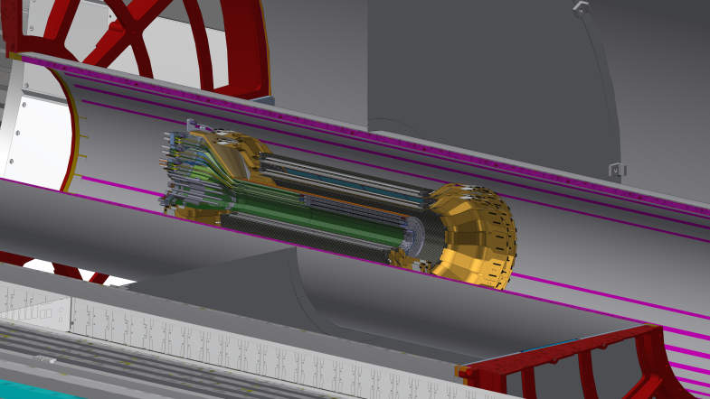
sPHENIX Silicon Detectors (3.X)
WBS Silicon Detectors
3.1 INTT
3.2 MVTX
Enables flavor-tagged physics
Separates multiple vertices at high luminosity
Provides tracking between vertex and TPC

Slide 14
Baseline Scope
MIE (1.X):
A Time Projection Chamber (TPC), Electromagnetic Calorimeter (EMCal), and a Hadronic Calorimeter (HCal) all covering 2π in azimuth. The TPC and HCal have pseudorapidity coverage of -1.1 ≤ η ≤ 1.1. The EMCal has pseudorapidity coverage of ‑0.85 ≤ η ≤ 0.85.
A Minimum Bias Trigger Detector (MBD).
Readout electronics to fully instrument the TPC, EMCal, HCal and MBD.
A data acquisition (DAQ) system with the capability to readout the TPC, EMCal, HCal and MBD with an event rate and data-logging rate commensurate with the sPHENIX physics goals.
A DAQ/Trigger system that can provide minimum bias and energy cluster triggers at a rate necessary to carry out the sPHENIX physics program in AA, pA and pp collisions at RHIC.
Project Management to carry the project scope through to a successful on time and on budget completion.

Slide 15
Baseline Scope
Infrastructure and Facility Upgrade (2.X):
SC-Magnet (formerly of BaBar) installed, mapped, commissioned and ready to operate at full current.
Includes cryogenics, power supplies and controls supporting SC-Magnet operation
Carriage/Cradle and mechanical structures necessary to support the detector
Includes magnet barrel flux return, pole tips, support platforms, access
Infrastructure in Building 1008 to support the detectors operation
Includes, HVAC, PS, water, gas systems, smoke detection/fire protection, safety systems including ODH
Integration and Installation of sPHENIX

Slide 16
Baseline Scope
Silicon Detectors (3.X):
INTT: Two layers of silicon strip sensors covering 2π in azimuth and -1 < η < 1 for a vertex cut of ±10 cm.
MVTX: Three layers of silicon pixel sensors employing Monolithic Active Pixel Sensor (MAPS) technology and closely modeled on the ALICE ITS detector.

Slide 17
Documents Required for PD-2/3
Documents provided to the committee and required for PD-2/3:
TDR – advanced draft
PMP (approved preliminary document) PMP is a minor revision of the approved PMP
BOEs and WBS Dictionary ( 26 BOEs covering 1.X and 2.X) WBS final. BOEs minor revisions due to 1 more PCR prior to PD-2/3
Hazard Analysis Plan - final
Risk Registry and RMP – final for PD-2/3
Cost Books (1.X, 2.X), P6 reports (1.X, 2.X), Critical paths(1.X, 2.X) – Minor revisions due to 1 more PCR prior to PD-2/3
In addition we’ve provided reports from previous Director’s and DOE reviews, NEPA, SVA’s, DOE/BNL Guideline for SC projects with TPC $50M or less.

Slide 18
Available Resources & External Dependencies
Complete
BNL has granted the sPHENIX MIE the Extraordinary Project Rate (Overhead)
Approved by BNL CFO 4/2017
Reuse of >$20M of existing infrastructure and equipment from the PHENIX experiment including use of the Building 1008 (PHENIX) complex
BNL-funded Infrastructure and Facility Upgrade (~$27M) to 1008 complex including bringing cryogenics for the SC-Magnet into the sPHENIX IR, upgrading safety, power, environmental controls, cooling systems, providing steel flux return for the magnet.
Former BaBar SC-magnet received from SLAC spring 2015. Tested to full current at BNL.
Si strip detector funded by RIKEN Lab –Japan
BNL and Collaborator contributed labor
Addition of MVTX silicon pixel detector. It is a BNL sub-$5M capital project.
Extended (in eta) EMCal coverage to (-1.1< eta < 1.1) from international sources
Potential NSF-funded instrumentation of an Inner HCal

Slide 19
sPHENIX Technical Progress Since CD-1/3A Approval
Three of four LLP’s approved at CD-3A have been ordered with then 4th submitted to BNL for approval. They are: 100k SiPMs, 2500km of Scin fiber for EMCal, 7000 Scin tiles for HCal, 19 metric tons of tungsten powder for EMCal
The preliminary project baseline is set and EVMS practice has proceeded since start of January.
Partial delivery of LLP-1 orders, 17,000 SiPMs, arrived at Univ. of Michigan. First partial deliver of LLP-2 scintillating fibers expected at UIUC in April.
Magnet Barrel steel sectors continue to arrive at BNL at a rate of ~ one/week.
As of April 5, 21 out of 32 sectors at BNL
EMCal preproduction Sector 0 construction underway. All sector 0 blocks complete.
Approximately 1000/1600 preproduction scintillating tiles for HCal fabbed with testing at GSU started. First 200 tested at GSU with >95% within the performance range. Testing continues.
Held Procurement Readiness Review for 1008 cryo component order. Prepping for issuing the RFP later this spring.
Held a Preliminary Engineering design review for the Carriage/Cradle. Prepping for start of RFQ process in summer 2019
R&D work progressing on all sPHENIX detector components.

Slide 20
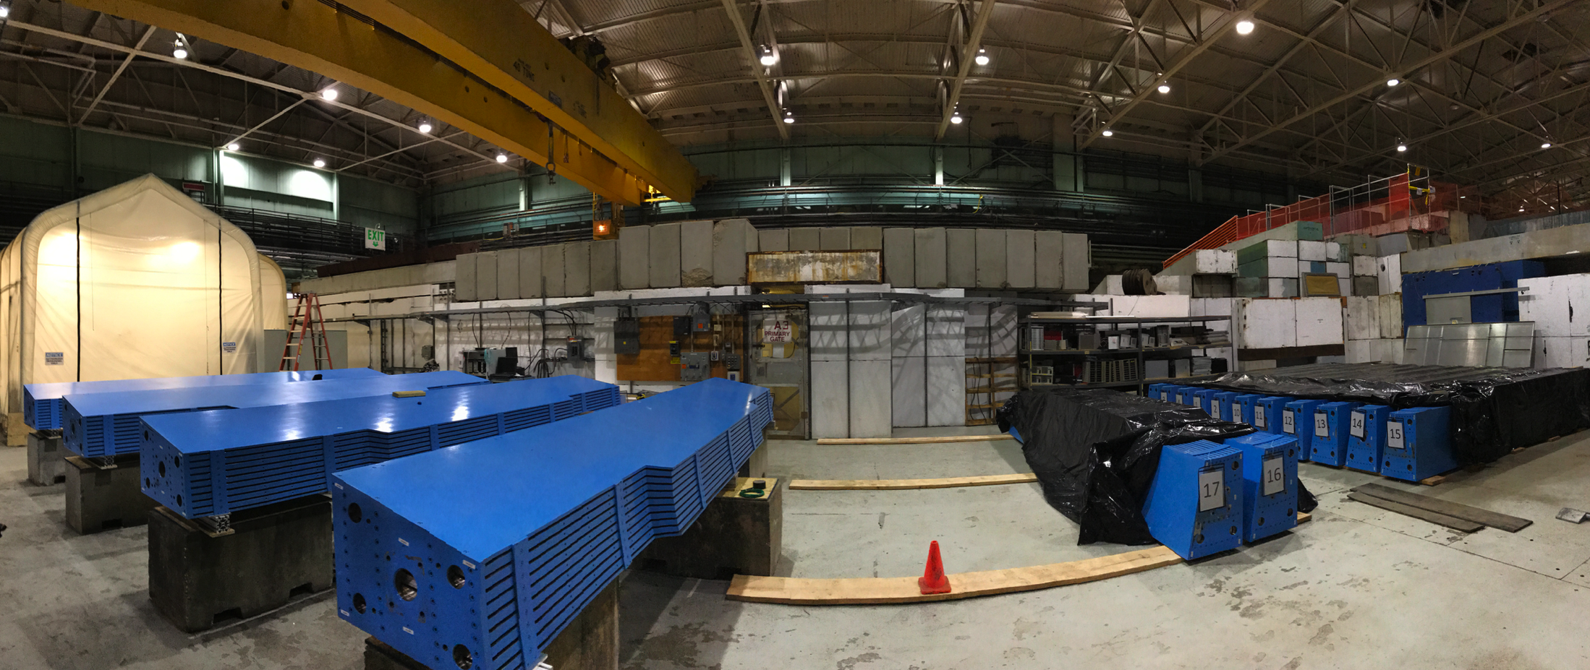
21 Barrel Magnet Steel Sectors at BNL
HCal assembly factory on the BNL AGS floor

Slide 21
sPHENIX Management Organization MIE(1.X)
We have an established and experienced project organization. The majority of the Project Office and L2 Managers have been working together on sPHENIX for over four years. Many in the organization have been collaborating for over twenty years, since the days of PHENIX construction.

Slide 22
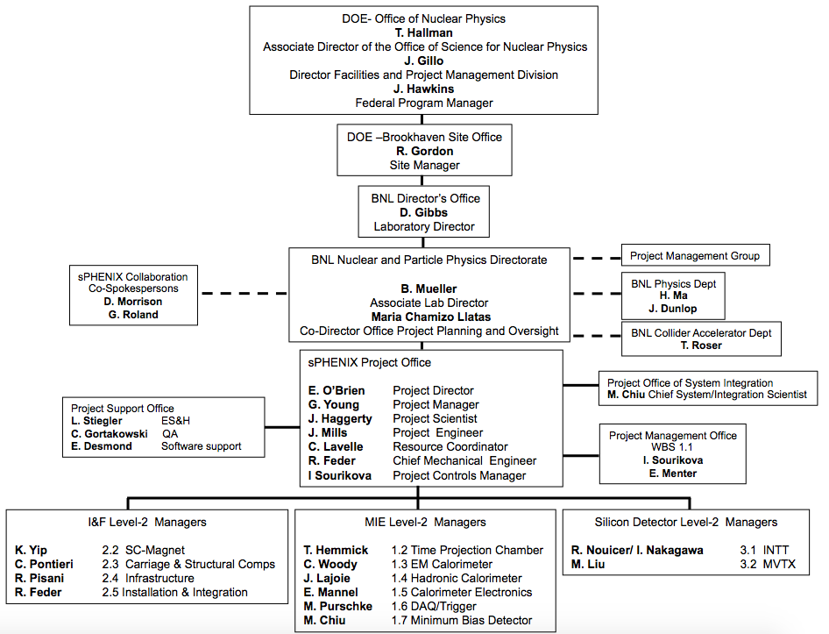
sPHENIX Management Organization 1.X, 2.X, 3.X
The organization for the management of the 1.X, 2.X and 3.X is identical to each other.

Slide 23
Project Team Experience
Edward O’Brien
Project Director
Senior Scientist, Physics Department, BNL
Relevant Experience
Four years as sPHENIX Project Director. Thirteen years as PHENIX Operations Director during which time he coordinated the addition of $25M in upgrade detectors to PHENIX and managed a staff of 25-30 FTEs. Four years as project manager of the $10M PHENIX Central Tracking system. Eight years as head of the PHENIX Central Tracking group and Project Manager of the $4M Time Expansion Chamber. Designed and built major components of the E814/E877 Tracking System, a BNL AGS fixed-target HI experiment.
John Haggerty
Project Scientist
Senior Scientist, Physics Department, BNL
Relevant Experience BNL AGS/E-787 1986-1996, DAQ and 500 MHz waveform digitizers; PHENIX Deputy Project Manager, 1997-2001; PHENIX Data Acquisition Coordinator, 2001-2007; PHENIX Deputy Operations Director, 2008-2016; PHENIX Run Coordinator 2009-2010; sPHENIX management 2012-present. Design, construction, implementation, and software support for PHENIX timing system, slow controls of front end electronics, high speed PCI interface to DAQ. Managed BaBar solenoid move to BNL. Lead Scientist for Fermilab T1044, the prototype sPHENIX Calorimeter test, 2014-2018.
Glenn Young
Project Manager
Senior Scientist, Physics Department, BNL
Relevant Experience
Glenn Young was at Oak Ridge National Laboratory from 1978 until 2009, serving in many capacities, including Physics Division Director. He led ORNL’s work on a series of heavy ion experiments at CERN (WA80, WA93, WA98). He was one of the founders of the PHENIX experiment in 1991 and led contributions by the Oak Ridge group to many PHENIX systems, and served as the experiment’s Deputy Spokesperson. He went to Thomas Jefferson National Accelerator Facility in 2009, and led the experimental program for the 12 GeV upgrade. He joined sPHENIX as Project Manager in 2017.
Cathy Lavelle, PMP
Resource Coordinator
Manager of the BNL Project Management Center
Relevant Experience
She obtained BNL Earned Value Management Systems (EVMS) Certification in 2008 and maintained certification to present day through DOE and Internal Surveillance Reviews and Implementation. She worked as NSLS-II Project Controls Manager from Project Inception February 2006 through completion March 2015, CFN, BGRR, HFBR and INSP Project Controls Specialist from 1994 through 2006. She worked for EG&G on the Superconducting Super Collider Project from 1990 through 1994 as the Cost Performance Manager and has worked for DOD contractors (Lockheed Sanders/GE Joint Venture, Honeywell, and Northrop Corporation) from 1980 through 1990 as a Project Scheduler and Project Controls Supervisor.

Slide 24
Project Team Experience
James Mills, P.E.
Project Engineer
Senior Project Engineer, Collider-Accelerator Department, BNL
Relevant Experience Over 37 years of Engineering and Project Management experience at Brookhaven National Laboratory. 8 years as Manager of the Modernization Project Office Engineering and Design Group (2006-2014) with overall responsibility for the successful completion of a portfolio of projects in excess of $15 million annually; 6 years as Project Engineer for conventional construction in support of facility operations at Brookhaven (2000-2006); managing projects up to $6 million in total scope. 4 years of experience as Head of the Facility and Experimental Support Group, RHIC Project (1996-2000). Responsible for approximately $13 million dollars of conventional construction in support of experiments at RHIC. 6 years as Project Engineer for the STAR Magnet (1990-1996), providing engineering analysis and design of the 0.5 Tesla solenoidal magnet.
Irina Sourikova, PMP
Project Controls
Physics Department, BNL
Advanced Applications Engineer
Relevant Experience Sixteen years as PHENIX software Engineer, database developer and database administrator. Designed, implemented and supported PHENIX calibrations and collaboration databases providing legacy data migration, data archival and replication. Two years as sPHENIX Project Controls. Certified Project Management Professional.
The sPHENIX Project team has decades of experience managing DOE (NP, BES, HEP and FES) projects, including sPHENIX, PHENIX, NSLS-II, JLab 12 GeV, STAR, NSLS, BNL F&O, ITER, NSTX-U…
Russ Feder, PE, PMP
Chief Mechanical Engineer
Mechanical Engineer, Physics Department, BNL
Relevant Experience
Twenty Five years as a Mechanical Engineer including nineteen years at Princeton Plasma Physics Lab (PPPL). Most recently served as Project Manager for the NSTX-U Recovery Project and before that spent seven years as Chief Mechanical Engineer and WBS Manager for US ITER diagnostic systems contributions to ITER. M.S. in Nuclear and Mechanical Engineering and has experience in structural analysis, nuclear shielding, optical design and various aspects of engineering management.

Slide 25
MIE Management Structure
All Control Account Managers are at L2

Slide 26
I&F & Silicon Management Structure
2.01 I&F Management I. Sourikova
2.02 SC-Magnet K. Yip
2.02.01 Reviews & Tests K. Yip
2.02.02 Transport & Assembly M. Anerella
2.02.03 Cryogenics R. Than
2.02.04 PS, Controls, Quench Protection C. Shultheiss
2.02.05 Magnet Mapping J. Haggerty
2.03 Carriage & Structural Components C. Pontieri
2.03.01
Carriage/Cradle J. Mills
2.03.03 Magnet Barrel Steel C. Pontieri
2.04 Infrastructure R. Pisani
2.04.01 Detector Support Services R. Pisani
2.04.02 Facility Support Services CAD
2.05
Installation Integration
R. Feder
3.01 INTT R. Nouicer, I. Nakagawa
3.01.01 Ladder/Det Assembly C. Miraval
3.01.02 Electronics I. Nakagawa
3.01.03 Mechanics & Integration D. Cacace
3.02 MVTX M. Liu
2.03.04
End Caps/Pole tips
J. Mills
2.03.02
Inner Rings
C. Pontieri
2.03.04 Bridge, Platforms & Access J. Mills
3.02.01 Management
M.Liu
3.02.02 Electronics & Power
J. Schambach
3.02.03 Mechanics & Assembly
G. Odyniec
3.02.04 Integration & Infrastructure
R. Corliss
All Control Account Managers are at L2
Key:
Level 2: Level 3:
WBS Code WBS Name Owner
WBS Code WBS Name Owner

Slide 27
MIE Summary Schedule
Critical Path runs through:
Calorimeter Elec. Procure
Calorimeter Elec. Fab/Assy
Calorimeter Elec. System test
EMCal system testing
Early completion
14 months schedule contingency

Slide 28
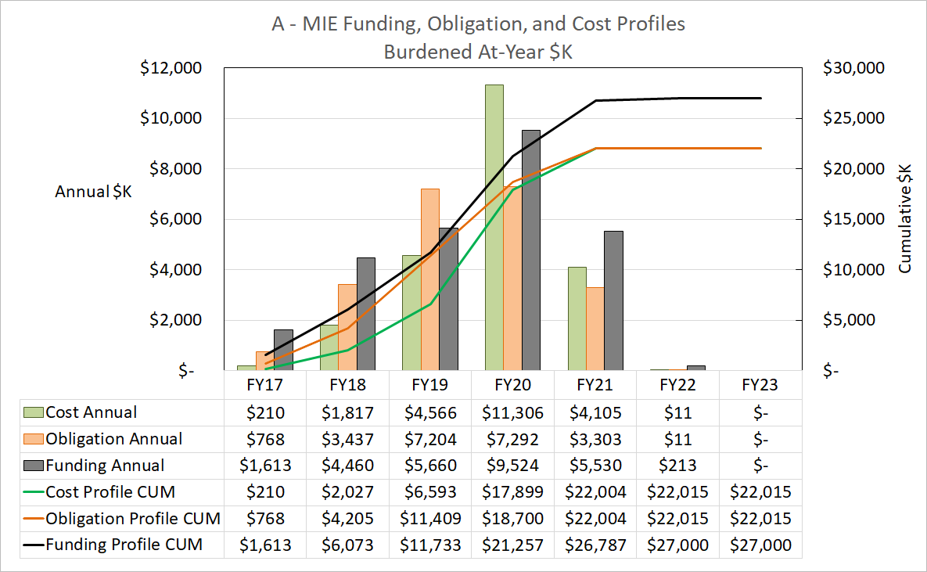
MIE Funding, Obligation, and Cost Profiles

Slide 29
Budget Profile to be Presented at PD-2/3 Review
sPHENIX Budget Profile

Slide 30
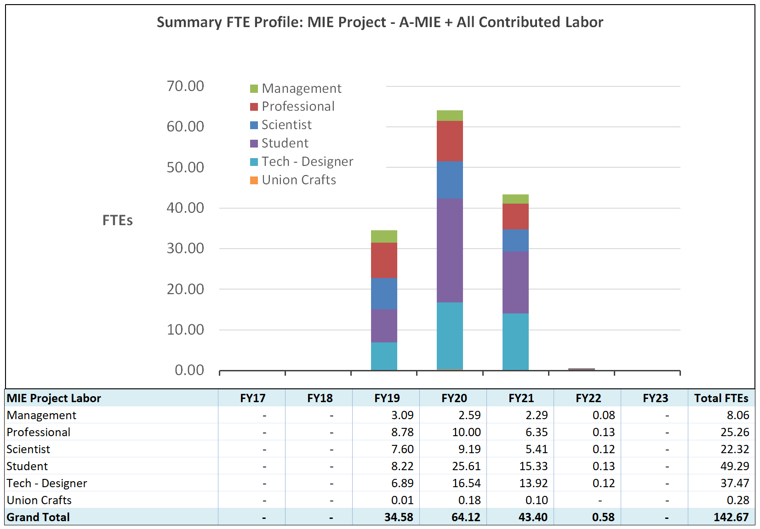
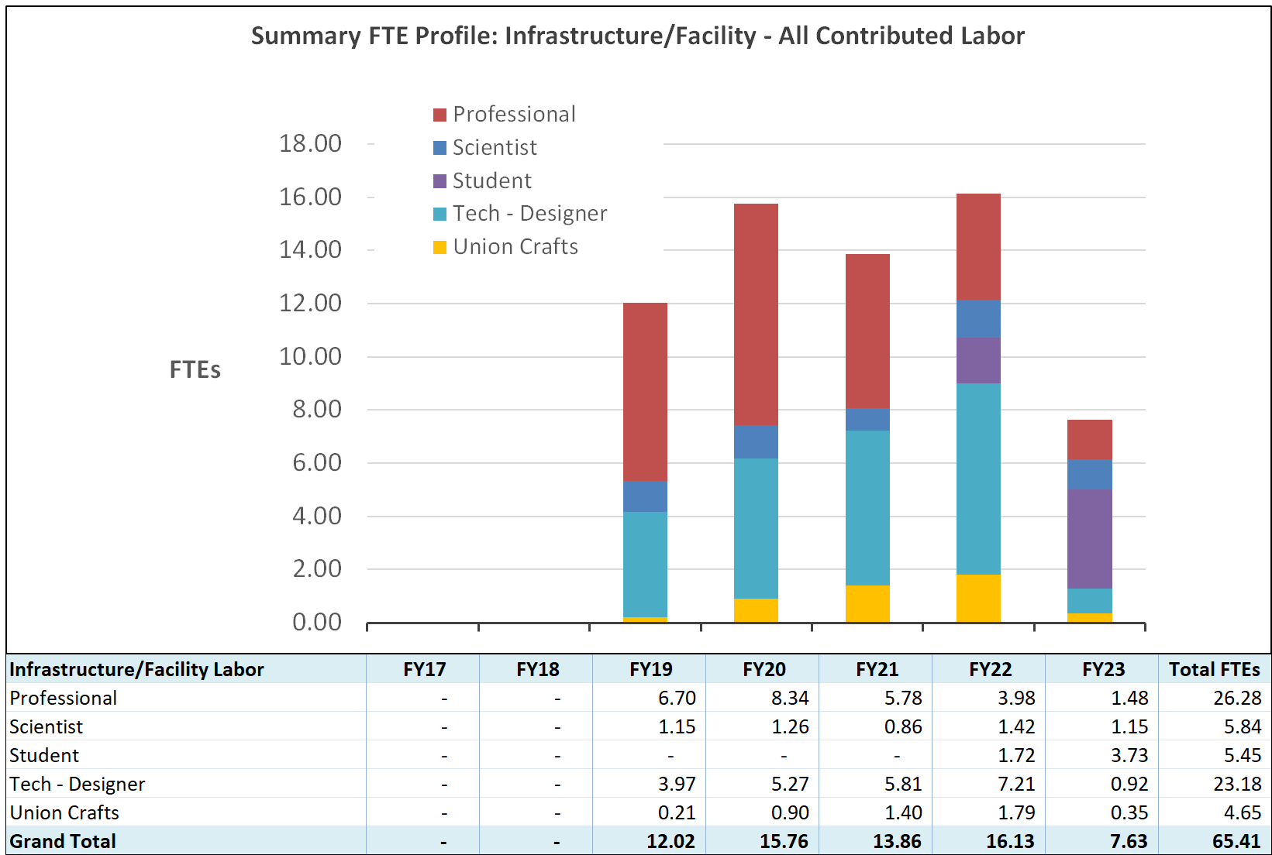
MIE and I&F Labor Summary by Labor Category
MIE
I&F

Slide 31
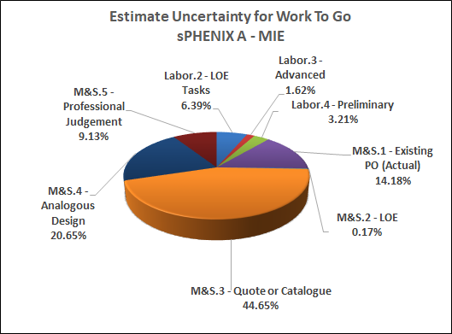
MIE Basis of Estimate Breakdown
We have a mature estimate for a project approaching PD-2/3.
The MIE is > 15% done based on March actuals.
Quotes +Catalog Prices + PO commits+ Level of Effort compose ~65% of the Work To Go
The basis of estimate is used to form the Estimate Uncertainty (EU) for the 1.X and 2.X.
The EU combined with the risk Monte Carlo provides the contingency needs for the 1.X and 2.X.
See talks by Cathy L. and Irina S.

Slide 32
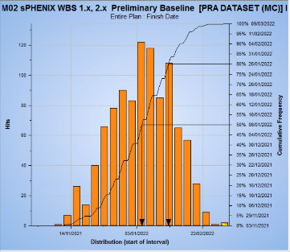
Risk Registry and Risk Management Plan
The Project team together with the L2, L3 Managers and engineers have developed a detailed Risk Registry and Risk Management plan for the MIE and I&F.
Risk Cost and Schedule impacts have been included in a Monte Carlo simulation. The resulting MIE and I&F risk are major inputs into our contingency calculations.
We’ve started to hold monthly Risk meetings with the Project Team and L2/L3 Managers.
The Monte Carlo’ed Risk value + Estimate Uncertainty is used to form our bottom-up contingency
See breakout talk by Irina Sourikova

Slide 33
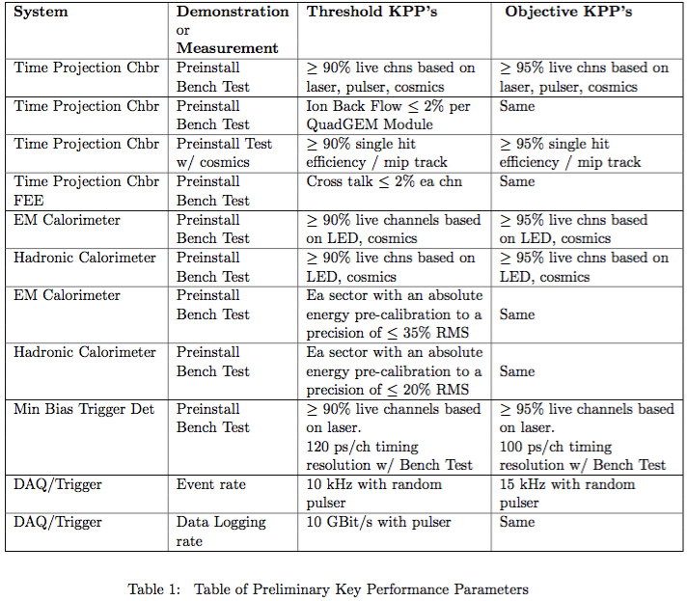
Threshold & Objective KPP’s
The individual L2 components of sPHENIX are the MIE deliverables.
Installation is not part of the MIE and not a deliverable.
Beam collisions are not needed to satisfy the KPP’s.

Slide 34
Ultimate Performance Parameters
Table from the PPMP:

Slide 35
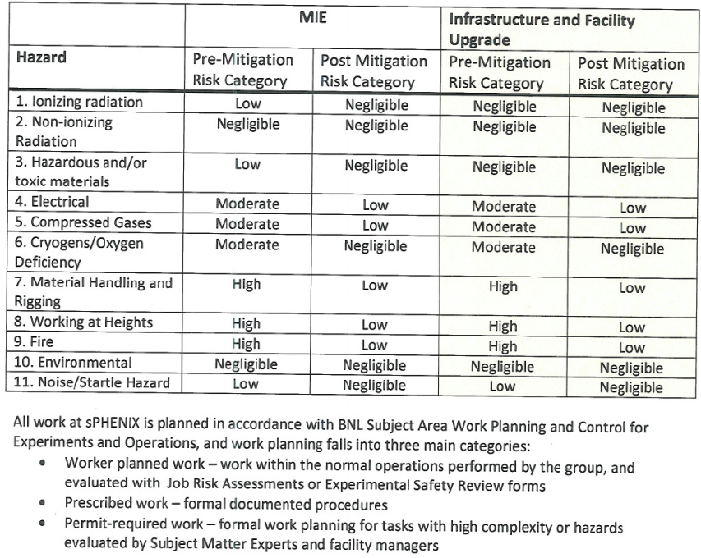
ES&H and QA
The sPHENIX MIE has ES&H and QA experts embedded by BNL in the project.
The ES&H and QA reps have led the effort to develop sPHENIX specific Safety and quality documents Hazard Analysis Report, Quality Assurance Plan.
The QA rep developed QA procedures and criteria for work on preproduction prototypes and production at collaborating universities, and R&D contracts with vendors .
ES&H experts are being used to develop plans for sPHENIX detector component fabrication areas at BNL.
https://indico.bnl.gov/event/5961/attachments/22263/31349/sPHENIX_Hazard_Analysis_Report_final.pdf
https://indico.bnl.gov/event/5961/attachments/22278/30996/QA_Plan_sPHENIX_Project.pdf
See:
ES&H breakout talk by Lori Stiegler
QA breakout talk by Chuck Gortakowski

Slide 36
Issues and Concerns

Slide 37
Summary
We have an advanced technical design of the MIE that can be delivered within the proposed budget and schedule. The completed detector will meet Mission Need and deliver on the KPP’s and UPP’s.
The Infrastructure and Facility Upgrade also has an advanced technical design that can be delivered within the proposed budget and schedule. It will support the MIE detector and allow it to obtain its UPP’s.
We have chosen designs that are cost effective, utilize modern technologies and build on existing multi-million dollar infrastructure of PHENIX.
We are strongly support by both BNL and DOE. We have been granted the BNL extraordinary overhead rate. We have received significant contributions from labor resources in PO, CAD, IO, SMD, PMC, PPM, ES&H, NSLS II, etc. Cooperation and assistance by DOE on budget requests, oversight and approvals.
We have a large international collaboration of 77 institutions and growing. All awaiting the first run of sPHENIX in 2023.
sPHENIX is ready for PD-2/3 approval

Slide 38
Back Up

Slide 39
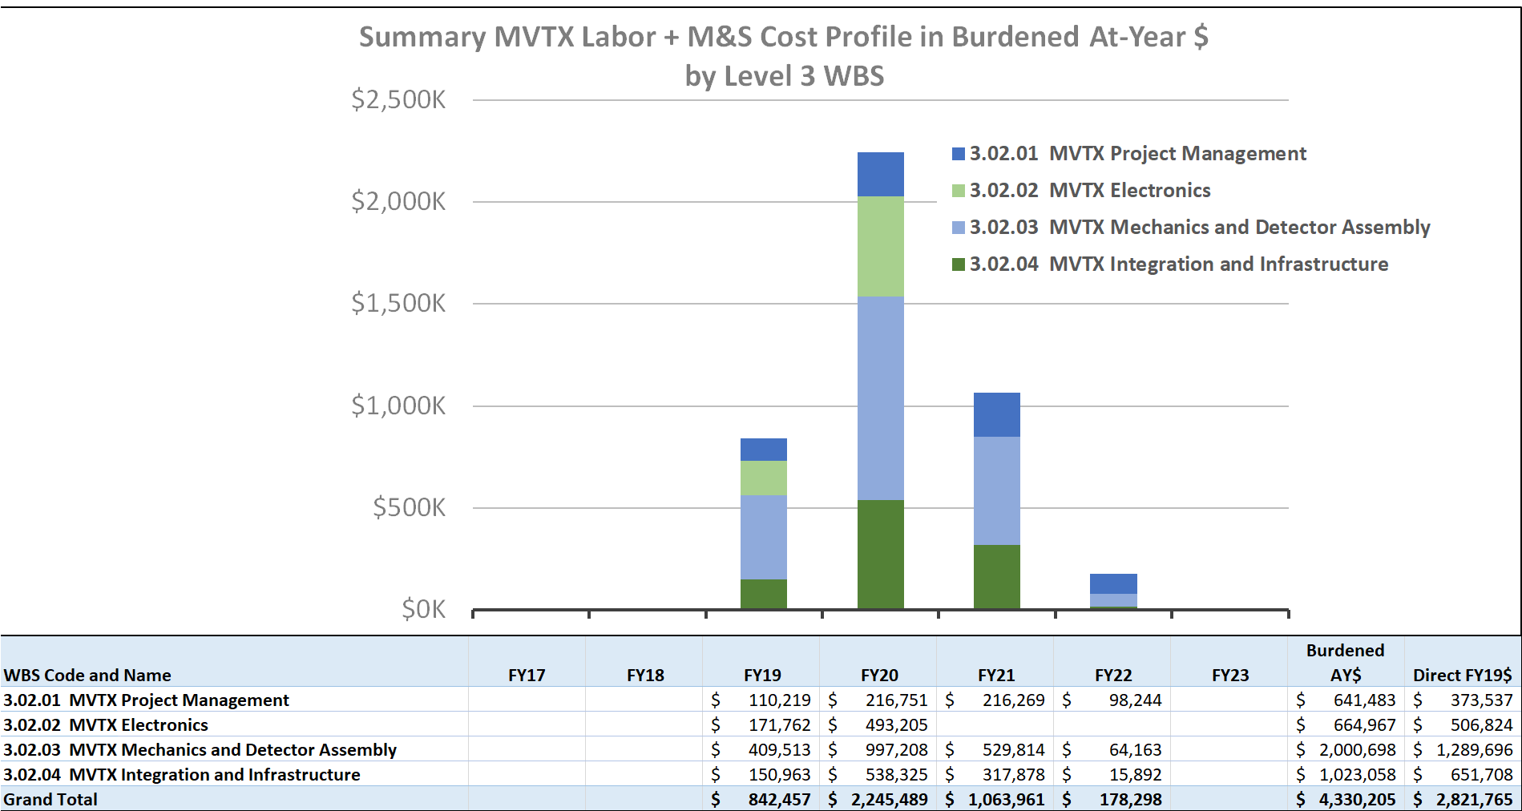
MVTX Budget Profile

Slide 40
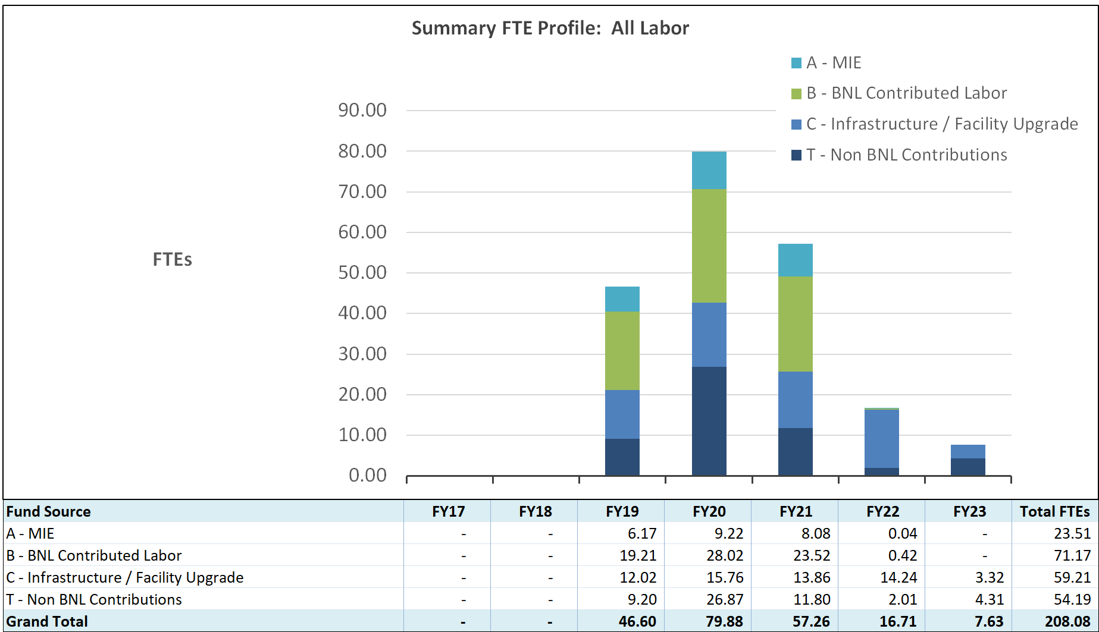
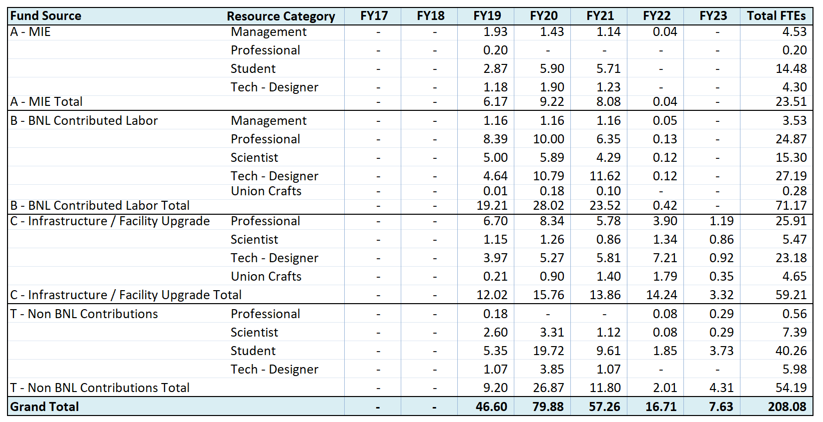
MIE and I&F Labor by Source

Slide 41
Budget Profile as of CD-1/3A
sPHENIX Budget Profile

