Slide 1
sPHENIX System Integration
Mickey Chiu
April 9-11, 2019
BNL

Slide 2
Office of System Integration (OSI)
Organize in detail the work on interfaces between subsystems
Ensure detectors co-exist well and physics program is not harmed
Enforce ”Work-planning” and Documentation
Arbitrate any disputes between subsystems.
Official procedure in place for disputes (includes approval from PM)
Strive for unanimity
If the dispute will cause large disruptions to the physics program, or there is disagreement within project, send dispute to the collaboration for final decision.
Mitigate any integration issues that have not been explicitly part of above process (catch things that fall through the cracks).

Slide 3
Integration Structure
For each subsystem, need liaison physicist, liaison mechanical and/or electrical engineer
Meeting at least monthly with entire group since Fall 2017
Different focus at each meeting, e.g. ICD-fest, cable-fest, power/cooling-fest, gas-fest, installation-fest, internal reviews, etc.
Smaller breakout groups meet more frequently, eg, Inner det’s (MVTX-INTT-TPC-MBD)
Envelope Document – defines the space for each subsystem
ICD’s (Interface Control Document) stored in DocDB
CAD Drawings in Vault (CAD collaboration/data management)
Organize interface design reviews
Have OSI representatives sit on design review committees

Slide 4
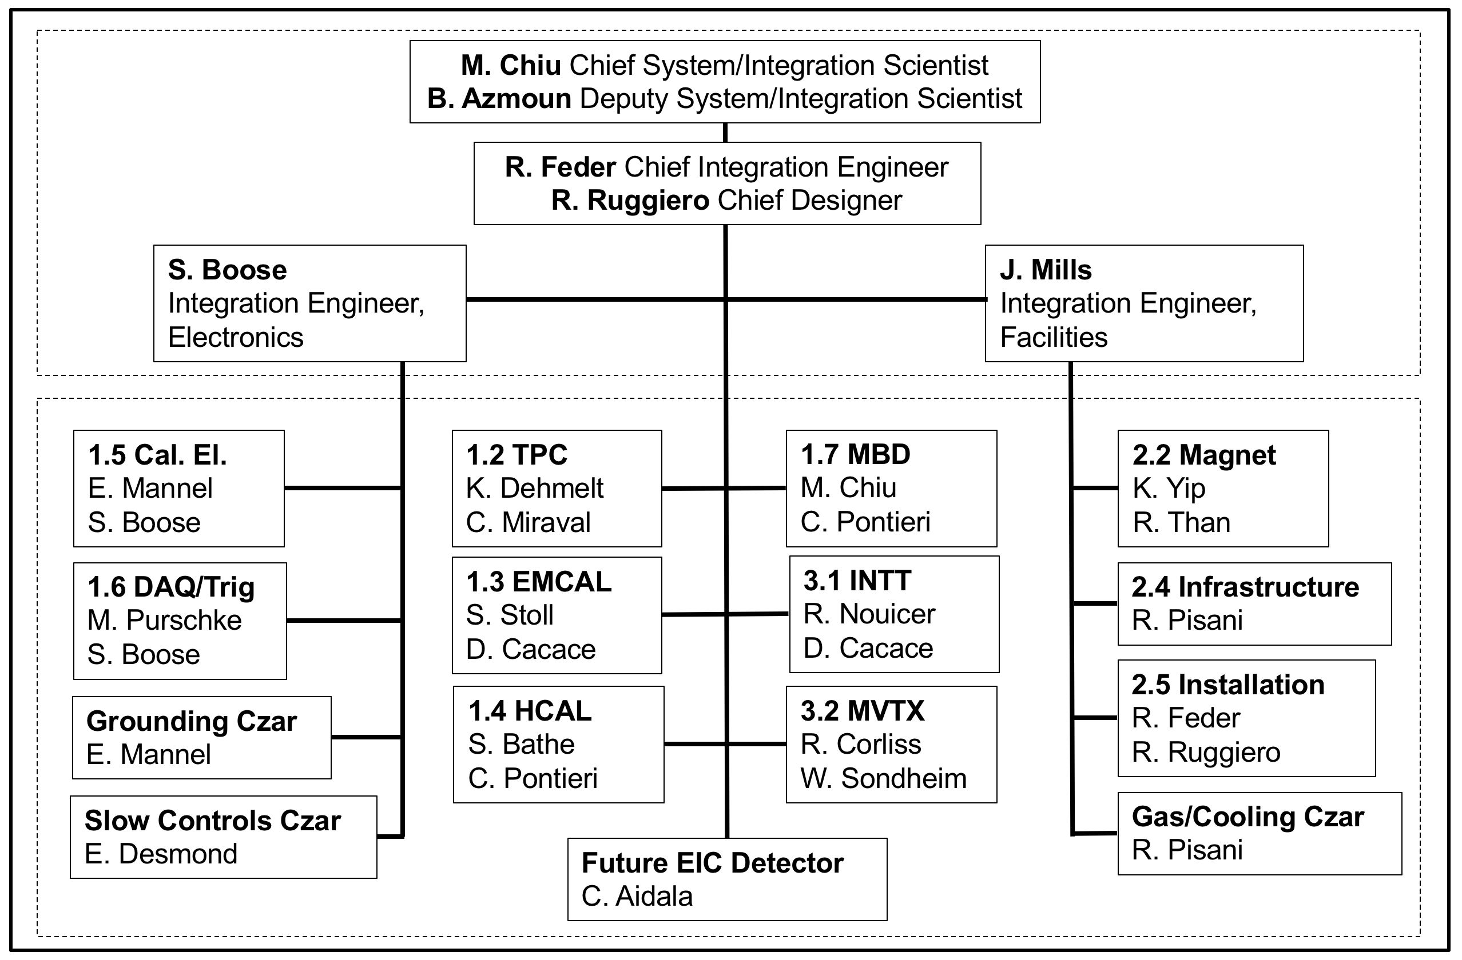
sPHENIX OSI Group

Slide 5
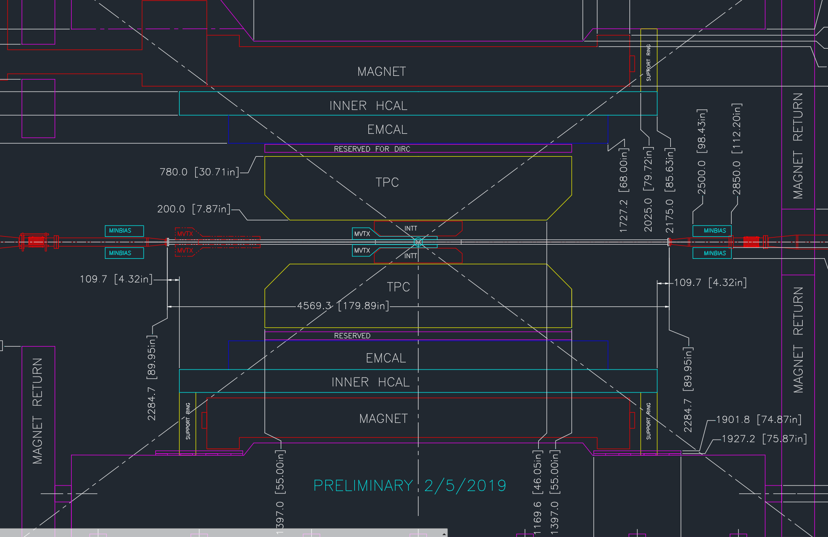
Envelope/Outline Drawings

Slide 6
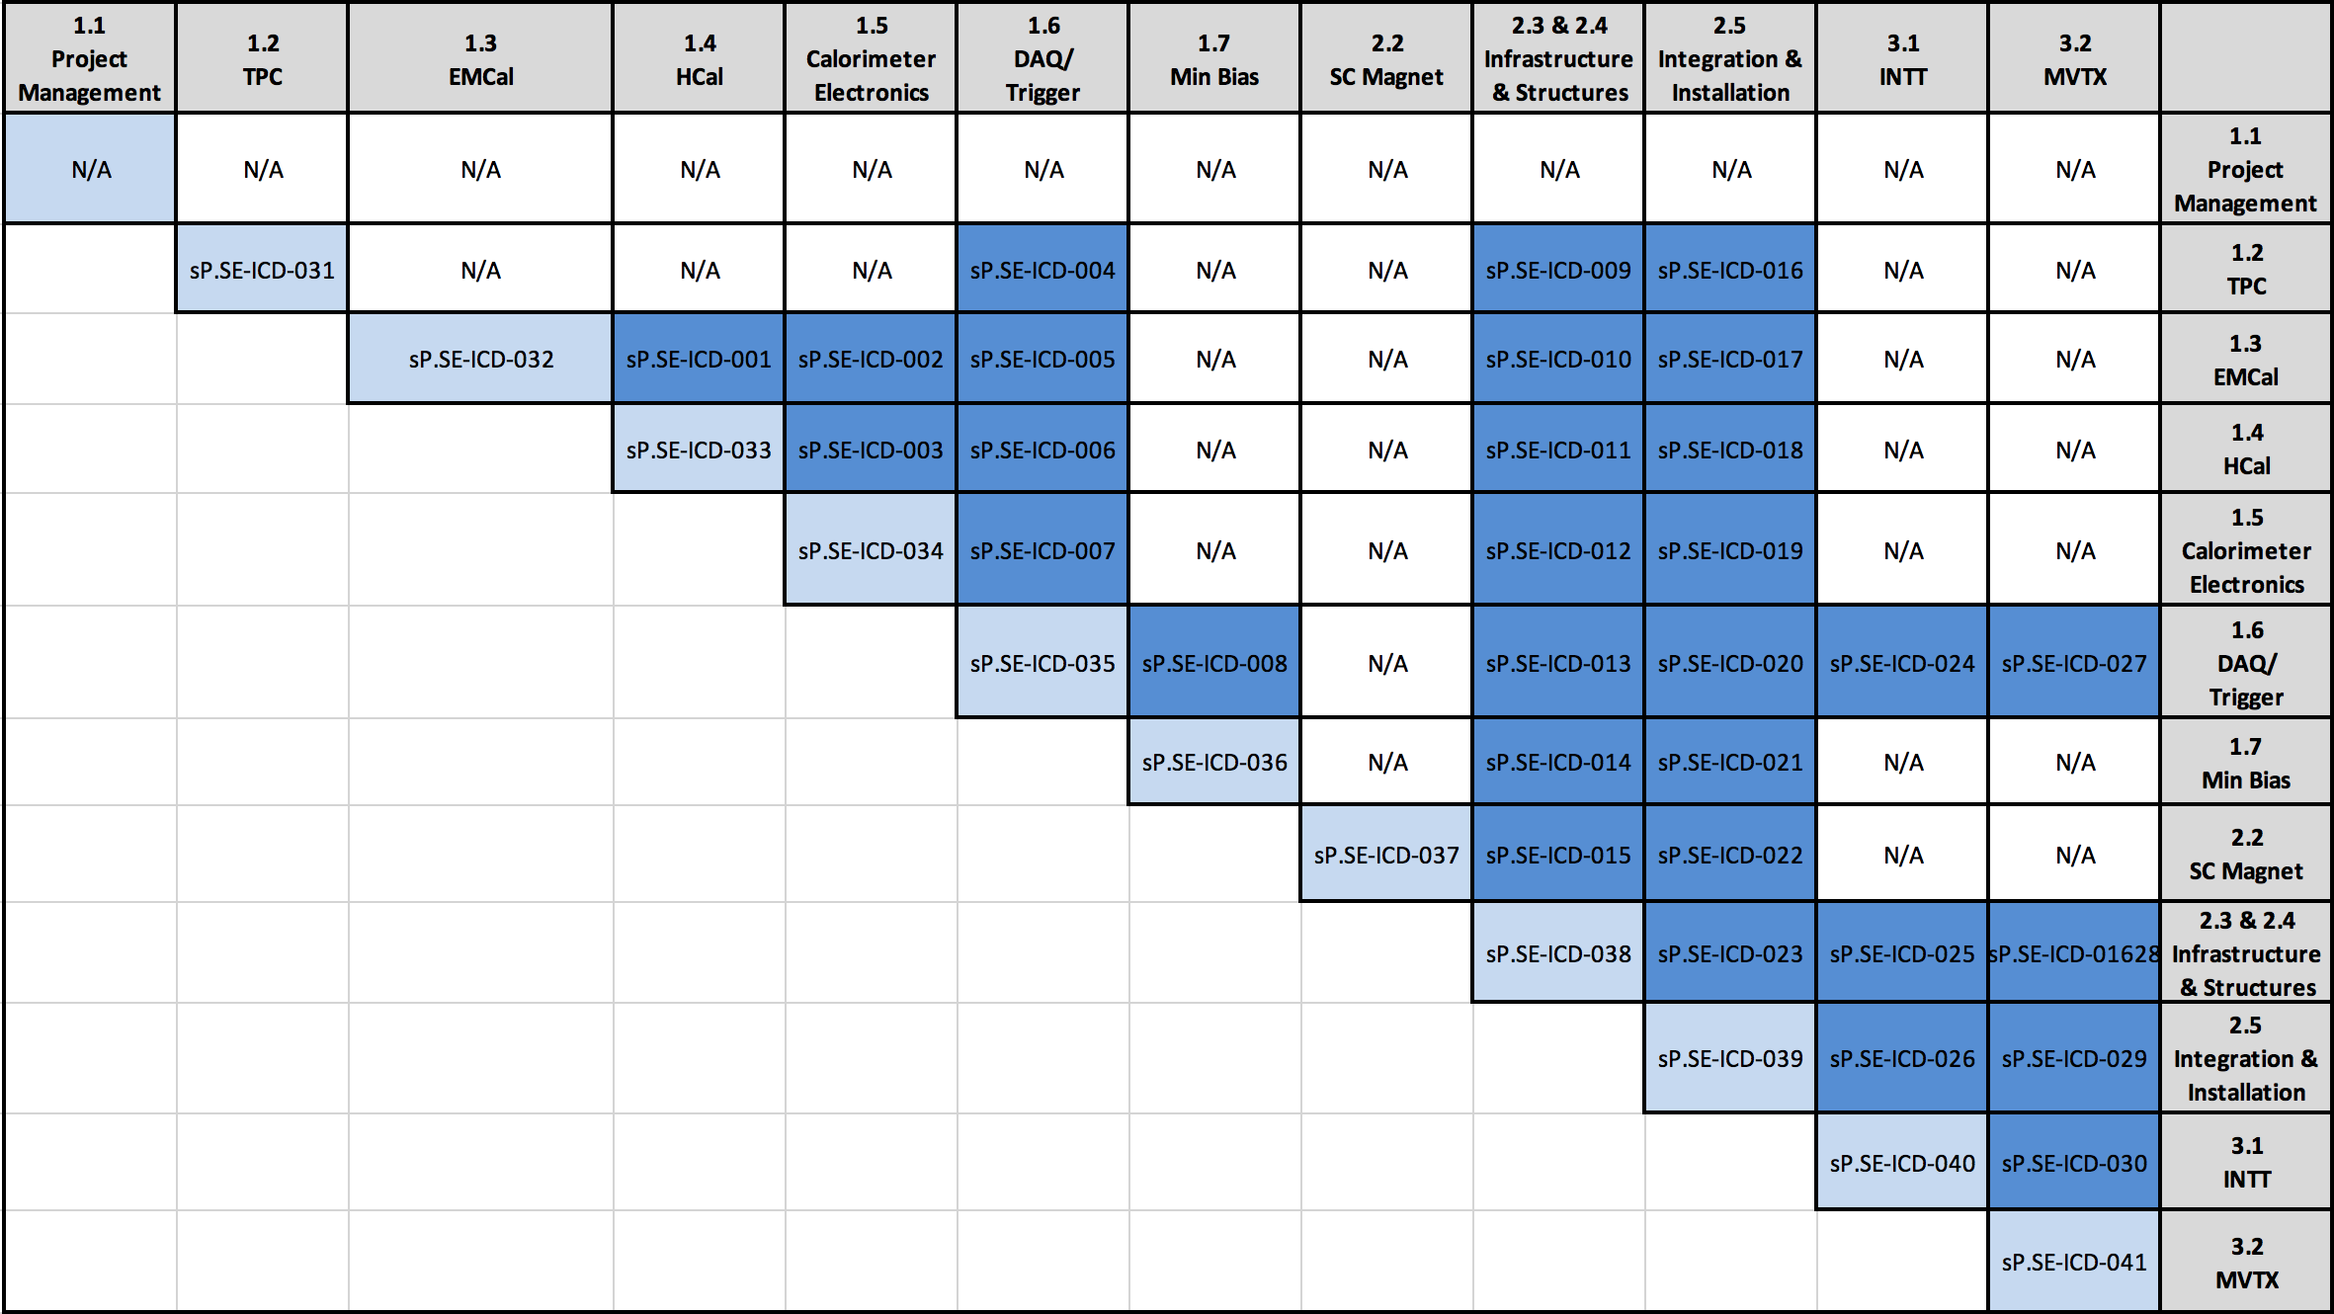
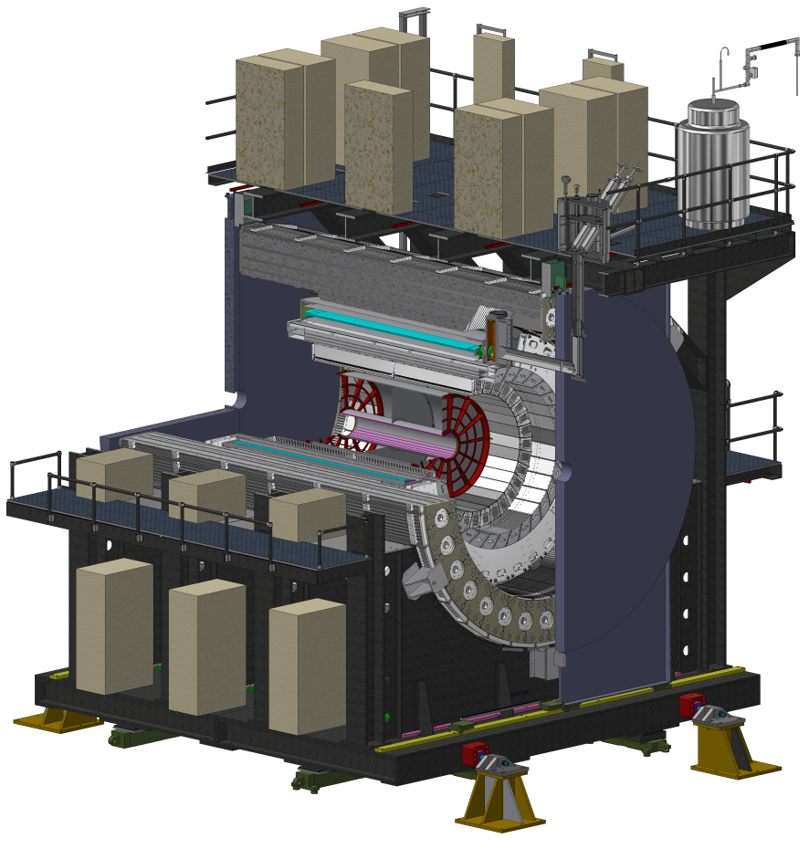
Interface Control Documents
Official versions stored in docdb
Working copy in google drive
Includes
Links to Mechanical Interface Drawings
List of Services required
Power, cabling, cooling
Deliverables (and who is responsible)
Compliance Demonstration
https://docdb.sphenix.bnl.gov/cgi-bin/public/ShowDocument?docid=152

Slide 7
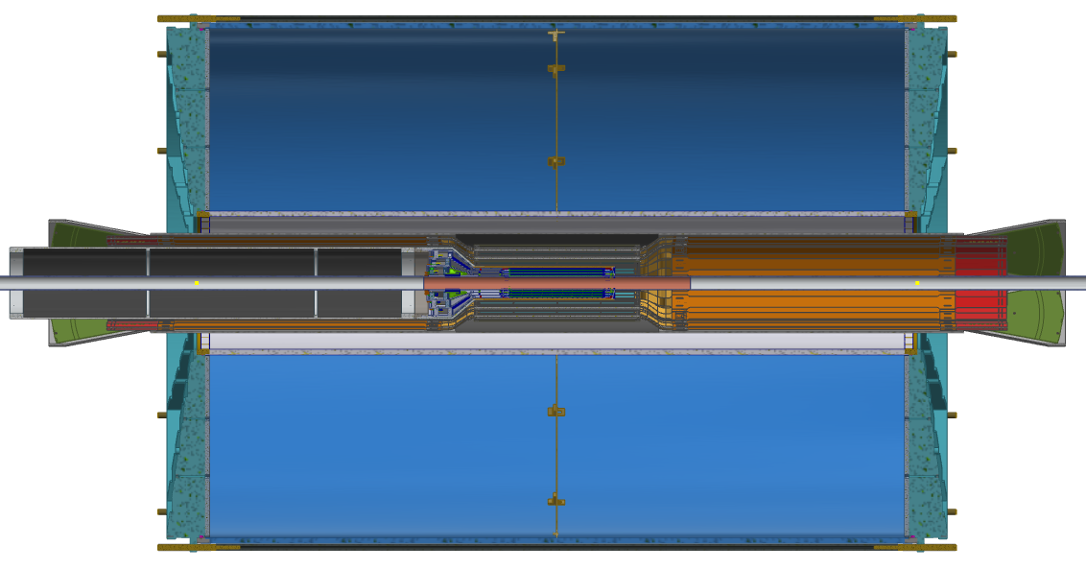
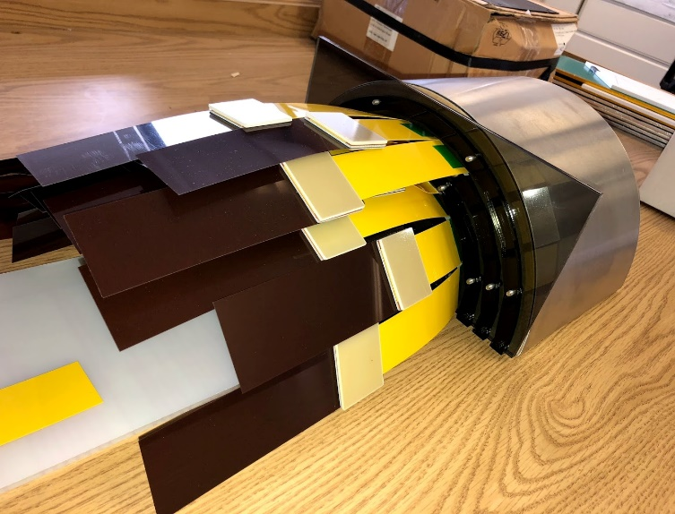
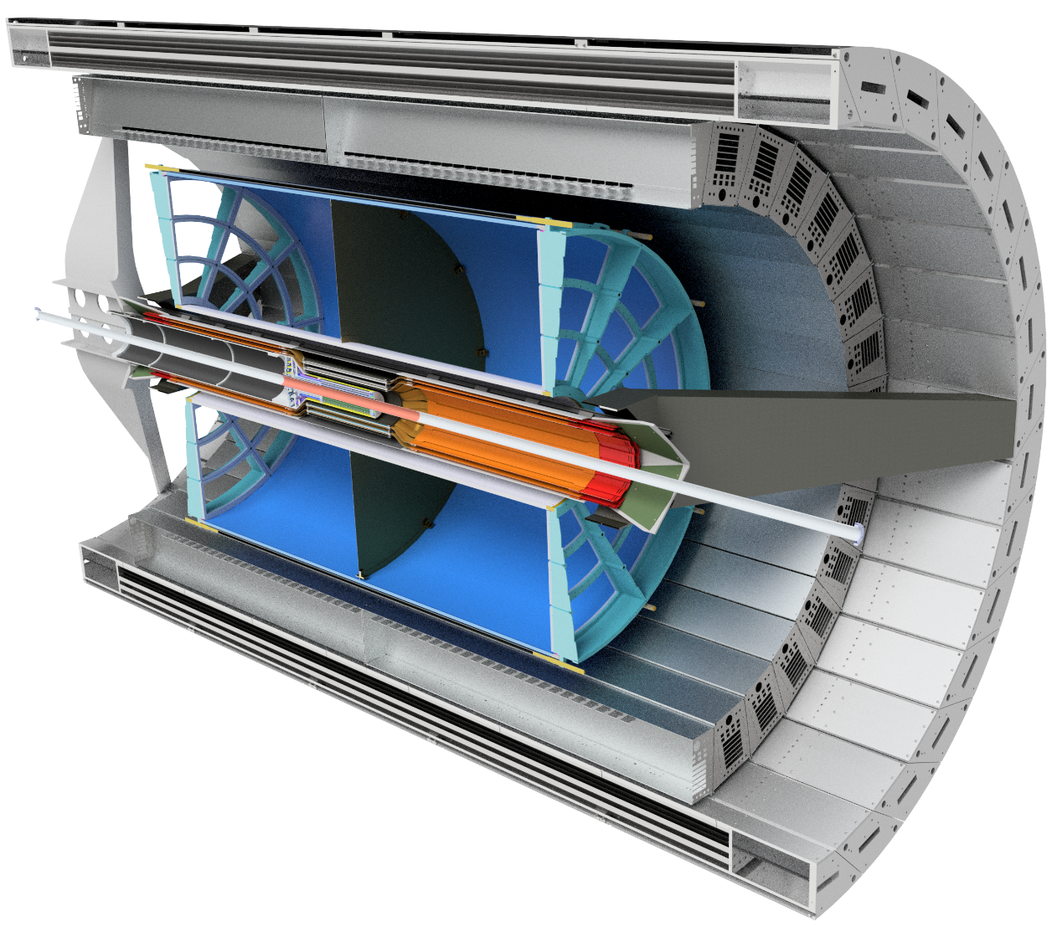
Ex1: Inner Detector Integration
3D mockup to ensure it actually fits
Integration of TPC, INTT, MVTX, and MBD has been most challenging aspect so far
Many meetings covering first the fine details of the integration of the silicon staves, then support, installation scheme, services

Slide 8
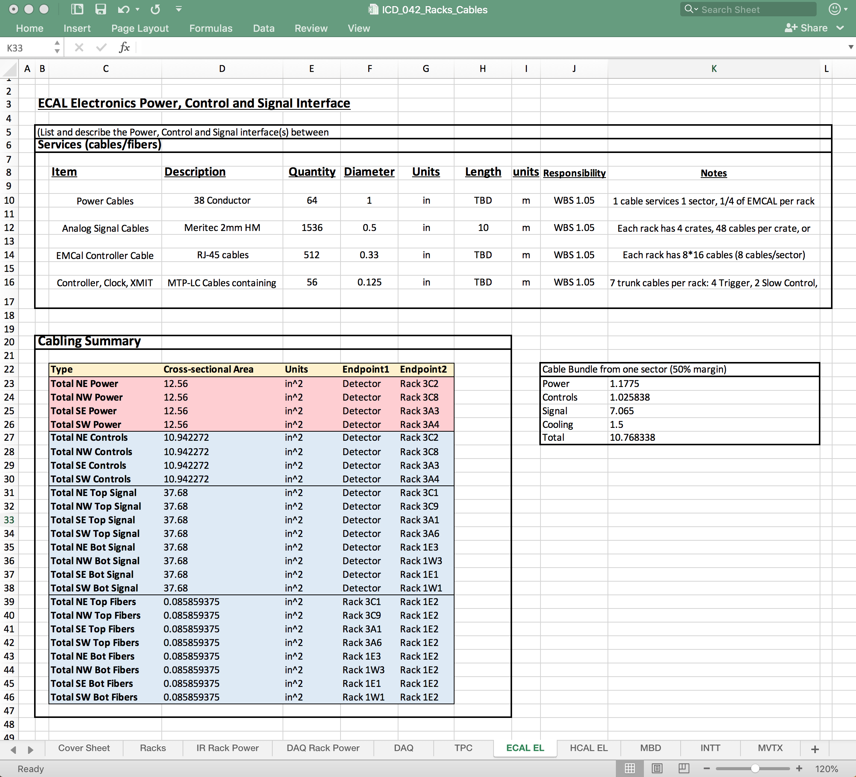
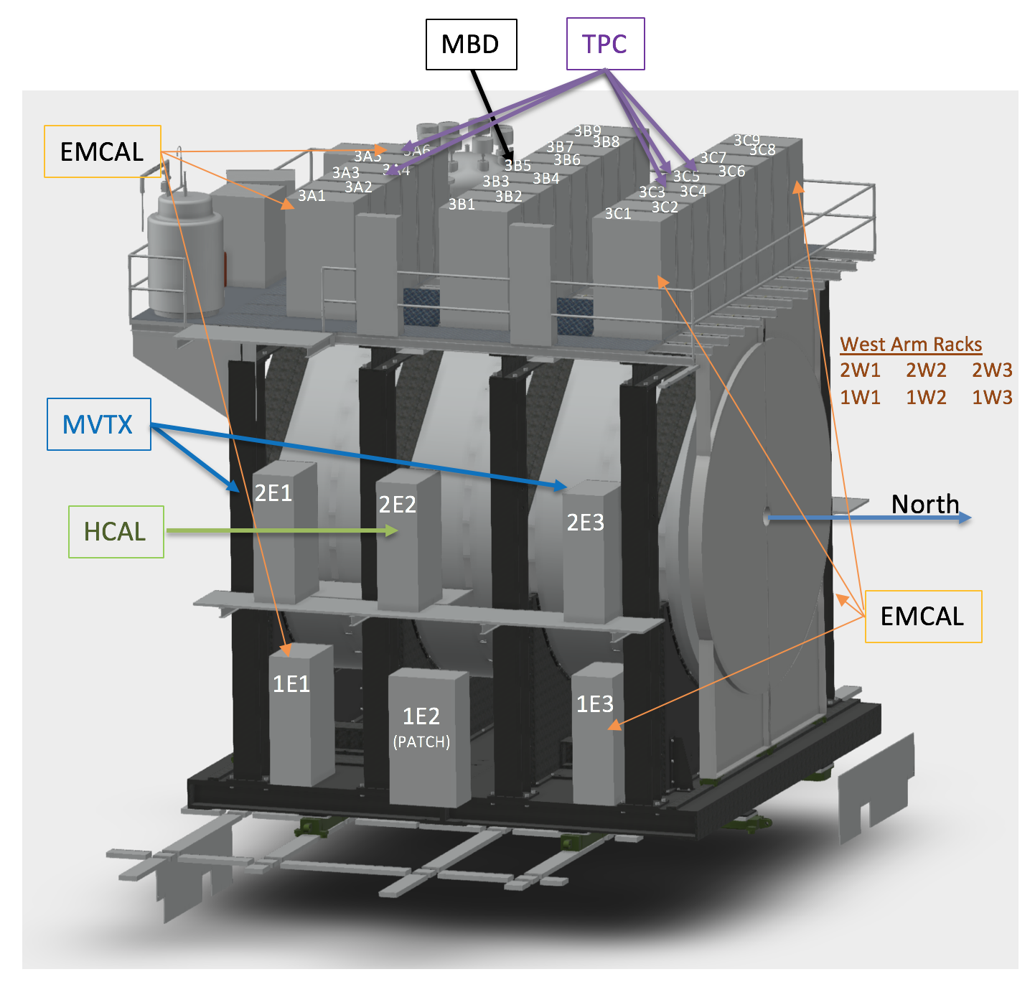
Ex2: Services ICD
Covers
Rack assignments,
Cabling requirements
Cable routing
Power requirements
Cooling requirements
Cooling hose routing

Slide 9
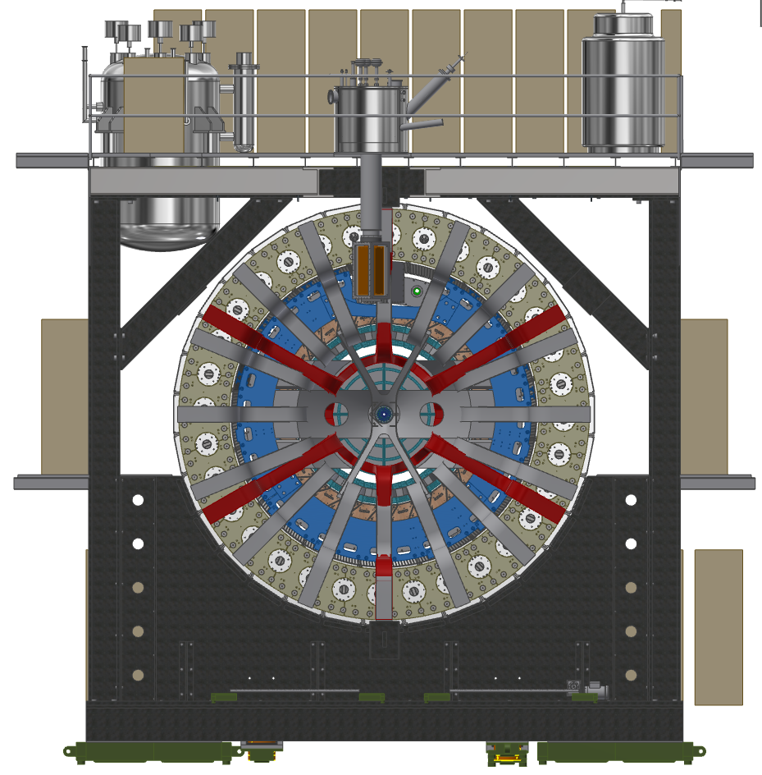
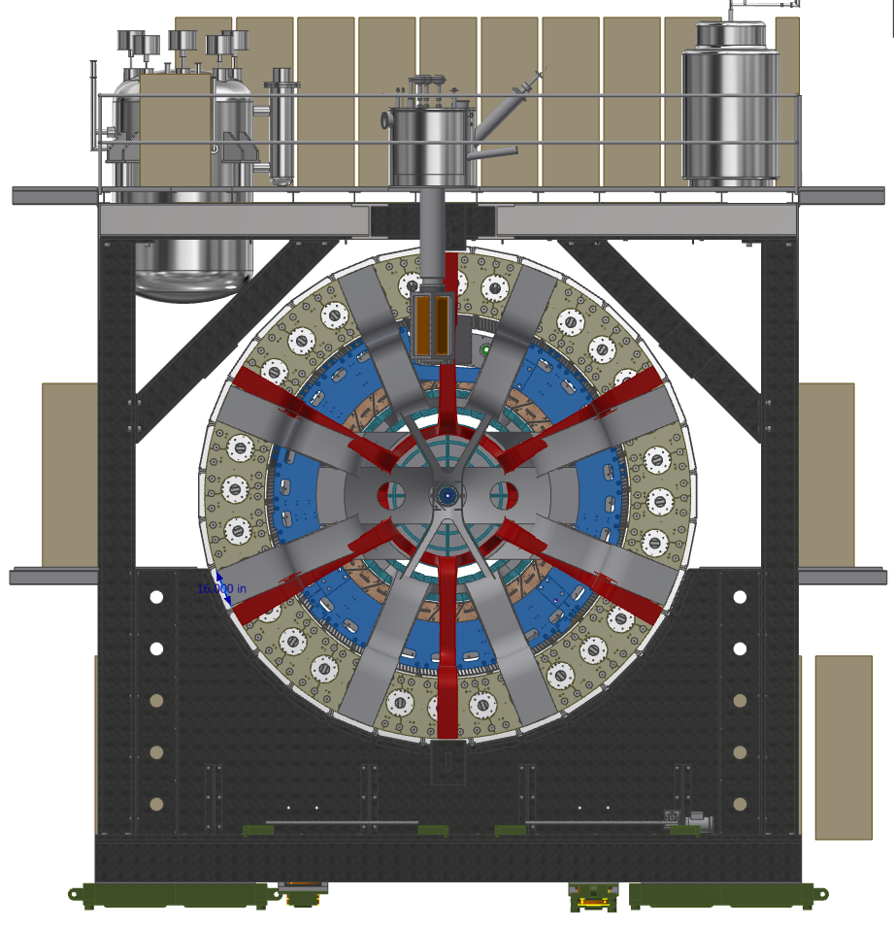
Ex2: Services (cont.)
Option 1
Option 2

Slide 10
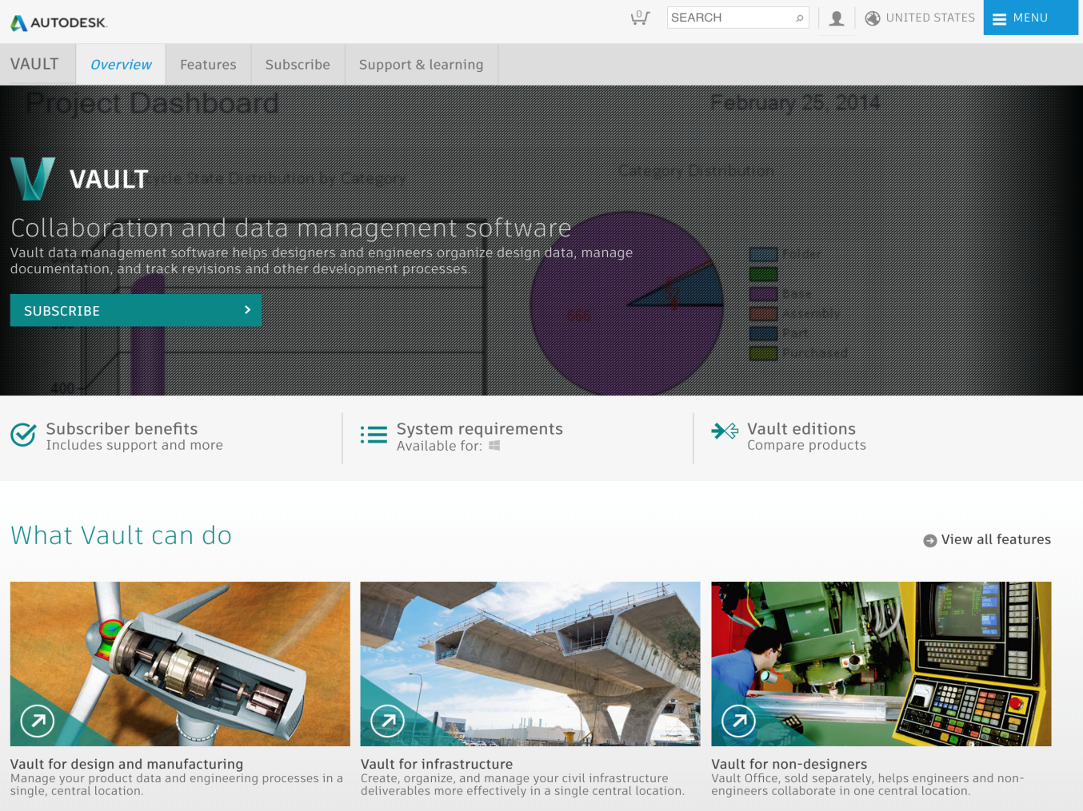
Engineering Collaboration
Single official repository for Drawings
Makes collaboration much easier
Especially important as more external engineers work on experiment
Enforces continuous review of design changes

Slide 11
Summary
We have a system in place to ensure that we have planned in advance how to bring all the different parts together
Includes representation from every group
Covers hopefully every aspect of integration, including things that are not obviously within any group’s purview
Process has been implemented since before CD1
Has been invaluable in solving problems with integration of the inner silicon trackers (INTT and MVTX) with the TPC, MBD, and rest of sPHENIX
Other system integration issues in progress:
Services management (racks, cabling routes, cooling hoses, etc.)
Mechanical Integration (installation scheme, support structures, etc.)
Documenting along the way in the ICDs
Useful for MIE project but also for future collaborators that support detector

