Slide 1

sPHENIX Directors Review
WBS 1.04: HCAL
John Lajoie
Iowa State University

Slide 2
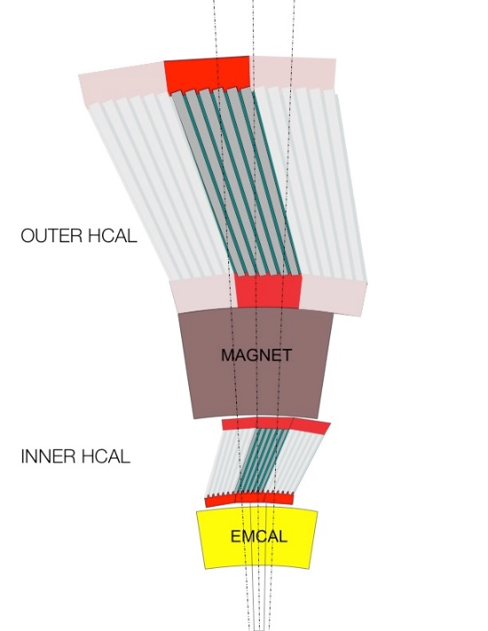
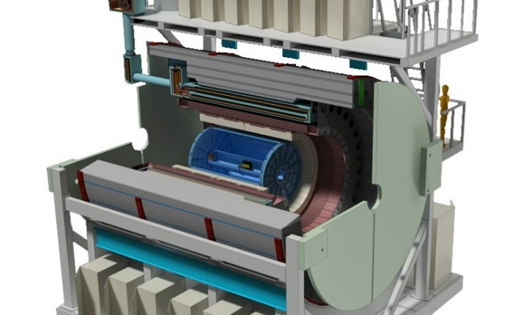
WBS 1.04: HCAL
HCAL steel and scintillating tiles with
wavelength shifting fiber
  Outer HCal (outside the solenoid)
  Δη x Δφ ≈ 0.1 x 0.1
  1,536 readout channels
SiPM Readout
Outer HCAL
Inner HCAL
(Frame)
HCAL performance requirements driven by jet physics in HI collisions
Uniform fiducial acceptance -1<η<1 and 0<φ<2π
  Extended coverage -1.1<η<1.1 to account for jet cone
Absorb >95% of energy from a 30 GeV jet
  Requires ~4.9 nuclear interaction length depth
Hadronic energy resolution of combined calorimetry:
  UPP:
  Gaussian response (limited tails)
HCAL created by instrumenting barrel magnetic flux return
Outer HCAL ≈3.5λ_{I}
Magnet ≈1.4X₀
Frame ≈ 0.25λ_{I}
EMCAL ≈18X₀≈0.7λ_{I}

Slide 3
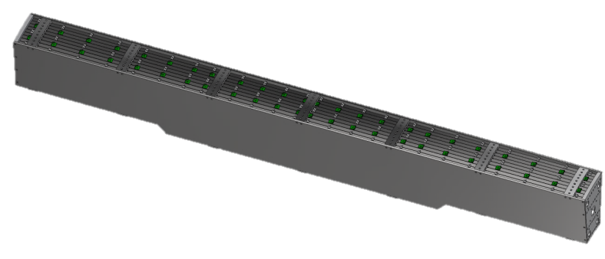
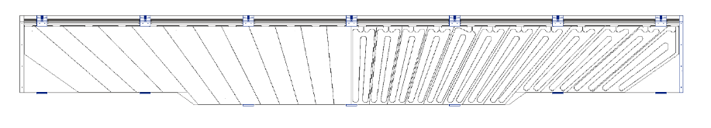
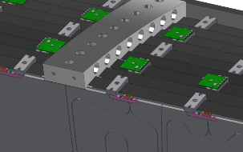
Scope and Deliverables
Outer HCAL Sectors Assembly:
“Inner HCAL” Frame and Supports
DELIVERABLE:
32 assembled and tested sectors - 1.9m inner radius, 2.6m outer radius
10 rows of 8mm scint. tiles (24 tiles per row), 12º tilt angle
Tapered 1020 steel plates ~26.1mm - ~42.4mm
Completed sector is 6.3m long, 13.5 tons
Assembly Detail:
5 scintillators/tower
48 towers per sector
32 sectors;
1536 channels (7680 SiPMs)
DELIVERABLE:
Al frame spanning 32 sectors - 1.16m inner radius, 1.37m outer radius
Includes “Support Rings” for full assembly.
oHCAL sector:
tiles in sector gap:
electronics/cable
routing:
Barrel Flux Return serves as HCAL absorber (WBS 2.3)
Electronics are in WBS 1.05

Slide 4
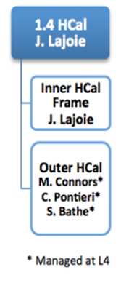

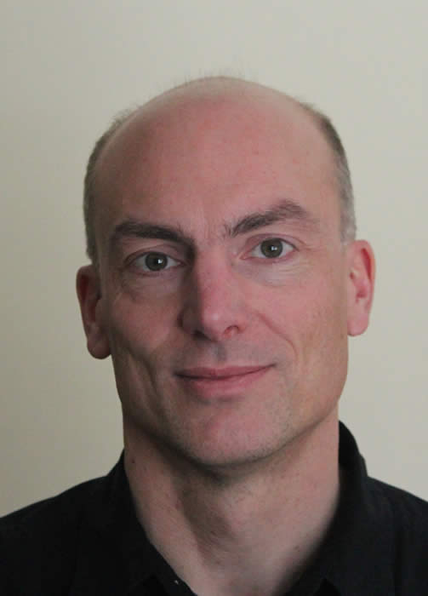
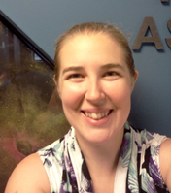
Subsystem Collaborators
Brookhaven National Lab
  Engineering
  L3 Chris Pontieri
Iowa State University
  Inner HCAL
  Student labor
Georgia State University
  Tile Testing
  Outer HCAL assembly
  Student labor
  L3 Megan Connors
Baruch College
  Outer HCAL assembly
  L3 Stefan Bathe
Augustana, GSU,
ISU, Rutgers,
UNCG
  Inner HCAL (NSF MRI)
MEPHI
  Tile mapping

Slide 5
Schedule Drivers
Scintillating Tile Assemblies:
  Key component for outer HCAL assembly
  Subject of CD3A request ($1.55M)
  Advanced R&D Production Underway,
  production contract through GSU
  First deliveries 130 days ARO
    Tile testing done at vendor, results databased
    Acceptance testing follows at BNL/GSU
  ~200 days of schedule float provided by CD3A
    Early procurement reduces risk associated with Russian vendor

Slide 6
Cost Drivers
Scintillator tile production ($1.55M)
  Surface flatness over long distances a key specification
  Identified Uniplast (T2K, PHENIX)
    Wrapped tile thickness < 8.0mm, Uniplast has met this spec.
    FNAL/Eljen also investigated,
    Uniplast most economical for complete tile assemblies
Inner HCAL Frame and Support Ring ($1.0M)
  Design exists for frame, conceptual design for support ring
Module Assembly and QA ($0.2M)
  Outer HCAL to be assembled at BNL (Bldg. 912)
    Labor provided by BNL (tech) and collaborating institutions (student)
  Four assembly stations in parallel, four weeks per module
  Assembly includes initial cosmics calibration

Slide 7
Basis of Estimate & Resource-Loaded Schedule
Cost and Labor estimates are based on:
  Prototype designs and test beam experience
  Budgetary quotes for scintillating tiles, iHCAL frame
  Engineering estimates and past experience for designs still in preliminary stages (support ring)
Schedule based on:
  Past experience with Uniplast delivery schedule (advanced R&D)
  Experience with assembly of test beam prototypes
  Engineering experience
BoE’s were used as input to RLS.

Slide 8
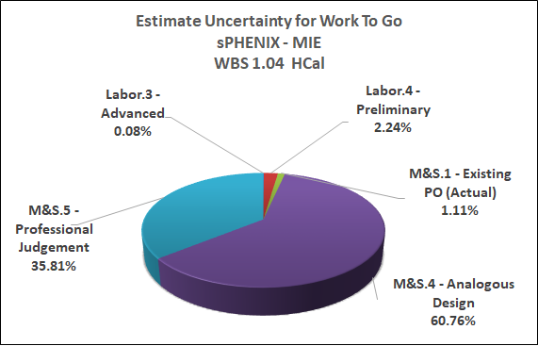
1.04 MIE M&S Basis of Estimate

Slide 9
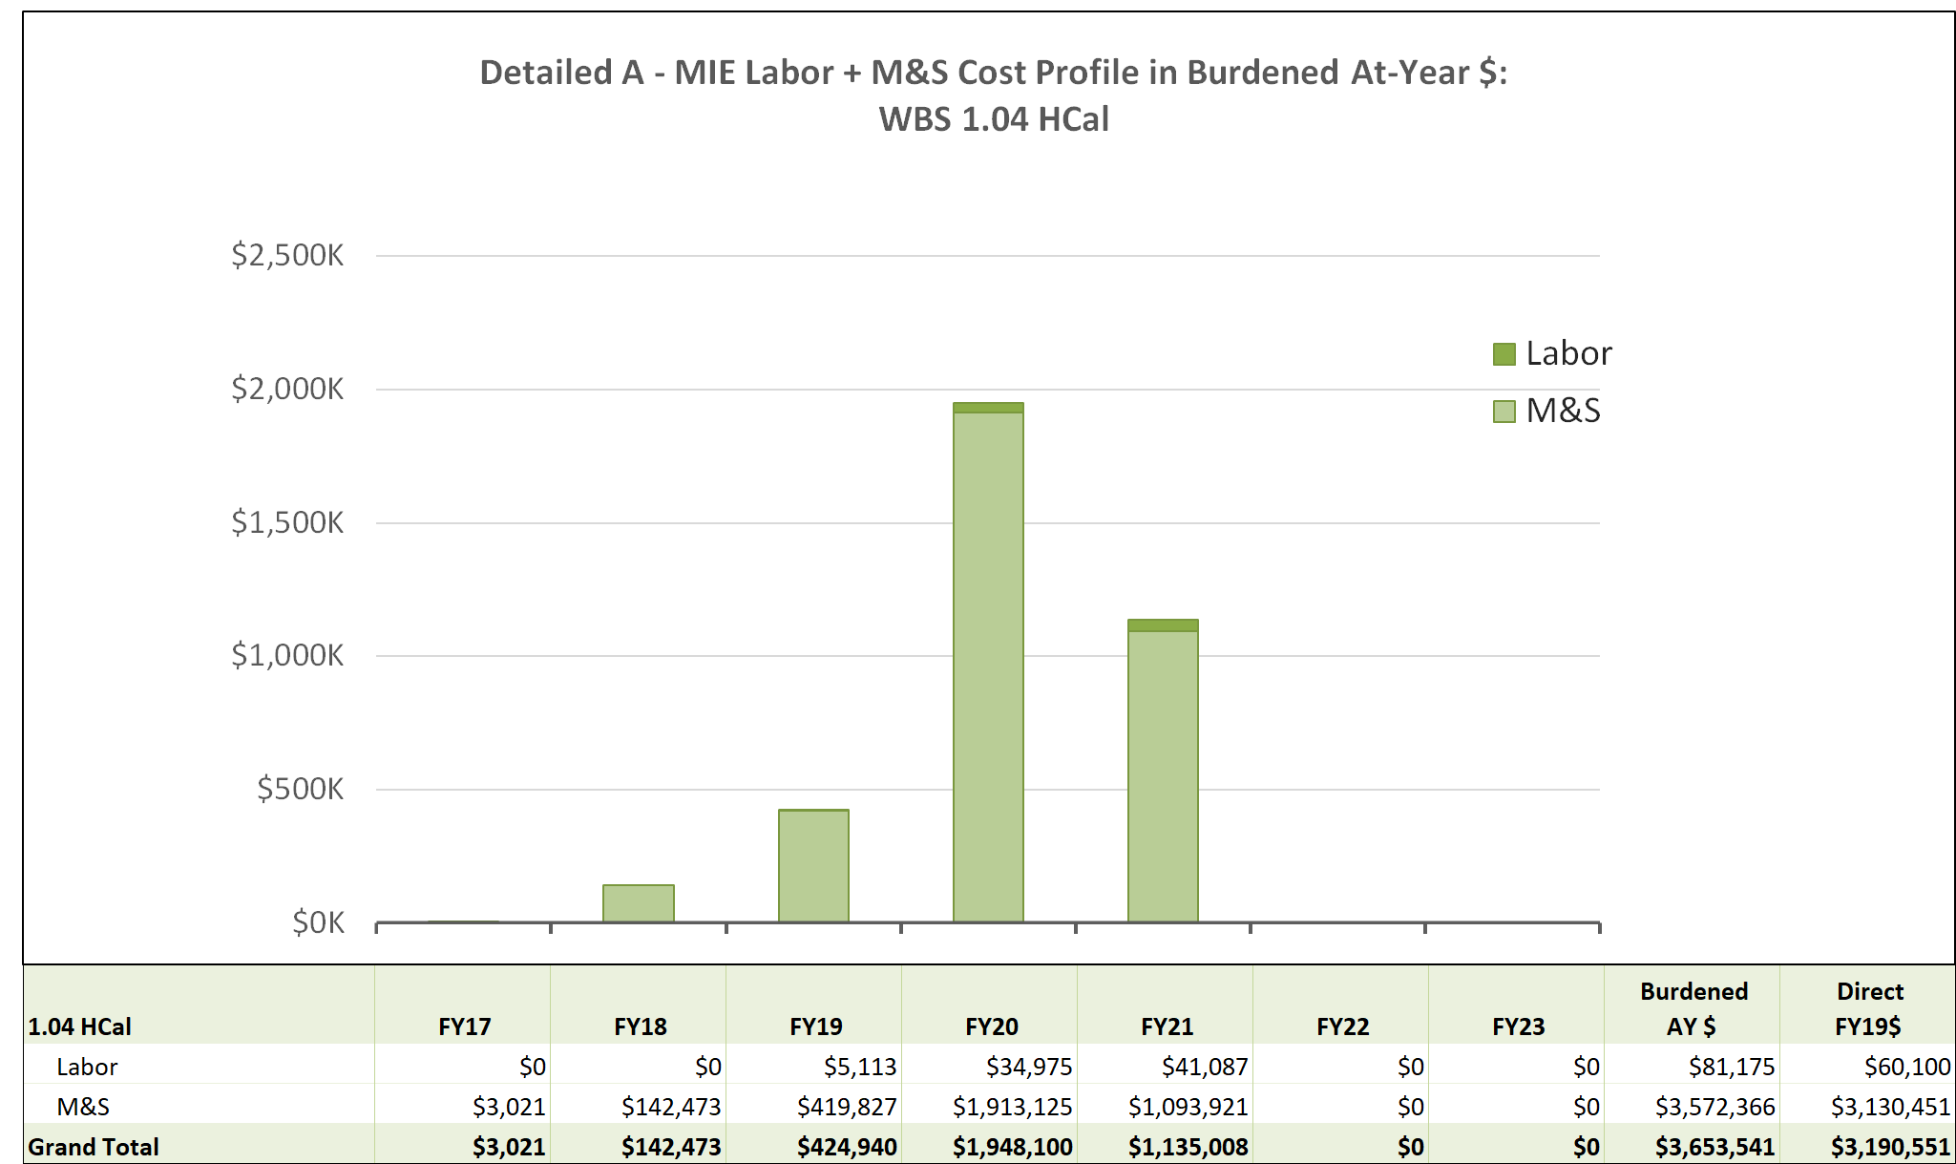
1.04 Labor and Cost Profile

Slide 10
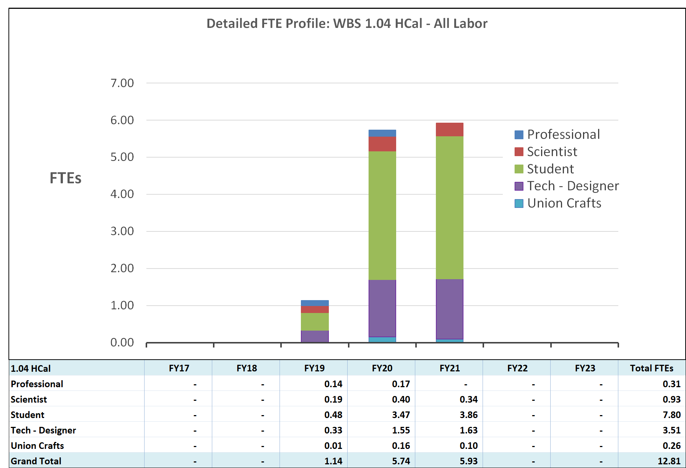
1.04 Labor FTE Profile

Slide 11
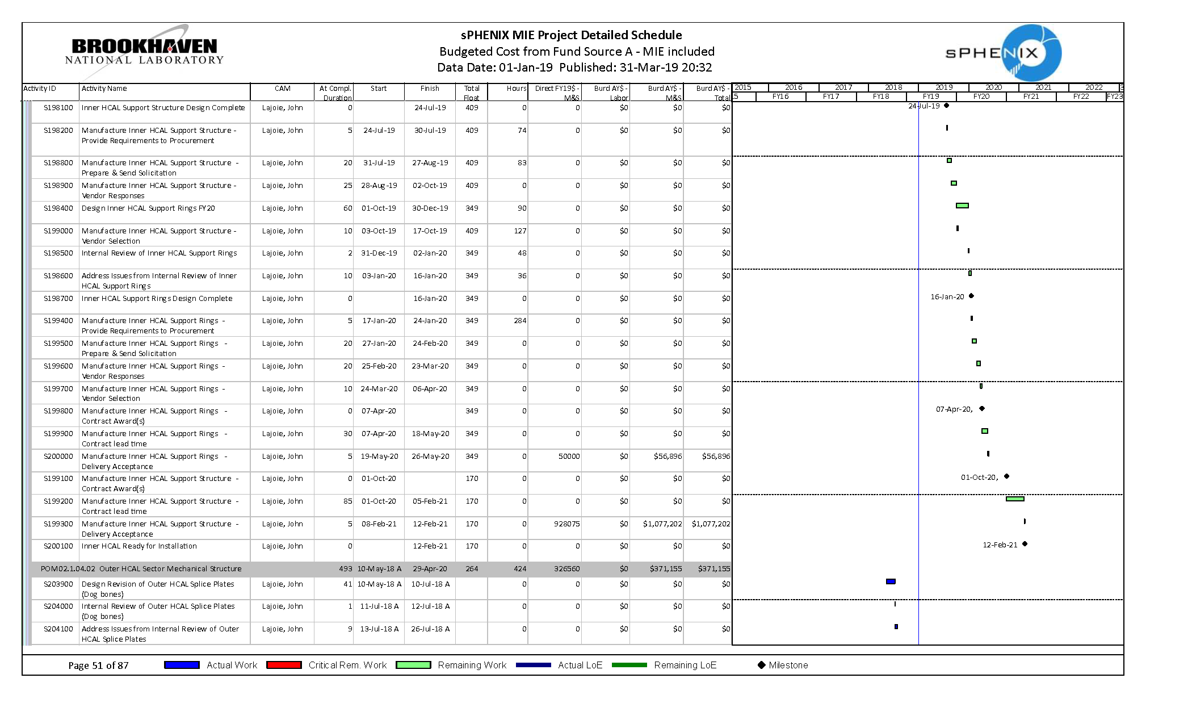
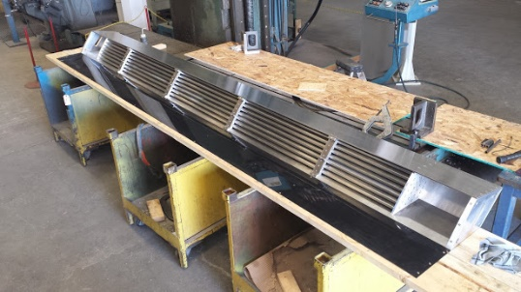
1.04.01 Inner HCAL (Frame) Milestones
Support Rings Ready for Installation – 26 May 2020
iHCAL Ready for Installation – 12 Feb 2021

Slide 12
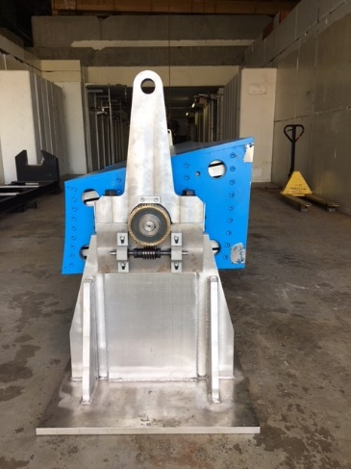
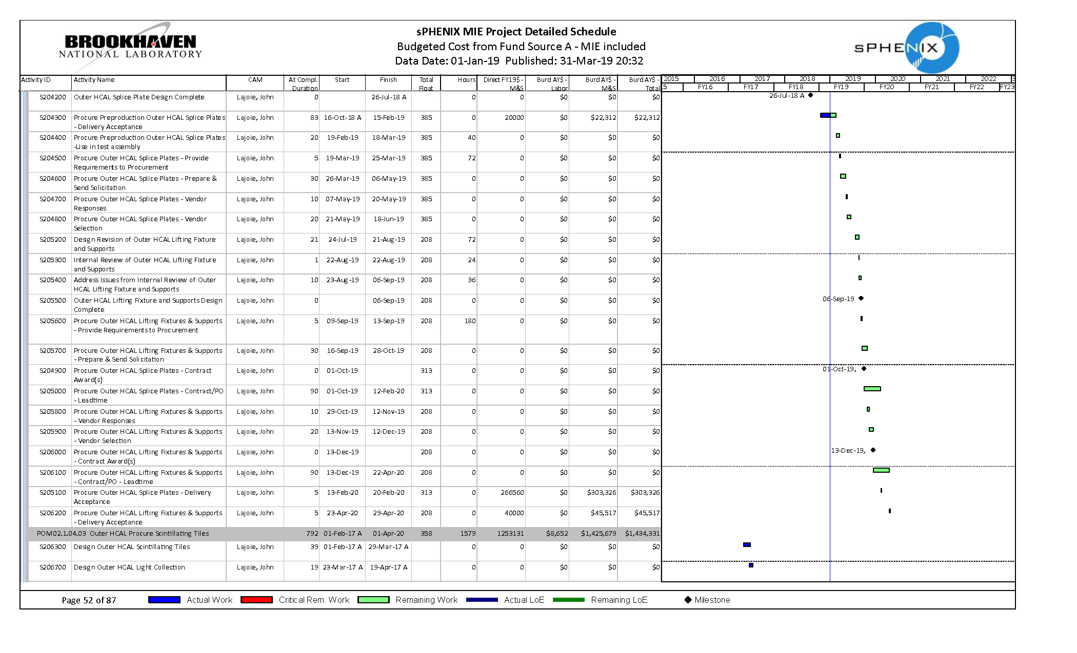
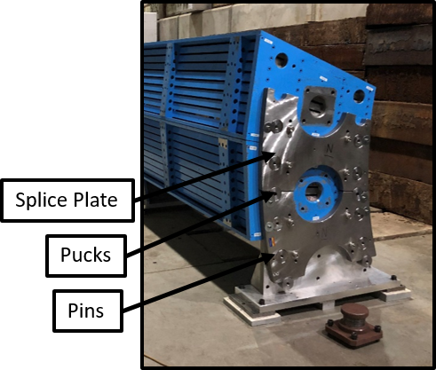
1.04.02 Outer HCal Mechanical Structure
Outer HCAL Splice Plates Procured – 13 Feb 2020
Assembly Lifting Fixture and Supports – 29 Apr 2020

Slide 13
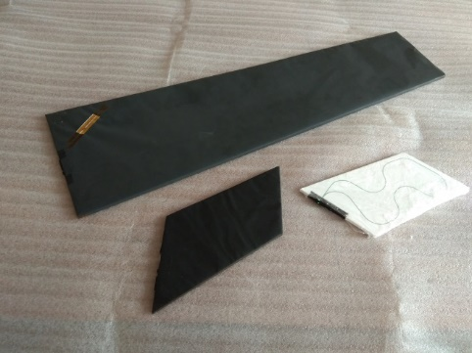
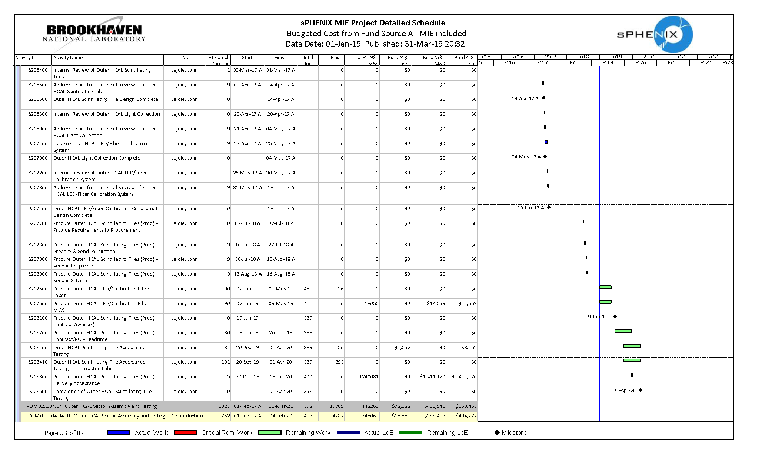
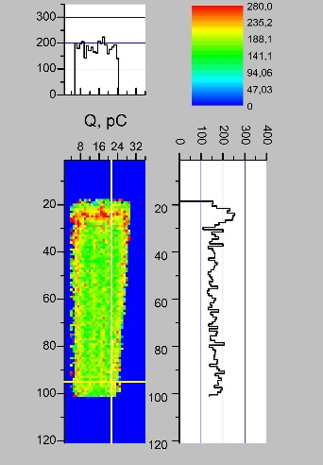
1.04.03 Outer HCal Scintillating Tiles
Tile Acceptance Testing (GSU) – 20 Sept 2019 – 1 Apr 2020

Slide 14
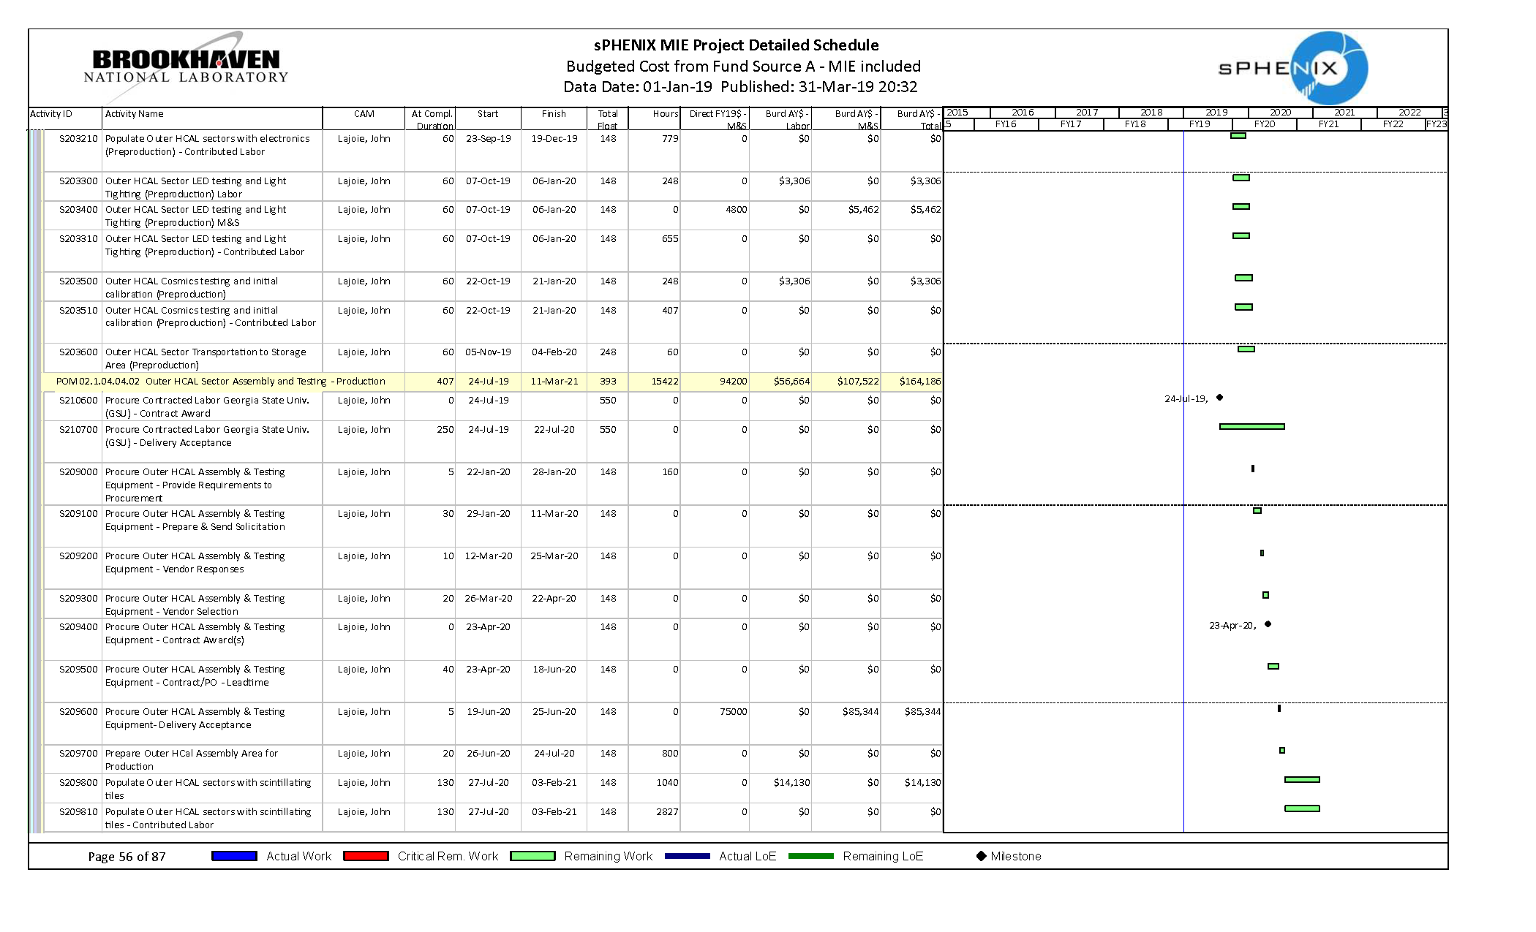
1.04.04 Outer HCal Assembly and Testing Milestones
First oHCAL Sector Ready for Installation – 4 Sept. 2020
Last oHCAL Sector Ready for Installation – 11 Mar 2021

Slide 15
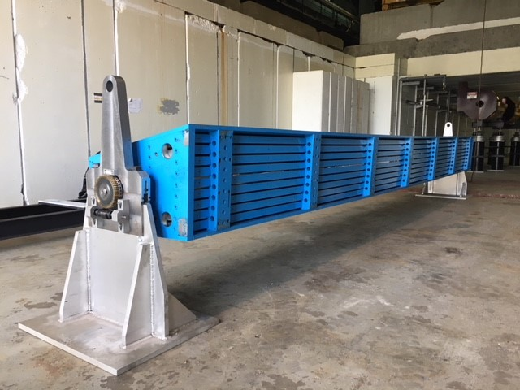
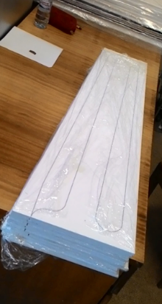
Status and Highlights
Test beams (2014/16/17/18):
Full scale mechanical prototypes manufactured
Outer HCAL Production Sector
In all cases, the combined system meets the sPHENIX spec!
Five rounds of prototyping with Uniplast – scintillating tile design very advanced.
Frame Prototype
https://arxiv.org/abs/1704.01461
(submitted to IEEE TNS)

Slide 16
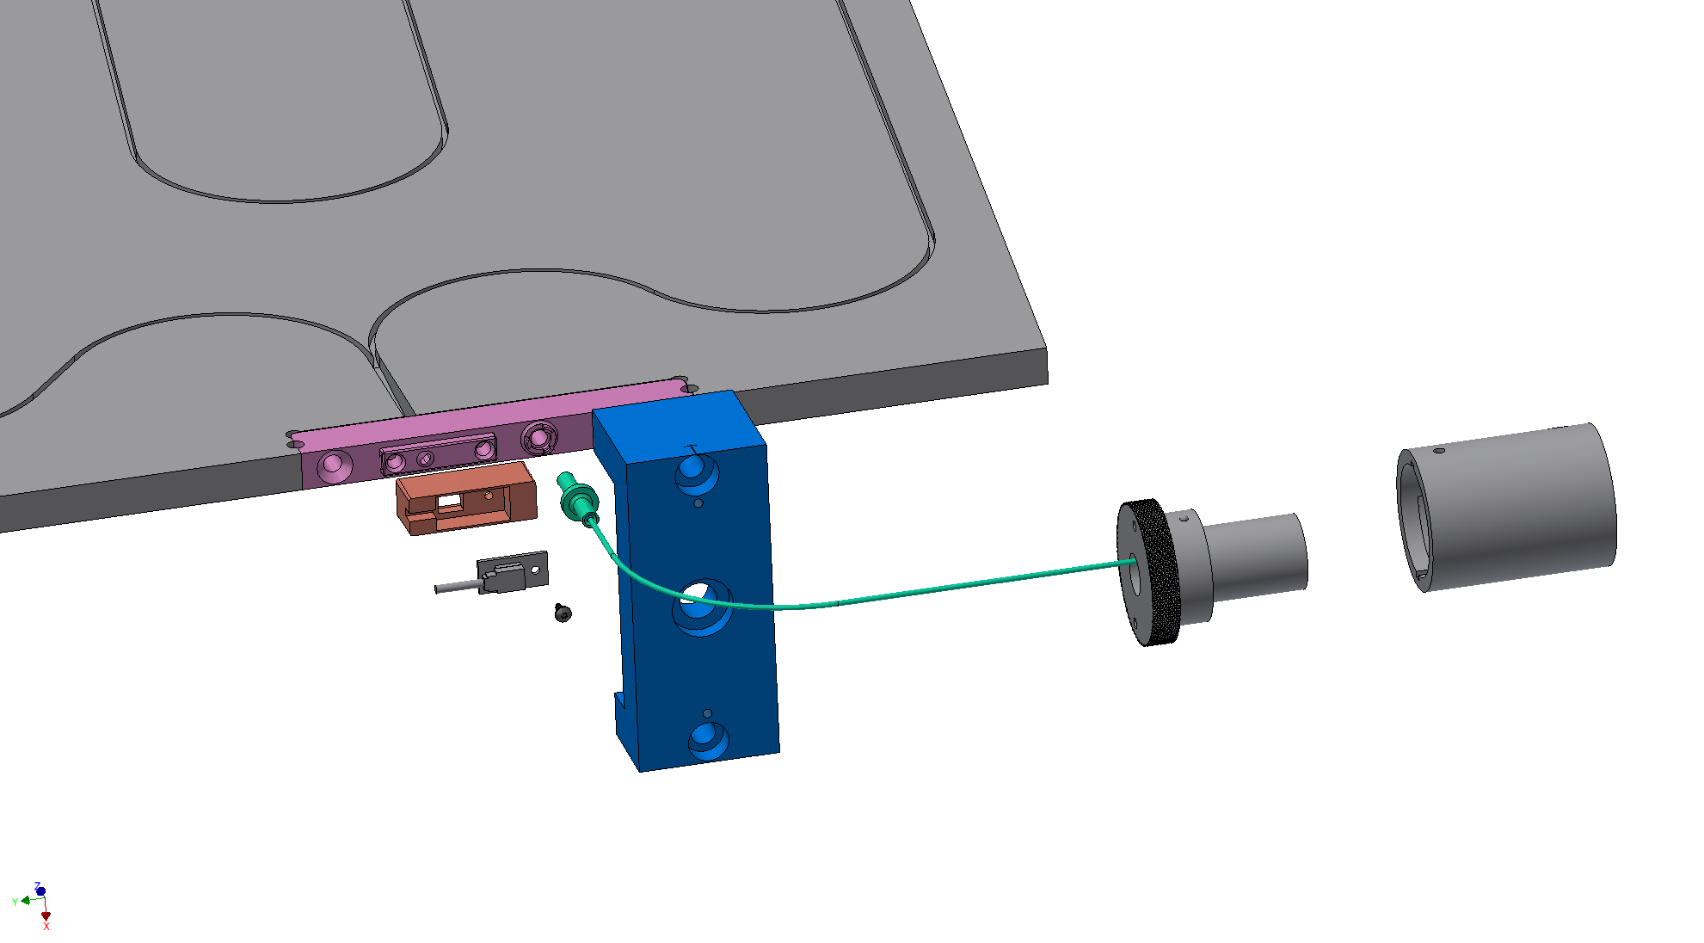
Scintillating Tile Advanced R&D
All aspects of the scintillating tile design are highly advanced
Advanced R&D contract (OPC funds):
  5th prototyping round
  (pre-production)
    ~20% of production total
    (1560 tiles)
    Includes tiles, clips, light blockers, SiPM mount, fiber bundles
  Exercise vendor production capabilities
Advanced R&D plan involves instrumenting six HCAL sectors with pre-production tiles and electronics
Scintillating Tile
(shown unwrapped)
Light block, SiPM mount and SiPM
Tile Retainer
Clip
Calibration
Fiber
Advanced R&D Production Underway

Slide 17
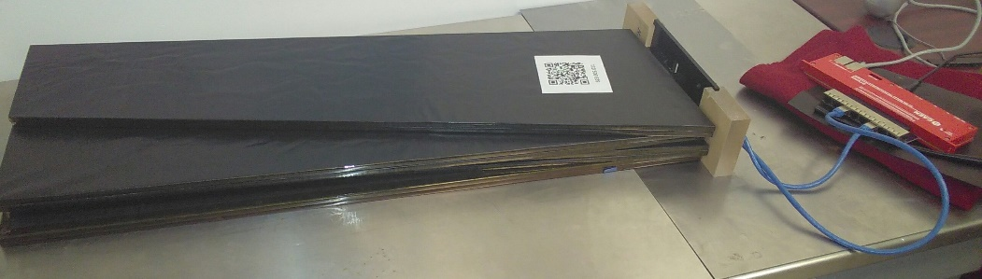
Adv. R&D Tile Performance
Results from testing at GSU (176 tiles) – characterize response relative to a reference tile (by shape):
5 tiles (3%) fall outside +/- 20%
Uniplast meeting HCAL production requirements

Slide 18
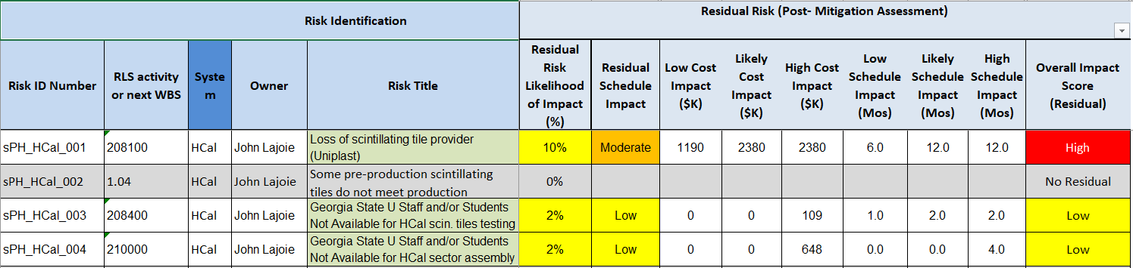
1.4 HCal Risks

Slide 19
Issues and Concerns
Loss of Scintillating Tile Provider (Uniplast)
  Uniplast is manufacturing scintillator sheets and providing completed scintillating tile assemblies, wrapped and tested, to sPHENIX specifications.
    Also providing access to inexpensive injection molding for key parts (light block/SiPM mount, tile clips)
    Uniplast has been extremely reliable
  Inability to execute with Uniplast would incur substantial schedule (+150 days) and cost (+$2.38M) cost impact
  Unlikely but impact is large
Availability of student labor
  Working with sPHENIX institutions to schedule summer 2019/2020 labor

Slide 20
Summary
sPHENIX Hadronic Calorimeter provides coverage for jet reconstruction between -1<η<1 and 0<φ<2π with an energy resolution better than
Design is highly advanced; multiple test beams establish performance within specifications.
  Four rounds of scintillating tile prototyping
Advanced R&D program sets the foundation for CD3A purchase and sector production.
The HCAL is ready for PD-2/3 approval.

