Slide 1
sPHENIX Director’s Review WBS 1.05: Calorimeter Electronics
Eric J. Mannel
April 9-11, 2019
BNL

Slide 2
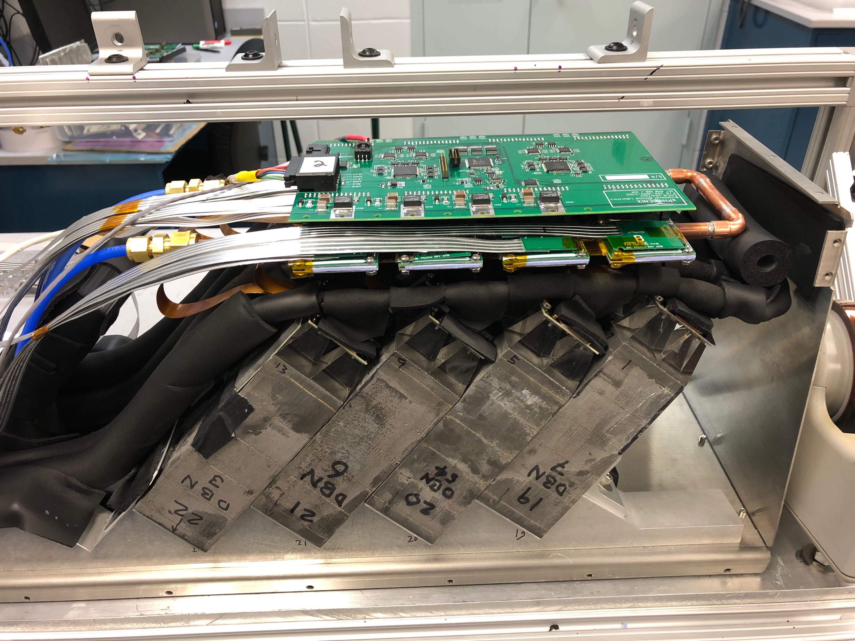
WBS 1.05: Calorimeter Electronics
“Common” design for both EMCal and HCal
Optical Sensor: Silicon Photomultiplier (SiPM)
Front End Analog Section:
Amplification/Shaping
Gain adjustment
Different packaging for EMCal and HCal
Digital Backend Section:
Continuous waveform digitization
Trigger primitives
Common Low Voltage and Bias Voltage Systems
Advance Design:
4 Stages of prototypes and beam testing.
Use commercial “Off the Shelf” components- No custom ASICS
EMCal V2.2 Prototype instrumented with preproduction electronics

Slide 3
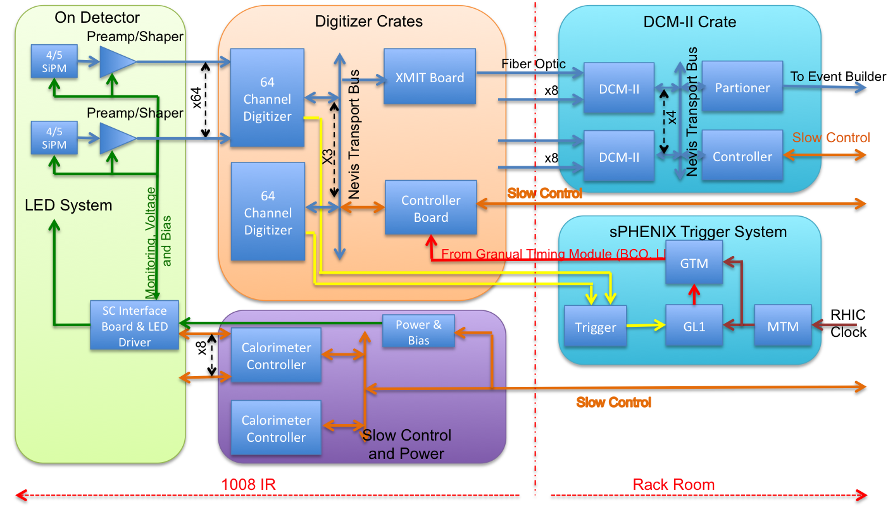
Calorimeter Electronics Block Diagram
WBS 1.05
WBS 1.06
WBS 2.09

Slide 4
Calorimeter Electronics Technical Overview
Silicon Photomultipliers:
Selected Device: Hamamatsu 12572-015P
Immune to magnetic fields
Pixels: 15 x 15 μm²
Dynamic range: 10⁴
Gain: 2x10⁵
Device: 3 x 3 mm²
Susceptible to neutron damage: increased leakage current
Analog Front End
Shaping time of 30 nSec
Switchable gain
normal gain
x 16 for calibration
Differential analog drivers
LED calibration/test system
Monitoring of voltages, current and temperature
Gain adjustment via bias voltage

Slide 5
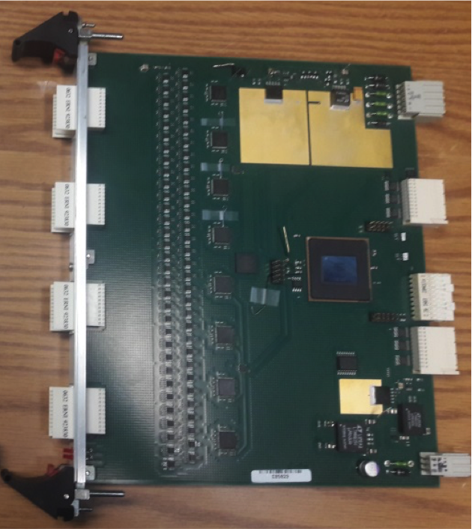
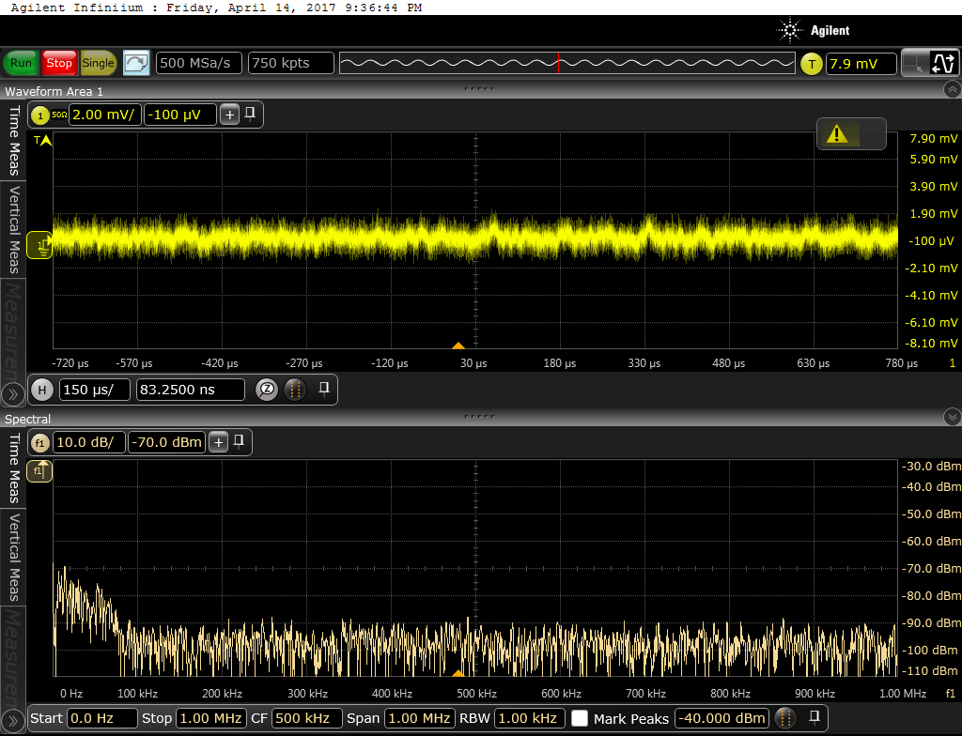
Calorimeter Electronics Technical Overview
Digitizer Back End
Identical for EMCal/HCal
Located “near” detector
14 Bit ADC (12 bit effective)
65 MHz maximum sampling frequency, operates at 6 x BCO
40 BCO latency for triggering
Maximum of 32 samples/channel/event
5 Event buffering
Generate trigger primitives based on 2x2 towers
Advance stage of design and Prototyping
Digitizer Board
Noise Measurement
2x8 EMCal Preamp

Slide 6
WBS 1.05: Scope
Optical Sensors
CD-3A Request: 77K devices ordered
EMCal: 70000
HCal: 7000
EMCal Front End Electronics
2x2 EMCal SiPM Daughter board: 3744
2x8 EMCal Preamp Boards: 936
64 Channel EMCal Interface Modules: 234
EMCal Controllers: 52
Crates, Power Systems and Cables
HCal Front End Electronics
HCal SiPM Daughter board:6240
HCal Preamp Boards: 1248
52 Channel HCal Interface, Backplane & LED Driver Modules: 64
HCal Controllers: 8
Crates, Power Systems and Cables
Digitizer System
Digitizers Modules: 367
XMIT Modules: 92
Controllers/Crates: 23
Clock Master: 6
Power systems & Patch Fibers

Slide 7
Radiation Damage Studies
SiPMs subject to neutron damage- Increased leakage current
Front end electronics subject to potential damage from ionizing radiation and neutrons
Component failure
Single event upsets
Details in breakout sessions
Silicon Photomultipliers: C. Aidala
Calorimeter Front End Electronics: S. Boose
Extensive studies of neutron damage on Hamamatsu 12572-015P
Expect ~10¹¹ n/cm²/run
Increased leakage current, 250μmA/device after 5 years
Front end electronics designed to handle increase
Power capacity
Cooling
Paper submitted to IEEE TNS: arXiv:1809.04594

Slide 8
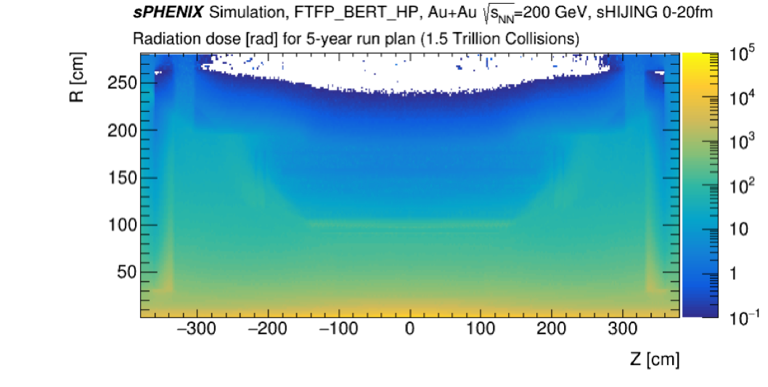
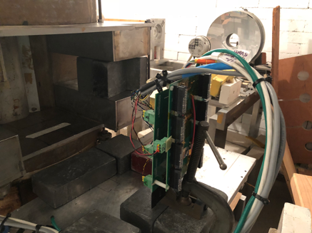
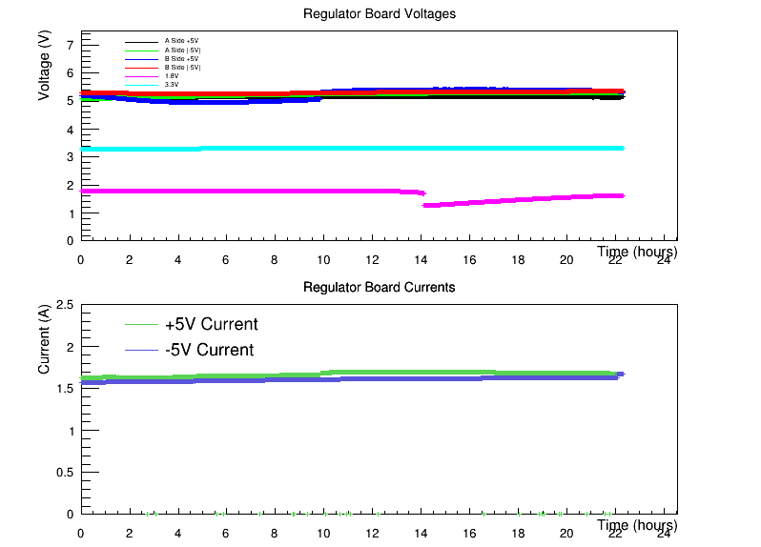
Radiation Damage Studies
Ionizing radiation studies done at the Solid State Gamma Ray Irradiation Facility at BNL.
Expect ~1k Rad/run at EMCal
Based on simulations
PHENIX IR measurements
Irradiate front end electronics up to 240 kRad.
Device selection based on studies.
Performance of selected regulators for EMCal and HCal front end electornics

Slide 9
WBS 1.05: Subsystem Collaborators
Brookhaven National Lab:
Eric Mannel, L2 for WBS 1.5
Steve Boose, L3 for analog front end electronics
Front end electronics design, production & testing
Columbia Univ./Nevis Labs:
Cheng-Yi Chi, L3 for digital back end system
Back end electronics design, production & testing
University of Michigan
Christine Aidala, L3 for optical sensor testing
Optical sensor testing
University of Debrecen
Testing Equipment design and production
Optical sensor testing
Augustana University
Database management
Electronics testing

Slide 10
WBS 1.05: Schedule Drivers
SiPMs:
CD-3A request for 77K Devices, $669K budgeted cost, order placed
First 17K delivered March 4 & April 1, 2019, 10 month delivery schedule
Extensive testing prior to assembly
Required for EMCal module assembly
31 Days of float
EMCal SiPM Daughter Boards/Preamps/Interface Boards and Interior Cables
PD-3 Request
Required for EMCal sector assembly.
On or near critical path

Slide 11
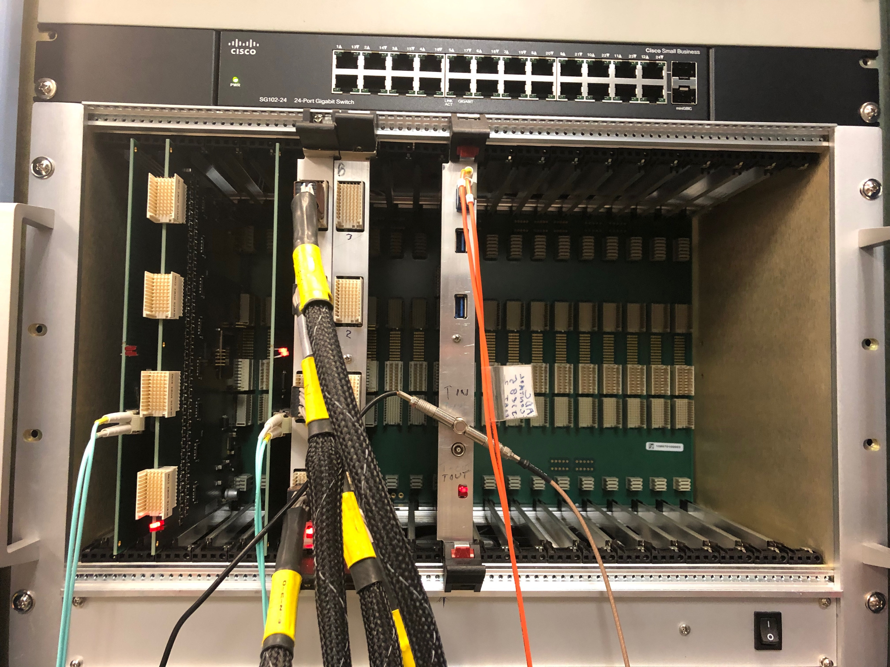
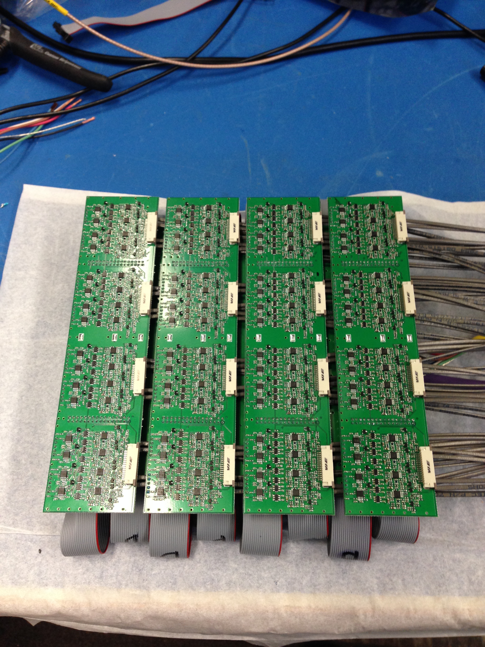
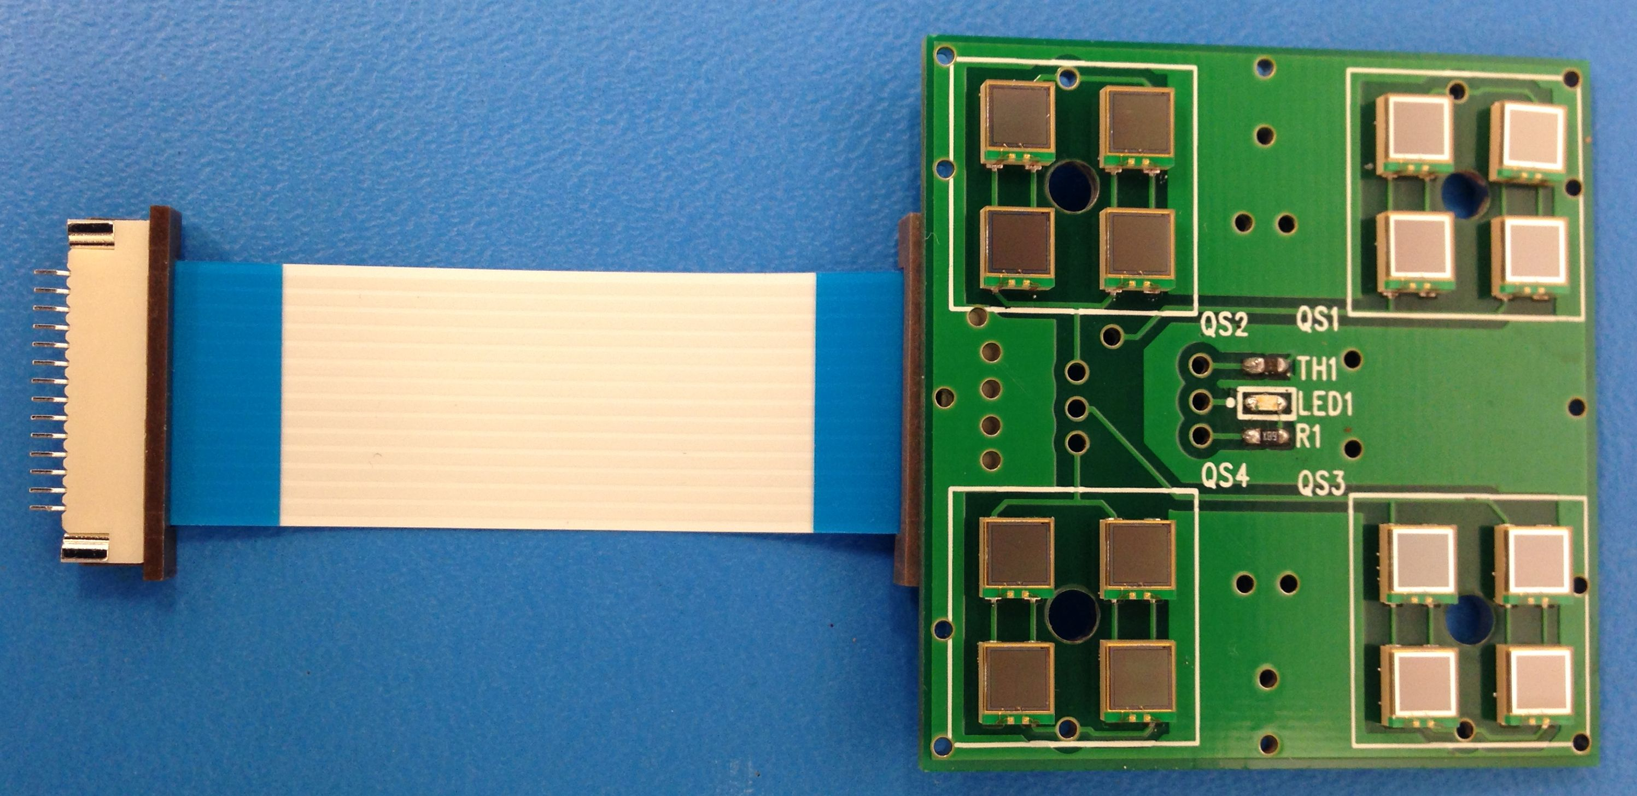
WBS 1.05: Cost Drivers
EMCal Preamps
Cost Drivers:
SiPMS: $669K, CD-3A item, order placed.
EMCal Preamps: $475K
EMCal Cables/Power Systems: $540K
HCal Preamps: $41K
HCal Cables/Power Systems: $140K
Digitizer System: $860K
Parts: $516K
Board Fabrication: $145K
Assembly: $124K
Other Costs: $75K
Digitizer Crate
EMCal SiPM Daughter Board

Slide 12
WBS 1.05: Basis of Estimate & Resource-Loaded Schedule
Cost and Labor estimates are based on:
Recent Prototype designs
Budgetary quotes for designs that are well developed
Engineering estimates and past experience for designs still in preliminary stages.
Schedule based on:
Budgetary quoted delivery schedule when available
Engineering experience
BOEs were used to develop the RLS.

Slide 13
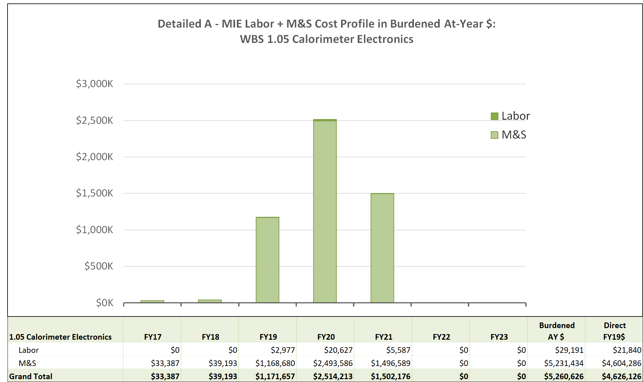
WBS 1.05 MIE Labor + M&S Profile
Electronics fabrication is done by commercial vendors
Detailed parts quotes/catalog pricings
Vendor assembly quotes
Labor is for Q/A testing

Slide 14
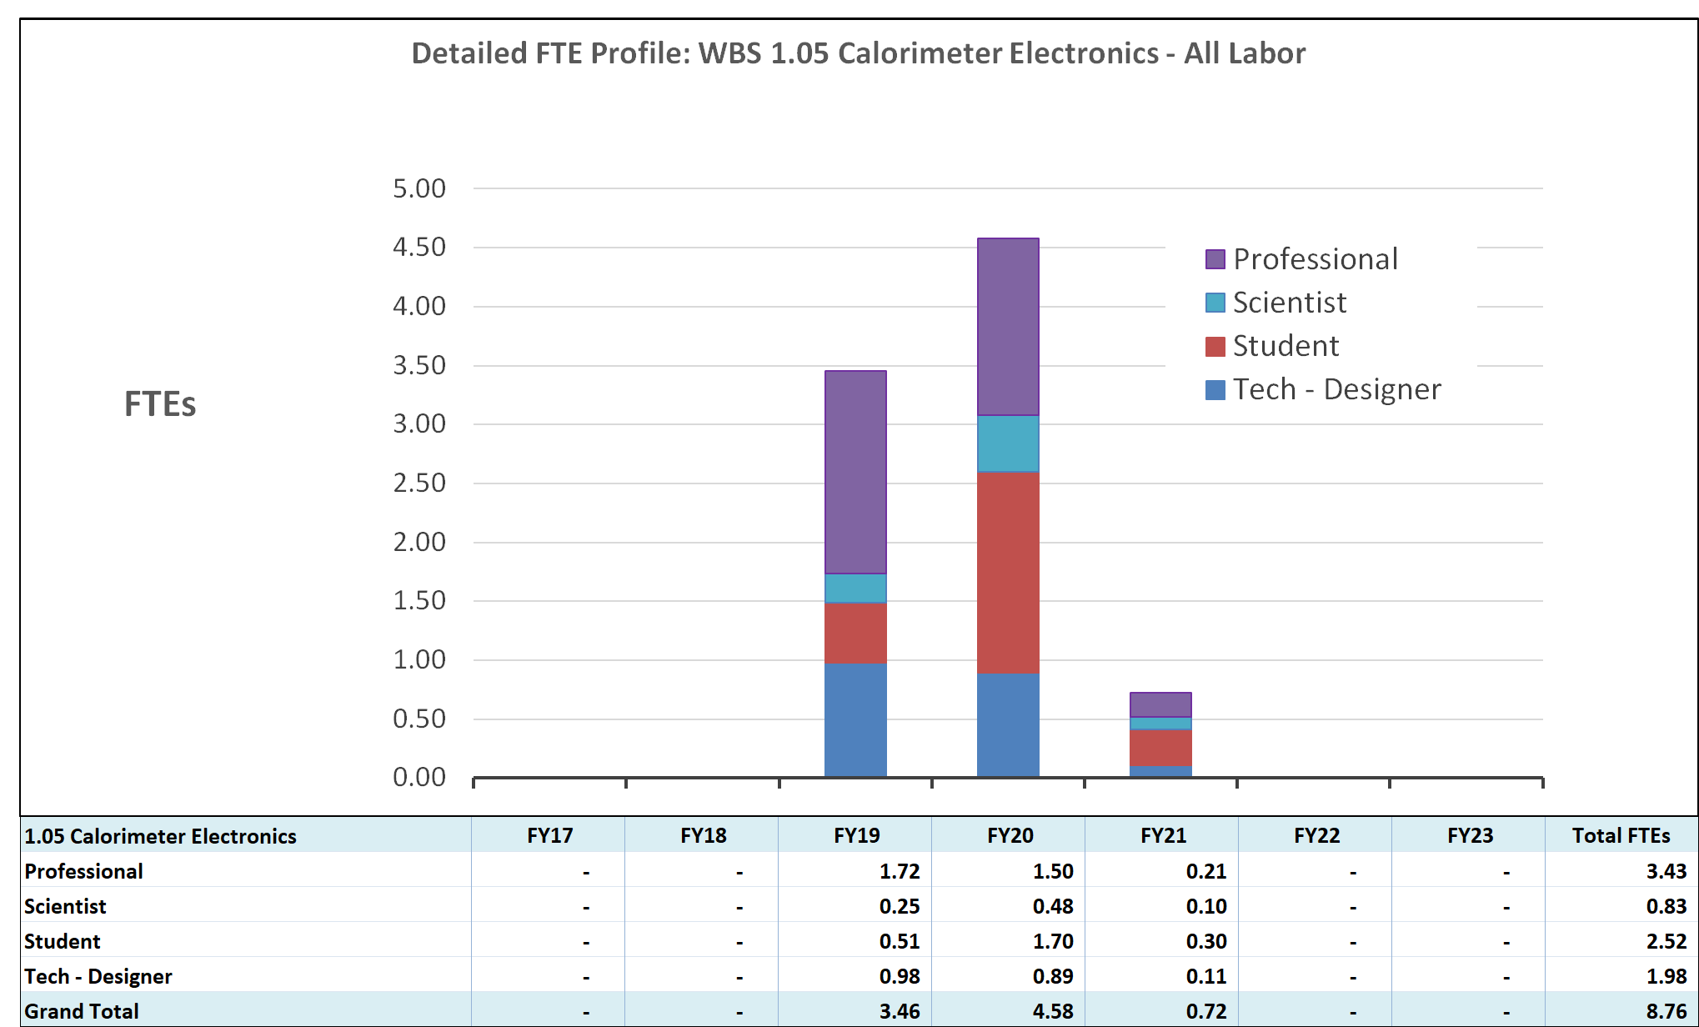
WBS 1.05 MIE FTE Labor Profile
Electronics fabrication is done by commercial vendors.
Labor is for order placement, and Q/A testing and inspection.
Installation labor is part of detectors and/or installation WBS’s.

Slide 15
WBS 1.05 Estimate of Uncertainty
BoEs are based on recent board design
Preproduction orders
Detailed parts quotes/catalog pricings
Vendor assembly quotes

Slide 16
WBS 1.05 Risk Registery

Slide 17
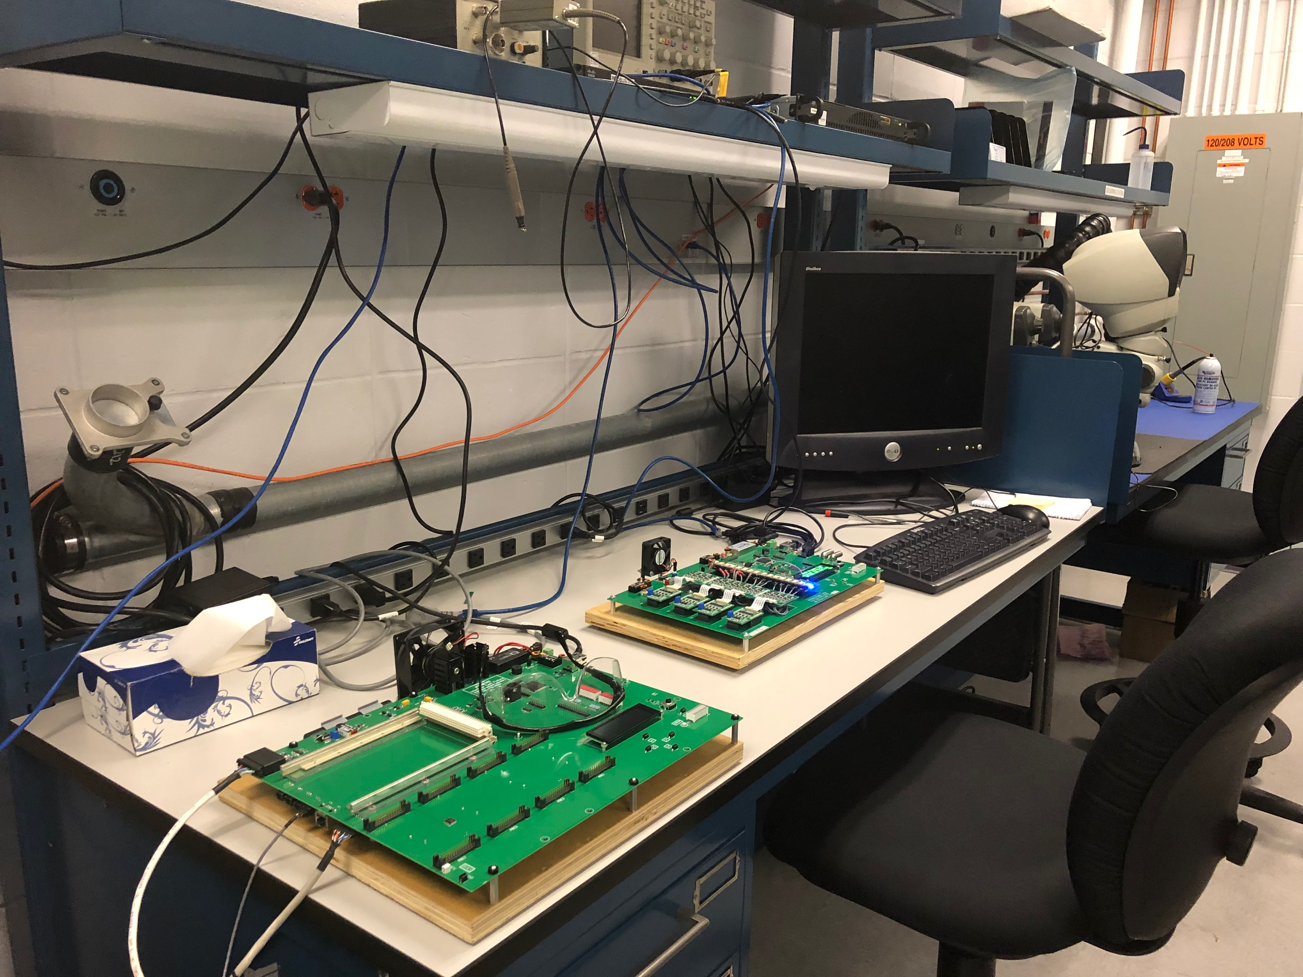
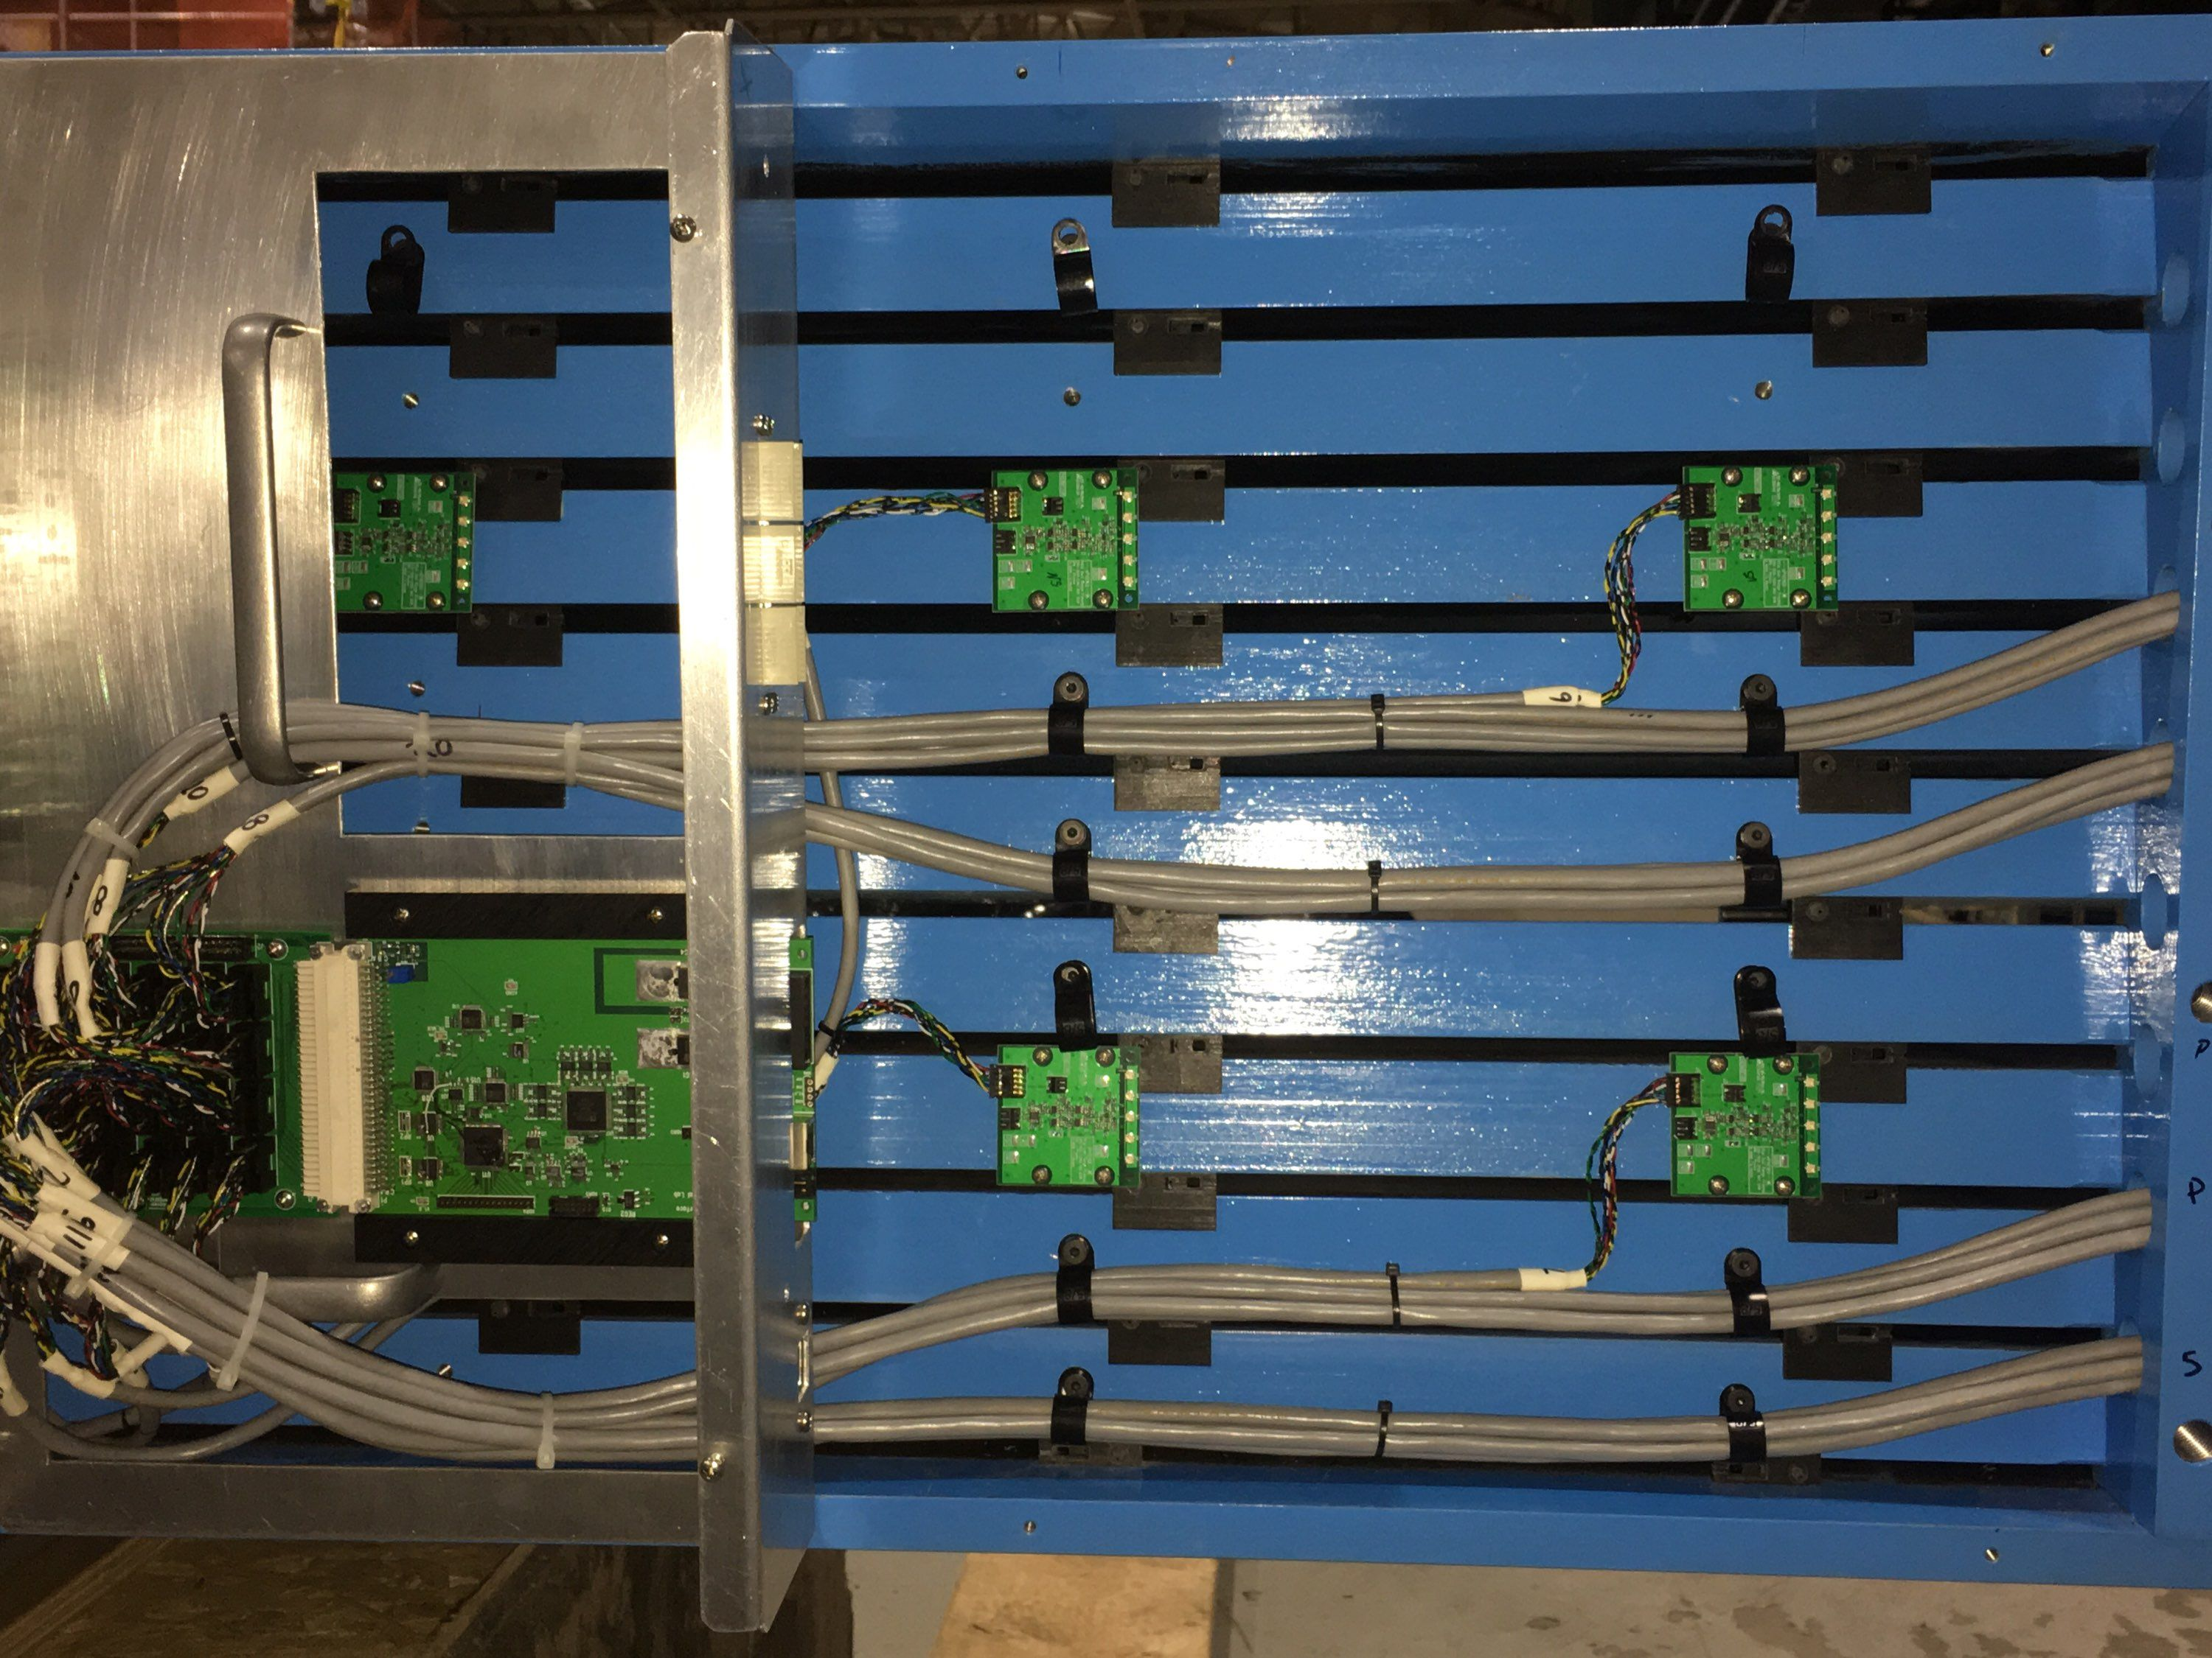
WBS 1.05 Status and Highlights
First 2 deliveries of SiPMs received: Mar 4 & April 2, 2019.
Test stands for Q/A testing setup and ready.
EMCal prototype updated with Sector 0 (preproduction) electronics.
EMCal Sector 0 electronics ready for installation.
HCal modules 1-6 electronics ready for installation
2 trays of SiPMs from the first delivery. Devices are sorted according to Vop
EMCal Interface and Preamp Q/A test stand in Hcal lab
Test fit of HCal electronics on Module 0 in bldg. 912

Slide 18
Issues and Concerns
SiPMs
Testing/Assembly
Critical for EMCal/Hcal performance
Tied to SiPM delivery schedule
Monitor schedule closely, multiple test facilities/sites
Value Engineer assembly process with potential assembly house(s)
Front End Electronics Assembly & Testing
Needed for EMCal Sector/HCal assembly
Closely monitor schedule
Early design of test procedures, value engineering
Advance Stage of design, 4 prototype stages complete and tested under “beam” conditions

Slide 19
Summary
CD-3A request for 77K SiPMs has been placed, first delivery March 4, 2019
The Calorimeter Electronics design is in an advance stage with 4 prototype rounds and testing at the Fermilab Beam Test Facility, arXiv:1704.01461
Additional radiation damage studies are being planned.
Design of cooling system is preliminary (WBS 1.03).
A resource loaded schedule has been developed based on knowledge gained from the prototype rounds.
Support documentation (e.g. BoEs, Testing Plans) have been developed.
Based on the advanced prototyping, there are no technical issues to be resolved.
Calorimeter Electronics is ready for PD-2/3!

Slide 20
Back Up

