Slide 1
sPHENIX Director’s Review DAQ/Trigger
Ed Desmond
(standing in for Martin Purschke)
April 9-11, 2019
BNL

Slide 2
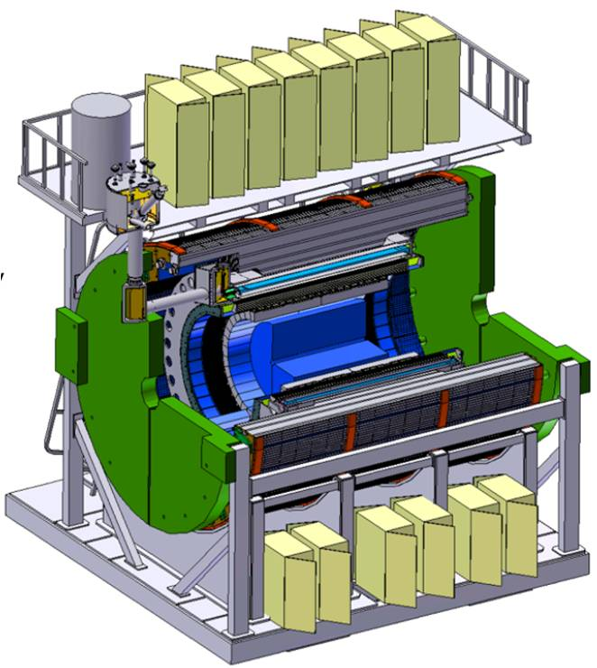
The DAQ/Trigger Subsystem
L2 Manager: Martin L Purschke, BNL
DAQ System Requirements
Configure detectors for operation
Control / Monitor detector systems
Readout detectors @ 15 kHz event rate @ 90% livetime
Stored data @ ~ 135 Gbit/sec to HPSS
Timing/Trigger

Slide 3
DAQ Technical Overview
FEM
DAQ interfaces to all detector systems built and working
Calorimeter, TPC, MVTX detectors successfully read out
Integration of separate DAQ components into an overall DAQ architecture now in development
DCM
DCM2
40+ Gigabit
Crossbar
Switch
DCM
DCM
Buffer Box
DCM
DCM
FEM
DCM
SEB
DCM
Buffer Box
DCM
DCM2
DCM
DCM
DCM
FEM
DCM
SEB
DCM
Buffer Box
DCM
To
HPSS
DCM
DCM2
DCM
DCM
SEB
DCM
Buffer Box
FEE
DCM
DCM
DAM
EBDC
Buffer Box
DCM
FEE
DCM
DCM
DAM
EBDC
Buffer Box
DCM
FEE
DCM
DAM
EBDC
Buffer Box
DCM
DCM
Interaction Region
Rack Room
sPHENIX Trigger System
Slow Controls
vGTM
LL1 Trigger
GL1
MTM
RHIC Clock

Slide 4
Scope
Deliverables:
Take 15 kHz event rate with 90% live time
store and transfer ~135 Gbit/s data
Provide sufficient rejection with Local Level 1 to get to 15 kHz
Configuration, Control and Monitoring system software

Slide 5
Hardware and procurements
Data Collection Modules ( DCM-II) 25 needed
SubEvent Buffers (SEB) (18) : commodity PC
Buffer Boxes (6) : commodity PC/File server
40 Gbit/sec per BufferBox
JSEB2 input cards (33) ( 40% in hand) custom board
Control Machines - control, monitoring (4) : commodity PC
Global level 1 system Xilinx FPGA based board in hand
Timing system Xilinx FPGA based board in hand
Network switches (one or two) : commodity switch

Slide 6
DAQ Technical Status
Data Collection Modules (DCM-II) reused from PHENIX with well known functional characteristics
sPHENIX Digitizer electronics already integrated into DAQ readout system
Tested extensively and used at the FermiLab beam test Feb – May 2018
Significant progress made with TPC readout with ATLAS Felix card
8 Sampa chip front-end card read out into FELIX cards
FELIX card integrated into our standard RCDAQ software and successfully read out
Global Level 1
New Xilinx FPGA based boards in hand
Basic operational functions now in place and used to trigger TPC readout
SubEvent Buffers (SEB ) , BufferBox components are commercial PCs
Reuse of PHENIX control software where appropriate
Readout of detector monitor data ( temp, DAC gain, status) available and in routine use ( extensively used at the Fermilab test beam with the Calorimeter Control Board)

Slide 7
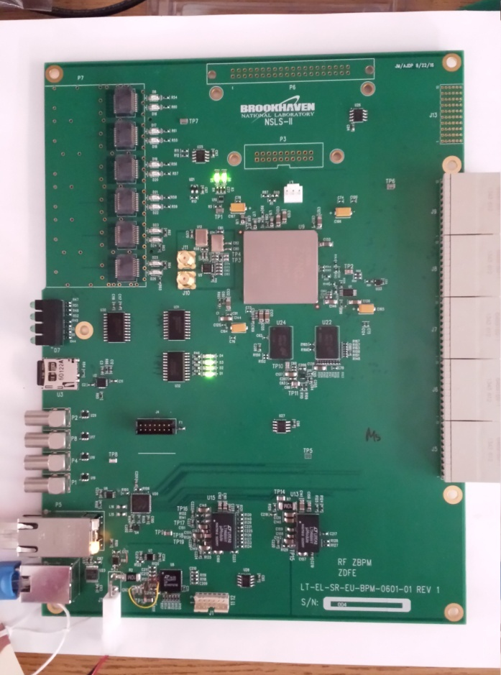
GL1 / Timing system
FPGA board selected (same for both GL1 and Timing system, different firmware)
Based on in-house development for the NSLS-2, design under our control, IP under our control, boards readily available
Zynq FPGA at its core, provides additional CPUs running Linux for all slow controls/configuration needs
Plenty of I/O blocks to cater to early R&D-themed needs
“Granule Timing Module” (GTM) firmware in use with TPC front end

Slide 8
Slow Controls
Configuration and control of Emcal, Hcal, and MBD digitizer and DCM-II components implemented through standard JSEB-II components
Used extensively in the PHENIX project
Well understood and established communication protocol
Detector Component Monitoring
Readout of Calorimeter temperature, DAC gains, and access to status parameters is implemented through in house developed Calorimeter Control Module
HV control via Weiner-ISEG and LeCroy HV (MBD)
ADAM/MODBUS Low Voltage control, reuse from PHENIX
Development of a standard API for these devices is in development

Slide 9
Subsystem Collaborators
1.6 Data Acquisition and Trigger (M. Purschke, BNL)
1.6.1 The core DAQ system (Ed Desmond, BNL)
1.6.2 Local-Level 1 Triggers (Jamie Nagle, U Colorado)
1.6.3 Global Level 1 Trigger (Ed Desmond, BNL)
1.6.4 Timing system (M. Purschke )
Joe Mead, BNL/instrumentation (Timing)
John Kuczewski, BNL/instrumentation (Timing,GL1, Time Projection Chamber interfaces)
Cheng-Yi Chi, Columbia/Nevis (Local Level-1) Dennis Perepelitsa, U Colorado (Local Level-1)

Slide 10
Schedule Drivers
Task | Finish date
GL1 Prototype Ready | Dec 2018
DAQ prototype ready for production | Aug 2019
Timing system prototype | Sep 2019
Local Level-1 prototype v1 ready | April 2020
Local Level-1 preproduction prototype | Oct 2020
DAQ components ready for operation | Dec 2020
Timing system ready | Dec 2020
GL1 ready | Mar 2021
Local Level-1 ready | Jul 2021

Slide 11
Cost Drivers
DCM2 Components $120.6k
8 DCM2 cards @ $12000/ea + 6 JSEB2 cards @ $4100
Commodity PCs $48.26k
18 SEBs @ $2280
4 JSEB2 hosts @ $2107
Buffer Boxes $268k
6 RAID boxes @ 44708
Network switch $79.8k
2 10Gb switches

Slide 12
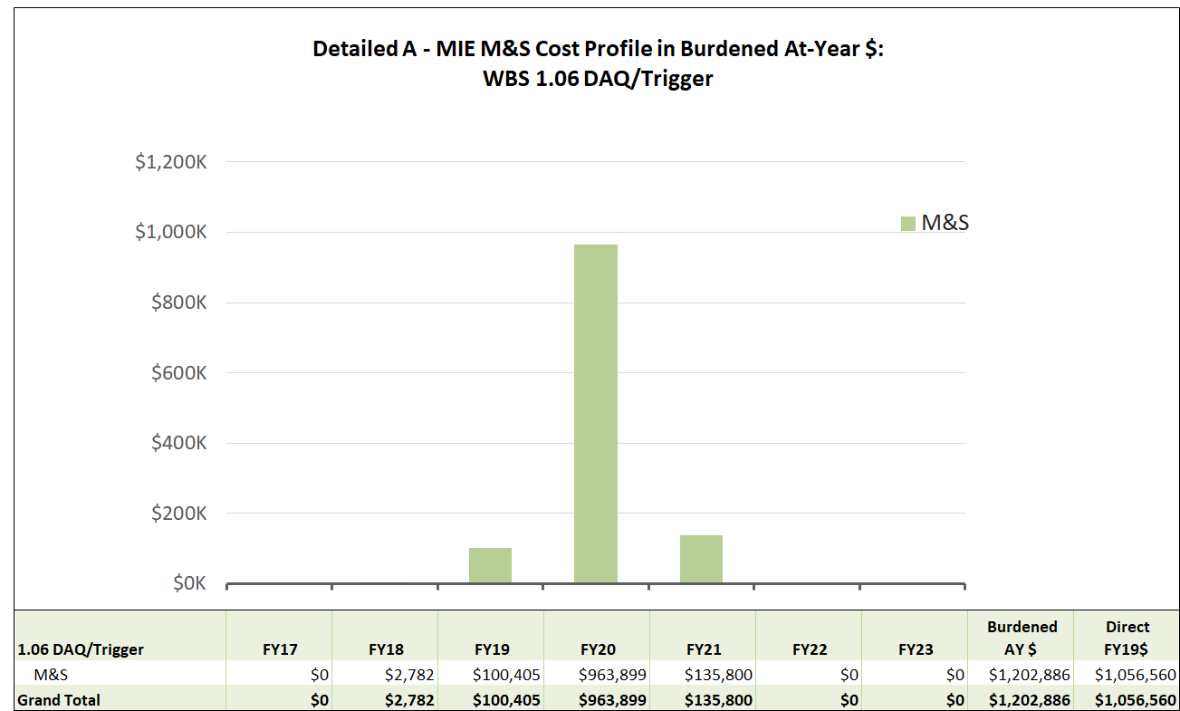
Cost Distribution WBS 1.6 DAQ/Trigger

Slide 13
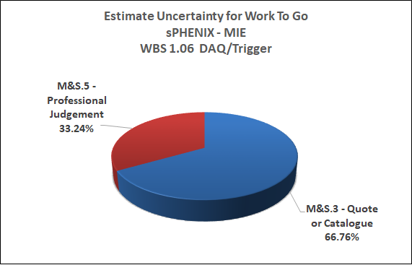
WBS 1.06 Estimate of Uncertainty

Slide 14
Status and highlights
We can already read the main components (calorimeters, Time Projection Chamber, …) with actual sPHENIX hardware (DCM2s, TPC front-end boards, etc)
We have a “legacy” high-end 10Gbit/s network switch available for development
We have enough PCs in hand for all development and similar tasks
Local-level-1 technology selected
The Global Level-1 and Timing technology is selected, procured and development underway and partially implemented
Final data format defined and software already implemented

Slide 15
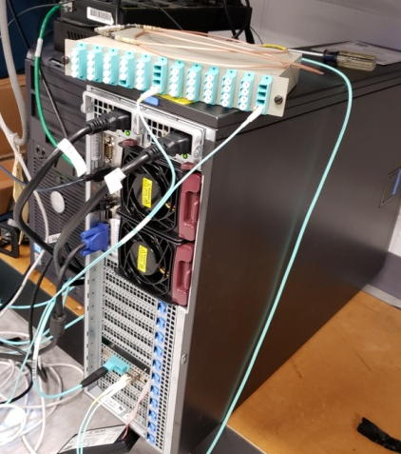
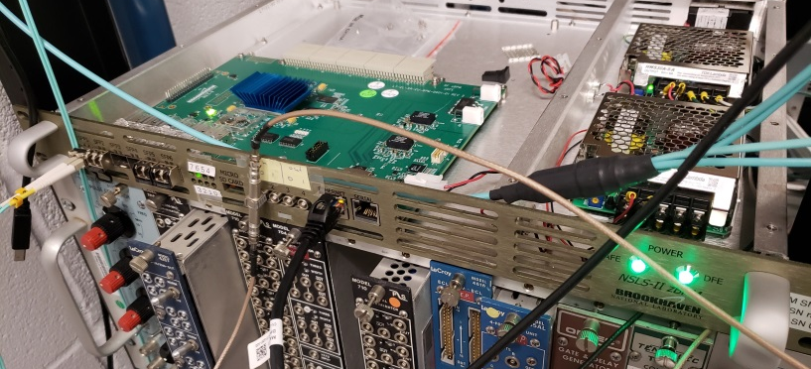
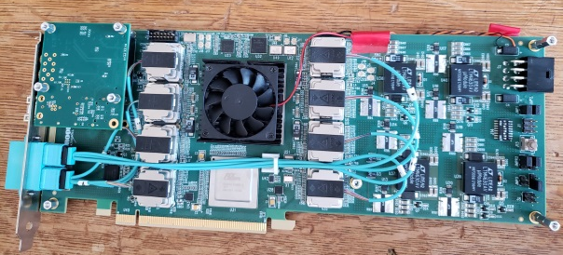
GL1 and Timing system (GTM) Status
We have demonstrated the readout of the TPC front-end card under the control of the timing system (GTM, Granule Timing Module)
GTM distributes a trigger and started the readout
Can in turn be controlled by a GL1 unit
Felix Card
Timing System
EBDC
Timing fiber Trigger Signal

Slide 16
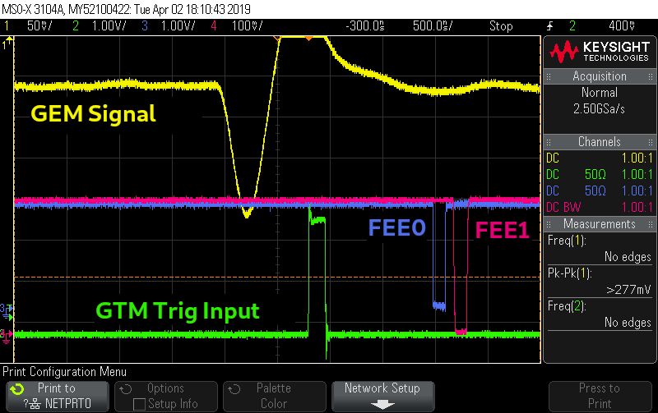
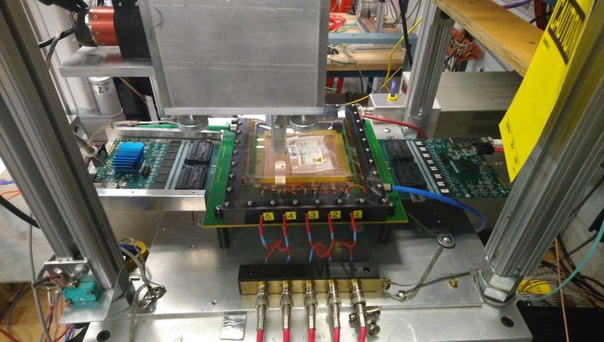
GL1 and Timing system TPC triggering
Test stand readout of the TPC front-end card with scope trace of GTM to FEE trigger signal
GTM/FEE trigger trace
Test stand for FEE/GTM

Slide 17
1.6 DAQ/Trigger Risks

Slide 18
Issues and Concerns
The TPC data rate could be higher than currently estimated from simulations
This may lead to more expensive network switches and more file servers, or reduced buffering depth

Slide 19
Summary
DAQ interface to all sPHENIX detector sub-systems in place and functional
The control and readout of the TPC, MVTX and Calorimeter detectors has been successfully implemented using the standard DAQ software
Calorimeter detectors successfully read out at Feb 2018 Fermilab test beam
A baseline Global level 1 has been implemented, including readout of trigger parameters
TPC and MVTX front-ends have used the GL1 information transmitted through the GTM timing system
DAQ system used for all tests implements standard sPHENIX data formats, allowing re-use of monitoring and analysis software.
The sPHENIX DAQ system is ready for PD-2/3

Slide 20
Back Up

Slide 21
Buffering and average data rates
We have ”built in” a factor of 0.6 for the combined sPHENIX x RHIC uptime (optimistic)
With buffering, we can take ~1.5 times the HPSS logging rate
The longer you can buffer, the higher the local rate can get
2016 PHENIX numbers: 12 Gbit/s local max from the DAQ
uptime: ~ 50%
12 hour average 6 Gbit/s
2-day average 4 Gbit/s
week < 3 Gbit/s
entire Run ~2Gbit/s
You average over machine-development days, short accesses, APEX days, and other small no-beam periods

