Slide 1
sPHENIX Director’s Review Minimum Bias Trigger Detector
Mickey Chiu
April 9-11, 2019
BNL

Slide 2
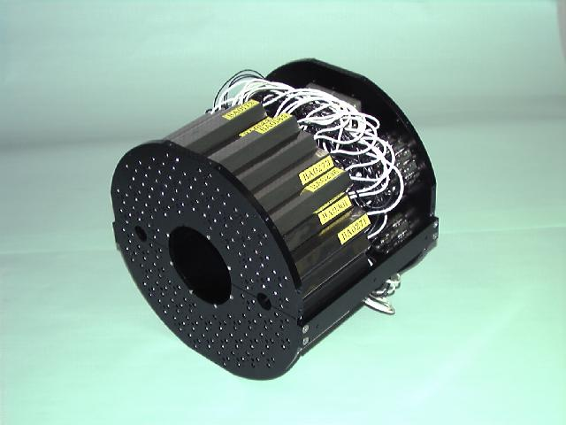
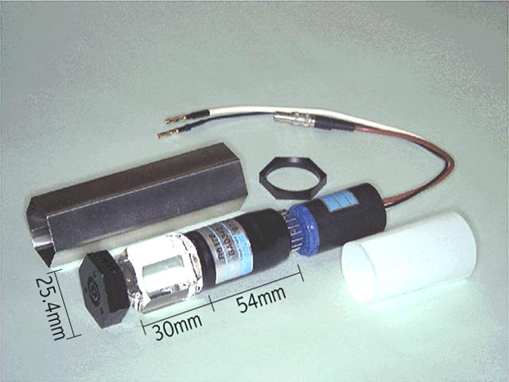
Minimum Bias Detector
Reuse of PHENIX BBC to provide high quality, cost effective solution
128 ch’s of 3 cm thick quartz radiator on mesh dynode PMTs
Provide minimum-bias trigger with high efficiency for heavy ion collisions (~90%)
Needs online z-vertex resolution of at least 2.5 cm, ie, 120 ps/ch
Contributes to centrality, reaction plane, and start time

Slide 3
Readout Design
In WBS 1.5 + 1.6 Scope
BBC PMTs
Disc/
Shaper
Board
sPHENIX Digitizers
(4 ADC boards)
sPHENIX DAQ
L1 Trig, Modebits, CLK
sPHENIX
Trigger
sPHENIX
Timing Module
In WBS 1.7 Scope
Use sPHENIX EMCAL digitizers, and build a transition board to convert single-ended PMT signal to 100 ohm differential that stretches PMT signal to be recorded by 60 MHz ADC
To satisfy the trigger and timing requirements, we process the PMT signal to produce
A shaped pulse for energy measurement
A square ~1V discriminator signal (for timing at trigger level and precisiong timing in offline).

Slide 4
MBD Project Team
BNL M. Chiu, M. Lenz, R. Pisani
Project Lead, detector and electronics testing
RIKEN Y. Goto
PHENIX BBCs
Nevis/Columbia C.Y. Chi, W. Sippach
Disc/Shaper Board
Lehigh University R. Reed
Detector and electronics testing, simulation, operations support

Slide 5
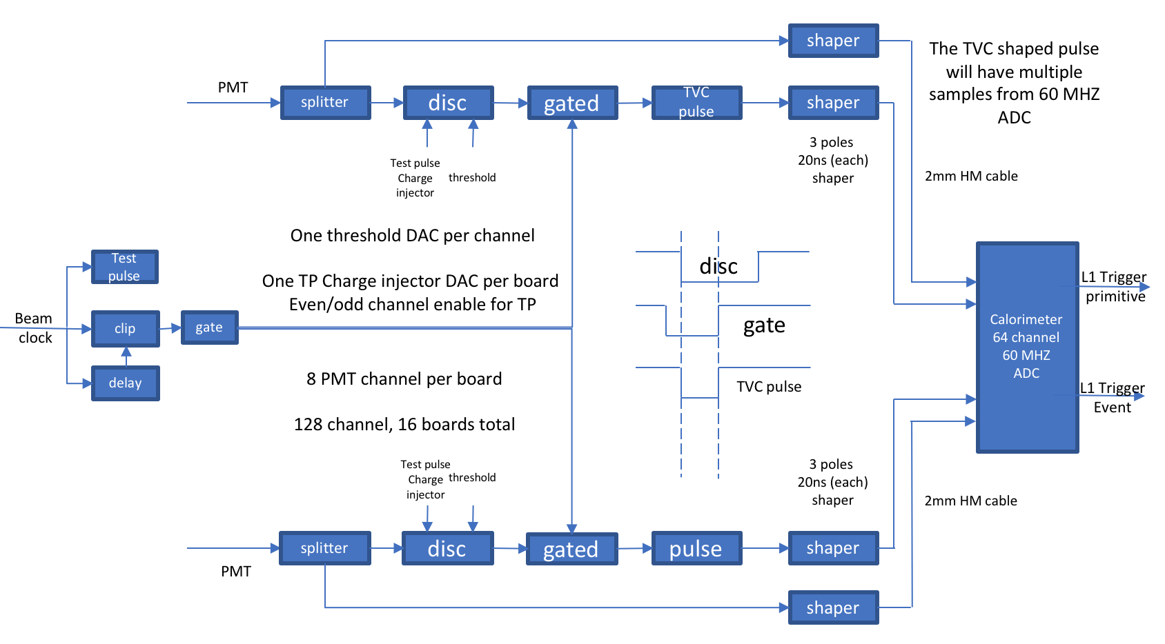
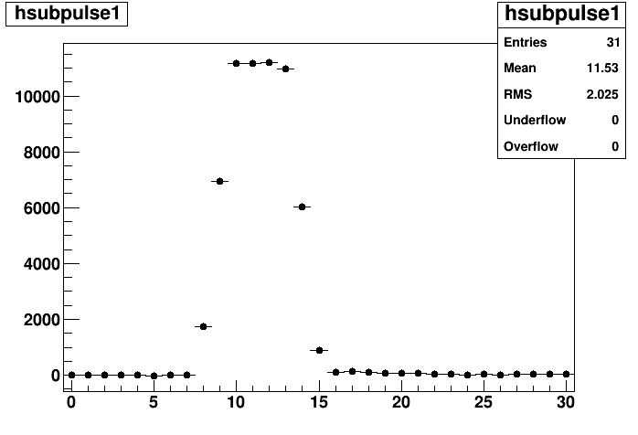
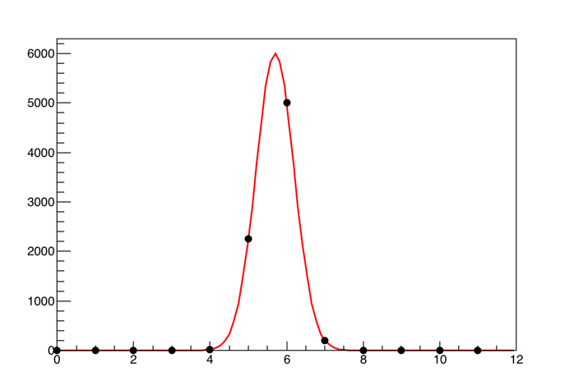
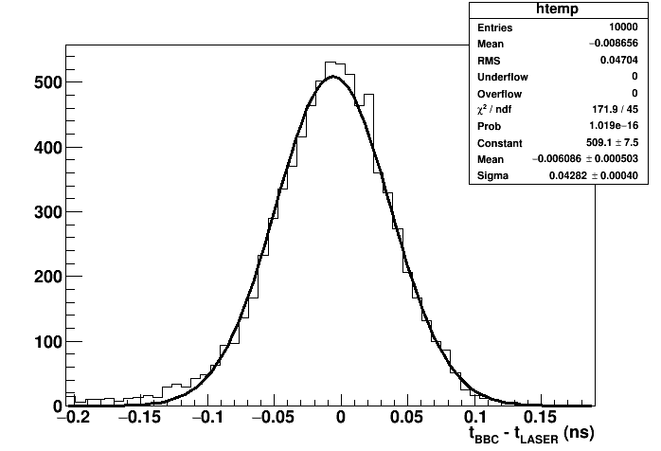
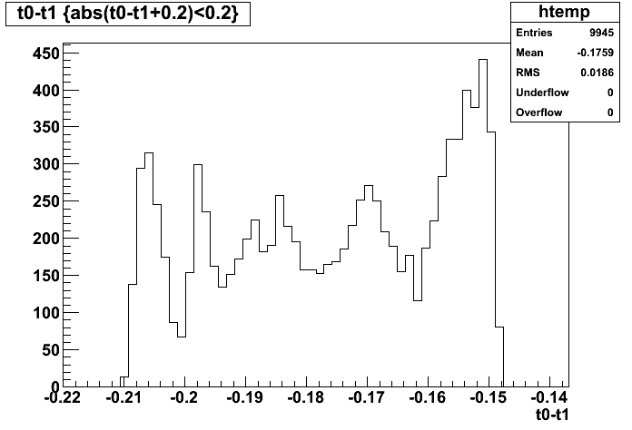
MBD Status
D/S Board
Discrim.
TDC
ADC
DAQ
sPHENIX Digitizer
LL1
Board
C.Y. Chi,
W. Sippach
Shaper
43² ps + ? + 13² ps <= 50² ps
Laser PMT Test*
Split Pulse Test
*Tested in B-field with magnitude expected in sPHENIX

Slide 6
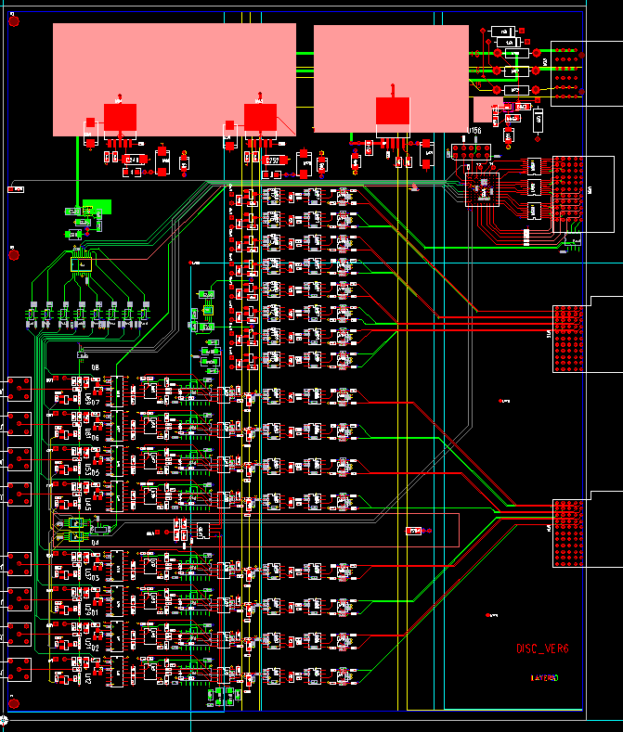
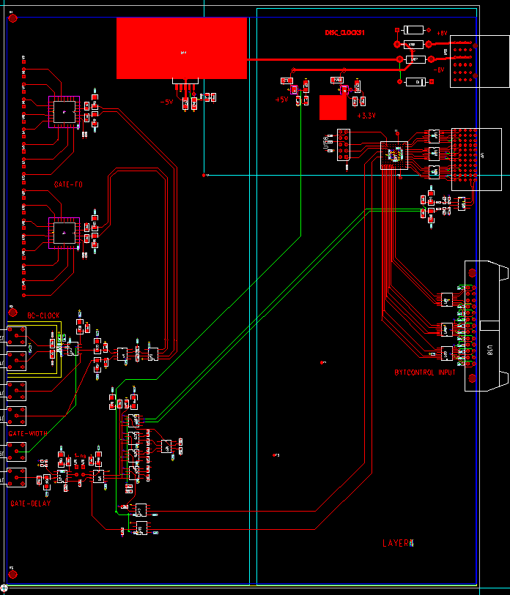
MBD Disc/Shaper Boards
Clock Fanout
Threshold DAC
PMT pulse
shaper
Input from
Calorimeter
Crate controller
MBD Discriminator
Clock
in
Gate
Width
MBD Clock module
discriminated
Pulse shaper
Test pulse
generator
discriminator
D/S Prototype Boards are being fabricated

Slide 7
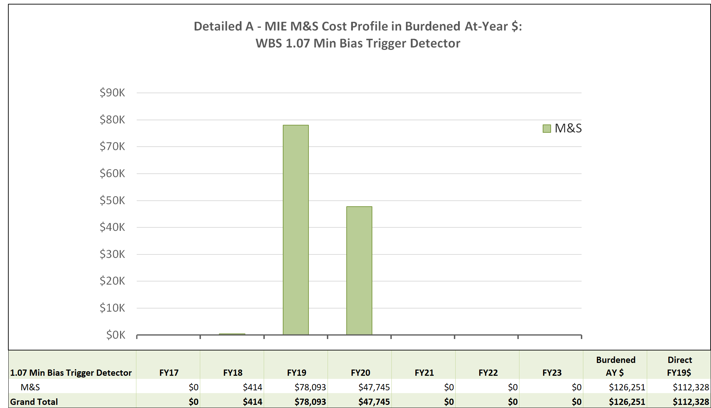
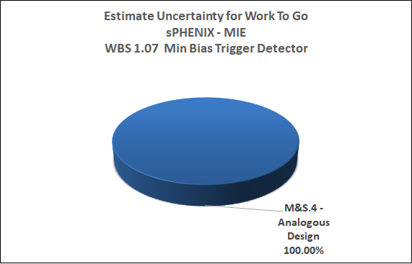
Cost & Schedule
MBD expected to be ready well ahead of sPHENIX requirements

Slide 8
MBD Risks

Slide 9
Issues and Concerns
Risk entirely associated with performance of D/S board, which we will be able to test soon.

Slide 10
Summary
Reuse of PHENIX BBC, with clever design of new electronics to interface with existing sPHENIX electronics, provides a high quality, cost-effective, reduced risk solution for the sPHENIX Minimum Bias Trigger Detector.
MBD is ready for PD-2/3 approval.

