Slide 1
sPHENIX Director’s Review
WBS 2.02: Superconducting Magnet
Kin Yip
Collider-Accelerator Department
Apr. 9, 2019
BNL

Slide 2
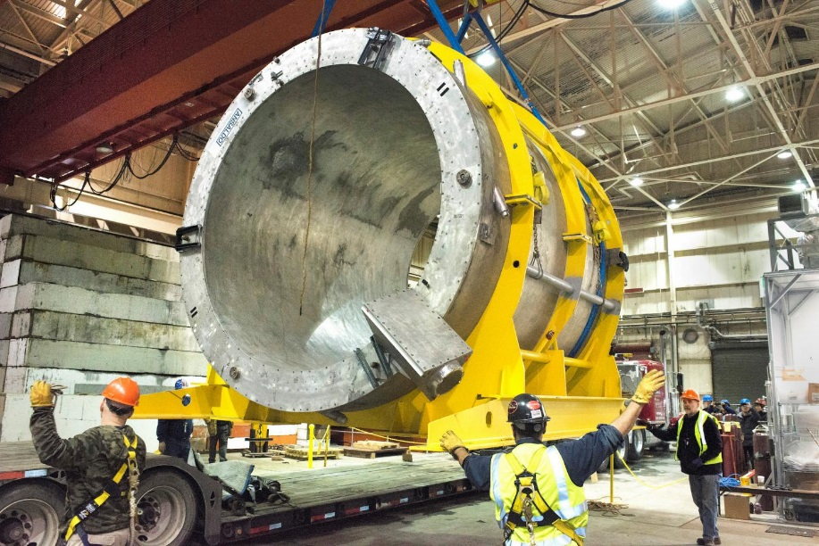
Superconducting Magnet
The Superconducting Magnet
was originally built ~1997-98 for
the BaBar Experiment at SLAC
and used until BaBar ended in
Apr. 2008.
It was brought to BNL ~ Feb. 3
(near midnight), 2015.
In the current design, it should produce ~1.4 T at 4596 A in sPHENIX in 1008
of RHIC.

Slide 3
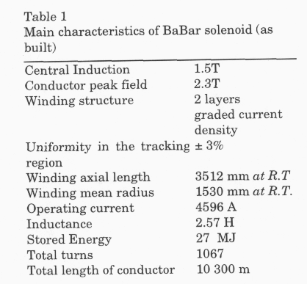
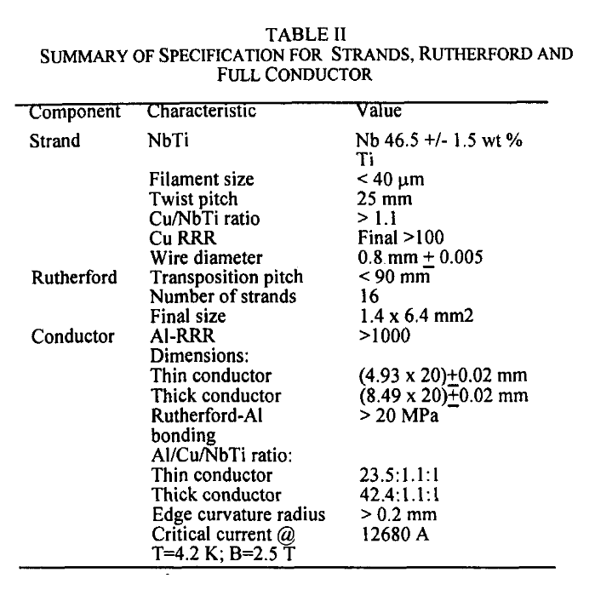
Original conductor/coil Specifications
~1.3 T in the High-Field Test
~1.4 T in sPHENIX
Heavily stabilized
~ 276% margin

Slide 4
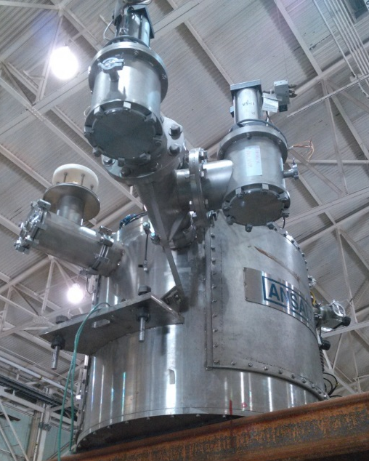
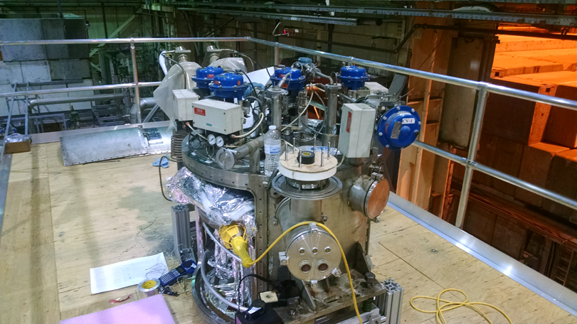
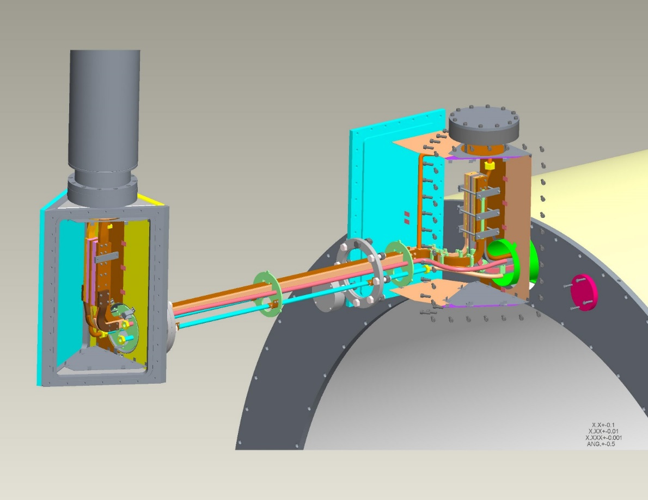
Valvebox
Extension

Slide 5
Technical Progress
~A year after its arrival, the Low-Field Test (100 A) was performed successfully on Mar. 22, 2016.
It took another ~20 months to build the Flux Return (Steel Box).
After the cool-down, we started the High-Field Test ~ Jan. 22, 2018.
On Feb. 13, 2018, we reached ~4830 A (5% over the operating current ~4600 A) and stayed until we needed to slowly discharge before the liquid helium ran out (~> 40 minutes). We repeated that on Feb. 16. We’ve also learnt that we can’t/shouldn’t ramp too fast.
This test has also been a test of the quench detection system.

Slide 6
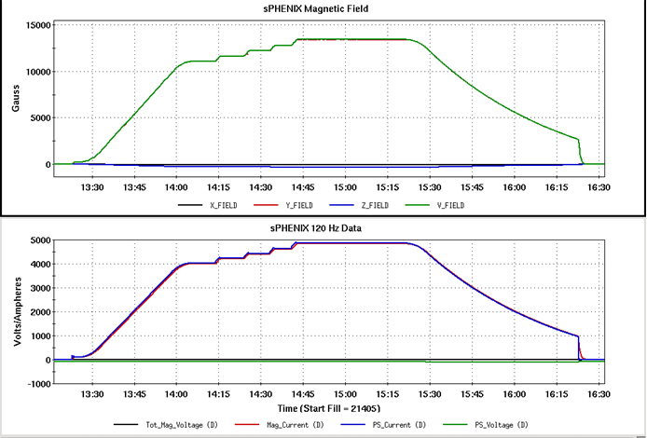
High-Field Test [ off-project ]

Slide 7
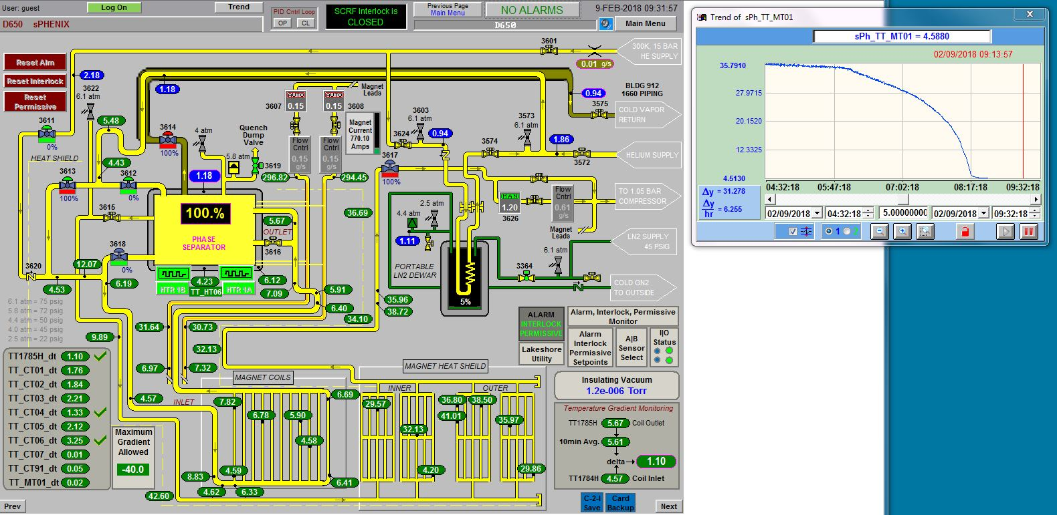
High-Field Test [ off-project ]

Slide 8
Recent Progress
Removed Valvebox on Feb. 1, 2019.
Opened up the junction-boxes (doghouses), the one underneath the Valvebox (new) and the one attached to the Magnet (old).
Checked the voltage tap connections in both doghouses and couldn’t actually locate the fault for the voltage tap VT11 (made by BaBar) so far.
  To open more fully the old doghouse to find/check around VT11 ;
  To add a pair of spare voltage taps to VT11 and VT5.
We have worked with others in the Infrastructure group to facilitate the final installation of the Magnet in 1008 ;
Settled on the choice of water-cooled buses for the Magnet Power Supply.
On Mar. 11, 2019, there was Procurement Readiness Review.
Our magnet physicist expert W. Meng has helped made the final sPHENIX Magnet model using the Opera pacakge.

Slide 9
An example of Purchase Order of similar nature
On Mar. 11, 2019, there was a Procurement Readiness Review on Helium Cryogenic System of the Magnet.

Slide 10
PROPOSED SCHEDULE
Mar 11 Procurement Readiness Review meeting
Apr 1 -Apr 5: Issue RFP package to PPM
Apr 22 - Apr 26: Post RFP on FedBiz
Apr 29 - Jun 7: Bid period: 5 weeks
Jun 10 - Jun 21: Bid eval
Contract Award: July 2019
Manufacture: 14 months
  GFE: Temperature sensors, bayonet shield return from solenoid valvebox
  Vendor deliver interface parts: LN2 bayonets
Delivery 1: Oct 2020. Install Group 1st before RHIC run 21 start, Dec 2020.
Delivery 2: 2-3 months later. We can take partial delivery if vendor cannot deliver everything Oct 2020.
Install remaining during July 2021 – Mar 2022 Depends on RUN 22
More aggressive than P6

Slide 11
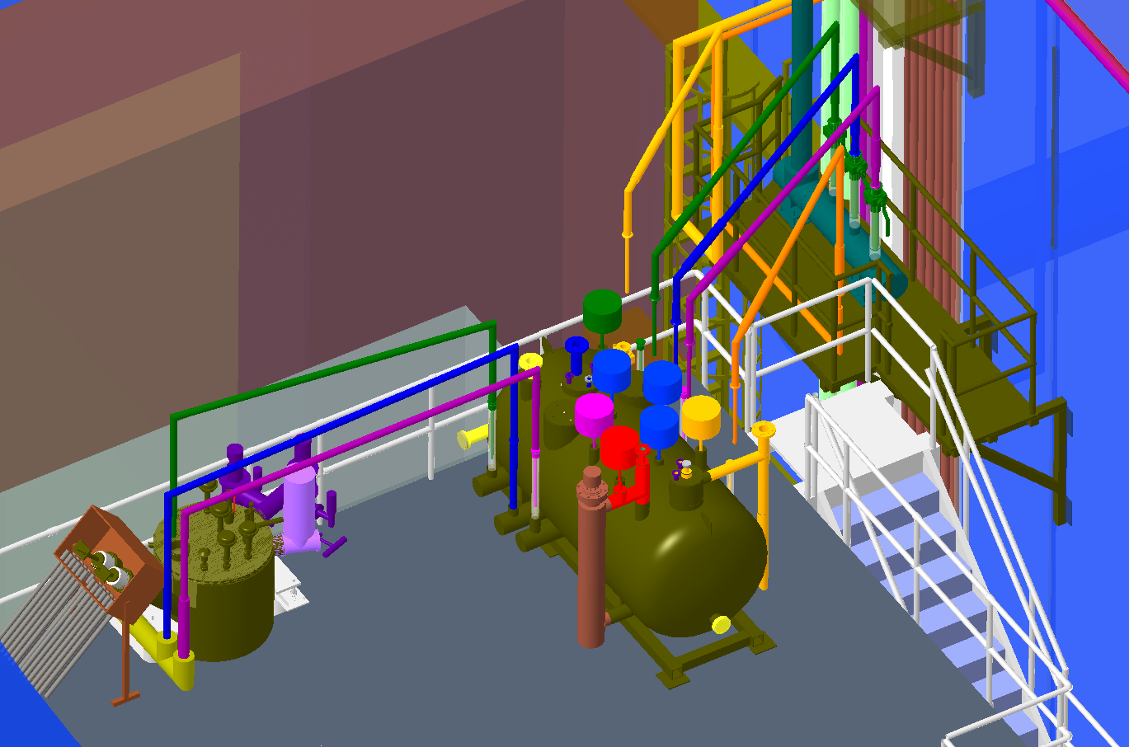
IP8 Cold Box Main Platform
South Steel
West (Penetration) Wall
Vacuum Port
Vacuum Jacketed Spools – tops clears hall opening
7’ height
Coaxial modification
IP8 Cold box

Slide 12
Recent Progress
Removed Valvebox on Feb. 1, 2019.
Opened up the junction-boxes (doghouses), the one underneath the Valvebox (new) and the one attached to the Magnet (old).
Checked the voltage taps in both doghouses and couldn’t actually locate the fault for the voltage tap VT10 (made by BaBar) so far.
  We’re trying to open more fully the old doghouse to see whether we can find and see VT10 ;
  Add a pair of spare voltage taps to VT10 and VT5.
We have worked with others in the Infrastructure group to facilitate the final installation of the Magnet in 1008 ;
Settled on the choice of water-cooled buses for the Magnet Power Supply.
On Mar. 11, 2019, there was a Procurement Readiness Review.
Our magnet physicist/expert W. Meng has helped make the detailed 3-D sPHENIX Magnet model using the Opera package.

Slide 13
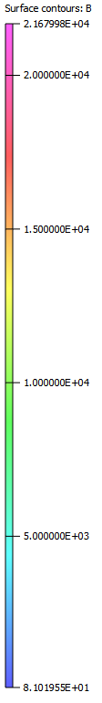
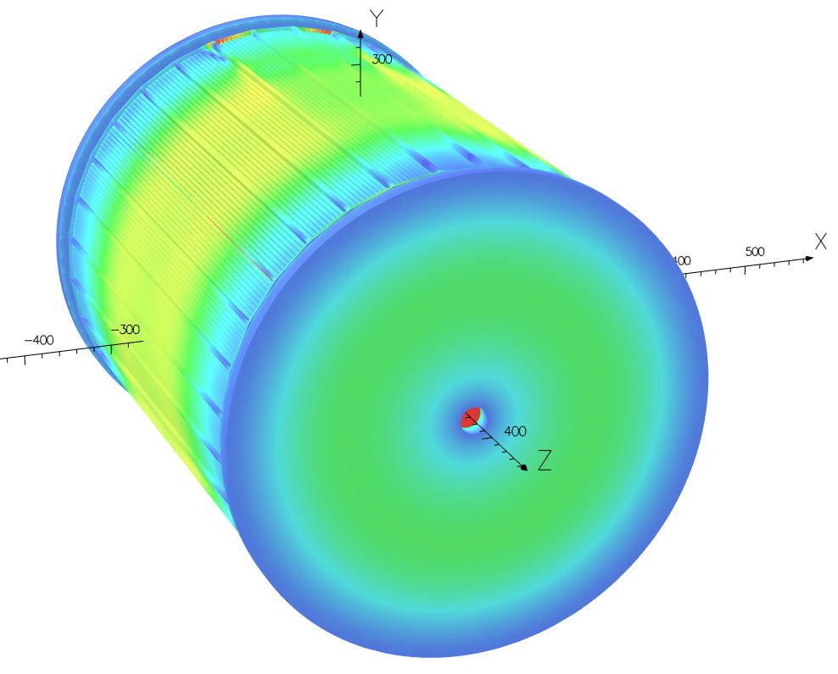
Surface B Contours
Detailed modelling of the HCAL Plate (steel and non-steel)
( Gauss )

Slide 14
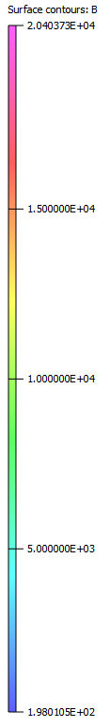
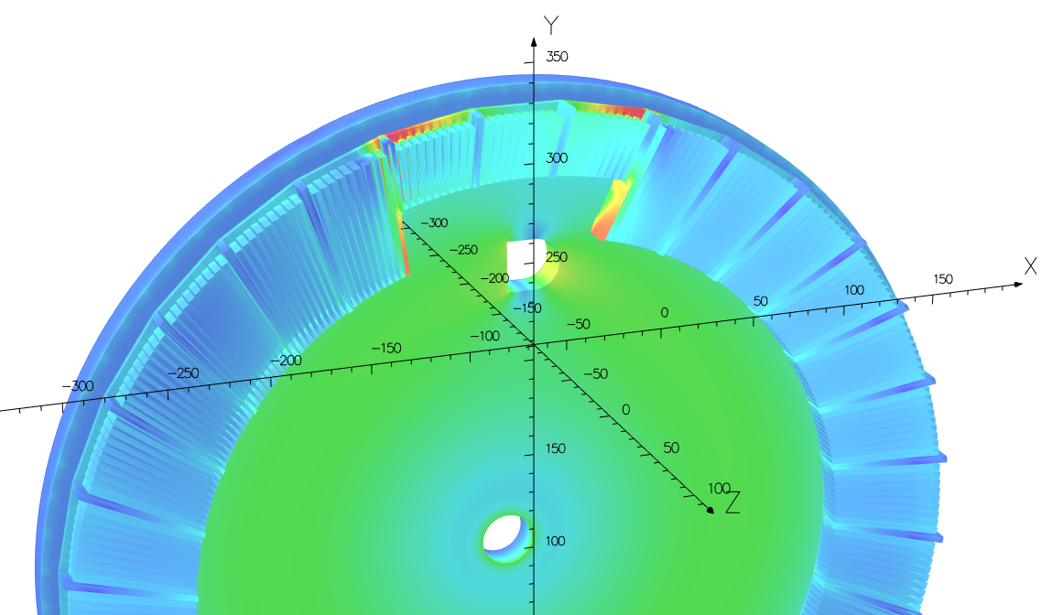
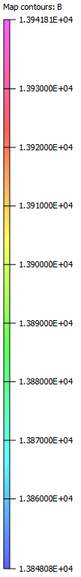
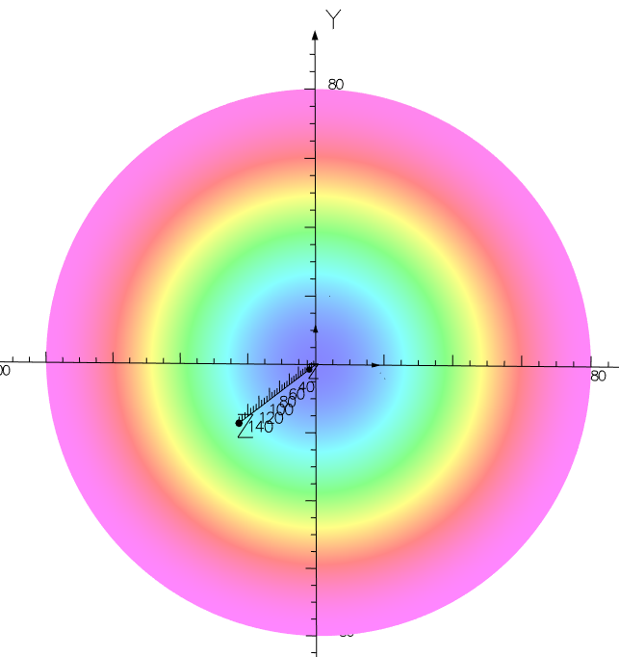
B Contours
Virtually no saturation
B (small range):
1.385 – 1.394 T
Volume within TPC (r<80 cm, z=0)
( Gauss )

Slide 15
sPHENIX Project and WBS
WBS 2.02: Superconducting Magnet
  2.02.01: Safety Reviews and Overall (K. Yip, C-AD)
  2.02.02: Mechanical Disassembly, Transport & Reassembly (M. Anerella, SMD)
  2.02.03: Cryogenic Systems (R. Than, C-AD)
  2.02.04: Power Supply & Quench Detection System (C. Schultheiss, C-AD)
  2.02.05: Magnet Field Measurement (A. Franz/J. Haggerty, Physics)

Slide 16
Documentation Made Available to the Committee
Basis of Estimate (BOE)
  https://indico.bnl.gov/event/5961/attachments/22282/31335/2.02_SC-Magnet_April2019_Directors.xlsx
WBS Dictionary:
  https://indico.bnl.gov/event/5961/attachments/22254/30949/sPHENIX_WBS_Dictionary_April_2019_Director_Review.pdf
Primavera P6 Dump:
  https://docdb.sphenix.bnl.gov/cgi-bin/private/ShowDocument?docid=112

Slide 17
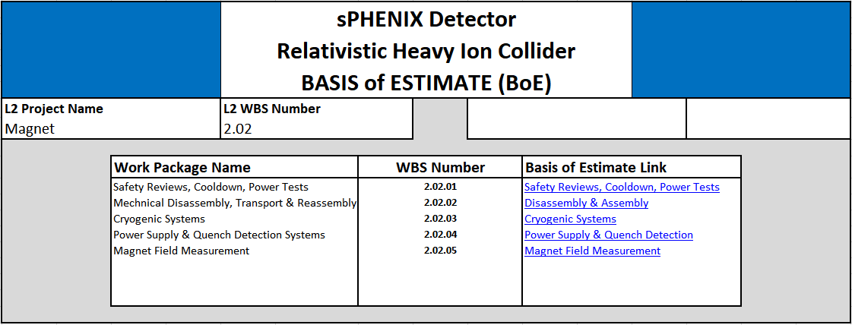
Magnet documentation status
The Basis of Estimate (BOE) for 2.02 is in sPHENIX docdb (docid=63).
An overview of the BOE looks like :
Virtually all details have been inserted into P6.

Slide 18
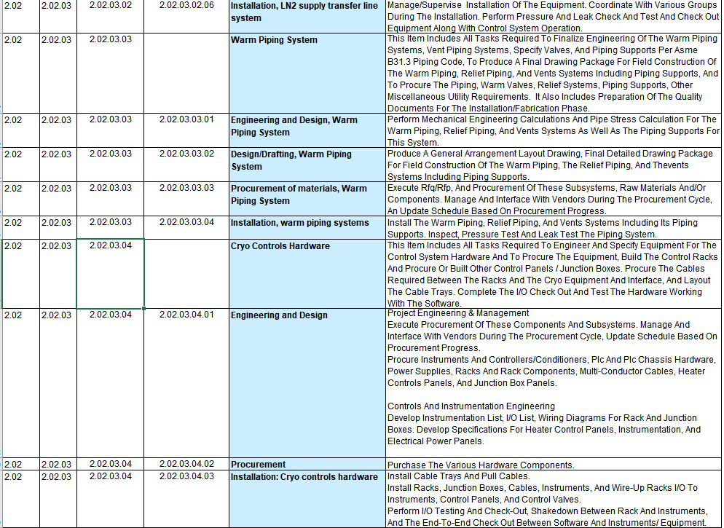
Example of WBS Dictionary

Slide 19
Schedule and Calendar
The High-Field Test [off-project] Done
Some milestones (from reality and P6):
  2019-2-1: ValveBox Disassembled (as scheduled ~Mar. 2018 Director’s Review)
  2019-10-22: Magnet (Field Measurement) Engineering & Design Complete
  2020-2-24: Coil Ready to Ship
  2022-2-23 : Installation (RHIC interface/He transfer system/Platform 4.5K/LN2 system) complete
  2022-3-18 : Cryo Hardware installed
  2022-6-22: Magnet is operational
The Magnet will be sitting in Bldg. 912 until ~Fall 2021.

Slide 20
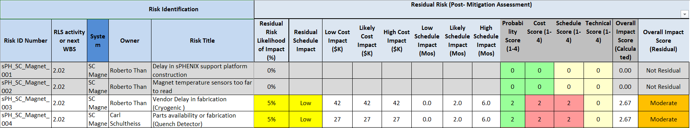
2.2 Magnet – Risk Registry
We have obtained one original CLTS（Cryogenic Linear Temperature Sensor) board from BaBar/Ansaldo which changes resistance to 4-20 mA. We have tested it and it worked. We have then made copies of this board for as many channels as we need.

Slide 21
Issues and Concerns
The issues with the vendor are probably not major concerns as we have already tried to start the procurement ahead of schedule (Cryo) …
2022 schedule is the most uncertain compared to the years before, as we need to wait for others to complete. The magnet testing and magnetic field mapping can be done either before or after the 2022 run as the sPHENIX Magnet Cryogenic System taps into the RHIC Cryogenic System.

Slide 22
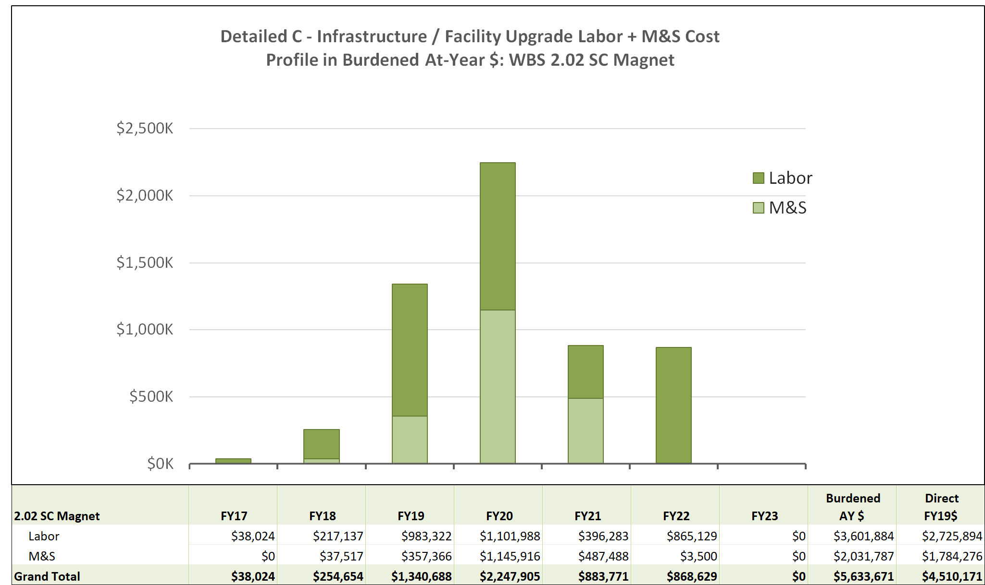
Labor Profile for WBS 2.2 SC-Magnet

Slide 23
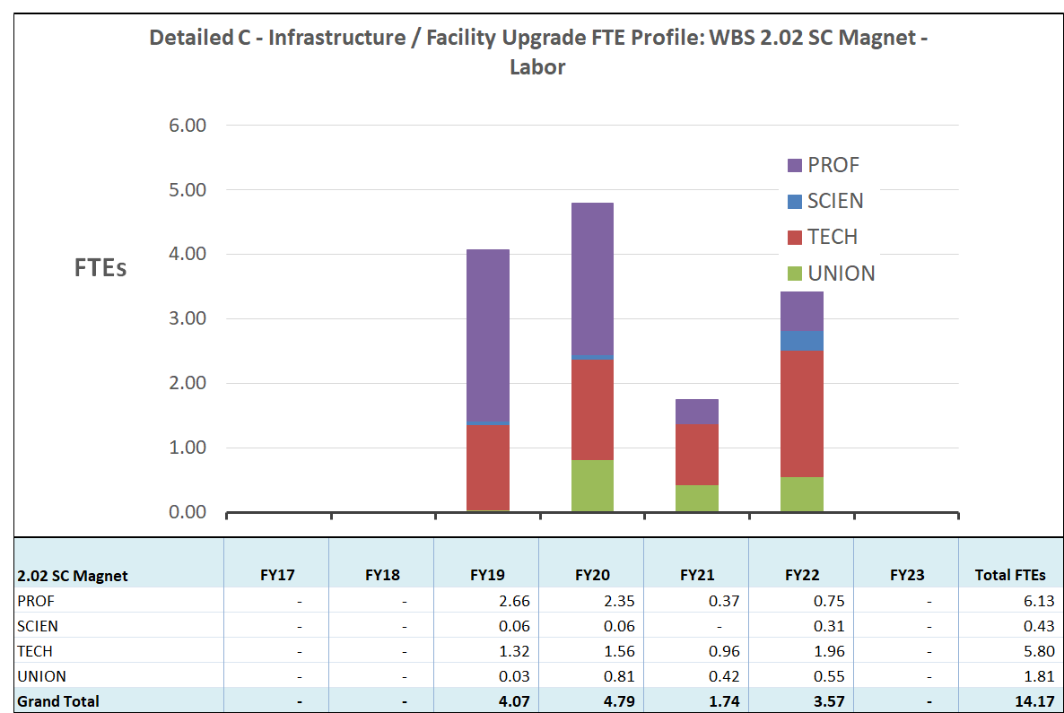
Labor by Category WBS 2.2 SC-Magnet

Slide 24
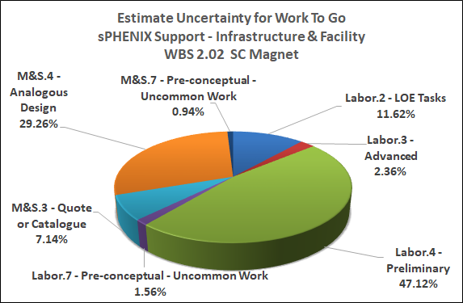
Estimate Uncertainty Breakdown WBS 2.02 SC-Magnet

Slide 25
Summary
We have done various tests on the BaBar Magnet successfully to verify that it can be used for the sPHENIX experiment.
Since the High-Field Test and last Director’s Review, we have made progress in various fronts including all the works necessary leading to the major (Cryo Helium) “purchase” and magnetic field simulation etc.
We have been working with others in the Infrastructure project to facilitate the Magnet installation at IR8.
You’ll hear more talks (Transport/Assembly, Cryo, Power Supply/Quench Detector and Magnetic Field) in the breakout session.

Slide 26
BACKUP

Slide 27
Cryogenic Process Flow diagram
External Portable LHE Dewar
New LN2 Cryo Line
LN2, 6 bar Storage
New Helium Cryo Line System
RHIC Interface box
New Interface Valvebox
S: 4.7K, 3.5BAR
LN2 Cooler
H: 60K, 12BAR
U: 4.6K, 1.25BAR
RHIC Distribution
400L LHe
WR: 290K, 1.2 BAR
10 o’clock location
18 g/s Compressor
Current Leads
Solenoid Cryostat
SC SOLENOID
Solenoid Valvebox
Externally reviewed in Jan. 2018
THERMAL SHIELD

Slide 28
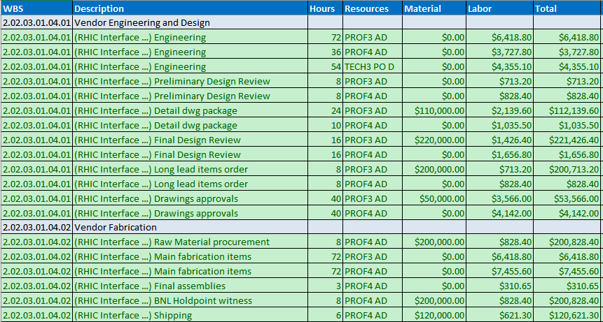
An example for the Basis of Estimate (Cryo)
“Cryogenic Systems” is our largest “spender” and here is a part of it :

Slide 29
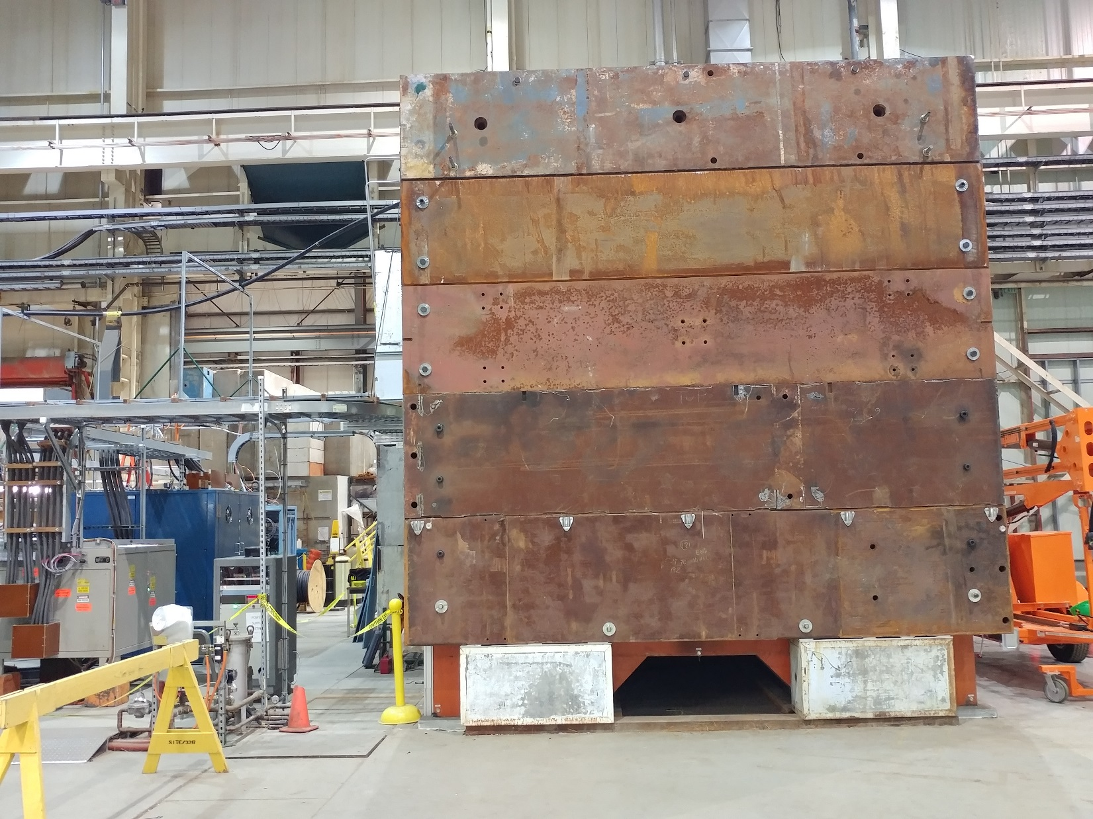

Slide 30
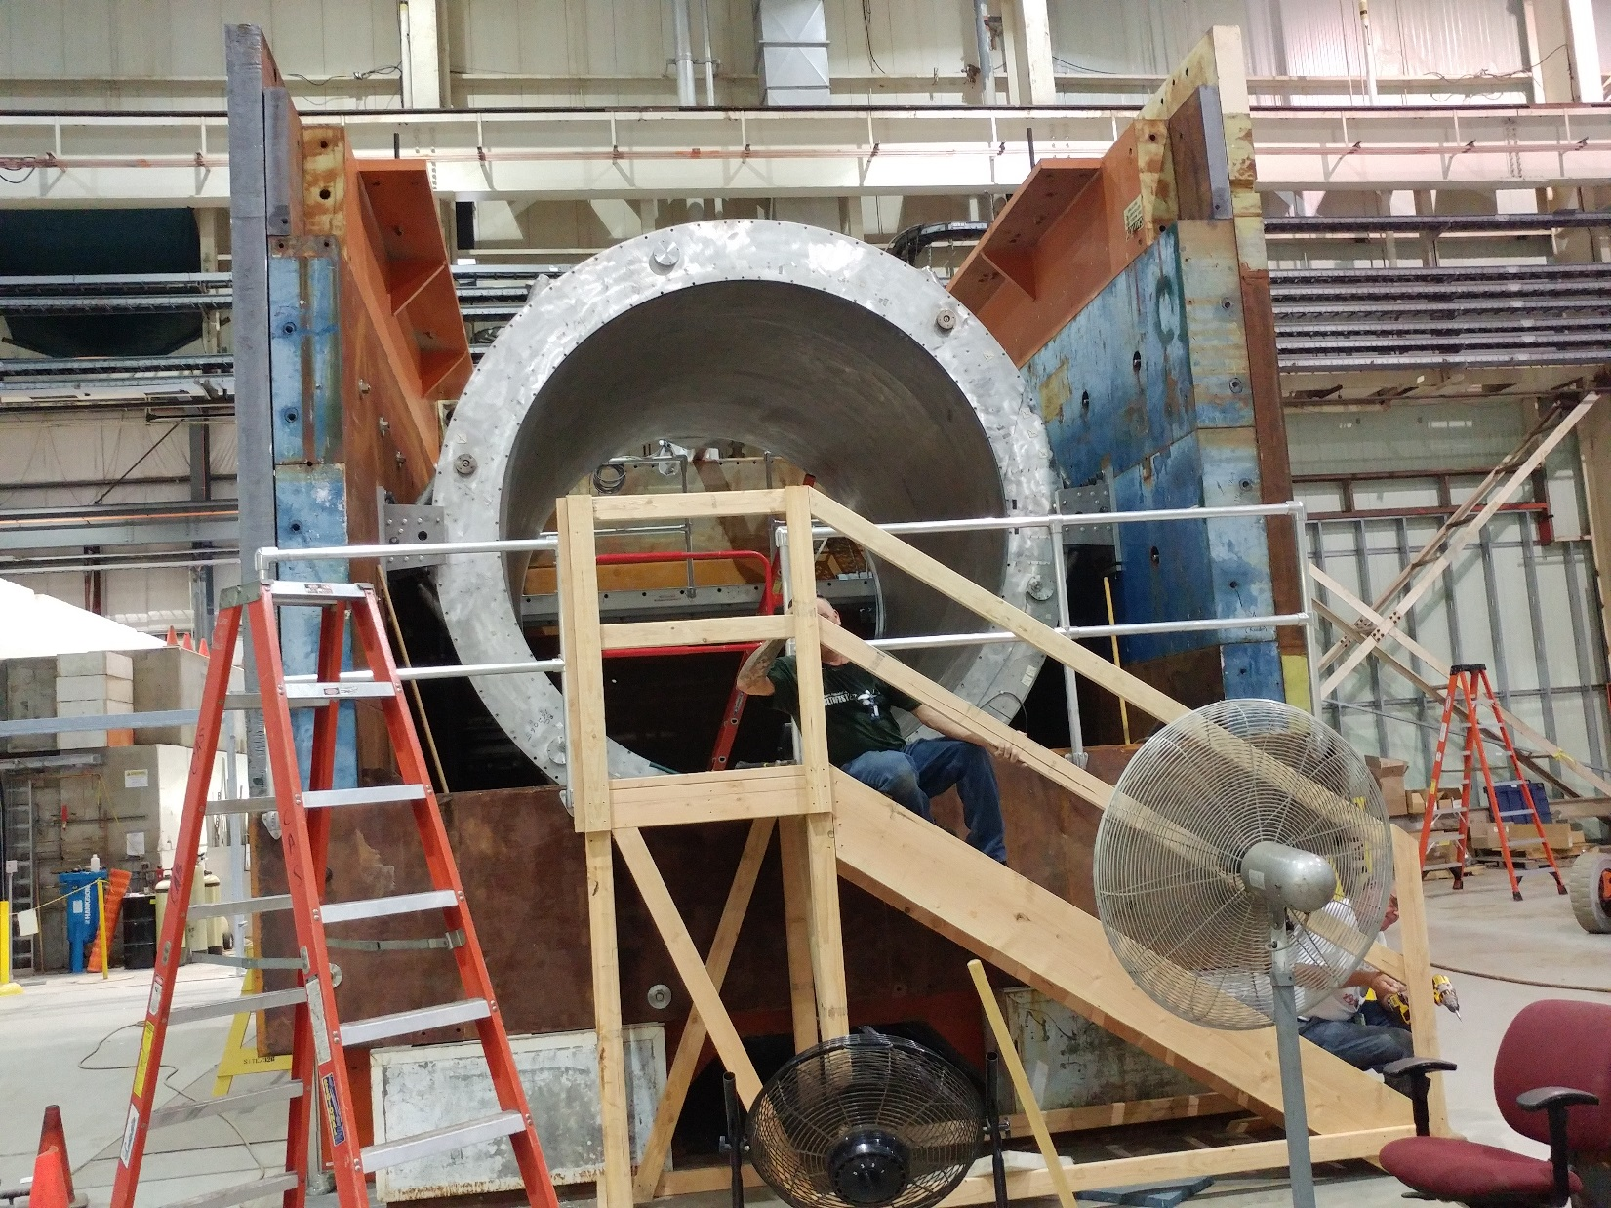

Slide 31
