Slide 1
sPHENIX Director’s Review 2.03 Structural Components
Christopher Pontieri
April 9-11, 2019
BNL

Slide 2
2.03 Carriage and Structural Components
2.03.05 Cradle Carriage Bridge, Mid Platforms, Access (50 Tons)
Space for electronics and access to cryogenics
Mode of egress
2.03.04 End Caps/Pole Tips (110 Tons)
Pole tips are used as a major component of the flux return
2.03.03 Barrel Steel (480 Tons)
Will provide a portion of the flux return for the magnet
Sector assemblies will be utilized as OHCal
2.03.02 Inner Detector Structural Support
North and South Support Rings
Inner Detectors Structural Supports
2.03.01 Cradle Carriage (130 Tons)
Is the base of the overall experiment
4 cradles are spaced across the base to support the Barrel Steel

Slide 3
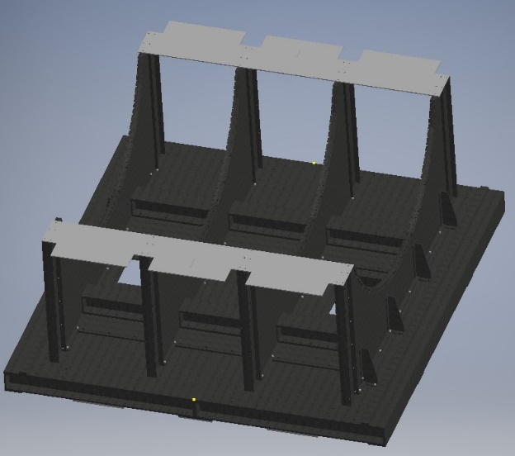
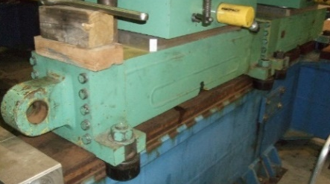
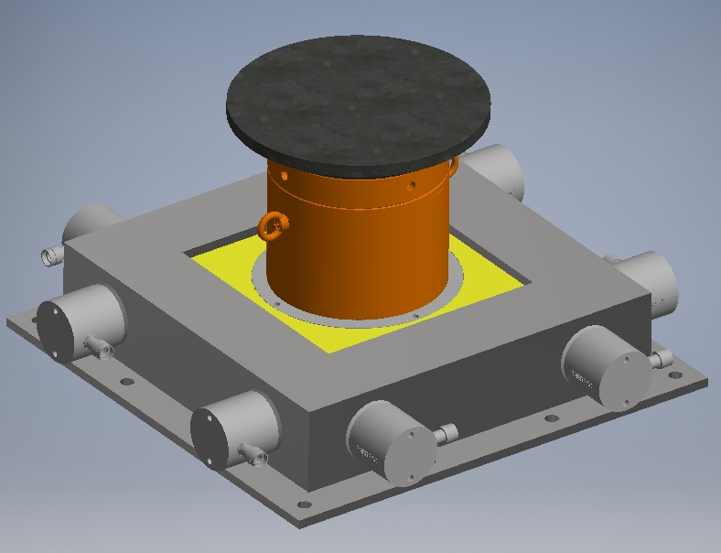
Scope
2.03.01 Carriage Cradle
Engineer, design, and analyze the requirements for an integrated support system which will support all of the sPHENIX experimental detector subsystems and the effort to fully design and procure the components of this system.
Carriage Base Assembly
Welded base, 4 cradle supports, stiffener beams, side supports
Assembly of carriage takes place in sPHENIX Experimental Complex at 1008
Drive & Alignment System
Drive/position controls, Hillman rollers, x-y table for adjustment
Track System
Evaluate current track system in building 1008
Seismic Supports
Supports that will ensure stability in case of a seismic event

Slide 4
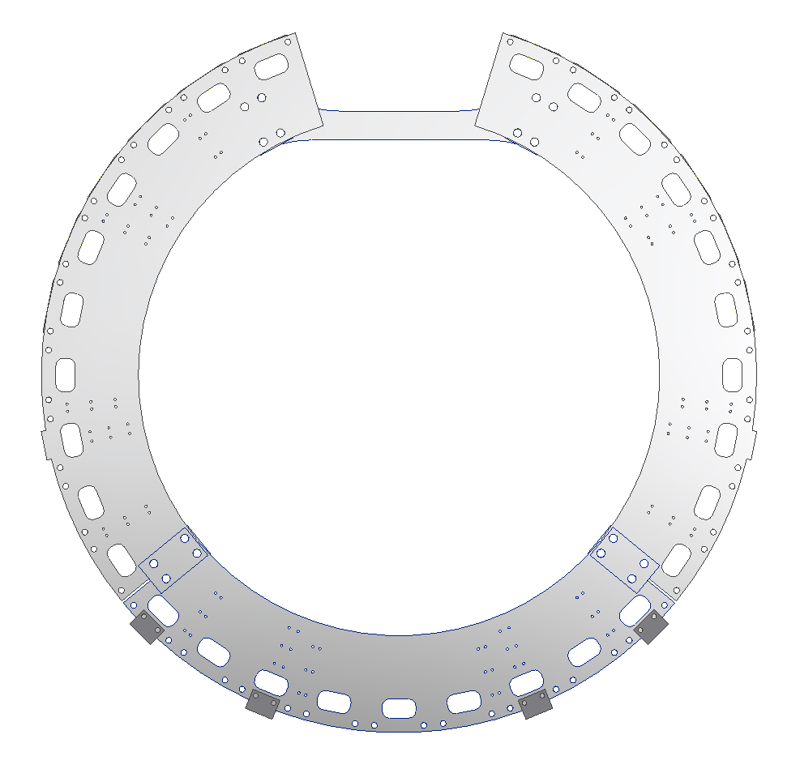
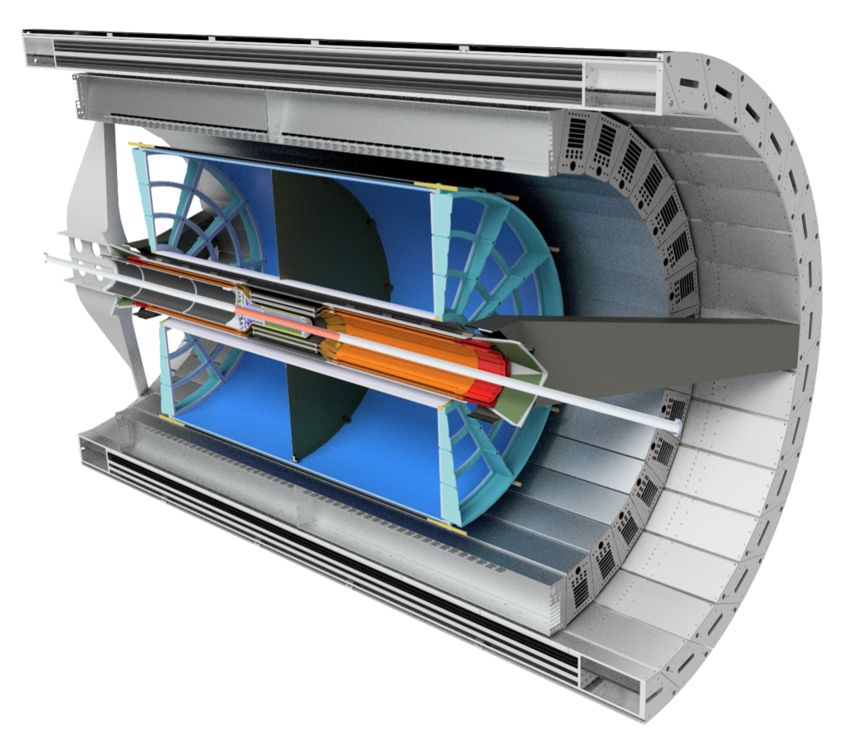
Scope
2.03.02 Inner Detector Structural Support
Develop an integrated support system which will support all of the sPHENIX experimental detector subsystems that are not directly supported by the cradle carriage. Analyze, design, and procure the structure required.
North and South Support Rings
Conceptual Design phase; will support barrel steel that is installed around sPHENIX magnet
Provide interfaces for inner detector structural supports
Inner Detector Supports
IHCal Mechanical Support
EMCal Mechanical Support
TPC Mechanical Support
INTT Mechanical Support
MVTX Mechanical Support
Min Bias Mechanical Support
IHCal
EMCal
TPC
INTT
MVTX
Min Bias

Slide 5
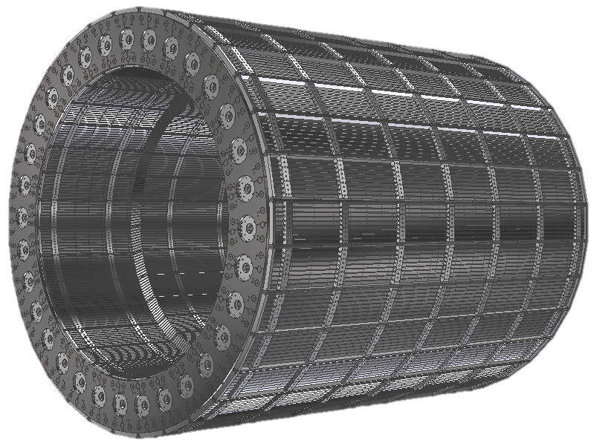
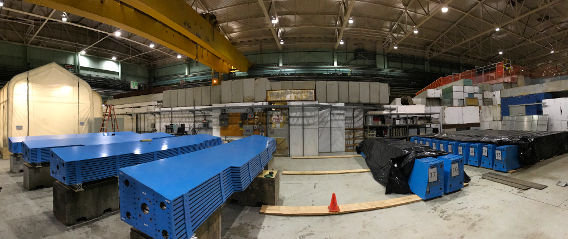
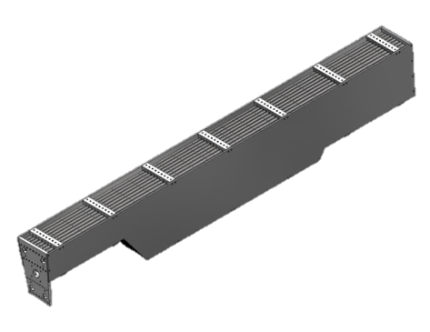
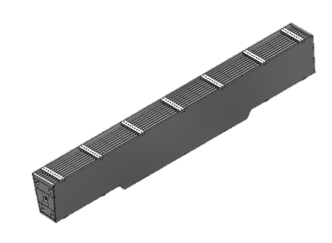
Scope
2.03.03 Barrel Steel
Engineer, design, procure, and inspect 32 modular steel sectors for the magnet flux return that will be populated with scintillating tile and be used as the OHCal.
29 Sector Assemblies
3 Chimney Assemblies (provide cutout for sPHENIX magnet chimney)

Slide 6
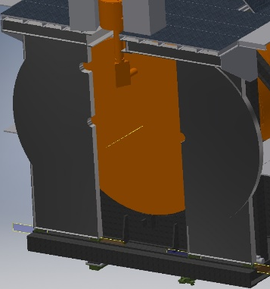
Scope
2.03.04 End Caps/Pole Tips
Engineer, design, analyze and procure magnet end caps/pole tips for the sPHENIX magnet
Pole Tip Assembly
North and South set of steel “doors”
Drive system
Need to be able to access detectors and magnet for maintenance purposes
END CAPS CLOSED
END CAPS OPEN (10’)

Slide 7
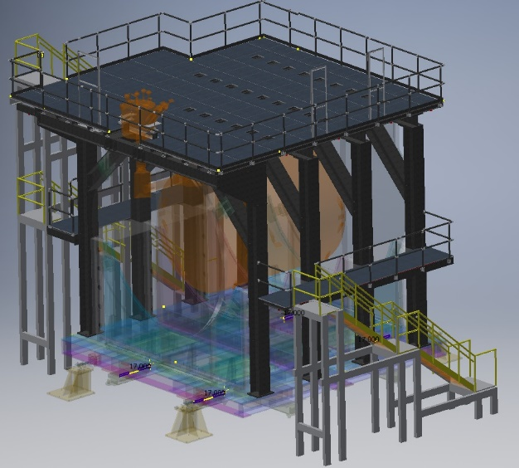
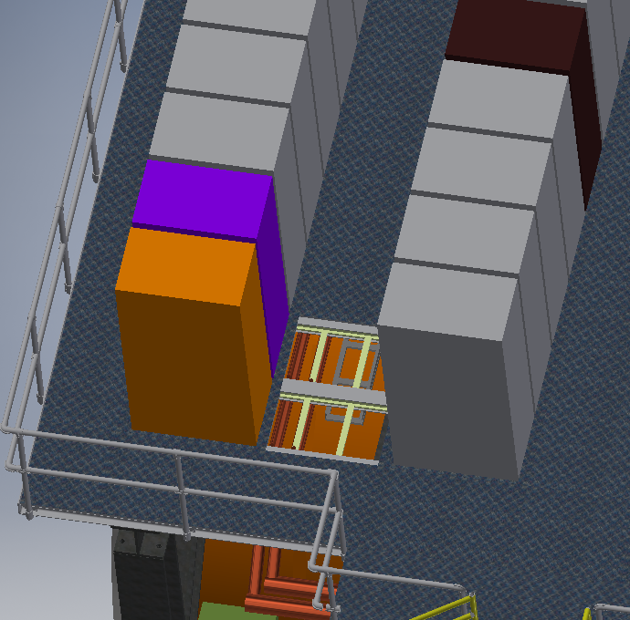
Scope
2.03.05 CC Bridge, Mid Platforms, and Access
Engineer, design, and analyze work platforms for electronics racks as well as cryogenics, and provide access to those components as well as a means of egress around the overall detector
Cradle Carriage Bridge
Support electronics racks and cryogenics system
Mid Platforms
Support for additional electronics racks
Access
Stairs on the East and West sides to reach CC Bridge and Mid Platforms
Access panels

Slide 8
Subsystem Collaborators
2.03 CARRIAGE AND STRUCTURAL COMPONENTS
2.03.01(Carriage)/2.03.04(End Caps)/2.03.05(CC Bridge, Platforms, Access)
Engineering/Design
Jon Hock (BNL-CAD)
Jim Mills (BNL-CAD)
John Scheblein (BNL-PH)
Dan Puleo (BNL-CAD)
2.03.02(Inner Detector Structural Supports)/2.03.03(Barrel Steel)
Engineering/Design
sPHENIX Engineers (Barrel Steel, North and South Support Rings, Magnet Supports, INTT, EMCal, IHCal)
Superconducting Magnet Division (TPC, Magnet Supports)
MIT Engineers (MVTX)
Majority of engineers and designers have 20+ years experience

Slide 9
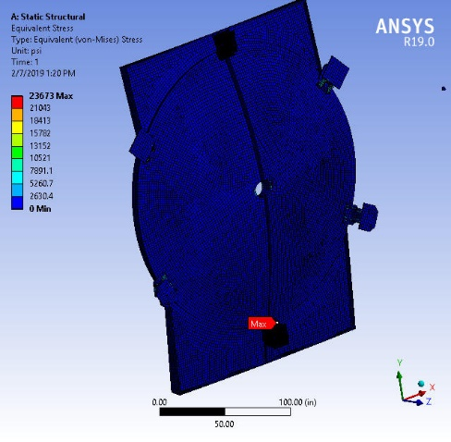
Schedule Drivers
2.03.01 Carriage
Complete a package of assembly and detail drawings
These drawings are currently in the checking phase
Potential additional time for track modifications
2.03.02 Inner Detector Structural Supports
Analyze and Evaluate Structural Supports for design review
2.03.03 Barrel Steel
Assemblies are being produced by a single vendor
Schedule is determined by the existing contract: Final delivery of last sector is Aug. 2019
2.03.04 End Caps/ Pole Tips
Complete Engineering, Analysis and Design
2.03.05 CC Bridge, Mid Platforms and Access
Complete Engineering, Analysis and Design
Finalize means of egress with BNL Safety and Fire Protection

Slide 10
Cost Drivers
2.03.01 Carriage
Fabrication of Cradle Base
Potential for volatile steel market for all steel
Potential additional cost of track modifications/replacement
2.03.02 Inner Detector Structural Supports and Interface to Mechanical Structural Supports
Fabrication of Inner Detector Rings
2.03.03 Barrel Steel
Steel Sector Assemblies (under contract)
2.03.04 End Caps/ Pole Tips
Fabrication of End Caps/Pole Tips
2.03.05 CC Bridge, Mid Platforms and Access
Fabrication of Platforms

Slide 11
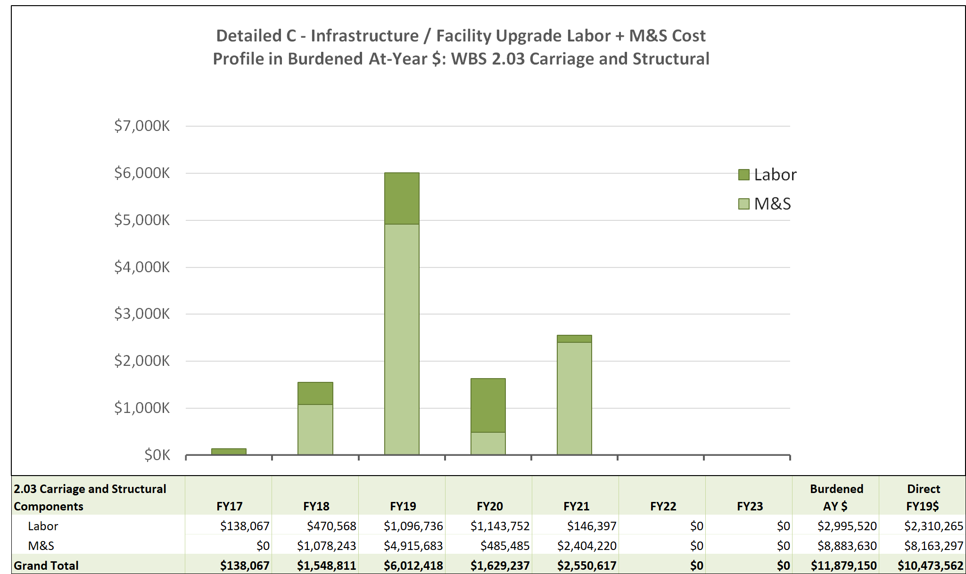
M&S/Labor Cost Profile for WBS 2.3 Carriage and Structural Components
Notes:
Costed amounts-
FY19- Barrel Steel
FY 20- Inner detector Ring
FY21- Cradle Carriage/Pole Tips

Slide 12
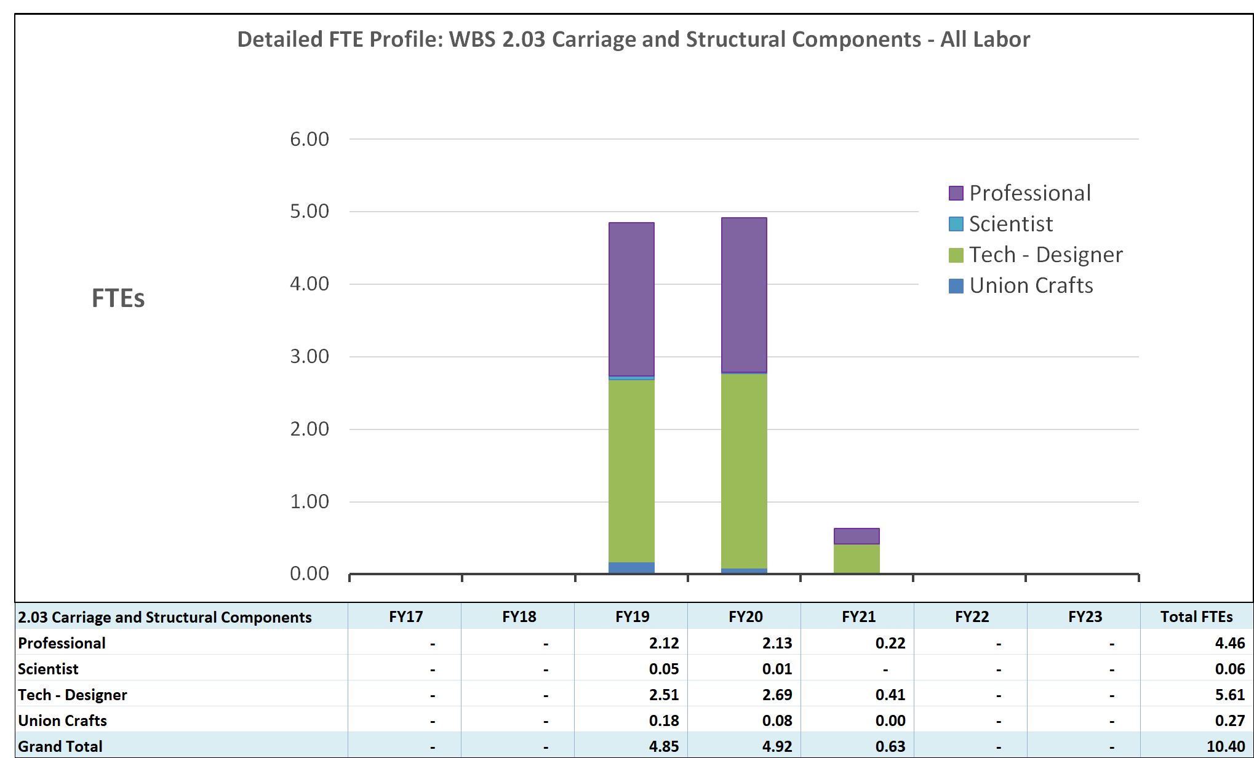
Labor by Category WBS 2.3 Carriage and Structural Components
All labor for installation of these structural components is covered by WBS 2.05(Integration/Installation)

Slide 13
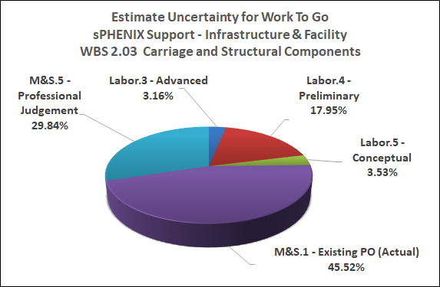
Estimate Uncertainty Breakdown WBS 2.03 Carriage and Structural Components

Slide 14
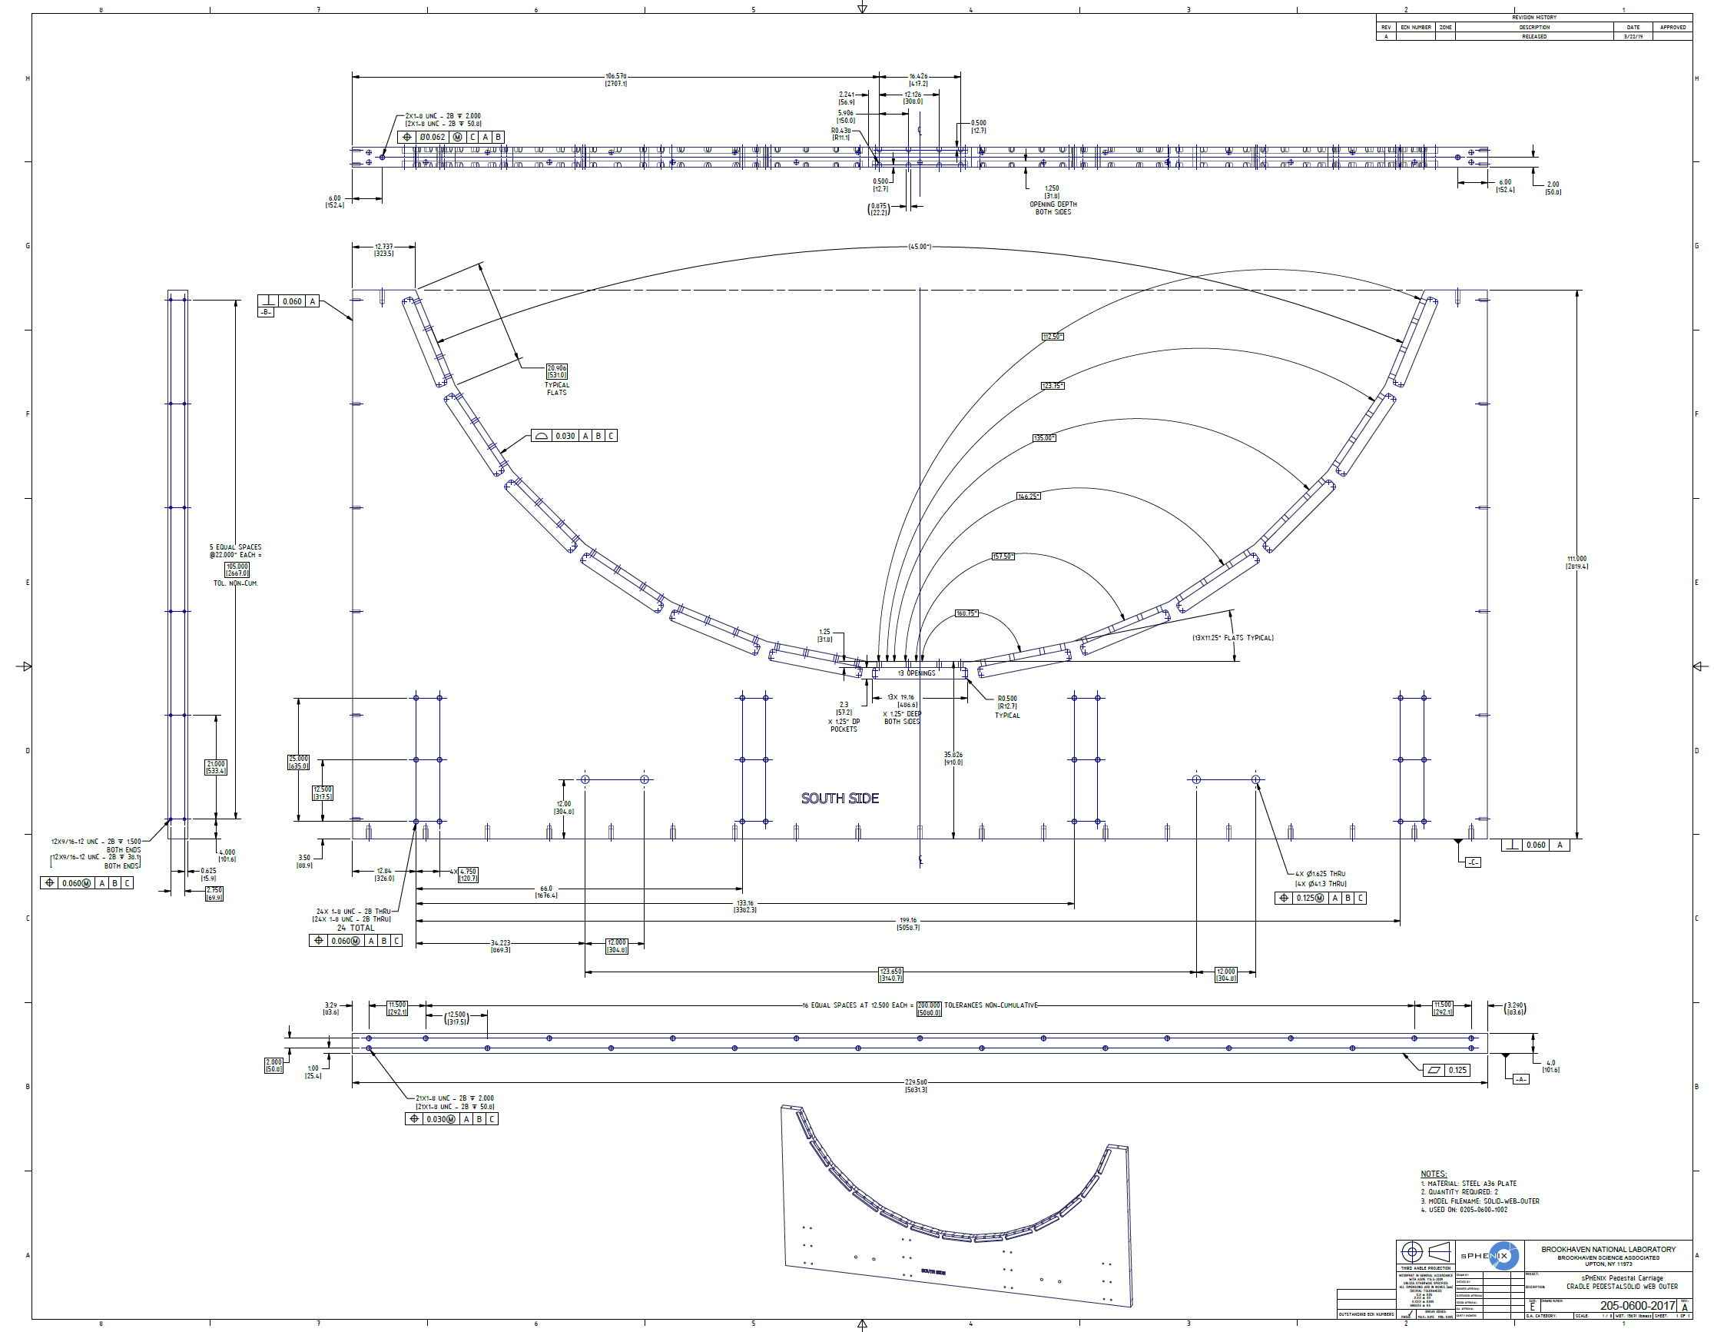
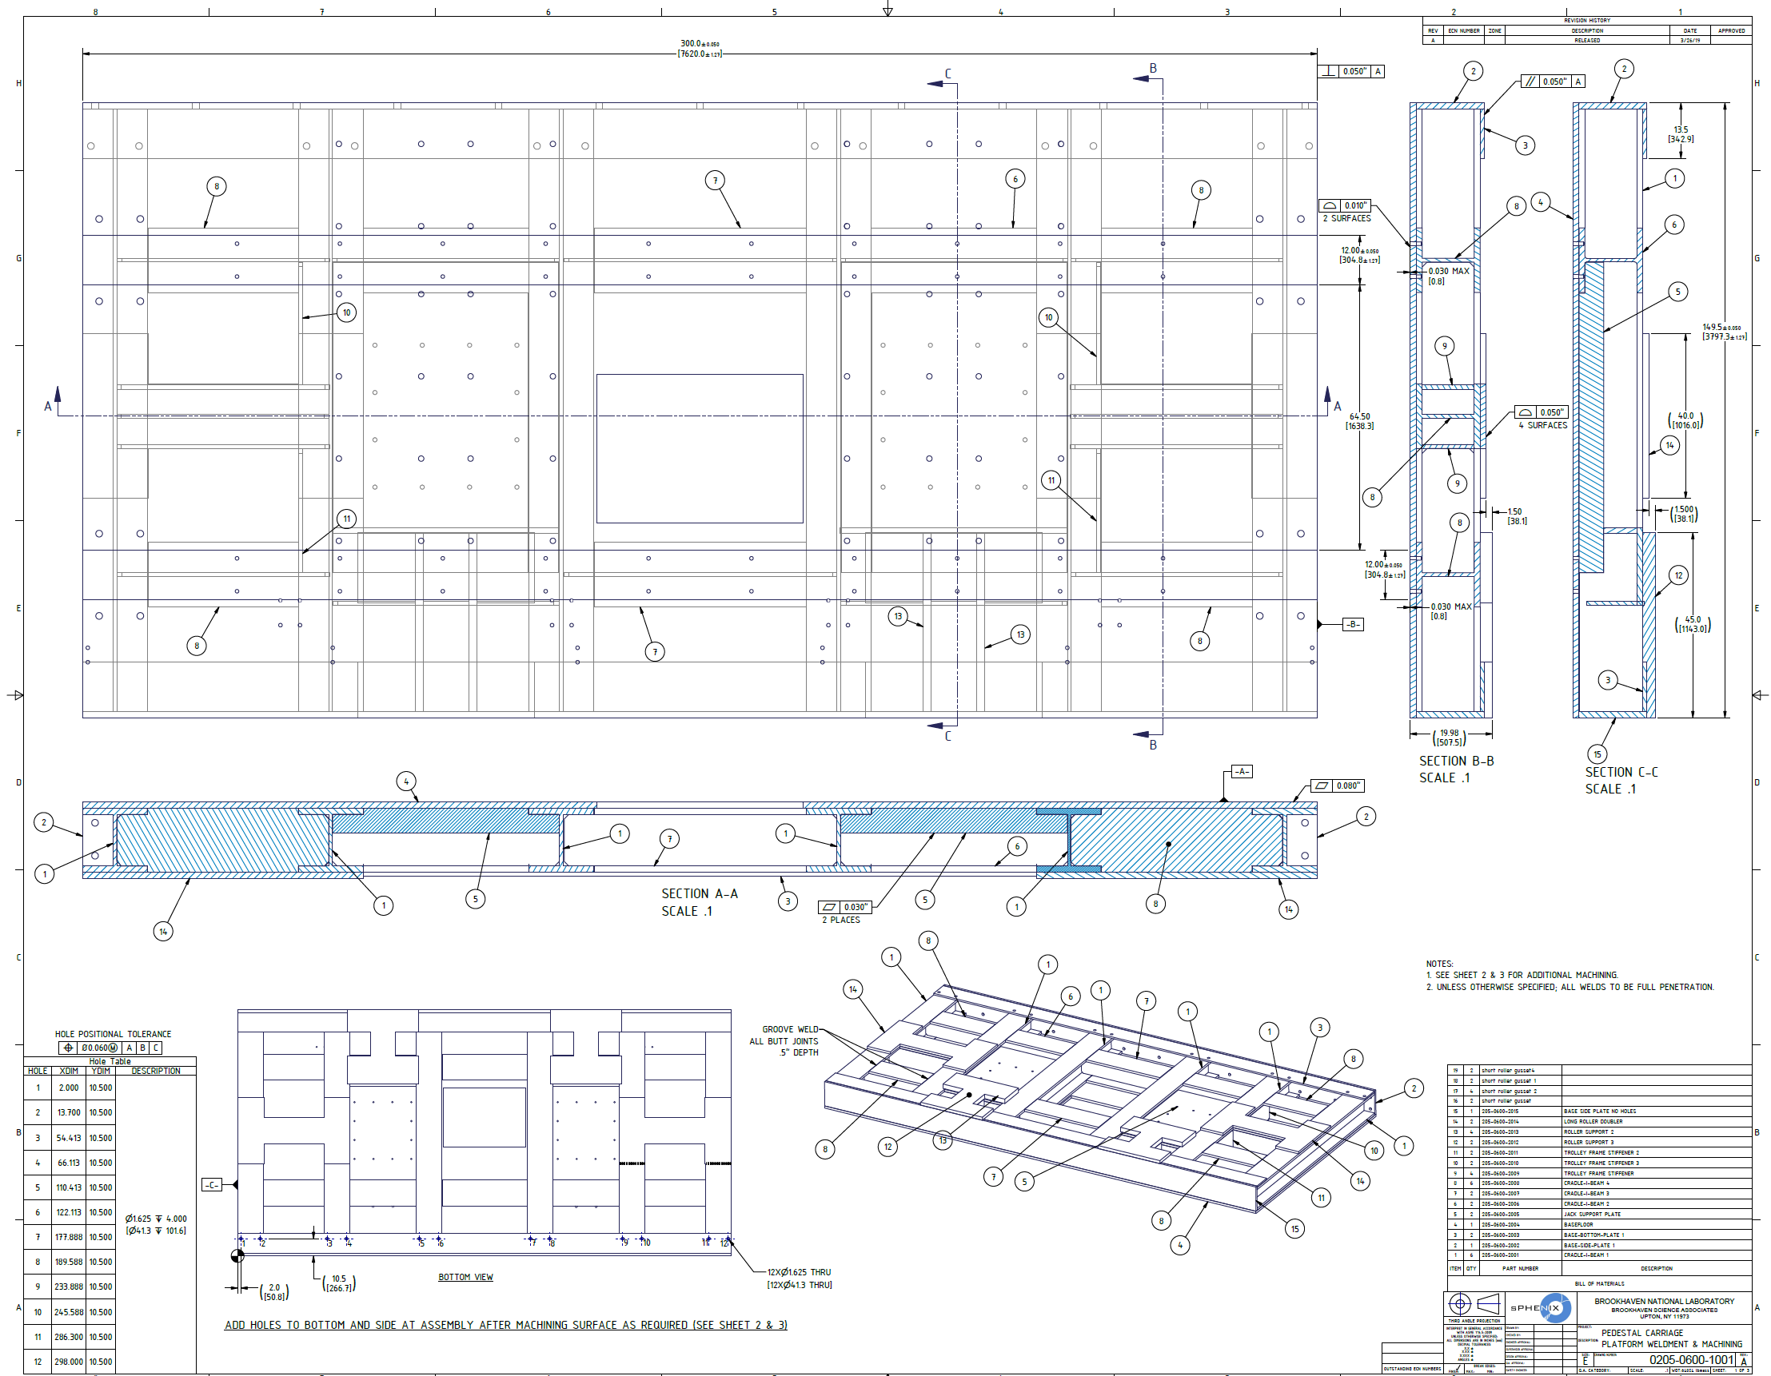
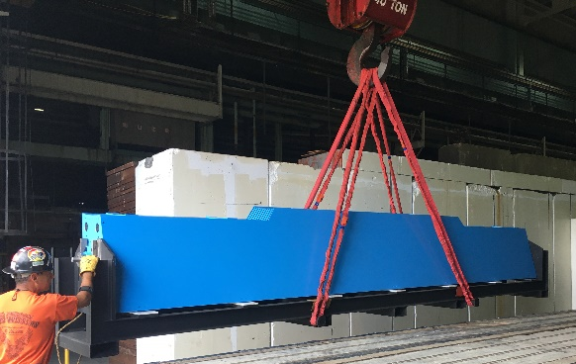
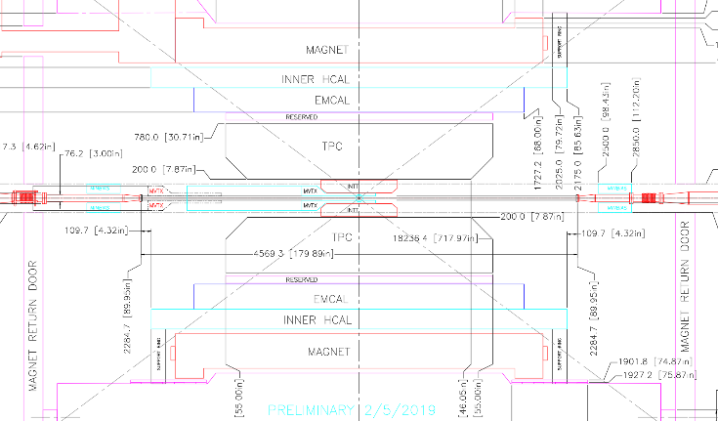
Status and Highlights
Design of cradle carriage is mature. Assembly/Detail drawings are currently in the checking phase.
Inner Detector Structural Support continues to be analyzed
Integration task force has been established to review all inner detectors interfaces and potential conflicts. Meet on a biweekly basis
Integration work fest occurred 3/13-3/14
Barrel Steel assemblies continue to be delivered on schedule
Milestone date of Aug. 2019 will provide 300+ float days for this subsystem
Pole Tips/Platforms proceeding with detail design
Will resolve rail modification/replacement within the next six weeks

Slide 15
2.3 Carriage/Cradle Risks

Slide 16
Milestones
Upcoming Design Reviews (As per RLS)
19-July-19 Internal Detector Structural Support- Final Design Review (Design & Safety)
17-Oct-19 Carriage Cradle - Final Review (Design & Safety)
23-Dec-19 End Caps/ Pole Tips - Final Design Reviews (Design & Safety)
14-Jul-20 CC Bridge, Mid Platforms & Access - Final Design Reviews (Design & Safety)
Future Milestones (As per RLS)
5-May-20 Internal Detector Structural Support Components Ready for Installation
17-Nov-20 End Caps/ Pole Tips - Ready for Installation
24-Feb-21 Ready to assemble Cradle Carriage in Assembly Hall
13-Apr-21 CC Bridge, Mid Platforms & Access - Ready for Installation
Notes:
27-Aug-21 Install Partial Barrel Steel
17-Sep-21 Install Magnet onto cradle
08-Nov-21 Install remainder of barrel steel
09-Dec-21 Install Platforms and Access

Slide 17
Issues and Concerns
Issues/Concerns
Potential increase in fabrication cost of cradle base
Potential rise in material costs
Major modifications required for existing rail system
Engineering support needed for internal detector support ring
Proposed Action/Resolution
Continue to value engineer and obtain budgetary quotes as soon as possible
Carry a conservative estimate uncertainty until contract stage
Evaluate existing rail system and determine range of scope, carry in Risk Registry as well
Plan to increase engineering staff to the sPHENIX project

Slide 18
Summary
2.03.01 Cradle/Carriage
Preliminary Design Review was completed in February 2019
Detailed drawings are in checking phase and will be sent to vendors shortly for budgetary quotes
2.03.02 Inner Detector Structural Supports and Interface to Mechanical Structural Supports
Structural Supports are at conceptual design phase and require additional engineering support
Subsystems that connect to rings are meeting biweekly for integration purposes
2.03.03 Barrel Steel
Received 21 sectors as of 4/5/2019, no delays are expected
Completion of sector fabrication is on schedule for August 2019
2.03.04 End Caps/ Pole Tips
Continue with engineering/design effort
Structural analysis is ongoing
2.03.05 CC Bridge, Mid Platforms and Access
Continue with engineering/design effort
Structural analysis is ongoing
Majority of L3 components are in an advanced design state

Slide 19
Back Up

Slide 20
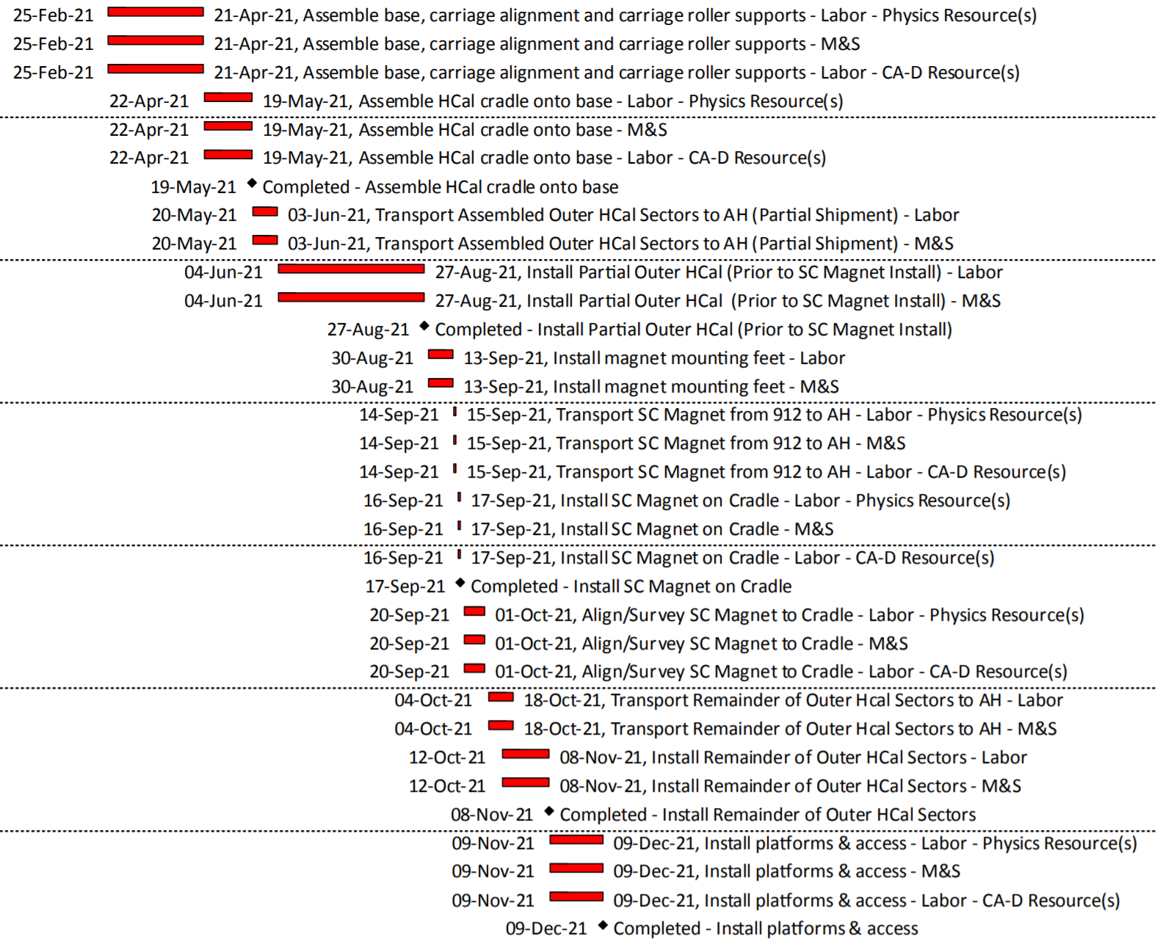
Critical Path Timeline
*Pulled from P6 Schedule Reports on Indico
Assemble base, carriage alignment/rollers
Assemble Hcal Cradle onto base
Install partial Barrel Steel
Install sPHENIX Magnet
Install remainder of Barrel Steel
Install Platforms and Access

