Slide 1
sPHENIX Director’s Review
WBS 2.04: Infrastructure
Robert Pisani
April 10-11, 2019

Slide 2
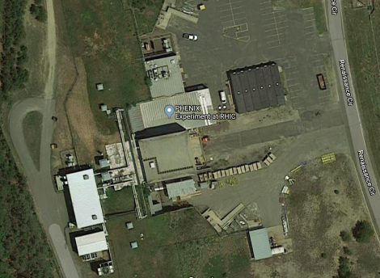
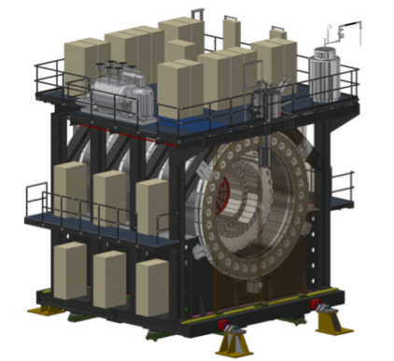
The Infrastructure Technical Overview
SPHENIX
Infrastructure Work Packages
2.04: sPHENIX Infrastructure
2.04.01: Detector Support Systems
2.04.02.01: Line Electric Power Distribution
2.04.02.02: Detector Support Services Systems Components
2.04.02.03: Detector Electronics Racks and Rack generic support
2.04.02.04: Detector Gas and Cooling Services Systems
2.04.02.05: Detector Safety Subsystems Work Package
2.04.02.06: Gas Mixing House & Gas Pad Components
2.04.02.07: Rack Room Modifications
2.04.02.08: Control Room Work Package
2.04.02:Facility Support Systems
2.04.02.01: Magnet Cryo, Electrical & Control Structural Support in IR
2.04.02.02: Beampipe and Vacuum Work Package
2.04.02.03: IR HVAC Work Package
2.04.02.04: IR Electronics Cooling Water Distribution System
2.04.02.05: IR/AH Safety Subsystems Components Work Package
2.04.02.06: Assembly Hall Modifications
sPHENIX Integration and Installation
4/5/2019
2

Slide 3
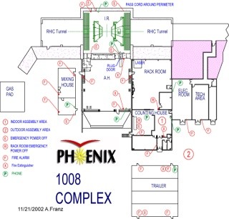
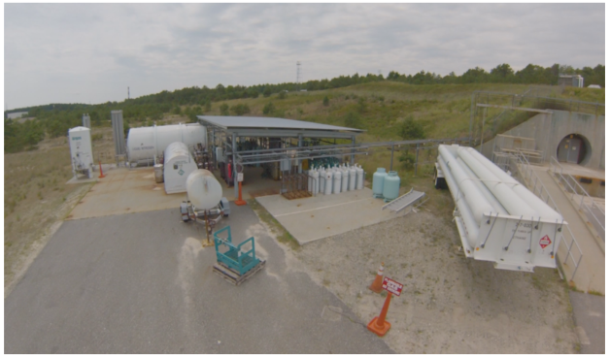
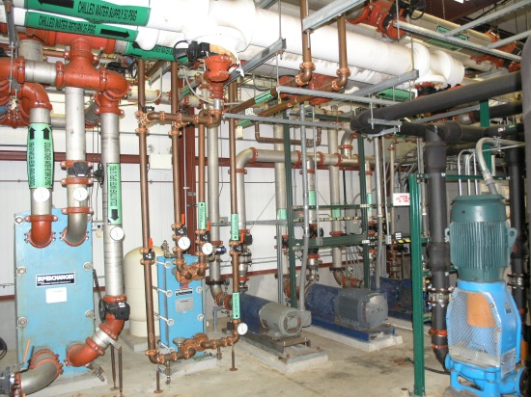
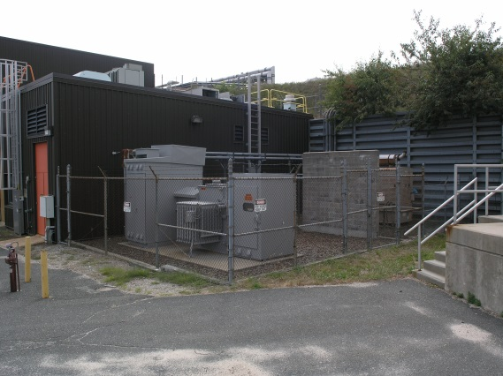
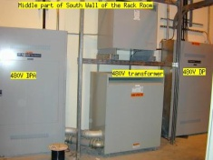
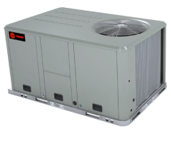
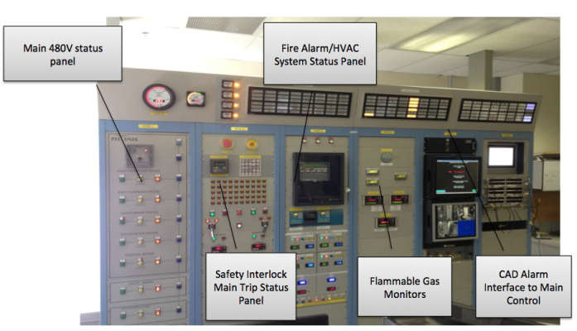
Infrastructure Overview
Detector special gasses
storage/mixing facility
1008F
Electronics cooling water
pump house/piping network
Electric power substations
13.8/480/208/120V distribution
HVAC
Detector supports racks, cable trays support equipment
Detector/Facility Safety System
Hall Modifications
CRYO Support

Slide 4
Scope
Detector Support Systems
Modify existing Power Distribution in IR and PRR and their components.
Detector Support Cables and Cable trays
Racks (Reuse), Rack power, rack cooling & layout
Support services for detector gas and detector cooling and layout
On Carriage detector safety systems
Modification of existing Support Services for Gas Mixing house and gas pads
PHENIX Rack Room modifications and updates
PHENIX Control room modifications and updates.
Facility Support Systems
Cryo routing, electrical support components, and layout
Existing Beampipe and vacuum line modification
Modification and maintenance of Existing HVAC for IR, PRR, Counting house as needed
Existing Electronics cooling water distribution modification to IR, Carriage and PRR
IR and Assembly Hall detector subsystem safety modification and new components.
Assembly Hall modification for sPHENIX
Reconfiguring much of the existing infrastructure
Generally includes labor involved in planning, design and procurement.
All labor for installation of these infrastructure components and equipment is covered by WBS 2.05.02(Infrastructure Installation).
April 10-11, 2019

Slide 5
Infrastructure: Key Personnel
Robert Pisani --sPHENIX Infrastructure Interim L2 Mgr
James Mills --sPHENIX Project Engineer
Russell Feder --- sPHENIX Chief Mechanical Engineer
Roberto Than/Paul Orfin ---CAD Cryogenic Support
Charlie Folz --- CAD Engineering Support
Jon Hock --- CAD Engineering Support
Brian Streckenbach --- CAD Engineering Support
C. Biggs ----sPHENIX Lead Technician

Slide 6
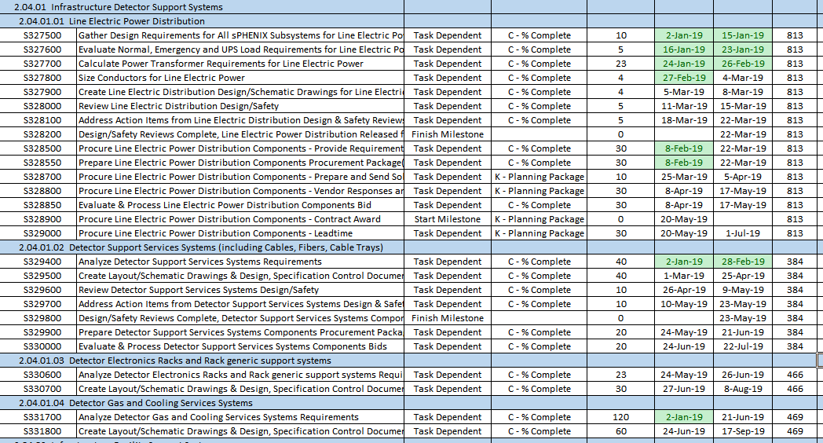
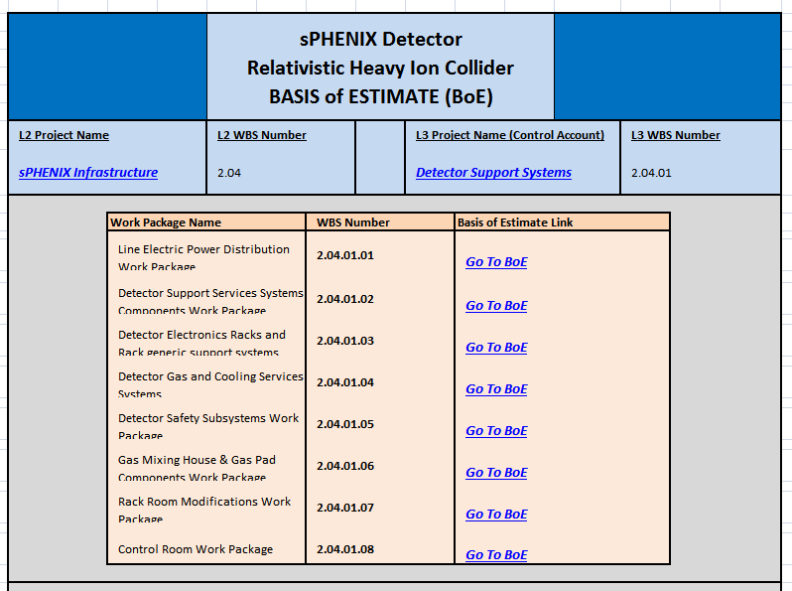
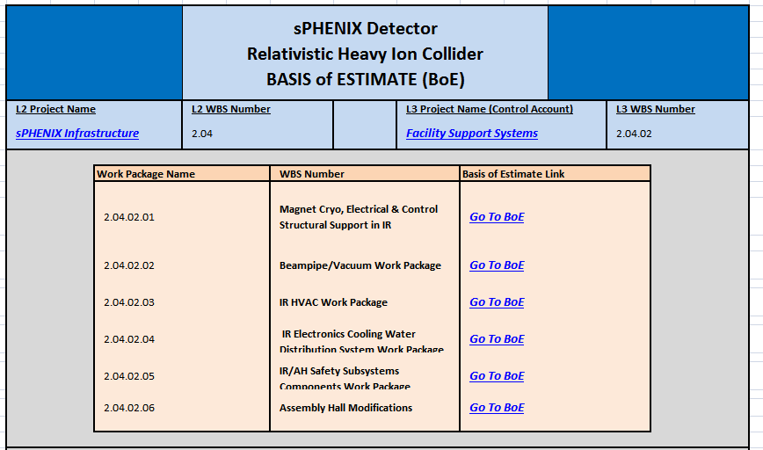
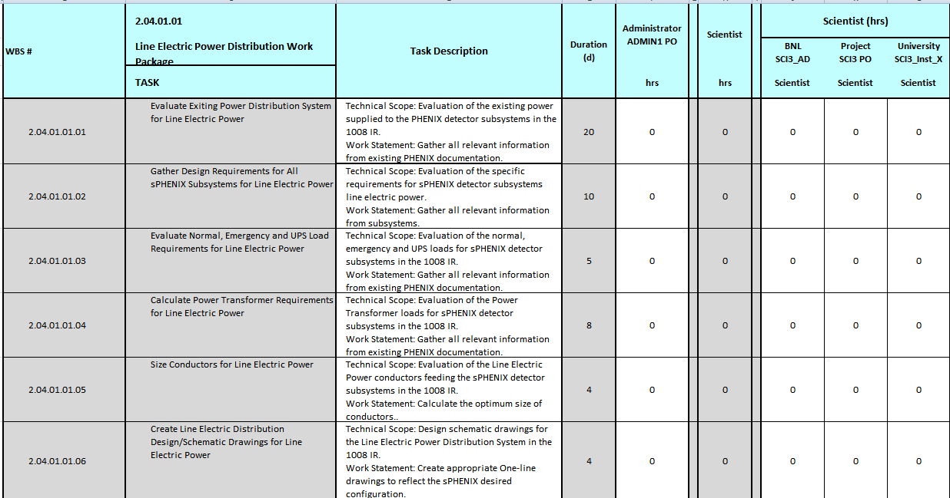
Basis of Estimate & Resource-Loaded Schedule
One file for 2.04.01 Detector Support Systems
One File For 2.04.02 Facility Support Systems
Fully Consistent w/ P6 RLS
Within each file, one Summary and one Details page per Work Package
(Excel “snapshot” of RLS)
Navigation links Imbedded and by Tab

Slide 7
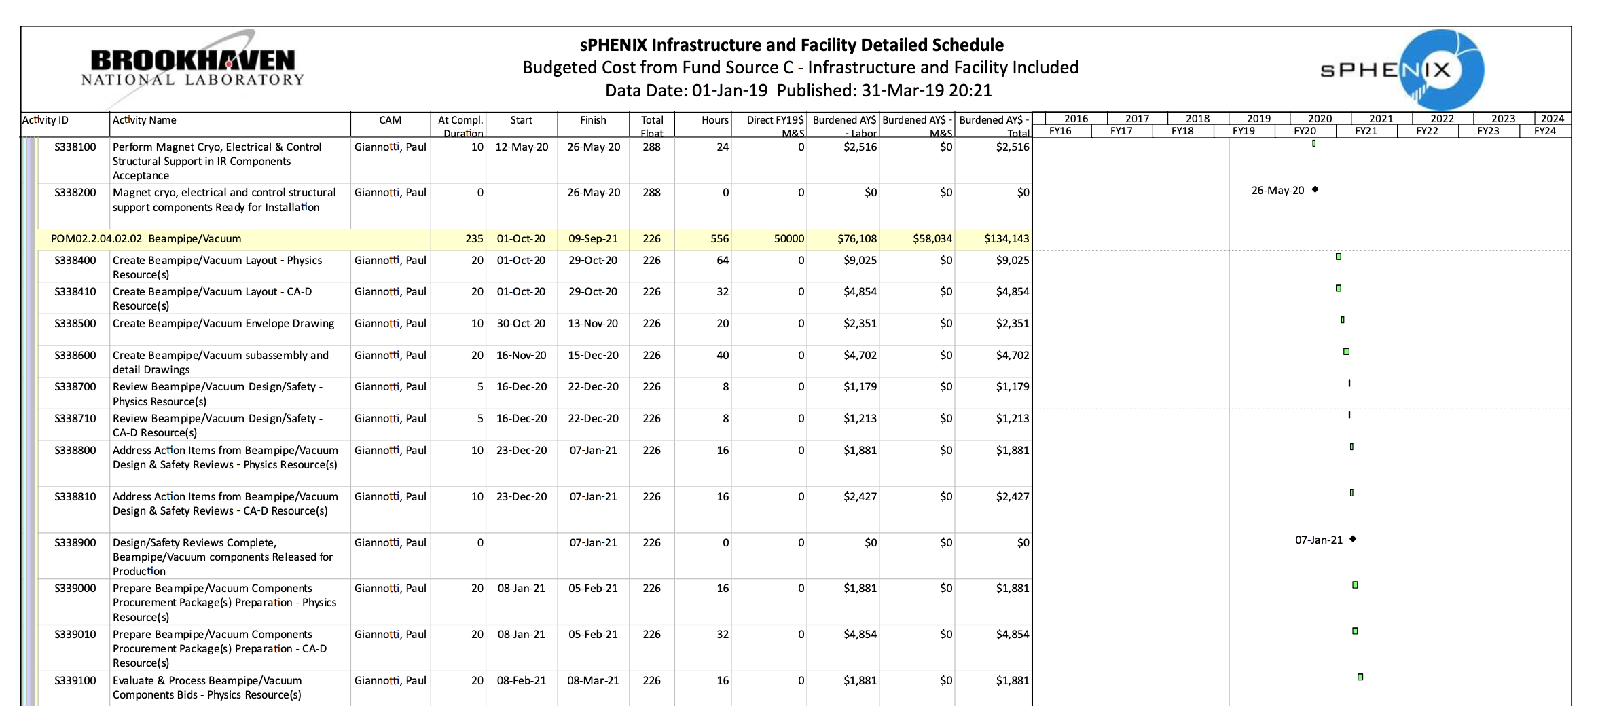
Schedule Drivers
Schedule driven by when items need to be ready for installation (2.05.02)
Design/Safety Review
Deliverable ready for installation
No Items on critical path
Most items have over 100 days of float before becoming critical
Few Key Items:
MoA with CAD– Spring 2019
Line Power Distribution-- April 2020
Cyro Support –May 2020
sPHENIX Safety System –July 2021
Beampipe Modifications—September 2021

Slide 8
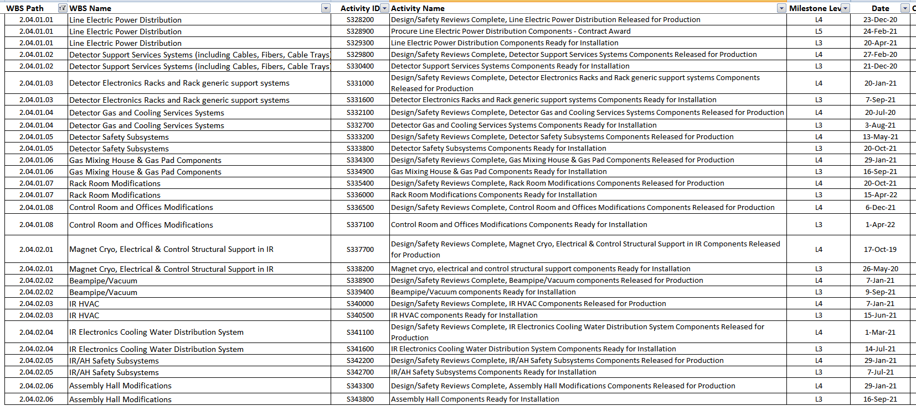
Schedule Drivers
Milestones for Infrastructure
Detector Support
Facility Support

Slide 9
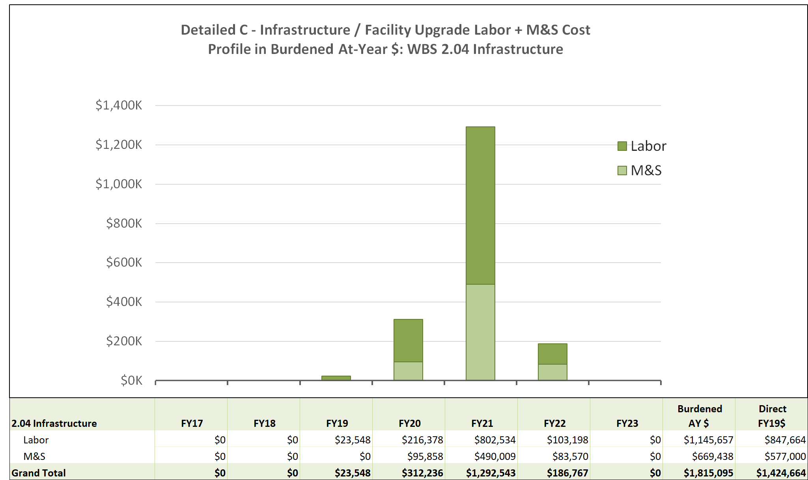
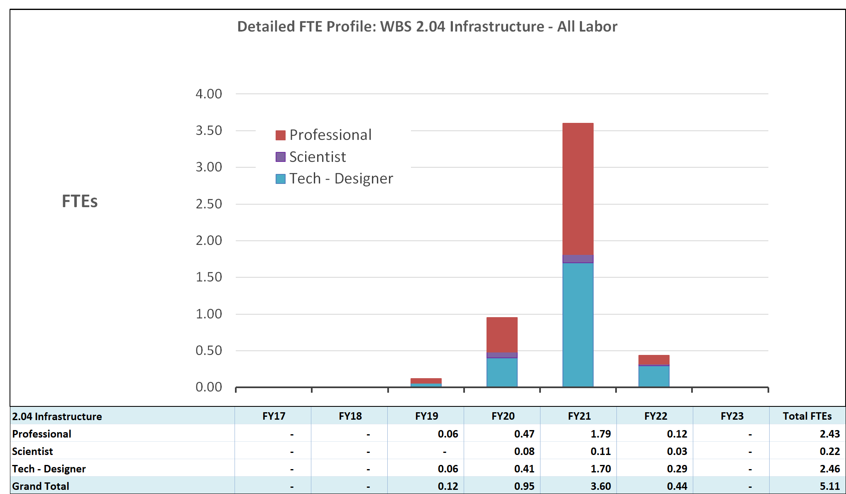
Cost Drivers WBS 2.4 Infrastructure
Infrastructure Cost Drivers:
Predominantly driven by labor cost.
Mostly Engineers and Technical support
Few key items:
Beampipe design and modification
Cryogenic support structures
Electrical and cooling water rerouting and distribution
Hall Modifications

Slide 10
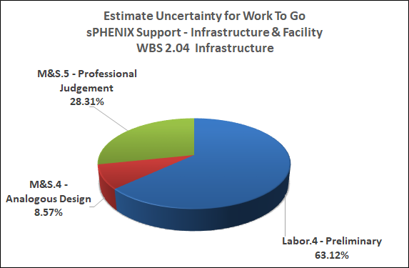
Estimate Uncertainty Breakdown WBS 2.04 Infrastructure
Majority Preliminary Labor estimates based on previous experience from PHENIX
M&S Professional Estimates from similar work done for PHENIX

Slide 11
2.4 Infrastructure Risks

Slide 12
Issues and Concerns
Senior Electrical Engineer Retired-- Transition Responsibilities, New Hire
Availability of non-sPHENIX Engineering and technical staff
MoA with Other BNL Departments, including schedule and resource requirements
Availability of funding as needed
Funding profiles and EVMS planning to meet required schedules
Failure of Major Facility Component
Contingency plans for repair or replacement.

Slide 13
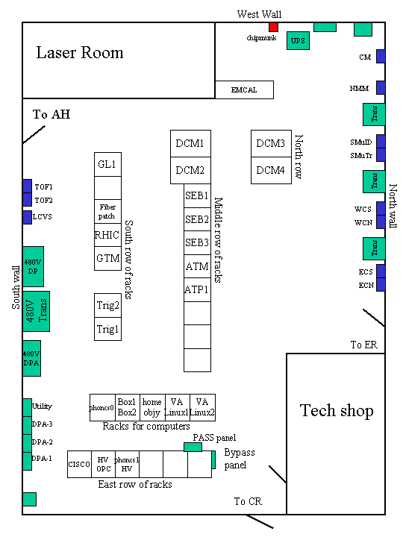
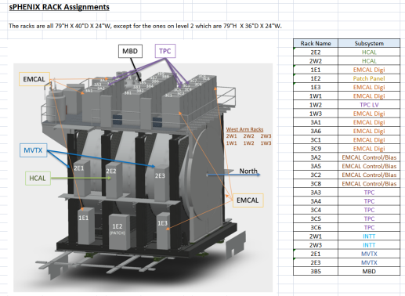
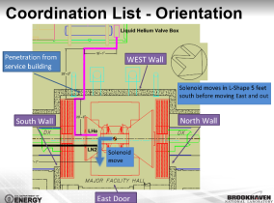
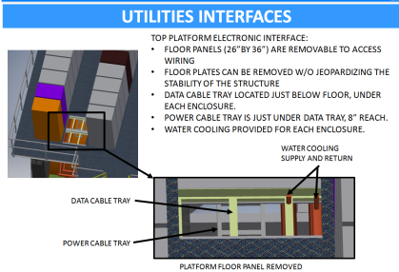
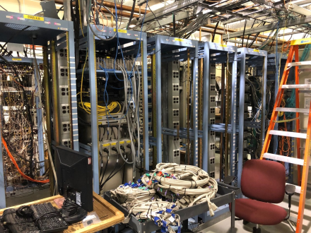
Summary of Status
Detector Support
Power Distribution –Early Design Stage
Detector Support –Cable tray, cooling lines, and gas lines requirement being developed– Early Design Stage
Electronic Rack and supports- Carriage rack location and assignments close to final –Design Stage
Detector Gas and Cooling -- Off detector support needs identified– Early Design Stage
Detector Safety System– Conceptual Stage
Gas Mixing house and Pad—Early Design Stage
Rack Room Modifications– Work has started
Control Room– Early Design stage
Facility Support
IP8 Cryogenic Layout almost complete—Early Design Stage for structural supports underway
Beampipe parameters close to finalized through integration group.—Pre-design stage
HVAC requirements being developed and analyzed-Pre-Design Stage
Cooling water requirement identified --Early Design Stage for distribution
IR/AH Safety Subsystem Components- Conceptual Stage
Assembly Hall Modifications underway

