Slide 1
sPHENIX Director’s Review
WBS 2.05 Integration and Installation
Glenn Young
(Soon: Russ Feder – Welcome!)
April 9, 2019

Slide 2
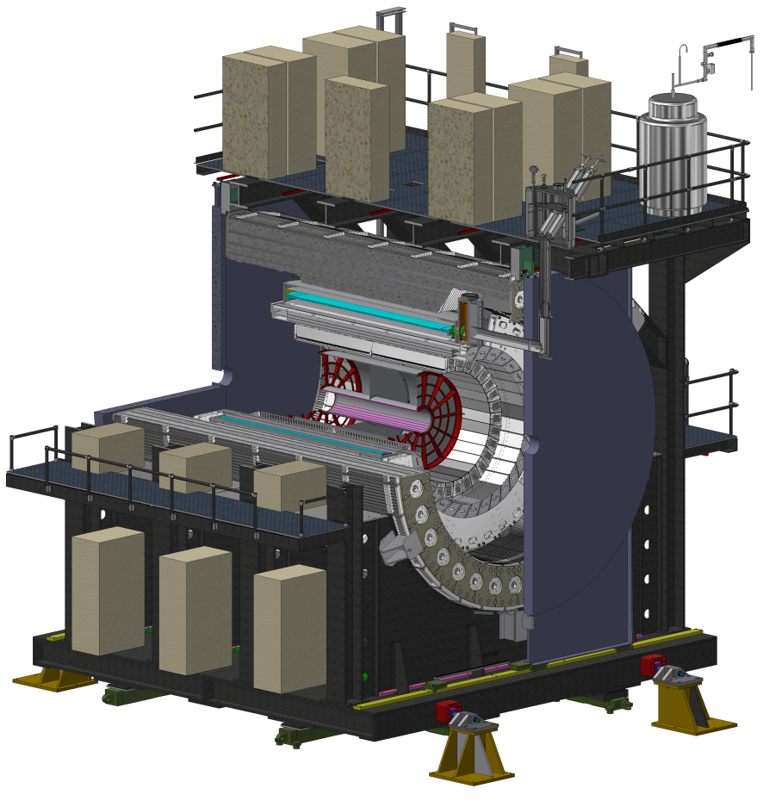
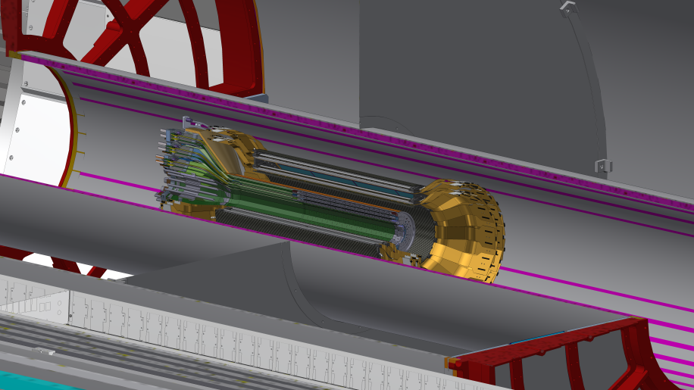
System Description
Racks
Cryogenics Services
Installation Requirements
  IR & AH Floor Loading Limits: 4000 psi, max
  Installation to be accomplished in the Assembly Hall (40 ton and 5 ton overhead cranes) until EMCal and Pole-tips are installed, then assembly is moved to IR for remaining installation
  Overall size requirements: sPHENIX must fit through existing wall opening
  Use existing rail system
  Alignment precision: defined in ICD’s (M. Chiu’s talk)
Outer HCal
Pole Tip
SC Magnet Cryostated Coil
TPC
INTT
Inner HCal
MVTX
EMCal
Cradle Carriages

Slide 3
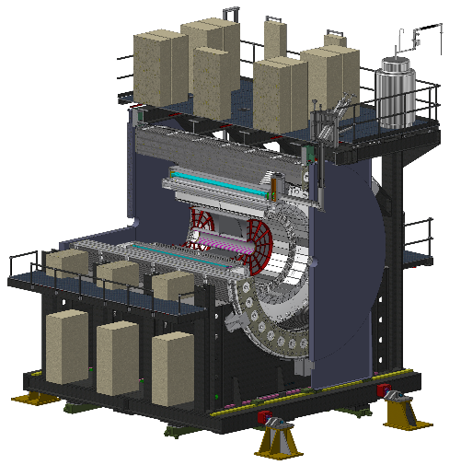
Subsystem Technical Overview
2.05: sPHENIX Integration and Installation
(Integration Documentation, Technical Coordination, Installation, Tooling, Fixtures and Subsystem Installation)
2.05.01: Subsystem Interface & Integration Plan
2.05.02: Infrastructure Installation
2.05.03: Cradle Carriage Integration/Installation
2.05.04: Outer HCal Integration/Installation
2.05.05: sPHENIX SC Magnet Installation
2.05.06: Inner HCal Integration/Installation
2.05.07: EMCal Integration/Installation
2.05.08: TPC Integration/Installation
2.05.09: INTT Integration/Installation
2.05.10: MVTX Integration/Installation
2.05.11: Min Bias Integration/Installation
2.05.12: sPHENIX Full Detector Installation
2.01.04: Installation Management
sPHENIX
Integration and Installation
Work Packages
sPHENIX Integration and Installation
4/8/2019
3

Slide 4
Scope and Deliverables – WBS 2.05
Integration
  sPHENIX Envelope
  Sub-system interface control
  Subsystem Outline Interface drawings
  Configuration management
  Documentation control
  Work planning
  Safety designed–in
  Procurement guidance
  Design review guidance
Installation
Design/spec all installation tooling, subsystem support fixtures (cf. also WBS 2.03.02), fixtures and access equipment.
Installation/upgrade of common Infrastructure including the cradle carriages, services support structure, pole tips, beam pipe, HVAC, electronics cooling water, racks, safety
Installation, survey, alignment and cabling of all sPHENIX subsystems:
  32 Outer HCal sectors
  Superconducting sPHENIX Magnet
  (Cryogenics, Controls, PSU, Quench Detection WBS 2.02)
  32 Inner HCal sectors
  64 EMCal sectors
  Tracking detectors (TPC, INTT and MVTX)
  Min Bias Detector
QA testing of all detector components prior to and subsequent to installation
Commissioning of the fully assembled sPHENIX subsystem

Slide 5
Status & Recent Accomplishments
Integration Status Notes
Envelope Control in operation System drawing issued, subsystem outline/Interface in progress Interface Control in operation 42 ICDs in use; recorded in DocDB
Documentation control in operation 11 procedures/guidelines released
Office of SPHENIX Integration in operation Set up to monitor and enforce interfaces and envelopes
and help resolve integration issues between subsystems
Installation Status Notes
Infrastructure Installation advanced conceptual Many repurposed components
Cradle Carriage Integration/Installation design Detailed 3D model, FEA, fabrication drawings in progress
sPHENIX SC Magnet Installation advanced design New feet in design, transport tooling modifications in design
Outer HCal Integration/Installation prototype parts Lifting & handling fixtures prototypes built; rotational next
Inner HCal Integration/Installation advanced conceptual 3D model almost ready to begin design
EMCal Integration/Installation advanced conceptual Final stages of modeling almost ready to design fixtures
Vacuum pipe conceptual Interface with silicon detectors, MBD
TPC Integration/Installation conceptual Modelling installation and handling fixtures
INTT Integration/Installation conceptual Internal support structure analysis/design
MVTX Integration/Installation conceptual Modified from ALICE MAPS; integrating w/INTT, beampipe
Min Bias Integration/Installation advanced conceptual Repurposing of BBC from PHENIX
sPHENIX Full Detector Installation conceptual 3D model, repurposed infrastructure ready for design

Slide 6
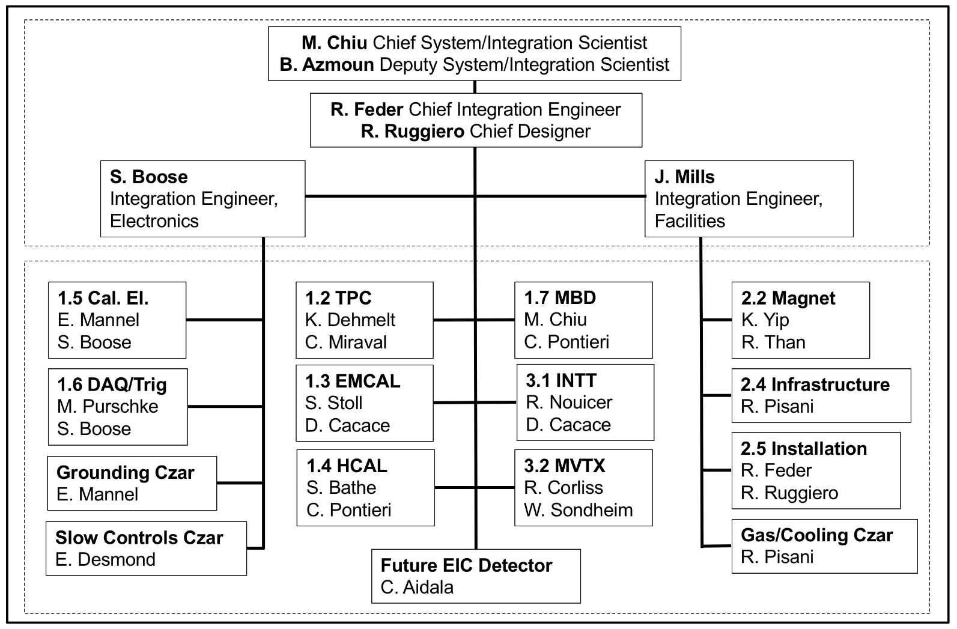
Integration: Key Personnel

Slide 7
Installation: Key Personnel
Installation: Planning & Design: R. Feder, R. Ruggiero
sPHENIX/CAD Safety
sPHENIX/CAD Q/A
Magnet and Cryo: K. Yip, R. Than
Outer Detectors
(Outer HCal, Inner HCal, EMCal):
C. Pontieri, D. Cacace
Inner Detectors (INTT, MVTX, MBD): D. Cacace, W Sondheim
Infrastructure: R. Pisani
Carriage and Support Structures: J. Mills, J. Hock
Electronics: S. Boose
Gas and Cooling: R. Pisani
All Detector Subsystems will supply scientists and students for individual detector and full experiment commissioning
TPC: J. Cozzolino
Electrical and Support Services: R. Pisani, TBD
Rigging Assembly and Technician Supervision:
C. Biggs
Facility: B. Streckenbach

Slide 8
Schedule Drivers – WBS 2.05
Design/Safety Reviews
Carriage Assembly
Delivery of Larger Subsystem/Detectors
  Outer HCal
  Inner HCal
  EMCal
  TPC
Magnet Cryo Delivery System
Delivery of Inner Detector Subsystems
  INTT
  MVTX
  MBD
Installation Procedures, including Work Plan, Critical Lift Plan, Detailed Assembly Plan
Installation Tooling Design and Fabrication

Slide 9
Installation Sequence
Carriage and then Cradles placed onto Track System, with alignment and roller system, in Assembly Hall
Lower 15 Outer HCal Sectors
SC Magnet Coil with Mounting Feet
Support Rings
Upper 17 Outer HCal Sectors
Platforms, Magnet Valve Box, Cryogenics items
Inner HCal - (in parallel with the above)
EMCal 64 Sectors (32 from each end)
Pole Tips (last item that needs 40 ton crane)
Roll sPHENIX from Assembly Hall in to Intersection Region
Complete Cryogenics and SC Magnet Commission – then Map Magnet
TPC
Beampipe
INTT
MVTX and finally MBD
Full System Commissioning

Slide 10
Installation Remarks
Critical path for Infrastructure/Facility goes thru Carriage/Cradle
Each detector subsystem “holds center stage” on installation until cable runs are complete (HCals excepted) and basic functionality is established
Installation is sequential, moving from one subsystem to next, while all installed subsystems perform commissioning on a ‘by-sector’ basis, using local sets of test electronics
Each subsystem will require a Subsystem Readiness and Safety Review before operation
Full subsystem commissioning needs full set of powered racks plus main fiber-optic runs to Counting House, which in turn requires moving in to the Intersection Region
sPHENIX Detector Readiness and Safety Review is required before full system commissioning starts

Slide 11
Cost Drivers – WBS 2.05
Integration & Installation Cost Drivers:
Installation Labor dominates cost (90%)
Inner HCal Assembly Fixtures
Outer HCal Assembly and Handling Fixtures
SC Magnet Coil Handling Fixtures
Cradle/Carriage Assembly Fixtures
EMCal Installation Fixtures
TPC Installation Fixtures
Inner Detector Installation/Handling Tools and Fixtures

Slide 12
Basis of Estimate & Resource-Loaded Schedule
One file for 2.05 Installation and Integration
Fully Consistent w/ P6 RLS
(“snapshot” of RLS)
within file, one Summary and one Details page per Work Package
Navigation links Embedded and by Tab

Slide 13
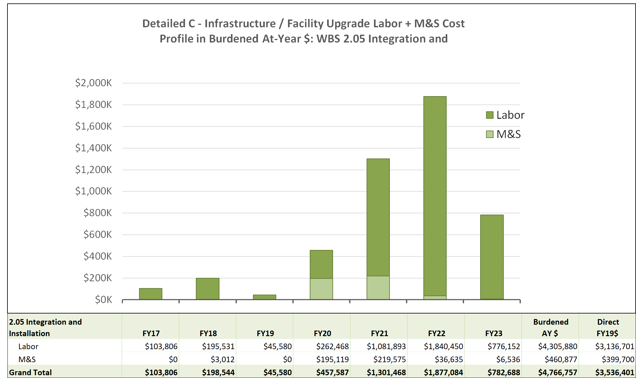
2.05 sPHENIX Integration and Installation Cost Profile
13

Slide 14
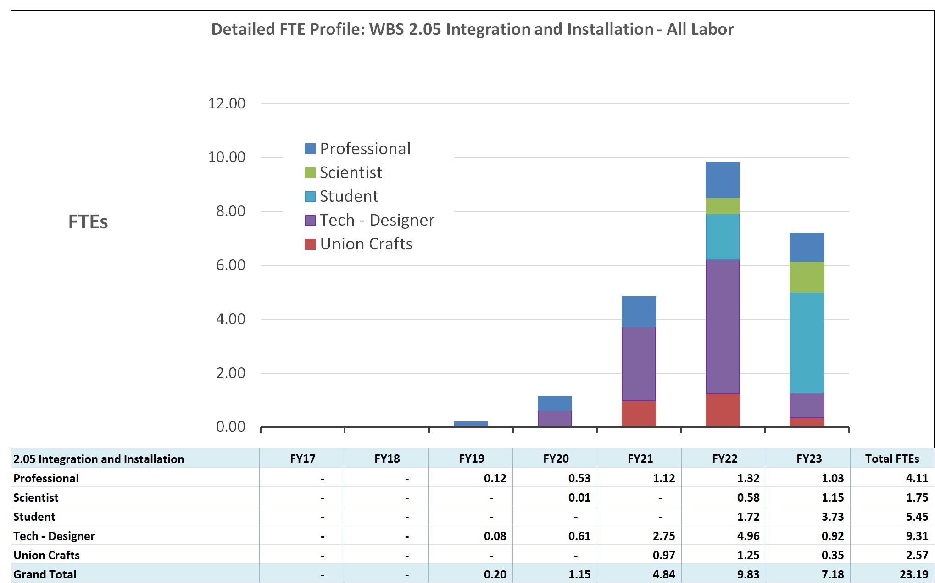
2.05 sPHENIX Integration and Installation Labor Profile
14

Slide 15
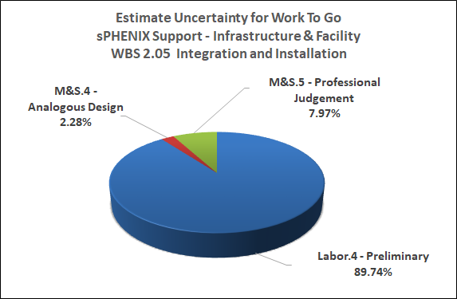
Estimate Uncertainty – WBS 2.05

Slide 16
Installation Issues and Concerns
Issues | Mitigation
Availability of non-sPHENIX engineering and Technical staff | MOA with BNL Departments – 4 are signed (Physics, Instrumentation, CAD for Cryogenics, SMD) and one in draft for Facilities Infrastructure
Availability of funding as needed Availability of detectors on schedule | Workload profiles adjusted to level effort without overly minimizing float. Prototyping series for calorimeters and TPC all underway; LLP items being procured; OHCal sectors (1st detector to install) fabricated with significant float
Notes:
Two issues we are currently facing with regards to the assembly process is the lack of manpower for pre-production assembly and the need for students/post-docs for testing, evaluation and data entry into the database during assembly.

Slide 17
Summary
Installation plans formed and sequence defined
Interfaces defined, control documents issued
Fixtures in design
Work plans and procedures under development
Initial test assembly with OHCal sectors underway
Looking forward to a “very good” 2022….

Slide 18
Back Up

Slide 19
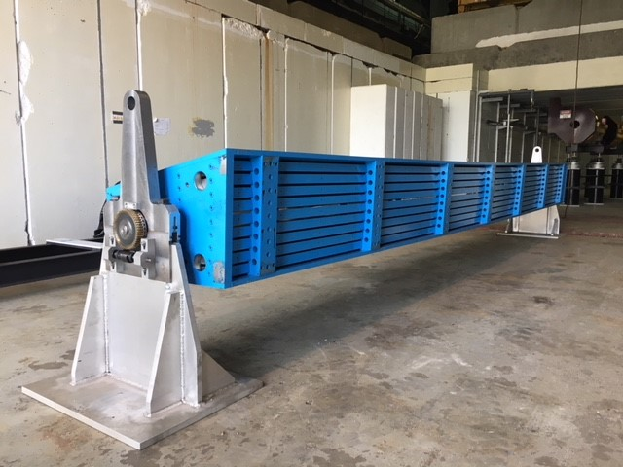
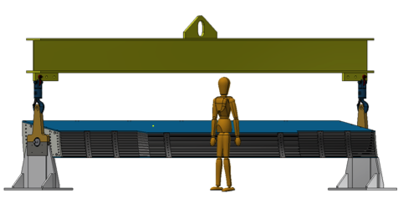
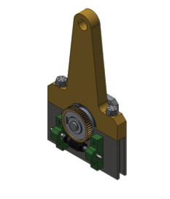
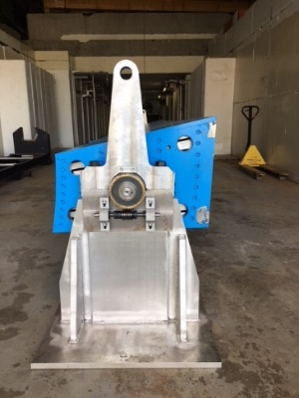
Outer HCal Sector Lifting Fixture
Parts involved for lifting
Lifting Plate(Lower)
  Fabricated
Lifting Plate(Upper)
  Fabricated
1 1/8”-7 Bolts
  Grade 8 required for lifting, McMaster item
  130,000 psi x .763in^2= 99,190 lbs. (yield strength)
  150,000 psi x .763in^2= 114,450 lbs. (tensile strength)
Roller Bearing
  Roller Bearing Part# 20218-MB
  Spreader Beam w/ Shackles & Swivel Hooks
  Purchased and already on site
Trunnion
Spreader Beam
Upper Lifting Plate
5’ 3”
1 1/8”-7 Bolts
Roller Bearing & Trunnion
Lower Lifting Plate

Slide 20
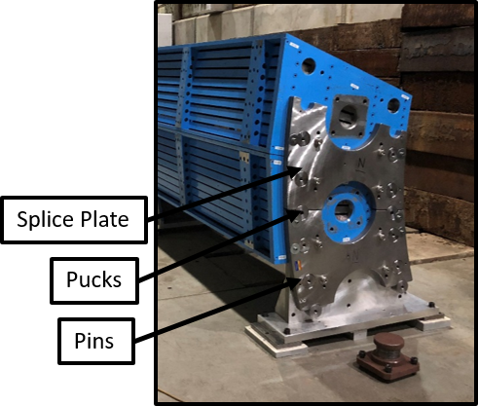
OHCal Sector-to-Sector Attachment
Upper sector (to be lowered)
Lower sector (fixed)

Slide 21
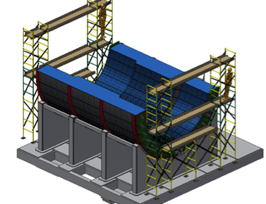
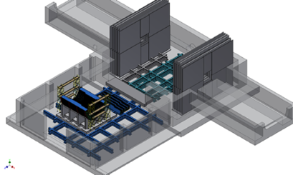
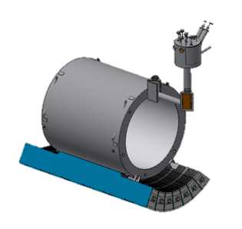
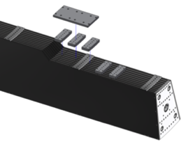
Magnet Installation
Half of Outer HCal installed before magnet installation, half after
ACCESS SCAFFOLDING
CRYOSTAT IS SUPPORTED
BY THE OUTER HCAL
Magnet Support
Space for Inner HCAL support ring
Pad Locations
6x North side
6x south side

Slide 22
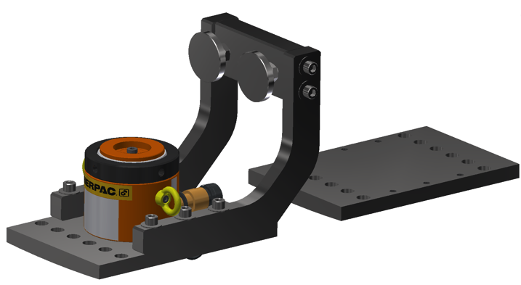
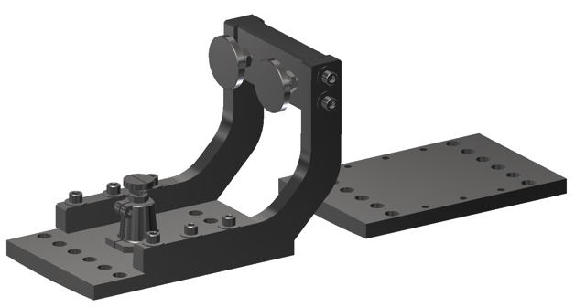
Magnet Integration
Goal: Fix the Babar Solenoid in place with ability to adjust in fine amounts.
Concern: It weighs a bit, and has magnetic forces that want to shift the magnet in Z direction (along beam pipe).
Possible solution: 12 Gap Plate Assemblies (4 Hydro Jacks for the bottom, 8 Screw Jacks for the sides and top)

Slide 23
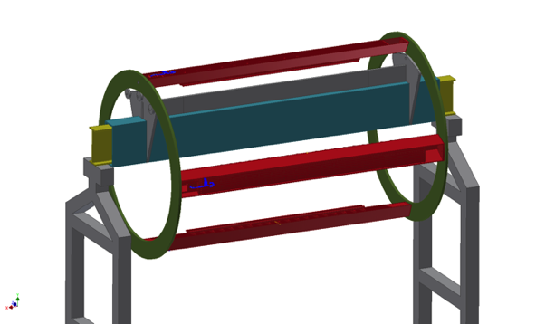
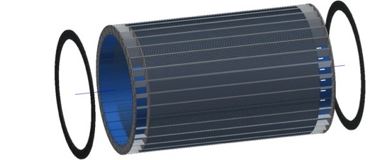
INNER HCAL INSTALLATION FIXTURE - Concept
ROLLERS
INNER HCAL END RINGS
I-BEAM
INNER HCAL
With rings offset
4 HCAL MODULES
INSTALLED

Slide 24
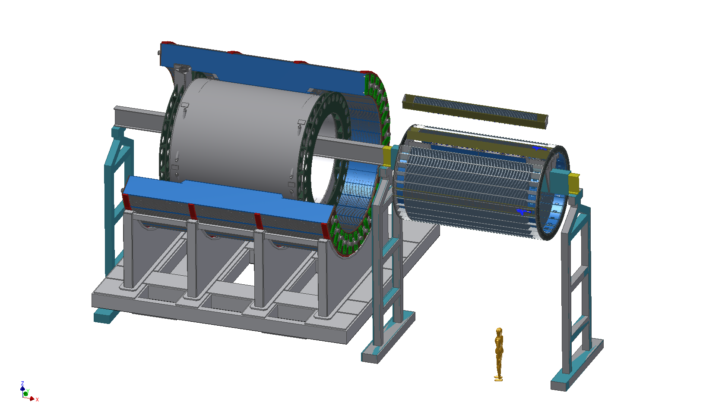
INNER HCAL INSTALLATION - Concept
SUPPORT RING
INNER HCAL MODULE
INNER HCAL
ASSEMBLY FIXTURE
I-BEAM
SUPPORT
SHORT I-BEAM
OUTER HCAL MODULES
REMOVED FOR CLARITY
I-BEAM
SUPPORT
I-BEAM EXTENSION
C3PO

Slide 25
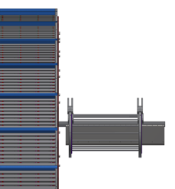
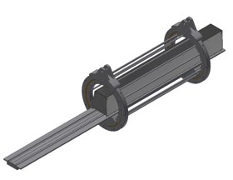
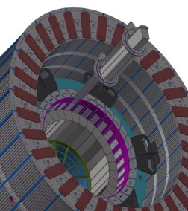
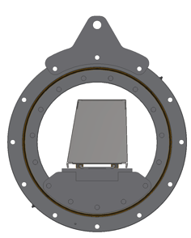
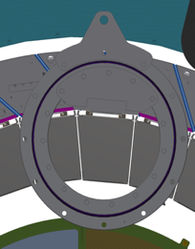
EMCal Lifting Fixture
Tool has lifting eyes for rough placement
Rail extension
Sector cg at center of insertion tool
Tool rail extension mounts to Inner HCal
Tool rotation feature mounts to Outer HCal

Slide 26
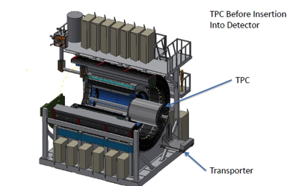
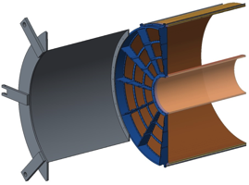
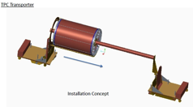
TPC Installation Tooling
  Concepts and tooling for TPC transport and installation into sPHENIX have been studied.
  Some of this tooling will be the same or very similar to that used for TPC assembly and handling.
    Cranes, hoists, cables, turnbuckles
    Stiffening beams, strong-backs
    Lifting beams
    Underside support frames
    Rotating and righting fixtures
    Cradles, work stations
    Transport dollies
    Accessibility and safety issues

Slide 27
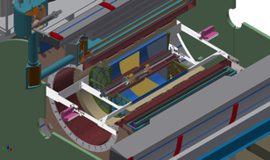
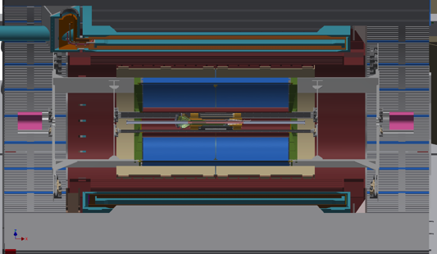
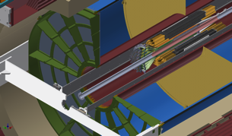
Inner Detectors Installation
Magnet pole tips/end caps, carriage platforms and electronics support (racks and services) are installed/completed then entire detector and carriage is moved to sPHENIX interaction region (IR) and centered on the interaction point (IP)
TPC is installed
Beampipe is installed
Inner detector support structure is installed and aligned
INTT and MVTX are installed and aligned on a common support structure. (either or both capability)
MBD is installed

Slide 28
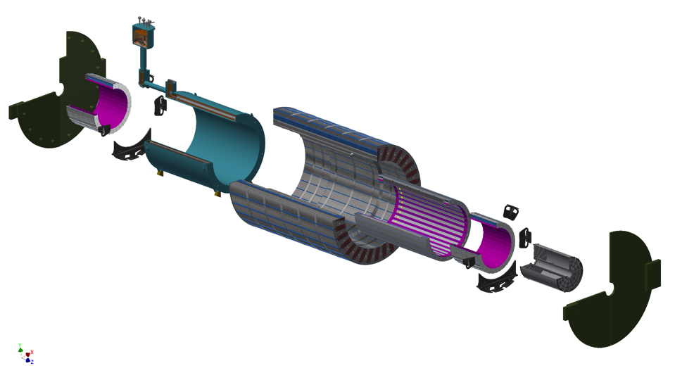
sPHENIX EXPLODED VIEW
SOUTH ENDCAP
(FLUX RETURN)
COIL CHIMNEY
CRYOSTAT/SC COIL
OUTER HCAL
INNER HCAL
NORTH ENDCAP
TPC
(FLUX RETURN)
SOUTH EMCAL
SOUTH DETECTOR SUPPORT
One quadrant not shown
MVTX
INTT
MINBIAS NOT SHOWN
NORTH EMCAL
NORTH DETECTOR SUPPORT

Slide 29
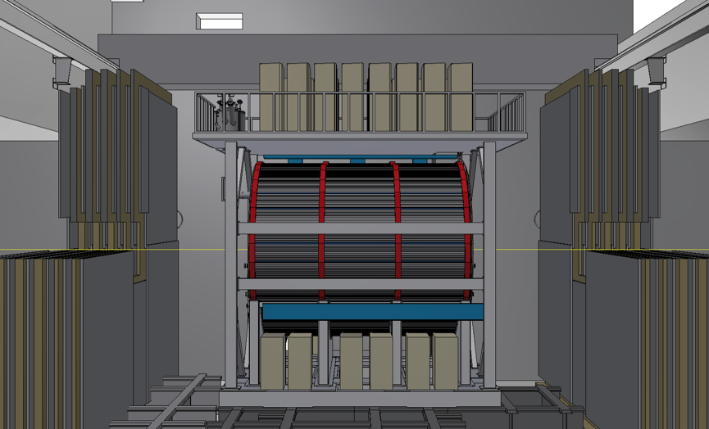
sPHENIX Installed Ready for Operations

Slide 30
Backup to the Backup
Earlier concepts

Slide 31
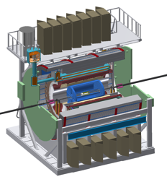
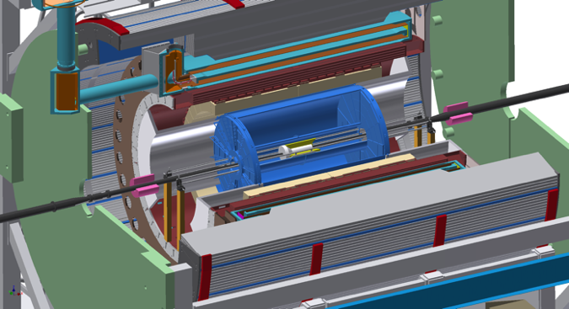
System Description
Installation Requirements
  IR & AH Floor Loading Limits: 4000 psi, max
  Installation to be accomplished in the Assembly Hall (40 ton and 5 ton overhead cranes) until EMCal and Pole-tips are installed, then assembly is moved to IR for remaining installation
  Overall size requirements: sPHENIX must fit through existing wall opening
  Use existing rail system
  Infrastructure defines most interfaces (except installation tooling and fixtures interfaces)
  Alignment precision: defined in ICD’s (M. Chiu’s talk)
INTT
MVTX
OUTER HCAL
INNER HCAL
EMCAL
TPC
MIN BIAS
BEAM PIPE
POLE TIP/FLUX RETURN
SC MAGNET
CRADLE CARRIAGE

Slide 32
Installation Sequence
2

Slide 33
Installation Sequence

