Slide 1
sPHENIX Director’s Review
Tracking Simulations
Tony Frawley, Florida State University
April 9-11, 2019
BNL
April 9-11, 2019
sPHENIX Director's Review

Slide 2
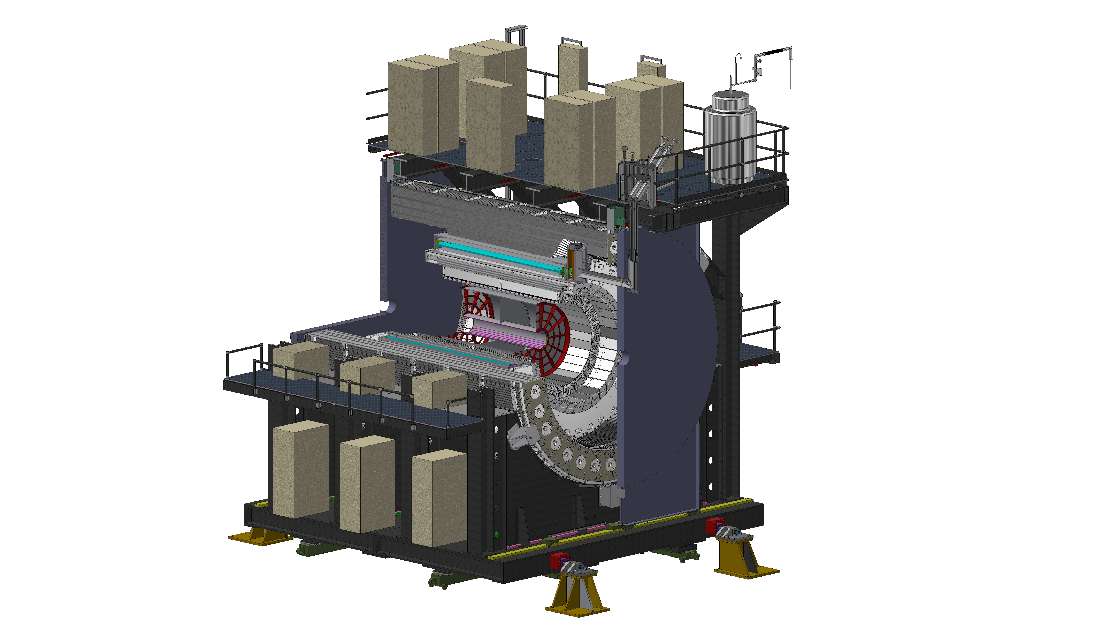
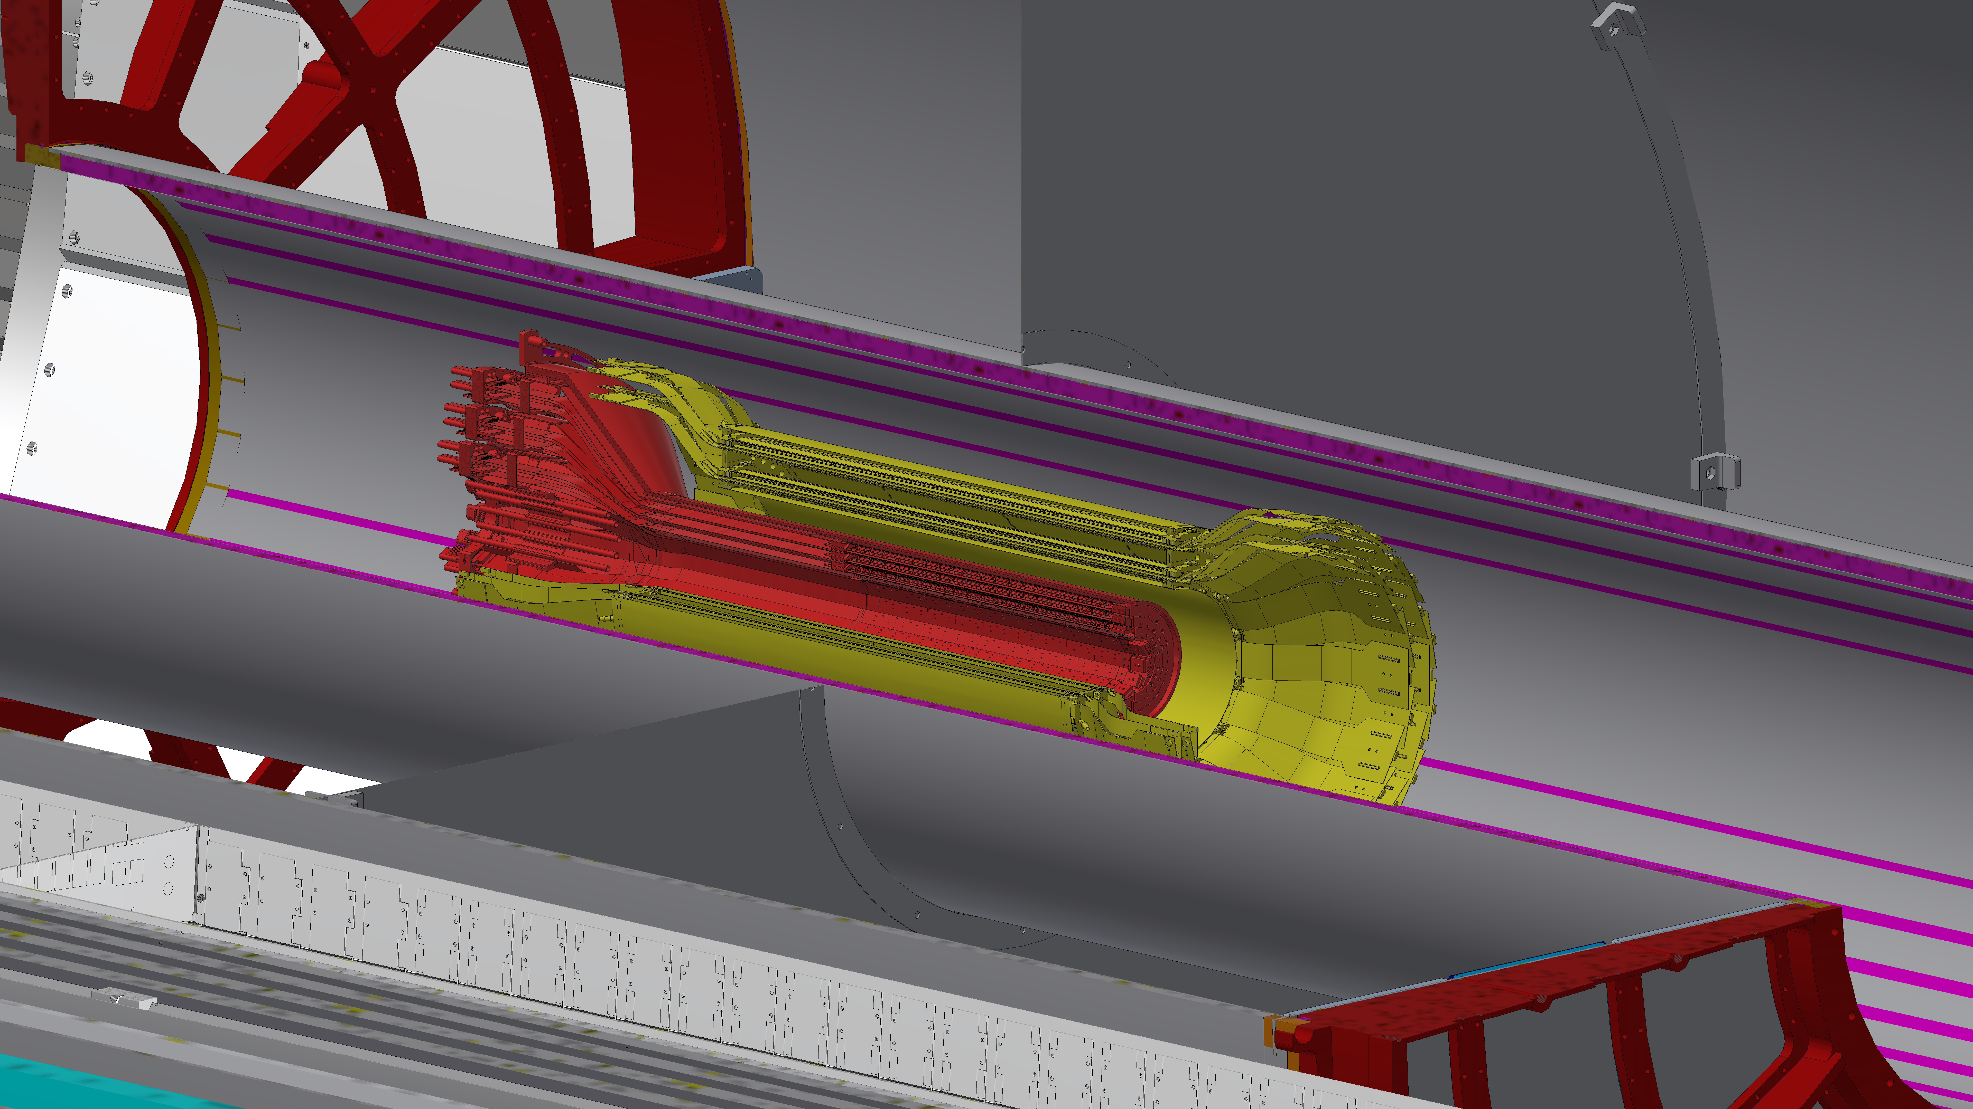
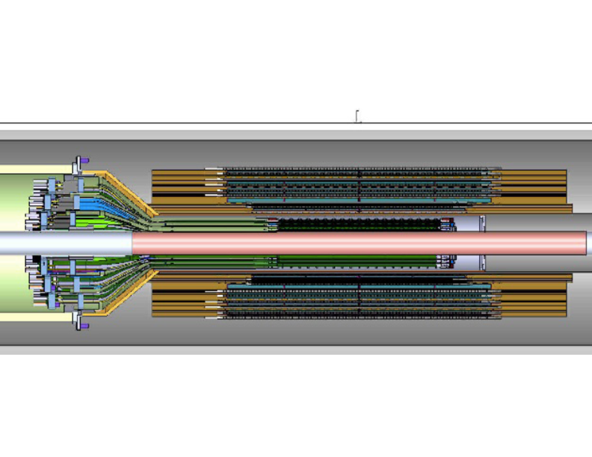
Functions of the Tracker
Momentum measurement
Provided by TPC measurement of sagitta
Need precise interaction vertex for best accuracy
obtained by adding MVTX hits
Pileup event disambiguation
provided by 2 hermetic layers of INTT silicon strips (can resolve 1 beam crossing)
Precise track vertex for DCA measurement
Provided by MVTX pixels
INTT
MVTX
April 9-11, 2019
sPHENIX Director's Review

Slide 3
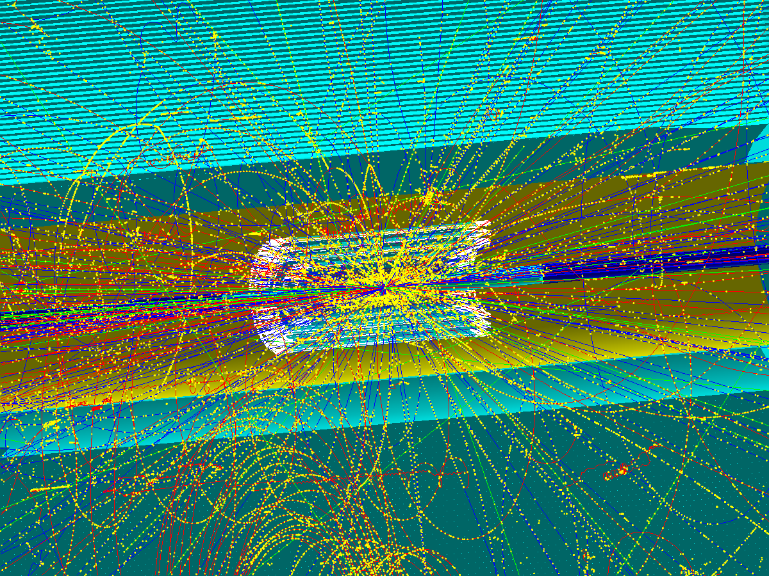
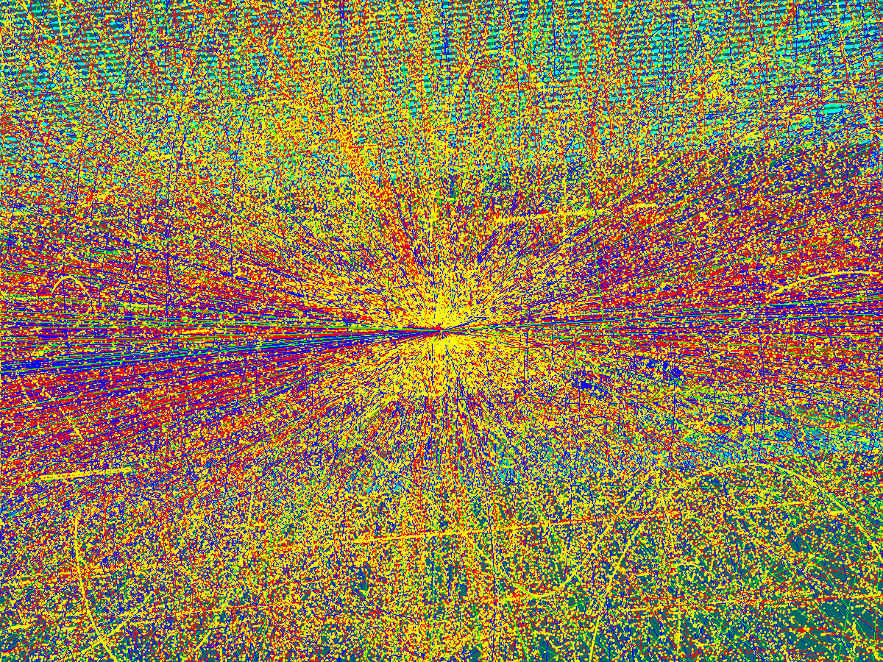
Tracking Simulations
Tracker configuration now finalized
Full Geant IV model of the tracker components
Conversion of G4 hits to readout values
Including all effects that contribute to resolution
Apply thresholds, dynamic range, digitization
Clustering
Tracking
Evaluation of performance using truth information
Realistic occupancy due to charge storage in TPC and MVTX
Event pileup from random min-bias collisions at specified collision rate
April 9-11, 2019
sPHENIX Director's Review

Slide 4
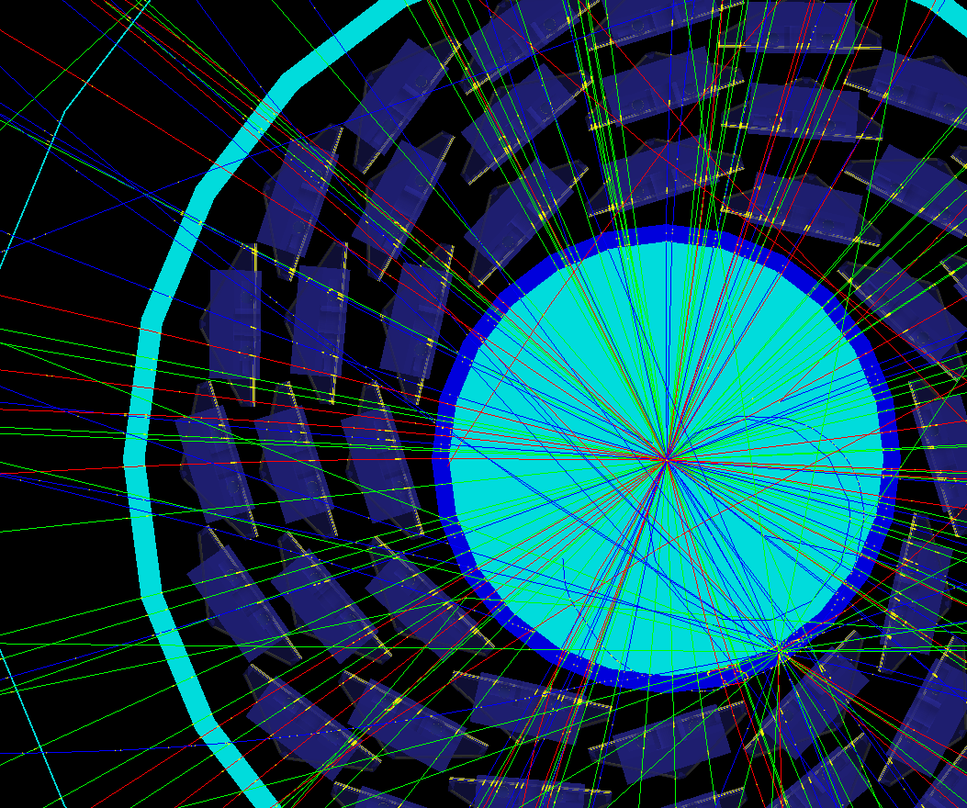
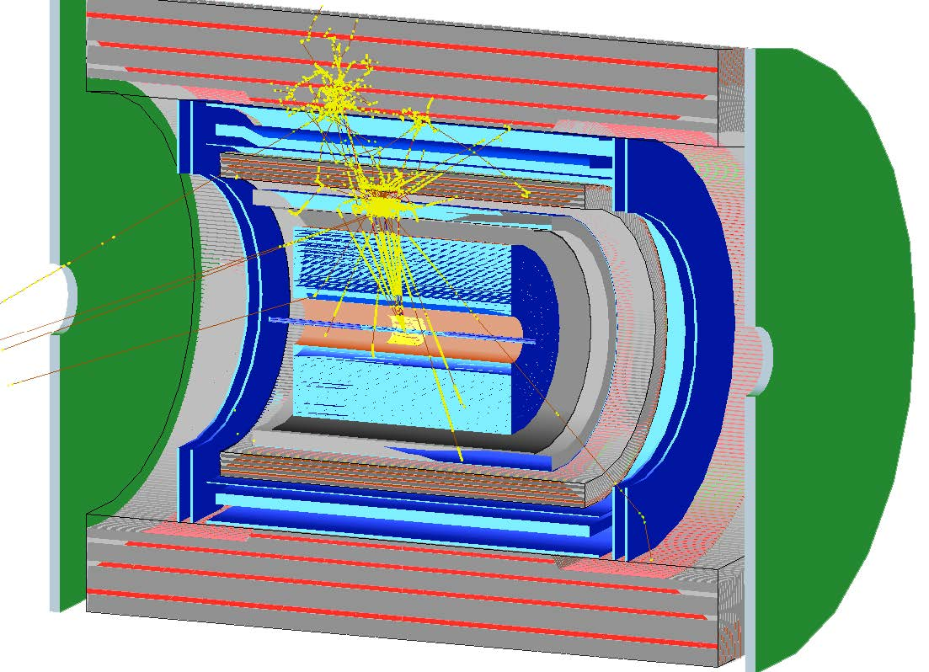
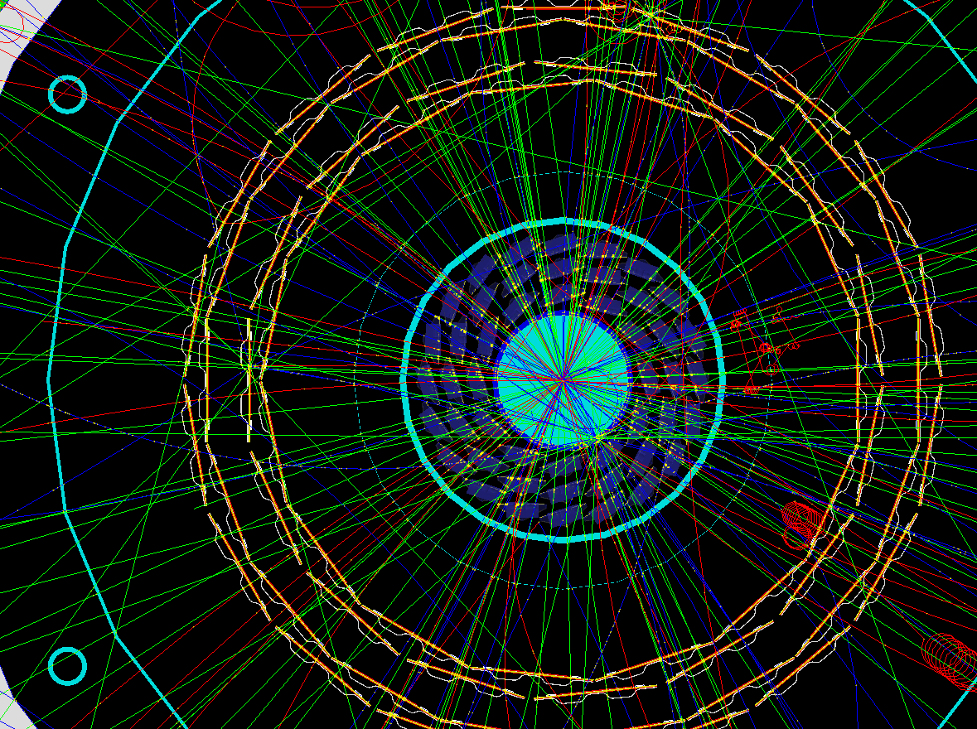
Tracking Simulations
HF event in MVTX
b-jet in sPHENIX
HF event in MVTX + INTT
April 9-11, 2019
sPHENIX Director's Review

Slide 5
TPC simulations
Single gas volume
Charge diffusion parameterized vs drift length
Space charge distortion correction uncertainty added
Readout:
GEM charge dispersion in rφ added
Charge distributed between pads using model of zigzag pads
SAMPA chip shaping folded with drift-diffusion time distribution
Z bins from realistic ADC binning of time distribution
Produces realistic occupancy effects in TPC
April 9-11, 2019
sPHENIX Director's Review

Slide 6
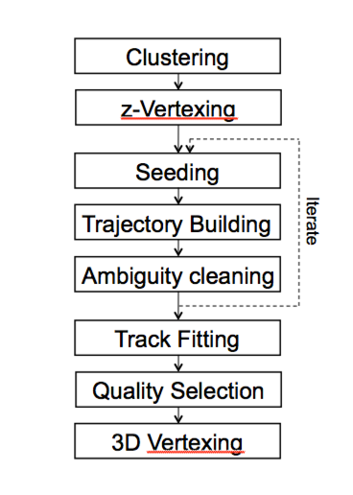
Track Reconstruction
All subsystems provide a standard cluster format
Weighted mean + full covariance matrix
Clustering optimized for high occupancy
Fast initial Z-Vertexing based on triplet tracks in inner tracking system
- Developed, not implemented yet
Seeding based on a Hough transformation of a subset of TPC layers
Seeding iterations
progressively looser seed requirements - redundancy for high occupancy
4 hits out of 7 layers
6 hits out of 12 layers
Trajectory building and Track fitting based on state of the art Kalman filter
Derived from Open Source GENFIT package
3D Track Fitting using RAVE package
Optional track refit including reconstructed vertex
Useful for prompt signals such as Upsilons
April 9-11, 2019
sPHENIX Director's Review

Slide 7
Collaborators (current and recent)
Anthony Frawley, Florida State U. (simulations, tracking, coordination)
Jin Huang, BNL (consultant, sPHENIX simulations oversight)
Sanghoon Lim, LANL (vertexing)
Sookhyun Lee, Iowa State University (vertex finding, tracking)
Darren McGlinchey, LANL (MVTX simulations, tracking)
Yasser Corales, LANL (MVTX simulations)
Takahito Todoroki, RIKEN (INTT simulations)
Carlos Perez, SUNY SB (TPC simulations)
Chris Pinkenburg, BNL (simulations, consultant)
Christof Roland, MIT (Tracking)
Veronica Canoa Roman, SUNY SB (TPC simulations)
Sourav Tarafdar, Vanderbilt University (QA)
Yorito Yamaguchi, RBRC (pileup studies)
Haiwang Yu, BNL (Tracking)
April 9-11, 2019
sPHENIX Director's Review

Slide 8
Status and Highlights - I
Effort in the last 12 months to enhance realism in the simulations.
TPC modeled as a single gas volume, with realistic transport of electrons to readout plane.
Implemented ADC readout and digitization for the TPC that includes all details as planned for the real detector, including noise.
Implemented realistic readout and digitization for INTT and MVTX.
The tracking detector model fully reflects the configuration agreed on following the tracking task force study.
April 9-11, 2019
sPHENIX Director's Review

Slide 9
Status and Highlights - II
Careful study of out-of-time track rejection using matching to the INTT+MVTX
Critical for tracking in p+p running
Requiring 2 MVTX and 1 INTT hit per track provides rejection of 44,000 for out-of-time (event pileup) tracks
More than good enough
April 9-11, 2019
sPHENIX Director's Review

Slide 10
Status and Highlights - III
Just completed a major upgrade of the tracking simulation and reconstruction software.
Simulations code modularized, and separated by subsystem.
More accessible to maintenance by subsystem experts
Tracking code modularized by function.
Facilitates adding new vertexing, seeding, track propagation and track fitting methods.
New hit and cluster storage containers and association maps implemented.
Easier and faster association to geometry details and to truth information.
Resulted in factor of two reduction in memory use.
This positions us for a big push in the next year to greatly improve code speed and memory use.
April 9-11, 2019
sPHENIX Director's Review

Slide 11
Tracking Efficiency
Track reconstruction efficiency in various occupancy scenarios.
Uses 100 pions embedded in Hijing events with different event pileup rates.
Efficiency in worst case occupancy is workable. Most likely can be improved with
Better clustering
More iterations
April 9-11, 2019
sPHENIX Director's Review

Slide 12
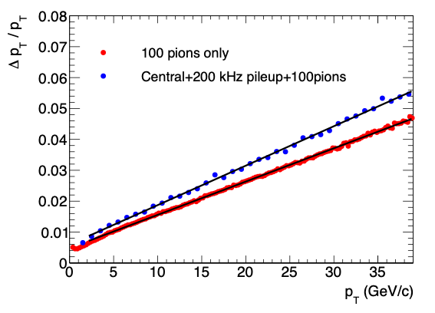
Momentum Resolution
Comparison of pT resolution in low and high multiplicity events.
Some deterioration of pT resolution in worst case occupancy scenario.
April 9-11, 2019
sPHENIX Director's Review

Slide 13
DCA Resolution
Comparison of DCA resolution in the bend direction for low and worst case occupancy cases.
Very robust against occupancy effects.
April 9-11, 2019
sPHENIX Director's Review

Slide 14
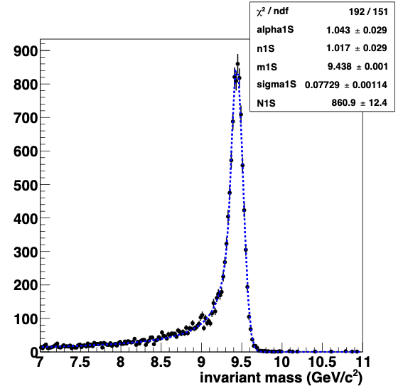
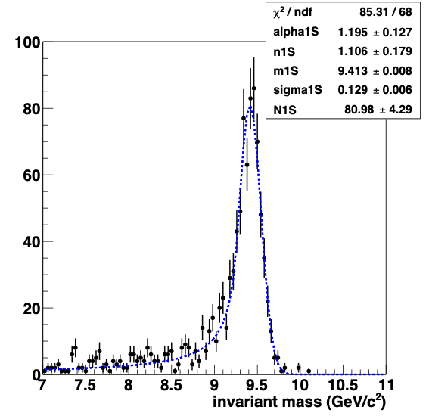
Upsilon Mass Resolution
Low occupancy events (100 pions/event)
Embedded Υ(1S) mass spectrum
Low occupancy events: 78 MeV
AuAu Central + 200 kHz pileup: 129 MeV
AuAu central + pileup from 200 kHz collision rate
April 9-11, 2019
sPHENIX Director's Review

Slide 15
Issues and Concerns
In worst case occupancy events (central event with 200 kHz rate pileup)
Tracking efficiency remains acceptable
But momentum resolution deteriorates somewhat, pushes Upsilon mass resolution beyond our goal of 100 MeV
Possible solutions:
Improvements to clustering algorithm in high occupancy
There is still room for improvement in determining CG of TPC clusters
Improving usable luminosity while reducing total luminosity
Currently, only about 1/3 of total luminosity is in our tracking acceptance
Discussing crossing angle and other options with CAD
Mar 6-8, 2018
sPHENIX Director's Review

Slide 16
Summary
Implement newly developed code to do initial vertex finding using MVTX + INTT
Implement scheme to track to multiple vertices/event using these seed vertices
Current tracking works, but is too slow and memory intensive
Investigate new track seeding algorithms
Investigate new track fitting algorithms
Example ACTS (open source ATLAS tracking package)
Reducing speed and memory consumption to levels needed for data reconstruction is feasible, and is a high priority for the near future.
April 9-11, 2019
sPHENIX Director's Review

Slide 17
Back Up
April 9-11, 2019
sPHENIX Director's Review

