Slide 1
sPHENIX Director’s Review Time Projection Chamber Mechanics
Klaus Dehmelt
April 9-11, 2019
BNL

Slide 2
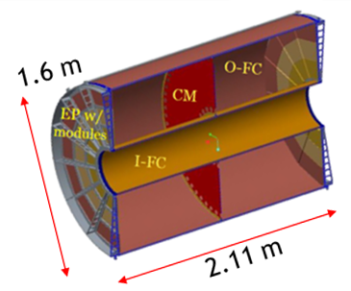
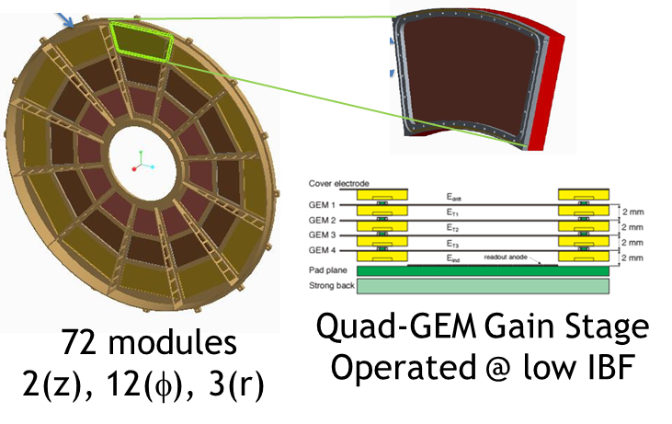
The L3 Component: 1.02.01
1.02.01: TPC Mechanics
Outer Field Cage O-FC, R = 78 cm, L = 211 cm
Inner Field Cage I-FC, R = 20 cm , L = 211 cm
Central Membrane CM
Endplates EP, 2 in z
Modules, 12 in φ, 3 in r
Quad-GEM Gain Stage
Operated @ Low Ion Back Flow

Slide 3
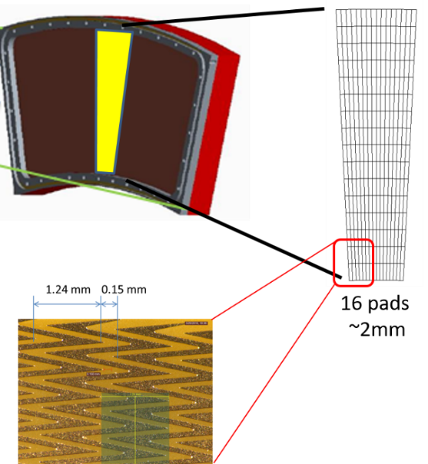
1.02.01 Technical Overview
Dimensions and designs dictated by
Inner/outer radius → magnet and inner/outer detector design
Length → pseudorapidity |η| < 1.1 (> 37° polar angle)
Design of field cages → minimum space
and maximum stability
Design endplates → minimum material
budget, maximum stability
Design modules → maximum integrity, simplest method of manufacture, maximum performance
Full technical understanding of all components
Photograph of readout board

Slide 4
1.02.01 Scope
WBS 1.02.01 contains all elements that lead to the successful assembly of the TPC mechanics (WBS 1.02.01.08) and eventually make the TPC ready to install
Dependences, all on items outside MIE
Detector Support Systems → sPHENIX Infrastructure WBS 2.09.02
Infrastructure Installation → sPHENIX Integration and Installation WBS 2.10.02
TPC Installation → sPHENIX Integration and Installation WBS 2.10.08

Slide 5
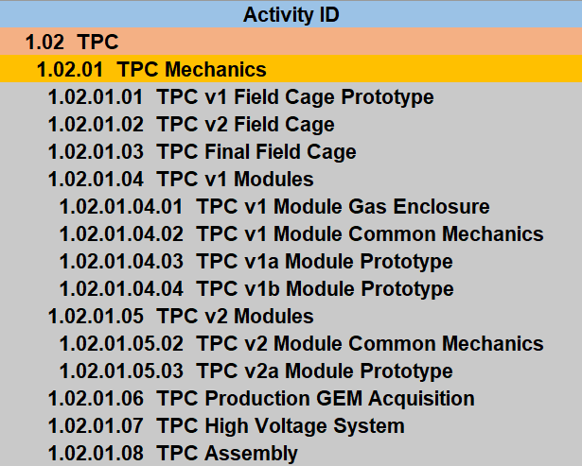
1.02.01 Scope

Slide 6
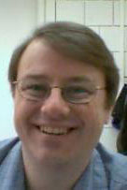
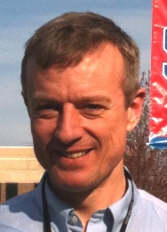
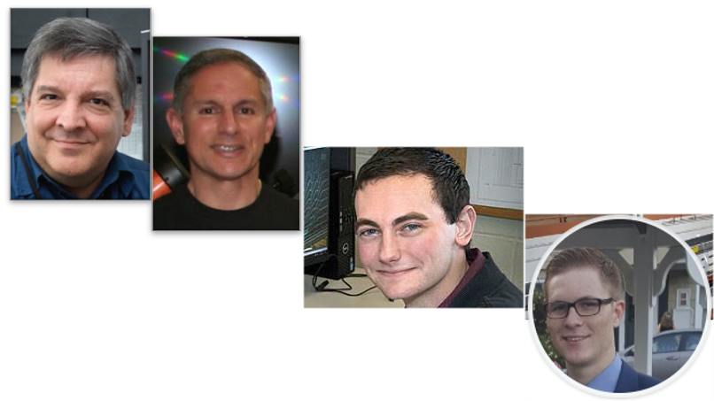
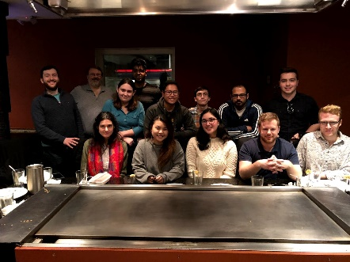
L3 Collaborators
L2 Manager WBS 1.02 TPC: Thomas K. Hemmick (Stony Brook University)
Distinguished Teaching Professor
L3 Manager WBS 1.02.01 TPC Mechanics: Klaus Dehmelt (Stony Brook University)
Research Scientist
John Cozzolino (SMD BNL)
Senior engineer
Steven Bellavia (CAD BNL)
Senior engineer
Daniel Cacace (Physics Department BNL)
Mechanical engineer
Connor Miraval (Instrumentation Division BNL)
Mechanical engineer
Stony Brook Postdocs, graduate students, undergraduate students

Slide 7
Schedule Drivers
WBS 1.02.01.06 TPC Production GEM Acquisition
Factory production follows a Start-Start relationship to GEM production
Module assembly takes less time than GEM production (PHENIX Hadron Blind Detector experience, ALICE TPC upgrade experience)
GEM schedule drives module production schedule and TPC overall schedule

Slide 8
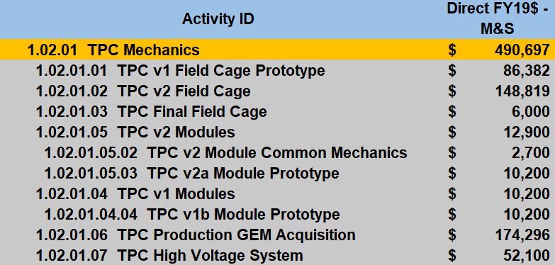
Cost Drivers
Possible opportunity

Slide 9
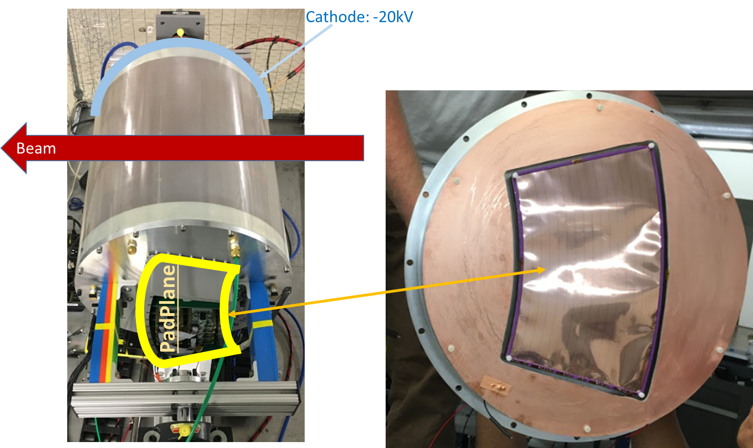
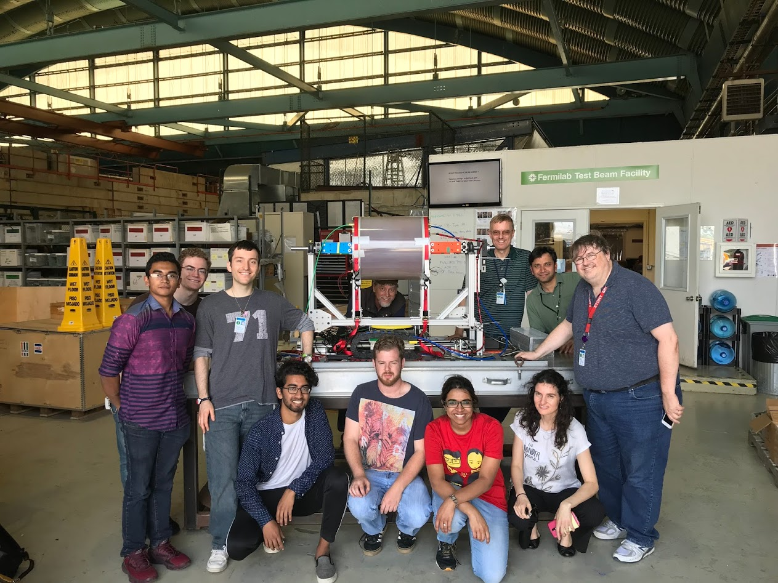
Status and Highlights
Test beam campaign at Fermilab Test Beam Facility FTBF: R2 module

Slide 10
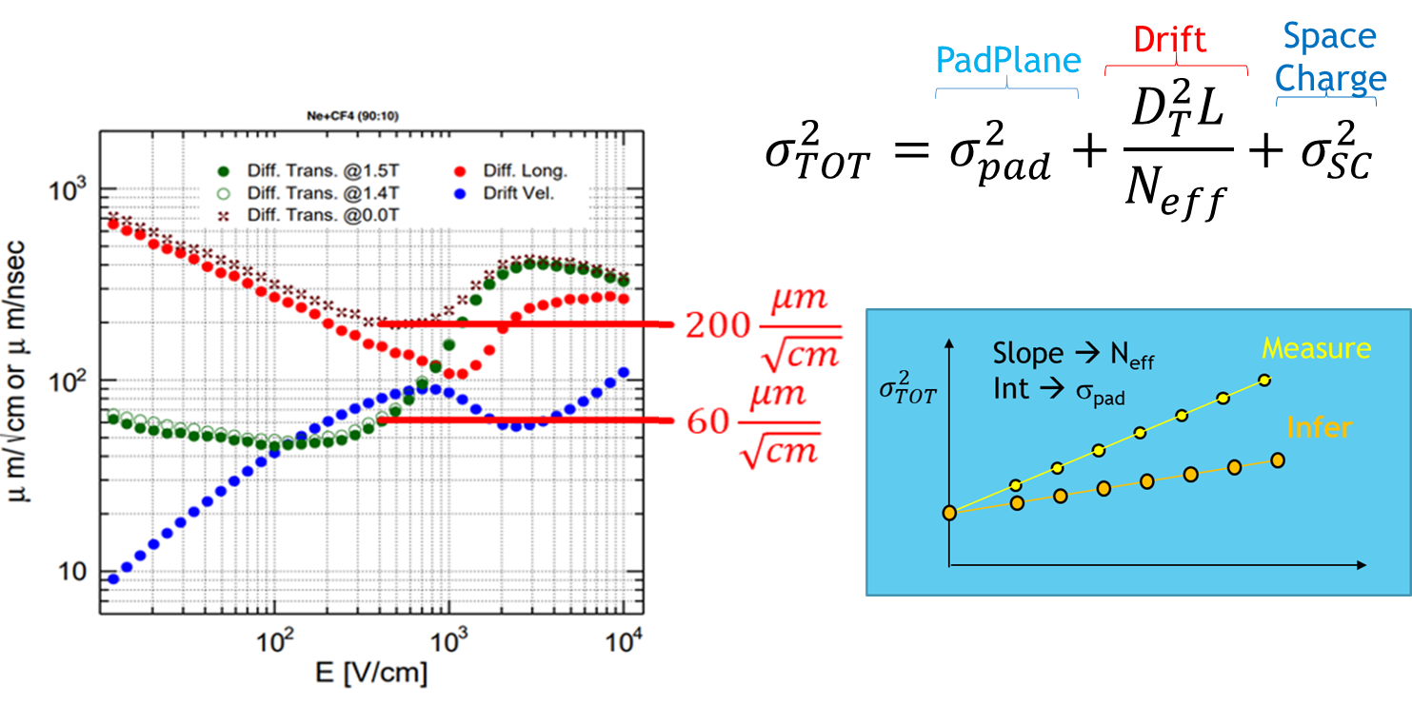
Status and Highlights
Test beam campaign at Fermilab Test Beam Facility FTBF
Main task: determine position resolution at B = 0 T and extrapolate to B = 1.4 T
L

Slide 11
Status and Highlights
Test beam campaign at Fermilab Test Beam Facility FTBF
Main task: determine position resolution at B = 0 T and extrapolate to B = 1.4 T
TPC simulation follows every electron
Simulation predicts resolution
Contains fudge factor on TPC resolution
Roughly matches prior parametrization
Measurement better than simulation
${\overline{σ}}_{meas}=114μm< {\overline{σ}}_{sim}=138μm$

Slide 12
Status and Highlights
Field cage production well under way
Inner field cage finalized
Outer field cage in its final production
Endplates (wagon wheels) in hand, inspected and approved
GEM module v2 parts in hand
Structure for TPC assembly in hand

Slide 13
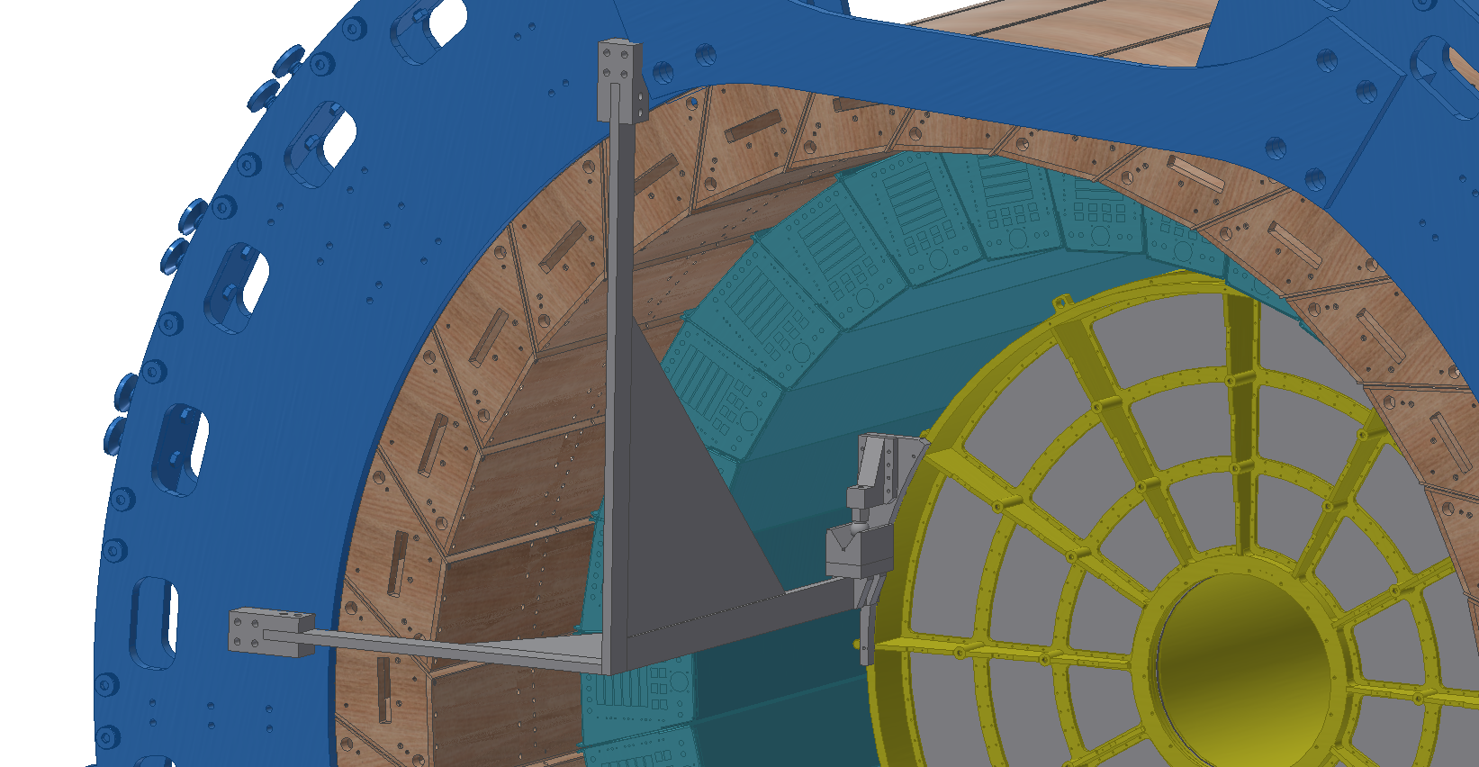
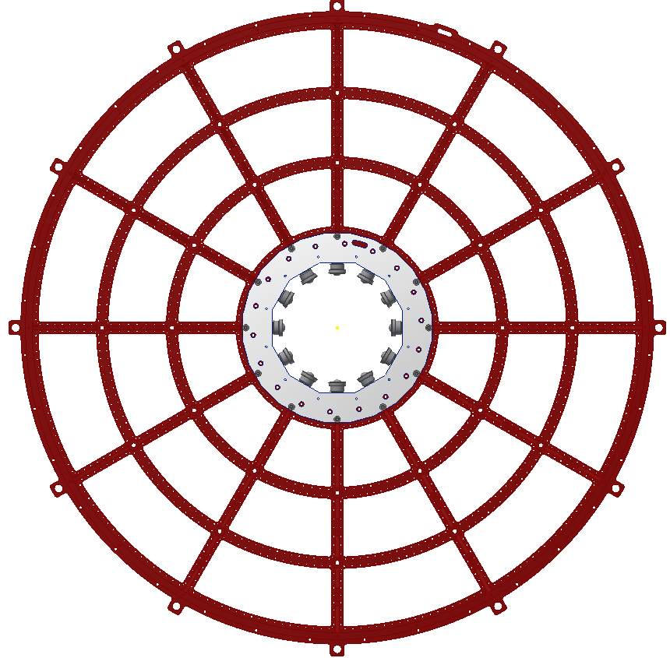
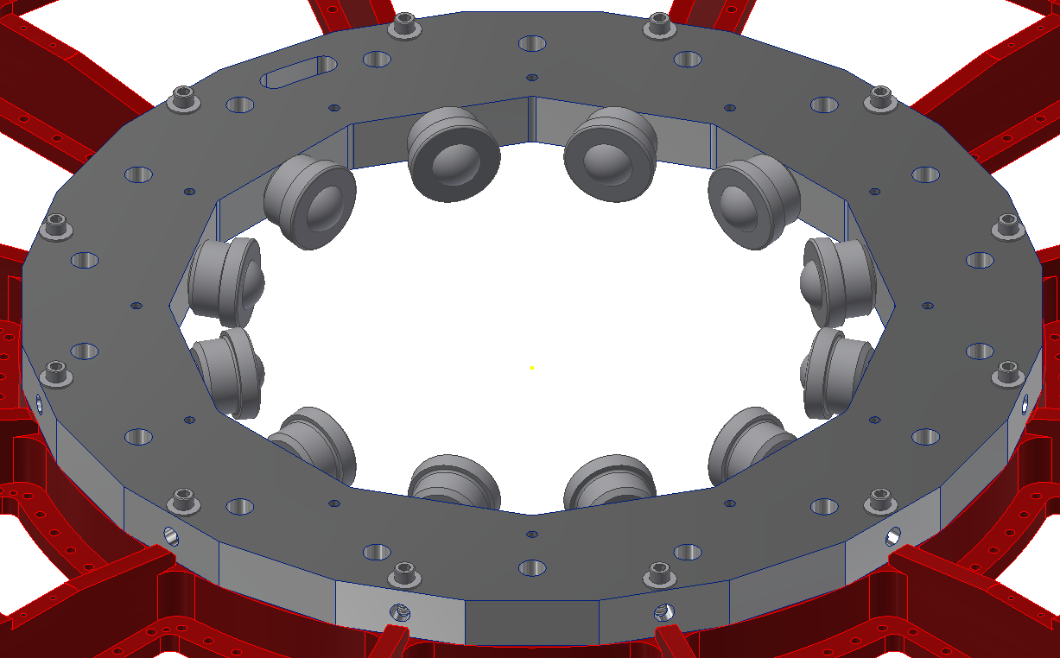
Status and Highlights

Slide 14
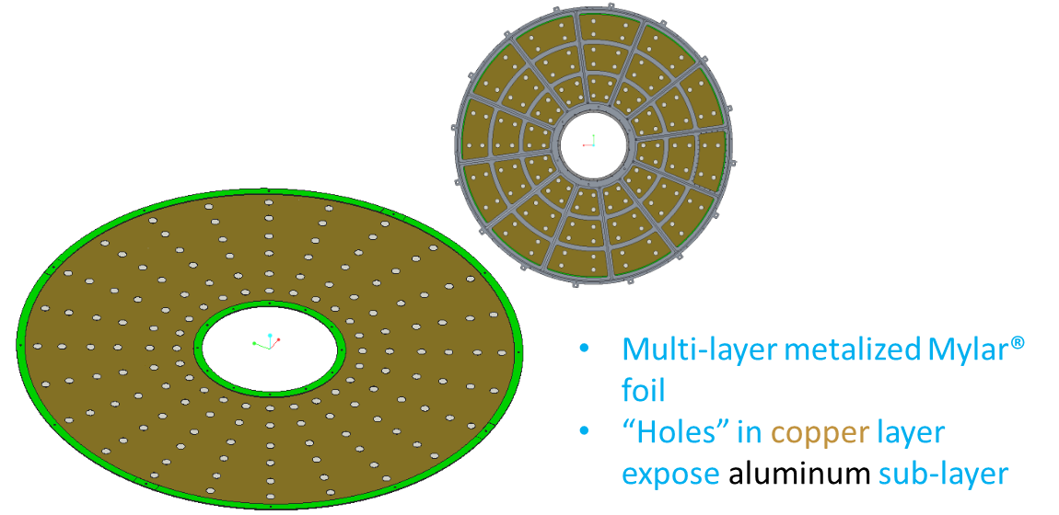
Status and Highlights

Slide 15
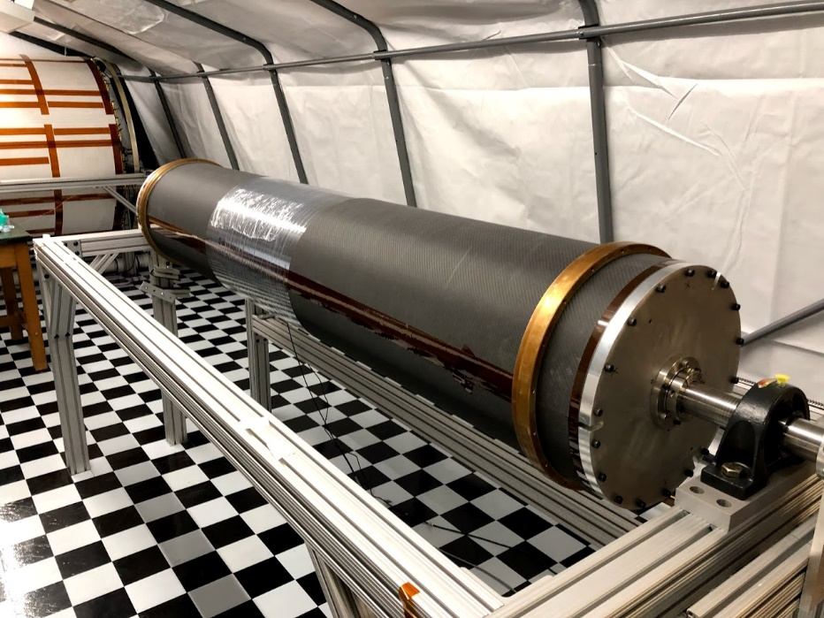
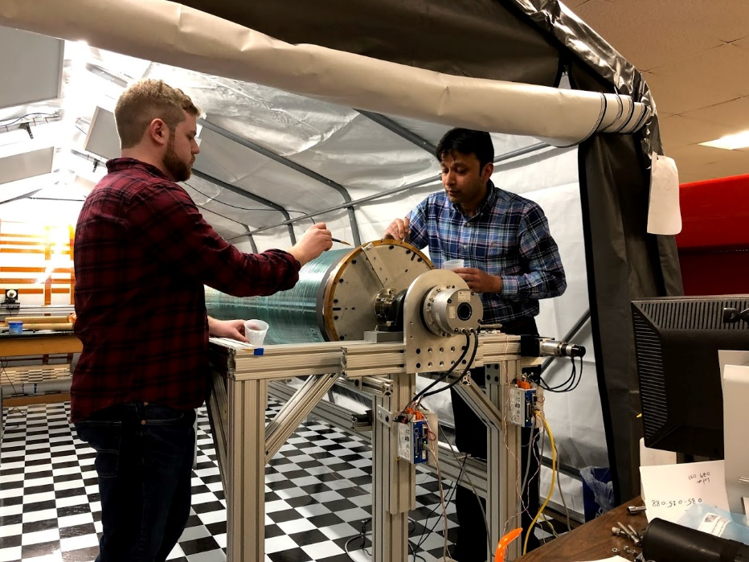
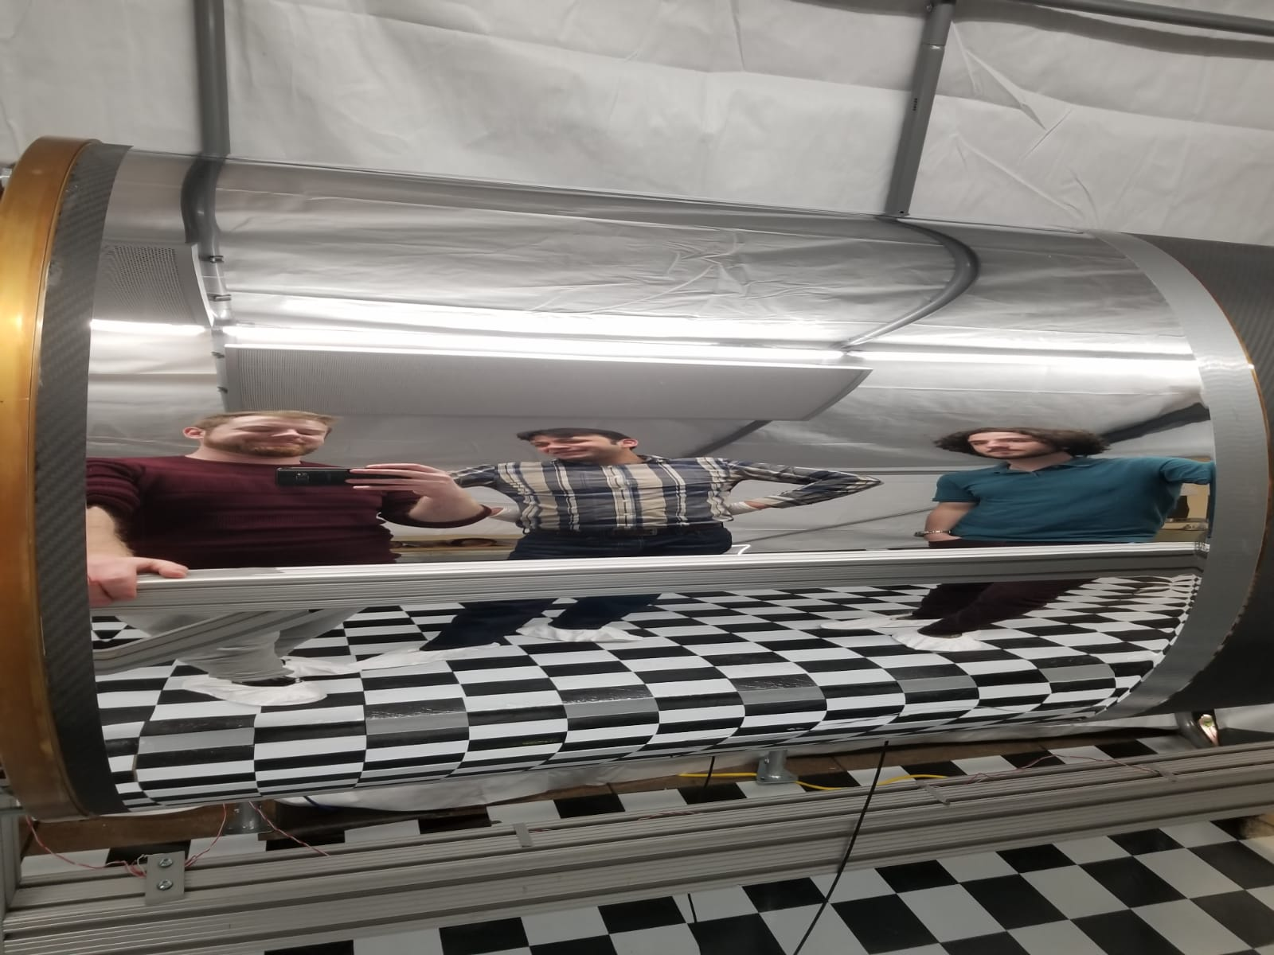
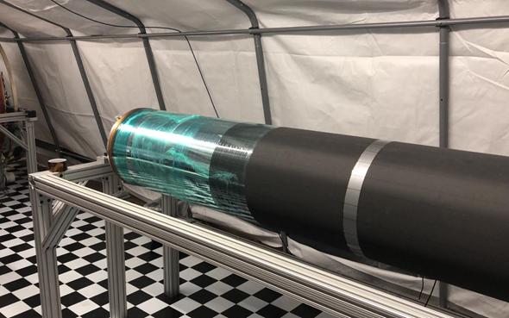
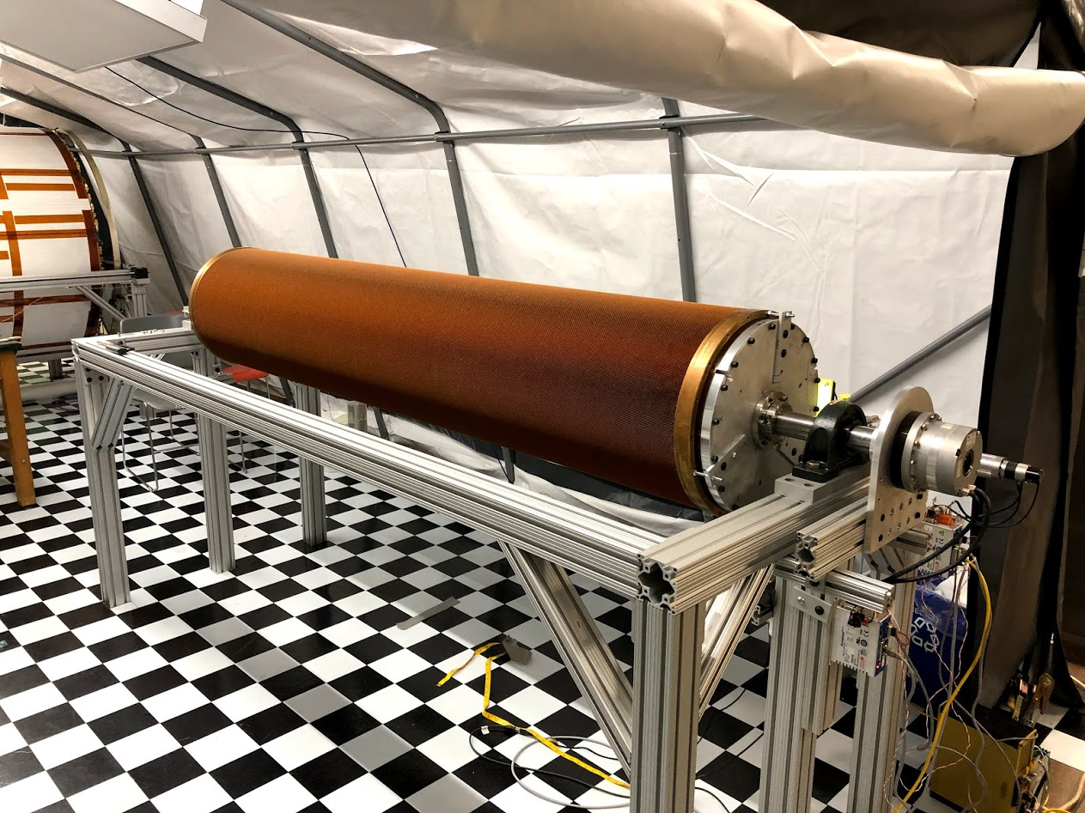
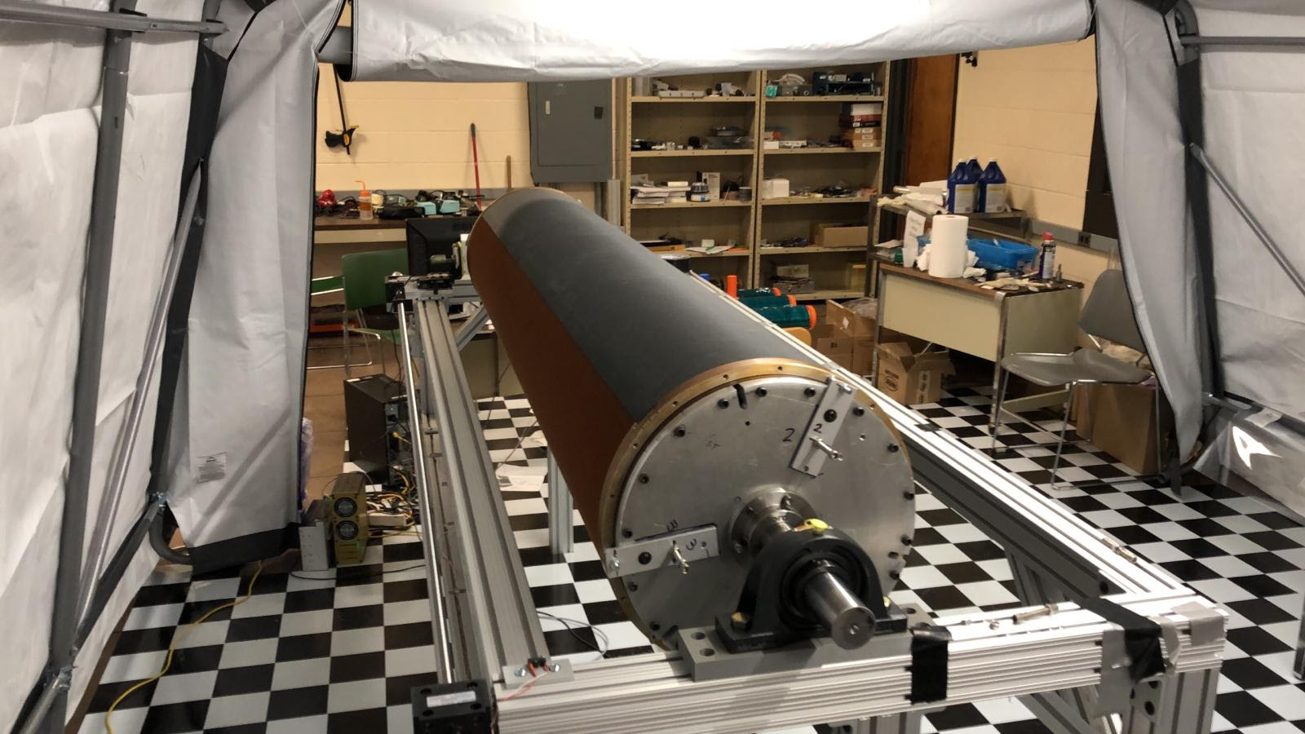
Status and Highlights

Slide 16
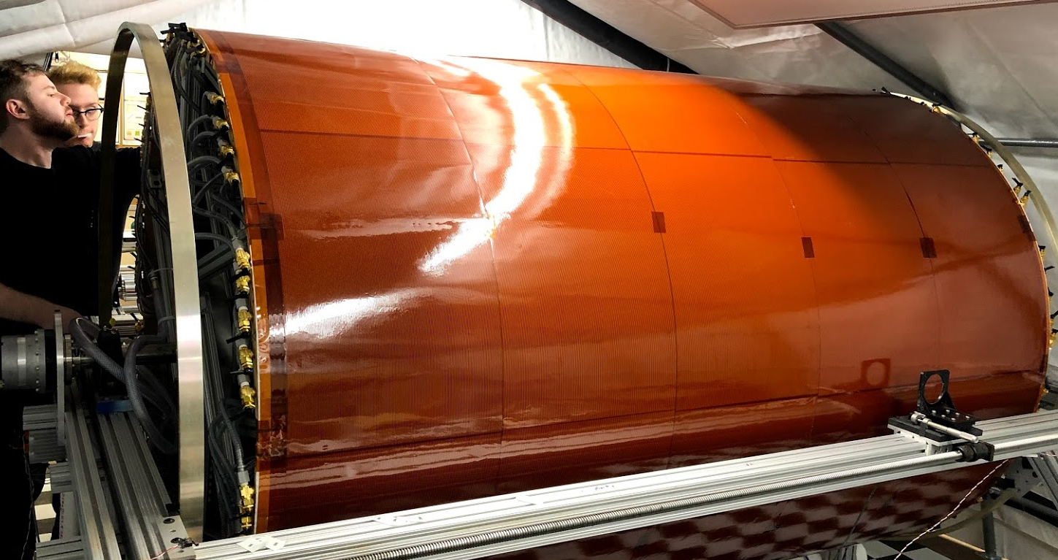
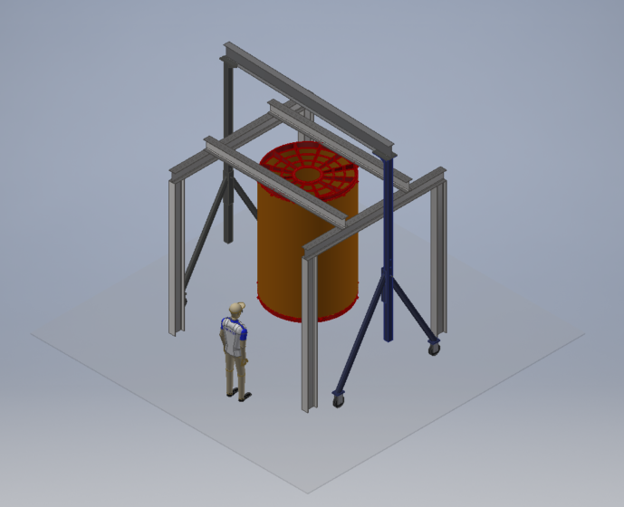
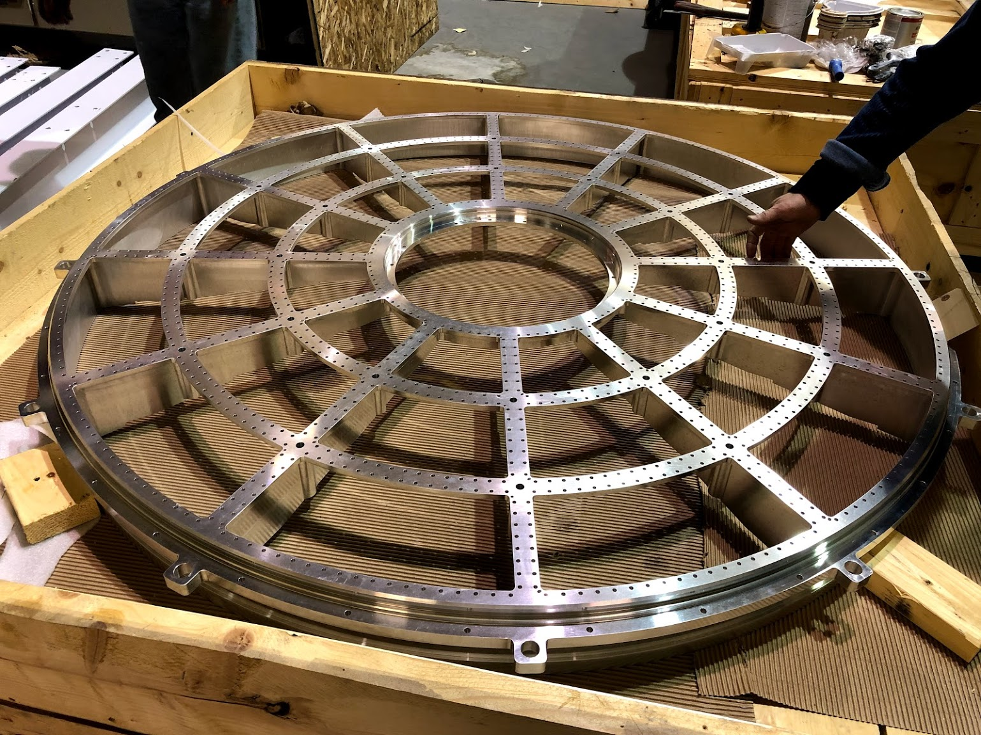
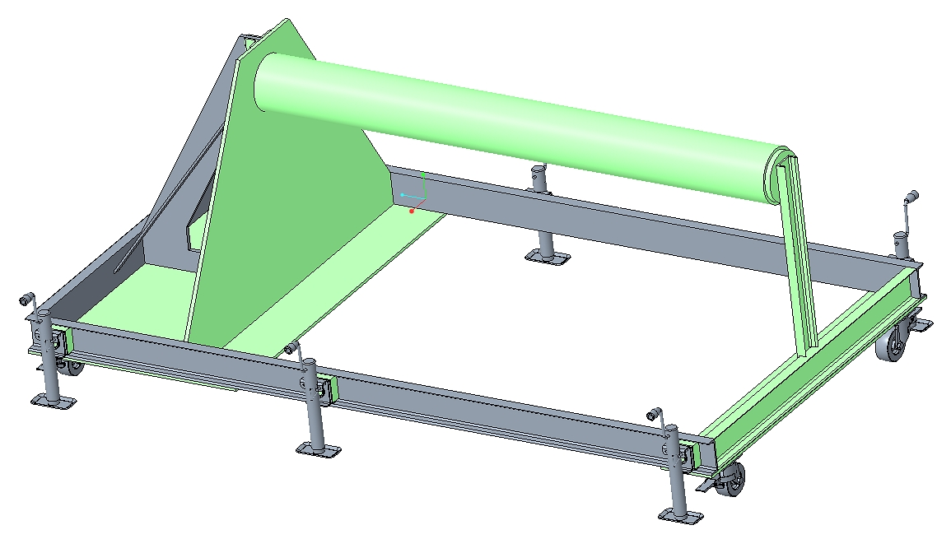
Status and Highlights

Slide 17
Issues and Concerns
GEM production exclusively at CERN
Mitigated by hiring employed technician at CERN Workshop exclusively for sPHENIX production
Big GEM production projects (ALICE TPC, CMS Forward Muon Detectors) have been completed in 2018 → No interference with sPHENIX TPC GEM production

Slide 18
Activities Over the Next Few Months
QA of field cage + end plates
Final R&D efforts on GEM modules
Test beam campaign with TPC v2a GEM Module prototype at Fermilab FTBF
Establishing and testing QA procedure for GEM modules
Start of TPC Production GEM Acquisition

Slide 19
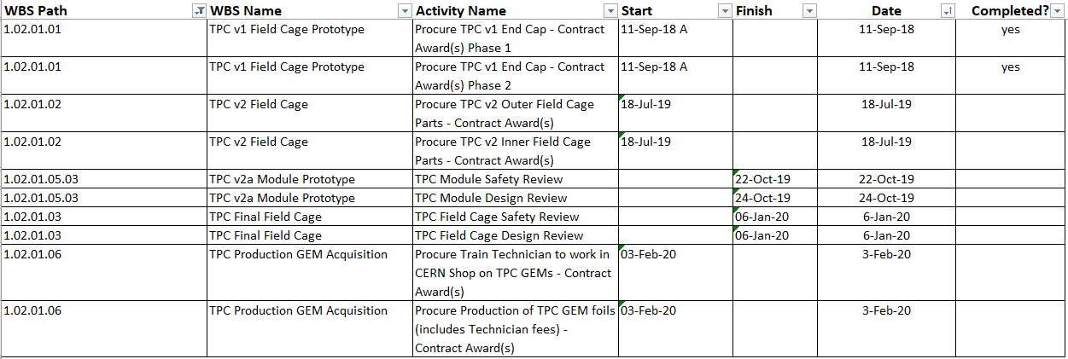
Milestones

Slide 20
Summary
TPC-Mechanics well understood
Design benefitted from previous/present TPC designs (STAR/ILC/ALICE)
TPC-Mechanics well on design and schedule
TPC-Mechanics will meet all performance goals for sPHENIX
TPC-Mechanics ready for PD2/3 approval

