Slide 1
sPHENIX Director’s Review
TPC Laser Calibration System
Bob Azmoun, BNL
April 10, 2019
BNL

Slide 2
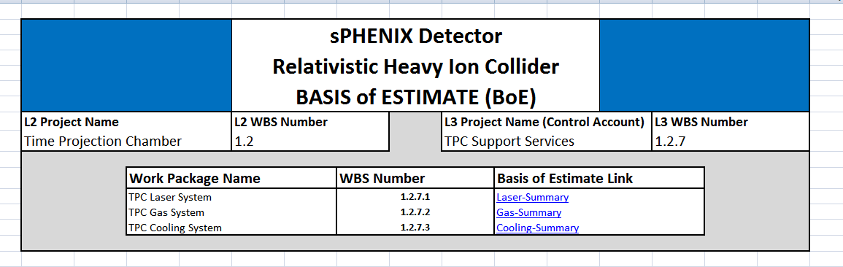
1.02.07.01 Scope
From the WBS Definitions
1.2.7 TPC Support Systems TECHNICAL SCOPE: CONTAINS ALL TASKS WHICH ARE REQUIRED TO PROVIDE NECESSARY SUPPORT SYSTEMS FOR THE TPC: LASER, GAS, COOLING SYSTEM. WORK STATEMENT: PROVIDE ALL PARTS TO SUPPORT TPC OPERATION.
  1.2.7.1 TPC Laser System
    TECHNICAL SCOPE: THIS ITEM CONTAINS ALL TASKS WHICH ARE REQUIRED TO IDENTITY COMPONENTS FOR THE TPC LASER CALIBRATION SYSTEM AND PROCURE AND CONSTRUCT THE ELEMENTS OF THE SYSTEM.
    WORK STATEMENT: PROVIDE ALL PARTS TO PRODUCE THE LASER CALIBRATION SYSTEM AND ASSEMBLE/INSTALL ALL PARTS.
  1.2.7.2 TPC Gas System TECHNICAL SCOPE: THIS ITEM CONTAINS ALL TASKS WHICH ARE REQUIRED TO IDENTITY COMPONENTS FOR THE TPC GAS SYSTEM AND PROCURE AND CONSTRUCT THE ELEMENTS OF THE SYSTEM. WORK STATEMENT: PROVIDE ALL PARTS TO PRODUCE THE GAS SYSTEM AND ASSEMBLE/INSTALL ALL PARTS.
  1.2.7.3 TPC Cooling System TECHNICAL SCOPE: THIS ITEM CONTAINS ALL TASKS WHICH ARE REQUIRED TO IDENTITY COMPONENTS FOR THE TPC GAS SYSTEM AND PROCURE AND CONSTRUCT THE ELEMENTS OF THE SYSTEM. WORK STATEMENT: PROVIDE ALL PARTS TO PRODUCE THE GAS SYSTEM AND ASSEMBLE/INSTALL ALL PARTS.
A Laser System(1.2.7.1) Lasers can be used to produce ionization in the TPC volume that provides both a source of signals and a calibration. This includes pattern applied to the central membrane ( STAR) as well as direct laser transmission through the gas (STAR and ALICE). In the case of STAR and ALICE, the lasers going through the gas are directed via fibers and mirror bundles to criss-cross planes at several Z locations. The fiber bundles take radial space that both STAR and ALICE can afford. Due to the small size, sPHENIX cannot afford to have a bundle running along Z. Therefore we shall use two solutions to laser calibration. First, we will shine diffuse laser light onto the patterned central membrane. Second, we will allow for angled\trajectories of laser light emanating from between the modules traveling at various angles through the gas. While not ideal it is a better solution than losing radial space.

Slide 3
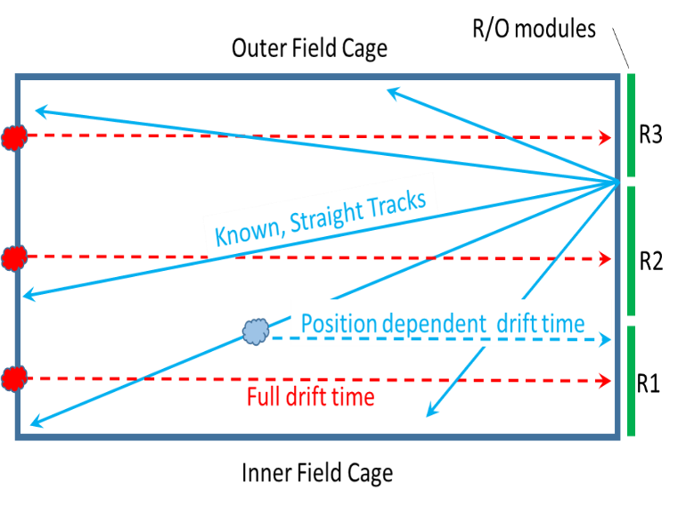
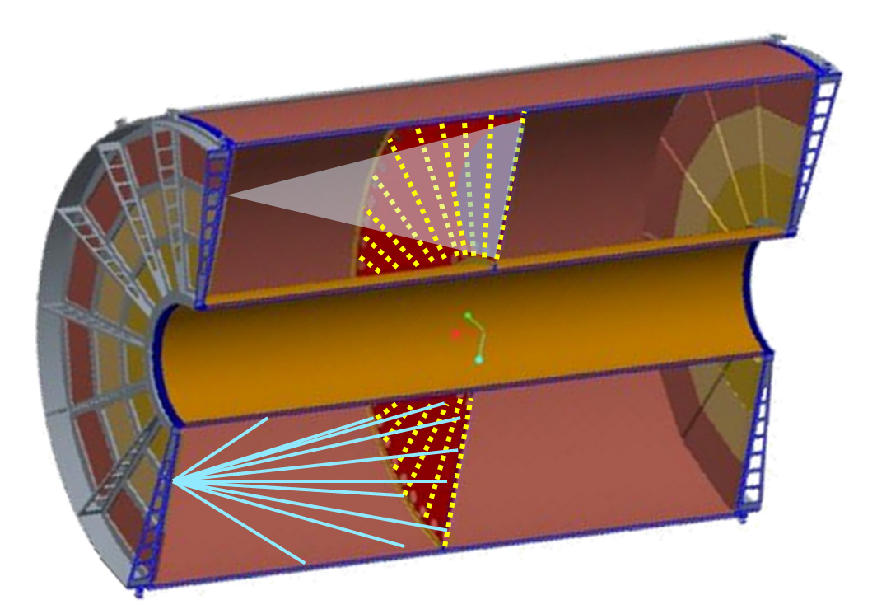
The L3 Component: 1.02.07.01
Charge liberated from the central membrane travels the full drift distance and reveals the absolute integrated drift velocity
A single sweeping laser beam allows for a continuous sampling of the drift velocity over a quadrant of the TPC volume
The integrated drift time serves as a hard constraint for the point by point determination of the drift velocity
Charge Cluster
PURPOSE: Calibration System
Determine drift velocity throughout TPC vol.
Determine electric field distortions
(due to space charge)
Determine precise alignment of field cage w.r.t. endcap and magnetic field
(ExB corrections)
Central Membrane
STRATEGY
Shine diffuse laser light onto central membrane to liberate clusters of charge
Shoot laser beams into TPC volume to mimic particle tracks
Compare straight tracks (w/o beam) to distorted tracks (w/ beam)
Diffuse laser light
Pattern of Al dots (low work function →release of e-’s)
Laser beam tracks ~MIPs

Slide 4
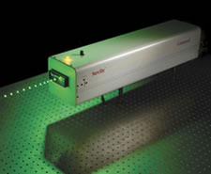
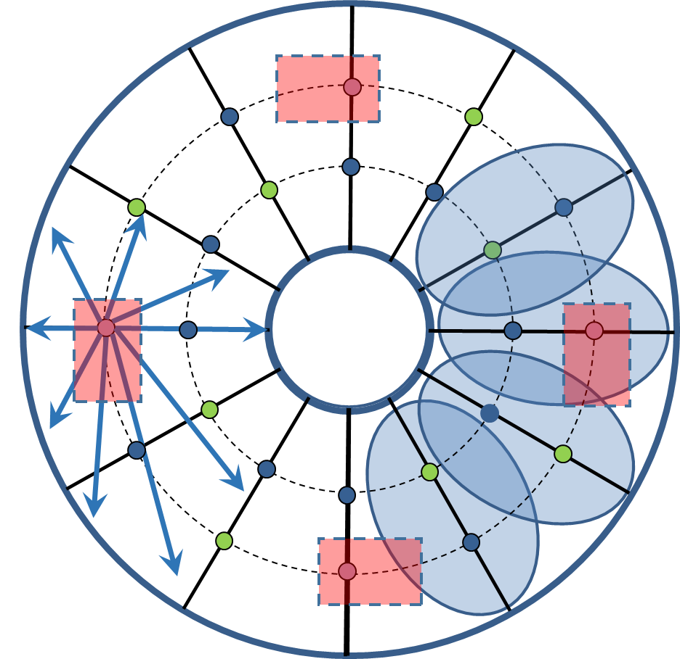
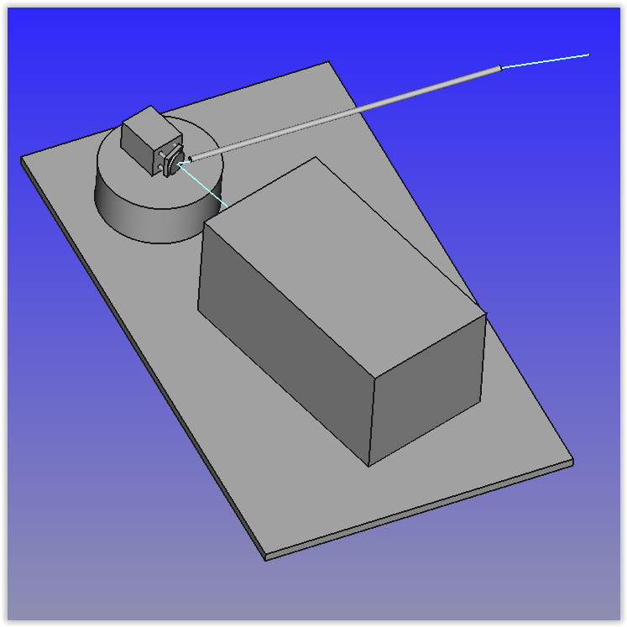
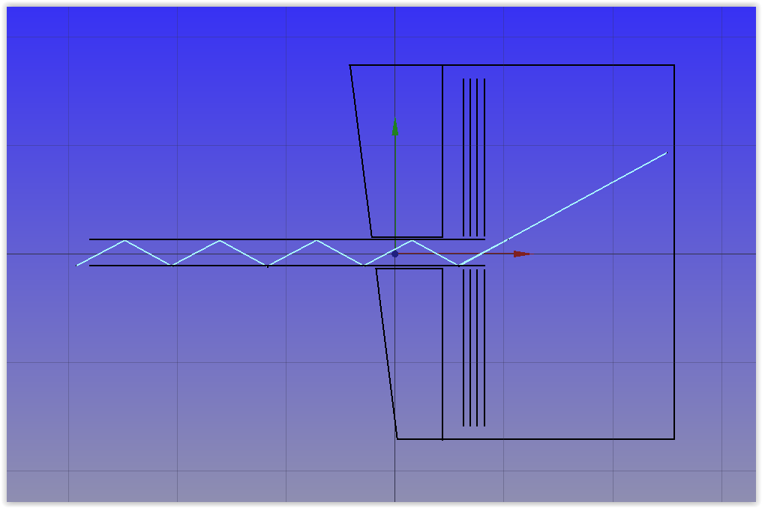
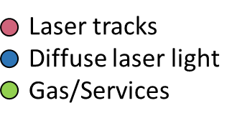
1.02.07.01 Technical Overview
266nm light coupled to fused silica fiber with large N.A.
Layout of TPC Wagon Wheel entrance ports
Two rings of 12 ¼” NPT Feedthrough’s
Optical bench supported by wagon wheel
Laser
Tracks
Diffuse Light
at membrane
Placed in rack:
High energy laser (60mJ, 4ns) + beam splitter
Optical bench
Piezo-actuated mirror
Wagon Wheel NPT port
TPC Vol.
θ_{i}
θ_{α}
Compact DPSS UV laser (200uJ, <2ns pulse )
GEMs
Wide aperture
rigid core silica fiber
Rigid waveguide delivers laser beam at controlled angles into TPC volume
Micro-actuated mirror allows a single laser beam to sweep an entire quadrant of the TPC volume

Slide 5


L3 Collaborators
Brookhaven staff
2 Scientists
3 Research Associates
2 Design Engineers
2 Technical staff
Stony Brook Staff
2 Faculty
2 Postdocs
Several grad. students
Undergrad. students

Slide 6
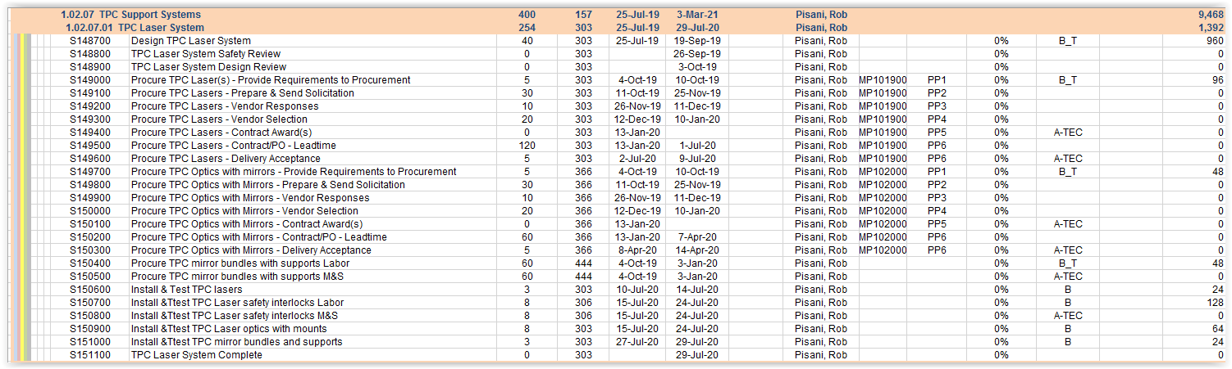
1.02.07.01 Schedule Drivers
The schedule for the TPC Laser System will be driven by
  S139300 Procure TPC Lasers - Contract/PO - Leadtime 120 days, from 13-Jan-2020 to 1-Jul-2020
Laser system milestones
  Design Fall 2019
  Safety & Design Review November 2019
  Procurement Assembly of system Winter 2019/2020
  Assembly of system Spring 2020
  System Complete July 2020
https://docdb.sphenix.bnl.gov/0001/000112/036/180423%20P6%20sPHENIX.xlsx

Slide 7
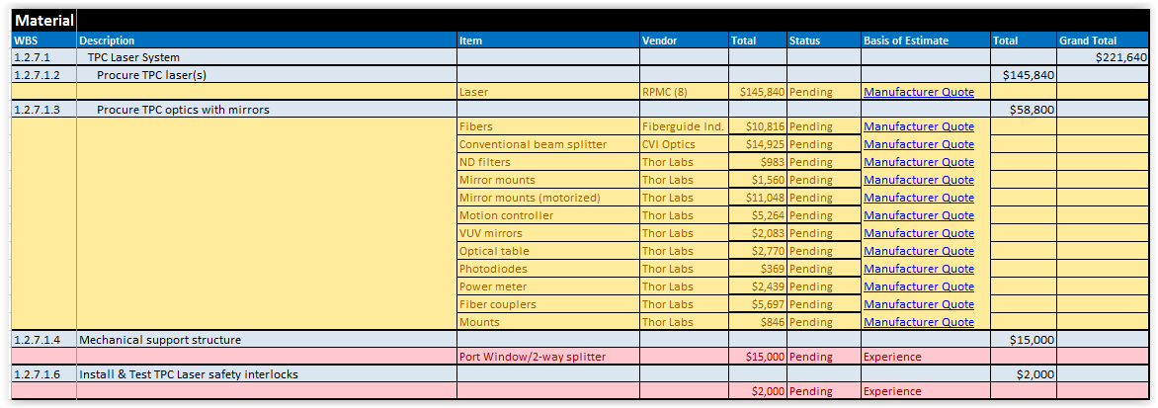
1.02.07.01 Cost Drivers
Cost Drivers:
Procure Lasers: $146K
Procure necessary beam optics: $59K
TPC Laser Components and Hardware
Table below is updated from docdb
The full material cost of the laser system is $222k
From BoE
Labor Hours:
1392
https://docdb.sphenix.bnl.gov/0001/000112/036/180423%20P6%20sPHENIX.xlsx
We have costed the laser system to include both membrane illumination and laser beam tracks so as to capture the highest estimate.

Slide 8
1.02.07.01 Issues and Concerns
Prototyping of the optical apparatus to illuminate the central membrane effectively
Prototyping of the optical system to deliver a laser beam at specific angles into the TPC volume
Operability/performance of laser in strong magnetic field
Long term operability/performance of laser in a high radiation environment
Space constraints for optical bench at TPC endcaps
Engineering designs needed

Slide 9
Summary
Purpose: field cage alignment and measurement of drift velocity and space charge distortions
Concept: illuminate pattern on membrane to liberate charge and shoot beams into TPC volume to simulate straight tracks from MIPS
The concept is based on existing and successful TPC laser calibration systems in STAR, ALICE and the ILC TPC
We have costed the laser system to capture the highest estimate
The full cost of the laser system is $222K
The full labor cost of the laser system is 1392 man hours
We have a skilled set of people in the collaboration and department with decades of experience to bring this project to realization
The TPC Laser Calibration System is ready for PD-2/3 approval

Slide 10
Back Up

Slide 11
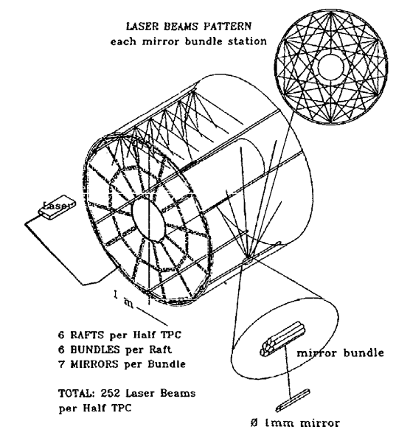
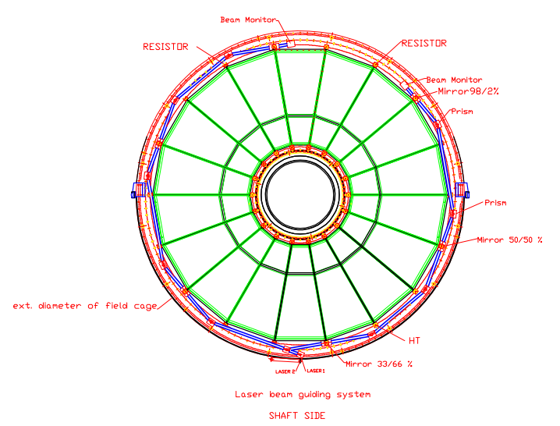
Laser Calibration Systems
STAR TPC
ALICE TPC

Slide 12
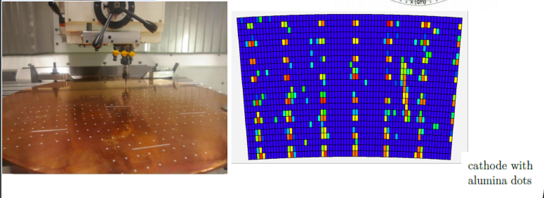
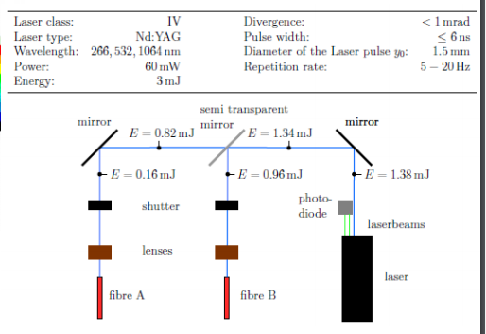
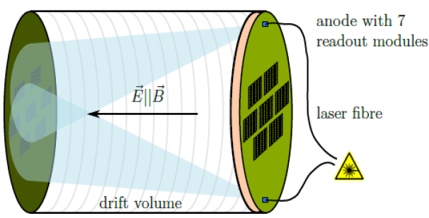
Example of Working System
ILC Prototype TPC Laser Calibration System
Array of Al dots
Reconstructed position after drift, which
integrates all distortions and misalignments
Diffuse laser light

