Slide 1
sPHENIX Director’s Review EMCal Module Production and Sector Assembly
Sean Stoll
April 9-11, 2019
BNL

Slide 2
The L3 Component
1.03.02 EMCal – Module Production and Sector Assembly
The goal of this WBS item is to assemble the EMCal blocks, optics, electronics, and cooling components into finished sectors that can then be installed into the EMCal structural framework in the experimental hall.
The Module Production and Sector Assembly work will be performed at BNL
1.03.02.01 Set Up Module Production, Sector Assembly and Test Area
1.03.02.02 EMCal Module Production
V2.1 Prototype  Preproduction Phase (1+12 sectors)  Final Production (52 sectors)
1.03.02.03 EMCal Sector Assembly
V2.1 Prototype  Preproduction Phase (1+12 sectors)  Final Production (52 sectors)

Slide 3
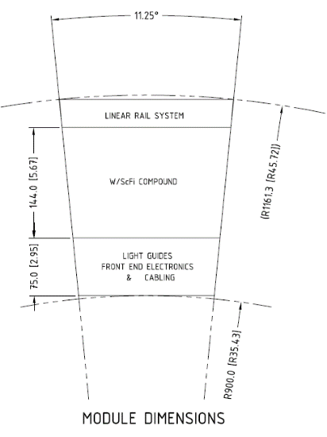
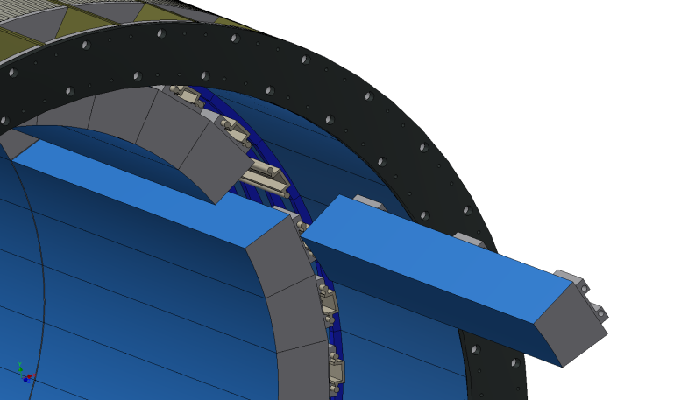
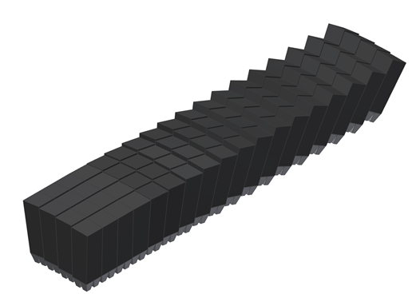
L3 Technical Overview
We have an advanced and detailed design, and are in the process of assembling our first full prototype sector.
EMCAL radial
space allocation
~14 cm absorber
(η=0)
7.5 cm
readout
2(±η) x 32 (φ) = 64 Sectors
Deliverable: 64 EMCAL Sectors
1 Full Sector = 72 Blocks
= 288 towers

Slide 4
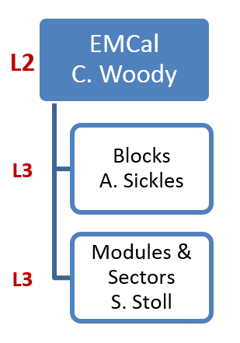
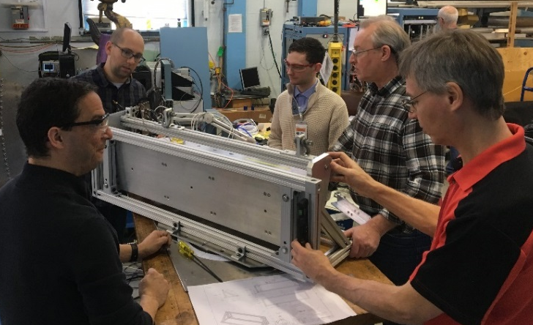
EMCal Modules and Sectors Team
L2 Manager
Craig Woody, Senior Physicist (BNL)
40+ years of detector experience (much of it with calorimetry)
L3 Managers
Caroline Riedl, Research Scientist (UIUC)
Access to large construction facilities with experienced staff in
building large detectors
Sean Stoll, Physics Associate (BNL)
25+ years in building and operating detectors
(including the PHENIX EMCAL)
C. Riedl
BNL scientists and engineer with V2.1 prototype at
FermiLab for beam test.
BNL Team
Physicists: Craig Woody, Jin Huang, John Haggerty, Martin Purschke
Chief Engineer: Russell Feder
Mechanical Technicians: Bill Lenz, Mike Lenz
Engineers & Designers: Rich Ruggiero, Dan Cacace, Chris Pontieri
Physics Associates: Sean Stoll, Rob Pisani
Electrical Engineer and Technician: Steve Boose, Sal Polizzo
Technicians and engineers with V2.1 prototype

Slide 5
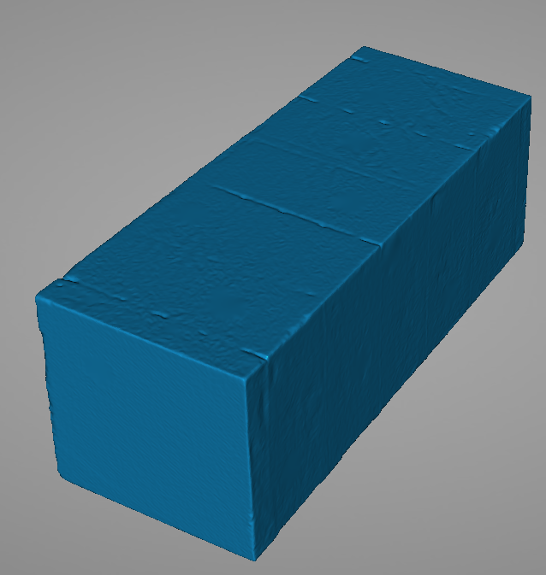
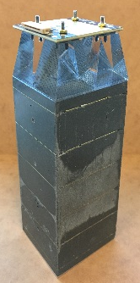
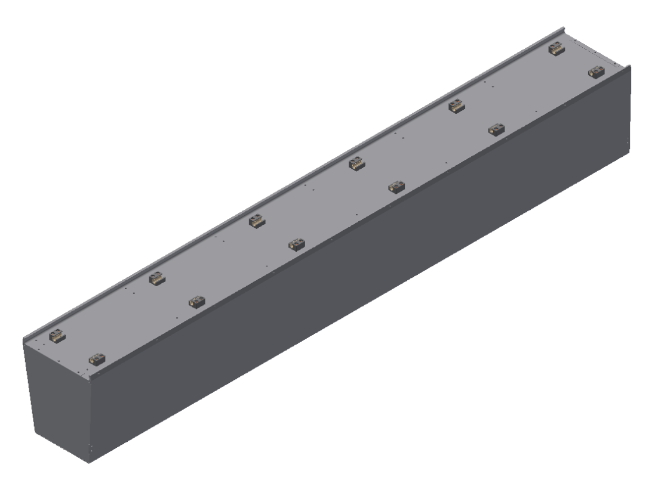
L3 Scope – Production Steps and Deliverables
Material
inputs
create
Fiber-screen
assemblies
Labor
tasks
UIUC Block Production
scint fiber
screens
Block
casting
dimensional
machining
end-cut
machining
QC
testing
Deliverable:
block
(4896)
mold parts
fixtures
set up
W powder
epoxy
BNL Module Production
light guides
end reflectors
pcbs w/sipms
Deliverable: module
(4896)
block
gluing jigs & fixtures
glue on
light guides &
end reflectors
attach pcb
w/ sipms
Sector Assembly
Preamps and
Interface pcb
cooling
cabling
Mechanically
Mount and Align
Sector box
Install electronics
Cabling, cooling
testing
Deliverable: sector
(64)

Slide 6
Schedule Drivers
1.03.02 consists of a series of assembly steps, and so relies on:
Having all of the components available when needed
Maintaining steady production/assembly rates - Our average production rate is 1 assembled sector every 6 days
Main Schedule Drivers:
Production of absorber blocks at UIUC and receipt of blocks at BNL
Production of Electronics at BNL – receipt of assembled SiPM daughterboards (Critical Path)
Obtaining components such as light guides, cooling assemblies, mechanical parts – Getting PO’s out on schedule
Maintaining module production and sector assembly production schedules

Complete
Complete
In progress…

Completion of V2.1 Prototype | 9/28/2018
Procure Light Guides for Sectors 1-12 – Contract Award | 3/5/2019
Completion of Sector 0 Prototype | 8/20/2019
Procure Mechanical and Cooling Parts for Sectors 1-12 | 9/13/2019
Procure Light Guides for Sectors 13-64 | 3/4/2020
Completion of Preproduction Sectors | 7/16/2020
Completion of All Sectors | 10/13/2021
Ready to Install EMCal Sectors Into sPHENIX | 10/15/2021
Key Milestones:

Slide 7
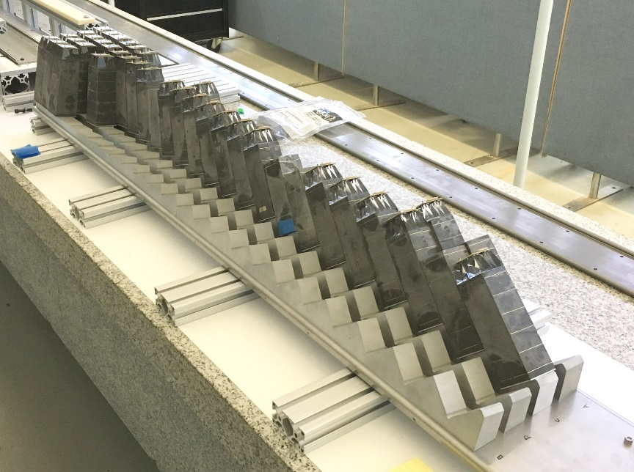
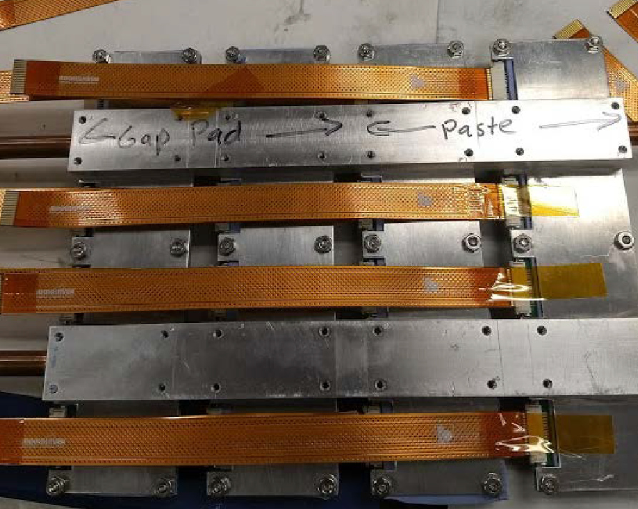
Cost Drivers
Total material costs $860k
Labor is BNL Contributed
Mechanical support and enclosure $390k
Box parts, block mounting, rails, rail blocks, reflective end-plates
Acrylic Light Guides - $292k
mold + production run, processing
Cooling System (internal to sectors) $90k for 64 sectors
Light Guides
Cooling plates

Slide 8
More Schedule and Costs
1.03.02 Consists mainly of assembly processes and is dominated by labor costs
Labor Estimates are based on experience with the production of our prototypes, and prior experience working on similar projects.
The module production steps are well understood. Production will involve scaling up the procedures and adding parallel production lines.
For the sector assembly, we have had experience assembling prototypes, but the final sectors are more complicated given the greater number of blocks, connections, cabling, and cooling. We are learning from the Sector 0 prototype about any challenges introduced as processes are scaled up.
Estimates for fixed-cost items such as light guides are based on manufacturer’s quotes. We have ordered light guides for sectors 1-12 with an option to buy additional parts for sectors 13-64.
Estimates for mechanical support and enclosures are based on manufacturer’s quotations and engineer’s estimates for designing and producing custom parts. We are evaluating the performance of mechanical parts purchased for Sector 0 before proceeding with the subsequent orders.

Slide 9
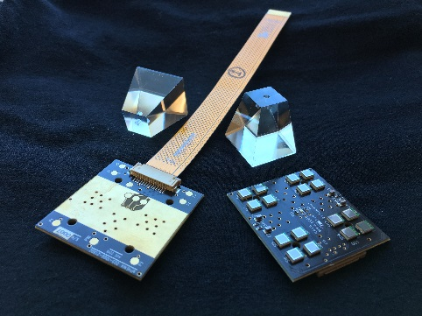
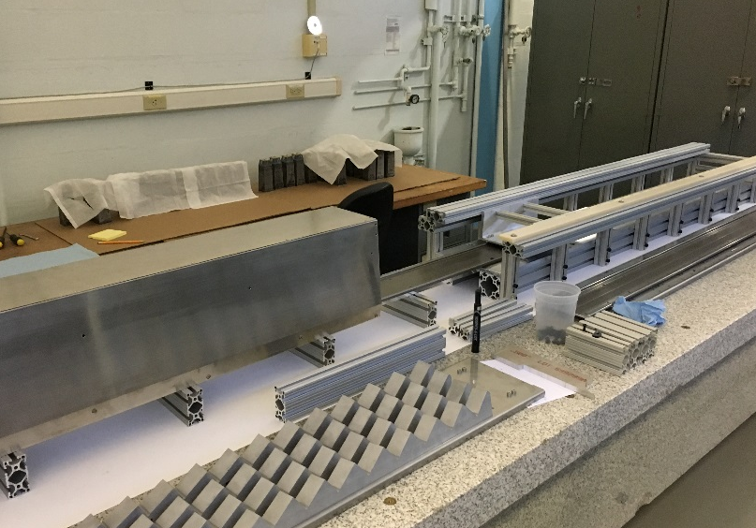
Status and Highlights
We refitted the V2.1 prototype with updated electronics and cooling for an SiPM/system radiation damage study
We have set up our sector assembly area in the Physics Hi-bay. We have been producing and calibrating fixtures for epoxying sectors, and test-fitting blocks.
We have been testing blocks and SiPM pcbs, and we plan to assemble Sector 0 during April.
We have made major procurements of light guides and will verify mechanical parts vendors with parts made for Sector 0.
SiPM pcbs, light guides
Sector assembly area, Physics high-bay

Slide 10
Issues and Concerns
We are assembling and testing our first full sector prototype (Sector 0). We will need to streamline procedures and workflow to scale up for full production.
We need to develop procedures to test, certify, and calibrate production sectors and enlist student help from the collaboration to do this.
Maintaining the critical path module production and sector assembly production lines over > 1 year time periods will be challenging with little float built into the schedule. Delays could be mitigated by allowing for storage of partially assembled components and sectors.
The allocated radial space for the EMCal is very tight. We need to fit all cabling and cooling in with some safety factor to allow for any variation during production. We will test this with the Sector 0 prototype.
We need to establish procedures for shipping and receiving production quantities of blocks from UIUC to BNL.

Slide 11
Summary
We have made progress developing our engineering design and testing it through our prototypes. We are progressing from CAD designs to manufactured parts and systems. We are assembling and testing our first full sector prototype (Sector 0). This will verify the design and fit of all parts prior to full production.
We are currently streamlining procedures and organizing workflow to scale up for full production. We are training technicians to do the work and also benefiting from the experience that they bring.
EMCal Module Production and Sector Assembly is ready for PD-2/3 approval.

