Slide 1
sPHENIX Director’s Review 1.04.02 HCal Sector Mechanics
John Lajoie
April 9-11, 2019
BNL

Slide 2
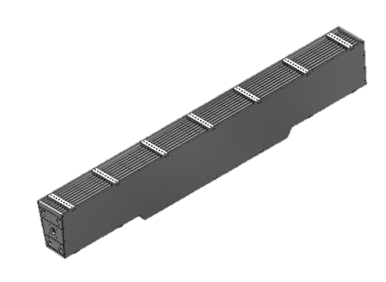
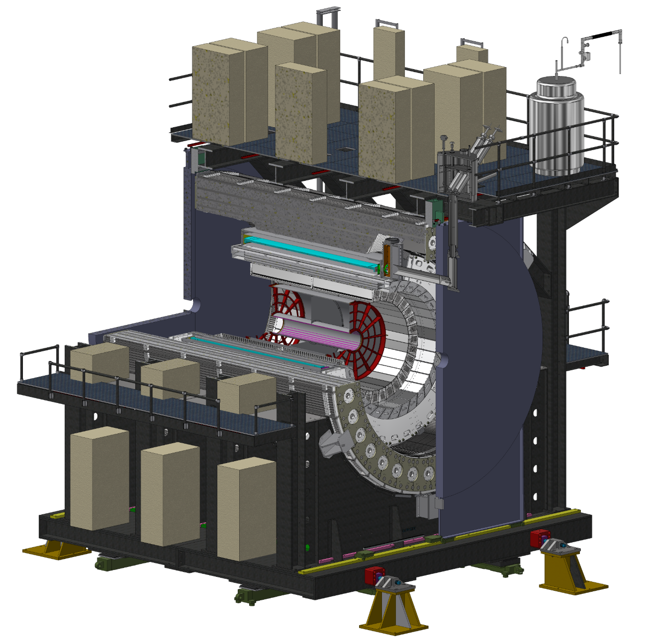
Outer Hadronic Calorimeter
32 Sector Assemblies
20’ long
15 Tons
1020 steel
Barrel Steel from WBS 2.03.03 will be populated with electronics and scintillating tile and then transported to bldg. 1008 where they will be installed around the sPHENIX magnet.
WBS 1.04.02 HCal Sector Mechanics includes lifting fixtures and splice plates, together with 2.03.03 they enable the construction and assembly of the entire outer HCAL.

Slide 3
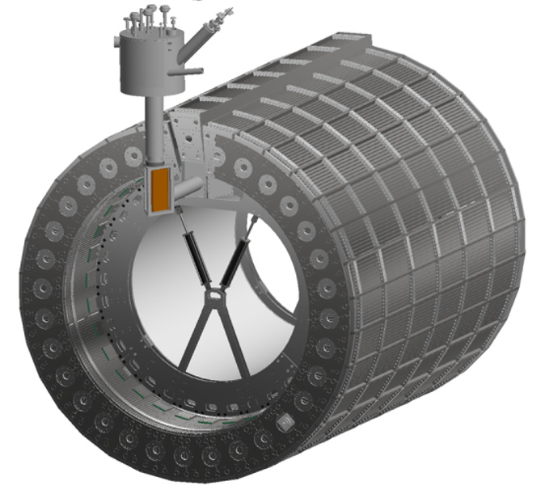
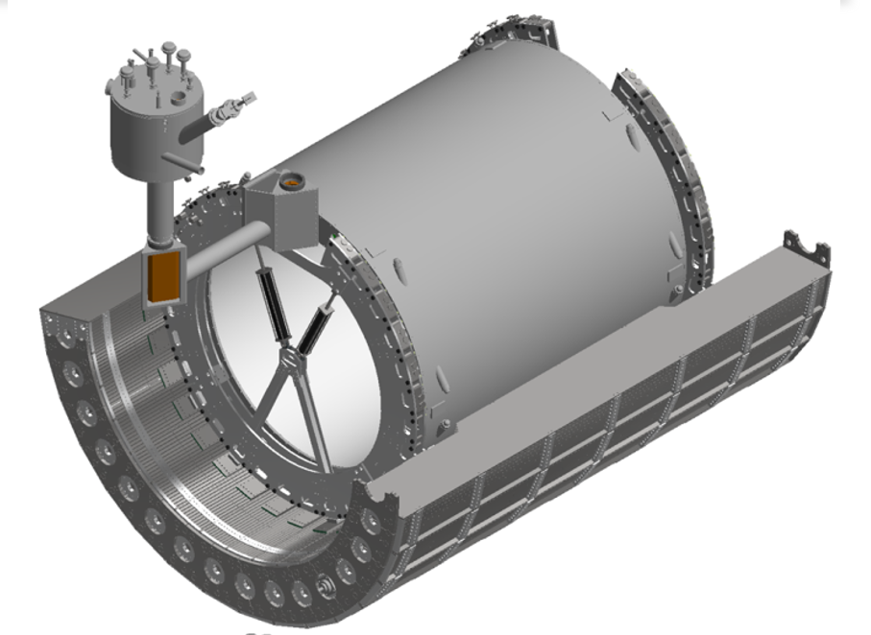
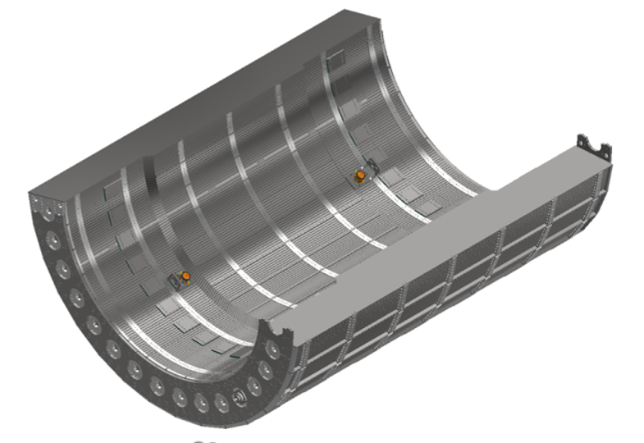
1.04.02 HCal Sector Mechanics
O-HCal will consist of 32 sectors that will be assembled around the sPHENIX magnet
The carriage cradle will support the lower 15 sectors, this will occur through bolted connections from the cradle into the sector combs
After the sPHENIX magnet and Inner Detector Structural Supports are in place, the remaining 17 sectors will be installed

Slide 4
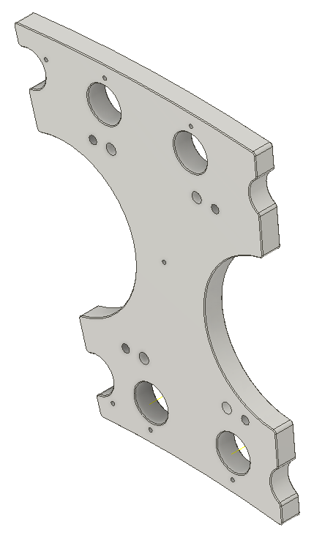
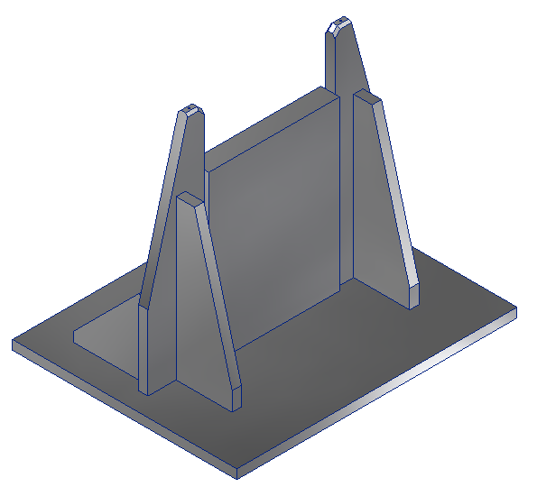
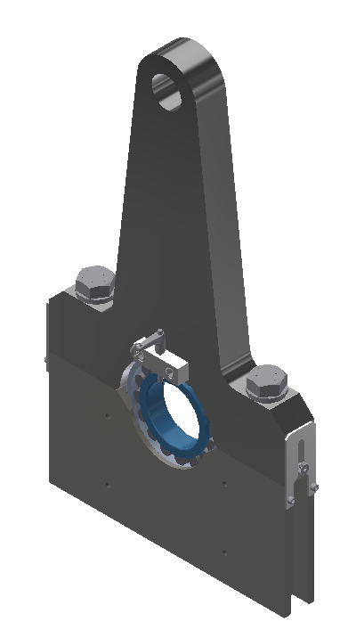
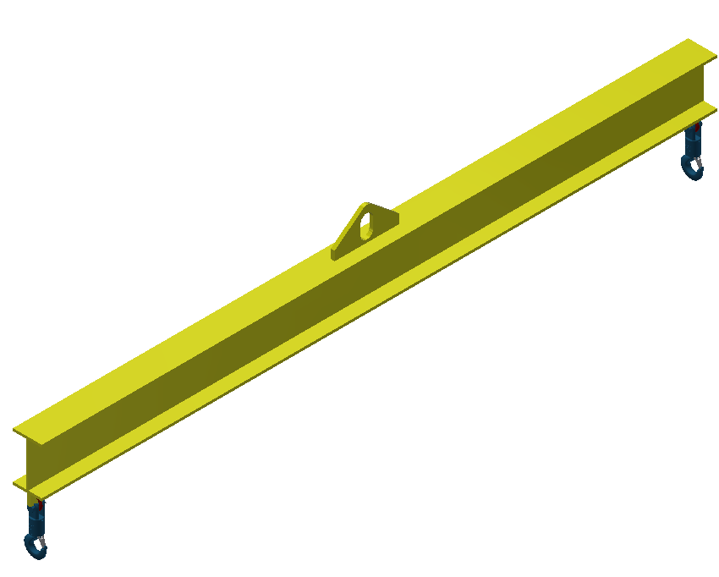
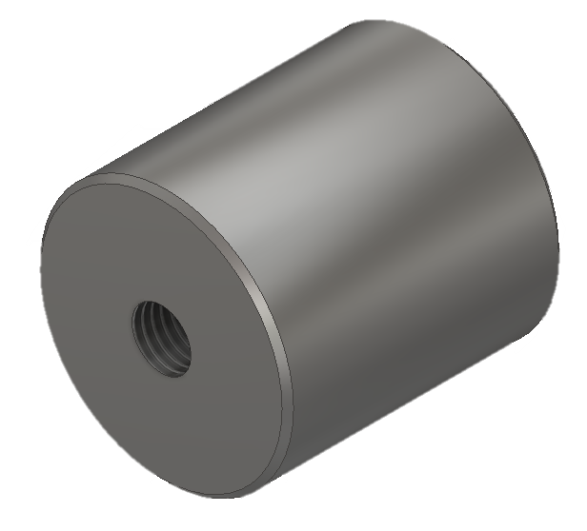
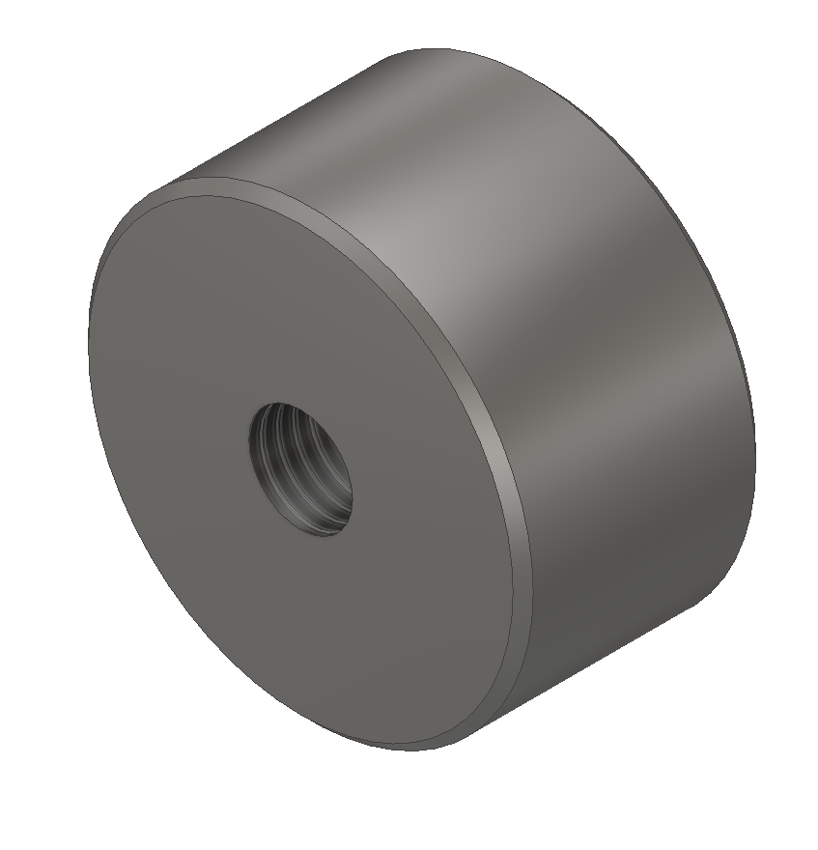
1.04.02 HCal Sector Mechanics
WBS 1.04.02 Sector Mechanics provides the following for this installation process
Splice plates
Pins and bolts will be the main connection from sector to sector
Pucks will be used to maintain a nominal gap of 2mm in between sectors at endplates
Rotation Fixture
Sectors will be rotated in support stands and pinned into nominal installation angles
Lifting Fixture
Will be utilized to pin sector into nominal installation angle
Take sector from support stands to installation area
Rotation Fixtures
Pins
Splice Plates
Spreader Beam
Support Stands
Pucks

Slide 5
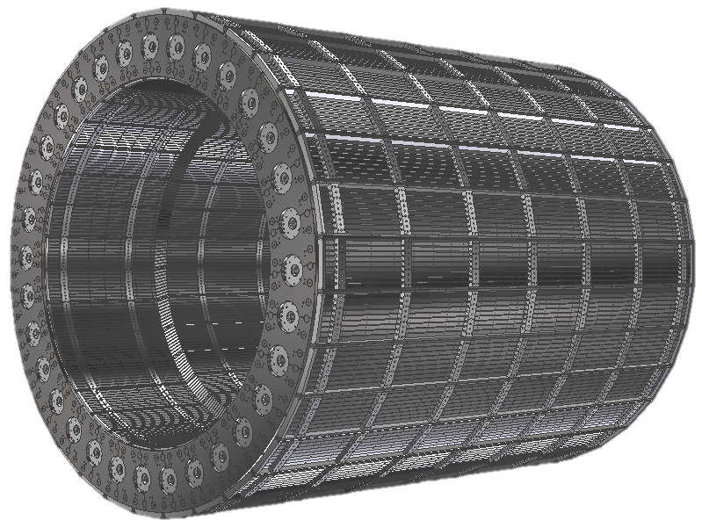
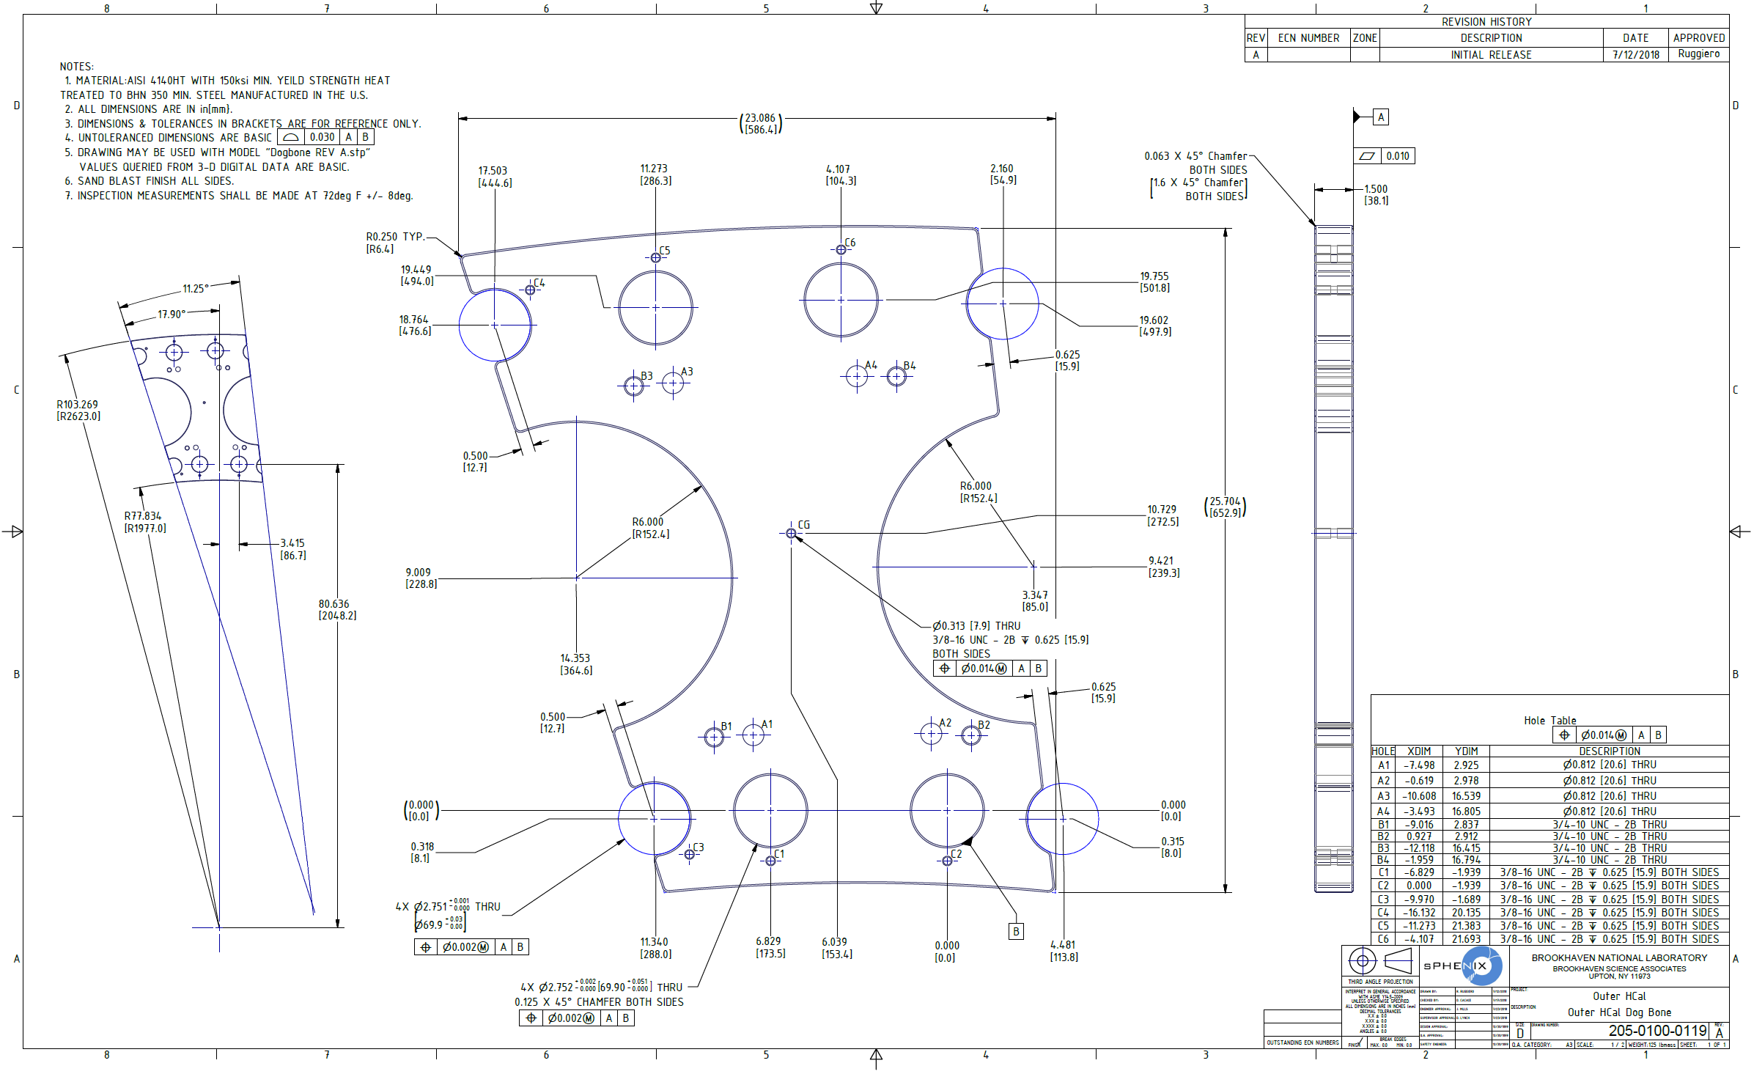
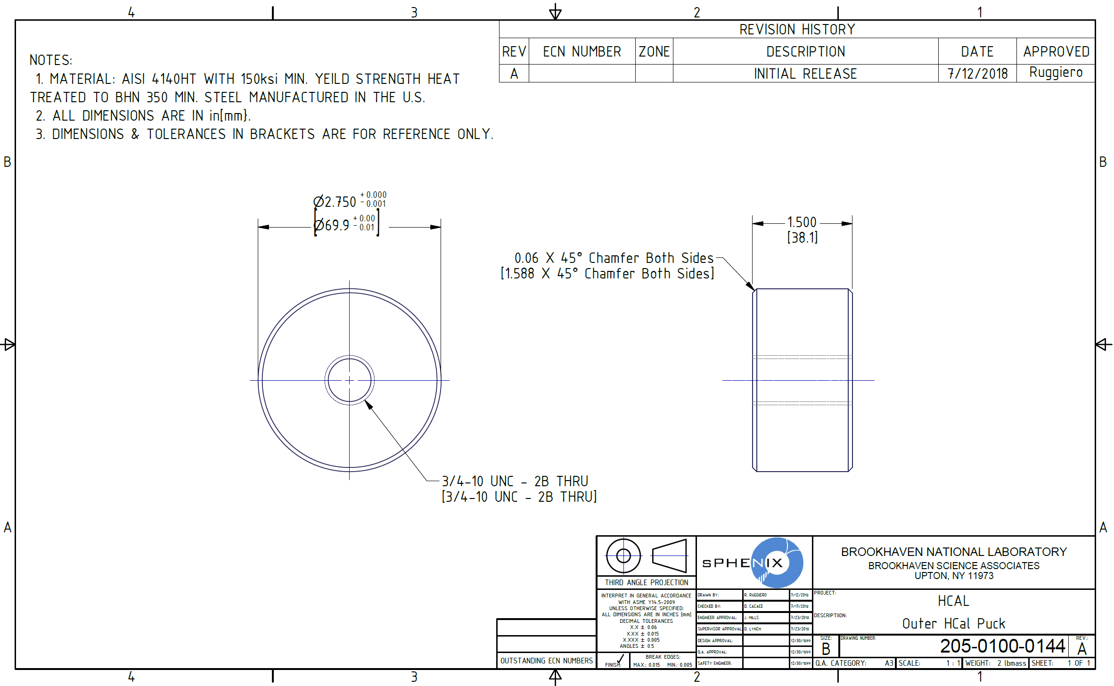
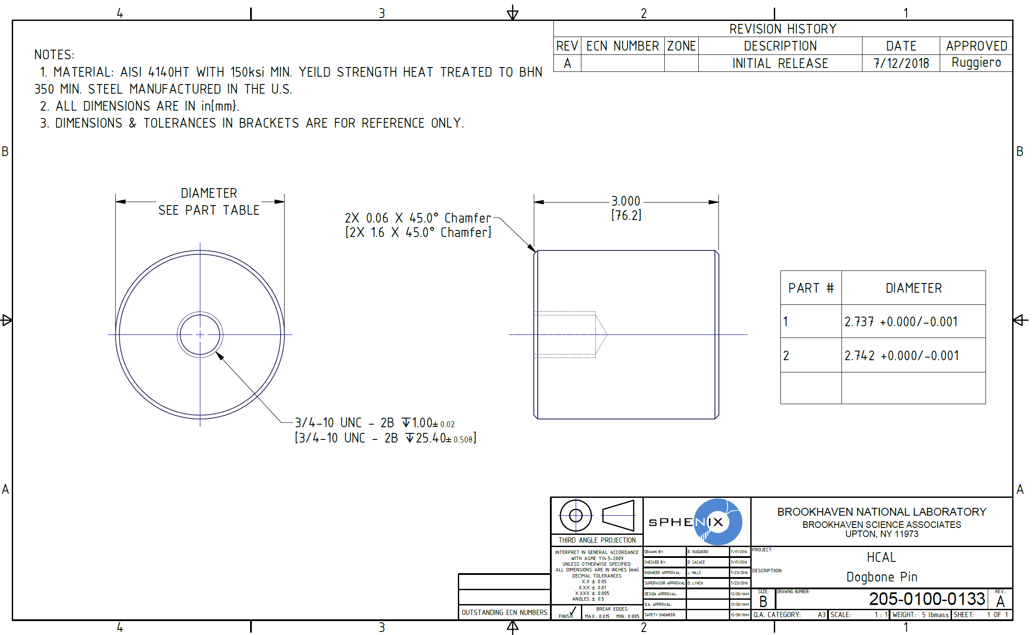
Scope
Engineer, analyze, design and procure a splice plate along with associated parts that will aid in the support of the Barrel Flux Return Steel individual sectors.
Deliverables
Splice Plates
64 Splice Plates (32 North, 32 South)
246 Pins
128 Pucks

Slide 6
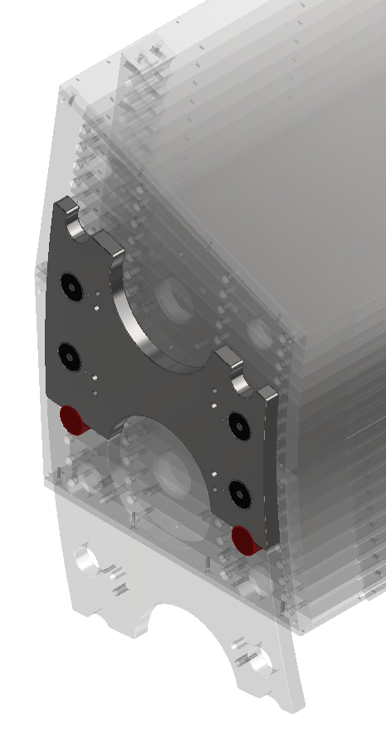
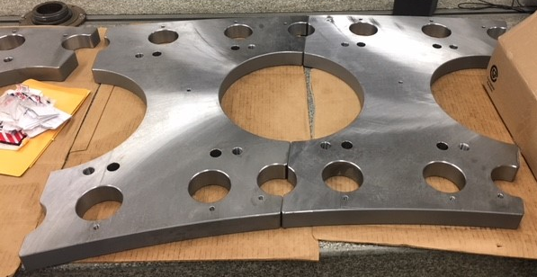
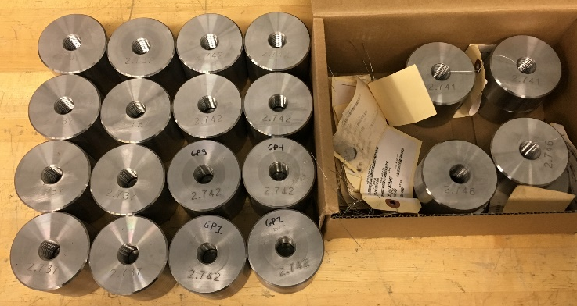
Preproduction M&S
4 Preproduction Splice Plates
Made to production level specifications (material, tolerances)
Pins
Pins/Pucks
Made to production level specifications (material, tolerances)
2 sizes made to perform fit up tests
Pucks

Slide 7
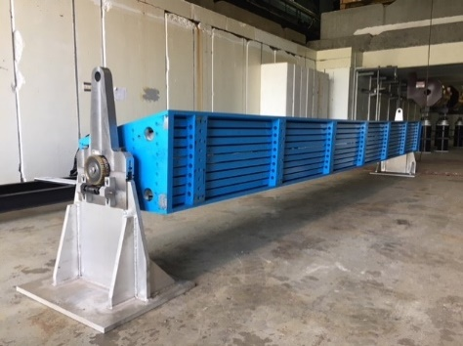
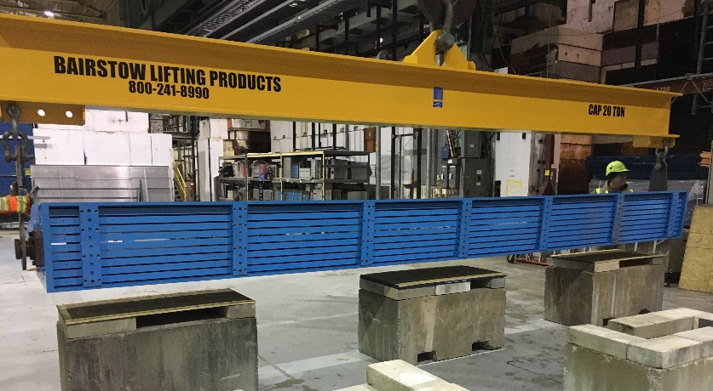
Scope
Engineer and design a lifting fixture that will be utilized to rotate each sector to its nominal installation position.
Engineer and design a set of supports that will hold each sector during the rotation process.
Deliverables
Lifting Fixtures
Spreader Beams
Fixtures that permits rotating
Sector Stands

Slide 8
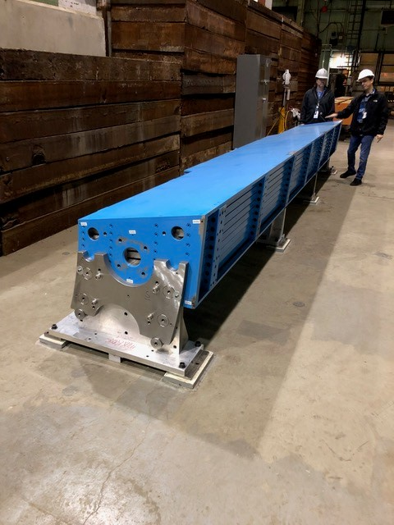
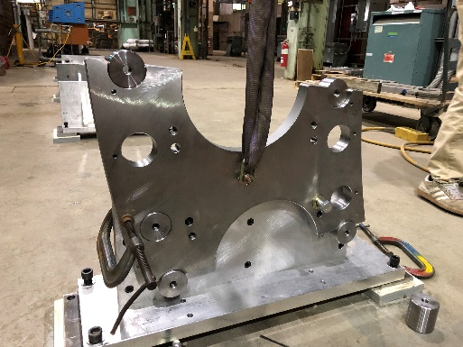
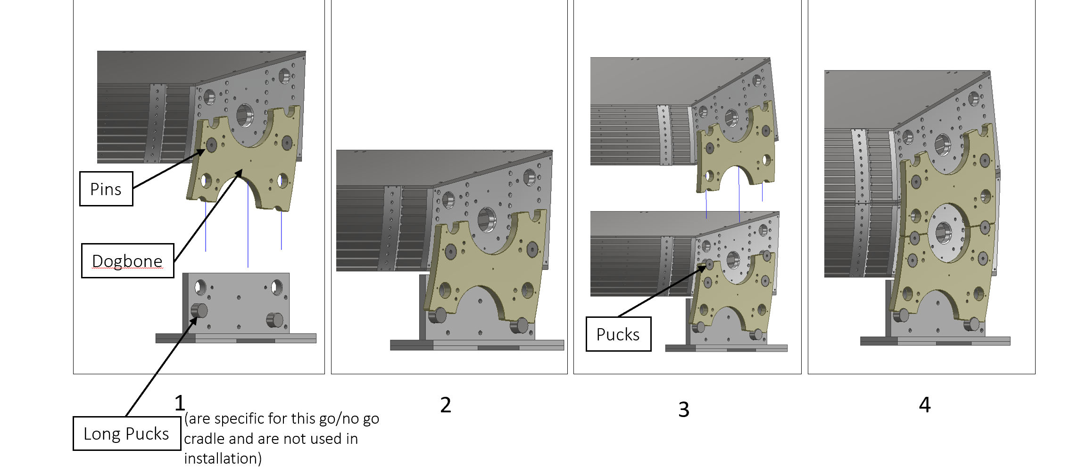
Technical Overview
Splice Plates
Testing of Preproduction splice plates began 3/29/2019
Confirming tolerances levels(plates, pins, pucks)
Continuing to develop installation and assembly plan
Lifting Fixtures & Supports
Spreader beam has proven to be adequate
Support stands are adequate
Additional engineering is required on the rotation fixtures

Slide 9
Collaborators
Brookhaven National Laboratory
Rich Ruggiero (Design/Integration)
Dan Cacace (Engineering/Analysis)
Carter Biggs (Lead Technician)
Iowa State University
John Lajoie (Outer HCAL L2 Manager)
Georgia State University
Megan Connors(HCal Scintillating Tiles)
Baruch College
Stefan Bathe(HCal Assembly & Testing)

Slide 10
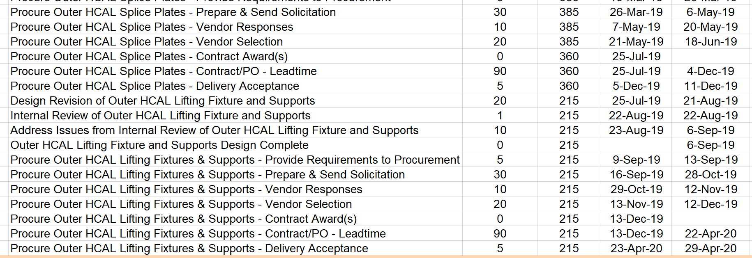
Schedule Drivers
Splice Plates
Testing sectors in assembly
Any changes to design need to go through a design review
Lead time for fabrication of splice plates
At current time we are well ahead of the critical path
Lifting Fixtures and Supports
Outer HCAL Lifting Fixture and Supports Design Complete (6-Sep-19)
Vendor fabrication time
Snapshot of RLS

Slide 11
Cost Drivers
Splice Plates
Fabrication of all parts
Preproduction PO was for 4 splice plates/16 pins/8 pucks (17k)
Price of material (4140 HT Steel)
Any changes to current design
Lifting Fixtures and Supports
Off shelf items
Fabrication of supports
Fabrication of additional rotation fixturing
Splice Plate
Pin
Puck

Slide 12
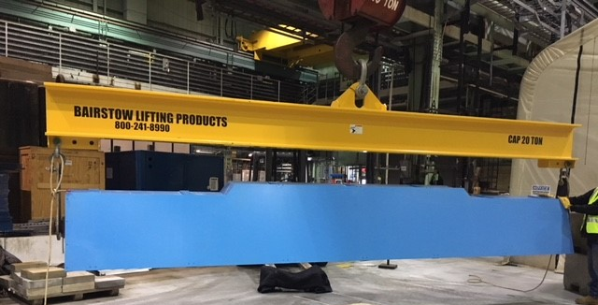
Status and Highlights
Splice Plates
Preproduction Splice Plates specifications have been achieved by vendor
Test fits to date have been successful
Lifting Fixtures and Supports
Rotation fixture requires additional engineering and design which will be resolved in the coming months

Slide 13
Milestones
Procure Outer HCAL Splice Plates - Contract Award(s)- 1-Oct-19
Installation of Barrel Steel, including splice plates is in June 2021
300+ days of float
Procure Outer HCAL Lifting Fixtures & Supports - Contract Award(s)- 13-Dec-19

Slide 14
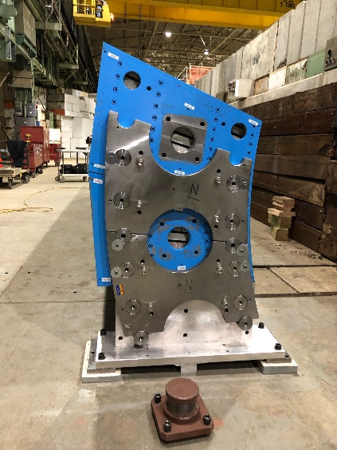
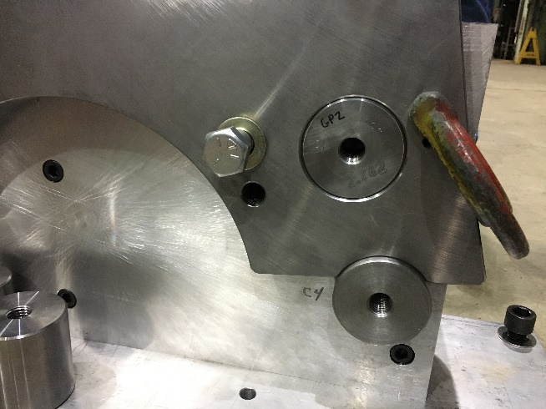
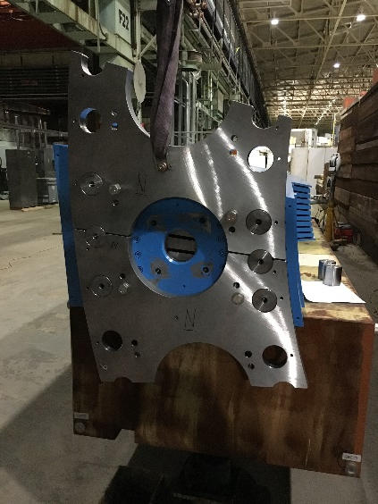
Activities over the next few months
Continue to utilize splice plates and accompanied hardware in sector to sector fit ups
Ensure that pin/puck sizes are appropriate for installation of all sectors
Continue to develop fixture to ensure a safe and effective rotation of sector

Slide 15
Issues and Concerns
Issues/Concerns
Proposed Action/Resolution
Potential increase in material cost for splice plates
Potential need to redesign rotating
fixture
Review preproduction splice plates and obtain quote as soon as possible for final production amount
Utilize as much of current fixture as possible with minimal redesign

Slide 16
Summary
Vendor was able to meet the tight tolerances on the preproduction purchases
The sPHENIX team will continue to test fit sectors to each other using these preproduction parts
We will hold additional meetings to discuss any changes that may need to be made to the splice plates
We are preparing for an internal design review in late August for any revisions of the lifting fixture and supports
We fully expect to be well within the schedule to complete the design and procurement process of this subsystem.
The HCal Sector Mechanics are ready for PD-2/3 approval

Slide 17
Back Up

Slide 18
Spreader Beam Information
Working Load Limit: 40,000lbs
Proof Test: 80,000lbs

Slide 19
Splice Plate Information

