Slide 1
sPHENIX DOE-SC CD-1/3a Review
WBS 1.04.03
HCAL Scintillating Tiles
Megan Connors
April 9-11, 2019
Brookhaven National Laboratory

Slide 2
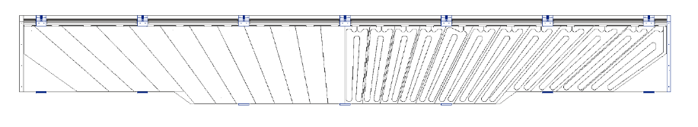
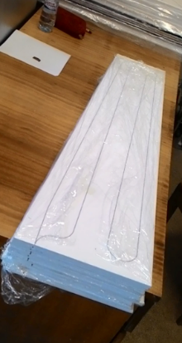
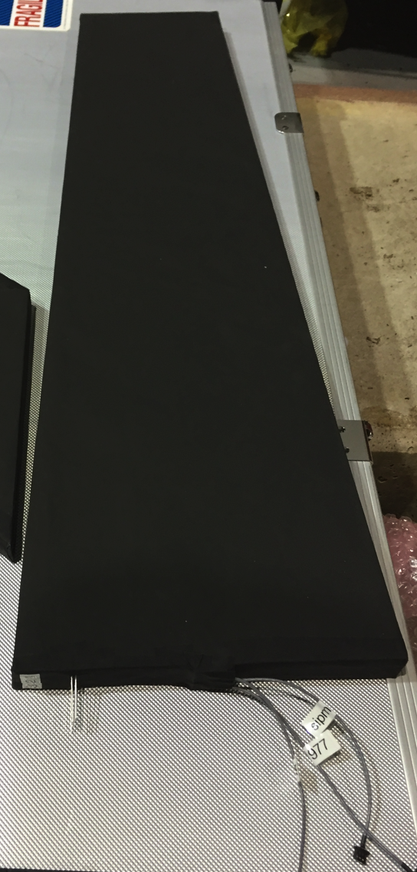
The L3 Component
Hcal Tiles (7,680):
  5 scintillators/tower
  48 towers per sector
  32 sectors
Four rounds of prototyping with Uniplast – scintillating tile design very advanced.

Slide 3
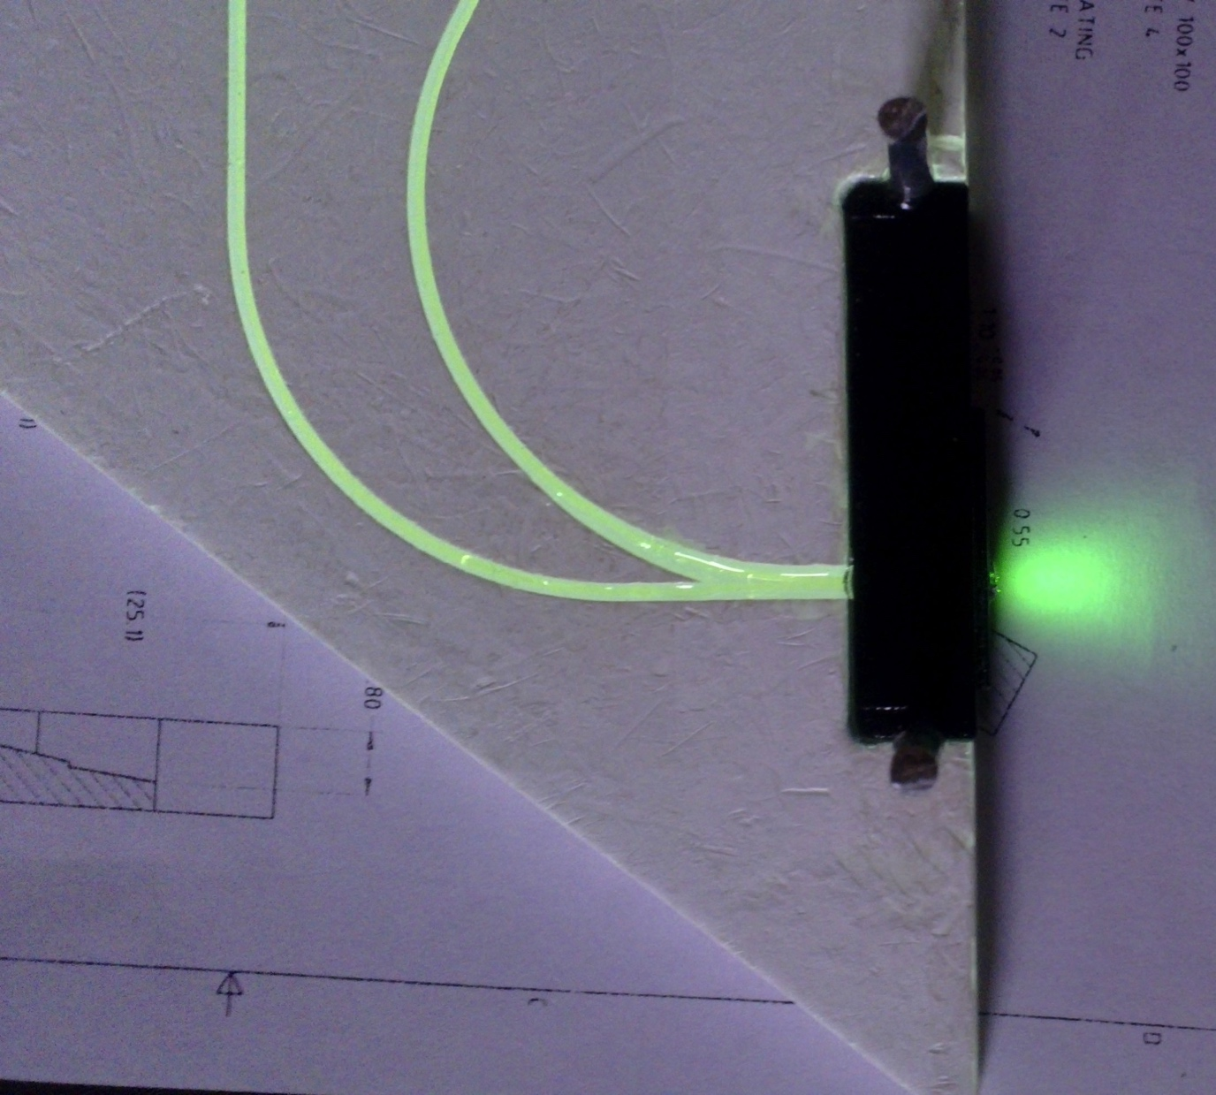
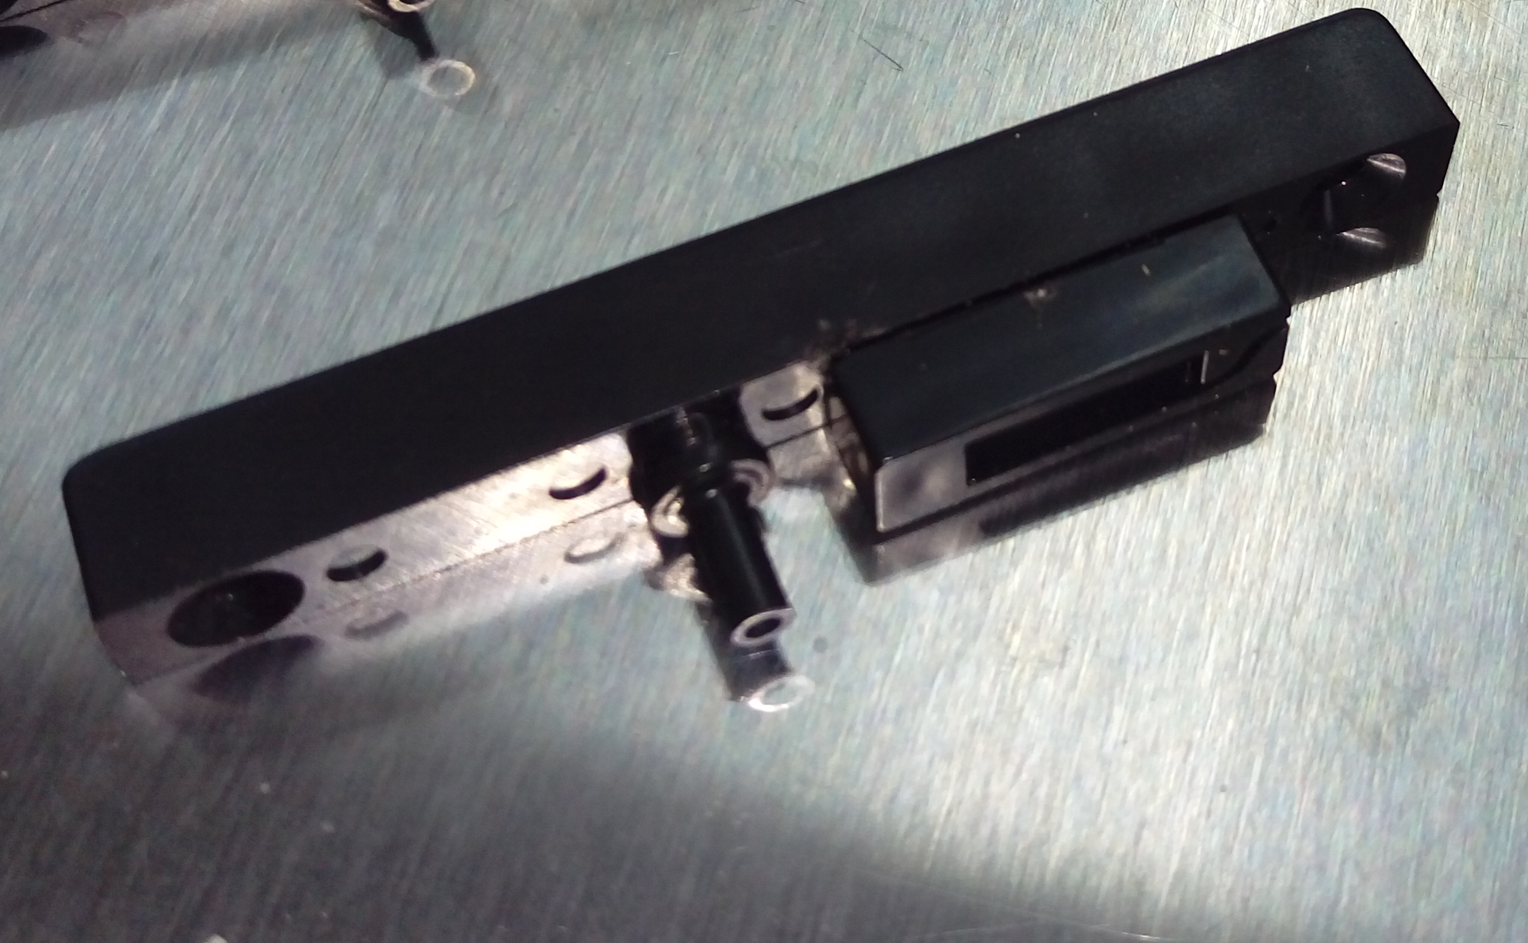
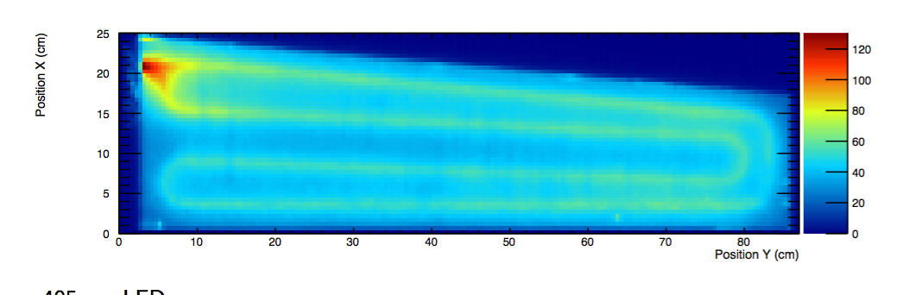
L3 Technical Overview
Scintillating Tile Assemblies:
  Extruded polystyrene (98.46%) plus 1.5% PTP and 0.04% POPOP
  Reflective coating (<0.05mm)
  1 mm Single Clad Kuraray Y11 Wave Length Shifting Fiber
  Wrapped with Al foil, Tedlar and Tyvek
  *Integrated Light blocker and SiPM mount*
2016

Slide 4
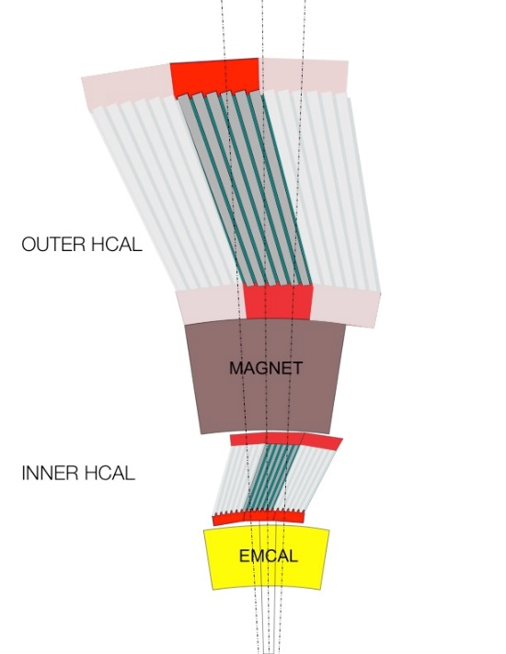
L3 Scope
HCal measures the hadronic component of the jet energy
Tiles fit between steel plates and the light collected in the fiber is read out by SiPMs
  unwrapped: 7.0±0.1mm; wrapped: < 8.0mm,
  Uniplast has met this spec
Tiles are tested individually before assembly into sectors for calibrations with cosmic ray measurements

Slide 5
QA
Tiles will be assigned a number indicating its shape and batch
Thickness measurements before wrapping recorded by vendor satisfying specification of 7.0±0.1mm
Thickness gauge <8.0mm to ensure wrapped tiles will fit between the steel plates
Scintillator performance
Wrapped tiles response to cosmic rays
Notes:
We will purchase fiber and wrapping and we need to do QA
Vendor should confirm acceptance testing
Sampling testing of fibers
when is barcode applied? how to keep track before hand
spares 2% yield allowance
LED QA to confirm?

Slide 6
T1044 2018 Tile Data Base - Uniplast

Slide 7
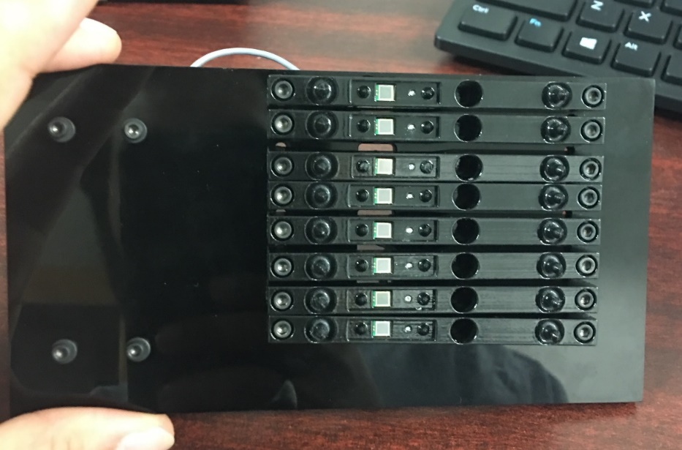
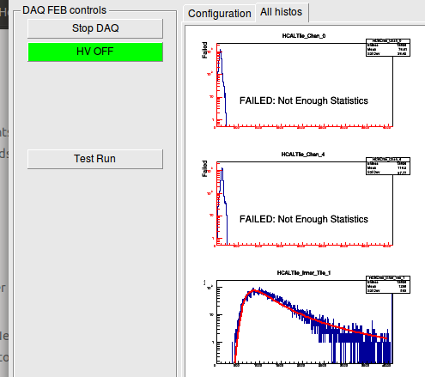
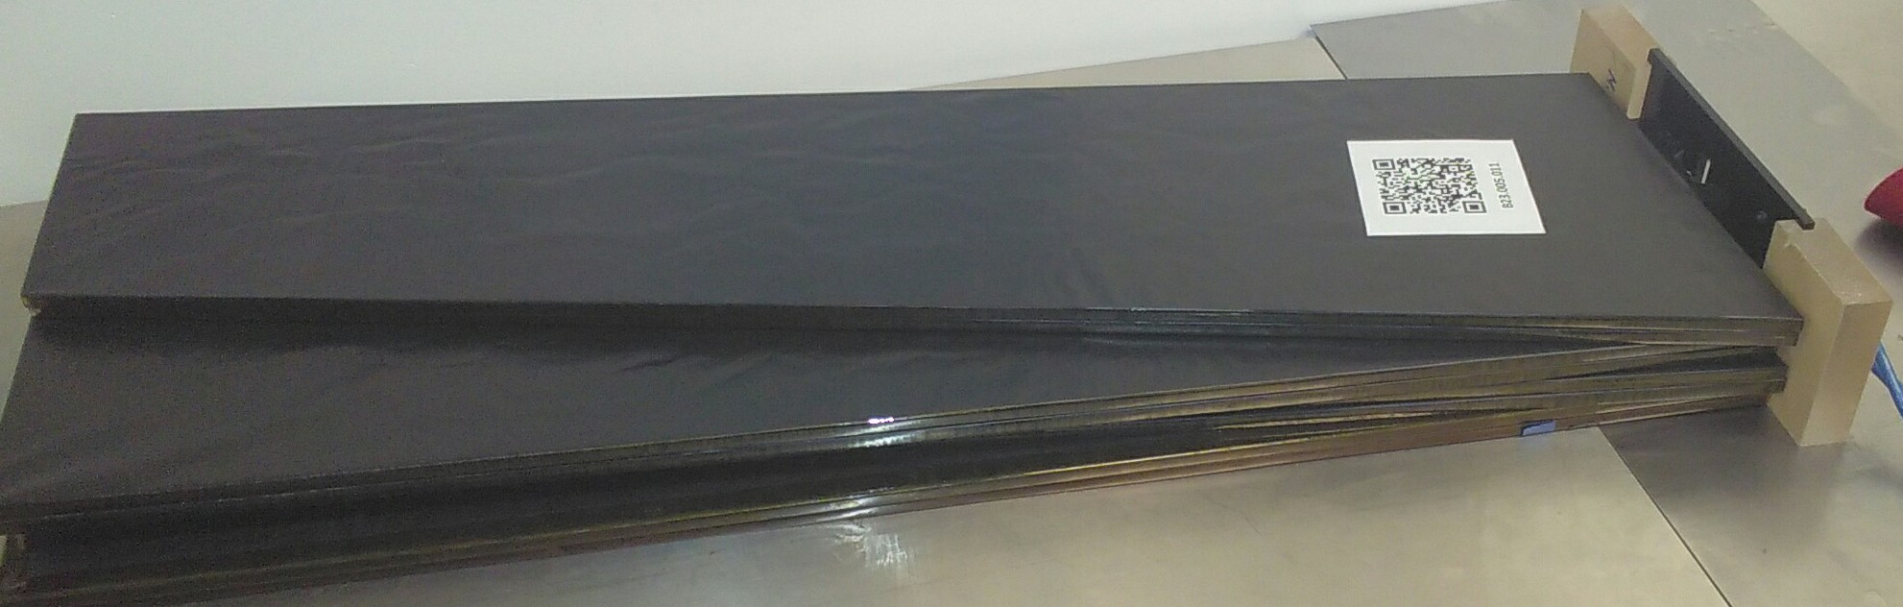
Tile Testing for production
2018 tiles
selected set of SiPM
Developed for use at:
Uniplast during production
-Immediate feedback
-Results saved for remote monitoring
2. GSU or elsewhere for testing with
SiPM before installation
Simple GUI for Uniplast

Slide 8
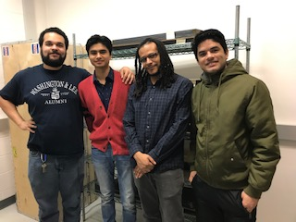
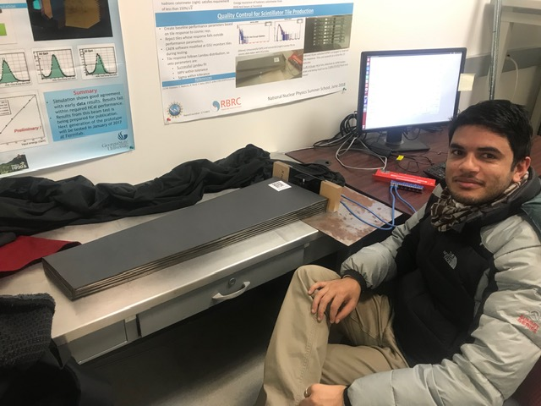
Collaborators
Georgia State University
  Faculty: M. Connors, X. He, M. Sarsour
  Graduate Students: A. Hodges & U. Acharya
  Several Undergraduates
  Tile Testing
Brookhaven National Lab
  E. Kistenev/J. Haggerty
MEPHI
  Igor Yahin
  Mapping

Slide 9
Schedule Drivers
Scintillating Tile Assemblies:
  CD3A approved ($1.55M)
  Key component for outer HCAL assembly
  Contract lead time 60 days
  First deliveries 130 days ARO
    Tile testing done at Uniplast, results databased
    Acceptance testing at BNL/GSU
  Early procurement reduces risk associated with Russian vendor

Slide 10
Cost Drivers
Scintillator tile production ($1.55M)
  Surface flatness over long distances a key specification
  Identified Uniplast (T2K, PHENIX)
    Wrapped tile thickness < 8.0mm, Uniplast has met this spec.
    FNAL/Eljen also investigated,
    Uniplast most economical for complete tile assemblies

Slide 11
Status and Highlights
2016 Test Beam
  Mid-rapidity tiles
    Good agreement between data and simulation
    Satisfies energy resolution requirement
2017 Test Beam
  High rapidity tiles
    Good agreement between data and simulation
    Satisfies energy resolution requirement
    Consistent response for positive and negative pions
2018 Test Beam
  High rapidity tiles
  Pre-production tiles and electronics
  Ongoing
2016
2017

Slide 12
Status and Highlights
All aspects of the scintillating tile design are highly advanced
  Completed four rounds of prototyping
  preproduction testing underway
Currently testing tiles in Advanced R&D contract (OPC funds):
  5th prototyping round (pre-production)
    ~20% of production total (1560 tiles)
    Includes tiles, clips, light blockers, SiPM mount, fiber bundles
    Exercise vendor production capabilities
Currently procuring CD1/3a contract for production tiles purchase through GSU (Site visit being scheduled)

Slide 13
Status and Highlights:Preproduction
176 tiles from First Shipment
Only 5 tested tiles (3%) outside of 20% benchmark
  Goal: to tower tiles with same performance so tiles clustered in tails may still be useful
~1K tiles received by GSU
  sample of all shapes received
  first set of tested tiles heading to BNL soon
Any questionable tiles will undergo additional testing
-Using two reference tiles for triggering on cosmics
-Corrections for effects due to SiPM, operating conditions or tile shape are applied

Slide 14
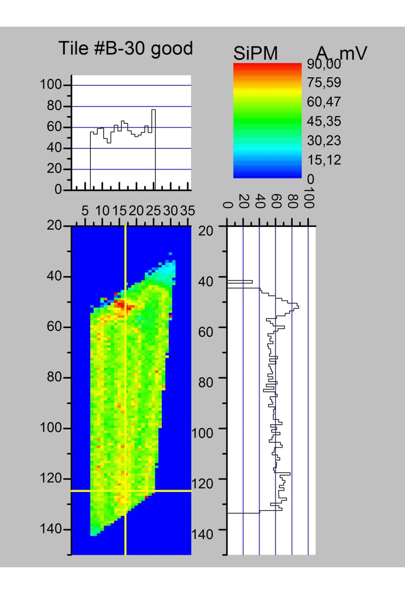
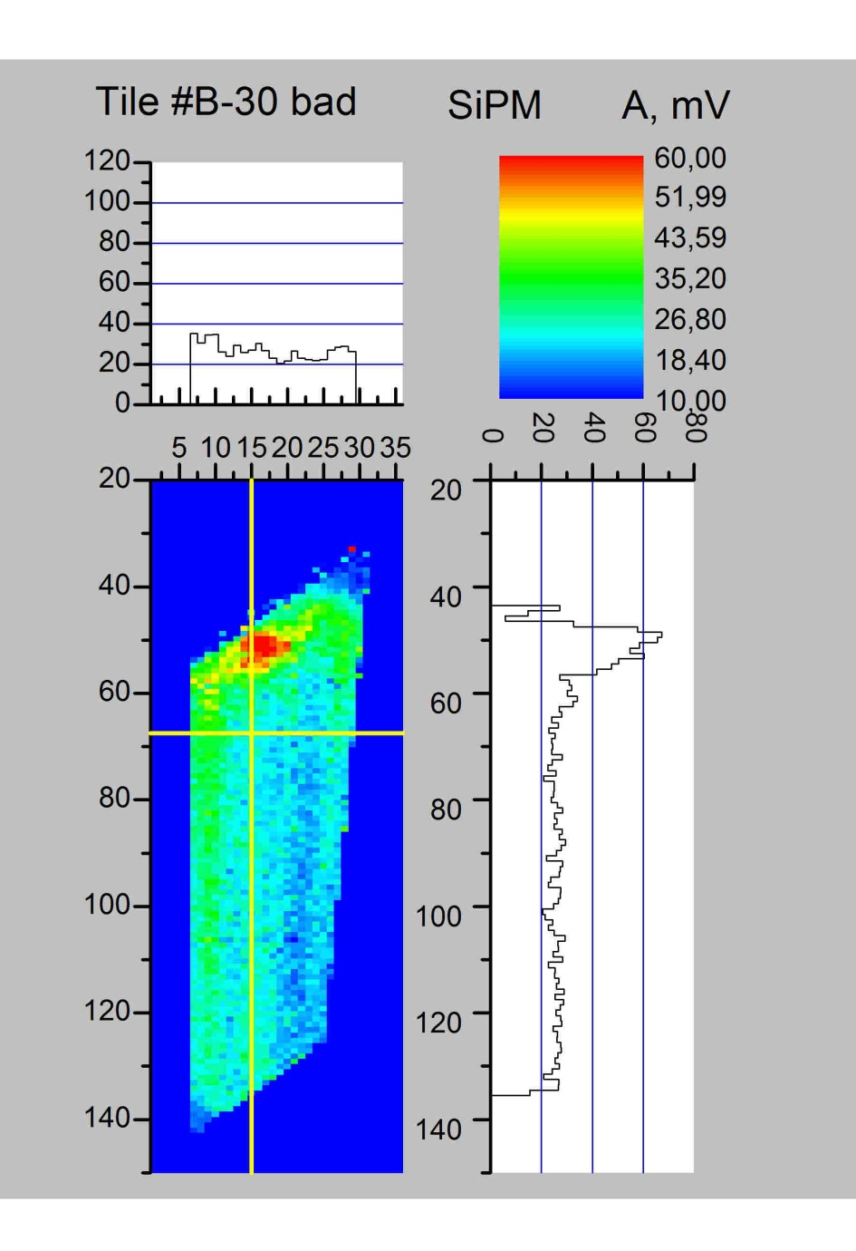
Status and Highlights:Preproduction
MEPHI: Muon hodoscope: “good” and “bad” tile maps

Slide 15
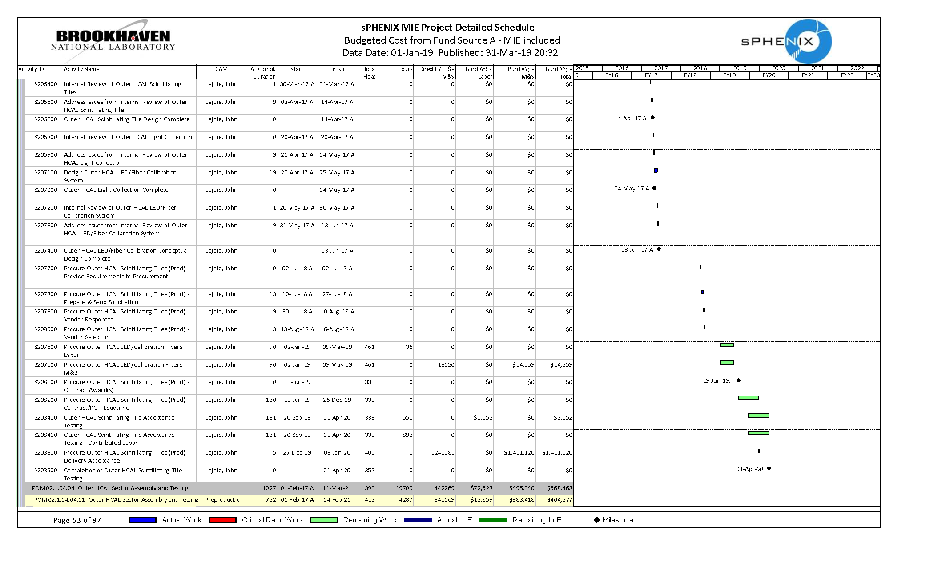
1.04.03 Outer HCal Milestones
Tile Acceptance Testing (GSU) – 20 Sept 2019 – 1 Apr 2020

Slide 16
Issues and Concerns
Loss of Scintillating Tile Provider (Uniplast)
  Uniplast is manufacturing scintillator sheets and providing completed scintillating tile assemblies, wrapped and tested, to sPHENIX specifications.
    Also providing access to inexpensive injection molding for key parts (light block/SiPM mount, tile clips)
  Uniplast has been extremely reliable
    Concerns centered on challenges executing a contract with a Russian vendor
  Unlikely but impact is large

Slide 17
Summary
sPHENIX Hadronic Calorimeter provides coverage for jet reconstruction between -1<η<1 and 0<φ<2π with an energy resolution better than
  Performance requirements driven by underlying event in jet reconstruction in Heavy Ion collisions
Design is highly advanced; multiple test beams establish performance within specifications
  Four rounds of scintillating tile prototyping
Advanced R&D program sets the foundation for CD3A purchase and sector production
HCal tiles are ready for PD-2/3 approval

Slide 18
Back Up

Slide 19
Test Beam 2016 – HCal Results
Resolution within sPHENIX expectations
Excellent data-simulation agreement

Slide 20
2017 HCal Performance
Agreement between data and π- simulation demonstrated in 2016
2017 demonstrates agreement for both π⁺ and π⁻
π+
π-

Slide 21
2017 calorimeter Performance
Energy resolution satisfies sPHENIX requirement
Good linearity as well

Slide 22
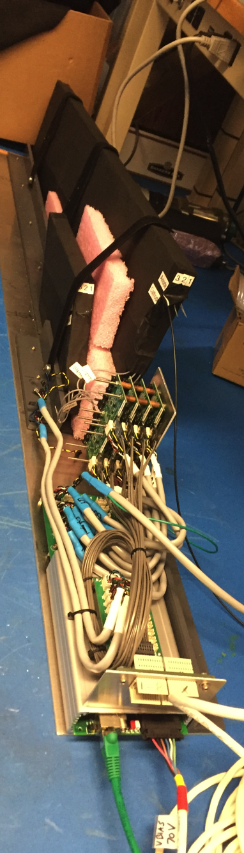
Tile Testing Studies
Tile Mapper used at FNAL test beam
Test stand with source/LED at Colorado
  Led to light blocker implementation
Test stand using cosmic rays GSU/any where
  Observed acceptable uniformity for tiles with light blocker
  Move toward QA for production

