Slide 1
sPHENIX Director’s Review
WBS 1.04.04
Outer HCal Assembly and Testing
Stefan Bathe
April 9-11, 2019
BNL

Slide 2
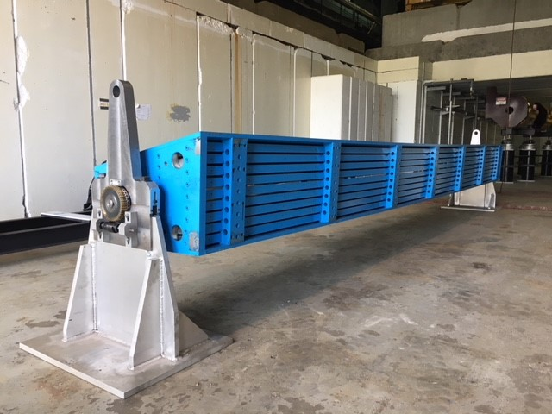
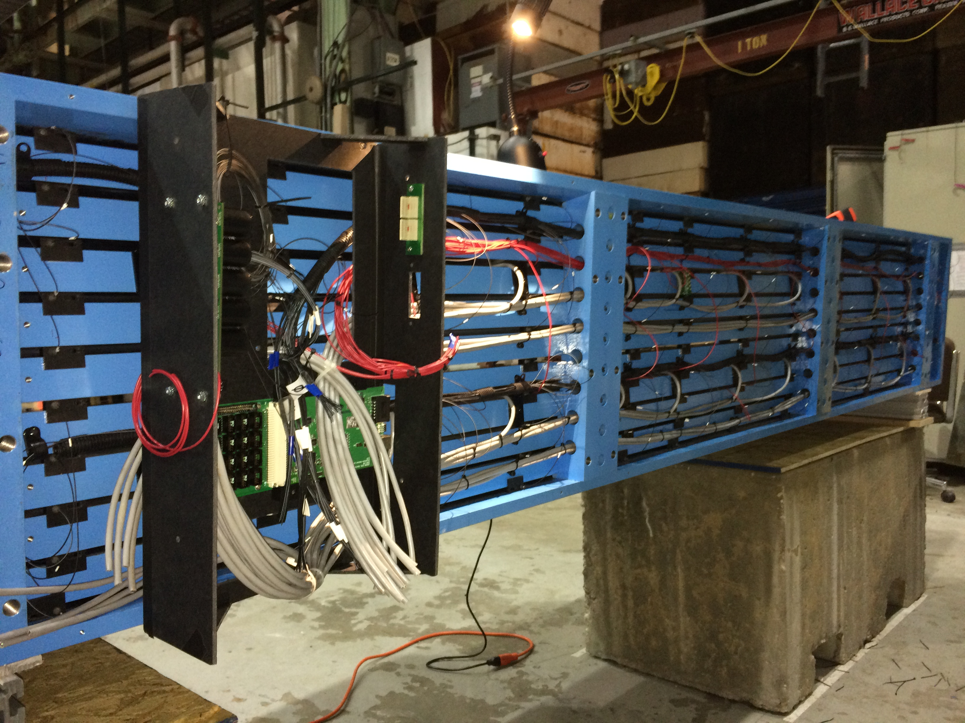
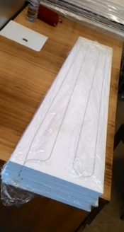
The L3 Component
Populate barrel-flux-return-steel sectors with scintillating tiles and electronics to create outer hadronic calorimeter
  From a collection of parts to a working detector

Slide 3
L3 Technical Overview
Technical steps for assembly and testing very similar to prototype assembly and testing: solved
Three main differences
  Size (prototype was smaller): stand to hold steel sectors horizontally
  Cosmics trigger: reconfigure electronics self-trigger for cosmic calibration
  Mass production: set up several stations for efficient assembly/testing
No technical issues that still need to be resolved

Slide 4
L3 Scope
HCAL assembly will involve four separate steps
  Install Scintillating Tiles in steel sector
    Scintillating tiles tested at Uniplast and GSU
    Sort tiles by response and install in gap with clips
    12 different tile shapes x 2 per gap, 10 gaps/sector
  Populate Sector with Electronics
    Install and wire pre-amplifiers, LED fibers, RO boards
  LED testing and Light Tighting
    Replace/Repair as necessary
  Cosmics Testing and Final Validation
    Cosmics results for each tower to be databased for initial calibration

Slide 5
L3 Scope (continued)
Four sectors will be worked on in parallel, one at each step
Four stations (one for each step) will be cycled through the four sectors
  easier than moving sectors around
5 days per sector, per step/station (assuming day shift only)
Full production will crank out one sector per week

Slide 6
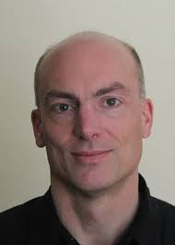
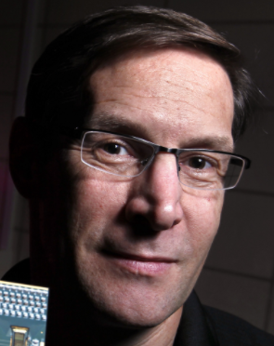



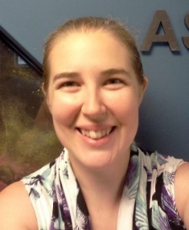

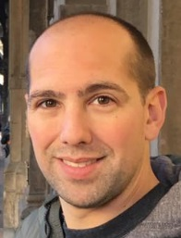

L3 Collaborators
also:
Colorado, UTK, Rutgers
UNCG, WSU
Stefan Bathe
L3 Manager
HCAL Assembly
John Lajoie
L2 Manager
Megan Connors
L3 Manager
Scintillating Tiles
Chris Pontieri
L3 Manager
Flux Return Sector Steel
May 23-25, 2018
6

Slide 7
Schedule Drivers
Assembly requires components:
  Flux Return Steel Sectors (infrastructure upgrade)
  Scintillating Tile Assemblies (CD3A approved)
  Calorimeter Electronics (WBS 1.05)
The assembly schedule itself is driven by labor:
  Time estimates based on experience with test beam prototypes:
    Two technicians assigned to factory
    One postdoc
    Two students per station
  Can add additional labor/shifts to maintain schedule

Slide 8
Schedule
Advanced R&D:
  Populate Outer HCAL Sectors with Tiles Start : 19 Aug 2019
  HCAL Advanced R&D Complete: 21 Jan 2020
Production:
  Populate Outer HCAL Sectors with Tiles Start: 27 Jul 2020
  First Outer HCAL Sector Ready to Install: 04 Sep 2020
  Last Outer HCAL Sector Ready to Install: 11 Mar 2021

Slide 9
Cost Drivers
Preparation of Assembly Area ($25k/station)
  One assembly station as part of pre-production
  Remaining three for full production
Light Tighting Materials ($0.6k/sector)
University Fixed Cost Contract (Labor, $61k)
  Support for students (travel, lodging, payroll)

Slide 10
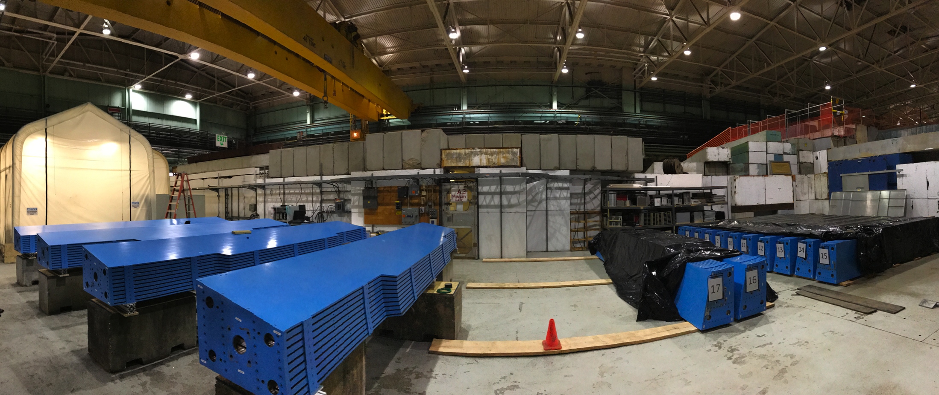
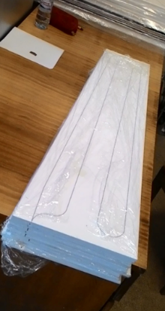
Status and Highlights
Test beams (2014/16/17/18):
21/32 Flux Return Steel Sectors at BNL
Outer HCAL Mechanical Prototype
In all cases, the combined system meets the sPHENIX spec!
Five rounds of prototyping with Uniplast – scintillating tile design very advanced.
Frame Prototype

Slide 11
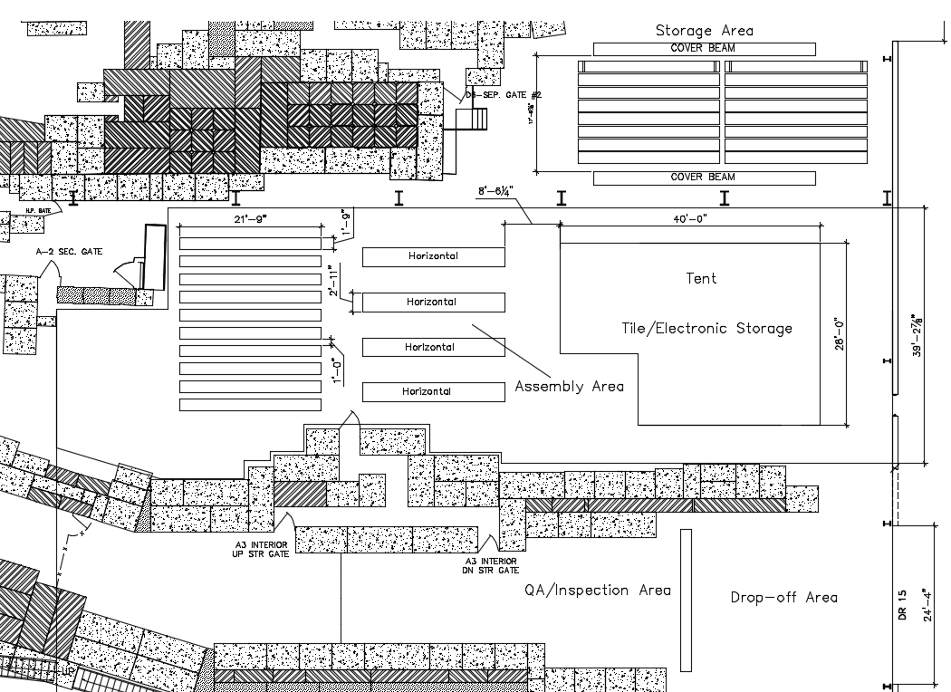
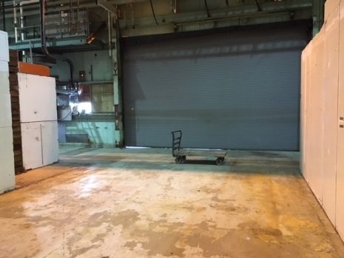
Status and Highlights (cont.)
Outer HCAL Assembly Factory prepared: BNL Bldg. 912
40-ton overhead crane to move sectors around
Fully equipped tent for testing (power, AC, heat, storage racks, etc.)
large staging area
Roll-up door for vendor drop-off

Slide 12
Status and Highlights (cont.)
Set up four stands for factory-style assembly and testing

Slide 13
Status and Highlights (cont.)
cabling mock-up to
  determine cable and fiber lengths
  decide cable routing
  demonstrate feasibility given space constraints

Slide 14
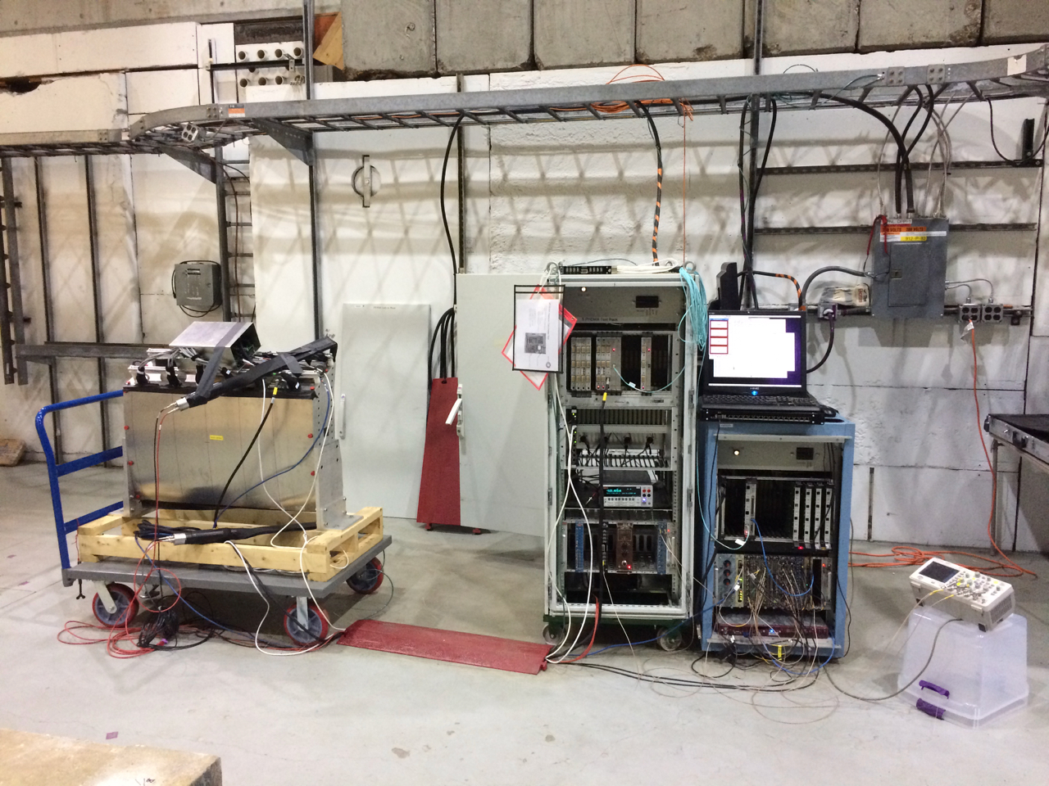
Status and Highlights (cont.)
Set up electronics for sector LED testing and cosmics calibration
Testing with HCal prototype

Slide 15
Issues and Concerns
Availability of contributed labor
  need ca. 5 person-years of labor total
  so far have commitments of ca. 3.5 person-years from collaborating institutions
  working on obtaining further committments

Slide 16
Summary
Assembly area prepared and ready to start assembly as planned in August, 2019
No major issues to be resolved
The Outer HCal Assembly And Testing is ready for PD-2/3 approval

Slide 17
Back Up

Slide 18
