Slide 1
sPHENIX Director’s Review
Calorimeter Electronics:
WBS 1.05.01 Silicon Photomultipliers
Christine Aidala
University of Michigan
April 9-11, 2019
BNL

Slide 2
The WBS 1.05.01 Component
Silicon photomultipliers (SiPMs) – choice of optical sensors for both the EMCal and HCal
Capable of detecting single photons
Advantages compared to photomultiplier tubes
  Insensitive to magnetic fields – critical for calorimetry inside solenoid
  Significantly lower operating voltages (< 100 V rather than > 1000 V)
Disadvantages
  Temperature sensitive: temperature must be monitored
  Susceptible to neutron damage: increased leakage current

Slide 3
WBS 1.05.01 Technical Overview
Hamamatsu S12572-015P SiPM
  Catalog item
  15 x 15 μm² pixel size
  40,000 μ-cells
  Dynamic range: 10⁴
  Gain: 2x10⁵
  Device: 3 x 3 mm²

Slide 4
WBS 1.05.01 Scope
WBS 1.05.01 Optical Sensors:
  77000 SiPMs for Production:
    EMCal: 70000 SiPMS
    HCal: 7000 SiPMs
SiPM procurement, testing, and sorting
  Q/A testing: measure gain as a function of operating voltage for a fraction of SiPMs for the EMCal and HCal
  Sort SiPMs into sets with operating voltage matched for shipment to assembly house
    For final detector, operating voltage will be controlled for individual calorimeter towers, i.e. groups of 4 SiPMs in EMCal/5 SiPMs in HCal

Slide 5
WBS 1.05.01 Collaborators
University of Michigan
  Christine Aidala – L3 Manager, Associate Professor
  Graduate students – currently Nicole Lewis as lead + 6 additional
  Undergraduates
Augustana University
  Nathan Grau – Associate Professor
  Undergraduates
Debrecen University – built the testing device
  Balazs Ujvary – Associate Professor
  Jozsef Imrek – FPGA expert
  Graduate students in physics, IT, and electrical engineering - Tamas Majoros, Zhandong Sun, David Baranyai, Balazs Gyongyosi
BNL
  Eric Mannel, Sean Stoll, Craig Woody

Slide 6
WBS 1.05.01 Schedule Drivers
CD3A request: Order 77k devices in batches of 8.5k every month starting March 2019.
Availability of working SiPM testing device capable of testing 156 SiPMs in a period of 10 hours or less
Means of recovering schedule slippage:
  Continue testing during weekends and nights
  Test only a fraction of SiPMs

Slide 7
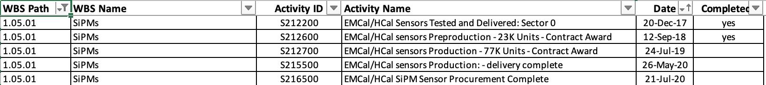
1.05.01 Optical Sensors Milestones

Slide 8
WBS 1.05.01 Cost Drivers
SiPM procurement: Final cost negotiated with Hamamatsu for SiPMs and testing performed by Hamamatsu
Hours of labor needed for SiPM testing
  Process is largely automated. Over the course of the year, 3-4 hours anticipated on average per day for setup and documentation
  Significant fraction of the time is contributed

Slide 9
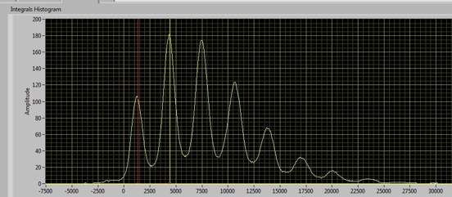
WBS 1.05.01 Status and Highlights
First two shipments of 8.5k SiPMs delivered to Michigan in March and April 2019
Debrecen has developed testing hardware
  Device self-contained including LED and power supplies, requiring only dedicated computer with Ethernet and virtual machine, and vacuum pump for robotic arm to pick up SiPMs
Michigan performing the testing efforts
  Lab space of C. Aidala, 867 sq. ft. (~81 sq. m)
Measurements
  Current as a function of bias voltage, allowing determination of breakdown voltage
  Integrated charge at 11 operating voltages, showing 1-, 2-, 3-pixel peaks, etc. Allows calculation of gain in order to determine operating voltage within 0.02 V
2p
1p
3p
0p
4p

Slide 10
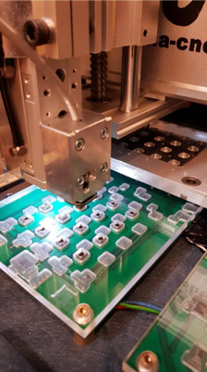
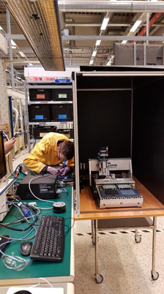
WBS 1.05.01 Status and Highlights
Robotic arm of testing device
Test stand at Debrecen

Slide 11
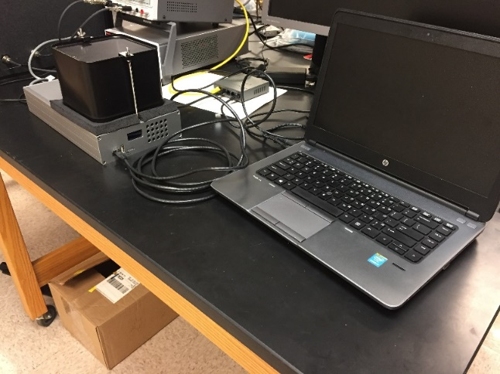
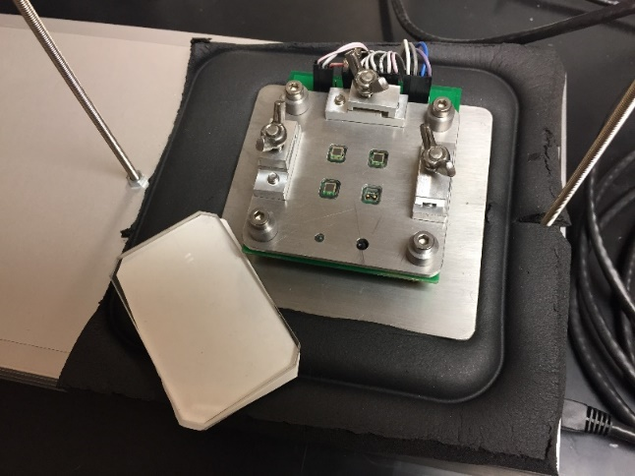
WBS 1.05.01 Status and Highlights
Testing and sorting of 1428 SiPMs for Sector 0 prototype calorimeter was performed at Michigan in December 2017 over 6 days by personnel from Michigan and Debrecen
Experience gained during this larger-scale testing was useful to finalize the design of the large SiPM testing device built by Debrecen
Prototype testing device at Michigan
SiPMs sorted by V_{op} after testing

Slide 12
WBS 1.05.01 Activities Over the Next Months
The automated testing device built by Debrecen is just getting set up now at Michigan, after delays getting through customs.
Over the next two months, we will begin production testing at Michigan, including extra shifts.
The following months will be steady-state production testing.

Slide 13
WBS 1.05.01. Issues and Concerns
SiPMs are susceptible to damage from neutrons
→ increased leakage current, most significant for EMCal
  Extrapolated from measurements during PHENIX running, EMCal will expect:
    of order 5 x 10¹⁰-10¹¹ n/cm² per run
Performed neutron flux measurements in PHENIX using RadMONs from CERN:
PIN diode sensitive to neutrons
Integrating devices
Locations:
  3 radial positions on North Nose Cone @ ~3 cm, ~8 cm and ~16 cm
  Mild radial dependence on fluence.
Placed in the IP8 interaction region for RHIC Runs 14-16
  Run 14: Mixed heavy ion running
  Run 15: 200 GeV p+p and p+A
  Run 16: 200 GeV Au+Au

Slide 14
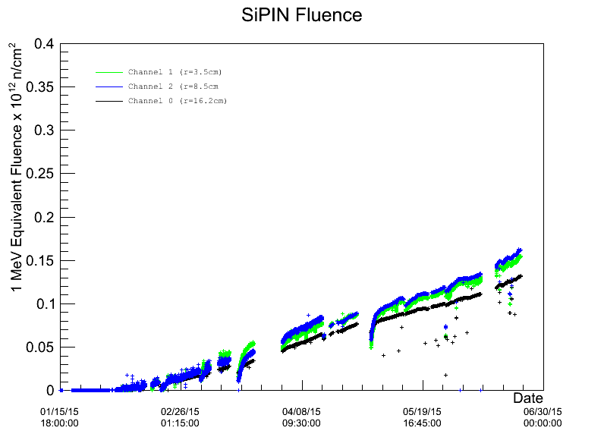
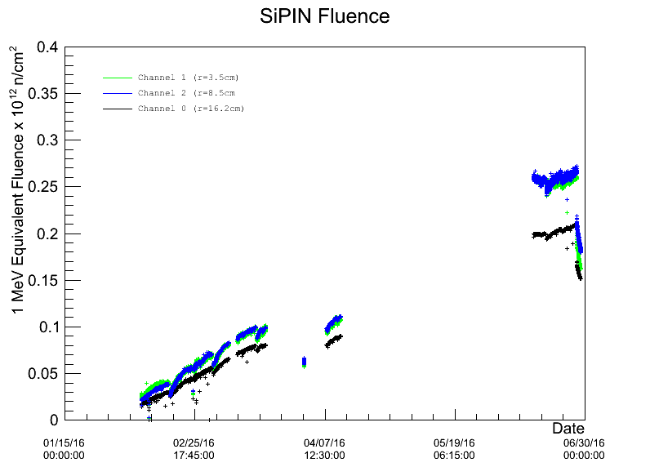
Issues and Concerns: Radiation Dose in sPHENIX
PIN diode measurements at PHENIX
R =3.5 cm
R =8.5 cm
R =16.2 cm
R =3.5 cm
R =8.5 cm
R =16.2 cm
Run-15
200 GeV p+p and p+A
Run-16
200 GeV Au+Au
Independent measurements at STAR during Run-13 510 GeV p+p (Fisyak et al., NIM A756:68, 2014):
R = 3-8 cm, |z| < 10 cm: Φ_{eq} ~ 8x10¹⁰ n/cm²
R= 100 cm, z = 675 cm : Φ_{eq} ~ 2.2x10¹⁰ n/cm²
sPHENIX EMCal SiPMs at R = 90 cm

Slide 15
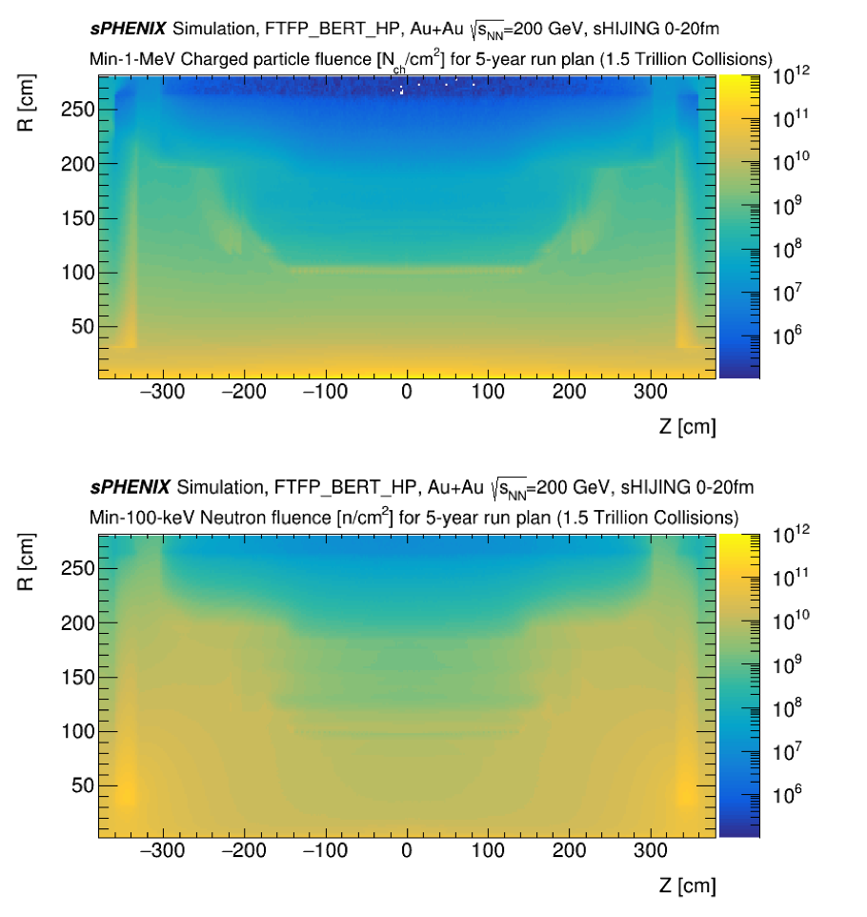
Issues and Concerns: Radiation Dose in sPHENIX
Simulation studies have also been performed and are in line with measurements at STAR and PHENIX.

Slide 16
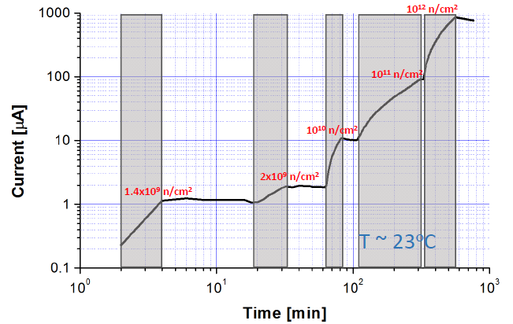
Issues and Concerns: Leakage Current from Radiation
SiPM neutron irradiation performed at ATOMKI in Hungary and at BNL to study increase in dark current
ATOMKI
With a fluence of 10¹¹ n/cm², leakage current is estimated to increase to 100 μA at T = 23 ºC.
With cooling, expect an upper current limit of 400 μA per device after 5 years.
More details on the effect of neutron radiation damage on the Hamamatsu S12572-015P are discussed in arXiv:1809.04594

Slide 17
WBS 1.05.01 Summary:
The Hamamatsu S12572-015P SiPM is our selected device and meets the performance requirements (e.g. photon detection efficiency, gain, dynamic range).
We have a detailed testing and Q/A process in place to certify the devices.
The damage due to neutrons has been measured along with its impact on the performance of the device, with further studies ongoing.
  We performed additional studies for neutron damage to SiPMs (arXiv:1809.04594)
  It will be necessary to cool the devices to below room temperature, ~10 ºC, after a few years of operations. The cooling system is being designed to meet these requirements. (WBS 1.03)
  The electronics is designed to provide the required power (WBS 1.05.02).
  Calibration of the EMCal is based on the physics measurements which are not expected to be significantly impacted by expected increases in leakage current.
Procurement of 77k devices has started. First delivery was March 2019. Last delivery estimated February 2020.
WBS 1.05.01 Calorimeter Electronics: Silicon Photomultipliers is ready for PD-2/3 approval.

Slide 18
Back Up

Slide 19
Testing Plan
Starting in March 2019, Hamamatsu will ship 8.5k SiPMs to Michigan every month, requiring about 425 devices to be tested each day (5 days a week). The SiPMs will be shipped in trays with V_{op} matched within 0.04 V.
The SiPMs will have an accompanying traveler sheet that lists the SiPMs by tray position and serial number. Hamamatsu will also provide the operating voltage and gain for 30 of the devices per shipment. Before testing begins on an individual tray, the traveler sheet will be scanned and its information uploaded into a database. This database will be part of the testing device software and is being developed by Debrecen and Augustana collaborators.
[Describe that it’s an automated process] Next, each SiPM will be placed in the 8x8 testing array and the SiPM array position will be recorded in the database. The handling of the SiPMs will only require common tweezers. Once the SiPMs are in place, the testing device will measure the gain at a series of supply voltage settings, determine the operating voltage (breakdown voltage + 4V) for each SiPM, measure the corresponding temperature, and automatically record this information into the database (TBD). The testing device will require about 4 hours (TBD) to complete measurements for all 64 SiPMs.
Tested SiPMs will be shipped from Michigan to BNL for assembly on a regular schedule.

