Slide 1
sPHENIX Director’s Review WBS 1.05.03: Calorimeter Digitizers
Cheng-Yi Chi
April 9-11, 2019
BNL

Slide 2
The WBS 1.05.03 Component
W 1.05.03 The calorimeter digitizer system
Off detector ADC system for both EM and Hadronic calorimeter.
Received the amplified signal from on-detector amplify through cables
Digitize the signal at 6x beam crossing rate, ~ 60 MHz, with 14 bits ADC
Offset the baseline to use most of the ADC range.
Provide at least 40 beam crossing of data buffers to cover L1 trigger latency
Provide Level 1 trigger primitives.
Minimum 4 Level 1 events buffer.
Maximum 31 ADC samples per channel per events, 16 samples planned.
15 KHz Level 1 trigger rate (16 Samples/channel/Event).
Send Level 1 trigger events to the DAQ system.

Slide 3
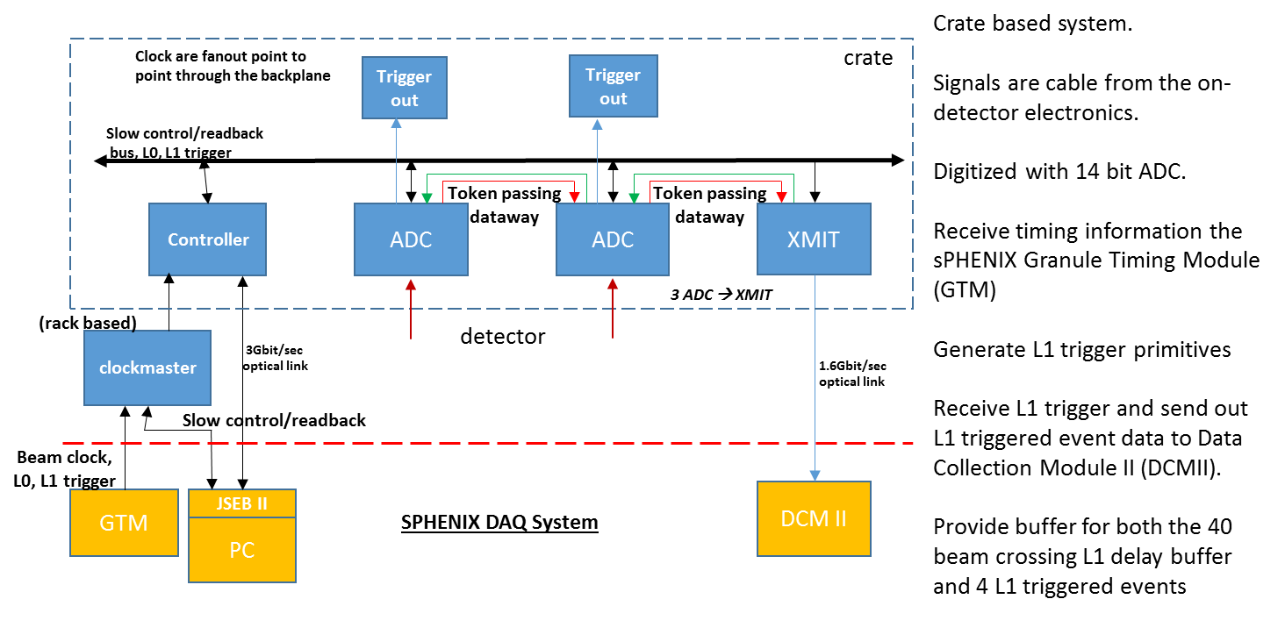
WBS 1.05.03 Technical Overview
2nd round
prototype
1st round
prototype
WBS 1.5.3
ALL decided

Slide 4
WBS 1.05.03 Scope
The sub-system consists of
276 ADC boards w/ Trigger Transmitter
92 XMIT modules
23 crates: 22 for EMCal, 1 for HCal
Power supplies/Patch fibers/Power cables
10 clock master modules (1 per Rack)
Analog cables from detector to digitizers are part of WBS 1.5.2
Fibers from IR to Rack Room are part of infrastructure.

Slide 5
WBS 1.05.03 Collaborators
The digitizer system has been designed by Nevis, Columbia University. We are doing the standalone testing.
Working with the BNL sPHENIX Calorimeter group on the integration testing.
John Haggerty, Eric Mannel etc.
Working with sPHENIX DAQ group on the control software.
Martin Purschke, Ed Desmond etc.
University of Colorado group is working on the Calorimeter Local level 1 trigger and will also work on the digitizer electronics testing.

Slide 6
Schedule Drivers
We have designed and fabricated prototypes of all the boards necessary to build the readout system.
ADC board, backplane and XMIT board are well tested
Chain test on the clock master board and crate control need to be done.
Not expect to be an issue.
We have solved the obsolete components issue
Altera EPROMS. Replacement parts in hand.
We have started the 7 crate pre-production fabrication cycle
In the components purchase phase.
Long lead time and minimum multiple requirements need to be managed.

Slide 7
Cost Drivers
The cost drivers are on the ADC board, 276 production boards.
The 8 channel Analog Device ADC AD9257 ($84 per chip)
64 channel board → 8 ADCs per board
The Altera Arria 5 FPGA ($322.10 per chip)
receive the ADC data and data manipulation, L1 delay, 5 events buffer and generating trigger primitives.
The differential receiver, AD8132 ($2.10 per chip)
Receiver the differential signals from the cable. One per channel.
The PCB board ($210 per board)
The PCB assembly ($285 per board)

Slide 8
Milestones
Milestones are based on fabrication and testing

Slide 9
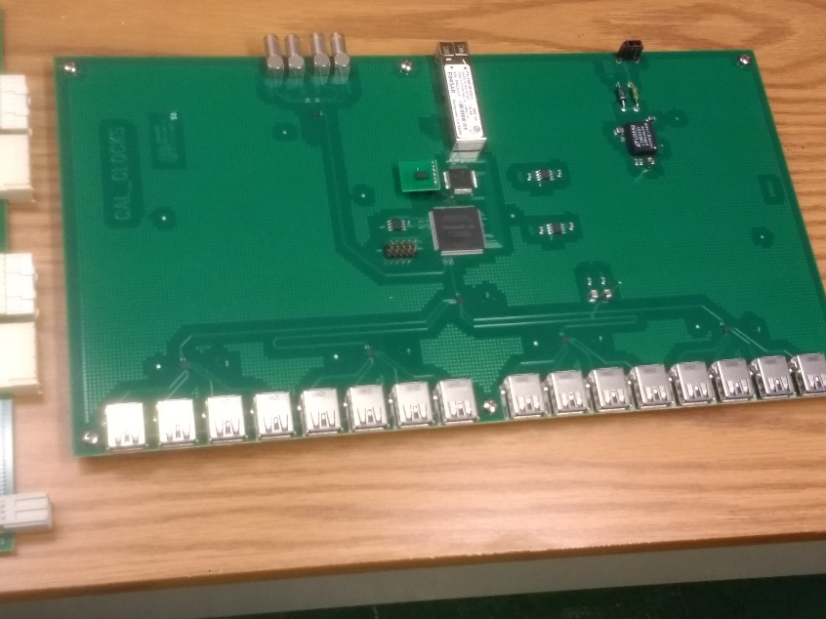
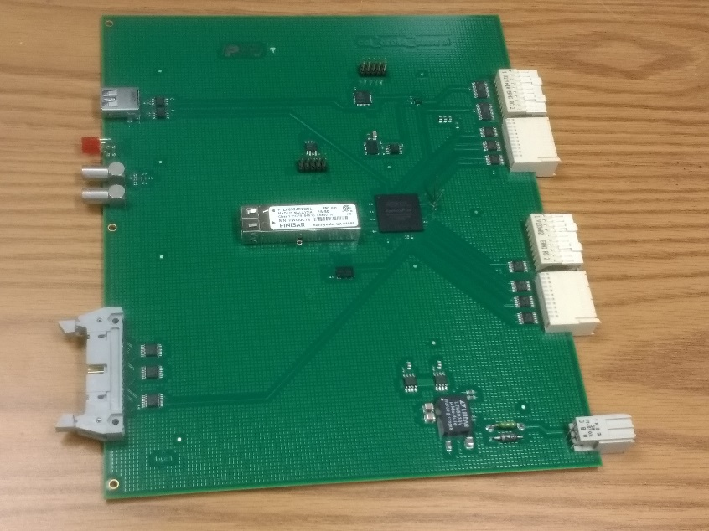
Status and Highlights
Went through Interim Design Review for the ADC system of the sPHENIX calorimeter electronics on 1/4/2019.
Clock master
Crate controller

Slide 10
Issues and Concerns
Production related issues are the biggest worries
Minimum multiple (cost) and long lead time (schedule).
Uncertainty of trade issue between China and US.
Extra duties raise the cost.
Show up in cost of components, for example capacitors.
Does not apply to major cost items like ADC and FPGA.
Fabricating PCB via China brings up extra shipping issues.

Slide 11
Summary
Design is well developed.
Prototype system was used for 2018 FNAL Test Beam run.
A ½-Crate system has been assembled and is being tested at Nevis.
Design review in preparation for 7-Crate pre-production fabrication run was conducted in Jan. 2019.
Prototype systems function as designed.
Costing and schedule is based on prototype production.
The sPHENIX Digitizer system is ready for PD-2/3!

Slide 12
Back Up

