Slide 1
sPHENIX Director’s Review
Level-3: Trigger
Jamie Nagle
(University of Colorado Boulder)
April 9-11, 2019
BNL

Slide 2
The L3 Trigger Component
Level-1 Trigger System (WBS 1.6.2)
1.5 EMCal FEE
1.5 HCal FEE
1.7 MBD FEE
Front End Electronics
1.6.2
Level-1 Trigger
MBD, EMCal, HCal
1.6 DAQ
Timing System
Global Trigger Decision
Goals – sample luminosity pp, pAu, AuAu for rare probes (photons, jets, Y→ee)
Trigger inputs – EM + H Calorimeter: tower energy sums 2x2 (8 bits each)
– Min.Bias. Detector (MBD): mean time each side, energy
Trigger outputs – Summary information to Global Level-1 within 4 microseconds,
trigger primitive archiving

Slide 3
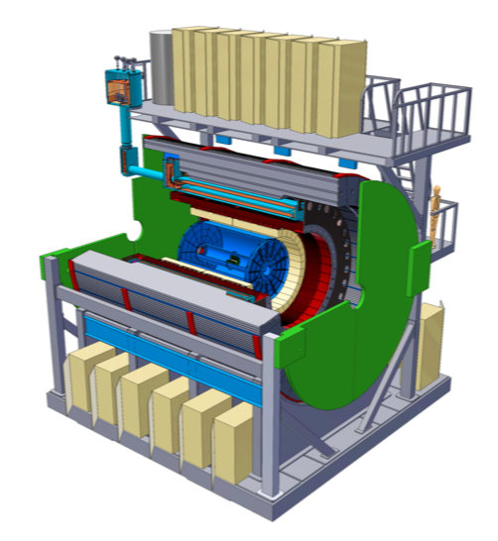
Key Physics and Trigger Detectors
Key Physics
High p_{T} Jets, Hadrons
High p_{T} Photons
Upsilon→ee
Key Trigger Detectors
Minimum Bias Detector
interaction, zvertex, mult.
Electromagnetic Calo.
photon, electron energy
Hadronic Calo.
- Combine with EMCal for jets

Slide 4
Trigger Rate Overview
sPHENIX 5-Year Run Plan
Trigger needs to deliver the physics within the
15 kHz DAQ bandwidth constraint.
Au+Au plan – record minimum bias events at ~ 15 kHz (MBD Level-1 trigger). This delivers 239 billion events.
p+p and p+Au plan – sample full luminosity for key physics (EMCal and HCal Level-1 triggers).
Again 15 kHz archive rate.

Slide 5
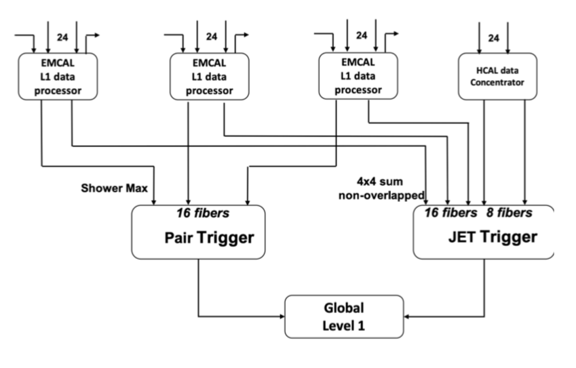
L3 Trigger Technical Overview
Digital inputs well-defined (advanced calorimeter FEE prototypes)
Level-1 digital electronics platform, two technology options
Custom electronics designed
at Nevis Laboratories
FPGA Algorithm development
underway
No major technical issues to be resolved

Slide 6
L3 Trigger Scope
Digital electronics system (boards [12-15], backplane, crate, slow controller) calculating trigger primitives
Well-defined Front End Electronics input (note that same Nevis team has designed the Calorimeter and MBD FEE).
Well-defined clock synch inputs
Well-defined latency time for Level-1 calculations
Final output bits to Global Level-1 for trigger decisions and additional output stream for archiving / debugging decision block (path through Data Collection Module II, also designed at Nevis).

Slide 7
L3 Trigger Collaborators
Professor Jamie Nagle
Professor Dennis Perepelitsa
Dr. Sanghoon Lim
University of Colorado Boulder
Dr. Cheng-Yi Chi
Columbia University, Nevis Laboratories
PHENIX Trigger Coordinator (2002-2010)
sPHENIX Jet Working Group Co-Convener
sPHENIX Calorimeter FEE, MBD electronics
PHENIX DAQ / Electronics
Previous successful electronics collaborations:
PHENIX Data Collection Modules
PHENIX Resistive Plate Chamber Electronics
PHENIX Data Collection Modules II

Slide 8
Schedule Drivers
Technology down-select January, 2019
→ review held January 23, 2019, endorsed custom
design selection with green light to proceed
Complete design and moving to first round prototype
Included second round of prototyping (to be conservative)
Already well-defined FEE trigger input (good)
No major external schedule drivers

Slide 9
Cost Drivers
Cost structured as four contracts with Nevis Laboratories for deliverables
Design ($90k), Prototype1 ($83k), Prototype2 ($60k), Production ($117k)
Engineering time and board components (FPGA, transceiver/receivers)
No big surprises, all components commercially available, project well within scale of similar projects by
Nevis/Colorado team.

Slide 10
Milestones
1.06.02.01 LL1 Trigger Design S261400 9/28/2018 → Complete
1.06.02.02 LL1 Trigger Prototype v1 S262300 4/10/2019 → Underway
1.06.02.02 LL1 Trigger Preprod complete S262700 4/15/2020
1.06.02.03 LL1 Trigger Prototype v2 S263900 10/01/2020
1.06.02.04 LL1 Trigger Production S264700 3/5/2021
1.06.02.04 LL1 Trigger Production Complete S265300 7/12/2021
Currently on schedule with milestones…

Slide 11
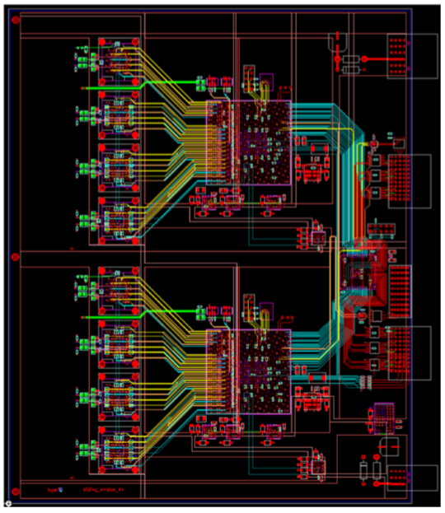
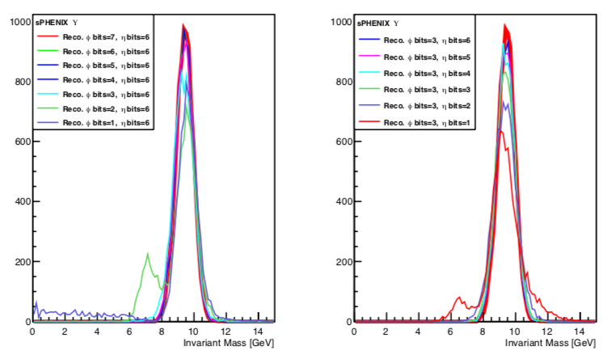
Status and Highlights
Preliminary board layout
Proceeding to full prototype
Algorithm development work
bit requirements for Upsilon pair trigger

Slide 12
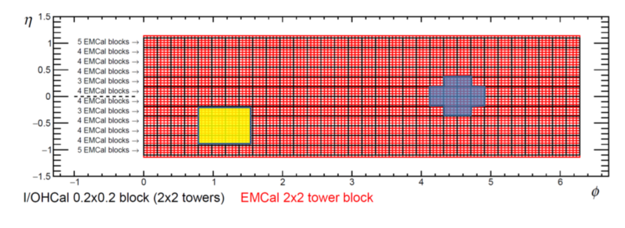
Full GEANT4 Trigger Simulations
Sliding Jet Window Algorithm

Slide 13
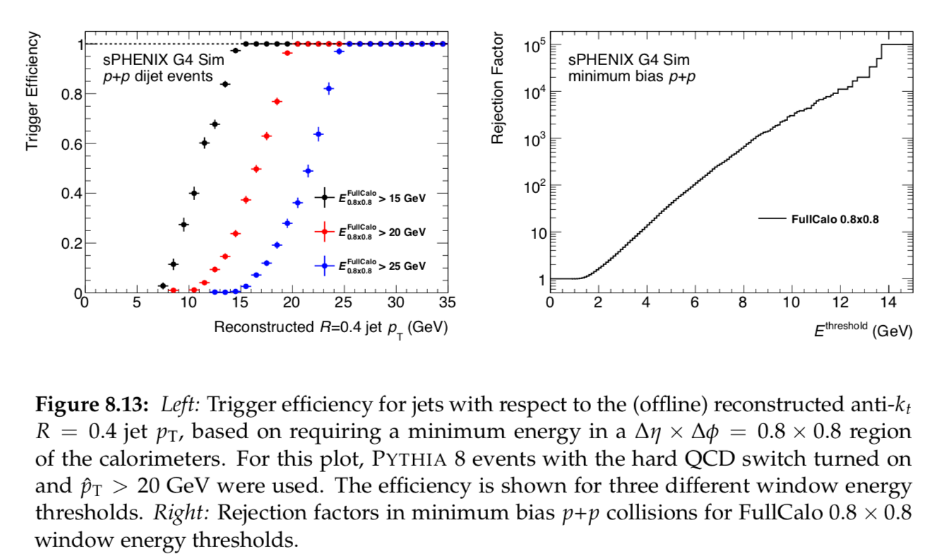
Full GEANT4 Trigger Simulations

Slide 14
Issues and Concerns
No major schedule, cost, or technical concerns.
Relatively straightforward trigger algorithms for p+p, p+Au.
Trigger rejections significantly exceed requirements.

Slide 15
Summary
Algorithms well understood.
Electronics well matched to physics / algorithm requirements.
Electronics design down-select complete.
Custom Nevis electronics has preliminary board layout.
The sPHENIX Level-1 Trigger system is ready for PD-2/3!

Slide 16
Back Up

Slide 17
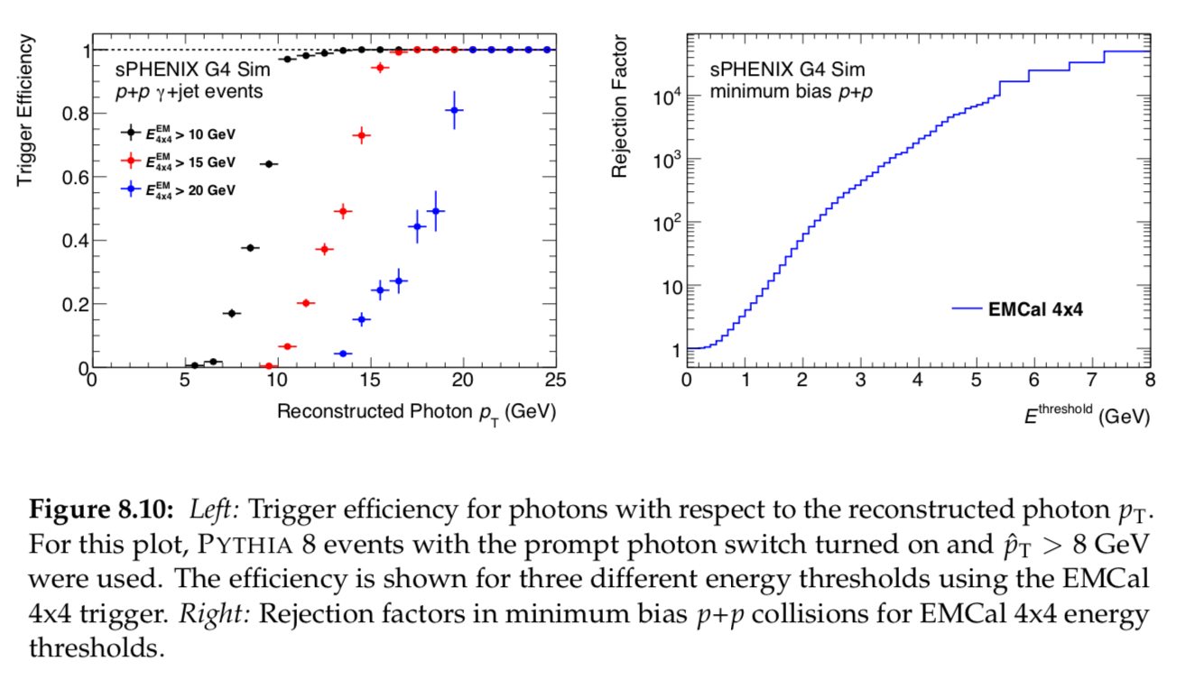
Full GEANT4 Trigger Simulations

