Slide 1
sPHENIX Director’s Review GL1/Timing System
Martin Purschke
April 9-11, 2019
BNL

Slide 2
The GL1 system
The Global-Level-1 (GL1) trigger decides for each RHIC crossing whether to accept the crossing, or not
It is aware of the busy state of the front-ends
It receives input from the Local-Level 1 triggers
It takes the scaledowns for individual triggers into account
Then takes a decision whether to accept that crossing.

Slide 3
The Timing system
The timing system receives the GL1 decision and distributes that info and the clock to the front-ends
A group of detector front-ends that receive the same timing info are called a granule
The core of the timing system is a “virtual Granule Timing Module” (vGTM)
“virtual” because it is entirely implemented in firmware
Think of a vGTM as an interface module that “translates” and packages the clock and trigger data in a way that is suitable for a given subsystem
Each detector system constitutes at least one granule, typically more
Detectors split into more granules than strictly needed from a timing perspective, for convenience
A granule can be operated independently during the commissioning phase and for troubleshooting

Slide 4
The GL1 - vGTM diagram
GL1
Granule
LL1
vGTM
Granule
FEM
FEM
FEM
FEM
vGTM
Granule
FEM
FEM
LL1
FEM
FEM
vGTM
Granule
FEM
Busy
FEM
FEM
FEM
vGTM
FEM
LL1
Busy
FEM
FEM
Busy
FEM
LL1
Busy
…
The Local-Level 1’s provide input to the GL1
The GL1 transmits decision to the vGTMs
The vGTMs transmit clock and trigger info to their front-ends
They are aware of their granule’s busy state

Slide 5
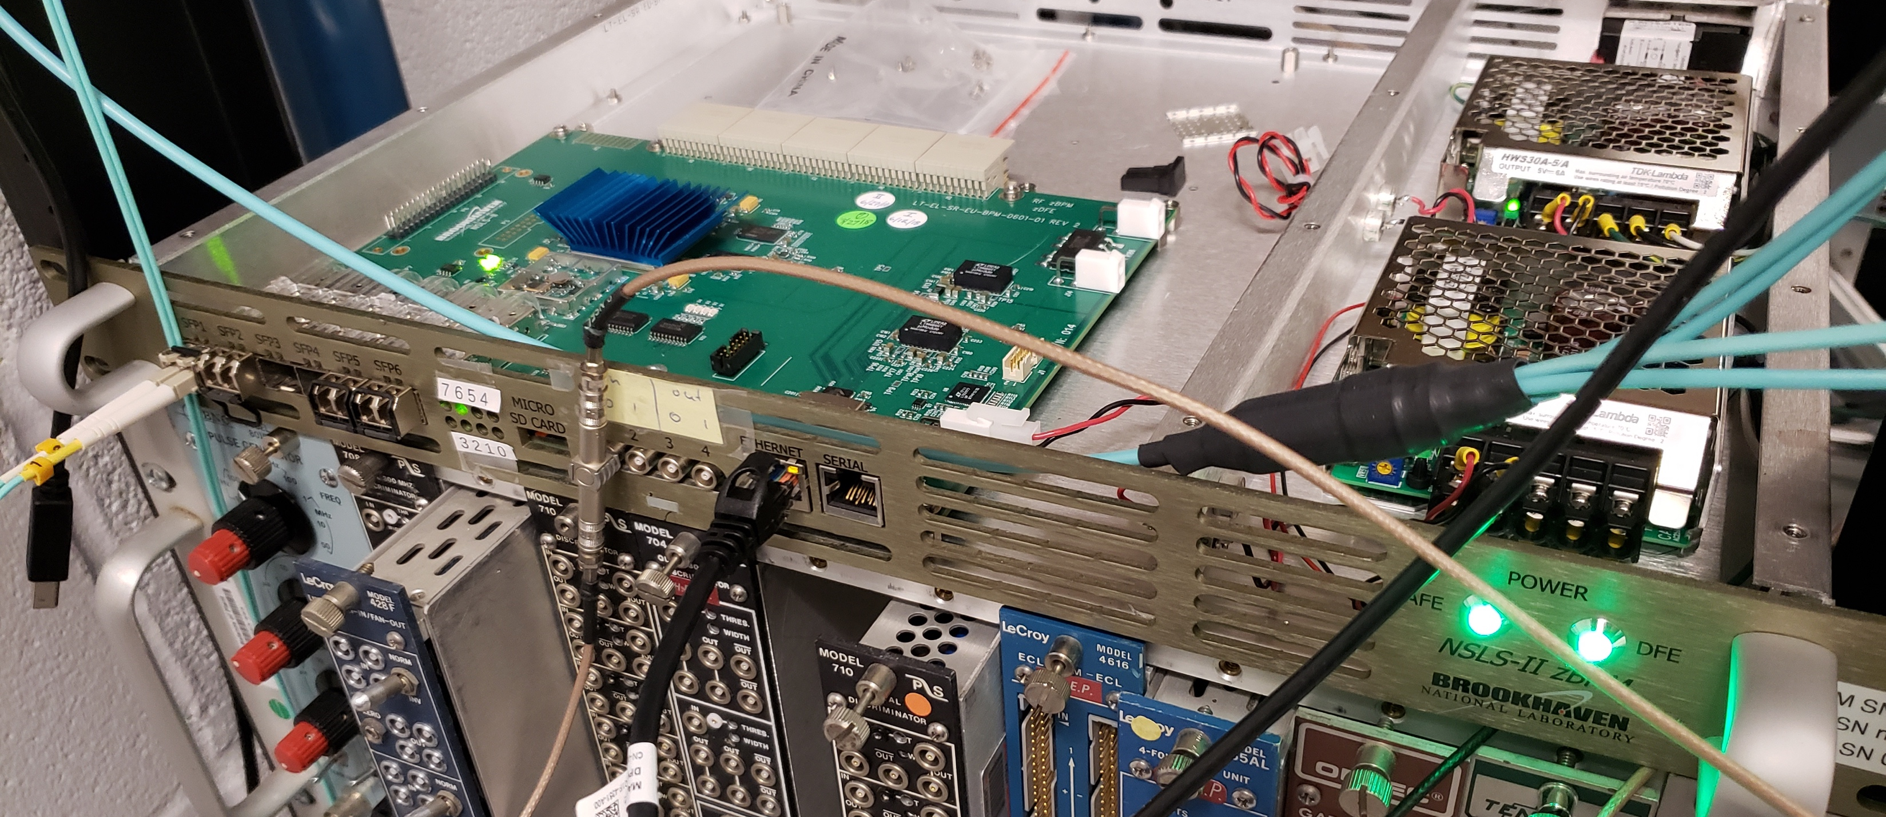
Component count
At present, we count 12 granules
Emcal 4
Hcal 2
MBD 2
TPC 2
INTT 1
MVTX 1
The GL1 and the vGTM FPGA boards are identical
Reduction in spares, development, etc
Difference is entirely in firmware
One board can accommodate up to 13 vGTMs (number of available transceivers)
Eventual setup will consist of one GL1 board, and one (or possibly two) GTM boards
(We might decide to split systems into more granules)

Slide 6
GL1 and Timing system Scope
Provide trigger and timing input to all detector systems
Provide the slow controls/GUIs/APIs to set up trigger configurations, and manage trigger scaledowns
Interface with the DAQ to provide per-event GL1 information
Hardware:
One GL1 FPGA Board
One (or possibly two) Timing FPGA boards
Break-out boards for access to all transceivers

Slide 7
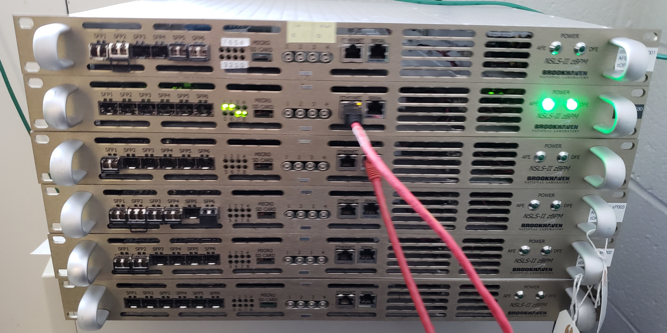
Technical status
We have already procured 6 FPGA boards, in hand
Boards are an in-house development for the NSLS-II
Well engineered, support available, no additional development costs
6 units allow us to have production and development stations
We can loan hardware to remote collaborators for their system integration efforts (e.g. Los Alamos for MVTX)
Remaining tasks are further firmware developments, and the design of a breakout board for the full set of 14 transceivers

Slide 8
L3 Collaborators
Martin Purschke, L2 and L3 (BNL, Physics)
Engineer (BNL, Instrumentation)
Engineer (BNL, NSLS-II)

Slide 9
Schedule Drivers and Milestones
Task | Finish date
Timing system prototype | Sep 2019
GL1 Prototype Ready | Dec 2019
Timing system ready | Dec 2020
GL1 ready | Feb 2021

Slide 10
Cost Drivers
6 boards Procured
Production boards ~$142K
(possible that the boards in hand are already the final ones)
Breakout board $12K

Slide 11
Highlight: vGTM protocol to TPC
The clock/trigger data are transmitted at 6x the beam clock speed (~56MHz)
6 x 16bit of data transmitted per RHIC beam crossing
8 Mode bits (“what to do at this RHIC crossing”)
40 bits (out of 64) of the global beam clock counter
Trigger accept and misc. housekeeping info
3 user bits (currently unused)
RHIC Beam Clock

Slide 12
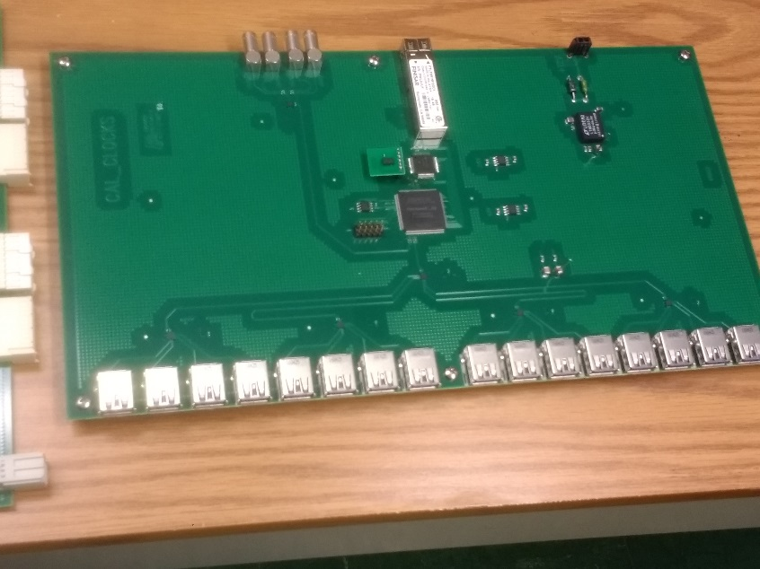
Issues and Concerns
We currently only have the technical ability to interface the timing system to the TPC and MVTX (Felix readout)
Calorimeters are waiting for the clock master board (two talks before) to become available
Clock master
From Chi’s talk

Slide 13
Highlights: GL1 readback
-- Event 2 Run: 4 length: 28 type: 1 (Data Event) Accept vector 1
Beam Clock 10533763685
T0 raw 1
T0 live 1
T0 scaled 1
T1 raw 0
T1 live 0
T1 scaled 0
-- Event 3 Run: 4 length: 28 type: 1 (Data Event) Accept vector 1
Beam Clock 10764577311
T0 raw 2
T0 live 2
T0 scaled 2
T1 raw 0
T1 live 0
T1 scaled 0
Two triggers accepted on input 0
11 out of 13 accepted on input 0
Two arrived while DAQ was busy
-- Event 12 Run: 4 length: 28 type: 1 (Data Event)
Accept vector 1
Beam Clock 12539380911
T0 raw 13
T0 live 11
T0 scaled 11
T1 raw 0
T1 live 0
T1 scaled 0

Slide 14
Activities over the next few months
Working towards a complete GL1 implementation
Number of triggers (currently 2 because of two convenient Lemo inputs) as parameter
Finalize APIs for GL1 configuration
Look into a “one-board” system - implement GL1 and vGTM in one FPGA for lab and beam tests
Interface to GL1 - GTM boards via fiber
Implement “fractional scaledowns” – integer currently but we want like ”2 out of 3”
Setting up a “multiple systems test” (likely calorimeter + TPC hardware)
Combine different flavors of hardware
Demonstrate proper alignment/reconstruction of events and GL1 info
This is awaiting the aforementioned clock master board and assorted firmware

Slide 15
Summary
Rudimentary GL1 implementation is functional with 2 hardware trigger inputs
Almost complete vGTM functionality interfaced with TPC front-end and MVTX front-end (the only systems where we currently have the technical ability)
Data available for alignment tests and event building software (generated beam clock data embedded)
Data taking in TPC lab setting routinely with vGTM support
Early version of the GL1 DAQ interface implemented (readback of per-event trigger decision data)
GL1 and Timing ready for PD-2/3 approval.

Slide 16
Back Up

