Slide 1
Engineering Management and Coordination
James Mills
April 9-11, 2017
Brookhaven National Laboratory

Slide 2
Engineering Management and Coordination
  Engineering Management and Staff
  Engineering Controls
  Standing Meetings
  Technical Project Reviews
  sPHENIX Documents and Procedures
  Integration

Slide 3
Engineering Management
  sPHENIX Senior Engineering Staff
  J. Mills – Project Engineer
  R. Feder – Chief Mechanical Engineer (start 4/8/2019)
  R. Ruggiero – Chief Design Engineer
  L. Stiegler/A. Franz – Safety Engineering
  C. Gortakowski – Quality Assurance
  Departmental Engineering Management (Support)
  J. Tuozzolo – Chief Mechanical Engineer – CAD
  J. Sandberg – Chief Electrical Engineer – CAD
  M. Anerella – Chief Mechanical Engineer – SMD
  C. Folz – Head, Facilities and Experimental Support - CAD
  B. Wahl – Chief Mechanical Engineer NSLS II
Experienced Senior Staff 25+ years experience
Senior Engineering Support from CAD/SMD/NSLS II
BNL ESH and Quality

Slide 4
sPHENIX Engineering Staff
Experienced Staff – Most Leads have been with sPHENIX since 2014. Some turnover of key people.

Slide 5
Engineering Design Staff
  Chief Design Engineer/Detector Integration - R. Ruggiero (PH)
  TPC - A. Ruga (PH), C. Miraval (ID)
  Cradle/Carriage - J. Scheblein (PH), D. Puleo (CAD)
  Magnet Cryogenics System – R. Meier (CAD)
  Calorimetry – D. Cacace (PH), R. Ruggiero (PH)
  Electronics – S. Polizzo
  INTT – C. Miraval (ID), D. Cacace (PH)
  MVTX – MIT/LANL
Experienced Staff – Most 20+ Years Experience

Slide 6
Engineering Controls
Engineering –
  Follows sPHENIX Procedures, CAD Procedures, BNL SBMS Engineering Design Standards, Applicable Industry Codes and Standards
Documentation –
  Drawing Numbering Plan and Revision Control is documented in procedure.
  Archiving of all Engineering Documents to be at sPHENIX Project office.
  Final approval to be from the sPHENIX Project Office and L2 Managers.
  Design changes will follow change control procedures, requiring approvals as appropriate and as designated by project office.
  Autodesk Vault to be used for sPHENIX released drawing and document revision control.
Reviews –
  Suite of Engineering Design and Production Readiness Reviews
Fabrication –
  Fabrication will follow BNL-Planning, Performance, and Quality Management Guidelines and Procedures. Fabrication Documents at non-BNL facilities will be reviewed and approved by sPHENIX PM, Safety, and Q/A.

Slide 7
Design Software
CAD/3D modelling software to be used by engineers and designer consistent with their respective departmental requirements. Final Released Drawings to be delivered to sPHENIX project office as PDF’s with the corresponding 3D model and electronics simulation files to be supplied in industry standard format (i.e. STEP). Engineering Drawings, Specifications, and Statement of Work shall be reviewed and approved by sPHENIX Project Office, Quality, and Safety.

Slide 8
Engineering Meetings and Progress Review
Regularly scheduled Subsystem-specific Engineering Working and Status Meetings
  attended by subsystem lead engineer (designer and support engineers), sPHENIX Project Scientist, Chief Engineer, Project Engineer, and L2/L3 scientists when appropriate.
Bi-weekly sPHENIX Project Engineering Meeting
  all engineers meet to review progress, problems and to discuss technical issues. General interface issues are discussed with follow-up meetings scheduled. Chaired by sPHENIX Project Engineer and attended by Project Scientist and Chief Engineer.
Weekly Construction Coordination and Safety Meeting
  technical staff and project management meet to review ongoing scheduled work and planned future work. Safety related issues and schedule discussed. Chaired by sPHENIX L2 Installation and Integration Manager (sPHENIX Chief Engineer), attended by sPHENIX Project Director, Project Engineer, Safety, Q/A, CAD Liaison Engineer and Scientist and Safety.
Standing Integration Meeting – Office of Systems Integration
Meetings are usually documented via INDICO and conducted using BlueJeans video conferencing. INDICO documents are accessible for reference to all sPHENIX staff.

Slide 9
Technical Reviews
TYPES OF REVIEWS
sPHENIX Conceptual Design, Preliminary Engineering and Design, Final Design Review, Interim Engineering Design Review
sPHENIX Procurement/Production Readiness Review
sPHENIX System Readiness and Safety Reviews to be conducted for all subsystems prior to the start of Subsystem Commissioning, Full Detector Operational Readiness Review
Other BNL reviews - Laboratory Environment, Safety & Health Committee Review (LESHC), Experimental Safety Review (ESR), Lifting Safety (Critical Lifts), Pressure Vessel and Cryogenic Safety
Reviews Highlights
  Follows guidelines in sPHENIX Conduct of Design Reviews
  Initiated by the sPHENIX Project Manager and Chaired by the Project Scientist or Project Engineer. Review is typically attended by subsystem lead engineer, scientific and design staff, L2 Manager, Project Director, Chief Engineer, Senior Design Engineer, Safety Coordinator, Quality Rep., Subject Matter Experts, CAD Safety Group/CAD Liaison Engineering, sPHENIX Lead Construction Technician, and members of sPHENIX Office of Systems Integration.
  Reviews design for fabrication, safety, constructability, integration, and operational effectiveness.
  More complicated components of a subsystem may have a separate design and safety review.
  All Reviews are part of the sPHENIX P6 Workflow

Slide 10
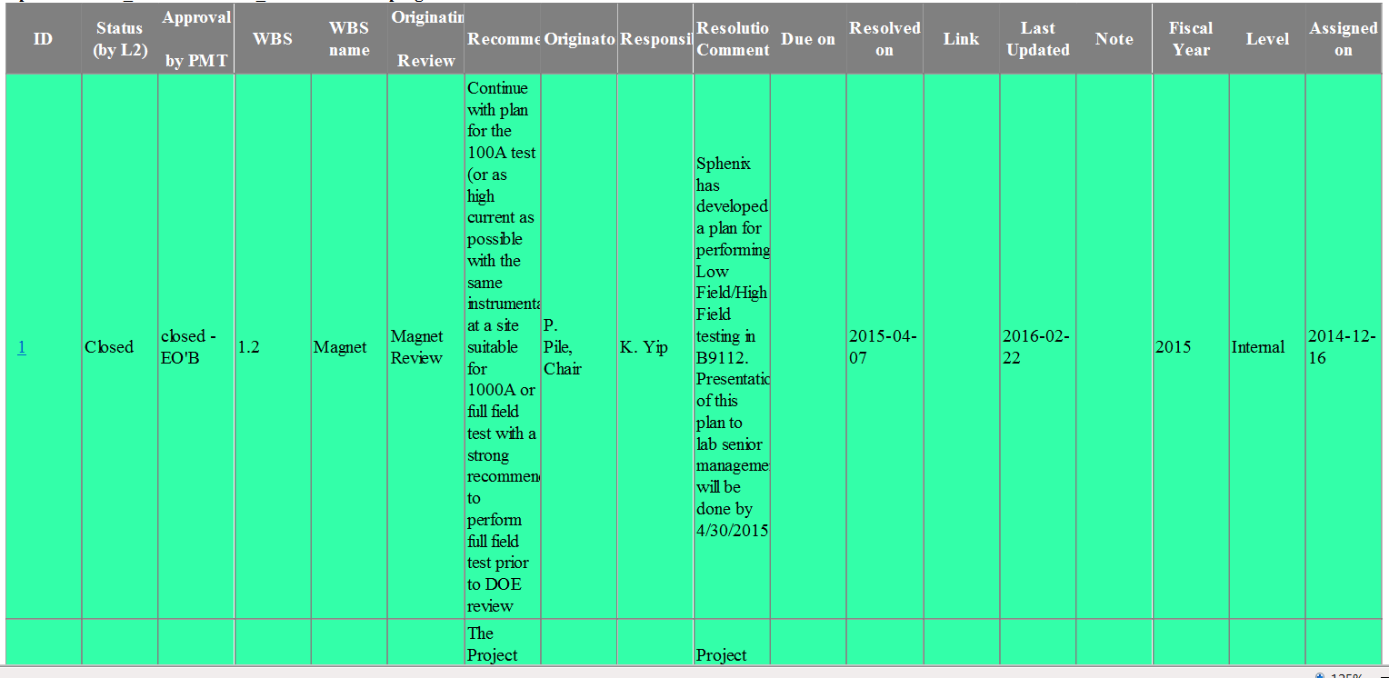
Comment Resolution Database
  Recommendations from Reviews to be entered into the sPHENIX Comment Resolution Database

Slide 11
Engineering Reviews
Over 40 Reviews Performed
All Reviews are in sPHENIX Resource Loaded Schedule
sPHENIX CRYOGENIC SYSTEM Procurement Readiness Review
sPHENIX Cradle/Carriage Preliminary Engineering Review
Calorimeter Trigger Preliminary Design Review
Calorimeter Electronics Digitizer System Design Review
LESHC 18-10 Review of the Cryogenic Systems for sPHENIX SC Solenoid IP8
MVTX Interim Design Review
Interim Design Review of Preproduction On-Detector HCAL Electronics
EMCAL Sector 1-12 Powder Review
sPHENIX HCAL Assembly Area Safety Review
EMCal Sector 0 Mechanics Preproduction Design Review
EMCal Sector 0 Electronics Preproduction Design Review
TPC Wagon Wheel Production Readiness Review
sPHENIX software and computing review
Outer HCal Scintillator Interim Design Review
EMCal Sector 0 Electronics Preproduction Design Review
EMCAL Block Design Review
sPHENIX Outer HCal Sector Steel Review Follow Up Review
INTT Pre-CD-1 Conceptual Design Review
sPHENIX Outer HCal Steel Sector Procurement Readiness/Design Review
sPHENIX Risk Registry and Mitigation Plan Review
EMCAL Fiber Procurement Readiness Review
Infrastructure, Installation and Integration Pre-CD-1 Conceptual Design Review
Cradle/Carriage Conceptual Design Review
DAQ/Trigger Pre-CD-1 Conceptual Design Review
TPC Pre-CD-1 Conceptual Design Review
Calorimeter Electronics Pre-CD-1 Conceptual Design Review
EMCAL Pre-CD-1 Conceptual Design Review
Nov HCAL Pre-CD-1 Conceptual Design Review
sPHENIX Calorimeter Prototype v2.1 IDR closeout & PRR
EMCAL Light Guide Preliminary Design Review
Time Projection Chamber mini-review
MAPs Vertex Detector mini-Review
sPHENIX Full Field Flux Return - Mechanical Design Review
sPHENIX Calorimeter Prototype Support Structure Mechanical design Review
Cost and Schedule Review Magnet/Decom/Install/Integn/Infra Practice
sPHENIX EMCal Review
sPHENIX EMCal Practice
sPHENIX Calorimeter Electronics Review
sPHENIX HCal Review
sPHENIX Decommissoning and Installation Review
sPHENIX Magnet Review
MAGNET Preliminary Design Review and Pressure Safety Review

Slide 12
sPHENIX Project Controls and Work Management Documents
sPHENIX Procedure Guidelines
sPHENIX Configuration Management
sPHENIX Document Control
sPHENIX Quality Assurance Plan
sPHENIX Conduct of Design Reviews
sPHENIX Work Planning
sPHENIX Awareness Training
sPHENIX Bottom’s-Up Estimate Uncertainty Guidelines
Interface Control Document/Interface Design Drawing
Integrated Safety Management Plan/Safety Hazard Analysis Document/CAD Conduct of Operations
Comment Resolution Database
sPHENIX Procedures and Documents for Engineering, Design, Fabrication, and Installation
Signed and released for use

Slide 13
Engineering Procedures
Typical sPHENIX Procedure - sPHENIX Q/A Plan, Conduct of Design Reviews, Configuration Management

Slide 14
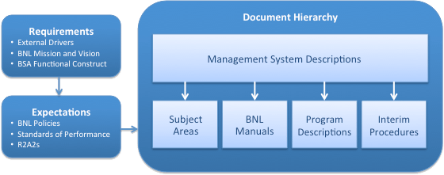
Engineering Management and Coordination
Brookhaven National Laboratory SBMS
The Standards-Based Management System (SBMS) provides Laboratory-wide procedures and guidelines for performing work safely and in compliance with requirements. All work at the Laboratory must comply with the minimum requirements specified in SBMS documents, including management system descriptions, subject areas, interim procedures, BNL manuals, and program descriptions.
Subject Areas
Engineering Standard
Design Standard
Configuration Control
Quality
sPHENIX Engineering Project Controls and Work Management Documents will meet all SBMS requirements but will be tailored to address complex multiple institutional and departmental collaborations.

Slide 15
Work Planning (SBMS)
Subject Area:
Work Planning and Control for Experiments and Operations
Introduction
This subject area uses the Integrated Safety Management core functions and guiding principles to establish a process for ensuring all work, operational and experimental, is properly planned and implemented to prevent accidents, injuries, and regulatory violations. It establishes requirements at Brookhaven National Laboratory (BNL) so that all work is properly managed by using a level of planning and control commensurate to the Environment, Safety, Security, and Health (ESSH) hazards, job complexities, and work coordination needs.
Line management is directly responsible for the protection of the public, the workers, and the environment.

Slide 16
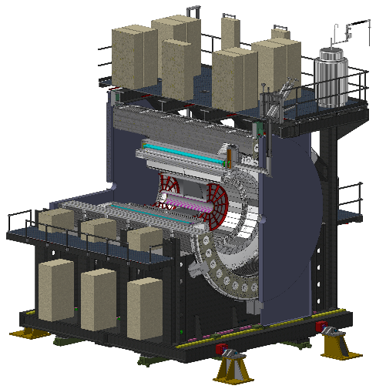
Interface Control Document (ICD)
sPHENIX ICD Matrix
ICD Links 2 and only 2 Subsystems
Documents which subsystems require a formal technical Interface to another subsystem. Total of 30 required for sPHENIX.

Slide 17
Interface Control Document (ICD)
Formal Handshake Between Subsystems
Describes Interface
Provides Technical Details of Interface
Specifies Deliverables between Subsystems and how to measure success
Administered by the Office of Systems Integration

Slide 18
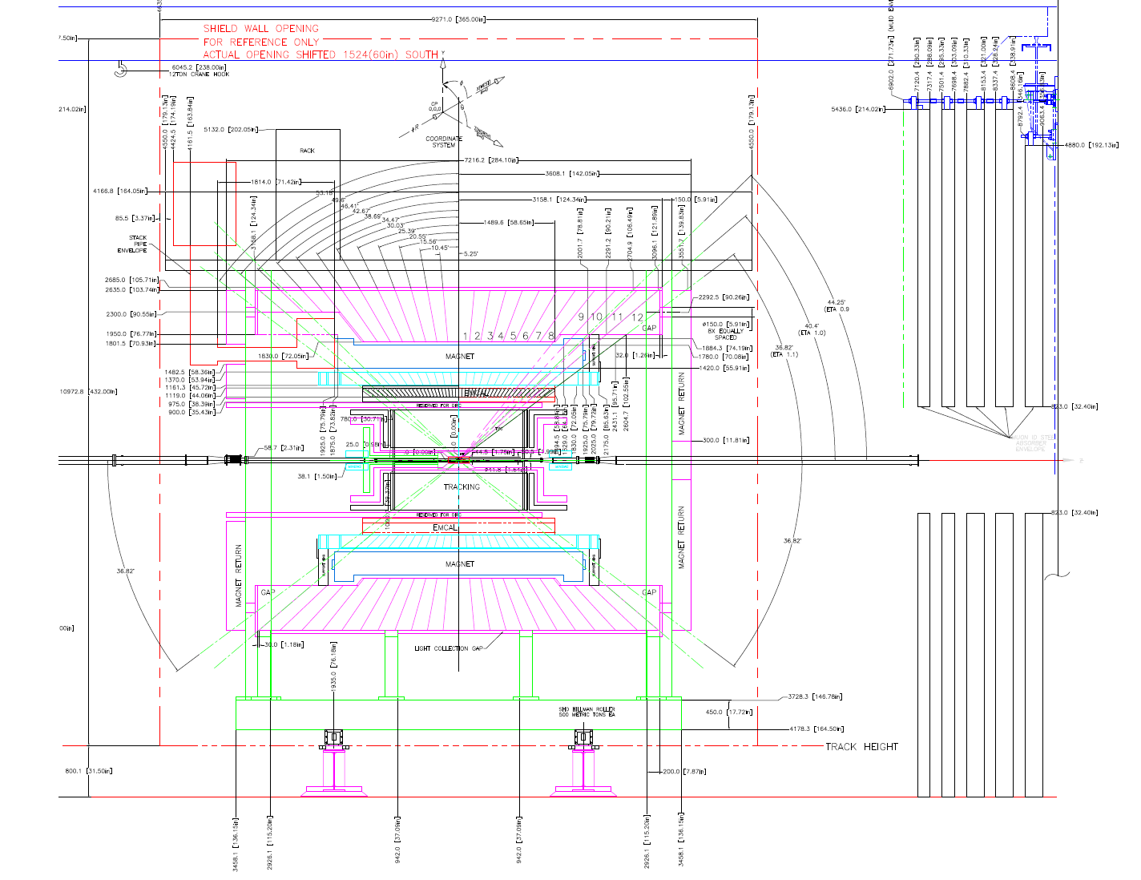
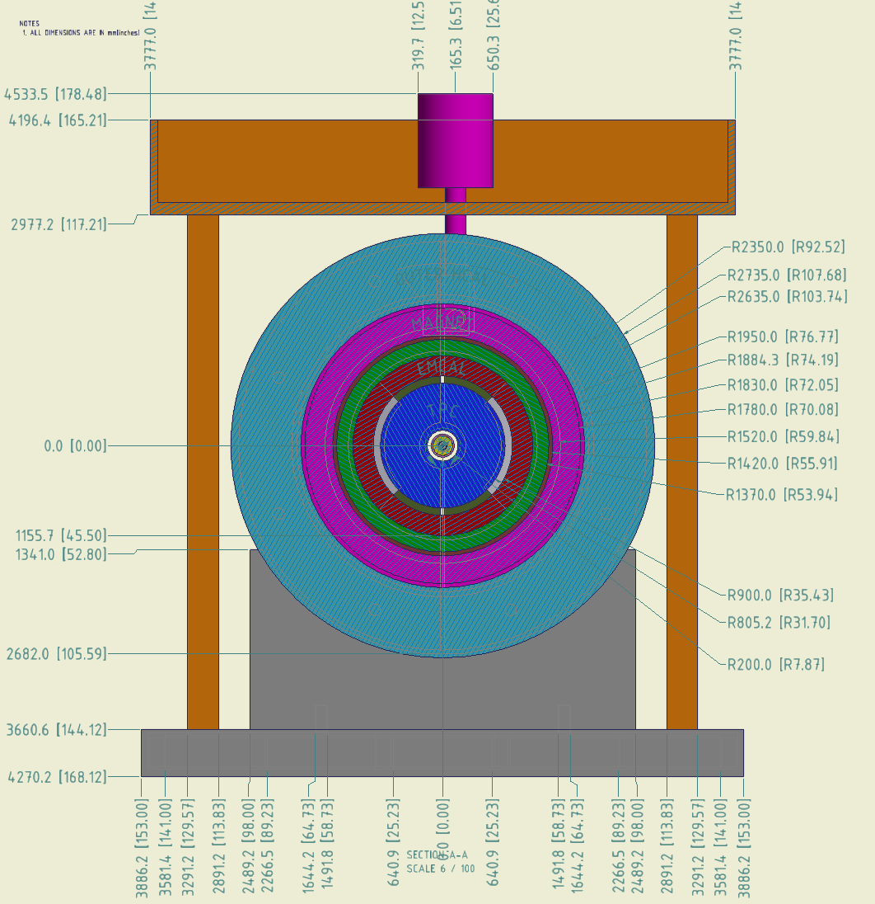
Interface Control Design Drawing (ICDD)
Dimensional Handshake Between Subsystems
Identifies Clearances and Stay Clear Zones
Released and Available to L2 Managers
Under Revision Control

Slide 19
Issues and Concerns
Issues and Concerns
Memorandum of Agreement for engineering support between sPHENIX and Collider Accelerator Department for Infrastructure needs to be finalized (4 of 5 MOAs Completed and Approved)
Would like an additional designer for detailing.
Some engineers are P/T - concerned about competing priorities
Proposed Resolution Plan
MOA with Requirements Document has been drafted and is now being edited for sign-off within the next 6 weeks
Continuing to address needs and work with CAD Chief Engineer in order to supplement as needed.
Closely monitor engineering and design support and if required work with supporting department in order to establish clear priorities for staff.

Slide 20
Summary
Engineering Organization Stable, Experienced, and Effective
Procedures and Configuration Control Rolled Out and Followed
Reoccurring Meetings Provides Appropriate sPHENIX Oversight and Important Conduit for Communications.

Slide 21
Engineering Management and Coordination
Back Up

