Slide 1
sPHENIX Director’s Review
SC MAGNET POWER SUPPLY AND CONTROLS
Carl Schultheiss
April 9-11, 2019
BNL

Slide 2
WBS 2.02.04
Magnet PS/Controls/Quench Protection
SC Magnet Power Supply
Energy Dump Resistor
Quench Detector
Controls
Results of High Field Test 1/29/2018 to 2/16/2018

Slide 3
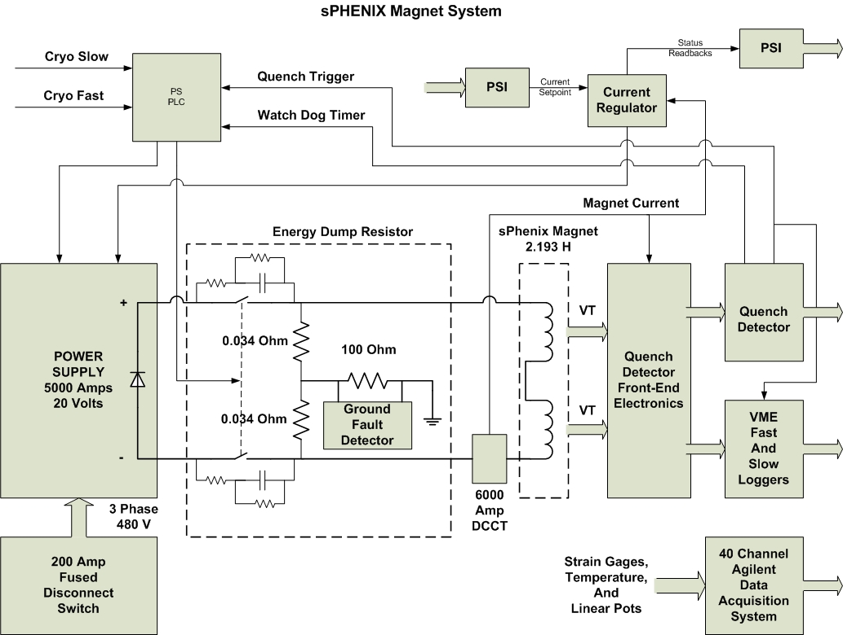
sPhenix Magnet System

Slide 4
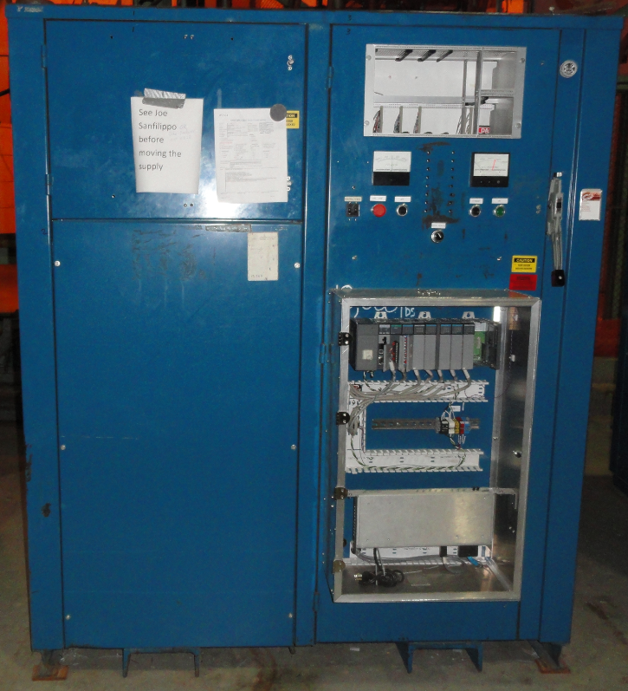
sPhenix Power Supply
Power Supply
  Output 20V @ 5000 Amps
  Input 480 Vac @ 200 Amps
  12 Pulse Star Configuration
  Free-Wheeling Diodes
  Water Cooled

Slide 5
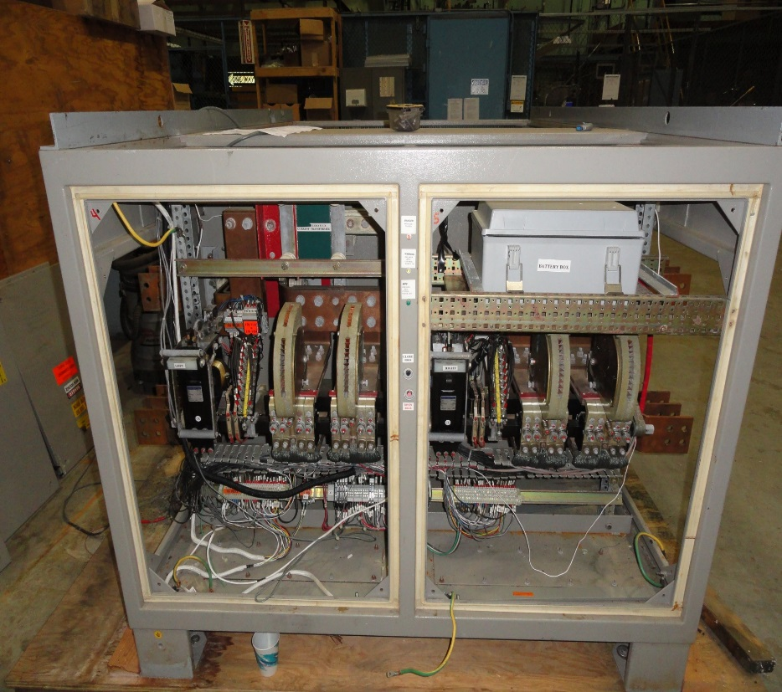
Energy Dump Resistor
2 Contactors 6000 Amps
Water Cooled Bus
Local Controls
Local Status
Relay Logic

Slide 6
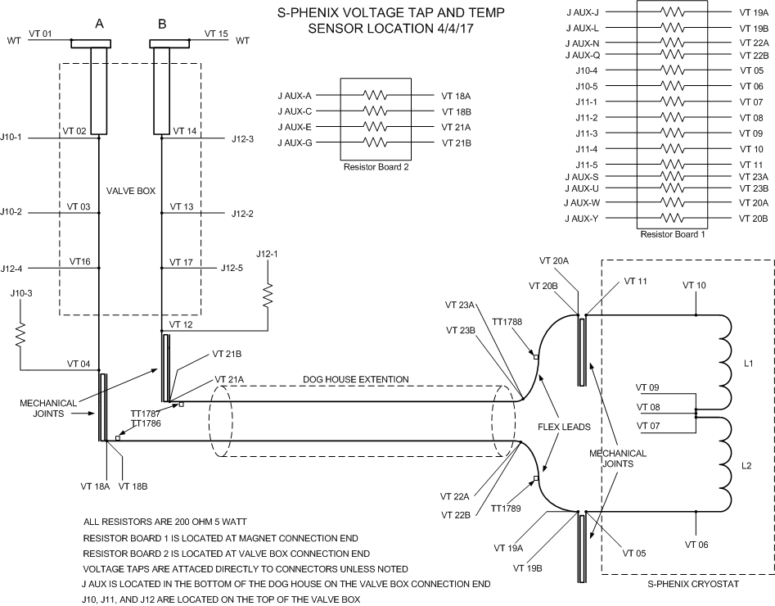
sPhenix Voltage Taps

Slide 7
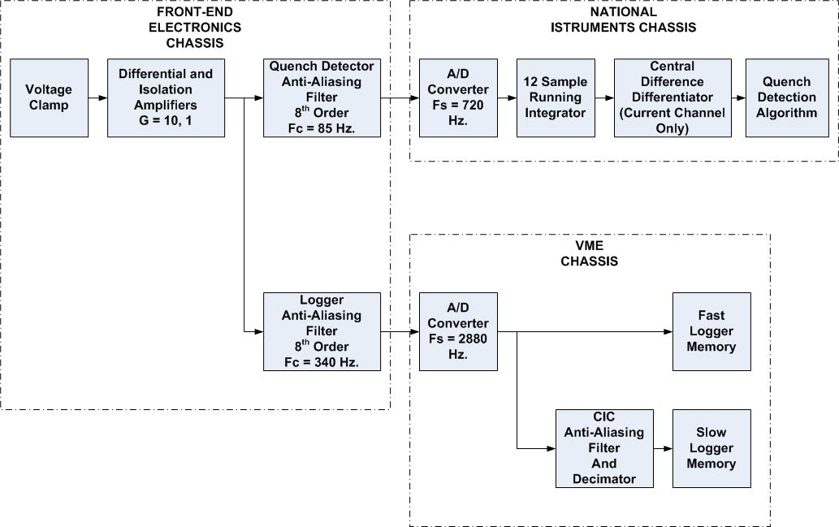
Quench Detector System

Slide 8
QD System Front End
Copy RHIC Quench Detector Front End
Voltage Clamp
  Designed for 300 V, exponential decay with a time constant of 32.25 seconds. (L/R = 2.193 H / 68 mOhm)
Open Lead Detection
Isolation
Gains
  Gain of 10 for superconducting busses, gas-cooled leads, and flex bus
  Dual Gains of 0.5/0.030 for magnet coils and total magnet voltage

Slide 9
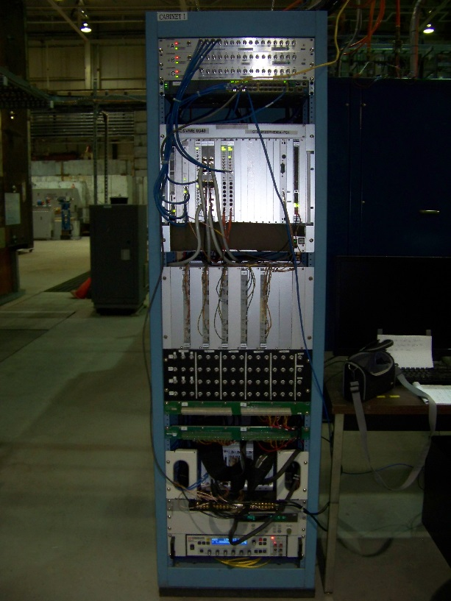
Quench Detector
22 Voltage Tap Channels
5 Aux Input Channels
  Magnet Current
  PS Current
  PS Voltage
  Ground Current
  Dump Resistor Voltage

Slide 10
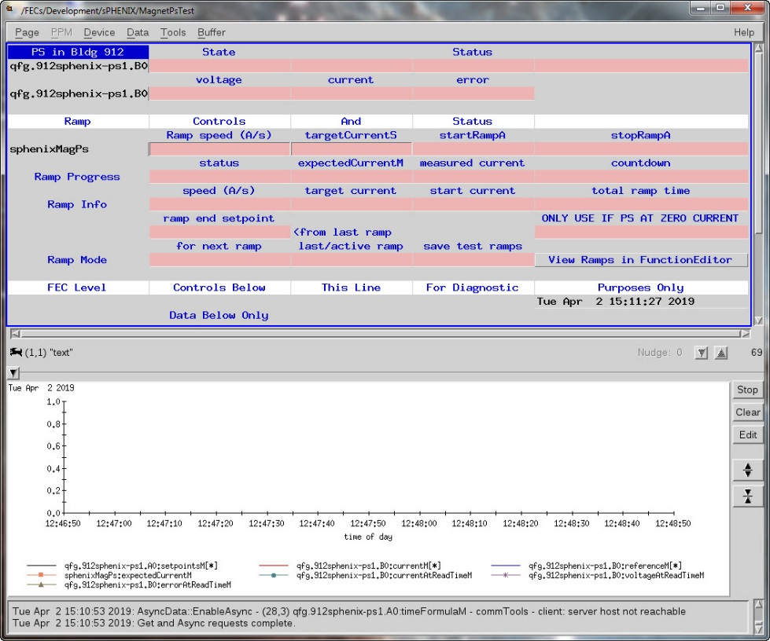
sPhenix PS Control Page

Slide 11
Schedule Drivers
Power Supply and Energy Dump Resistor moved to 1008B.
  Not in final position, depends on the final design of water-cooled bus.
  Quench Detector rack will be in 1008B, near the power supply.
New Quench Detector Calculation Engine is under design.
  Prototype planned by 2021.

Slide 12
Cost Drivers
Water-cooled Bus
Cable Tray
Electrical Distribution
Quench Detector Calculation Engine

Slide 13
High Field Test Results
Completed the High Field Test.
  Operated magnet at 4830 Amps
  105% of operational current (4596 Amps).
  Proved Quench Detector Operation
    Established quench limits, 50 mV
    Tested quench interlocks
      Fast Discharge
      Slow Discharge
  Measured Inductances, Inner 1.081 H, Outer 1.112 H
  Measured Gas-Cooled Leads’ flow-rate requirement
  0.32 g/sec at 105%.

Slide 14
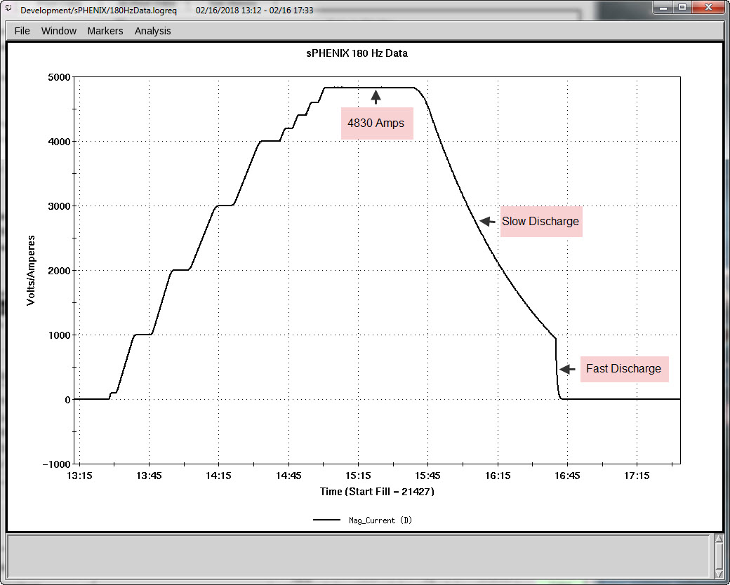
High Field Test Results
Notes:
2.0 Amps/sec to 2000 Amps
1.5 Amps/sec to 4830 Amps
Slow Discharge took 1 hour

Slide 15
Issues and Concerns
New Quench Detector Calculation Engine.
  NI system was not fast enough to do all the calculations we wanted.
  Make the sPhenix Quench Detector a satellite of the new RHIC QD.
  Working on prototype, it should be ready 2021.
Voltage Taps VT10 and VT11
  VT11 opened during cooldown
  VT10 opened during test at 2800 Amps on 2/9/2018
  Rerouting wiring to connector at bottom of chimney
  Opened up “Old Doghouse” to repair VT11 and add redundant taps.

Slide 16
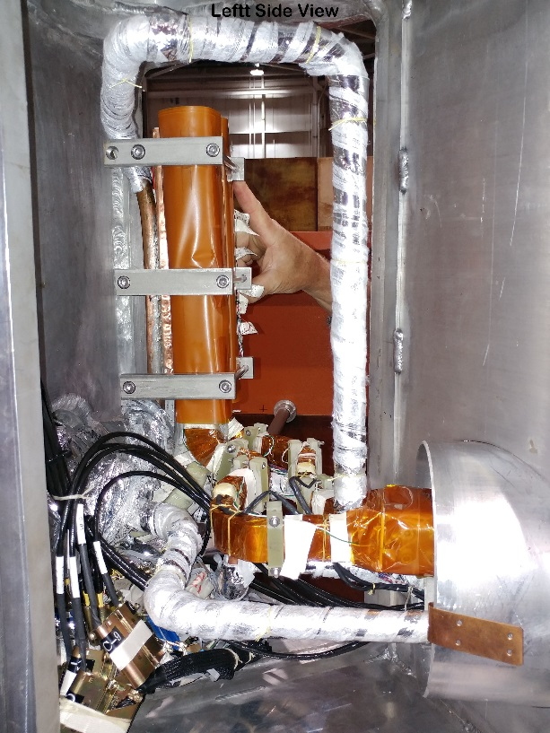
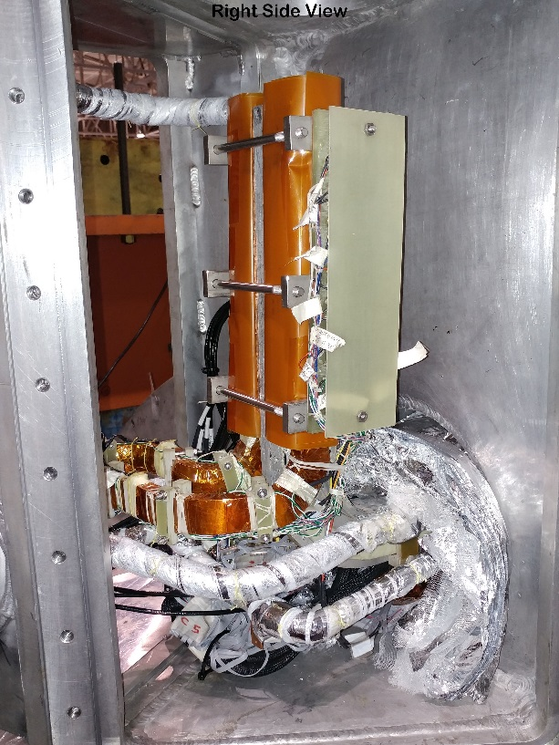
New Doghouse SC Junction

Slide 17
Milestones
  2.02.04.02.01 Install Power Supply at 1008B 3-Dec-19
  2.02.04.01.03 Install PS AC/DC Cable Tray 9-Mar-20
  2.02.04.01.03 Install PS AC/DC Cabling 23-Dec-21
  2.02.04.02.01 Install Power Supply Water Cooled Bus 6-Apr-22
  2.02.04.02.01 Power Supply Testing 20-Apr-22

Slide 18
  END

Slide 19
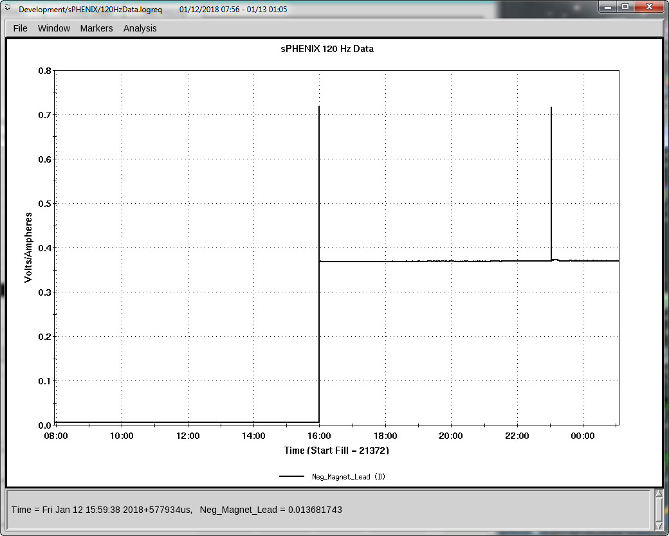
VT11 Opening 1/12/18

Slide 20
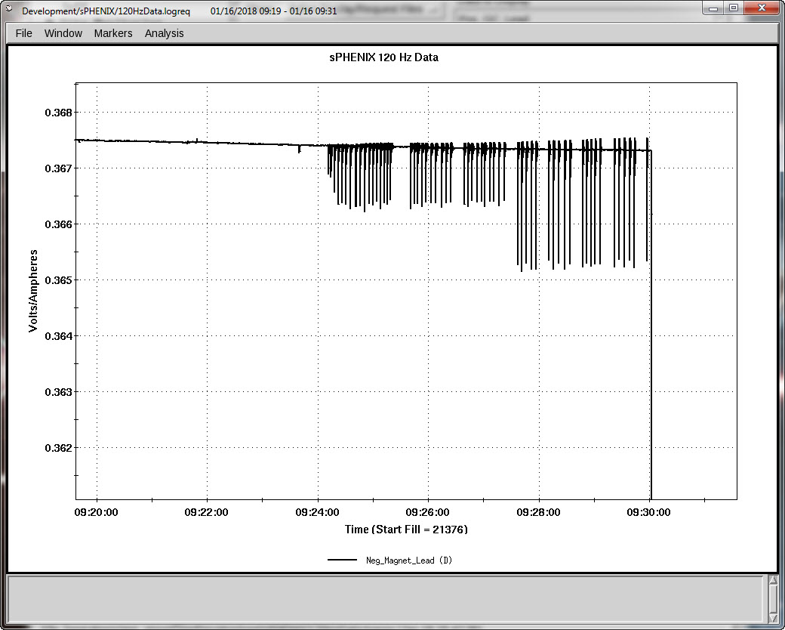
VT11 Reconnection 1/16/18

Slide 21
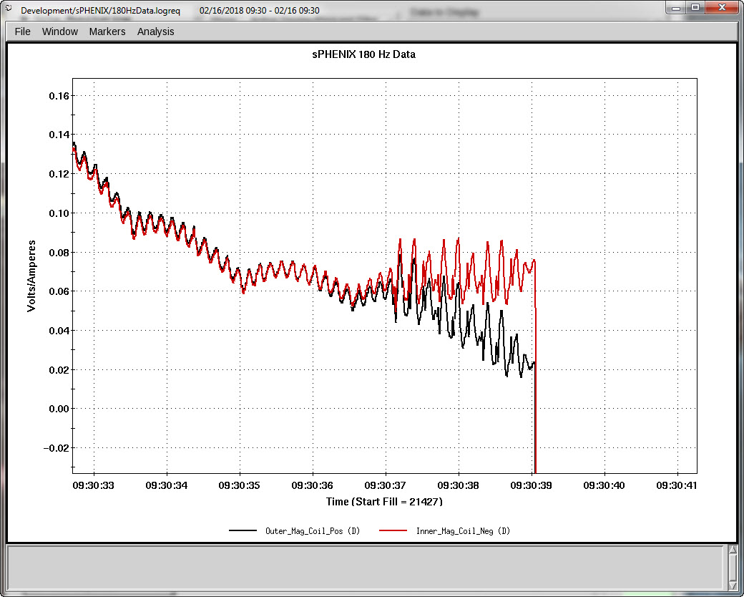
First Quench 2/16/18

Slide 22
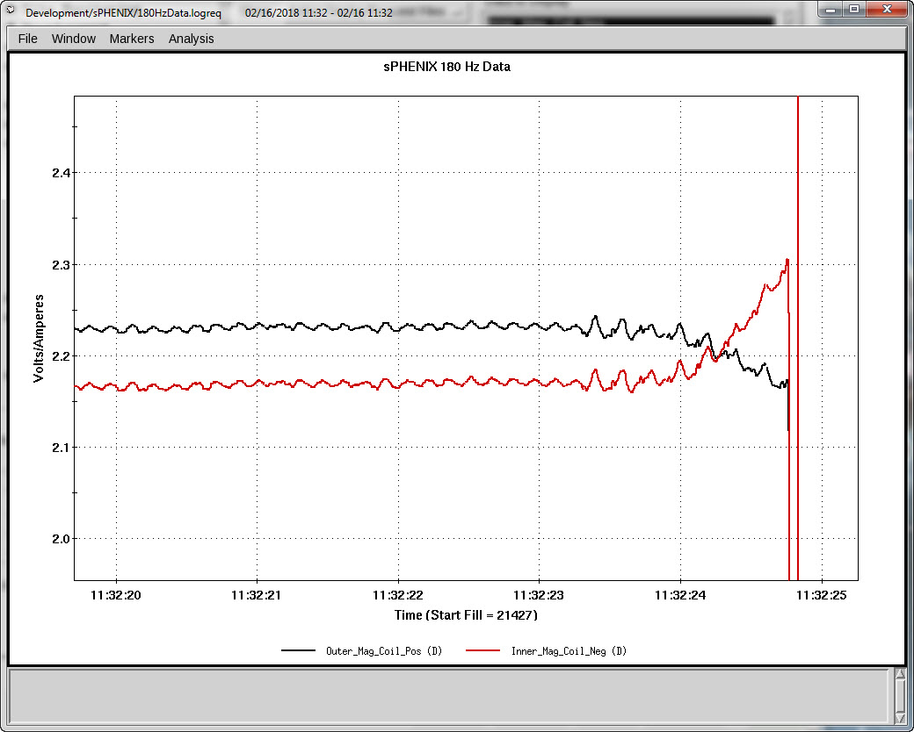
Second Quench 2/16/18

