Slide 1
sPHENIX Director’s Review Magnet Mapping
John Haggerty
April 9-11, 2019
BNL

Slide 2
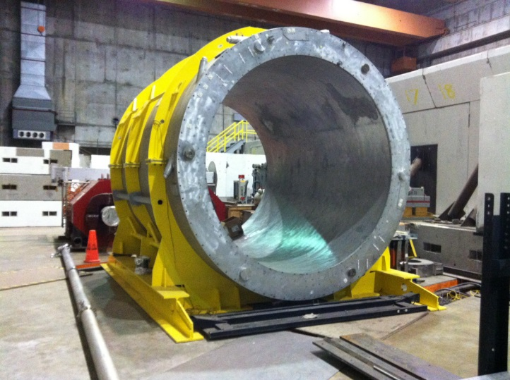
WBS 2.02.05 Magnetic Field Measurements
Magnet Field Measurements Engineering and Design, Field Studies and Stress Analysis
Magnet Field Measurements Equipment Purchase and Fabrication
Magnet Field Measurements Installation and Test, Post-Test Field Studies and Stress Analysis

Slide 3
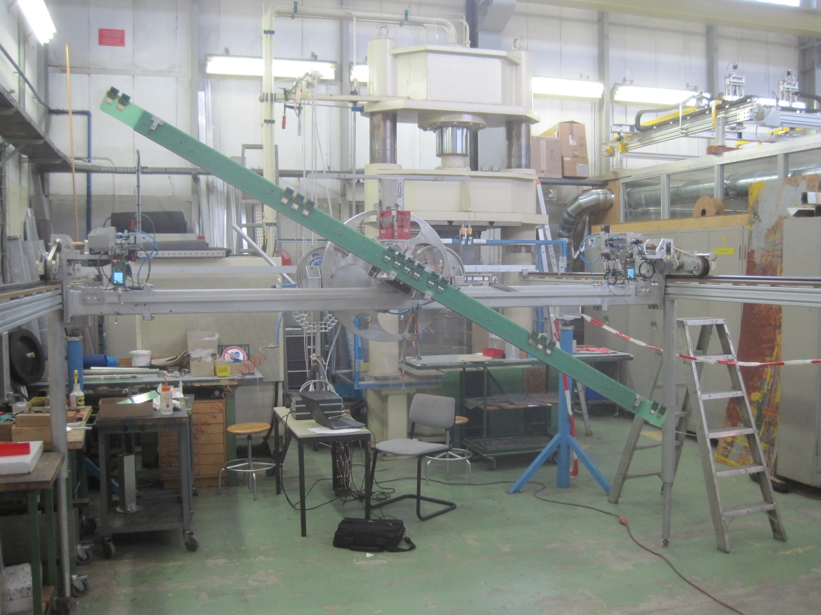
Technical Overview
Map the tracking volume (r < 80 cm, |z| < 110 cm) to a precision of ∼0.1% at operating current and compare with calculated field before installation of TPC
Contract with CERN magnet mapping group (Felix Bergsma)
http://ep-dep-dt.web.cern.ch/b-field-mapping-magnet-support

Slide 4
Technical Overview
Design and install probes to monitor the field during experimental operation
Hall probes for monitoring the field need to be chosen
Metrolab MagVector MV2 probes are promising, but need to test calibration, radiation hardness

Slide 5
Scope
WBS 2.02.05 includes
Calculation of field and forces
Measurement of the field within the tracking volume
Design and installation of probes to monitor the field in operation

Slide 6
Collaborators
Kin Yip and the cryo and power supply groups needed to energize the magnet
Achim Franz, who was responsible for the PHENIX magnet map

Slide 7
Milestones
WBS Path | WBS Name | Activity ID | Activity Name | Milestone Level | Date
2.02.05.01 | Magnet Field Measurements Engineering and Design, Field Studies and Stress Analysis | S308000 | Magnet Field Measurements: Magnet Engineering and Design Complete | L3 | 22-Oct-19
2.02.05.02 | Magnet Field Measurements Equipment Purchase and Fabrication | S308510 | Completed - Magnet Field Measurements: Fabricate NMR probe readout parts | L5 | 22-Jan-20
2.02.05.03 | Magnet Field Measurements Installation and Test, Post-Test Field Studies and Stress Analysis | S308820 | Completed - Magnet Field Measurements: Install NMR probes to monitor field | L5 | 16-Nov-21
2.02.05.03 | Magnet Field Measurements Installation and Test, Post-Test Field Studies and Stress Analysis | S309010 | Completed - Magnet Field Measurements: Map Magnetic Field of SC Magnet | L5 | 12-Jul-22

Slide 8
Schedule Drivers
Magnet mapping is the final part of the magnet project before the magnet goes into operation; all other systems must be operational before mapping
The magnet mapping cannot begin until the solenoid is enclosed in the barrel steel, the platform is on, the carriage is rolled into the IR, and RHIC cryo is available
Expected to be in mid-2022

Slide 9
Cost Drivers
BoE assumes that we will make our own mapping hardware
Contract with CERN magnet mapping group is estimated to cost about the same

Slide 10
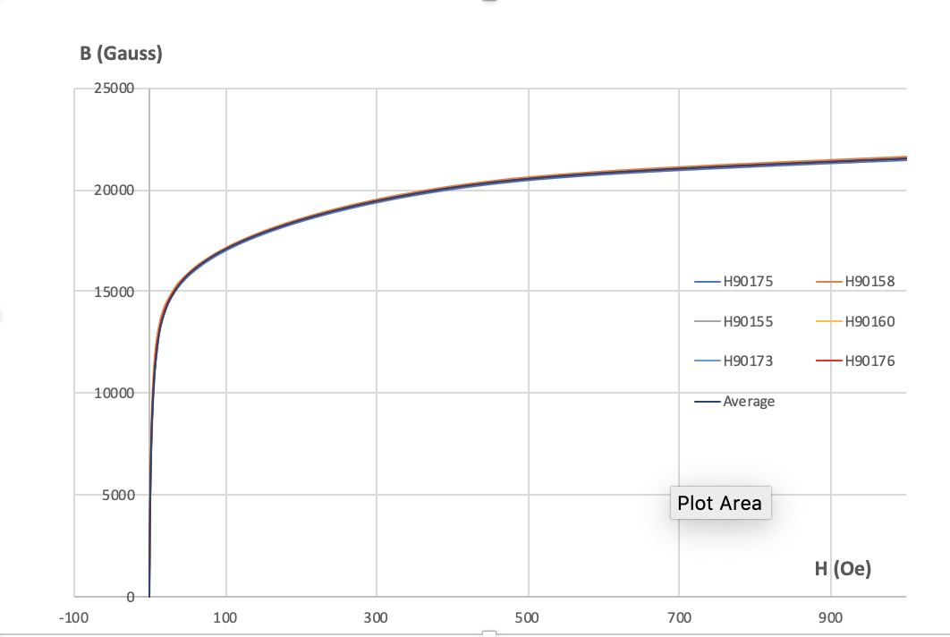
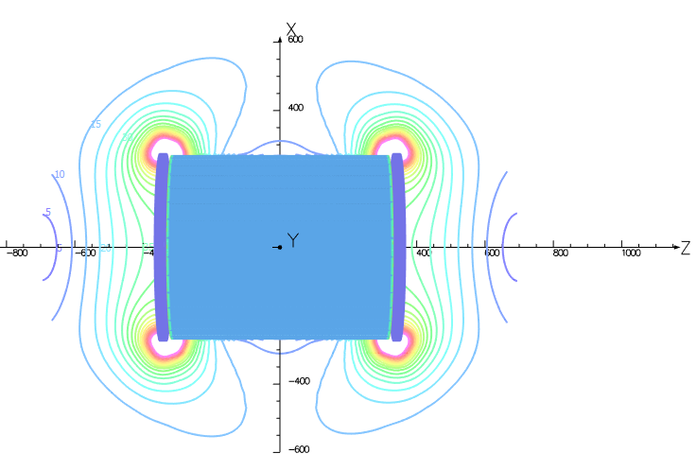
Status and Highlights
Magnetization of 6 samples of barrel steel have been measured by Magnetic Instrumentation
Wuzheng Meng has done a full 3D OPERA calculation of the field accounting for magnetic material as carefully as possible (barrel steel plates, end doors, holes for beam pipe and chimney)
Model will be carefully compared to engineering drawings
Map to be integrated into GEANT4 simulation
Forces from eddy currents in a quench have been calculated
Fringe field from 3D OPERA

Slide 11
Issues and Concerns
The CERN magnet mapping group has to be available in mid-2022 or the detector installation schedule is impacted

Slide 12
Summary
A careful calculation of the magnetic field is under way
Plans for mapping the tracking volume of the solenoid have been made
Probes for monitoring the field in operation are being planned
Magnet Mapping
is ready for PD-2/3

