Slide 1
sPHENIX Director’s Review
2.03 – Cradle Carriage/Pole Tips/Platforms
J. Mills
April 9-11, 2019
Brookhaven National Laboratory

Slide 2
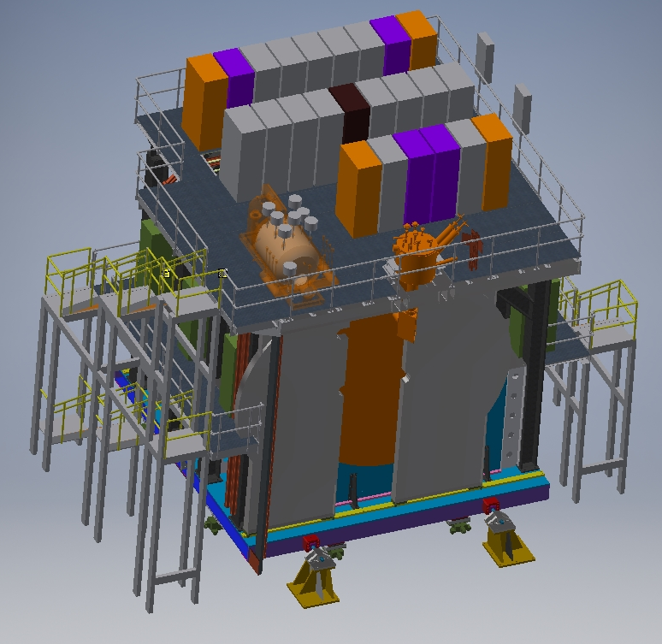
2.03.01, .04, .05 CARRIAGE/CRADLE SYSTEM
2.03.05 Access Stairs
2.03.05 Top and Mid Platforms
2.03.05 Access Stairs
2.03.04 End Caps/Pole Tips
2.03.01 Drive, and Alignment System
2.03.01 Carriage Assembly
2.03.01 Seismic Supports

Slide 3
CARRIAGE Support Preliminary Design Loads
Top and Mid Platforms
150 psf
RACKS= 12 TONS
CRYO = 6 TONS
BALANCE:
  CABLES
  UTILITIES
  DEAD LOAD
  PERSONNEL
50 TONS
(analysis also includes seismic loads)
Magnet and Detector Subsystems
565 TONS
End Caps/Pole Tips
110 TONS
Carriage assembly
130 TONS

Slide 4
WORK BREAKDOWN STRUCTURE
2.03 CARRIAGE AND STRUCTURAL COMPONENTS
2.03.01 CARRIAGE
- CARRIAGE BASE ASSEMBLY
-TRANSPORT SYSTEM
-ALIGNMENT SYSTEM
-TRACK SYSTEM
-SEISMIC SUPPORTS
2.03.02 Inner Detector Structural Support
2.03.03 Barrel Steel/OHCal Sectors
2.03.04 CAPS/POLE TIPS
-MAGNETIC CAPS
-MOVABLE TO ALLOW ACCESS TO DETECTOR
2.03.05 CC BRIDGE, MID PLATFORMS AND ACCESS
- Platforms supporting electronics racks
- Means of egress (stairs/ladder)

Slide 5
Collaborators
Level 2 Manager – C. Pontieri (BNL-PH)
Engineering
  J. Hock (BNL-CAD)
  J. Mills (BNL-CAD)
Design Engineering
  J. Scheblein (BNL-PH)
  D. Puleo (BNL-CAD)

Slide 6
Scope
Perform engineering and design needed to assemble full specification and construction document packages necessary for fabrication.
Develop appropriate interfaces with other subsystems.
Perform design reviews in accordance with sPHENIX procedures.
Develop bottom-up cost estimate and schedule for this subsystem.
Fabricate necessary components needed to deliver subsystem to B1008 for assembly. Provide technical oversight during fabrication and assembly.

Slide 7
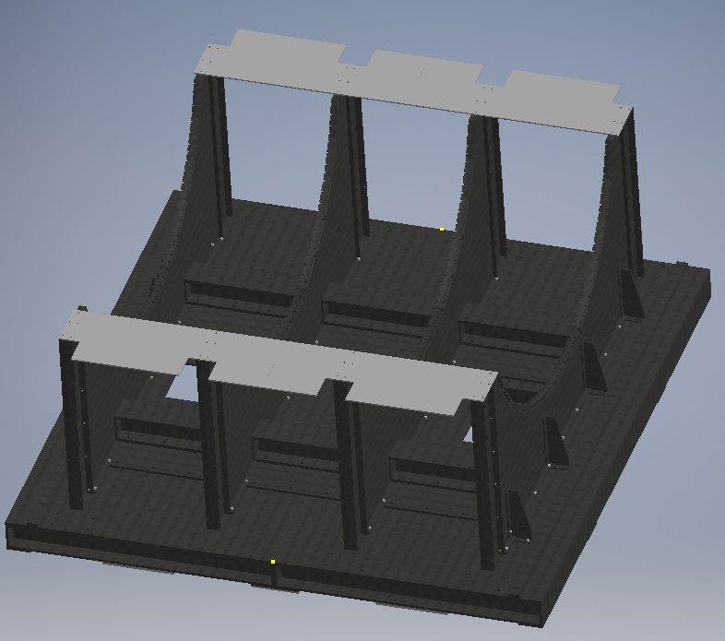
Carriage Base Assembly
STIFFENER BEAMS WITH DOUBLES
CARRIAGE PEDESTAL (Cradle)
TOP PEDESTAL SUPPORT
PEDESTAL SIDE SUPPORT
WELDED BASE

Slide 8
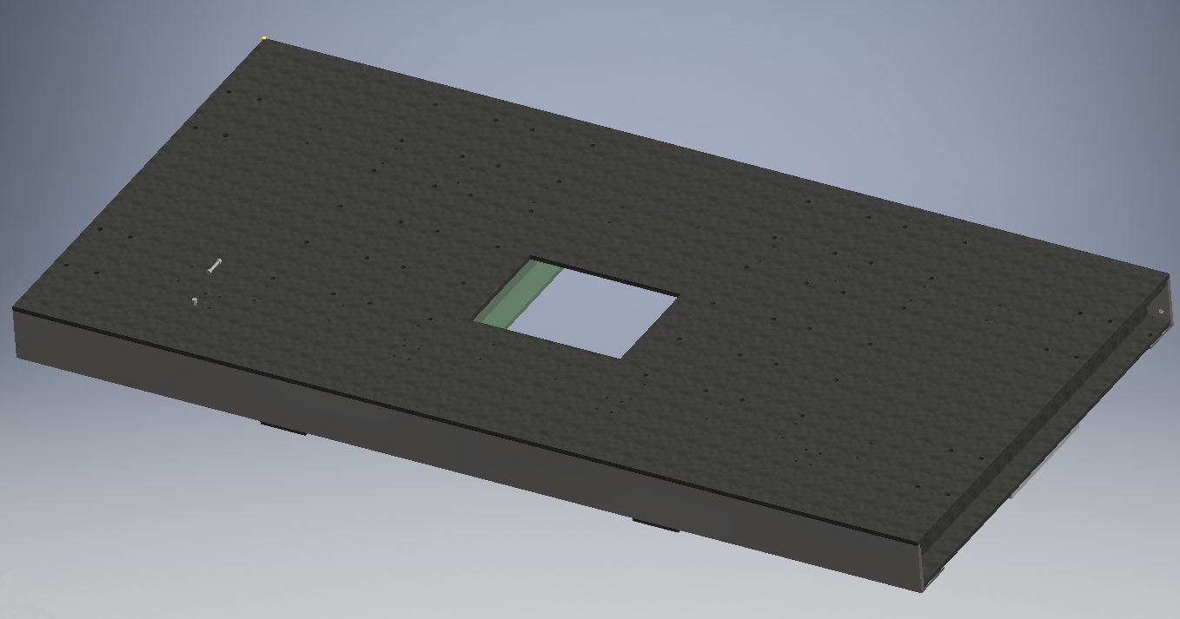
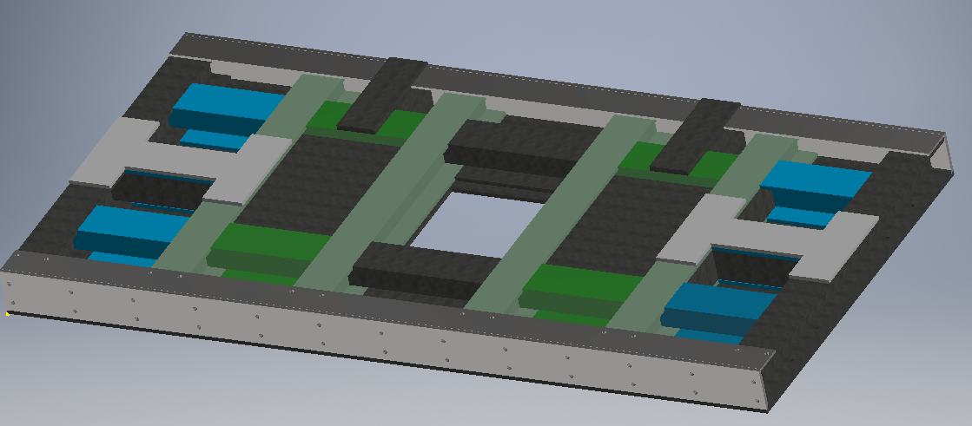
CARRIAGE WELDED ½ BASE
ACCESS HOLE
1 ½” THICK TOP PLATE
FRAME IS MAINLY W14X193 BEAMS
STIFFENERS FOR LONG ROLLER ASSEMBLY
STIFFENERS FOR SHORT ROLLER ASSEMBLY
HOLES FOR CONNECTING HALVES
6” THICK PLATE TO SUPPORT LIFTING JACKS

Slide 9
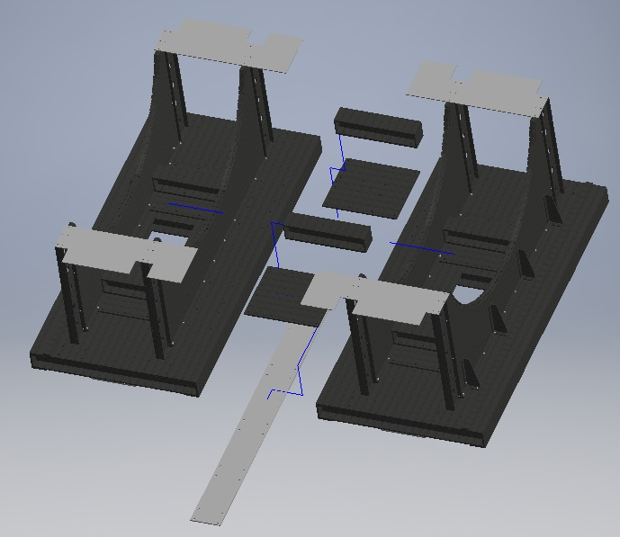
CARRIAGE BASE HALVES JOINED
TOP JOINING DOUBLE AND BEAM
STIFFENER BEAMS WITH DOUBLES
TOP PEDESTAL SUPPORT
CARRIAGE PEDESTAL
PEDESTAL SIDE SUPPORT
CARRIAGE ASSEMBLY
BOTTOM JOINING DOUBLE

Slide 10
Production Drawings
Preparing Detailed Production Drawings
To be used for Fabrication and Budgetary Quotes
Base Assembly Drawing

Slide 11
Production Drawings
Checking and Preparing for Budgetary Quotes

Slide 12
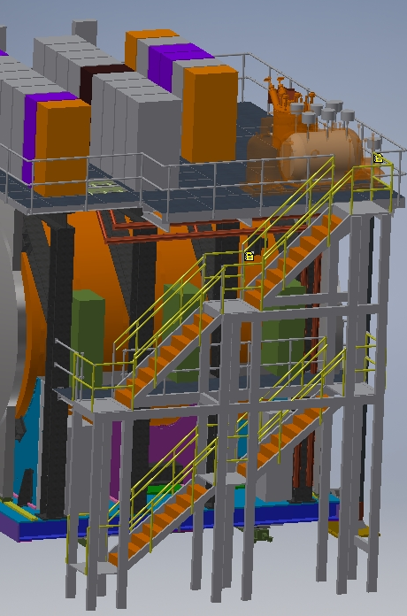
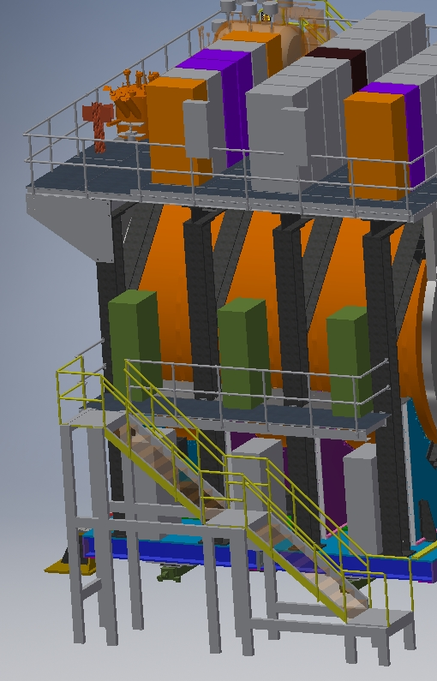
PLATFORM/ACCESS
CARRIAGE SYSTEM
ELECTRONIC RACKS
2ND TIER
STAIRS
WESTSIDE ACCESS
EASTSIDE ACCESS

Slide 13
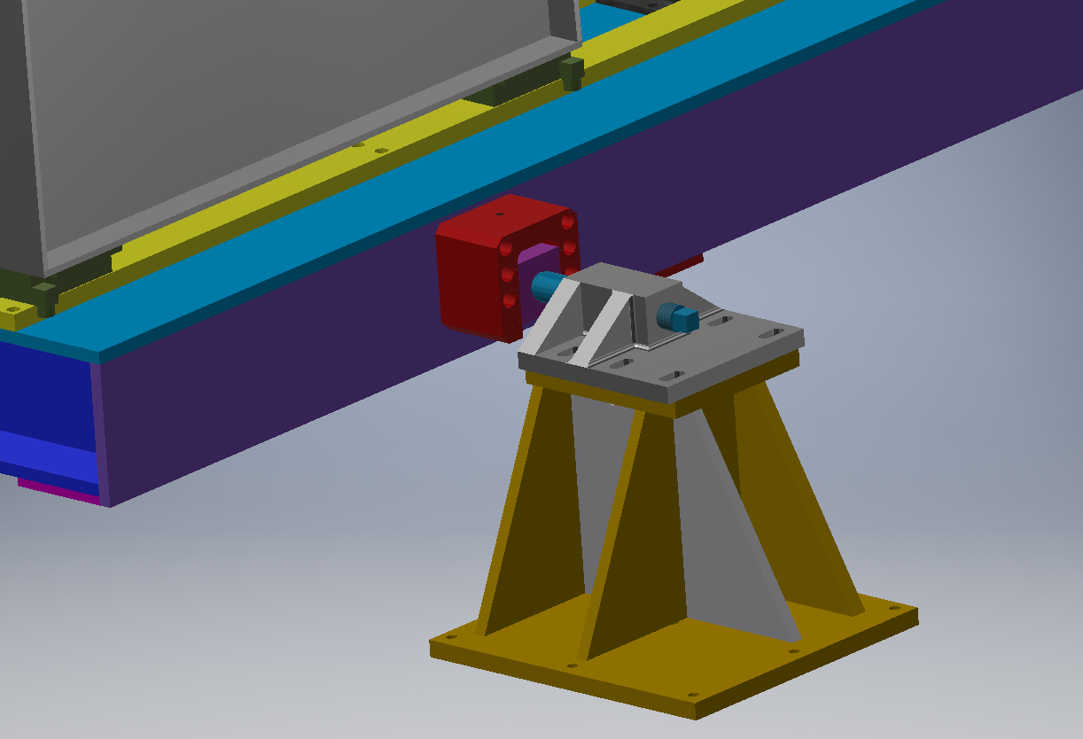
SEISMIC SUPPORT
CARRIAGE SYSTEM
CARRIAGE BRACKET FLOATS IN THE
Y DIRECTION
REMOVABLE PIN ALLOWS FOR ADJUSTMENT IN THE Z DIRECTION
Y
TOP BRACKET ALLOWS FOR ADJUSTMENT IN THE X DIRECTION
Z
BASE BRACKET
X

Slide 14
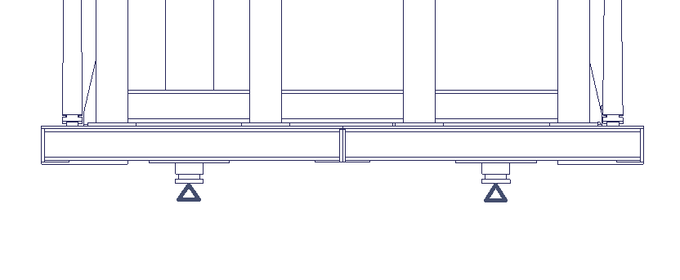
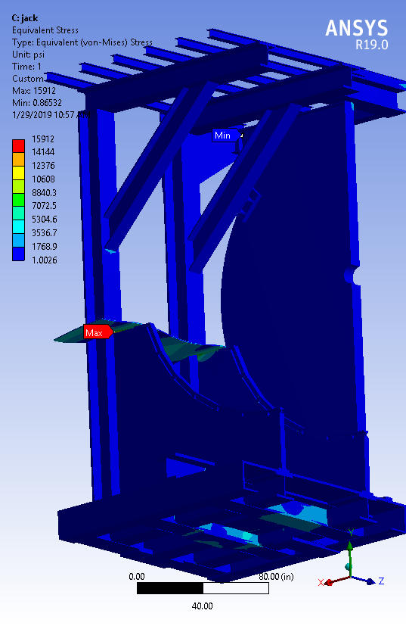
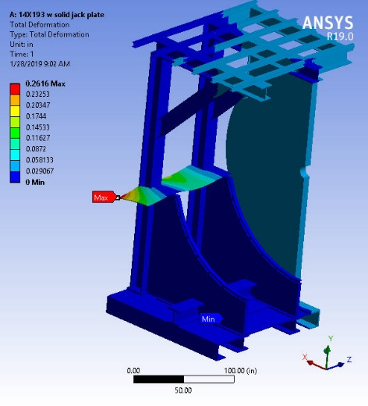
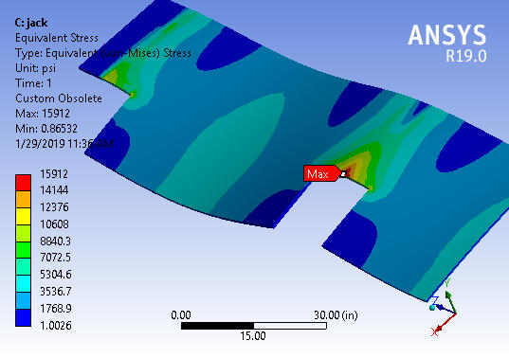
CARRIAGE FEA ANALYSIS CASE A1
CARRIAGE ON JACKS
¼ OF THE STRUCTURE WAS MODELED USING SYMMETRY
LOADS:
WEIGHT OF STRUCTURE (GRAVITY)
WEIGHT OF DETECTOR (565 TONS)
WEIGHT OF PLATFORMS (150#/F²)
MATERIAL: A36 STEEL
YIELD STRENGTH= 36.3 ksi
ULTIMATE STRENGTH=58 ksi
MAX STRESS= 16KSI
AVERAGE STRESS= .57 KSI
SF=2.27
MAX DEFLECTION = .26
MAX VON MISES STRESS

Slide 15
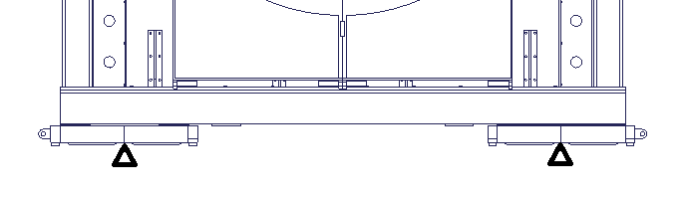
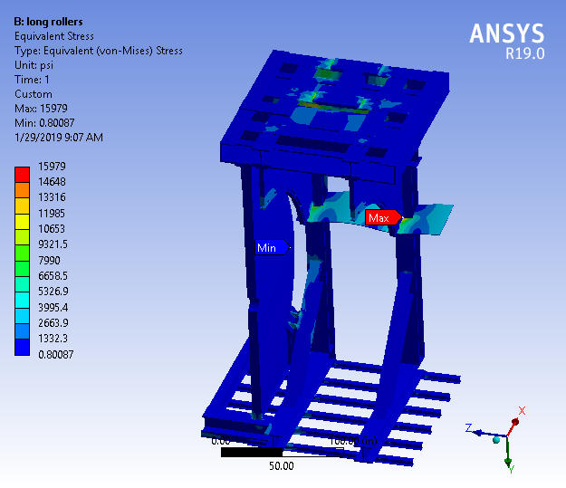
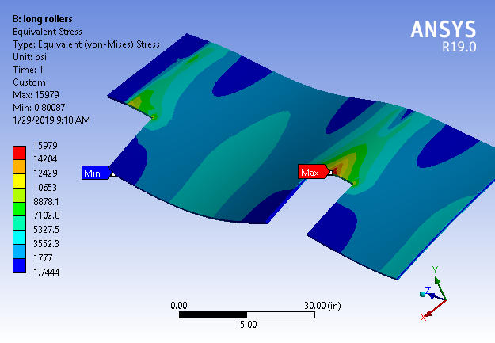
CARRIAGE FEA ANALYSIS CASE A2
CARRIAGE ON LONG ROLLER ASSEMBLY (EAST-WEST TRANSLATION)
¼ OF THE STRUCTURE WAS MODELED USING SYMMETRY
LOADS:
WEIGHT OF STRUCTURE (GRAVITY)
WEIGHT OF DETECTOR (565 TONS)
WEIGHT OF PLATFORMS (150#/F²)
MATERIAL: A36 STEEL
YIELD STRENGTH= 36.3 ksi
ULTIMATE STRENGTH=58 ksi
MAX STRESS= 16KSI
AVERAGE STRESS= .64 KSI
SF=2.27
MAX VON MISES STRESS

Slide 16
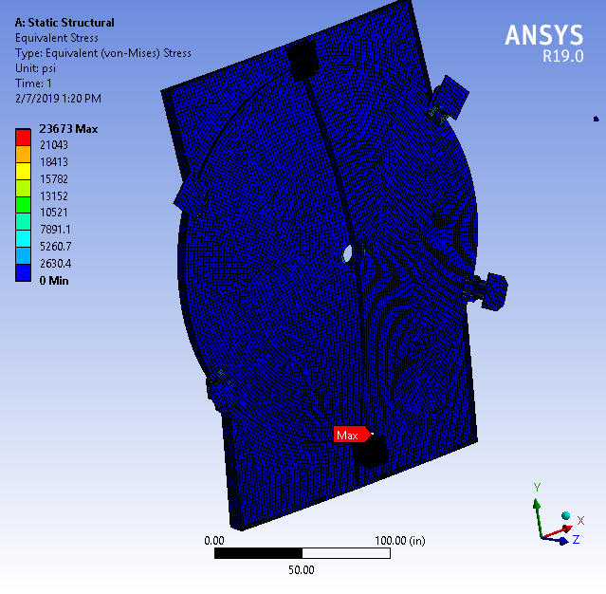
MAIN MAGNET END CAPS

Slide 17
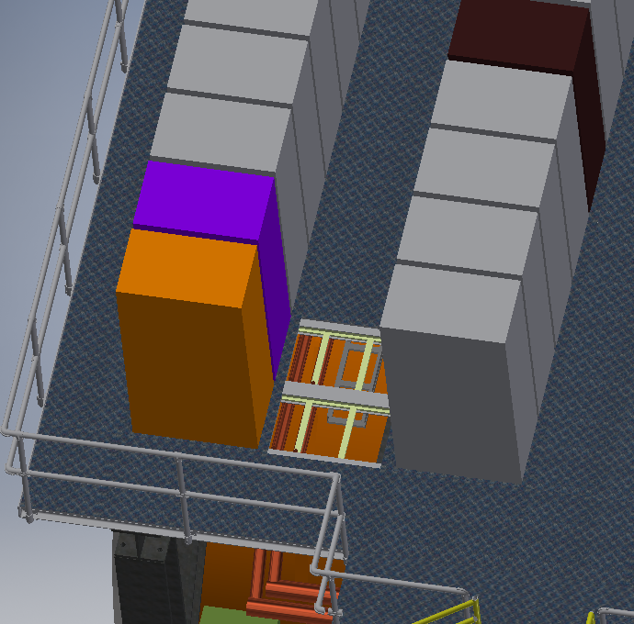
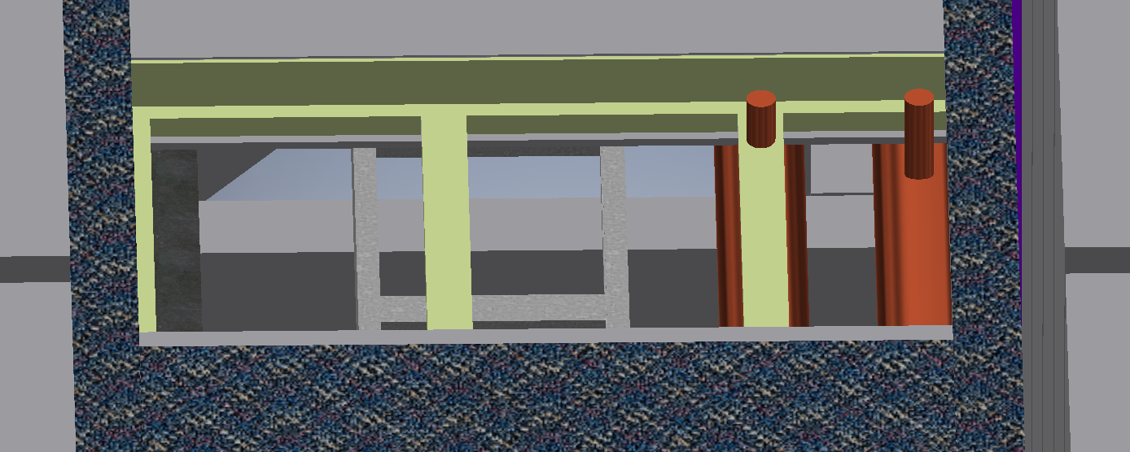
UTILITIES INTERFACES
TOP PLATFORM ELECTRONIC INTERFACE:
FLOOR PANELS (26”BY 36”) ARE REMOVABLE TO ACCESS WIRING
FLOOR PLATES CAN BE REMOVED W/O JEOPARDIZING THE STABILITY OF THE STRUCTURE
DATA CABLE TRAY LOCATED JUST BELOW FLOOR, UNDER EACH ENCLOSURE.
POWER CABLE TRAY IS JUST UNDER DATA TRAY, 8” REACH.
WATER COOLING PROVIDED FOR EACH ENCLOSURE.
WATER COOLING SUPPLY AND RETURN
DATA CABLE TRAY
POWER CABLE TRAY
PLATFORM FLOOR PANEL REMOVED

Slide 18
Schedule Drivers
2.03 CARRIAGE AND STRUCTURAL COMPONENTS
2.03.01 CARRIAGE
- Complete Engineering and Design
- Resolve issue related to tracks
2.03.04 CAPS/POLE TIPS
Complete Engineering and Design
2.03.05 CC BRIDGE, MID PLATFORMS AND ACCESS
- Complete Engineering and Design
- Finalize means of egress with BNL Safety and Fire Protection

Slide 19
Schedule Development
Bottom-Up Approach to task and duration
Engineers and Designers Participated, Buy-In From All
Assistance from Project Management Professional
Vetted by Project Management Professional
Linking and Flow of Tasks Performed in Real Time with Team

Slide 20
Milestones

Slide 21
Cost Drivers
Fabrication of the Cradle Base
Fabrication of Pole Tips
Fabrication of Platforms
Potential additional cost of rail modifications/replacement

Slide 22
Cost Development
Bottom-Up Cost Estimate
Based on Engineering Experience and Judgement
Vetted in August 2018 by team of Senior Engineers from CAD and sPHENIX.
Working on drawing package for Cradle/Carriage in Order to Solicit Budgetary Quotes.

Slide 23
Status
Engineering Design Review Completed - 2-11-19
SCOPE OF REVIEW -
CARRIAGE BASE DESIGN
OUTER HCAL INTERFACE
ASSEMBLY/TRANSPORT SEQUENCE
TRANSPORT SYSTEM
ALIGNMENT SYSTEM
PLATFORM/ACCESS
MAGNET END CAPS
SYSTEM INTERFACES
SEISMIC SUPPORTS
STRUCTURAL ANALYSIS
  COMPLETE CARRIAGE ASSEMBLY
  BOLTED BASE PLATFORM JOINT
  XZ ALIGNMENT SYSTEM
  TRACKS
TRACK SYSTEM MODIFICATIONS
Committee Members
J. Bowers – LLNL Senior Mechanical Engineer
C. Folz – CAD Head, Facilities and Experimental Support
J. Haggerty – sPHENIX Project Scientist
J. Mills, Chair – sPHENIX Project Engineer
C. Pearson – CAD Senior Mechanical Engineer
J. Tuozzolo – CAD Chief Mechanical Engineer
Other Participants
sPHENIX Project Director and Manager
CAD Engineers
sPHENIX Chief Designer
sPHENIX Engineers
Q/A, Safety, Office of Systems Integration

Slide 24
Issues and Concerns
Issues/Concerns
Proposed Action/Resolution
Potential increase in fabrication cost for cradle base.
Potential rise in raw steel prices due to market fluctuations.
May need major modifications or replacement of existing rails.
Continue to value engineer, obtain budgetary quotes as soon as possible. Carry conservative Estimate Uncertainty until contract award.
Monitor steel market for changes. Carry conservative Estimate Uncertainty until contract award.
Fully evaluate existing rails and make determination of scope. Carry conservative Estimate Uncertainty until contract award and carry in Risk Registry.

Slide 25
Summary
Design of cradle carriage is mature. Detail drawings for fabrication have been developed and are being checked. Will solicit budgetary quotes within next month.
Design of Pole Tips/Platforms proceeding with detail design complete later this year.
Will resolve rail modification/replacement within next 6 weeks

Slide 26
Back Up

Slide 27
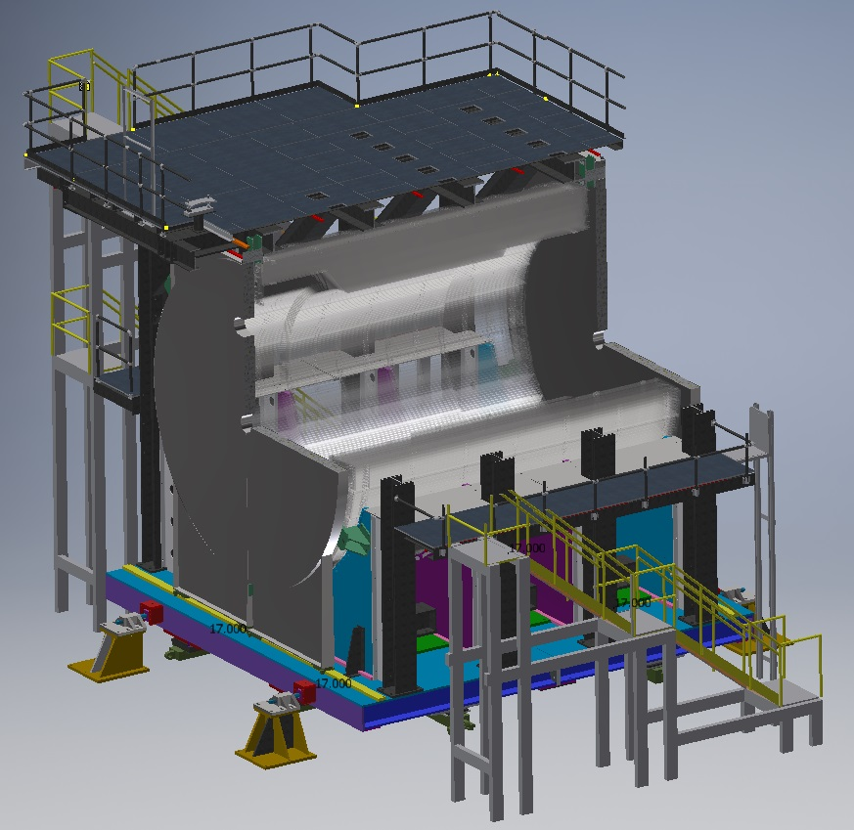
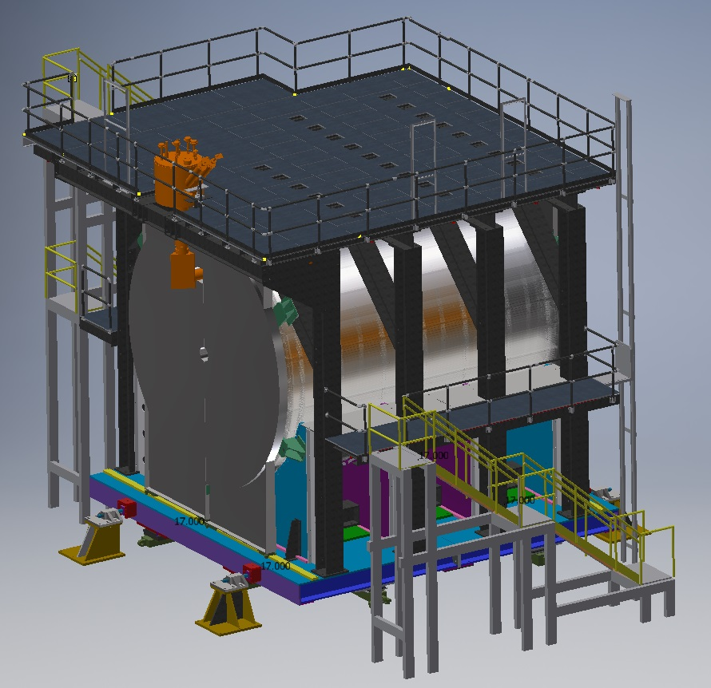
2.03 Current Layout

Slide 28
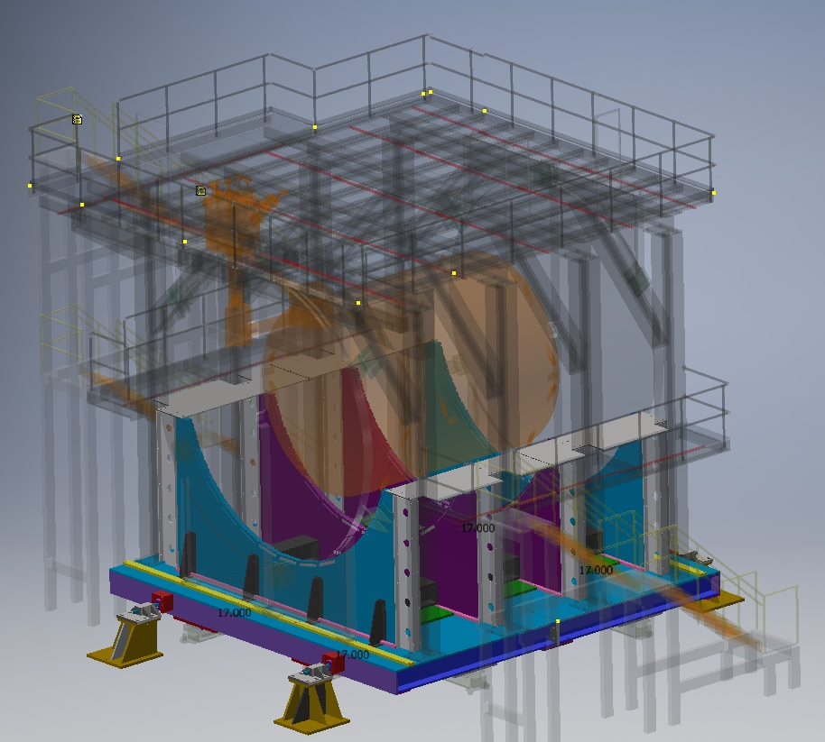
2.03.01 Cradle Base

Slide 29
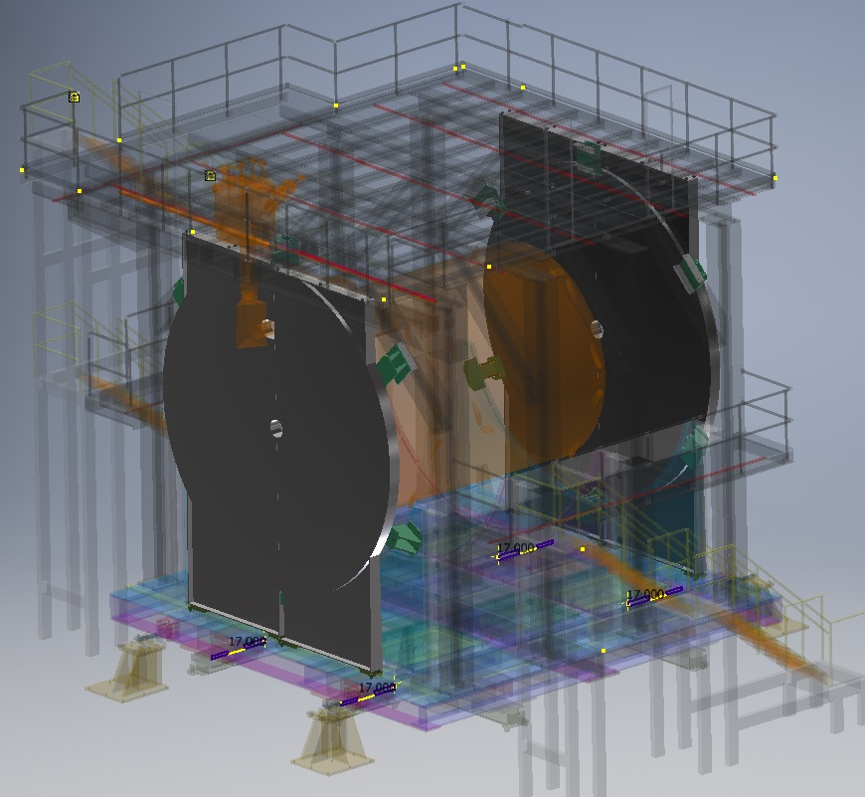
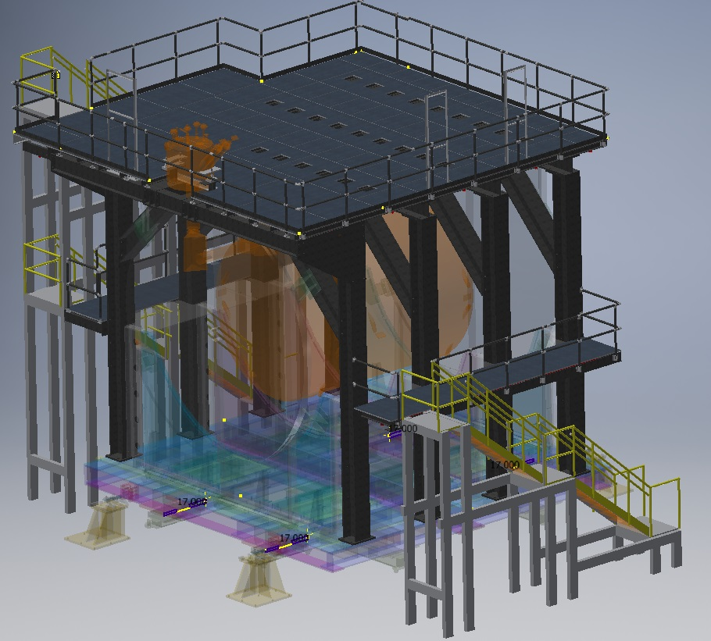
2.03.04 Pole Tips, 2.03.05 Platforms and Stairs

