Slide 1
sPHENIX Director’s Review Barrel Steel/Inner Detector Structural Support
Jim Mills
April 9-11, 2019
BNL

Slide 2
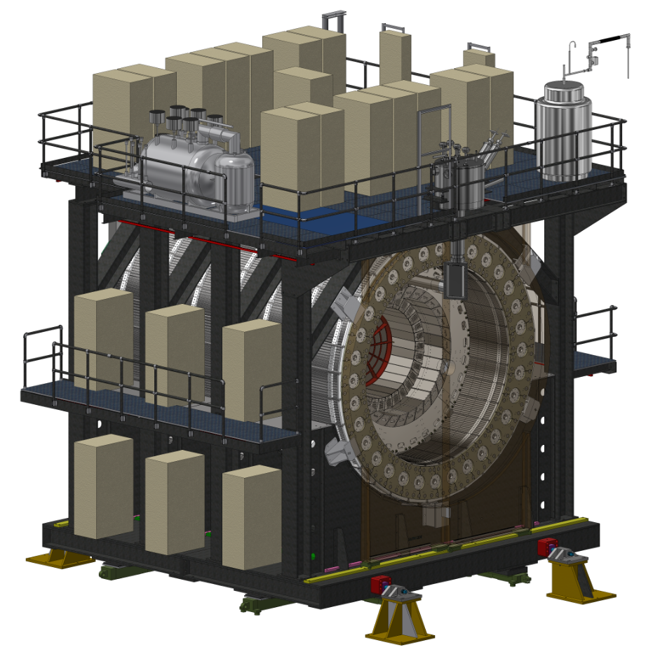
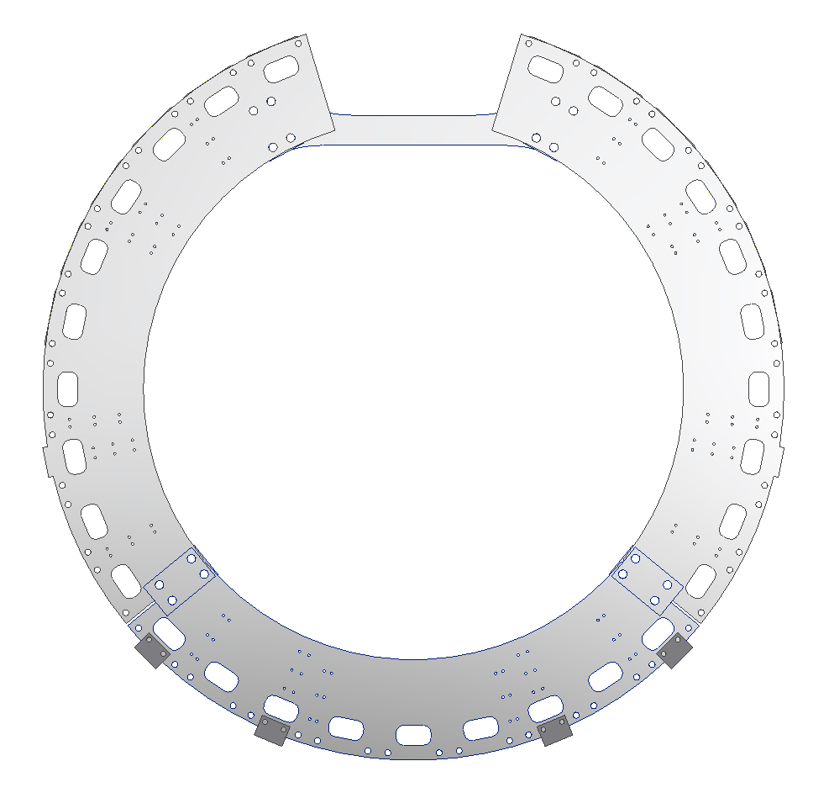
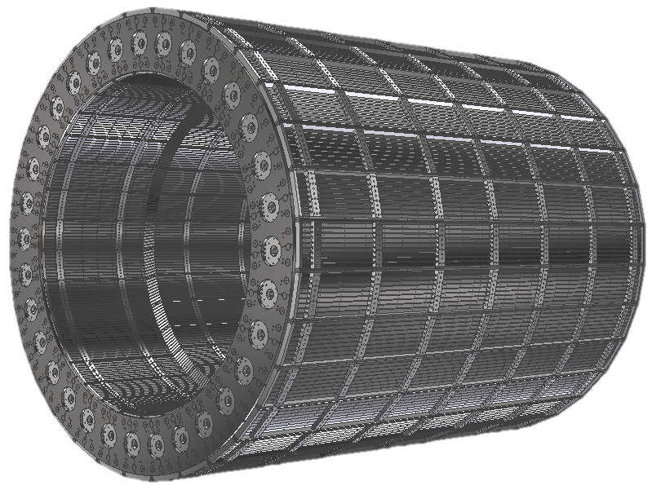
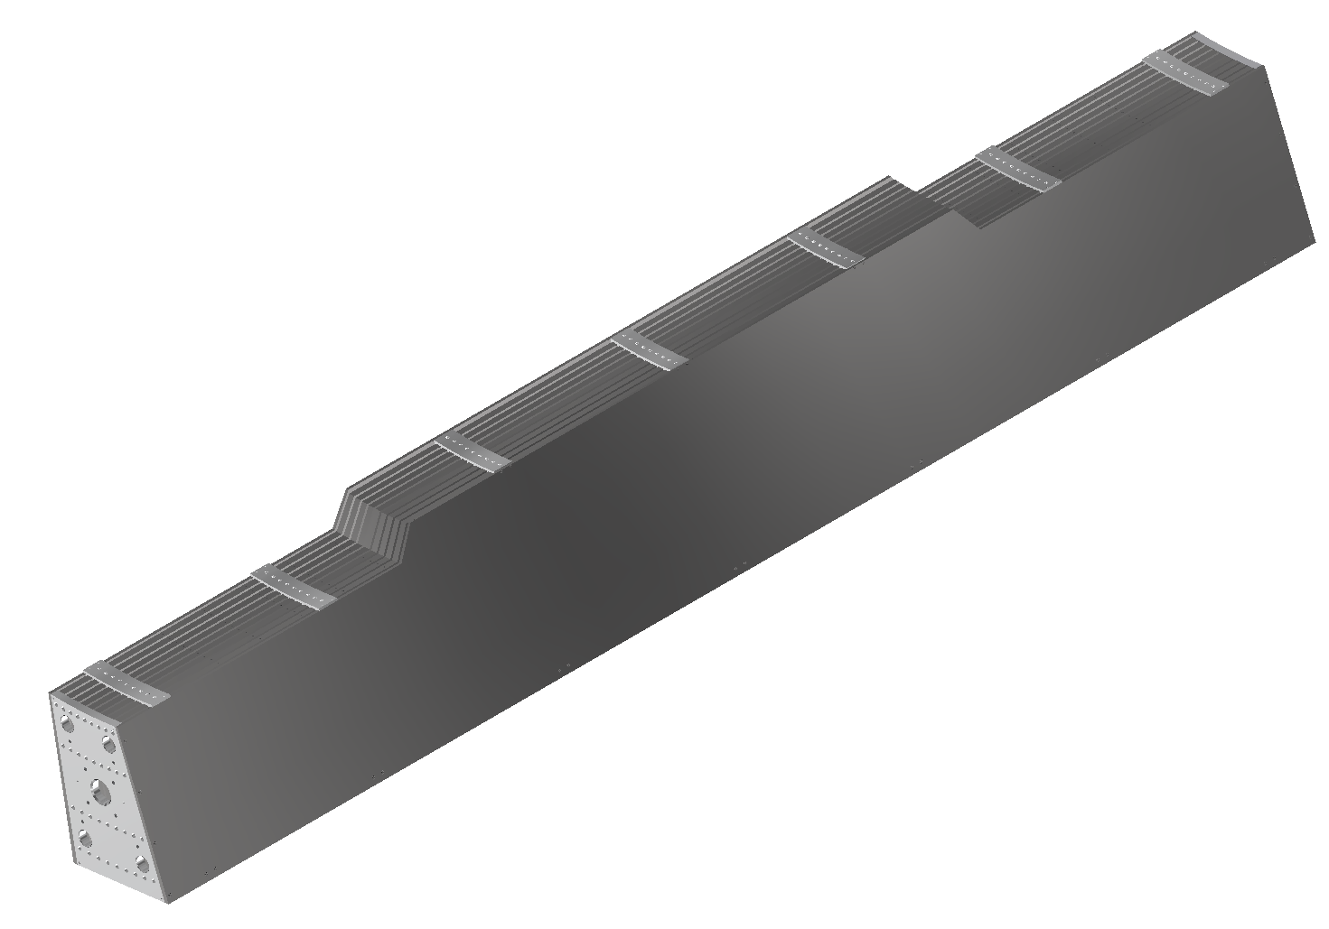
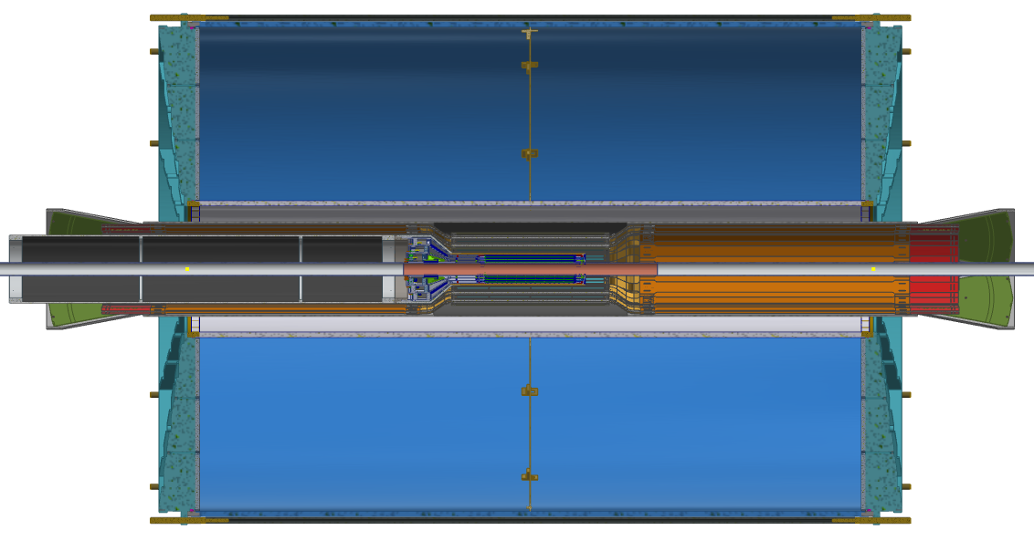
Barrel Steel/Inner Detector Structural Support
Inner Detector Support Ring
2x North and a South Ring
Structural Support
Barrel Steel
32 Individual Sectors
Internal Detector Supports
IHCAL, EMCal, TPC, INTT, MVTX

Slide 3
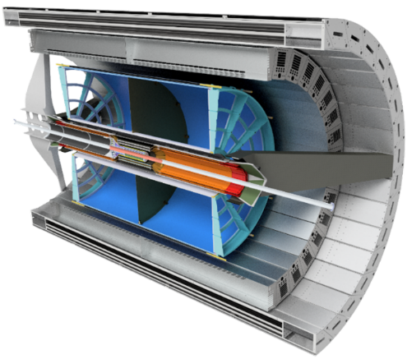
Technical Overview
Inner Detector Structural Supports (2.03.02)
North and South Support Rings
Conceptual Design stage
Design, analyze, review, and procure an integrated support system which will support all of the sPHENIX experimental detector subsystems that are not directly supported by the cradle carriage.
Internal Detector Supports
Conceptual Design Stage
Subsystems will be responsible for engineering their
individual supports.
Inner Detectors
IHCal
EMCal
TPC
INTT
MVTX
Min Bias
Barrel Steel (2.03.03)
In Production
Engineer, design, and procure 32 steel sectors to be utilized as the enclosure for the sPHENIX magnet, serving as a major portion of the magnet flux return, as well as the OHCal.

Slide 4
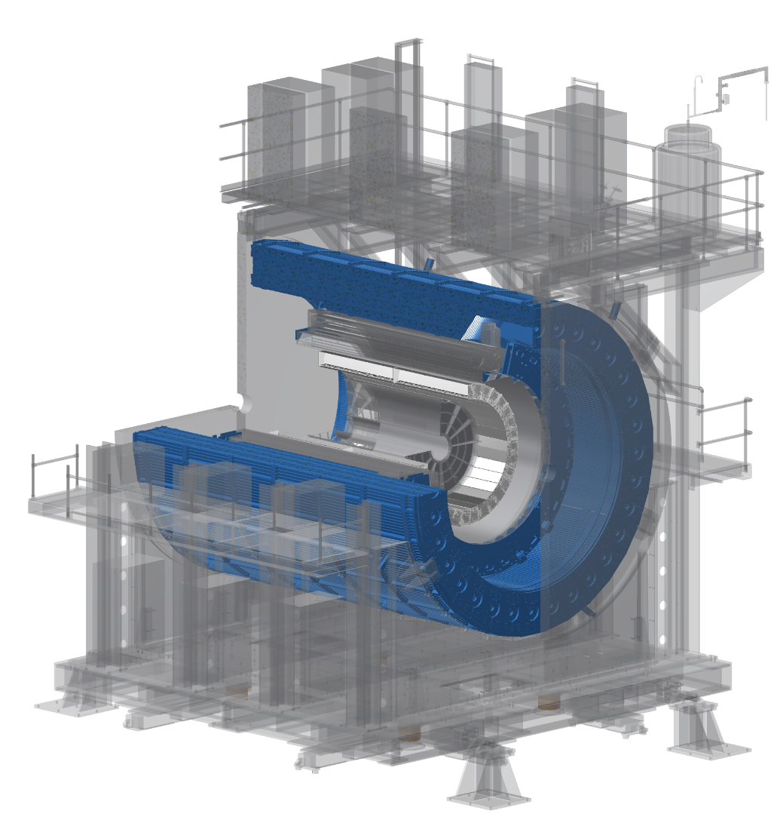
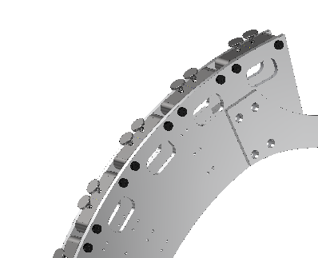
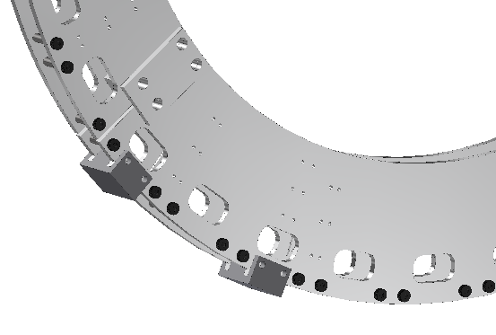
Scope
Inner Detector Structural Support (2.03.02)
North and South Support Rings
Provide structural support for installation of barrel steel around the sPHENIX magnet
Provide capabilities to manipulate Barrel steel installation
Provide attachment points to inner radius of barrel steel
Provide a load path and interface points for the structural support of inner detectors
Provide Interface points for installation of inner detectors
IHCal, EMCal, TPC, INTT, MVTX, & Min Bias
Adjustable pads to assist during installation of Barrel Steel
Preliminary attachment points for inner detectors
Connection points made to inner radius of Barrel Steel

Slide 5
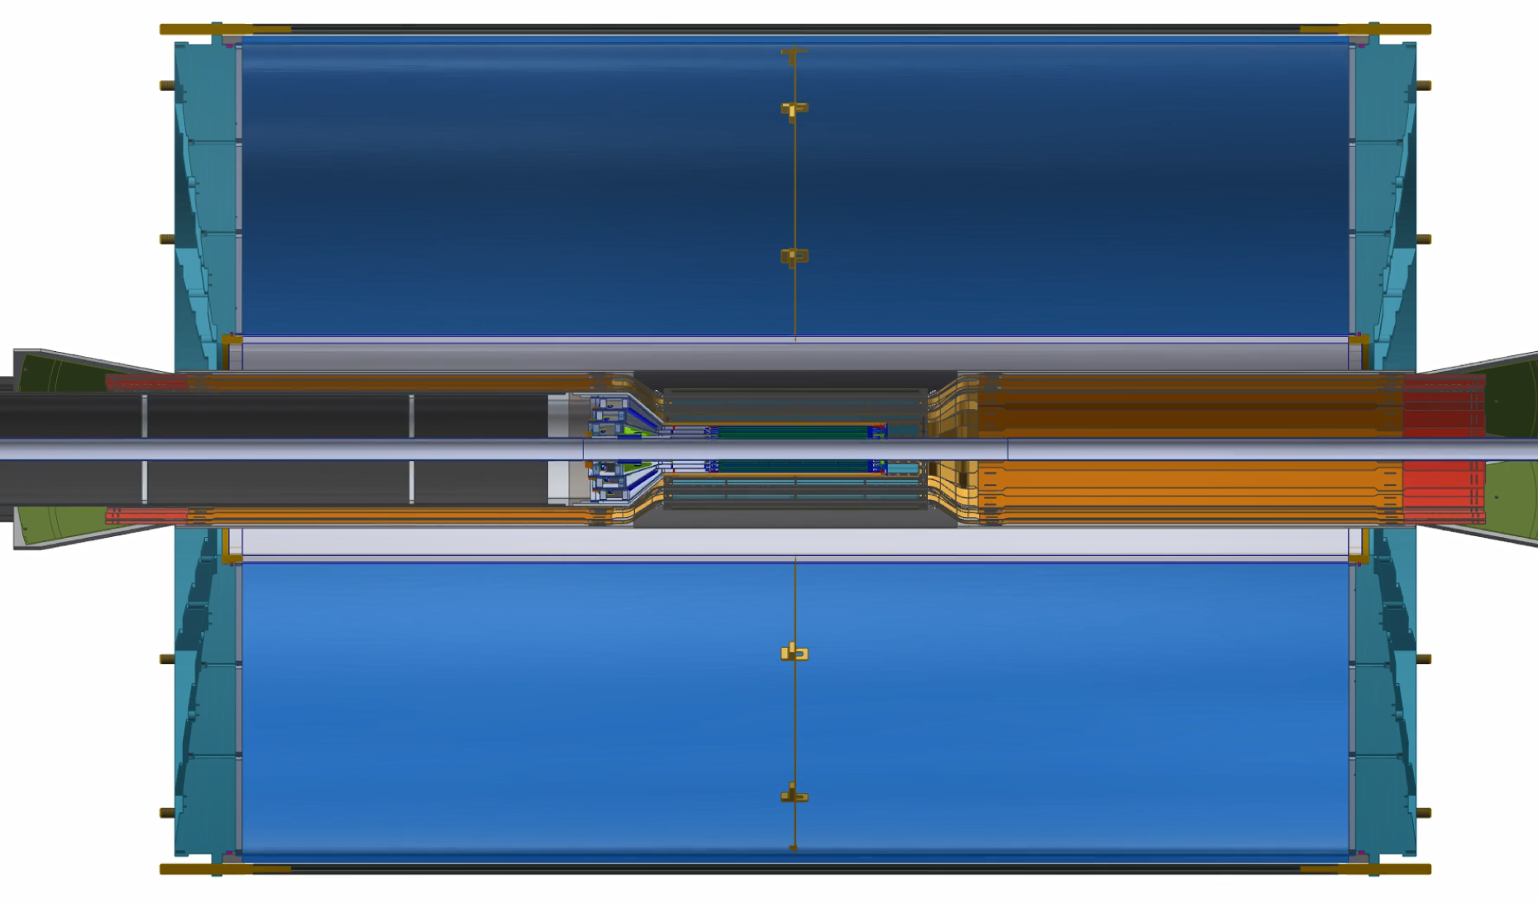
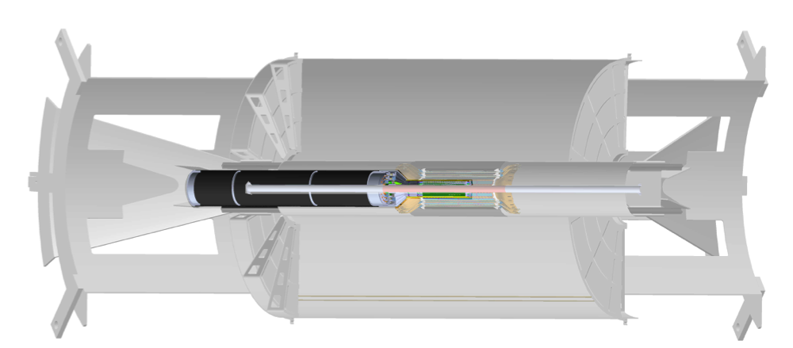
Scope
Inner Detector Structural Support (2.03.02)
Internal Detector Supports
Provide structural supports for installation of internal detectors
Individual subsystems are responsible for engineering
This WBS will be responsible for reviewing, procuring, and acceptance

Slide 6
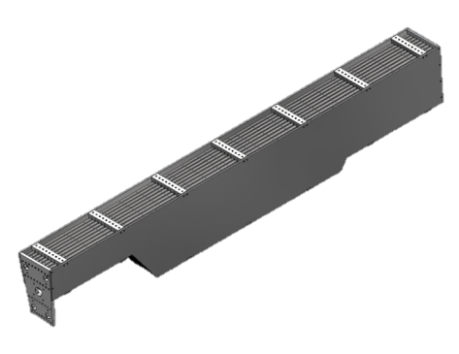
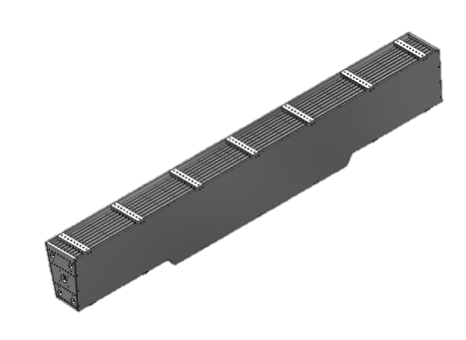
Scope
Chimney Sector Assembly
Sector Assembly
10x 8.5mm gaps for scintillating tiles
Over 20’ long
30,000 lbs. each
Barrel Steel (2.03.03)
Assemblies are made up of 9 absorber plates + 2 ½ absorber plates
Creating 10 gaps that will be populated with scintillating tiles and electronics for use in an Outer Hadronic Calorimeter
3 of the assemblies will fabricated with a cutout to allow for the sPHENIX magnets chimney
When assembled, the sector will make up the majority of the flux return for the sPHENIX magnet

Slide 7
Collaborators
Barrel Steel- sPHENIX Engineers
Inner Detector Structural Support- sPHENIX Engineers
MVTX- MIT Engineers
TPC- Superconducting Magnet Division (SMD)
INTT- sPHENIX Engineers
Magnet Supports- sPHENIX Engineers, SMD

Slide 8
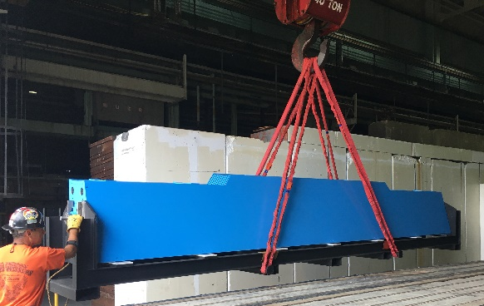
Schedule Drivers
Barrel Steel
Assemblies are being produced by a single vendor. Therefore our schedule is determined by the contract
Contract Schedule
We receive 1 deliverable sector per week (excluding built in holiday weeks)
Currently have 21 Sector Assemblies
Milestone date of Aug. 2019 will be hit with 300+ float days leftover
Inner Detector Structural Supports
North and South Support Rings
Currently in design phase of inner detectors
Internal Detector Supports
Development of inner detectors structural supports is ongoing

Slide 9
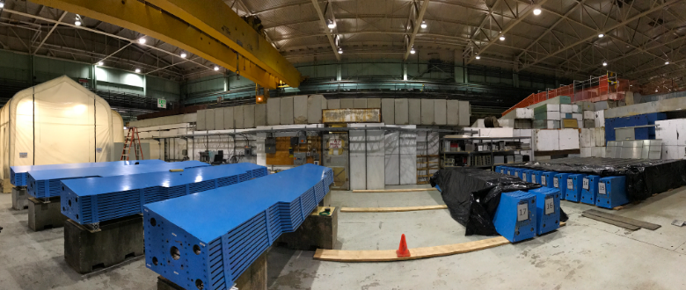
Cost Drivers
Barrel Steel
Sector Assemblies
Largest single component of sPHENIX procurement
Price is fixed, we are more than half way through the receiving process
Contract will be closed by mid August 2019
Inner Detector Structural Supports
Fabrication of the North and South structural support rings
Rough order of magnitude estimate
As plans for inner detector supports begin to solidify we will be able to move forward with interface areas
Fabrication of Internal Detector Supports
Conceptual designs are being developed by each subsystem

Slide 10
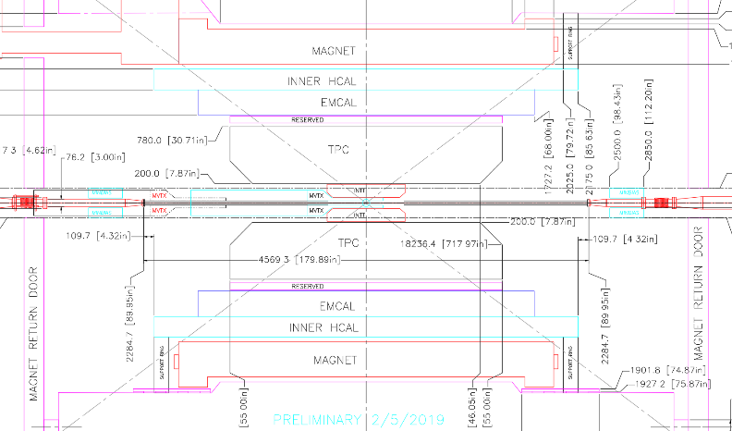
Status and Highlights
Barrel Steel
Sector assemblies continue to be delivered on schedule
Assemblies are being prepped for future installation
Factory space has been vetted by Collider Accelerator Division as well as Physics staff
Inner Detector Structural Supports
North and South Support Rings
Conceptual design and engineering
Internal Detector Supports
MVTX- conceptual design and engineering*
INTT-conceptual design and engineering*
TPC- conceptual design and engineering*
*Integration committee has been established and meet biweekly
Inner Detectors Integration Workshop was held 3/13-3/14

Slide 11
Milestones
Inner Detector Structural Support 2.03.02
Design/safety reviews complete July 2019
Procure Internal Detector Structural Support
Components ready for installation May 2020
Installation occurs October 2021 (300+ days of float)
Barrel Steel 2.03.03
Barrel steel Mechanical Design Complete
Procure Barrel Steel Structure Components – First Article Received (Nov. 2017)
Procure Barrel Steel Mechanical Structure Components-Production (Aug. 2019)
Installation occurs June 2021 (300+ days of float)
Established inspection process, readying assemblies for scintillator population
Preproduction assembly begins June 2019 (6 Sectors)

Slide 12
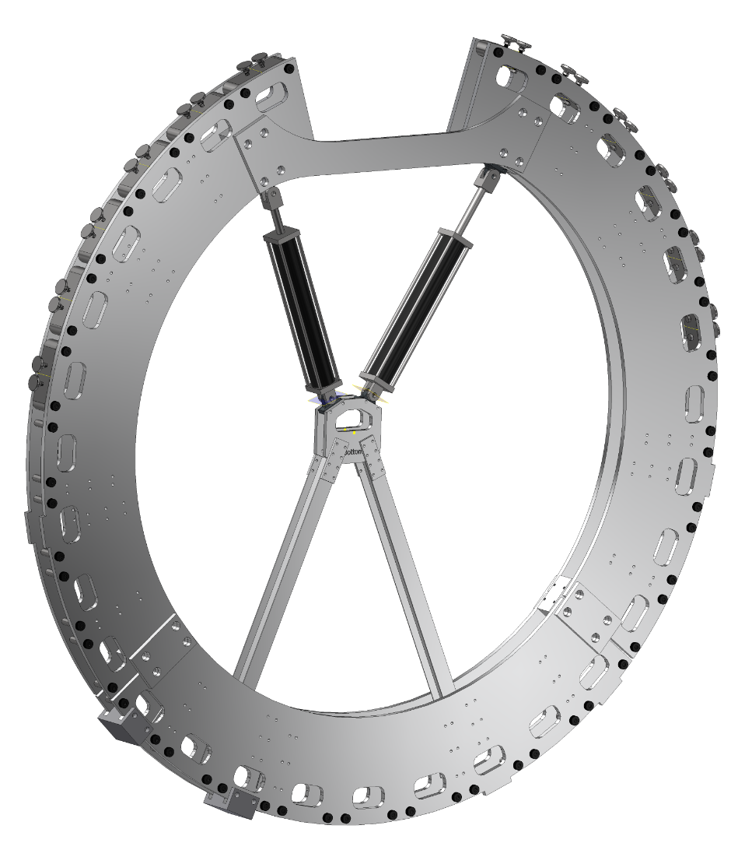
Activities over the next few months
Barrel Steel
Continue acceptance testing
Complete barrel steel procurement
Inner Detector Structural Supports
North and South Support Rings
Complete overall design
Analyze and evaluate the structural support
Create assembly/detailed drawings
Review design/safety of the support
Prepare procurement package
Inner Detector Support Structures
Await designs from subsystems
Review and analyze designs
Prepare procurement packages

Slide 13
Issues and Concerns
Issues/Concerns
Proposed Action/Resolution
Barrel Steel
Installation process of assemblies
Inner Detector Structural Support
Concepts to be completed and requires budgetary quotes
Engineering Support needed for North and South support rings
Continue development on advanced conceptual design plan. Significant studying of sectors being fitted together
Begin process of bottoms up estimate and begin detailed drawings for budgetary quotes
Plan to increase engineering staff to the sPHENIX project

Slide 14
Summary
Barrel Steel
The barrel steel is currently being received at a rate of 1 per week
Milestone date of Aug. 2019 will be hit with 300+ float days leftover
Assemblies are being prepped for future installation
Continue integration discussions to formulate our interface/interaction points with the cradle
Inner Detector Structural Supports
We are in the conceptual design phase
We fully understand the scope of this subsystem and continue to collaborate with the inner detector subsystem engineer/design teams through a well established integration committee
We are moving forward with the design/detail process that will permit us to acquire budgetary quotes for the North and South Support Rings

Slide 15
Back Up

