Slide 1
sPHENIX Director’s Review
INTT Electronics
Itaru Nakagawa
April 9-11, 2019
BNL

Slide 2
The L3 Component
Readout cables and electronics
Electronics are reuse of FVTX electronics
Succeeds established FVTX readout design
Still technical challenge in signal transmission

Slide 3
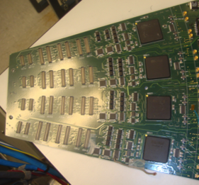


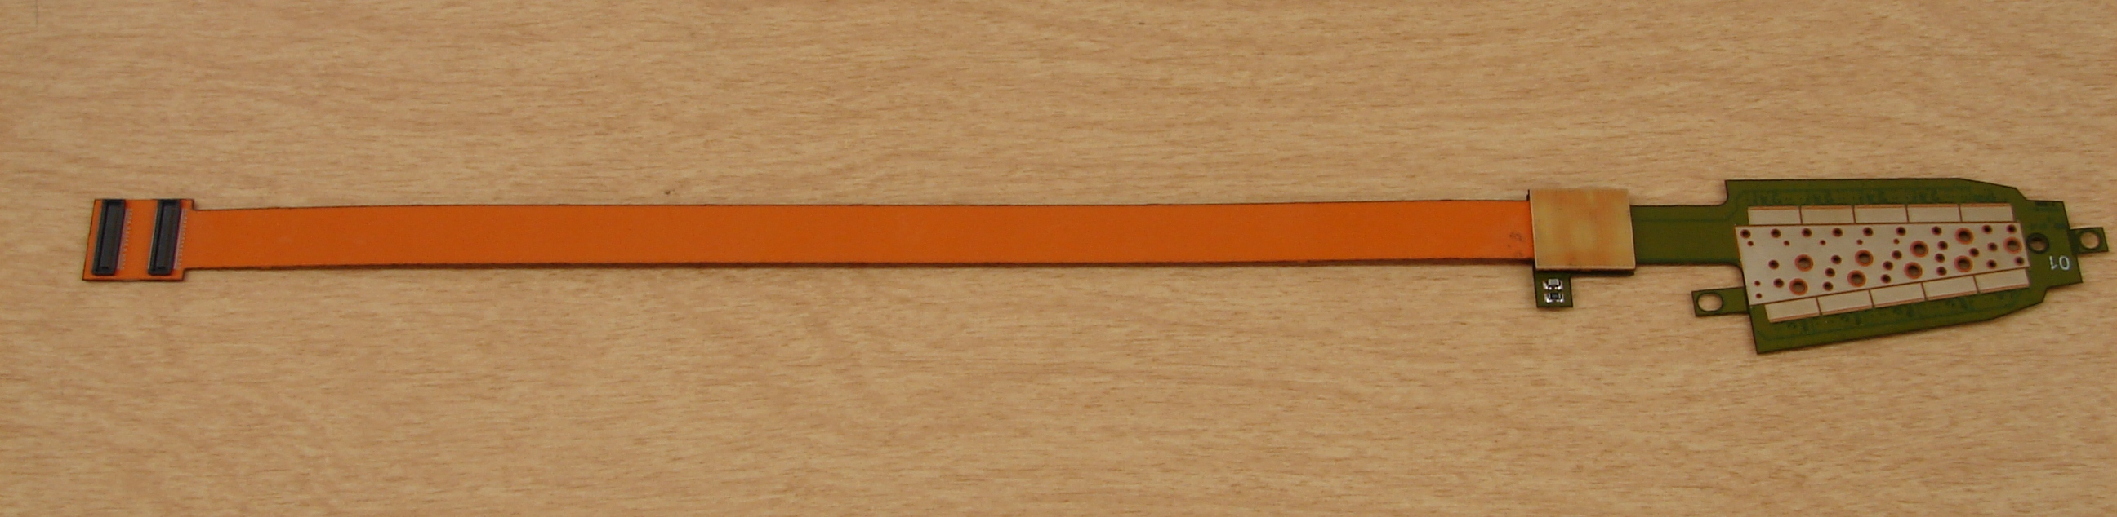
L3 Technical Overview
Requirements
Significantly longer (>1.2m) signal transmission
Tight space budget to fit between MVTX and TPC
High signal line density
High frequency signal 200Mbps transmission
Flexibility
40cm
40cm
120cm
20cm
Silicon
INTT
HDI
Bus Extender
Conv. cable
R&D : Multilayered Flexible Print Cable
FVTX
30cm
ROC

Slide 4
L3 Scope
HDI
Conv. cable
Conv. cable
7-layer structure
HDI Cable (Preproduction)
Conversion Cable (Preproduction)
HDI & conversion cables are manufactured by Yamashita Co. with relatively relaxed technological specifications compared to FVTX
Technological challenge in the 1.2m bus extender FPC
Specification | FVTX | INTT | Technical Challenge
Length | < 30cm | 120cm | Signal amplitude reduction
Line pitch [μm] | 40 | 120 | Constant line width
Insulation | Polymid | Liquid crystal polymer (LCP) | Peel strength
# of Cu layer | 7 | 4 | Through hole

Slide 5
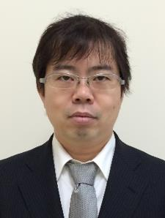


L3 Collaborators
Collaborative R&D Program for Manufacture Industry Funded by Tokyo Metropolitan Gov.
R&D
RIKEN (Physicist)
REPIC.co
(Mech. Engineer)
TIRI (Elec. Engineer)
Print Denshi Kenkyujo Co. (Factory)
2017, 2018, 2019*
Concept, Testing
*to be applied
+ Itaru Nakagawa
+ 3 undergraduates
~$10k/year
Takashi Hachiya
~$10k
Design
Fabrication
Simulation, Infrastructure
~$10k

Slide 6
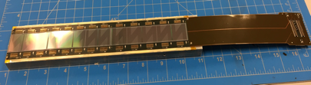
Schedule Drivers
2016 |  | 2017 |  |  |  | 2018 |  |  |  | 2019
Beam test I
Beam test II
Prototype-0
Readout OK
Ladder
Prototype-II
Silicon S/N OK
production
Final Design Review
Pre-Production
Conversion Cable
Pre-Production
Bus Extender
Simulation & Design
Prototype-I
Prototype-II
Prototype-III
Final design review after beam test-II except for the bus extender
Need another round to finalize the bus extender. Possible review in 2020

Slide 7
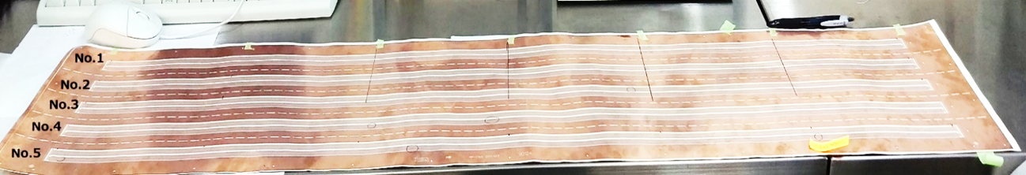
Cost Drivers
Yield Rates of Bus Extender : only 25% at this moment
  $2~4k/cable ($0.4~0.8M for total)
  Difficulty mostly originated from the large size and unestablished technology in the LCP manufacturing.
Primary Causes
1. Exposure process
2. Lamination process
Still struggling in optimizing parameters; pressure, temperature, duration, vacuum, etc
☞ Overexpansion of LCP, imperfectly stiffened adhesive, weak peel strength, incomplete thru hole, etc
Dusts, creases, air between a mask and copper plane…
☞ broken and/or shorted signal lines

Slide 8
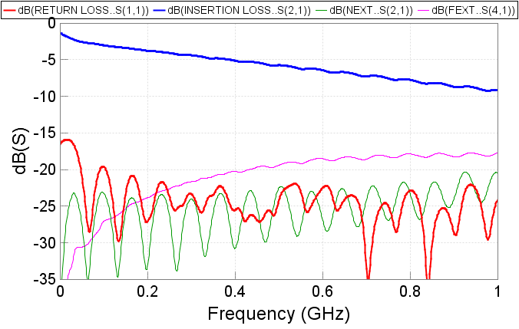
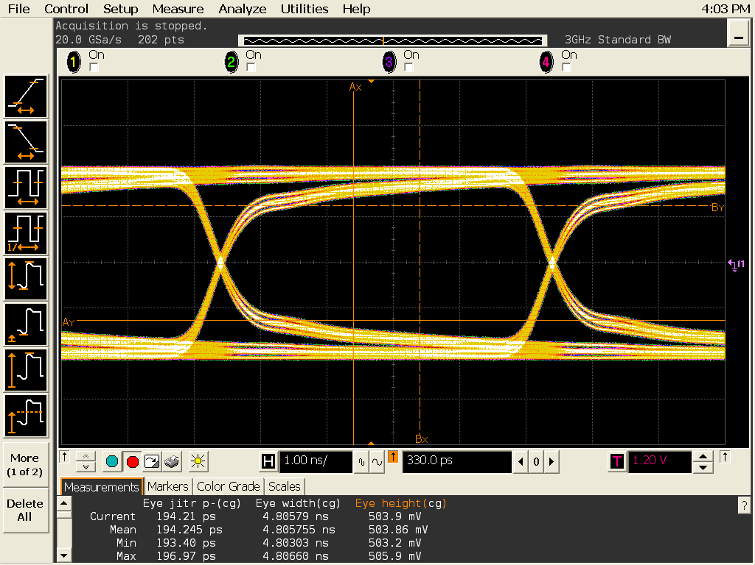
Status and Highlights
The Bus Extender Prototype-II
120cm FPC w/ 200Mbps
62 LVDS pairs within 5cm width
4 layers with signal/power/GND
Observed signal transmission performances are as designed.
To ROC
Cu plating t35μm
To HDI
Cu
Cu
Cu
Cu
LCP
LCP
Thru hole φ=300μm
Adhesive
Adhesive
Cu
Cu
Signal loss ~ 30%
Reflection < 10%
LCP
LCP
200Mbps
Cu
Cu
Adhesive
Adhesive
LCP
LCP
120cm
Cu
Cu
Eye-diagram
To be tested in the beam test.
Successful
Clear opening

Slide 9
Issues and Concerns
☜The cu-plating on thru holes has not been established yet
☟Full chain test of readout cables to be executed soon
good
bad
  ⇫ROC
  Reuse of 5 years of operation
  Some broken function in some ROCs
  Many components are discontinued
  Original FPGA coder left the field long time ago

Slide 10
Summary
Recycle FVTX Readout Electronics.
  Working system
  Need to assign efforts to repair and maintenance work
Readout cables are developed based on FVTX design
  HDI & Conversion cables are relaxed technology compared to FVTX
  1.2m bus extender is under development using the cutting edge technologies.
  Another 1 more year to optimize the design and yield rate
R&D is in the final stage except for the bus extender
  Bus extender will be independently reviewed in 2021.

Slide 11
Back Up

Slide 12
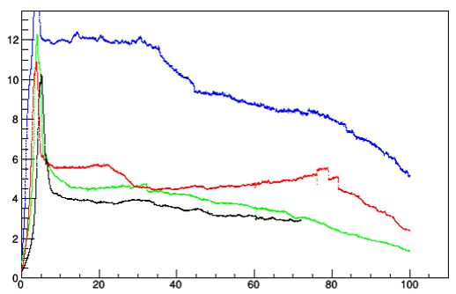
Issues found in 1st prototype
Peel strength is too weak
  1N/cm → 10N/cm improved
    Vacuuming to prevent contamination of air-bubbles and dusts when laminating FPC’s
Roughening treatment of cu surface
Peel strength test
Cu
Chemical1
Chemical2
New FPC
Polymide
LCP
Cu
Adhesive
Peel strength[N]
broken
Cu
LCP
Cu
Cu
LCP
Peel length[mm]
Cu
Adhesive
LCP breaks at 10N/cm
Cu
LCP
Cu

Slide 13
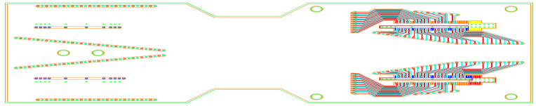
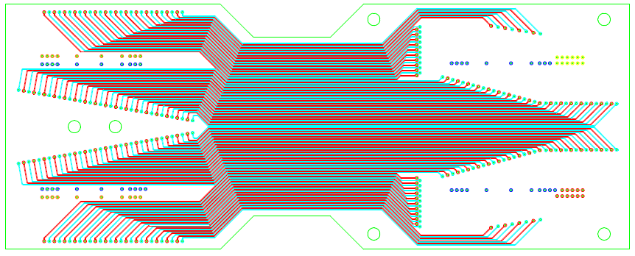
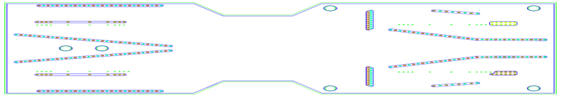
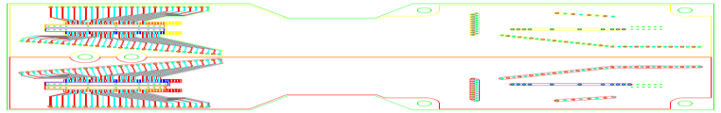
Status and Highlights
The Bus Extender Prototype-II
120cm FPC w/ 200Mbps
62 LVDS pairs within 5cm width
4 layers with signal/power/GND
Observed signal transmission performances are as designed
L１ （DGND）
L2 signal
L3 （AGND）
Cu plating t35μm
Cu
Cu
L4 : VD＋VA
Cu
Cu
LCP
LCP
120cm
Thru hole φ=300μm
Adhesive
Adhesive
Cu
Cu
LCP
LCP
To ROC
Cu
Cu
Adhesive
Adhesive
LCP
LCP
Cu
Cu
Successful
To HDI

