Slide 1
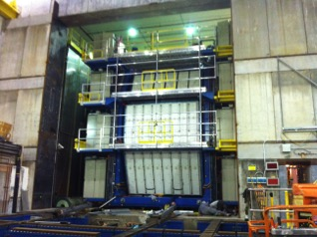
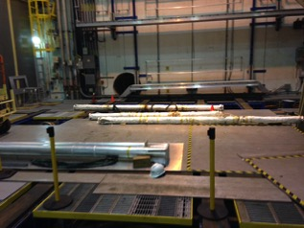
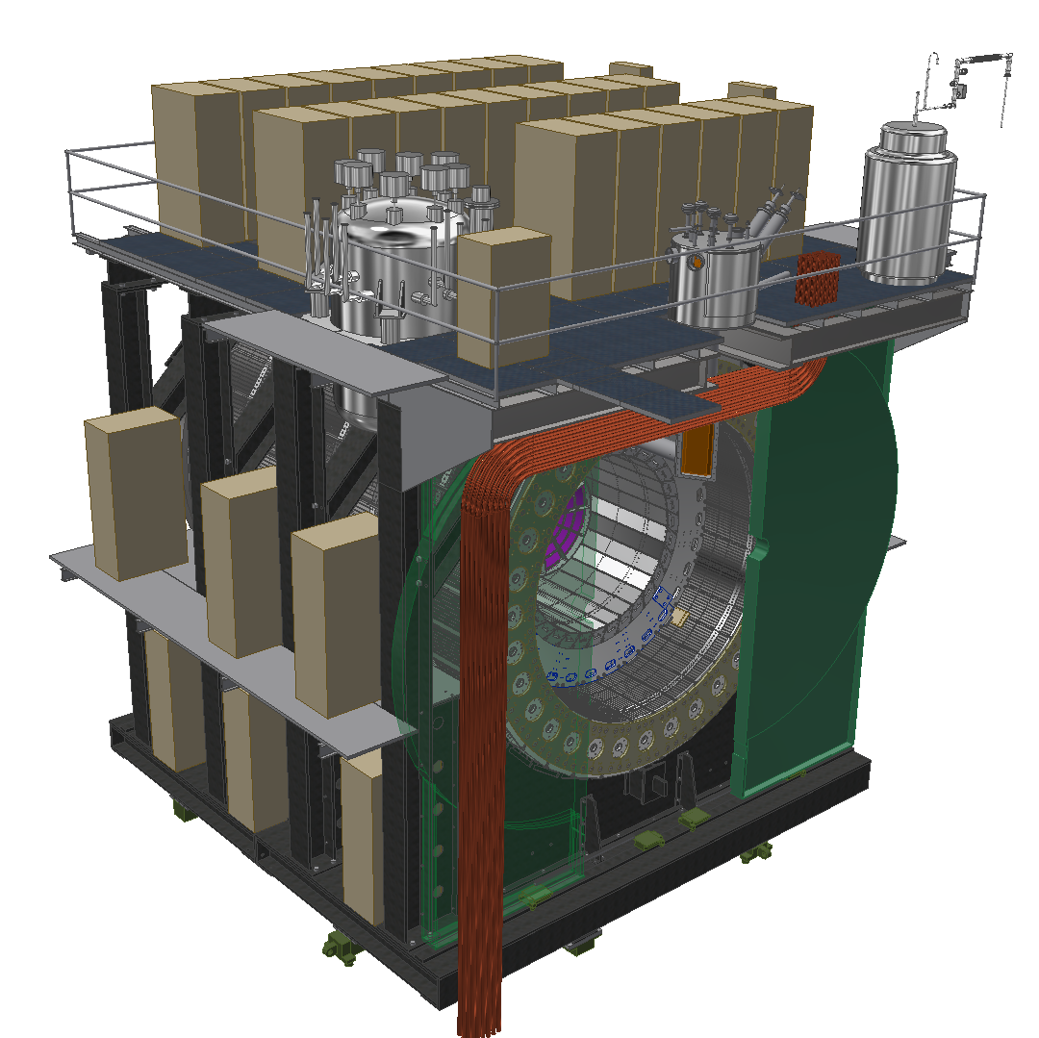
sPHENIX Planning
Weekly Planning Meeting: 7/11/19

Slide 2
HCAL
TASK | STATUS | NOTES
Continue to Support O-Hcal Factory in 912 | ONGOING | Sector delivery tomorrow Final Sector Delivery
O-Hcal sector inspection (Go/No Go Gauge) | ONGOING | 20+ Sectors complete
Develop SiPM work stations (HCAL) | ONGOING | Complete
Sort out tiles onto shelving in 912 (HCAL) | ONGOING | Skid #7 has arrived
Documentation of tiles (HCAL) | ONGOING
Separate epoxy chemicals in 510 Hi-bay. |  | Mike L. and HCAL students will begin to separate for shipping
HCAL Electronics box | ONGOING | Another round of quoting
Preproduction Skins | ONGOING | 1st round of quoting
Tile Dimension Tester | ONGOING | COMPLETE
SiPM Arrival | July | Ask Eric Mannel!!
Additional Student Labor Arriving | July | Some have arived

Slide 3
HCAL

Slide 4
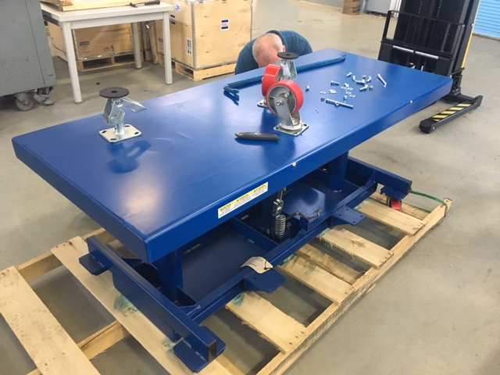
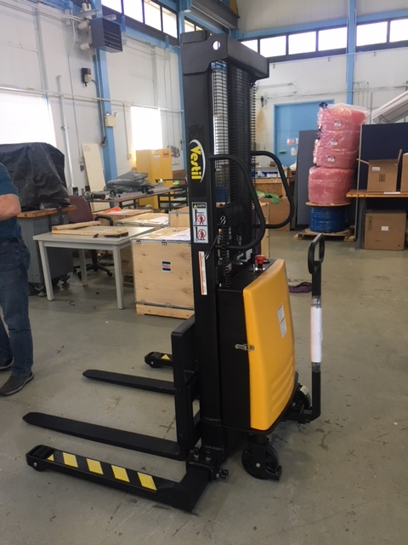
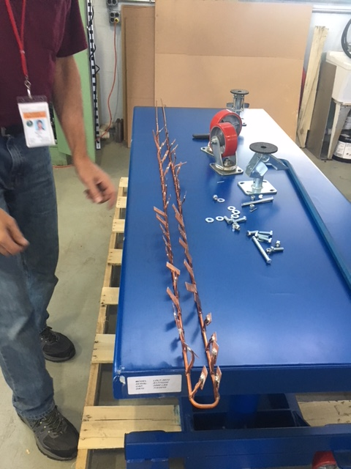
EMCAL
TASK | STATUS | NOTES
EM Cal Cooling Work | ONGOING
Procure Die Table | Done
Procure Forklift | Done

Slide 5
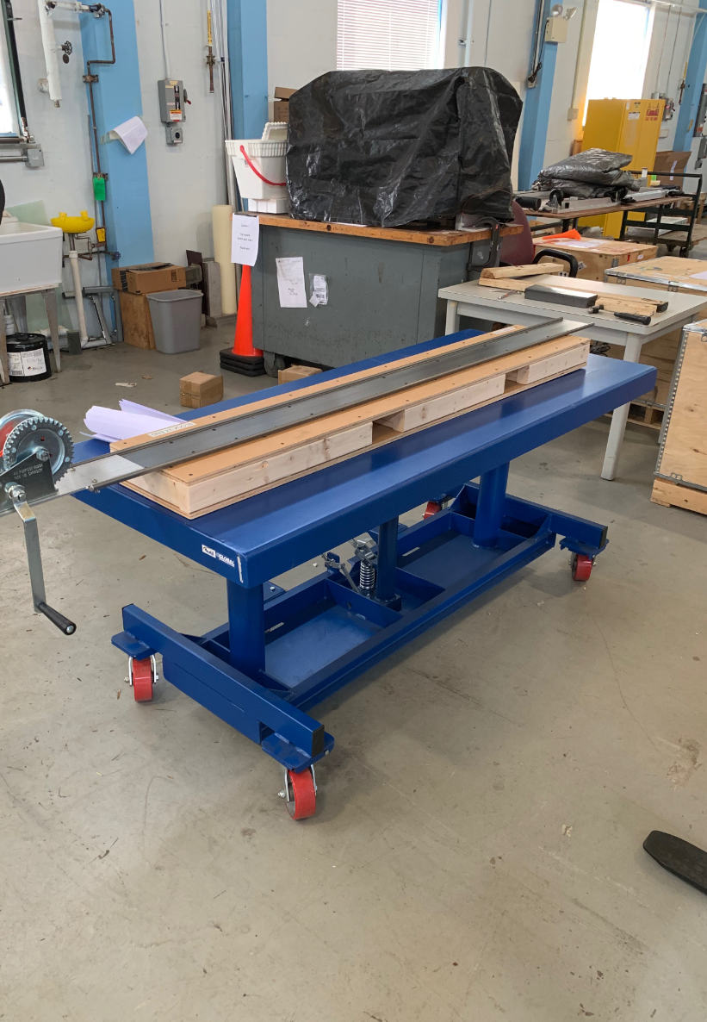
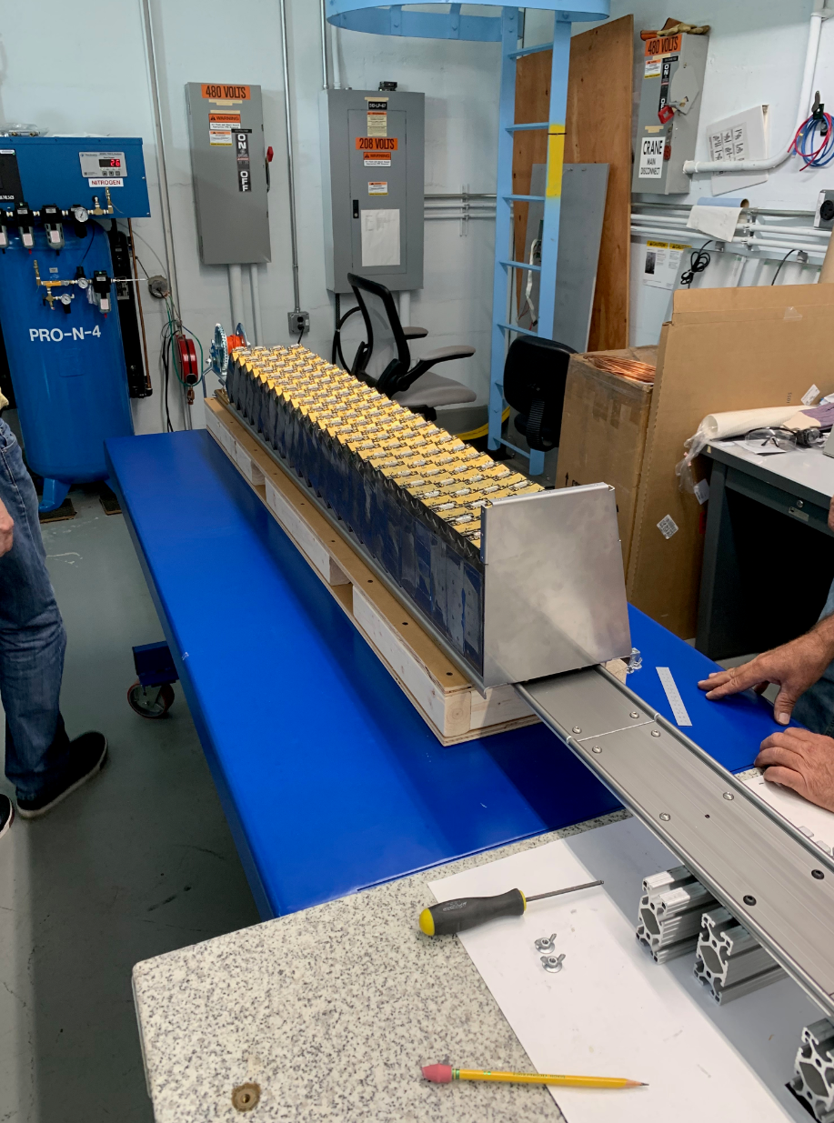
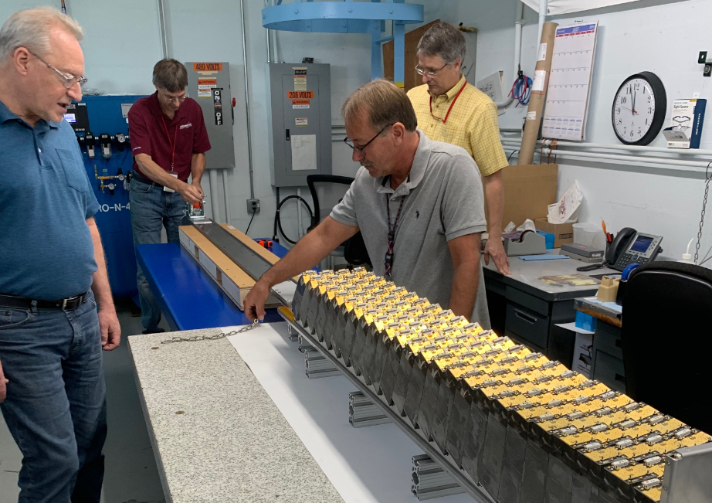
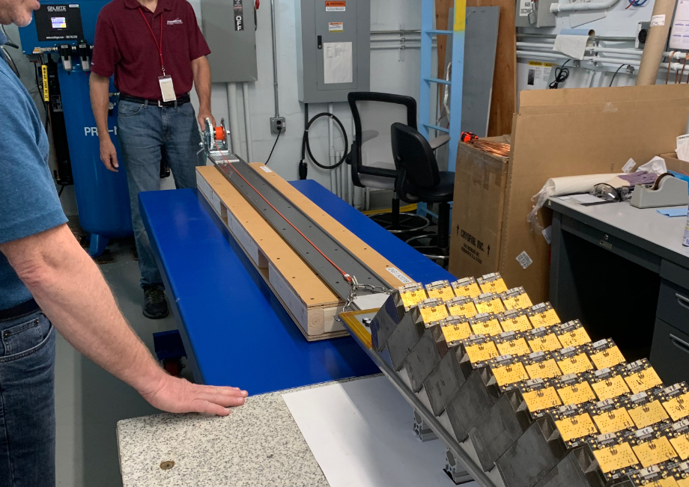
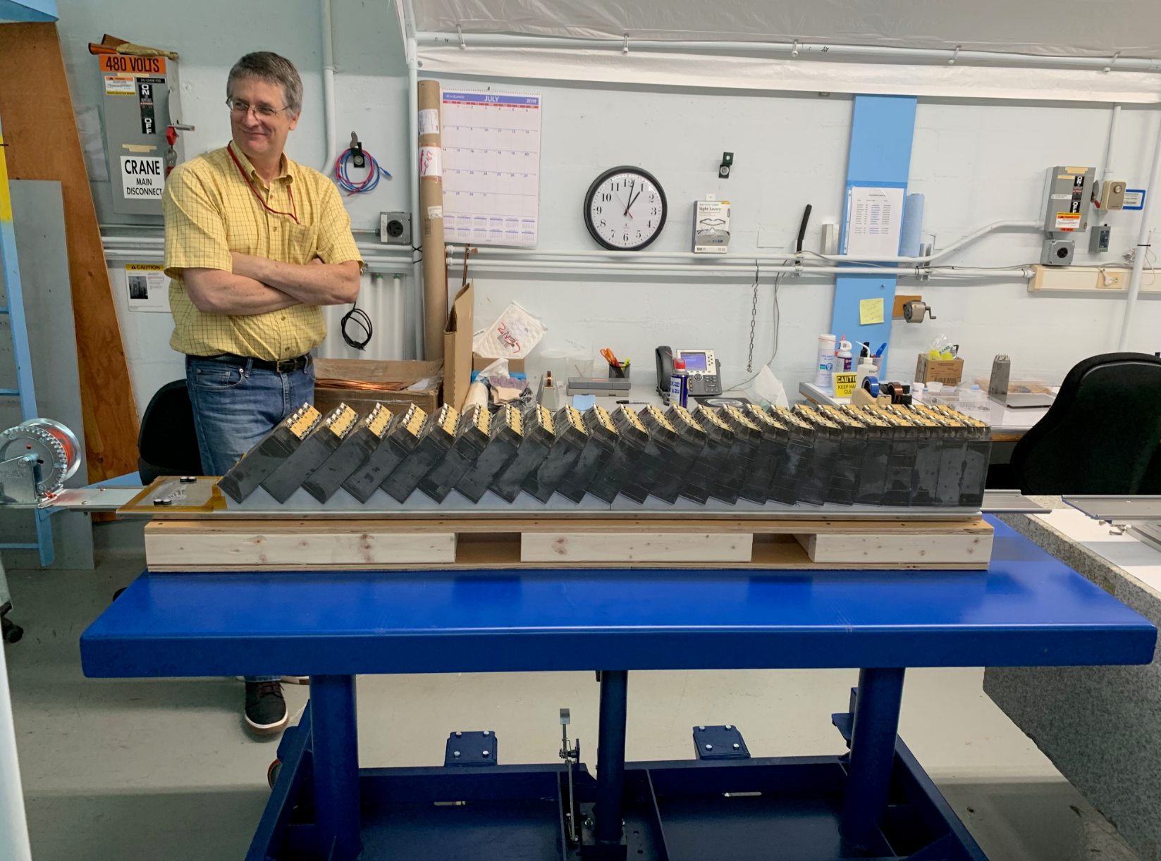

Slide 6
Infrastructure/1008
TASK | STATUS | NOTES
Remove Shield Wall and Plug Door | July 17-26
Remove North Section of Beampipe | July 29-Aug 2
Resume cutting of North Magnet Steel | Aug 5-Sep 6
Gather Magnet Test Items |  | Racks, supports, electronics, etc. Get it all crated and brought to 1008, transferred to Carter
sPHENIX Cryogenics | Procurement | Allocate space for material

Slide 7
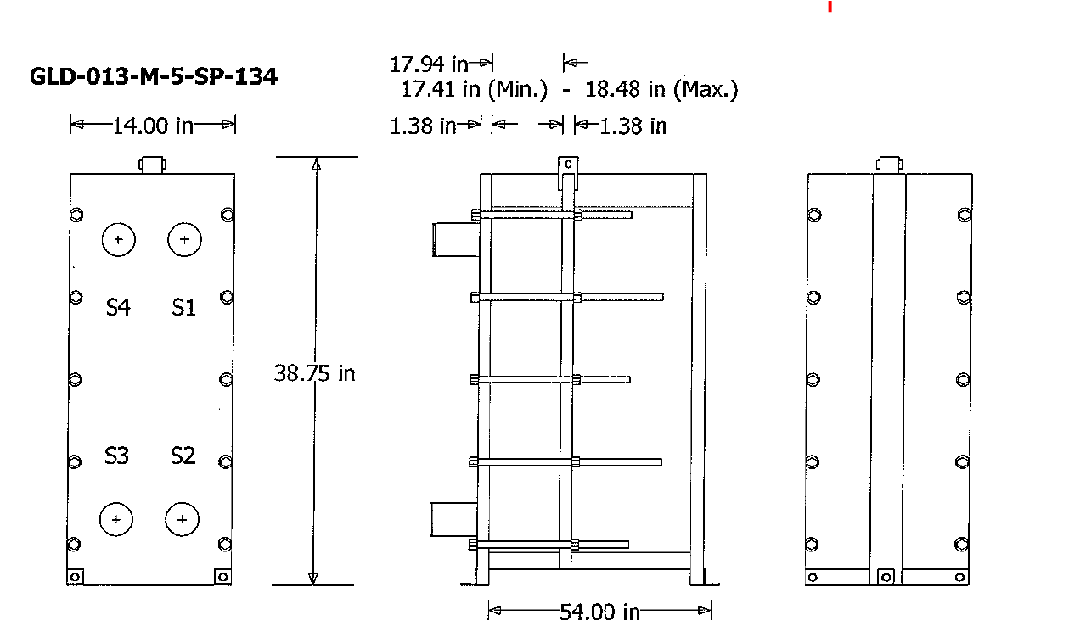
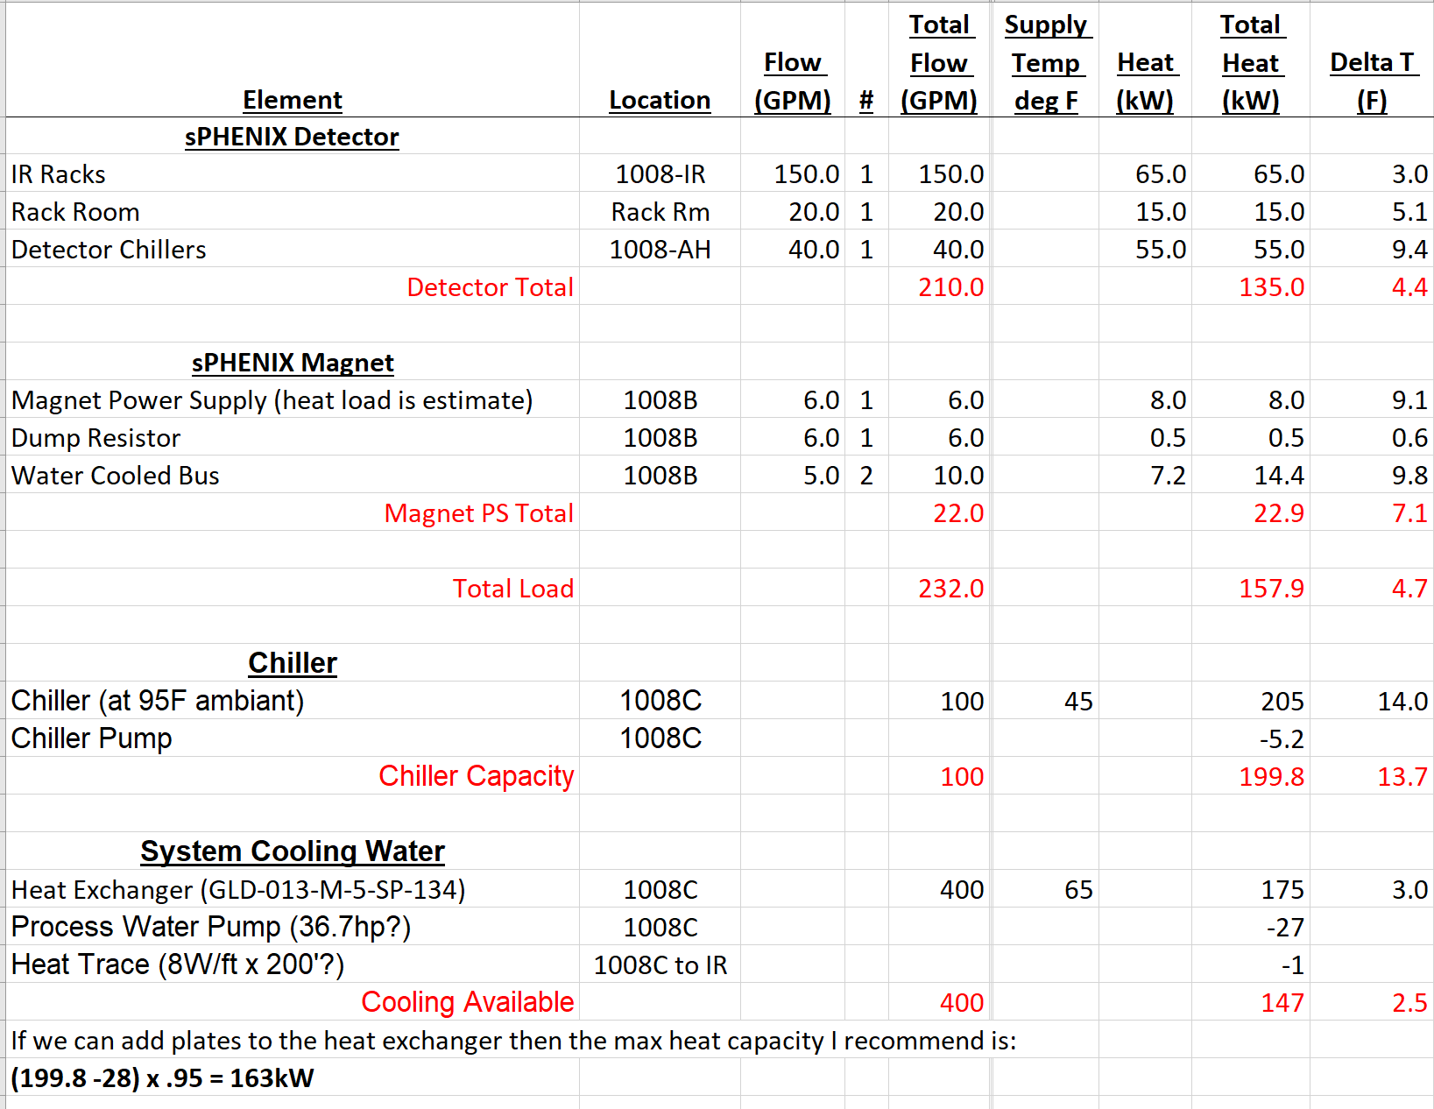
Electronics Cooling Loop
Dave calculated capacity of loop
  150 kWatt up to 163kWatts with some modifications to the heat exchanger plates.
  About 25% less than the numbers we were originally given
  Capacity is adequate for sPHENIX Detector needs.
Will be looking into putting the magnet on its own loop

