Slide 1
Science Mission and Collaboration
April 9-11, 2019
BNL
David Morrison (BNL)
Gunther Roland (MIT)
co-spokespersons

Slide 2
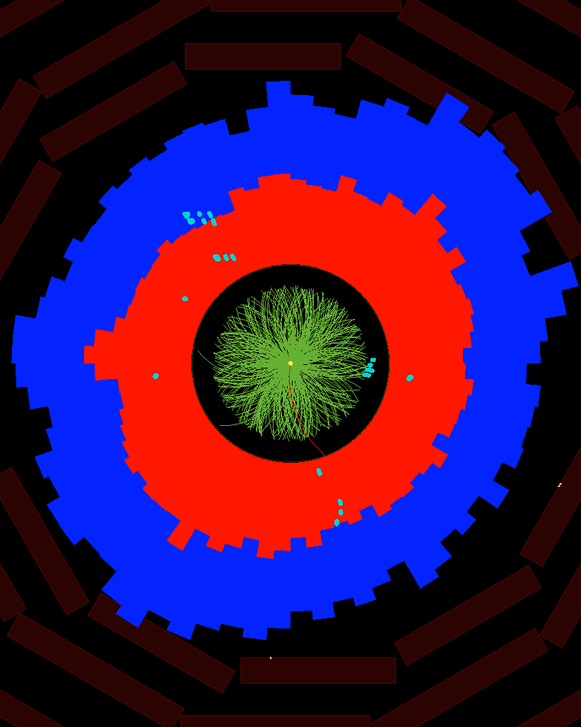
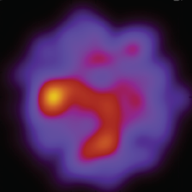
Hot QCD – today and future directions
ψ₂
First RHIC results demonstrated surprising properties of Quark-Gluon Plasma created in heavy-ion collisions: near perfect fluidity and extreme opacity
Precision studies at RHIC and LHC showed that many aspects of final state structure can be understood through viscous hydrodynamics models of QGP evolution
LHC experiments demonstrated importance of large acceptance, high resolution tracking, high collision rates and full EM+Hadronic calorimetry
Next decade: Use improved experiments at RHIC and LHC to understand emergence of QGP properties from underlying (asymptotically) weakly coupled interaction

Slide 3



Planning for the coming decade
2015 US NP LRP
WG5 for 2019 ECFA document

Slide 4


Complementarity of LHC and sPHENIX for QGP studies
“This programme after LS2 includes precision studies of the flow of heavy quarks and of open heavy flavor and quarkonia production , the detailed analysis of fluctuations of conserved charges and of quenched jet fragmentation via high statistics photon/Z-jet correlations, and access to signals of electromagnetic radiation from the dense medium. This will enable to fully establish the long-wavelength matter properties of the plasma produced at the LHC, and to get access to the partonic dynamics that underlies the observed surprisingly strong collective phenomena. “
“As the temperature dependence of transport properties can be accessed experimentally by varying the center of mass energy over a logarithmically wide range, the combined analysis of LHC data and future high precision data from RHIC offers a qualitatively novel handle on the temperature dependence of properties of hot and dense matter. The Town Meeting observes that the recently approved sPHENIX proposal targets these opportunities by bringing greatly extended capabilities to RHIC…
2015 US NP LRP
WG5 for 2019 ECFA document

Slide 5
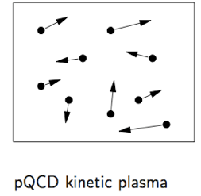
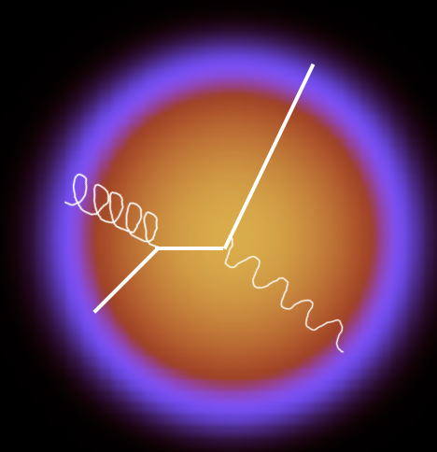
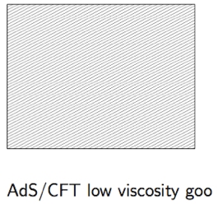
Experimental approach
Full characterization
of final state
Short
Wavelength
?
Scale
Different QGP
initial conditions
and evolution
at RHIC and LHC
Long
Wavelength
Same hard process
What is the microscopic structure of the QGP?
How does long-wavelength physics emerge from underlying gauge theory?

Slide 6
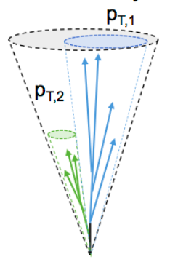
Studying QGP at multiple scales with sPHENIX
Jet structure
vary momentum/angular scale of probe
Quarkonium spectroscopy
vary size of probe
Parton energy loss
vary mass/momentum of probe
g
u,d,s
b
b
b
b
b
b
c
ϒ(3s)
ϒ(2s)
ϒ(1s)
b
Continue developing more detailed connections between particular measurements and underlying physics – driving work with theory community generally and specific efforts like JETSCAPE.

Slide 7
Core physics goals ⇒ MIE Ultimate Performance Parameters (UPP)
Physics goal | Analysis requirement | UPP
Maximize statistics for rare probes | Accept/sample full delivered luminosity | Data taking rate of 15kHz for Au+Au
Precision Upsilon spectroscopy | Resolve Y(1s), Y(2s), (Y3s) states | Upsilon(1s) mass resolution ≤ 125MeV in central Au+Au
High jet efficiency and resolution | Full hadron and EM calorimetry Jet resolution dominated by irreducible background fluctuations | σ/μ ≤ 150%/√pTjet in central Au+Au for R=0.2 jets**
Full characterization of jet final state | High efficiency tracking for 0.2 < pT < 40GeV | Tracking efficiency ≥ 90% in central Au+Au** Momentum resolution ≲ 10% for pT = 40 GeV**
Control over initial parton pT | Photon tagging with energy resolution dominated by irreducible higher order processes | Single photon resolution ≤ 8% for pT = 15 GeV in central Au+Au**
(**) to be extracted using Au+Au, p+p data and simulations, following LHC examples

Slide 8
Multi-year run plan for sPHENIX
Campaign 1
Campaign 2
https://indico.bnl.gov/event/4788/attachments/19066/24594/sph-trg-000_06142018.pdf
Minimum bias Au+Au at 15 kHz for primary vertex |z| < 10 cm (in acceptance of silicon trackers):
47 billion (Year-1) + 96 billion (Year-3) + 96 billion (Year-5) = 240 billion events recorded
                cf. STAR 2016 200 GeV Au+Au data set of 6.5 billion events [PAC 2017 presentation]
          Topics with Level-1 selective trigger (e.g. high pT photons) can sample 0.5 trillion events within |z| < 10 cm
~40x more

Slide 9
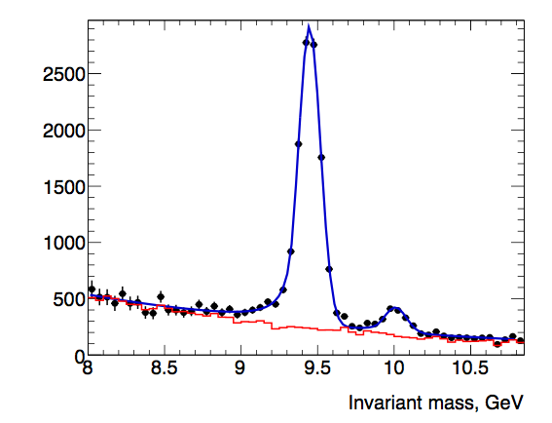
Upsilons at sPHENIX and LHC compared
Central Au+Au
√sNN = 200 GeV
Y(1s)
CMS data
sPHENIX
projection
Y(ns) → μ⁺+μ⁻
Y(ns) → e⁺e⁻
Y(2s)
Differential suppression of Y(nS) states connected to QGP Debye screening length

Slide 10
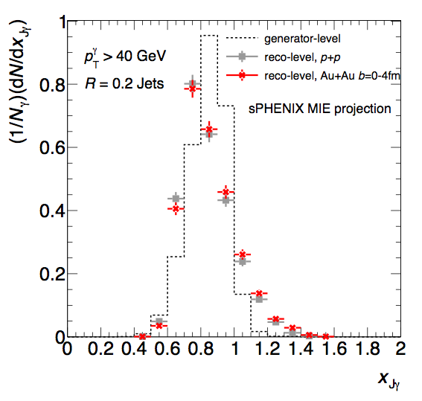
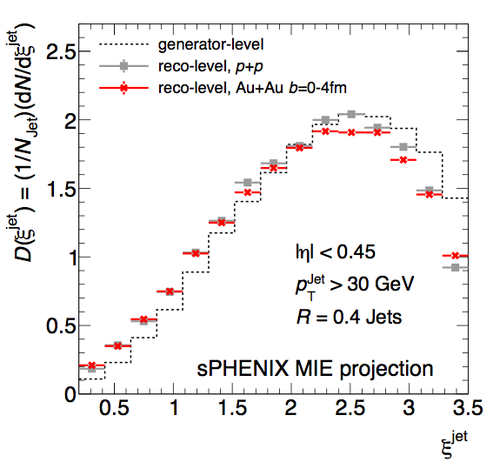
Example observable: photon-tagged jets
Parton energy loss in QGP
Modification of parton shower in QGP
γ+Jet momentum balance
γ+Jet fragmentation function
sPHENIX projection 100B Au+Au

Slide 11
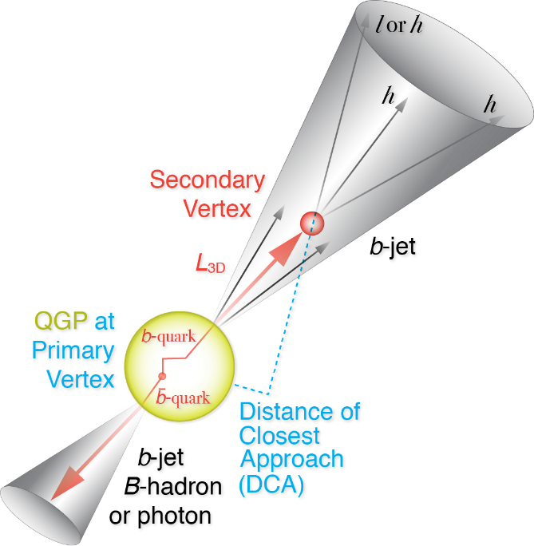
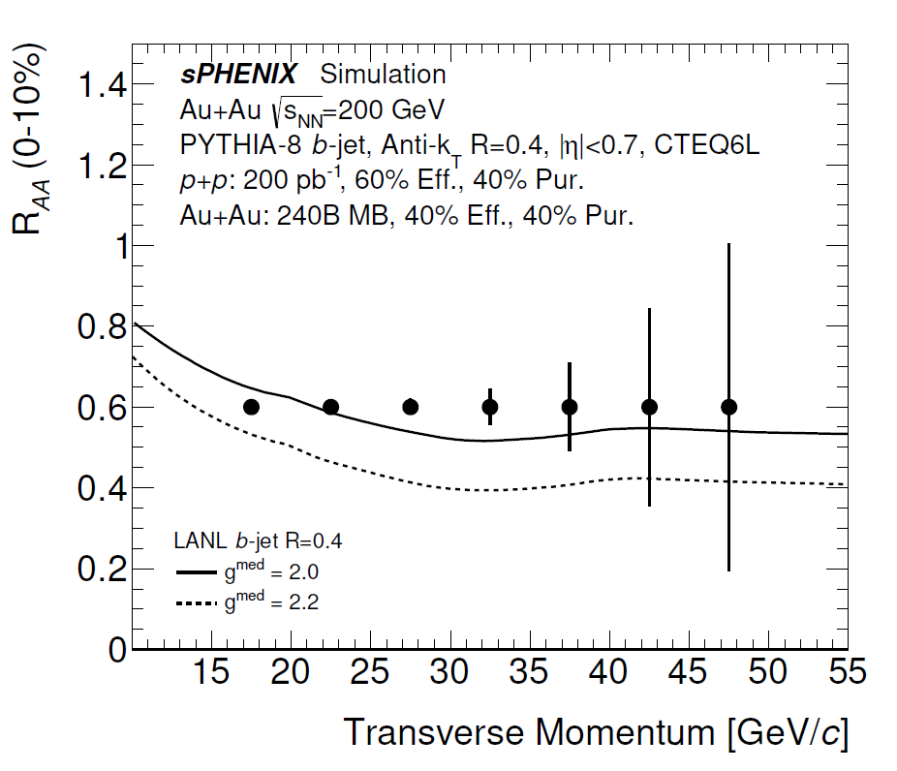
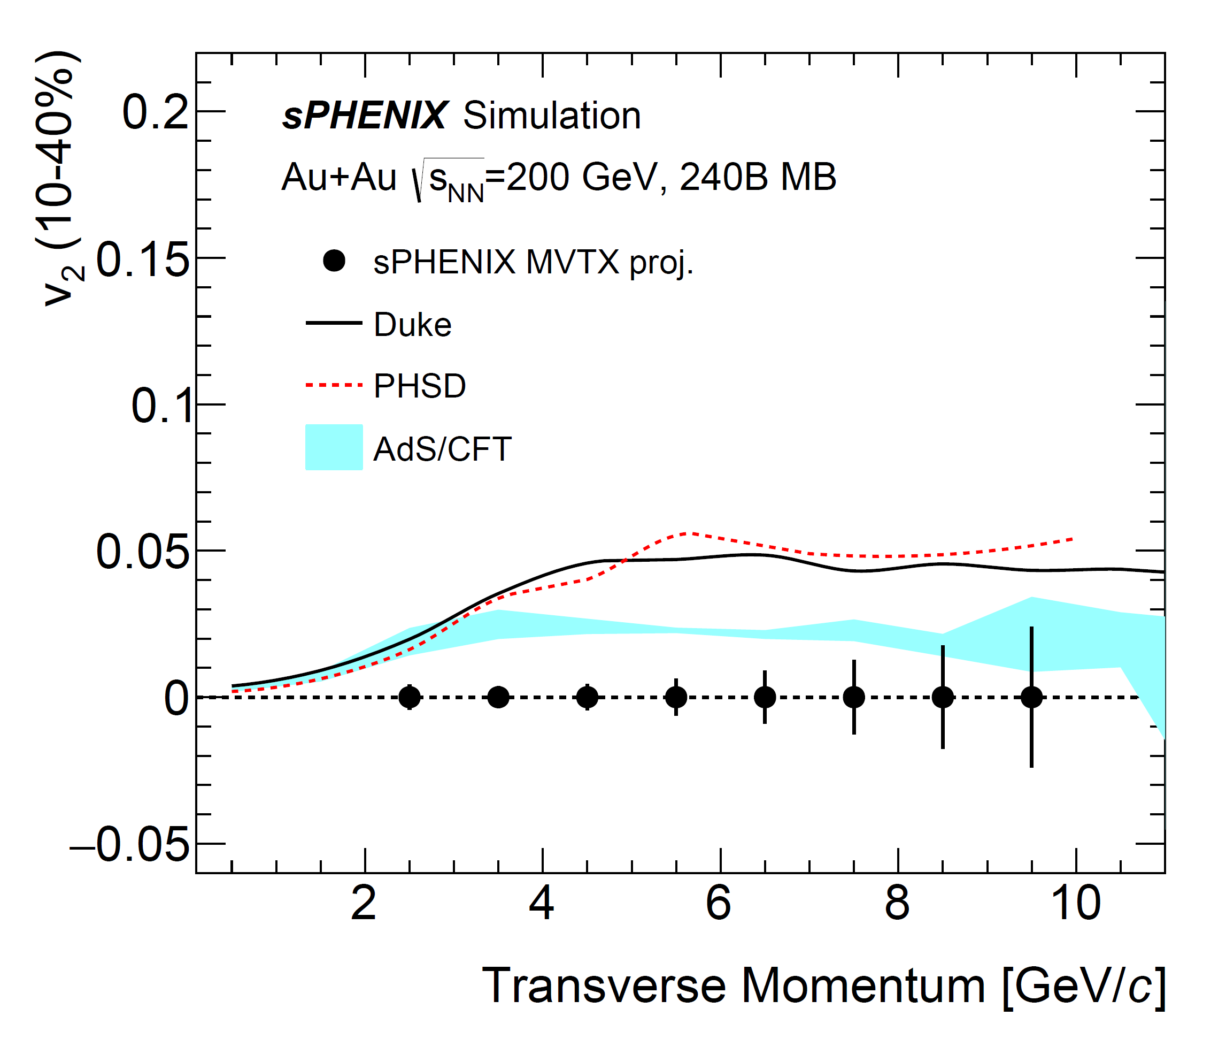
Example observables: HF-tagged jets and open HF
Inclusive b-jet R_{AA}
B-meson reconstruction: b-quark flow
Requires MVTX

Slide 12
Example of theory progress connected to sPHENIX plans
Z-B Kang, J Reiten, I Vitev, B Yoon, “Light and heavy flavor dijet production and dijet mass modification in heavy ion collisions”, Phys. Rev. D99 034006 (2019)
Partly supported by LANL LDRD connected to sPHENIX
More pronounced effect at RHIC energies
Requires MVTX

Slide 13
Compelling physics, future potential ⇒ strong collaboration
77 institutions – 17 since formation of collaboration in December 2015
Augustana University
Banaras Hindu University
Baruch College, CUNY
Brookhaven National Laboratory
China Institute for Atomic Energy
CEA Saclay
Central China Normal University
Chonbuk National University
Columbia University
Eötvös University
Florida State University
Fudan University
Georgia State University
Howard University
Hungarian sPHENIX Consortium
Insititut de physique nucléaire d’Orsay
Institute for High Energy Physics, Protvino
Institute of Nuclear Research, Russian Academy of Sciences, Moscow
Institute of Physics, University of Tsukuba
Institute of Modern Physics, China
Iowa State University
Japan Atomic Energy Agency
Charles University (CUNI), Prague
Czech Technical University in Prague (CTU)
Korea University
Lawrence Berkeley National Laboratory
Lawrence Livermore National Laboratory
Lehigh University
Los Alamos National Laboratory
Massachusetts Institute of Technology
Muhlenberg College
Nara Women’s University
National Central University
National Research Centre "Kurchatov Institute"
National Research Nuclear University "MEPhI"
New Mexico State University
Oak Ridge National Laboratory
Ohio University
Peking University
Petersburg Nuclear Physics Institute
Purdue University
Rice University
RIKEN
RIKEN BNL Research Center
Rikkyo University
Rutgers University
Saint‐Petersburg Polytechnic University
Sejong University
Shanghai Institute for Applied Physics
Stony Brook University
Sun Yat Sen University
Temple University
Tokyo Institute of Technology
Tsinghua University
Universidad Técnica Federico Santa María
University of California, Berkeley
University of California, Los Angeles
University of California, Riverside
University of Colorado, Boulder
University of Debrecen
University of Houston
University of Illinois, Urbana-Champaign
University of Jammu
University of Maryland
University of Michigan
University of New Mexico
University of North Carolina at Greensboro
University of Sao Paolo
University of Tennessee, Knoxville
University of Texas, Austin
University of Tokyo
University of Science and Technology, China
Vanderbilt University
Wayne State University
Weizmann Institute
Yale University
Yonsei University
World class expertise in relevant physics, silicon, TPCs, calorimetry, electronics, computing
Recent expressions of interest from additional strong institutions in Europe, Asia

Slide 14
The science collaboration and the project
Institutional Board
Institution representatives
Executive Council
Project and collaboration representatives
Topical Groups
Jet structure
D. Perepelitsa, R. Reed
Y spectroscopy
T. Frawley, M. Rosati
Heavy flavor
J. Huang, X. Dong
Cold QCD
C. Aidala

Slide 15
Summary
sPHENIX science mission defined in 2015 NP LRP: study microscopic structure of QGP through high precision jet, open (D,B meson) and closed (Upsilon) HF data sets
Advantageous complementarity with CERN LHC plans through 2020s
  sPHENIX granted “CERN recognized experiment” designation by CERN based on mutual technical and scientific benefits
Science goals yield performance parameters that inform detector design
sPHENIX science collaboration well coordinated with sPHENIX project. Continued steady growth with key strategic additions
Continued work in collaboration and with theory community to sharpen, broaden science addressed by sPHENIX
Collaboration is committed to building a world-class experiment with the capabilities needed to deliver the full suite of sPHENIX physics

Slide 16
Answers to questions

Slide 17
b-jet projections for three year run plan

Slide 18
Number of particles per jet

