Slide 1
sPHENIX Director’s Review 1.2 sPHENIX TPC
Thomas K. Hemmick
April 9-11, 2019
BNL

Slide 2
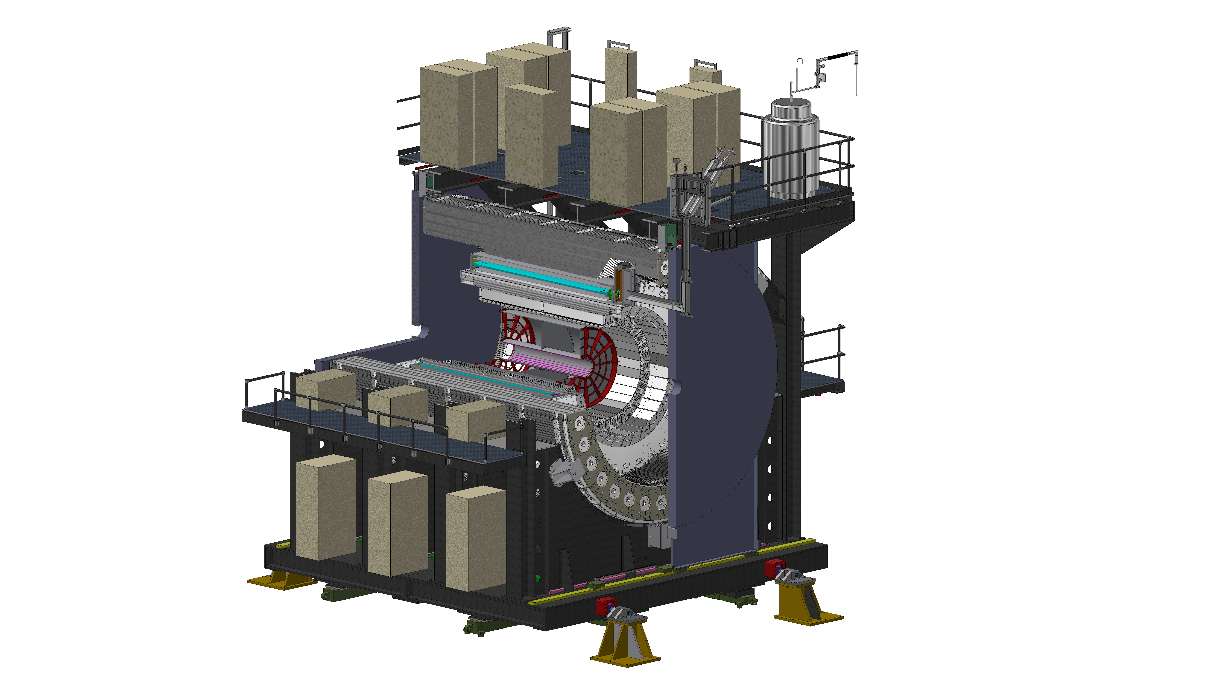
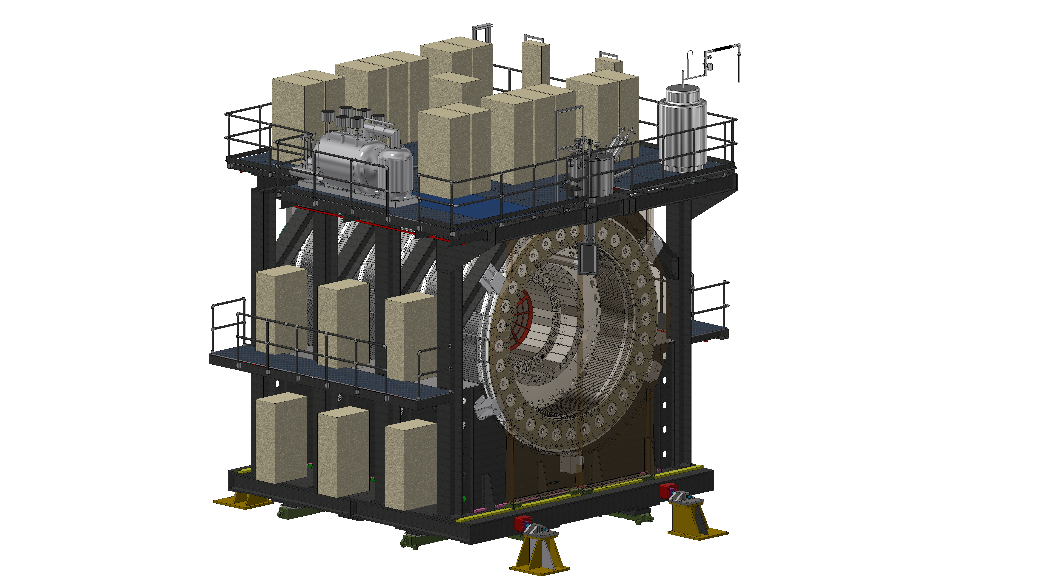
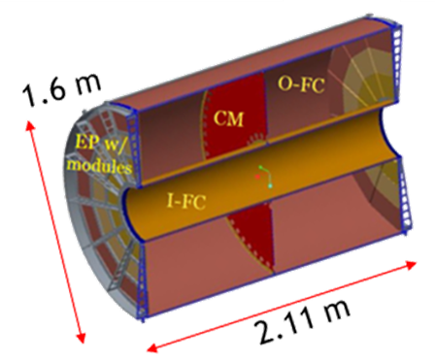
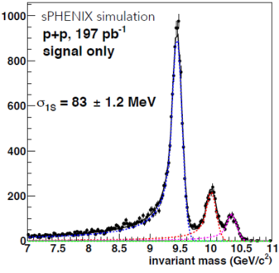
The Subsystem
A next-generation TPC operated in continuous readout mode using Gas-Electron Multiplier (GEM) avalanche w/ low Ion Back Flow (IBF).
Front End Electronics (FEE) uses SAMPA chip (developed by ALICE).
Data Aggregation Module (DAM) uses the FELIX board (ATLAS exp)
Charged Tracking in sPHENIX:
TPC provides p-resolution

Slide 3
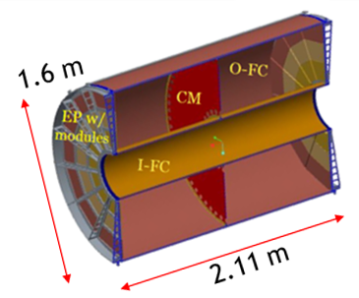
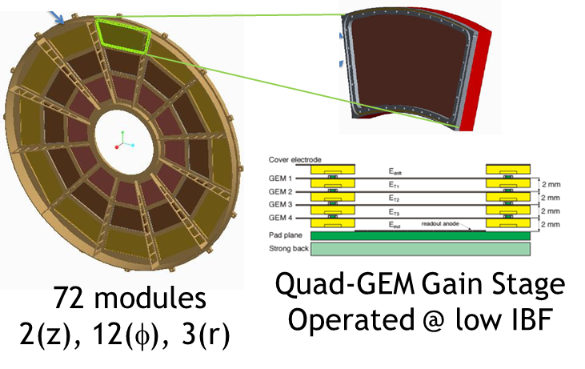
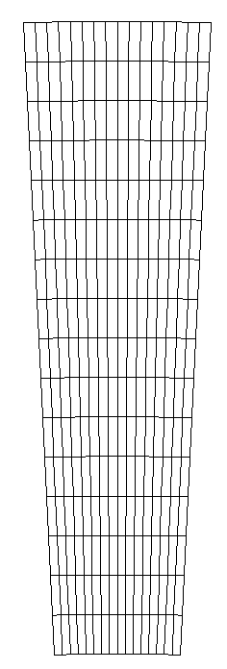
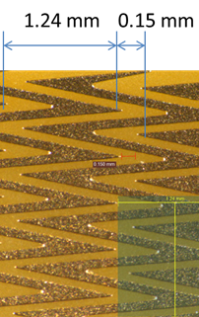
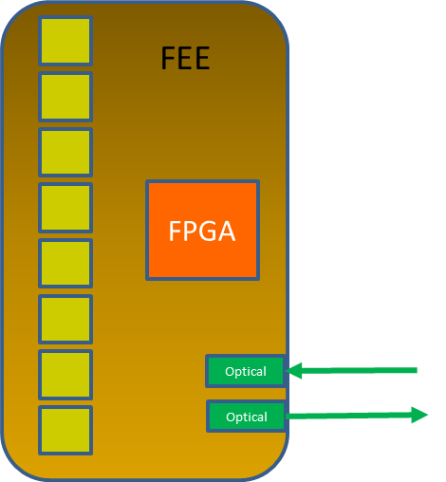
The Subsystem Technical Overview
“Wedge”
EBDC 1/DAM
DAM Cards
Item | Count
Field Cage | 1
Modules | 72
FEE | 624
DAM | 24
EDBC | 24
256 pads/FEE
25 FEE/sector
1 DAM/sector
RHIC Comp Facility
charge
Digitized
Compressed
Zig-Zag Pads

Slide 4
Scope
1.2.1: TPC Mechanics
TPC Field Cage: v2 prototype; final field cage.
TPC Modules: v1a prototype; v1b prototype; v2b prototype.
TPC GEM Production: CERN Shop (mirroring ALICE production)
TPC High Voltage Systems: (GEM & Central Membrane)
TPC Assembly: (Modules, Electronics, Testing).
1.2.(2-4): Rn Modules (n=1, 2, 3a, 3b):
Factory Preparation; Pre-production Module; Module Production
1.2.5: TPC FEE:
FEE v1 Prototype; FEE v2 Prototype; FEE Production
1.2.6: TPC DAM:
DAM v1 Prototype; DAM v2 Prototype; DAM Production
1.2.7: TPC Services:
Laser Calibration System; Gas System; Cooling System
Funding Source Key:
OPC
TEC

Slide 5
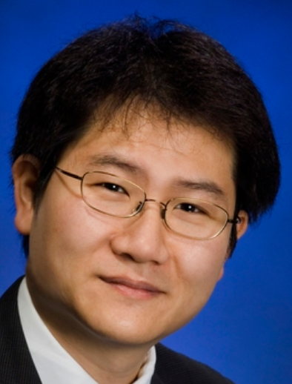
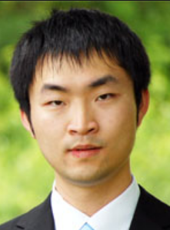
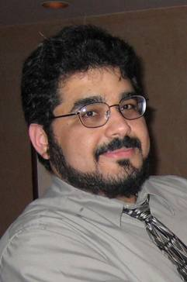
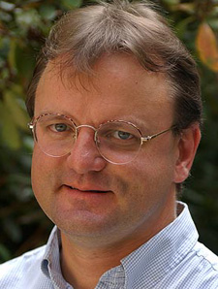
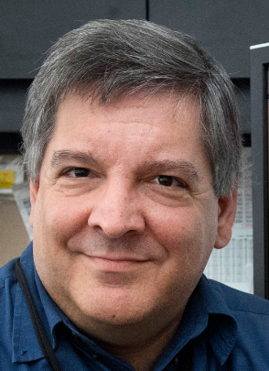
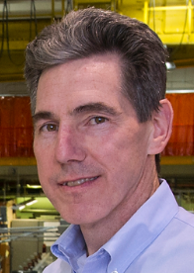
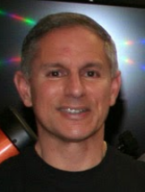
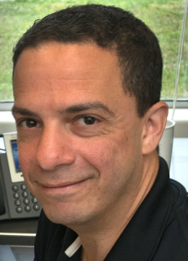
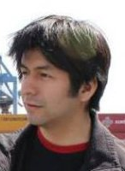
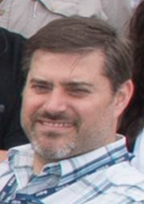
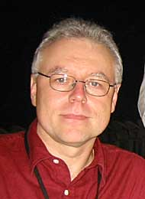
Subsystem Collaborators
Factory Managers
L2/L3- Management
Engineering
Additional Scientific
EE:
Lots of Students
Mead

Slide 6
Schedule Drivers
Module production rate limited by GEM availability
CERN GEM Production
Module Production
Float
Test to Threshold KPP
Ready to Install
S119800 3-Feb-20 S120100 13-Aug-20
S132800 14-Aug-19
S134100 29-Sep-20
SAMPA Chip Development
FEE Production & Assembly
S121800 26-Mar-21
S121800 25-Jun-21
S121900 25-Jun-21
S137800 29-May-18
S140800 13-May-20
S140900 10-Dec-19
S143400 11-Mar-21
Module production rates from PHENIX Hadron Blind Detector experience (SBU, BNL, WIS) and ALICE experience (WSU, Yale).
Module production (1/week/factory) is entirely limited by GEM availability.
FEE has SAMPA chip (80 nsec development) & off-the-shelf components.
SAMPA production/testing completion drives board assembly.

Slide 7
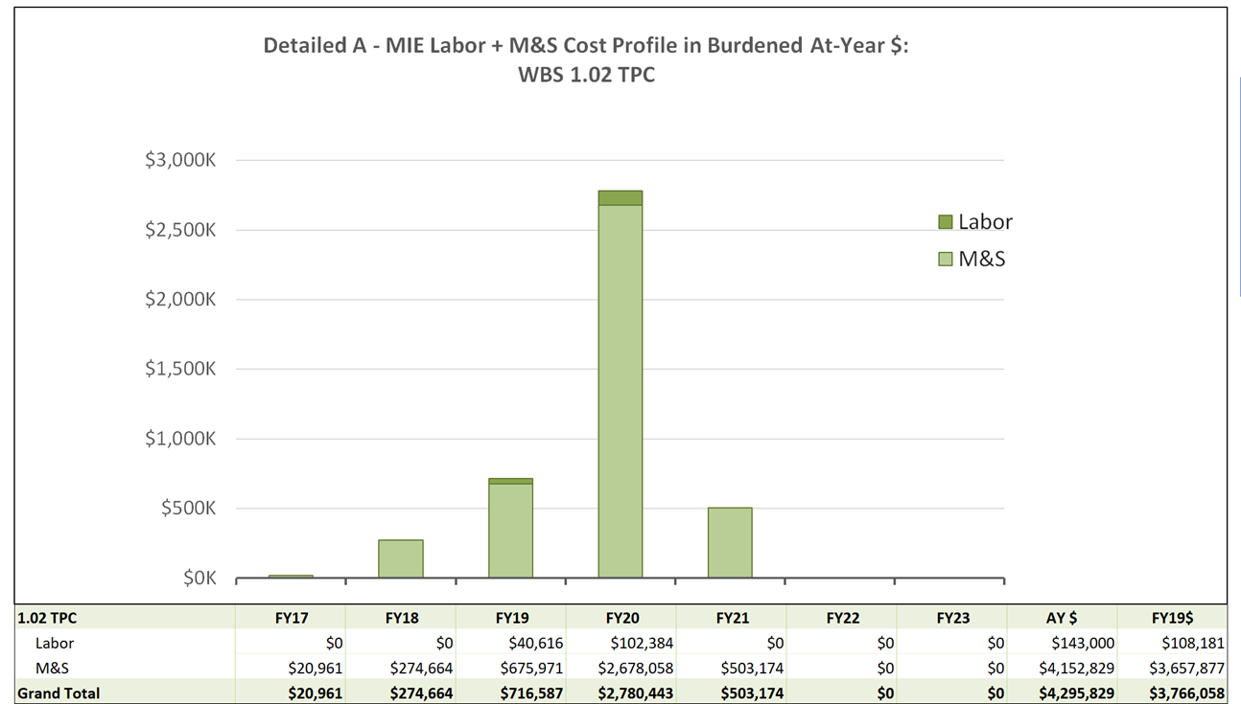
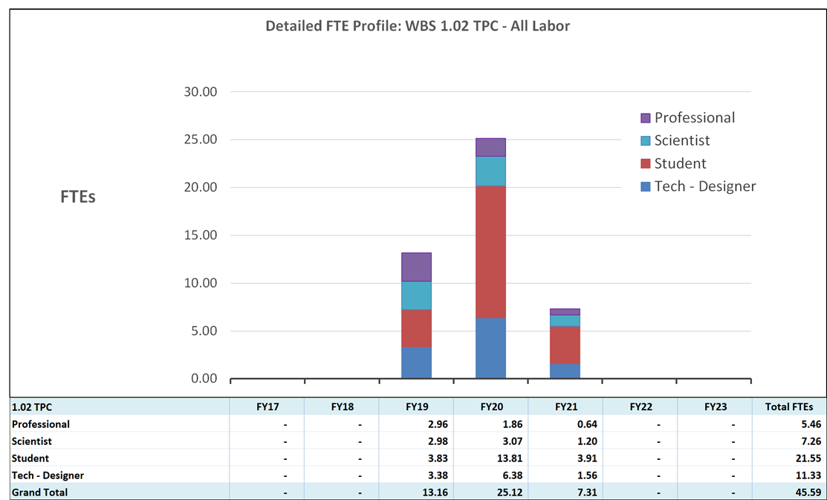
Cost Drivers
Costs are driven by M&S.
Most labor contributed.
Exception:
Pay for former ALICE tech
CERN-produced GEM foils.
SAMPA readout chips via Sao Paulo
DAM (Felix2) ala ATLAS expt.

Slide 8
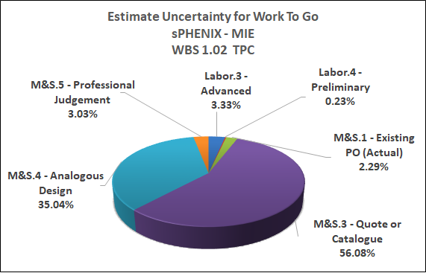
Basis of Estimate & Resource-Loaded Schedule
Contributed labor simplifies cost estimate
Estimates dominated by quote/catalog
Estimates benefit from similarity to prior GEM projects:
ALICE TPC
WSU (ALICE Factory)
Yale (ROC validation)
PHENIX HBD
COMPASS TRACKERS

Slide 9
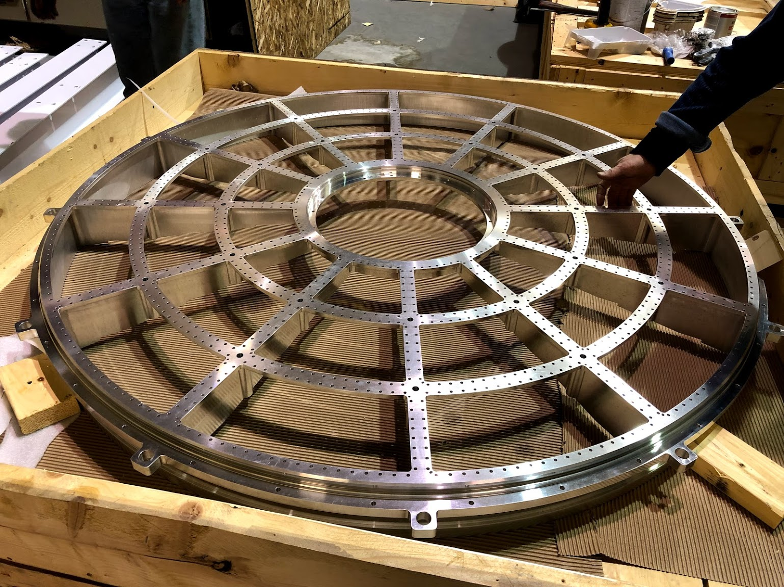
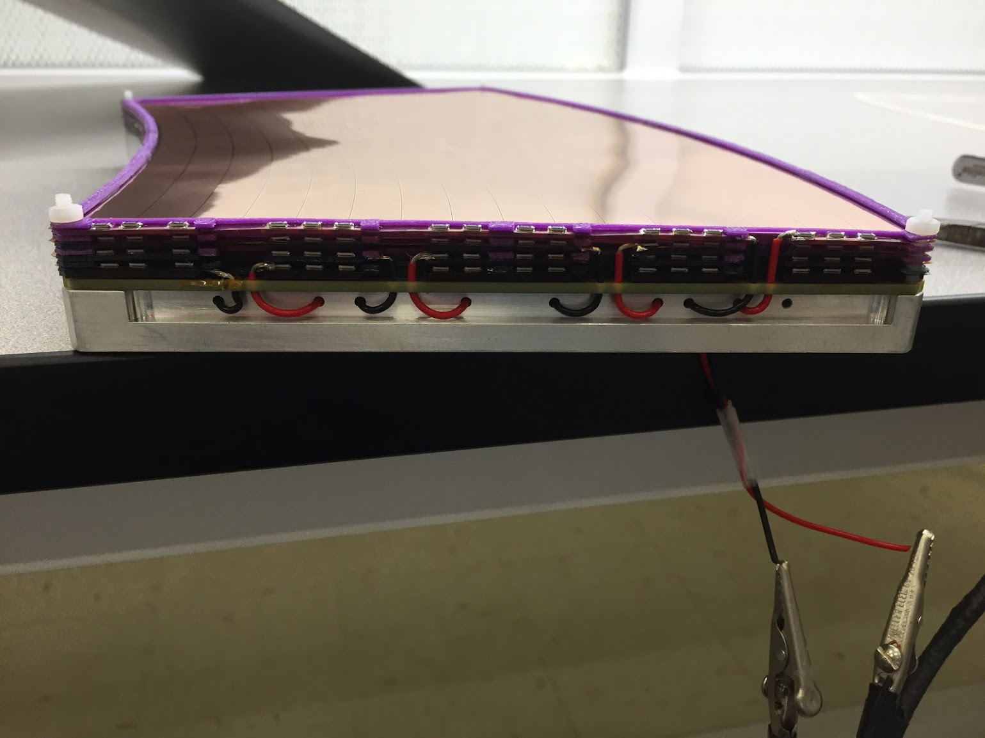
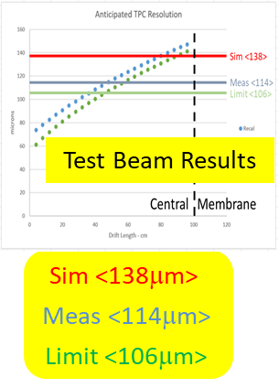
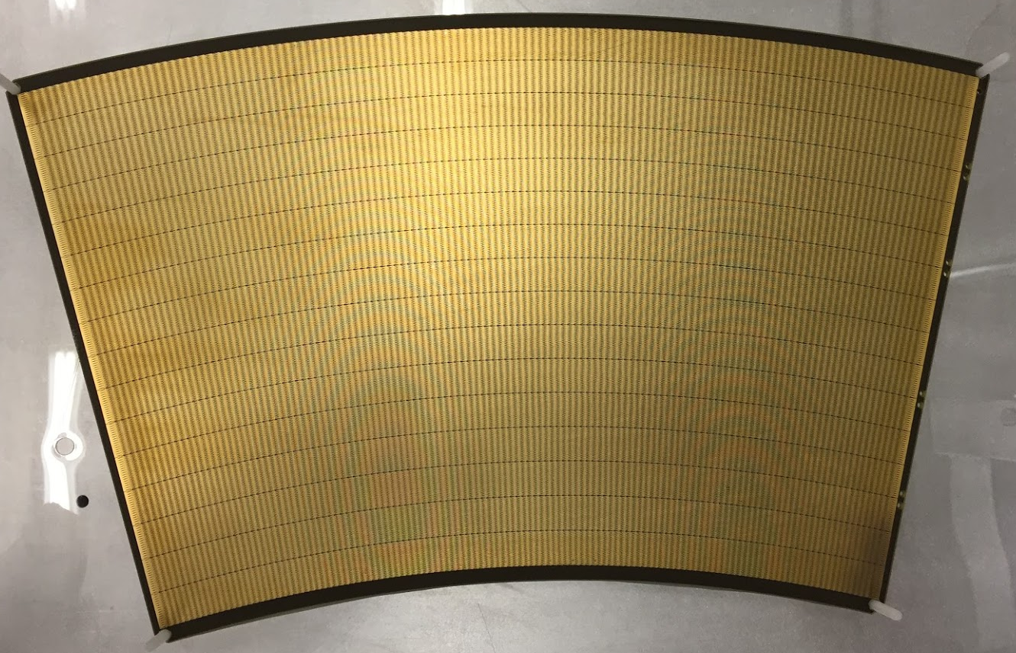
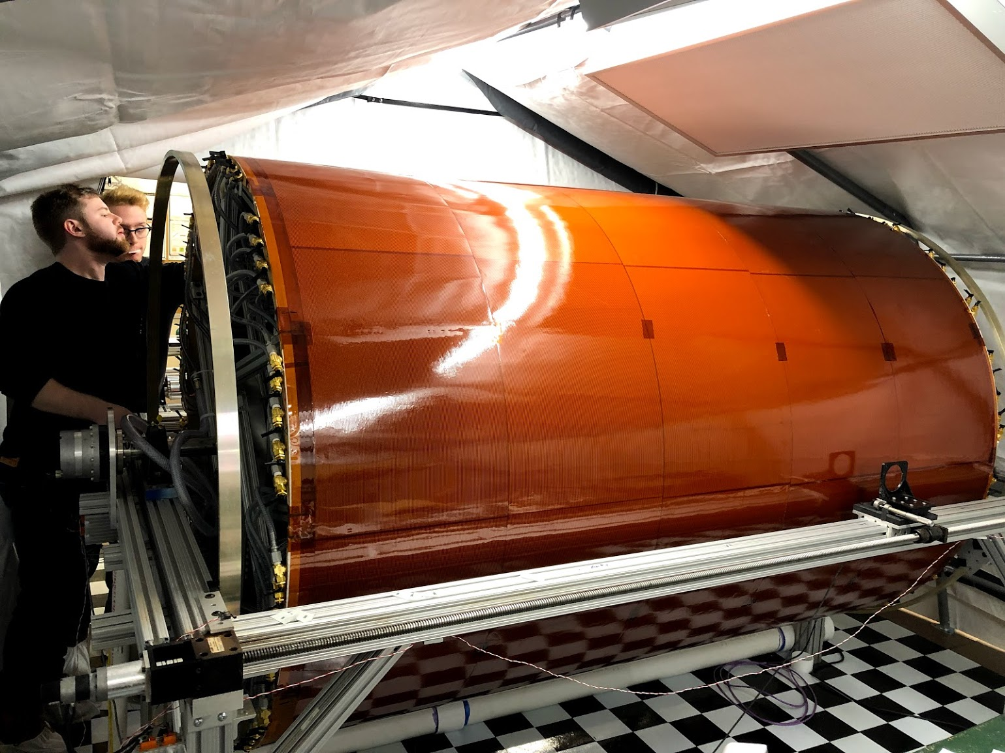
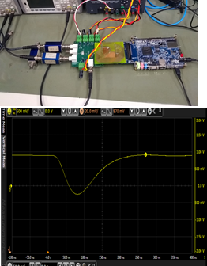
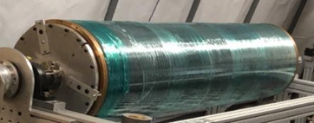
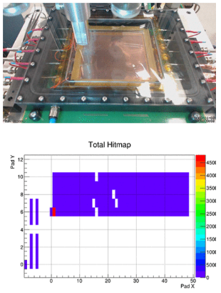
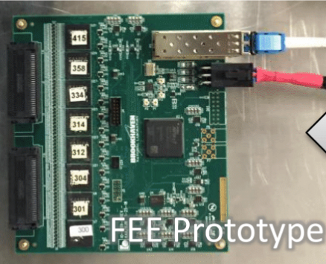
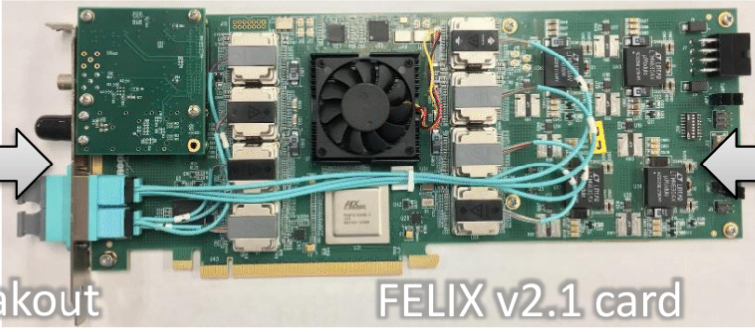
Status and Highlights
“Wedge”
EBDC 1/DAM
DAM Cards
Item | Count
Field Cage | 1
Modules | 72
FEE | 624
DAM | 24
EDBC | 24
256 pads/FEE
25 FEE/sector
1 DAM/sector
RHIC Comp Facility
charge
Digitized
Compressed
SAMPA v5 Waveform
Zig-Zag Pads
Full Chain Readout

Slide 10
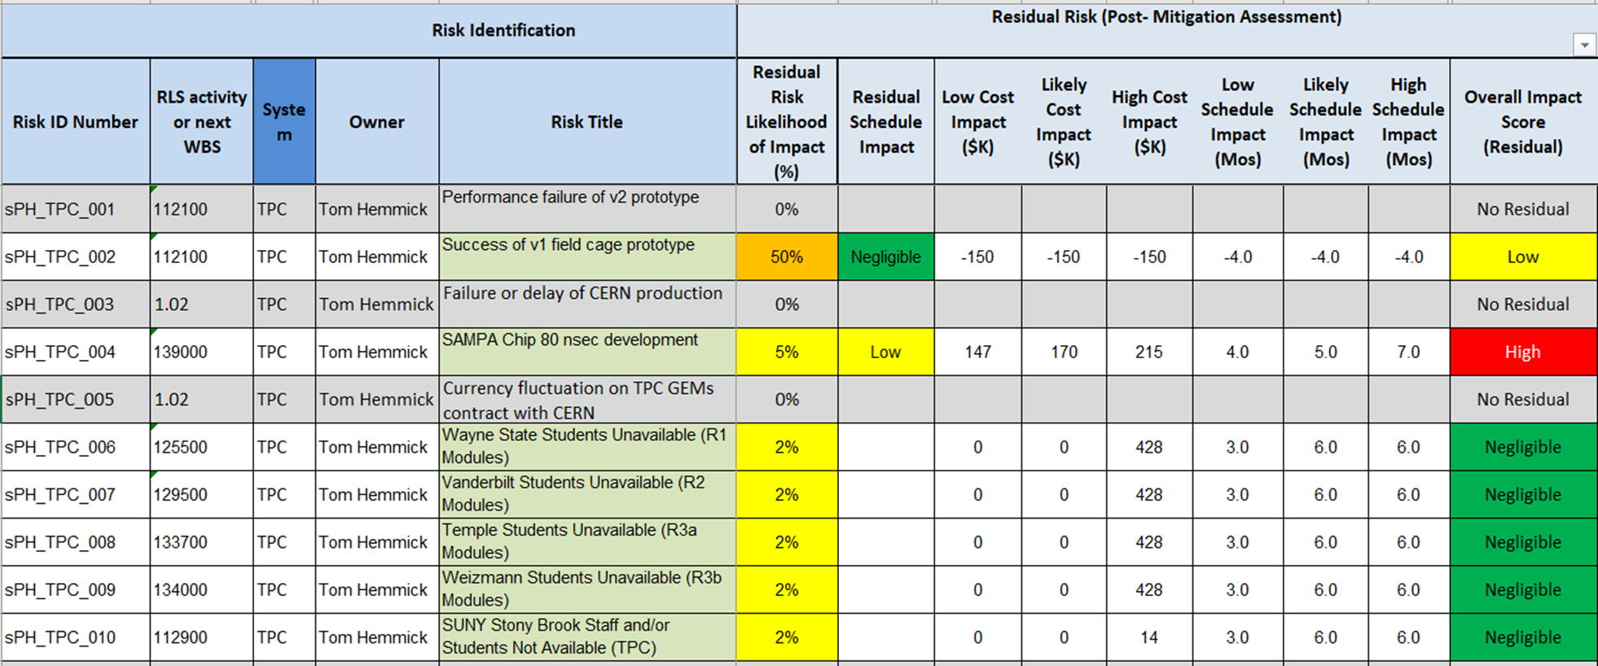
Risk Registry

Slide 11
Issues and Concerns
SAMPA development is going well thus far:
Change #1: Implement again an existing design for 80 nsec peaking time (developed by later dropped by ALICE).
Change #2: Improved coupling to digitizer to allow 20 MHz operation (opted against by ALICE).
If a second engineering run is required prior to production the cost & schedule impact is significant (as coded into our risk registry).

Slide 12
Summary
The Time Projection Chamber design has benefitted significantly from the R&D for the ALICE upgrades.
The TPC will meet all the performance goals for sPHENIX.
The TPC group has close relations with the Sao Paulo and development of SAMPA v5 is going well.
The TPC schedule is not critical path.
TPC team has a long successful track record working together.
The TPC team benefits from ALICE experience via sPHENIX collaborators (WSU) and R&D partners (Yale).
The sPHENIX TPC is ready for PD-2/3 approval.

Slide 13
Back Up

Slide 14
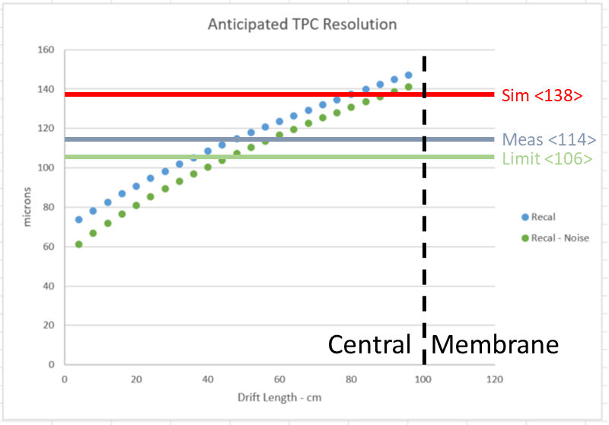
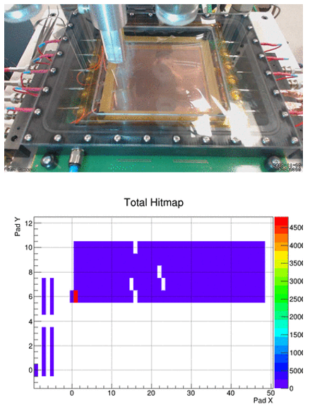
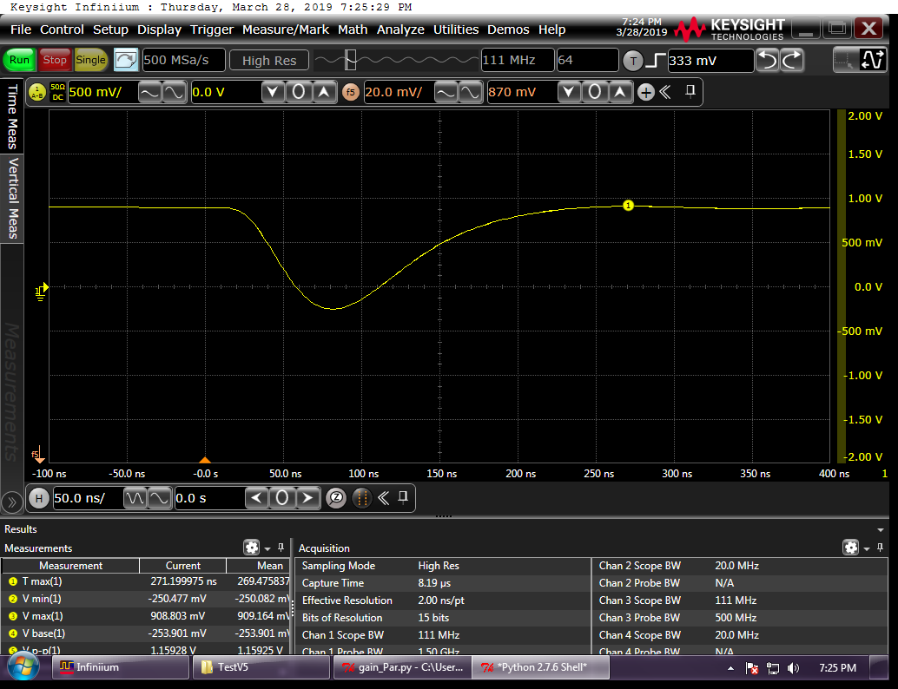
Status and Highlights
V1a Module
Inner Field Cage Mechanically Complete, Electrical Assm Ongoing
Large Field Cage Assm Ongoing
40cm-drift Prototype Test Beam
SAMPA v5
Test Beam Results
Sim <138μm>
Meas <114μm>
SAMPA Waveform
Wagon Wheels Delivered/Accepted
X-ray scan measured/analyzed through full chain
Limit <106μm>

