Slide 1
sPHENIX Director’s Review
Silicon Detector Overview
John Haggerty
April 9-11, 2019
BNL

Slide 2
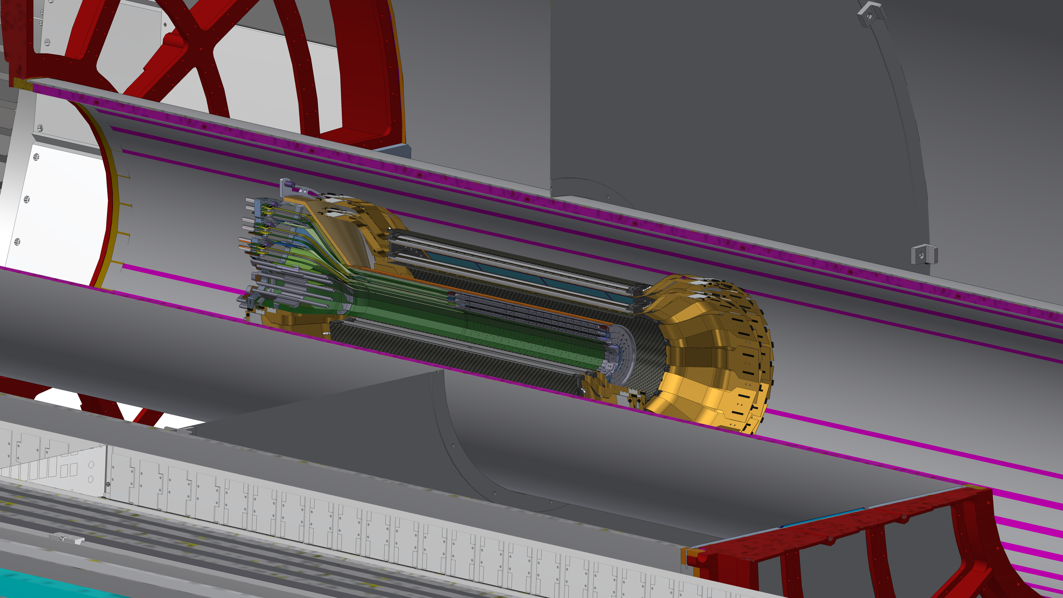

Slide 3
Silicon Detector Projects in sPHENIX
MVTX and INTT are separate projects coordinated with sPHENIX construction
MVTX is a LANL/MIT/LBNL/UTA/… consortium
  R&D supported by LANL LDRD
  ALICE Staves and Readout Units acquired by BNL
INTT is a RIKEN/RBRC project funded by Japan
Both projects have BNL DAQ, Infrastructure, Integration, and Installation support

Slide 4
TTF: Tracking Task Force
Convened by spokespersons to optimize tracking system
Tony Frawley and Christof Roland chaired the TF
  Many collaborators participate: Ross Corliss, MIT; Haiwang Yu, NMSU, Mickey Chiu, BNL; Sanghoon Lim, UCB; Jin Huang, BNL, Molly Taylor, MIT,…
Many of the following slides from Christof Roland’s summary

Slide 5
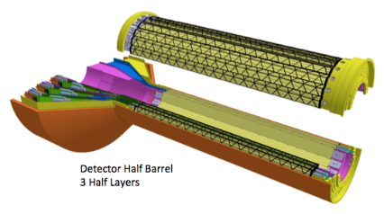
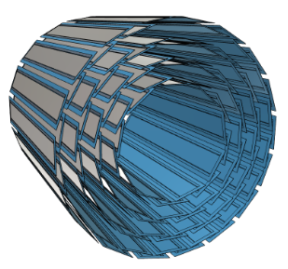
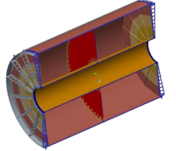
TTF: The sPHENIX tracking system
MVTX
  3 layer vertex tracker based on Monolithic Active Pixel Sensors
  Provides impact parameter resolution
INTT
  2 Layers of Silicon Strip detectors
  Fast response time for pileup disambiguation
TPC
  48 layer continuous readout TPC
  Main tracking device
  Provides momentum resolution

Slide 6
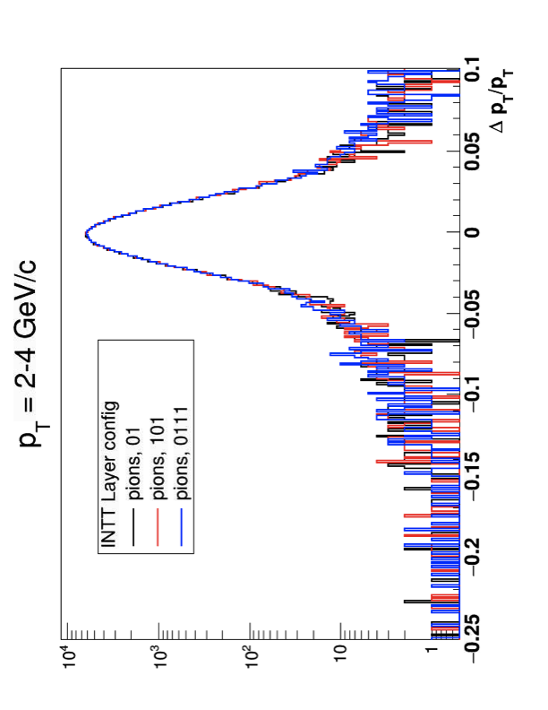
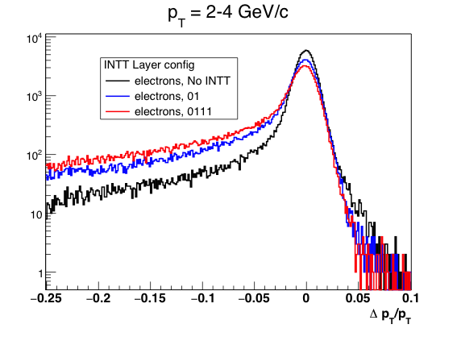
TTF: Track Parameter Estimation vs INTT Mass
Pions
2, 3 and 4 Layer INTT
Electrons
0, 2 and 4 Layer INTT
The pion momentum resolution does not depend on the number of INTT layers
  Verified by independent study based on the LIC detector model
The electron reconstruction is severely affected by the material budget
Tony Frawley

Slide 7
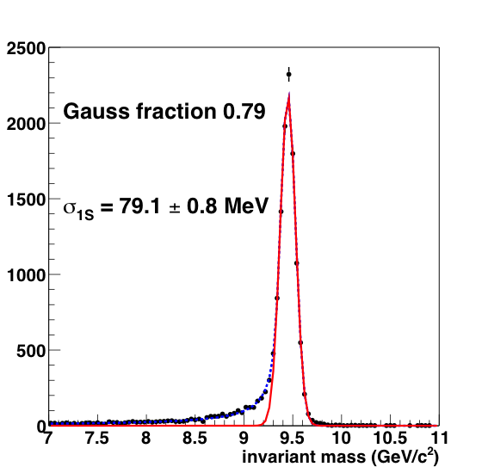
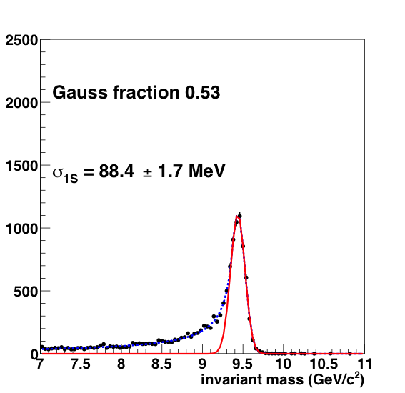
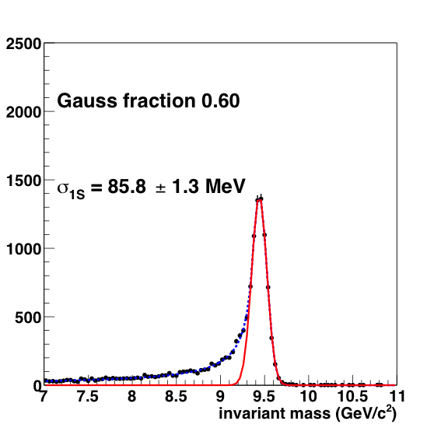
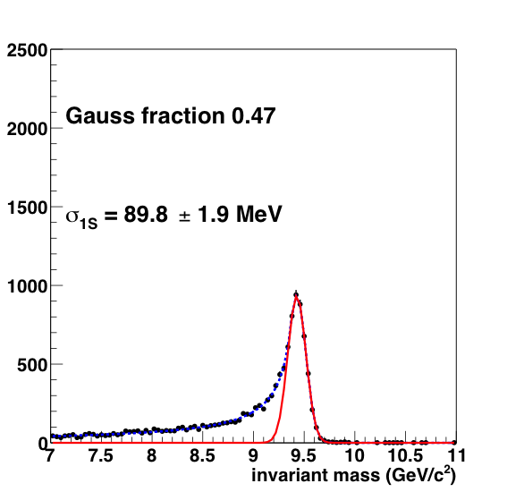
TTF: Impact on Upsilon Mass Spectra
No INTT
2 Layer INTT
3 Layer INTT
4 Layer INTT
0.47!
Simulation done with the latest INTT and TPC simulation
  Need to reduce the material budget to the minimum necessary

Slide 8
Tracking Task Task Force – Executive Summary
Radiative tails in Upsilon in the e+ e- channel
  Strongly suggest to limit the mass budget of the detector to the minimum necessary
Momentum Resolution
  Unaffected by the number of INTT layers
Tracking efficiency
  Low number of layers gives best performance, 0 layers probably not a viable option
Pileup rejection
  One INTT hit per track sufficient for out-of-time vertex and track rejection
Calibration precision for the TPC
  No INTT layout can provide a single track pointing resolution that is smaller than the calibration accuracy requirement
  Low number of INTT layers give best extrapolation performance
Dead channel considerations and redundancy requirement
  Install one more layer than the minimum number of hits required
A 2 Layer (4 sub-layer) configuration probably gives the best performance while keeping sufficient redundancy with respect to dead channels and malfunctioning detector modules
The radii of the layers should be chosen sufficiently small to provide full coverage of |η| < 1 (1.1?) for |vz|<10
  Default positions of Layers 2 and 3 would provide full coverage for |η| < 1

Slide 9
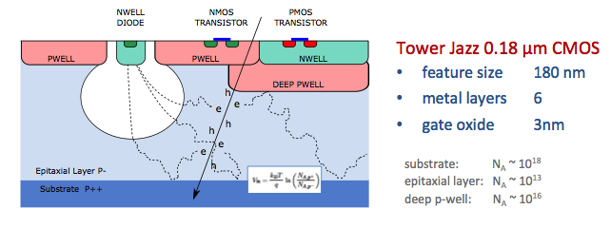
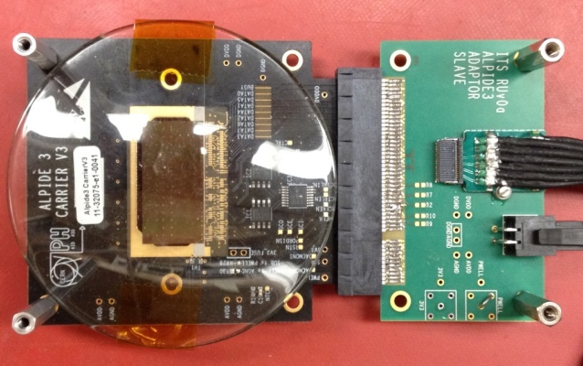
MVTX ALPIDE Sensor
ALICE Pixel Detector
Very fine pitch (27μm x 29μm), for superb spatial resolution
High efficiency (>99%) and low noise (<10⁻⁶), for excellent tracking
Time resolution, as low as ∼5 μs, for less pileup
Ultra-thin/low mass, 50μm (~0.3% X₀), for less multiple scattering
0.5M channels with on-pixel digitization, for zero-suppression and fast readout
Low power dissipation, 40mW/cm², for minimal service materials
ALPIDE sensor
1.5cm x 3.0cm, 0.5M pixels

Slide 10
MVTX Stave
Stave designed and used by ALICE
Cover |η|<1.1
DCA resolution < 50 μ
>80% efficiency for charged pions at 1 GeV/c in central Au+Au
∼0.3%X₀/layer

Slide 11
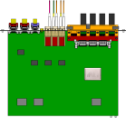
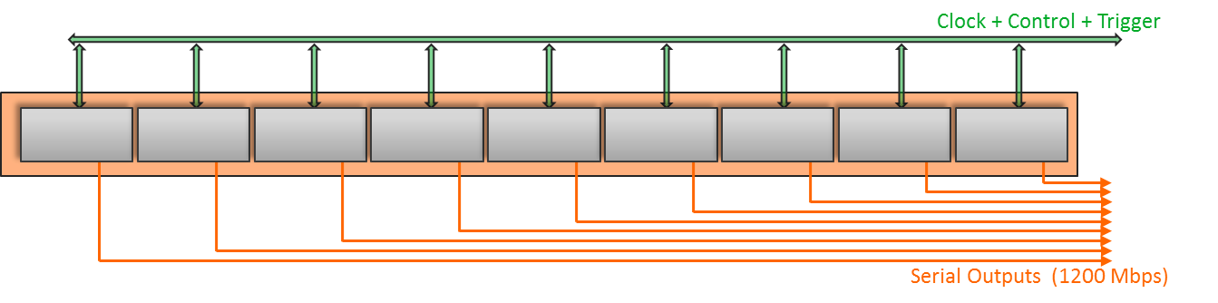
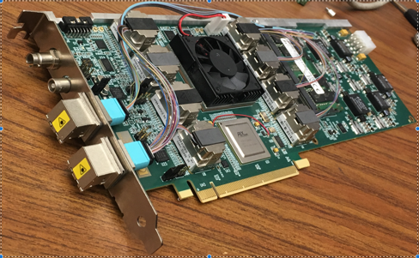

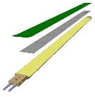
MVTX Readout
CAN bus
DCS
Trigger & Clock
Readout Unit
Front End
GBT Optical Links
9 Data (1.2Gbps)
1 Clock, 1 Control/Trigger
Control
Data (9.6 Gb/s max)
Trigger
9-sensor Stave
Samtec Twinax “FireFly”
FELIX
Back End
FPC
Power
Alpide Sensors
Flex PCB Filtering Capacitors
regulators
Power
Regulated Power
CAEN Power supplies
Cold Plate
Power Board
Interaction Region
Experimental Hall
Counting House

Slide 12
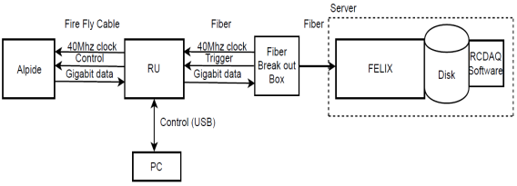
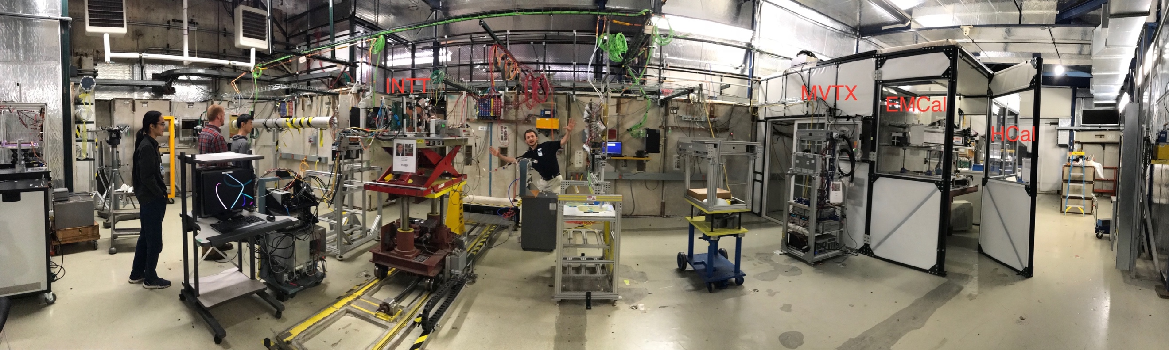
MVTX Beam Test
4-MAPS
telescope
Fermilab Test Beam: Feb-Mar, 2018
- Tracking spatial resolution: <5 um
- Hit efficiency: > 99.5%
120 GeV proton
beam
4-hit track
4-MAPS telescope

Slide 13
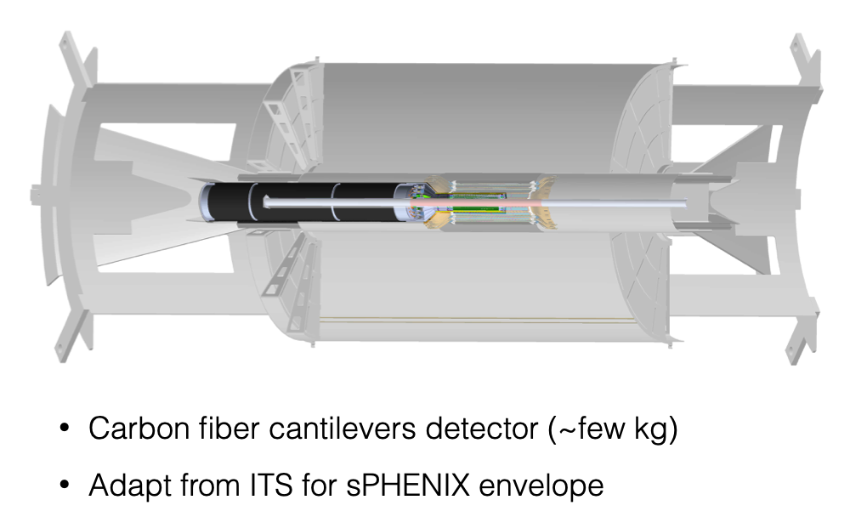
MVTX Mechanical Support

Slide 14
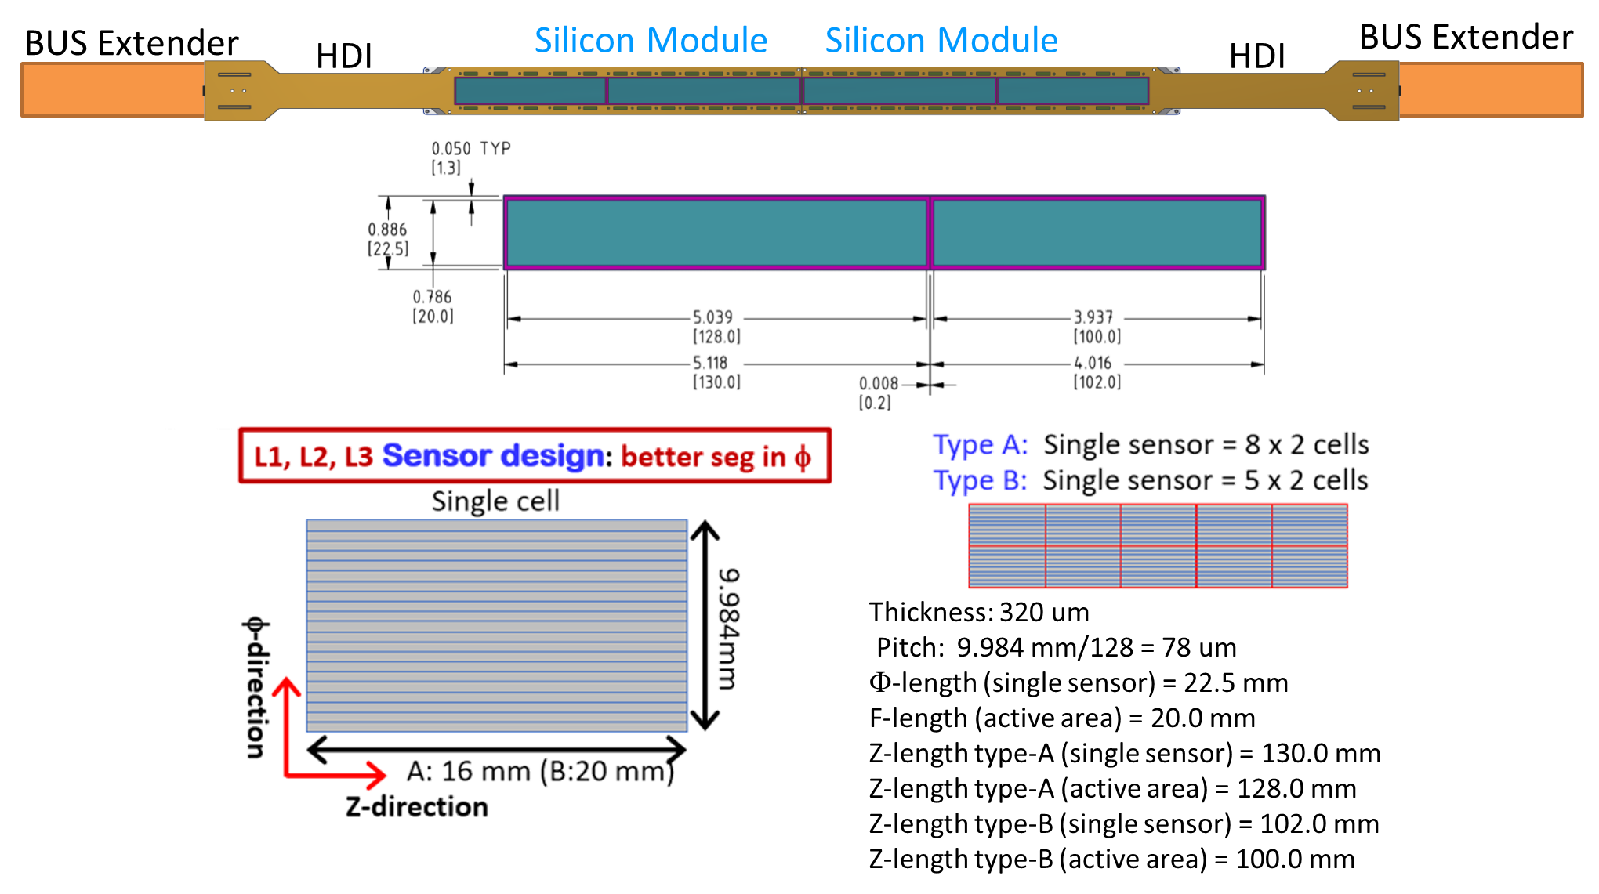
INTT Basics
Sensors from HPK
  78 μ pitch
  single-sided
  AC coupled
  320 μ thick
Two sizes of sensors
  128x20 mm
  100x20 mm
FPHX ASIC (developed for PHENIX)
  128 channels
  3 bit ADC
  64 mW/chip
  200 MHz data port
Near detector Readout Cards (ROC’s) from PHENIX FVTX
Data acquisition by FVTX FEM + DCM II/JSEB II
  Alternative under consideration

Slide 15
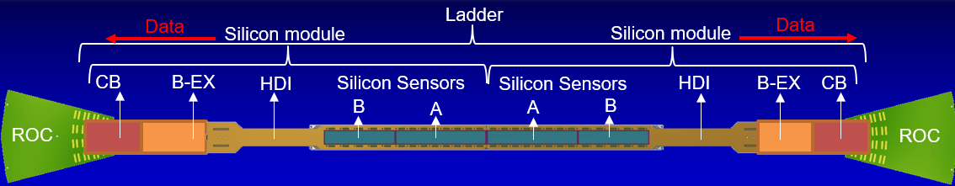
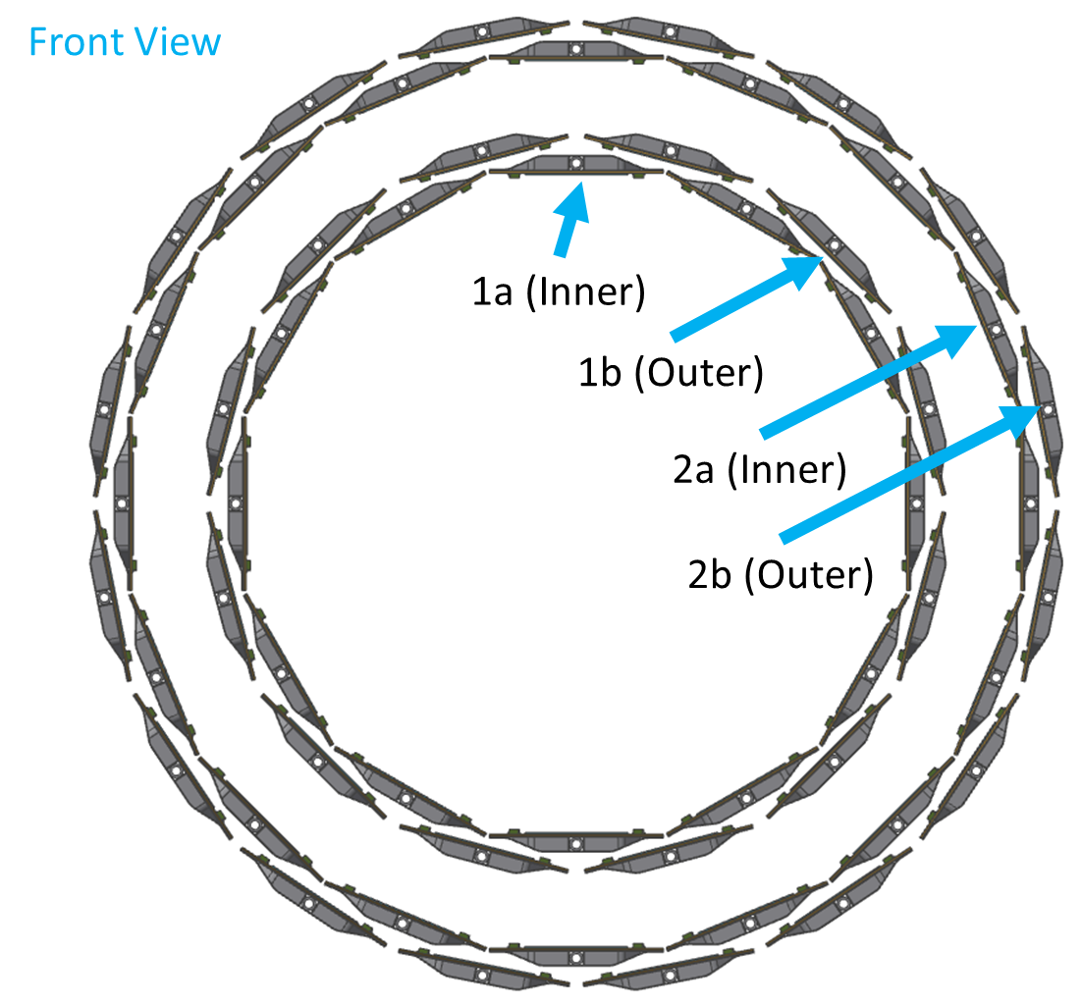
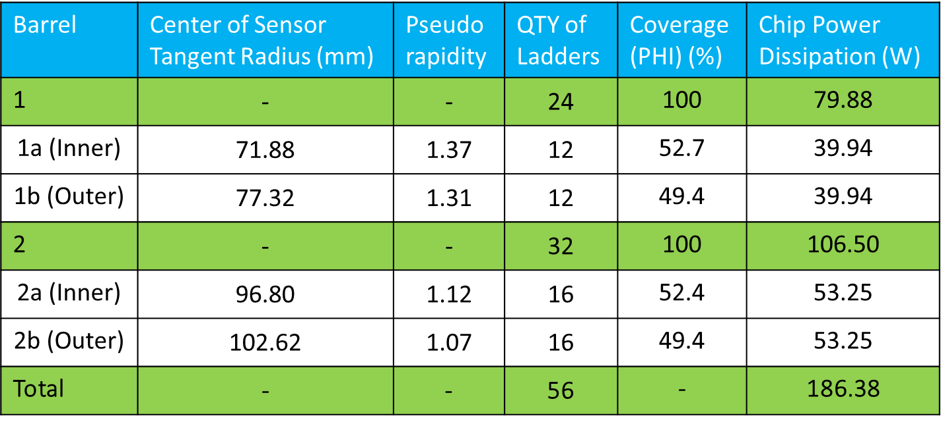
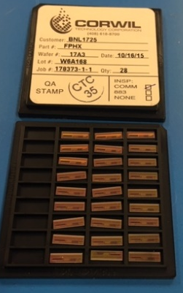
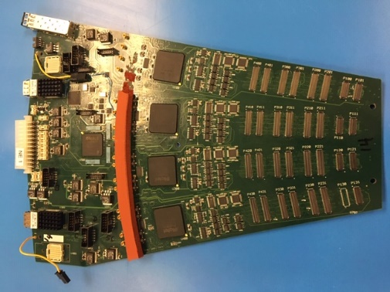
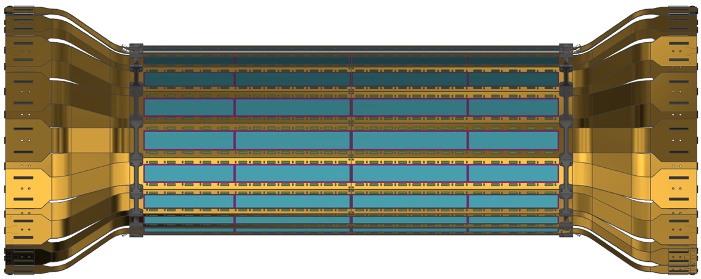
INTT Ladder
Two
Barrels
FPHX and ROC

Slide 16
INTT Prototype Stave Design
Z-length total: 497 mm
Material: Carbon Fiber, polymethacrylimide (PMI) and Epoxy
(radiation length = 0.25% )
Thickness: 0.38 mm
Height: 3.5 mm
Width: 38.0 mm

Slide 17
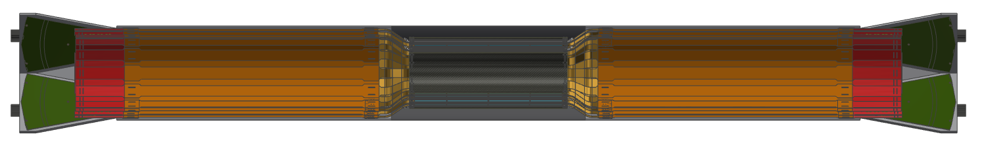
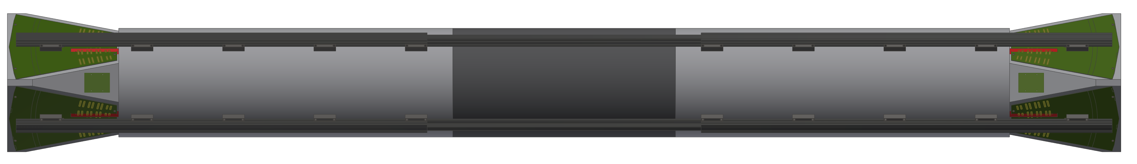
INTT Service Barrel
Extension Cables
Silicon
Conversion Board
Service Barrel
(Carbon Fiber Sandwich)
Rails
(Carbon Fiber)
ROCs

Slide 18
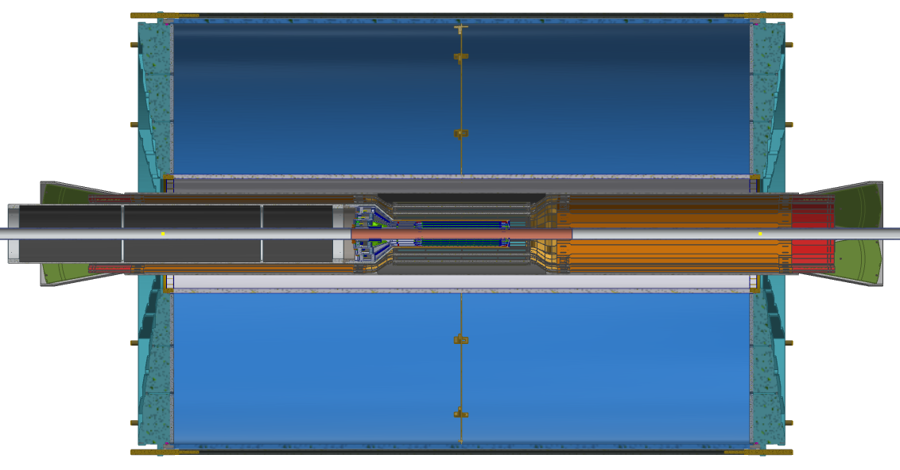
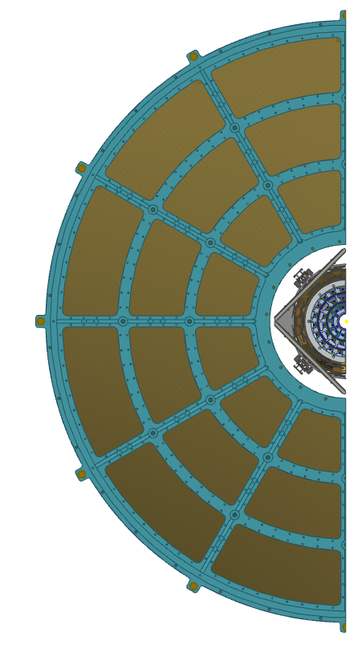
INTT Integration
150 mm Clearance
5 mm Clearance
15 mm Clearance
20 mm Clearance

Slide 19
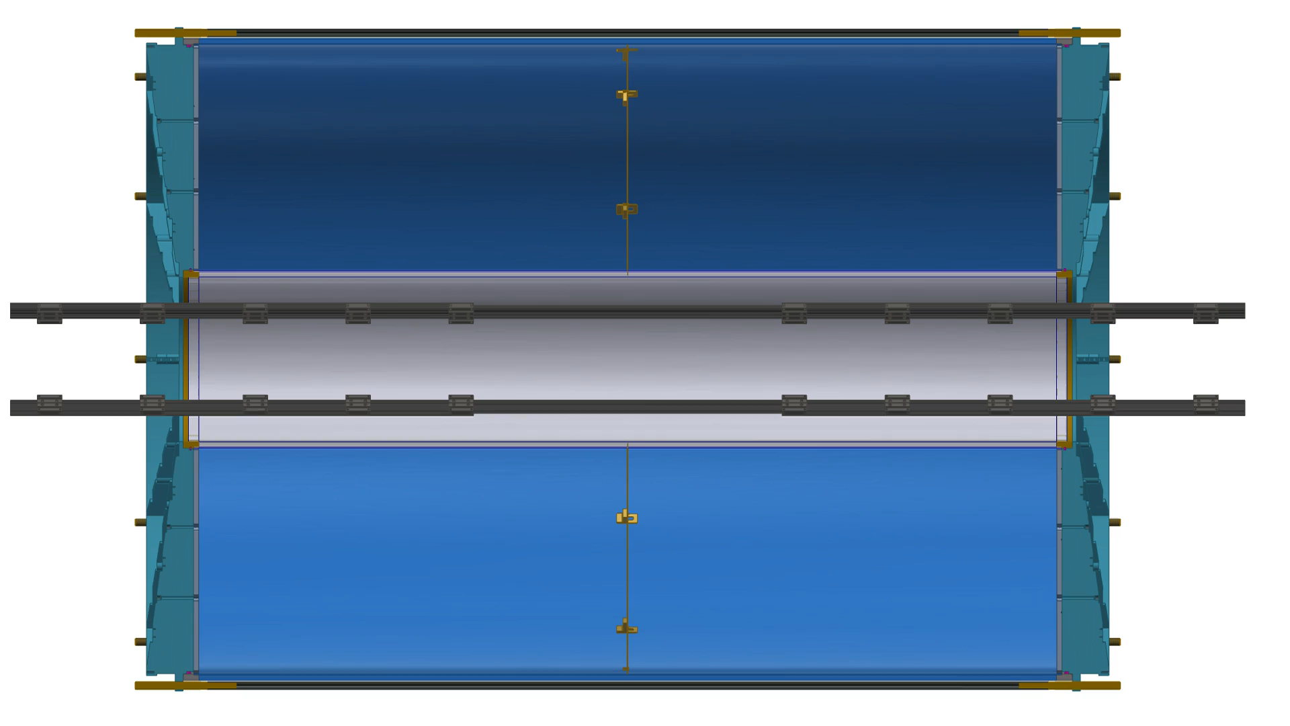
Installation
Dan Cacace, BNL

Slide 20
Issues and Concerns
Electronic engineering in both MVTX and INTT is minimal
  Expertise on INTT (FVTX) ROC and FELIX development
Installation of the MVTX so close to the beam pipe has to be very carefully thought out

Slide 21
Summary
sPHENIX has converged on a design of a robust tracking system including two silicon detectors inside the TPC
The MVTX and INTT are upgrade projects to the baseline sPHENIX MIE
Both the MVTX and INTT projects are based on tested technologies which have been mastered by the collaboration
The MVTX and INTT are at the stage of advanced conceptual design that has carefully addressed mechanical and electronic requirements

