Slide 1
Contingency Analysis –MIE 1.0
Cost Contingency based on risk event analysis (Monte Carlo) and estimate uncertainty.
Risk Registry prepared for MIE and Infrastructure/Facility Upgrade with mitigation strategies developed.
Monte Carlo analysis conducted 90% confidence level for MIE and Infrastructure/Facility Upgrade projects. (See Sourikova talk in Mgmt breakout).
Estimate Uncertainty assessed for labor and material at resource level based on pre-defined categories. (see tables in backup)
MIE Cost Contingency is 25% of work to go, Cost contingency at CD-1 was 30%.

Slide 2
Contingency Analysis 2.0
Cost Contingency based on risk event analysis (Monte Carlo) and estimate uncertainty.
Risk Registry prepared for MIE and Infrastructure/Facility Upgrade with mitigation strategies developed.
Monte Carlo analysis conducted 90% confidence level for MIE and Infrastructure/Facility Upgrade projects. (See Sourikova talk in Mgmt breakout).
Estimate Uncertainty assessed for labor and material at resource level based on pre-defined categories. (see tables in backup)
Infrastructure Facility Upgrade was initially estimated at 15% of labor and 30% of M&S.

Slide 3
Contingency Analysis 1.0 and 2.0

Slide 4
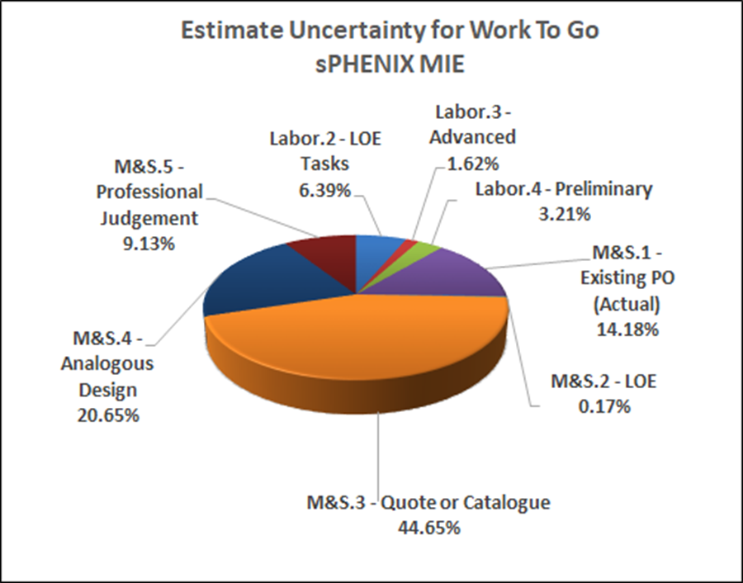
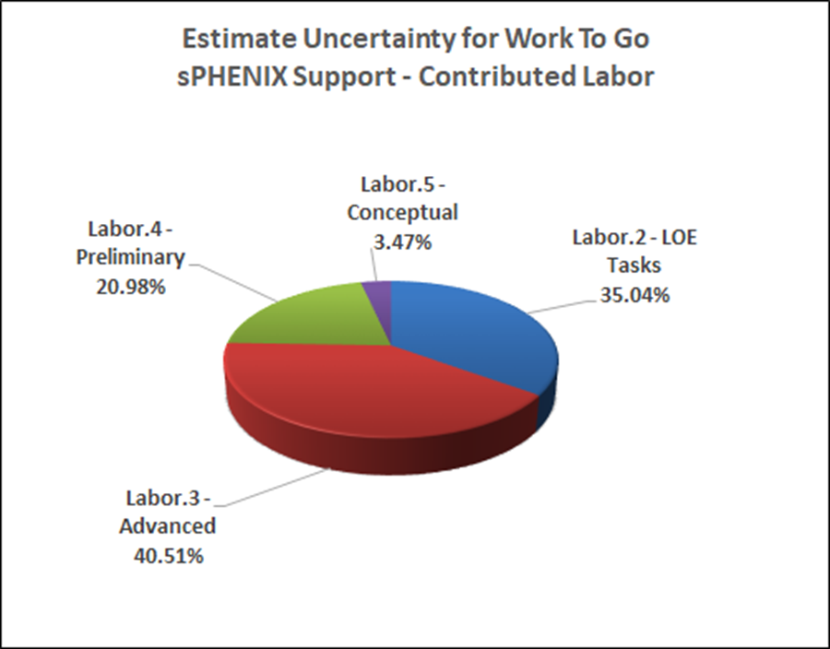
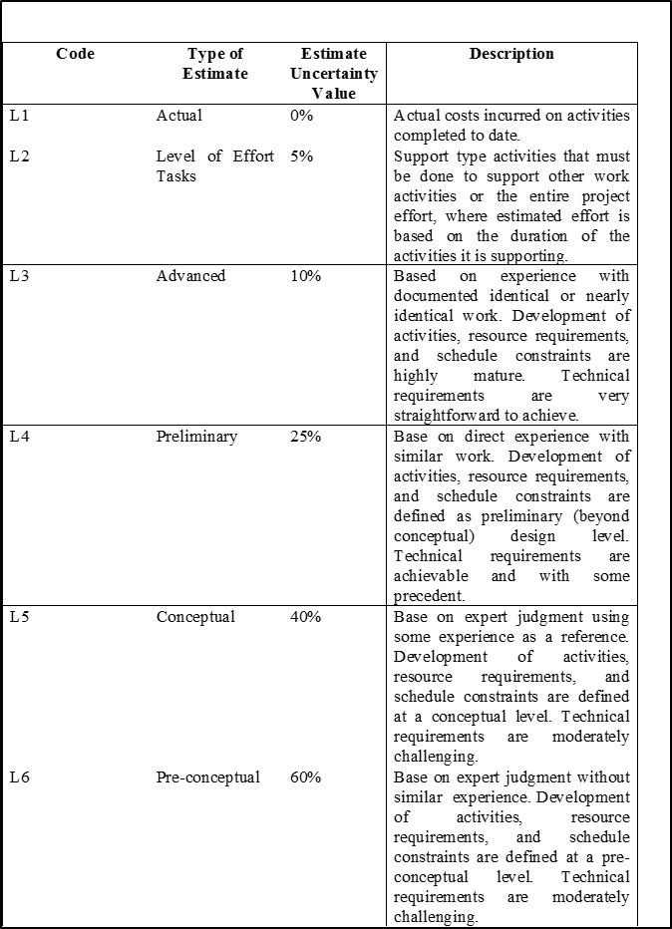
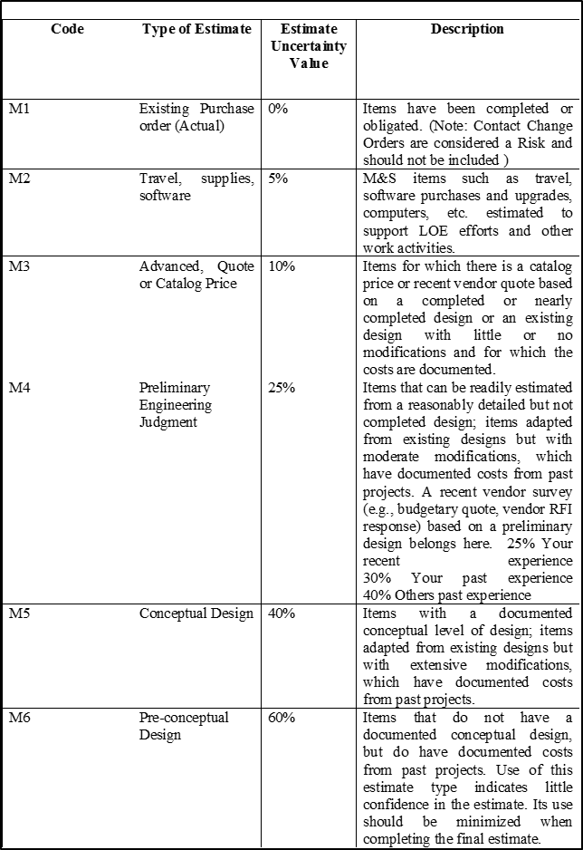
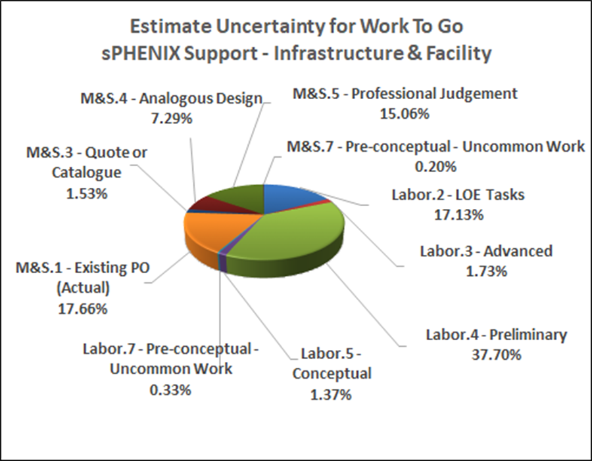
sPHENIX MIE Project - Basis of Estimate
Basis of Estimate Codes for Labor and M&S in Assumptions Document

Slide 5
sPHENIX MIE Project - Basis of Estimate
Basis of Estimate Codes for Labor and M&S in Assumptions Document

