Slide 1
sPHENIX Director’s Review TPC Factory Production
Vicki Greene, Vanderbilt University
April 9-11, 2019
BNL

Slide 2
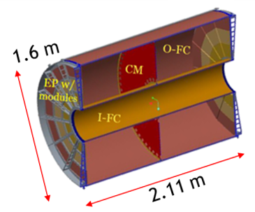
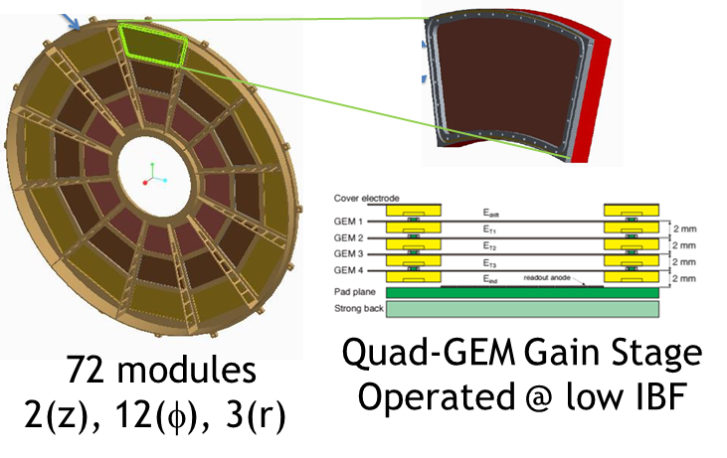
The L3 Component
1.02.03: TPC R2 Modules Factory
(also on behalf of R1/R3 Module Fact. - 1.02.02/1.02.04)
Central Membrane CM
Endplates EP, 2 in z
Modules, 12 in φ, 3 in r

Slide 3
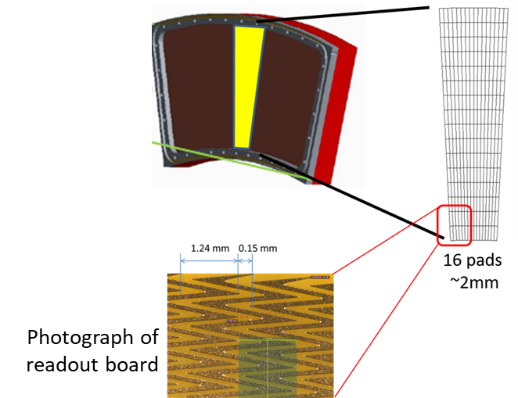
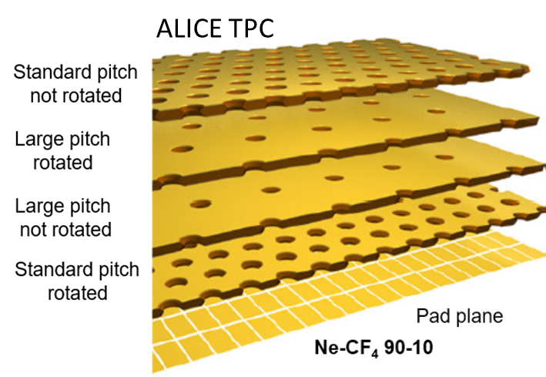
L3 Technical Overview
Production of final modules framed & tested GEMs:
Framed & Tested GEMs -- Factory
Strong backs & Readout boards → SBU
Module Testing & Characterization → SBU
ALICE model.
ALICE-based QA
No duplication:
Gas Systems,
Radiation sources,
Translation Stages
NOTE: We have adopted the ALICE factory model at all relevant stages.
Emphasize any technical issues that still need to be resolved. If all has been decided put it on the slide.

Slide 4
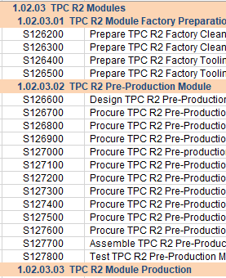
L3 Scope
Factories are responsible for:
Preparation of factories for production
Testing quality of components: frames & GEMs
Assembly of components: Framing of GEMs
Testing quality of assembly: ¹GEM arrival, ²After gluing, ³After trimming
Shipping to final destination (SBU/BNL)
Conservative yield assumptions:
Fragile items (GEMs) and irrecoverable (after gluing) items are assumed to have a 24/30 yield (24 modules required…materials for 30 modules).

Slide 5
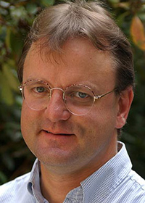
L3 Collaborators
Wayne State University: Bill Llope* (L3 manager) Oleg Grachov*
Vanderbilt University: Vicki Greene (L3manager) Julia Velkovska
Temple University: Bernd Surrow (L3 manager) Matt Posik
Weizmann Institute: Sasha Milov (L3 manager) Evgeny Shulga
(Yale University: Dick Majka**, Nikolai Smirnov**)
*Llope/Grachov ran ALICE IROC GEM Factory; wrote sPHENIX TPC GEM Factory QA Documents/Procedures
**Majka/Smirnov ran ALICE IROC Module Testing; wrote sPHENIX TPC Module Testing QA Documents/Procedures

Slide 6
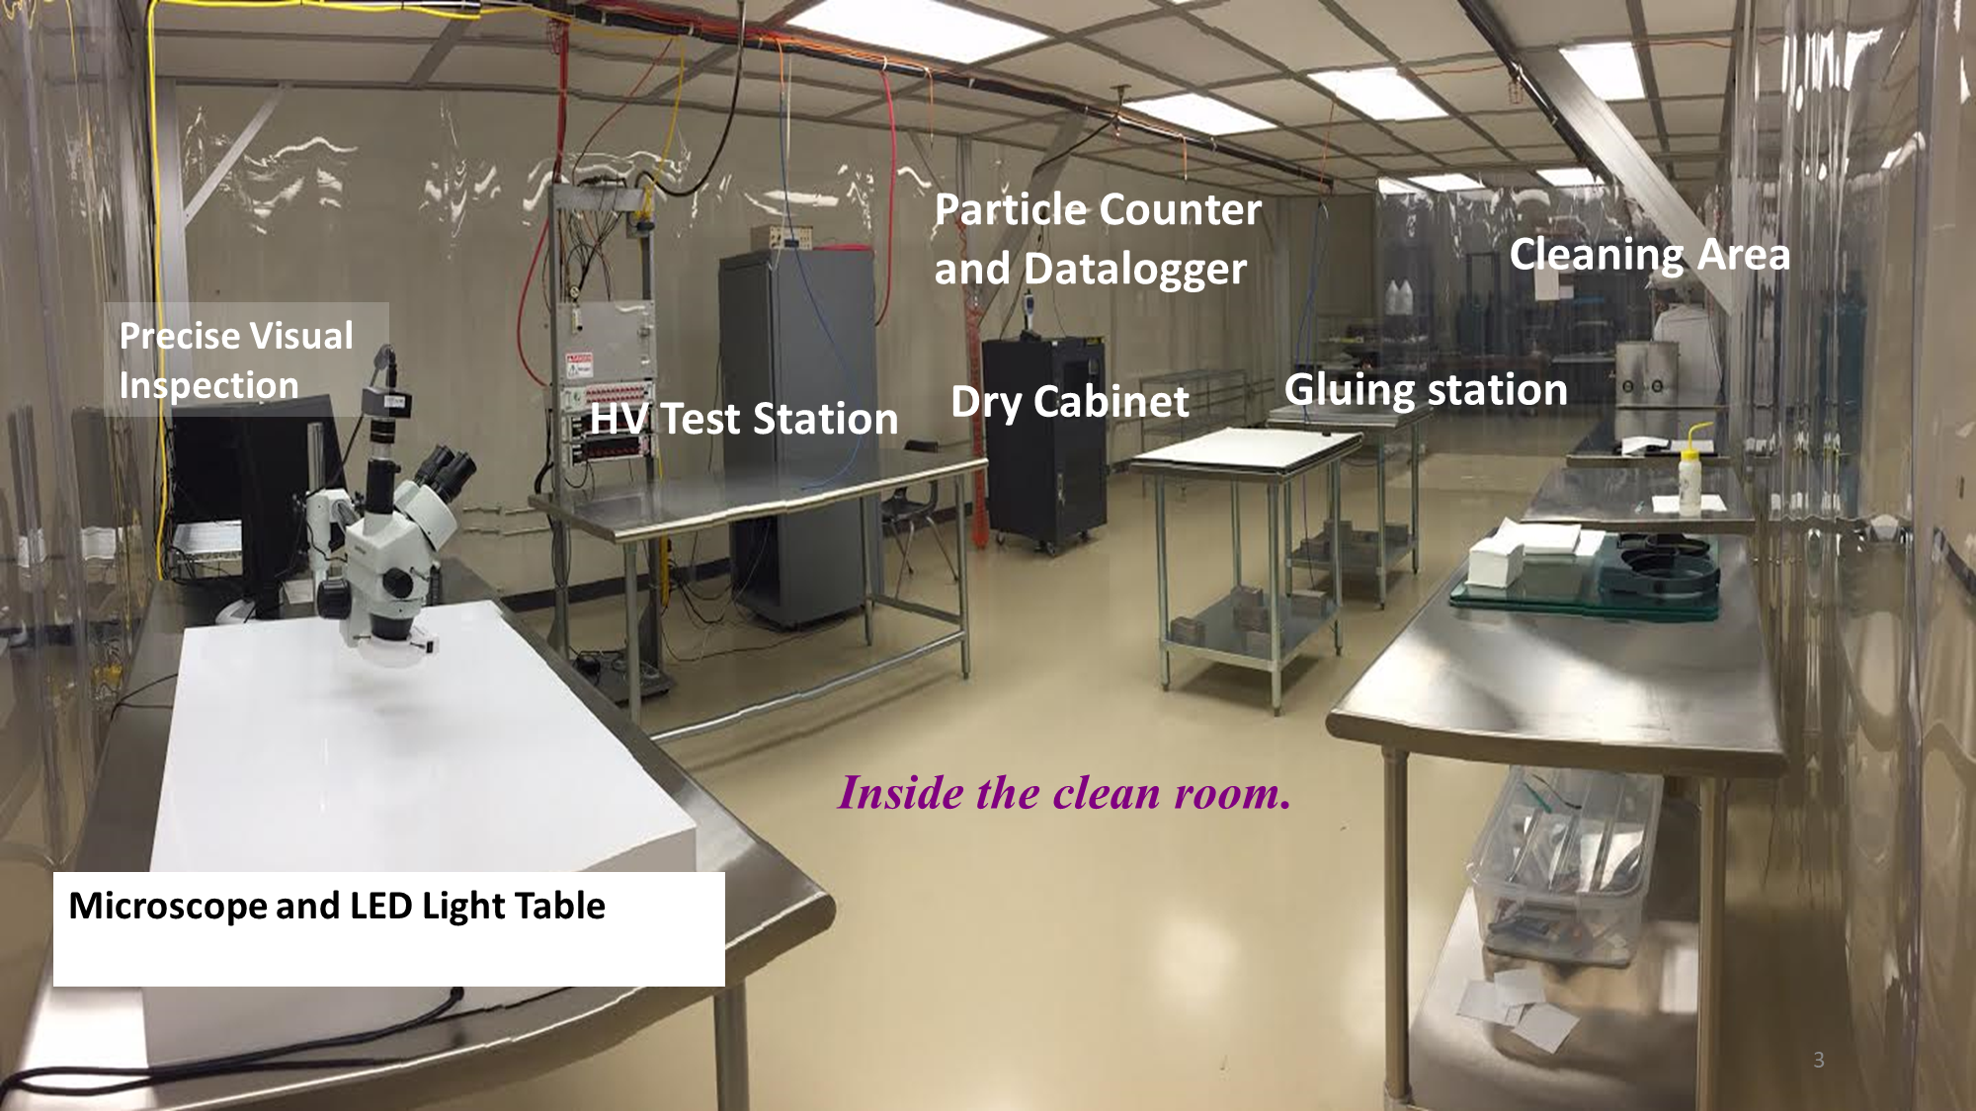
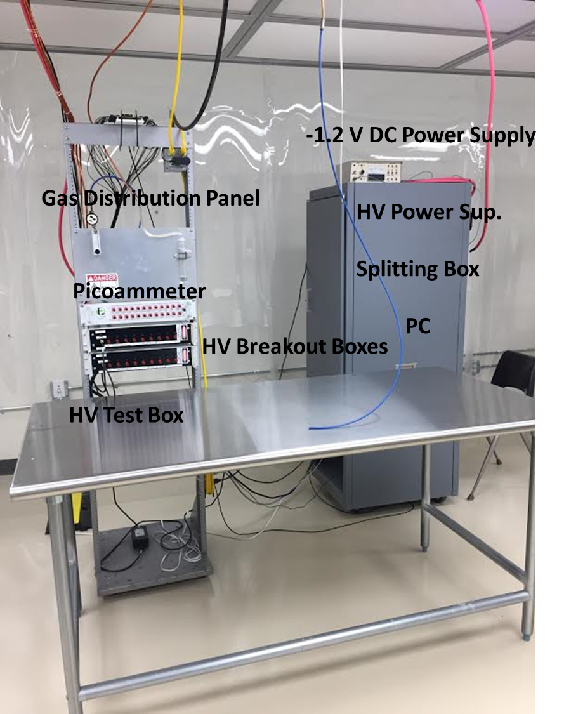
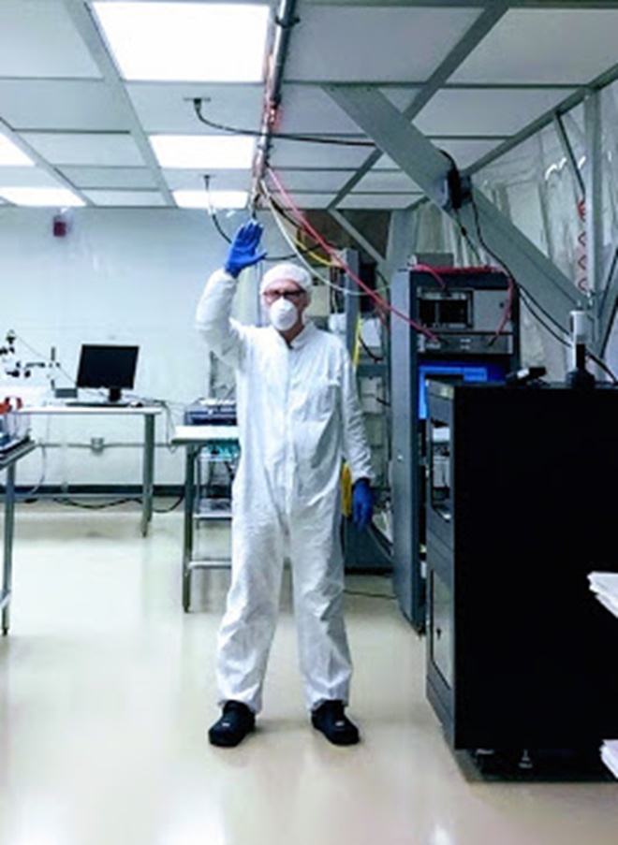
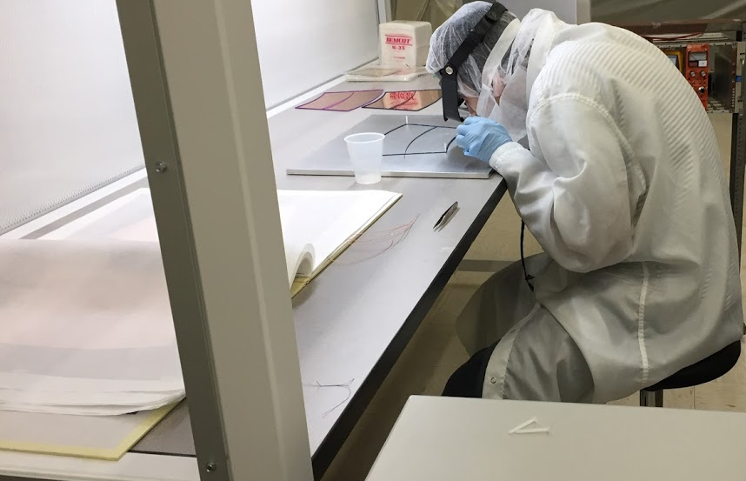
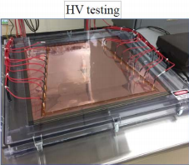
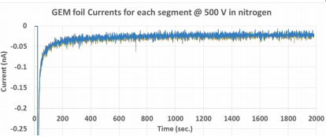
L3 Scope – Basic Workflow
Shipping “booklet”
PCB Workshop @ CERN
Produces GEMs, attaches resistors, cleans, tests, and only ships working GEMs
Test Regimen before Framing
Visual inspection
Resistors value measurements (4.65 MΩ – 5.35 MΩ)
Leakage current measurements before framing (nitrogen, -500 V, < 10% RH): 15 min
Long term leakage current after framing (nitrogen, -500 V, < 10% RH): at least 5 h
Test Regimen after Framing
Leakage current measurements before trimming (nitrogen, -500 V, < 10% RH): 15 min
Leakage current measurements after trimming (nitrogen, -500 V, < 10% RH): 15 min
ALICE, typical
Time

Slide 7
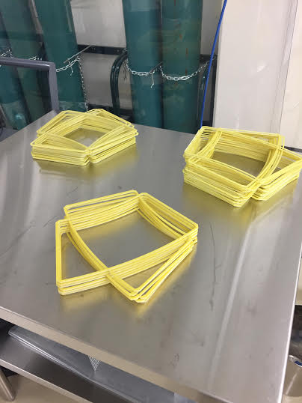
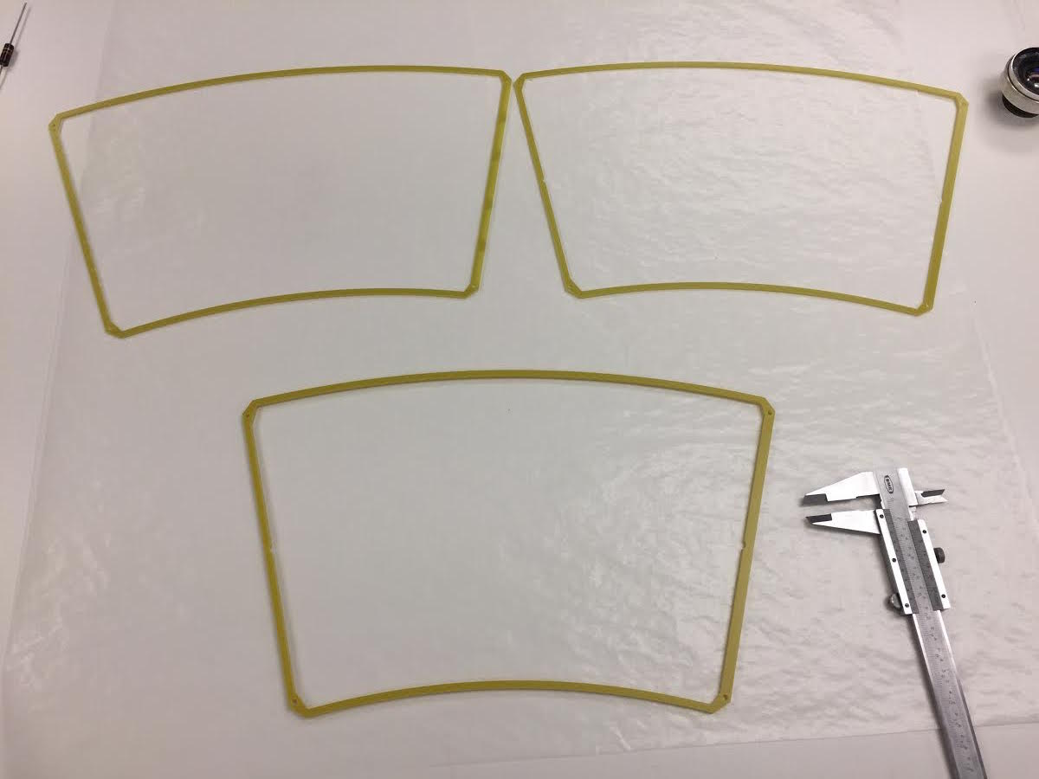
Frames for 11 chambers Visual inspection
3 different types of frames

Slide 8
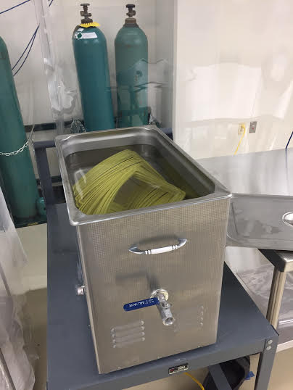
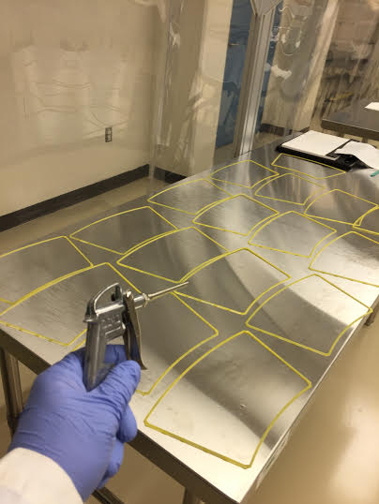
L: Cleaning in ultrasonic bath ( 70% isopropyl + 30% distilled water) R: Drying with compressed air

Slide 9
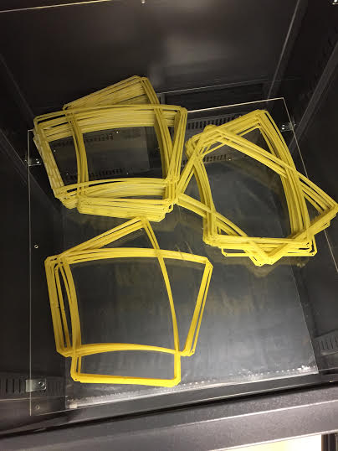
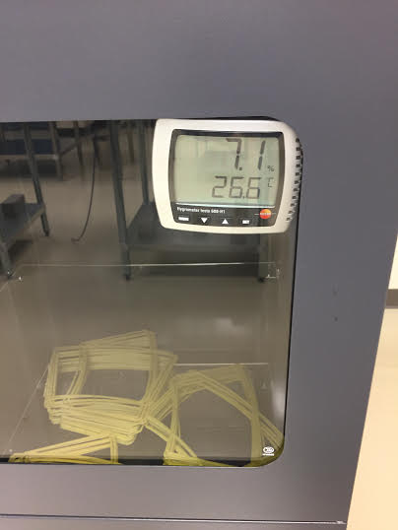
Placing into dry cabinet with low relative humidity at room temperature at least for 12 hours.

Slide 10
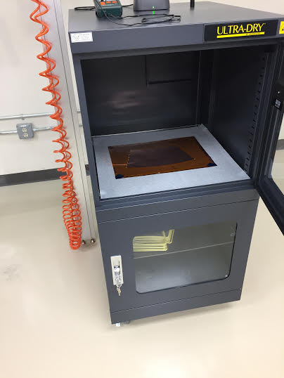
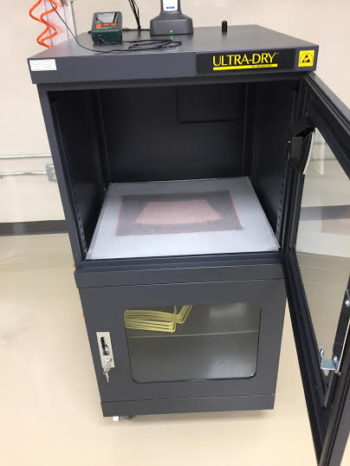
Placing GEMs between layers of papers into dry cabinet

Slide 11
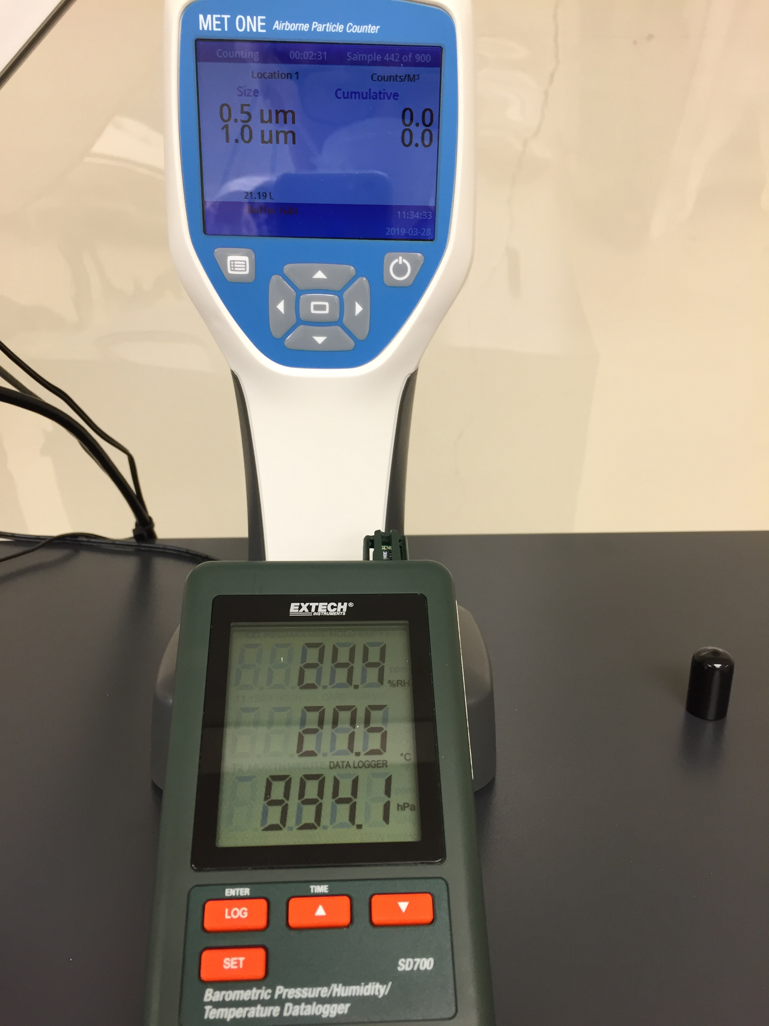
Leakage current measurements
Air
Room Temperature 27.5 C
Relative Humidity 24.4 %
Atmospheric pressure 994.1 hPa
HV = -500 V
Time of measurements : 30 min

Slide 12
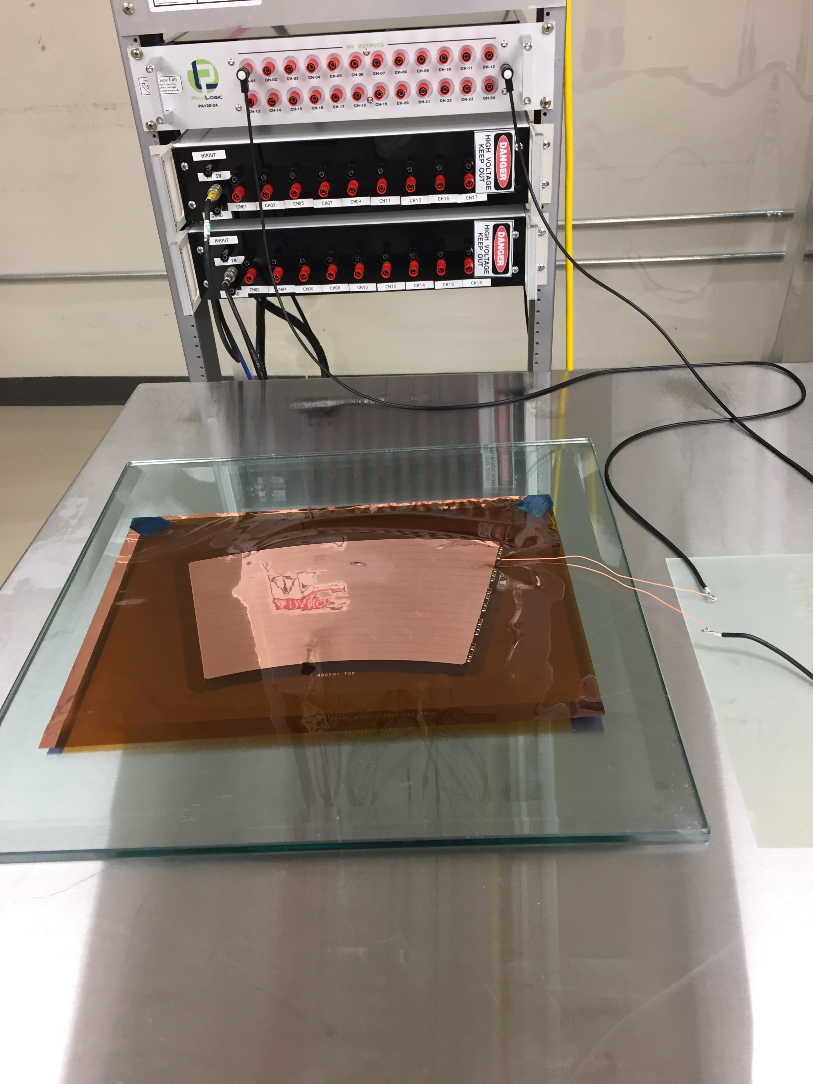
Zagreb pA
1 HV channel and Ground connected to the GEM

Slide 13
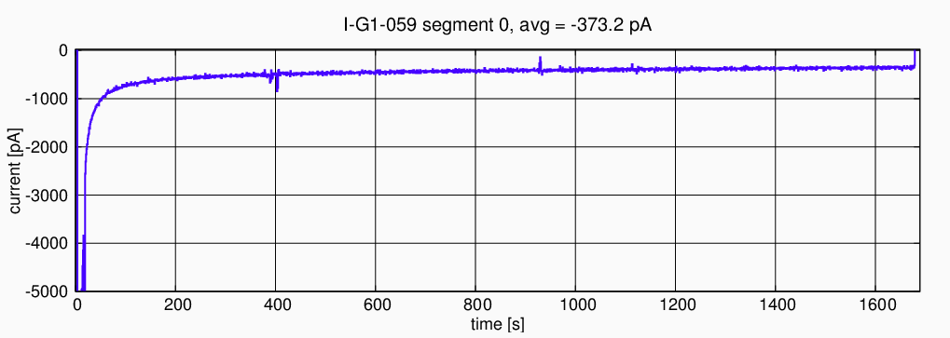
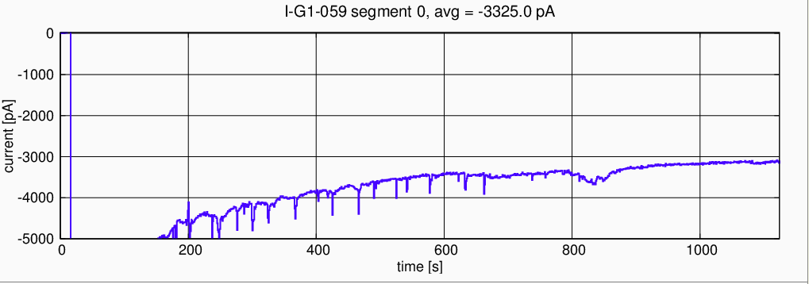
Test Results

Slide 14
Summary and future activity
Frames for 11 chambers visually inspected, cleaned in ultrasonic bath and ready for gluing with GEMs
2 GEMs used for leakage current measurements and also will be used for modeling procedure for foil tension with adhesive tapes
Modeling procedure for gluing frames and foils
Modeling procedure for HV testing GEMs before gluing with frames and after gluing

Slide 15
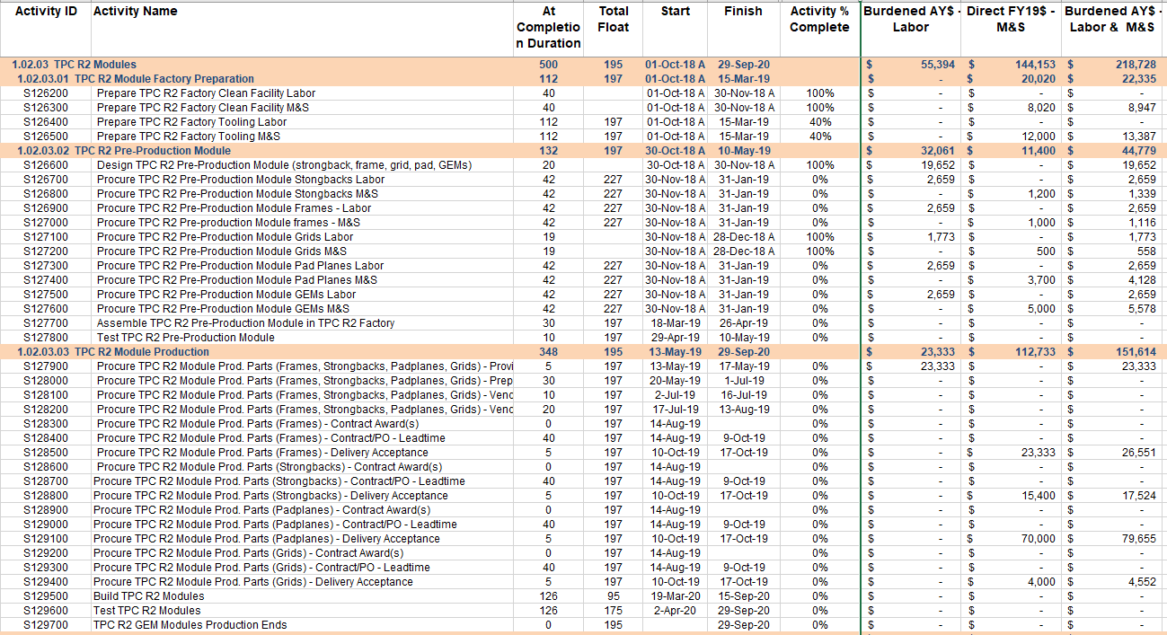
Schedule Drivers
Module production begins based upon first ability to make initial procurements.
Module production rate entirely limited by CERN GEM delivery schedule.
driver

Slide 16
Cost Drivers
Module Cost Drivers: GEMs (1.02.01…centralizes purchase for all factories)
“L3-visible” Cost Driver: Pad Planes (2.7mil gap between pads…sole source--TTM)

Slide 17
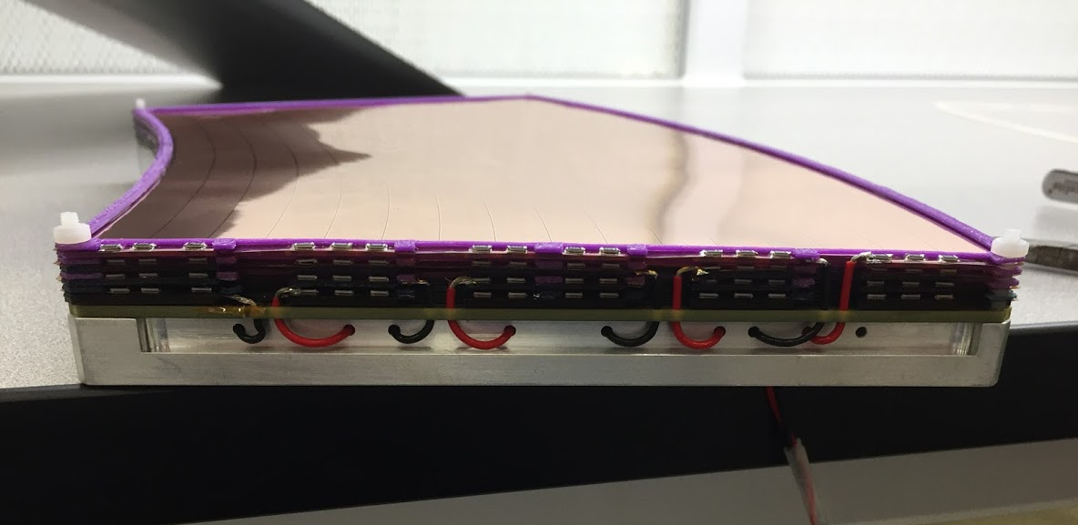
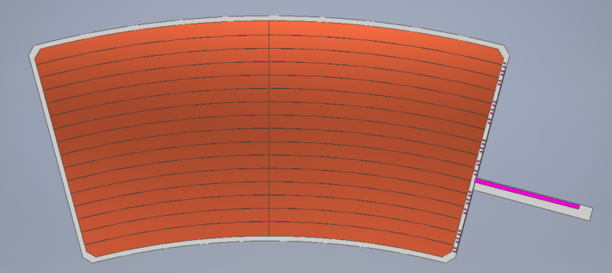
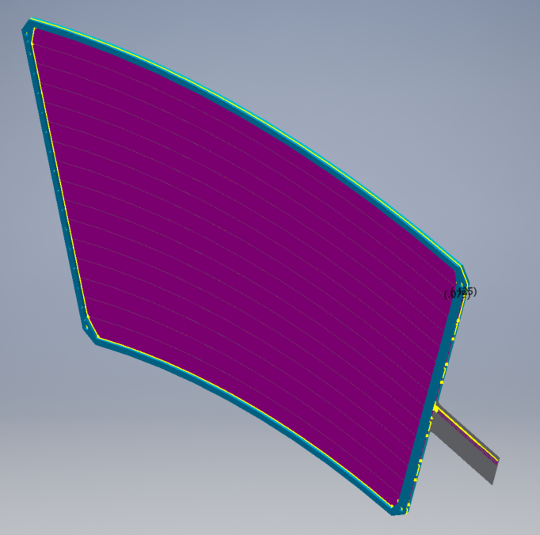
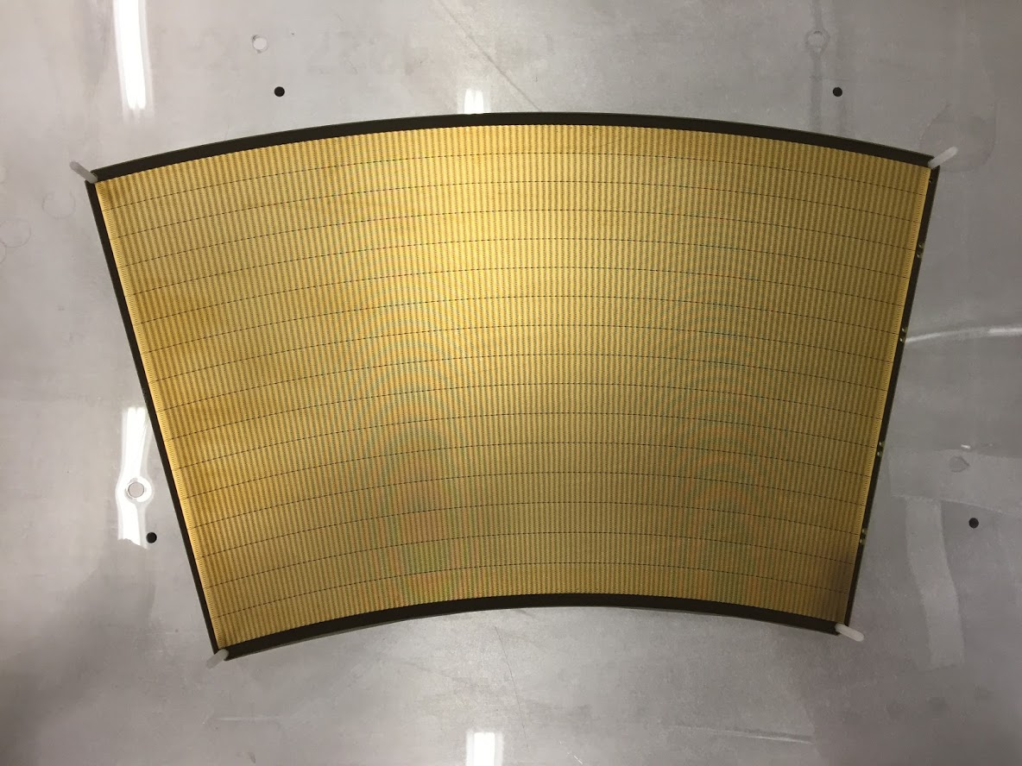
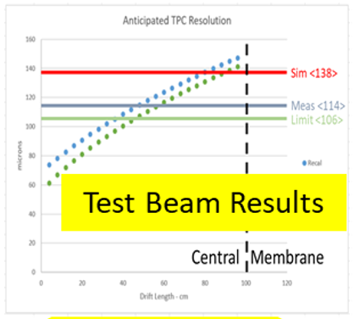
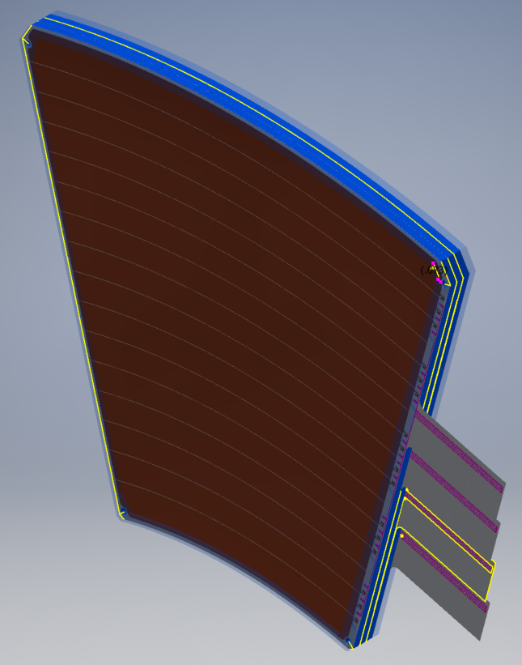
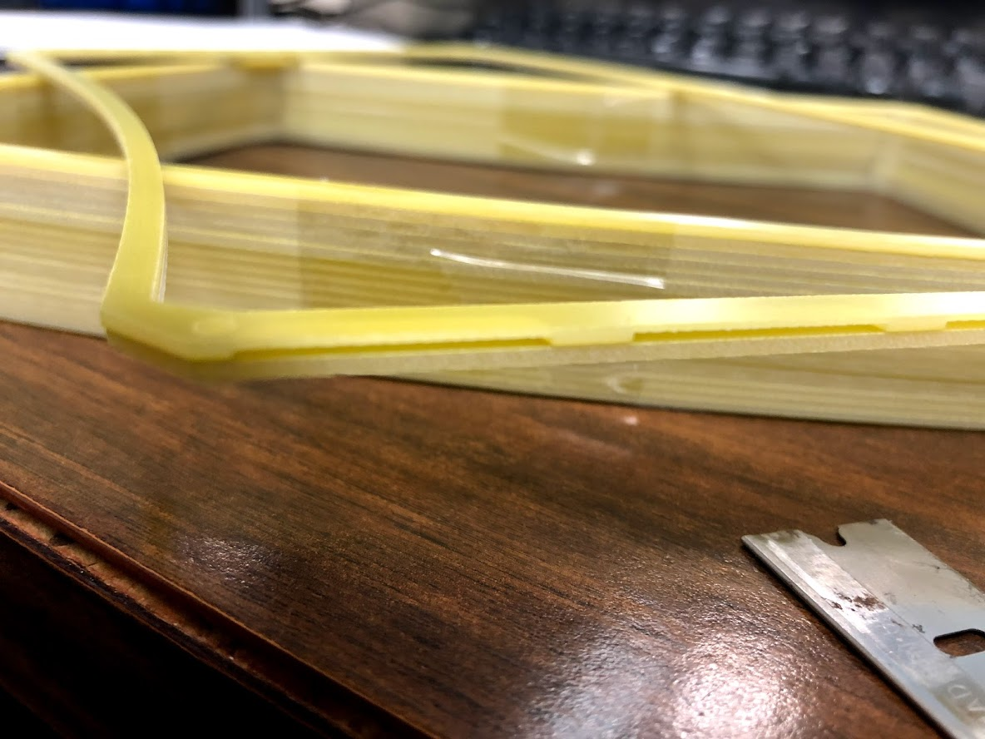
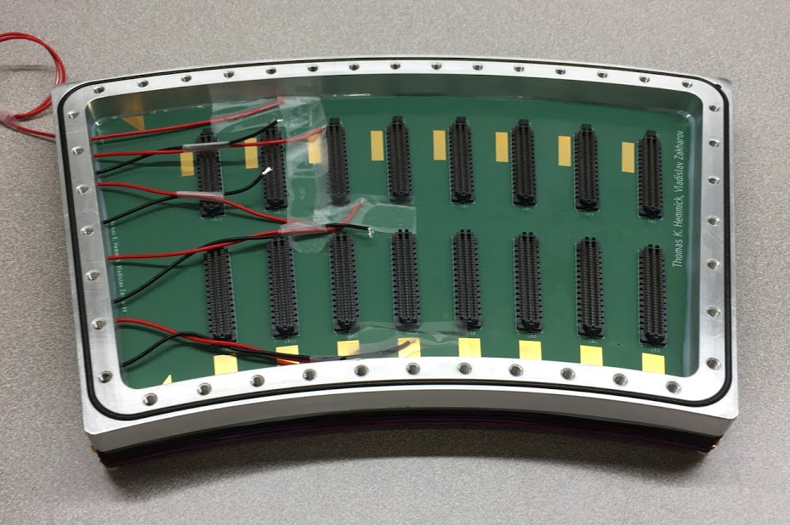
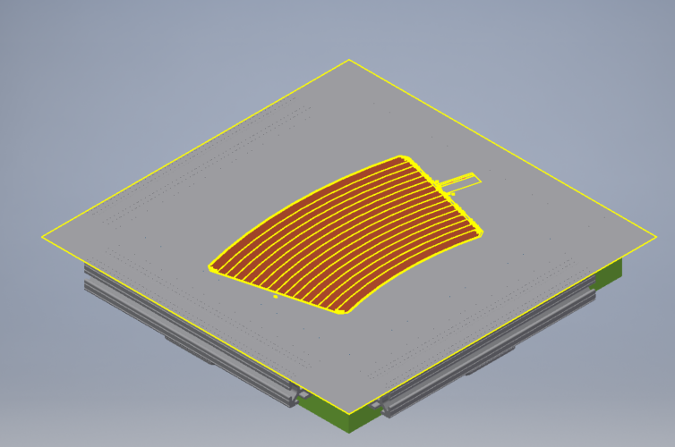
Status and Highlights
Prototype Framed GEM
Prototype Module
GEM Foil Design (R3)
Framed GEM (R2)
Prototype Padplane
Stack (R1)
Pre-Production Frames. (R2)
Prototype Module
R2 Glue-plate Design
Gravity-tensioned
J-contact limits solder migration
Pocketed frame allows R-potting
Prototyping
Pogo-pin protection
PreProd

Slide 18
Just arrived: Preproduction GEMS V2

Slide 19
1.02.03.03 Milestones
Procure TPC R2 Module Prod. Parts (Frames) - Contract Award(s) 10/1/19
Procure TPC R2 Module Prod. Parts (Strongbacks) - Contract Award(s) 10/1/19
Procure TPC R2 Module Prod. Parts (Padplanes) - Contract Award(s) 10/1/19
Procure TPC R2 Module Prod. Parts (Grids) - Contract Award(s) 10/1/19
TPC R2 GEM Modules Production Ends 9/29/20

Slide 20
Issues and Concerns
Mostly the TPC factory production is contributed labor (good).
One scientist from WSU is paid, thereby creating a limited “standing army” issue.
Performed all ALICE IROC factory work.
Wrote sPHENIX QA procedures.
Designs gluing fixtures for all sites.
Provides training to all factory sites.
Well-justified exceptional expense.
Student labor must be realized at production time.
These labor risks are captured in the Risk Registry.

Slide 21
Summary
sPHENIX has maximally adapted our plans to the ALICE model, successfully leveraging the experience of Wayne State University (sPHENIX collaborators…ALICE GEM framing factory) and Yale (fully engaged in all R&D leading up to start of production).
Preproduction designs benefit both from the successful test beam run (June 2018) and all known concerns discovered and mitigated during the ALICE production.
Factories shall produce framed GEMs that are extensively tested and characterized.
sPHENIX 1.2.2-4 are ready for PD2/3 approval.

Slide 22
Back Up

