Slide 1
sPHENIX Director’s Review 1.2.6 TPC Data Aggregator Modules
Jin Huang
April 9-11, 2019
BNL

Slide 2
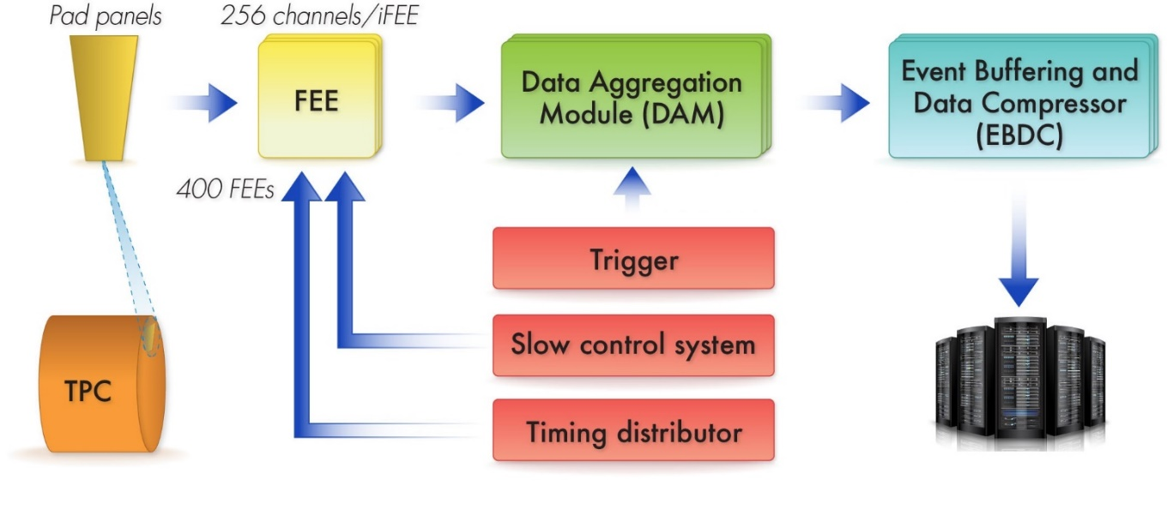
The L3 Component
Input data stream:
960 6-Gbps bidirectional fibers links
Max continuous: 4 Gbps / fiber
Average continuous: 1.1-1.8 Tbps total
Clock/Trigger input:
Optical links
Clock = 9.4 MHz
KPP Trigger Rate = 15 kHz
Output data stream to buffer box:
24 x 25 Gbps Ethernet via fiber After triggering and compression
KPP Total continuous output: 80 Gbps
TPC DAM L3 Scope, WBS 1.2.6
160k chan
624 FEEs
24 sectors
Continuous readout
Transfer to RCF continuously
Buffer box
Structure/
GEM L3 Scope WBS 1.2.1-4
FEE L3 Scope WBS 1.2.5
DAQ L2 Scope WBS 1.6

Slide 3
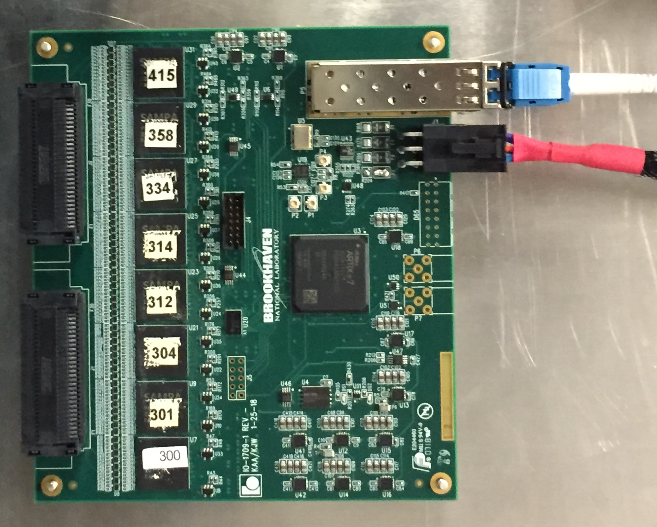
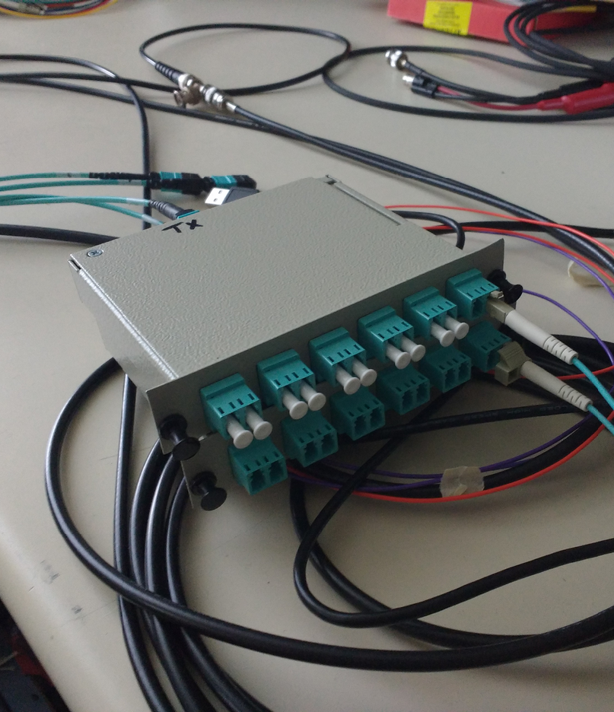
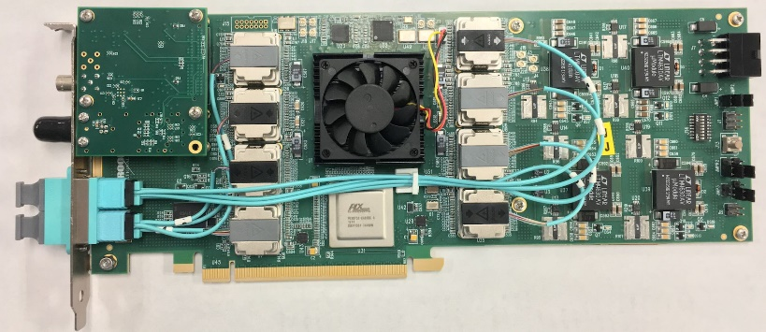
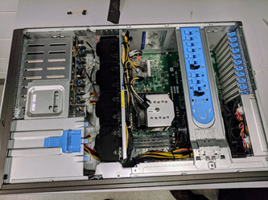
L3 Technical Overview
Collect data from 960 bi-directional 4+ Gbps fiber links to FEEs at rate of 1100-1800 Gbps
Reducing data via triggering and compression: reduce data to 160-240 Gbps
Driven to use FELIX DAQ interface cards: large-FPGA based data acquisition cards with multi-10Gbps input and PCIe Gen3 output, hosted on commodity servers.
Similar architecture adopted for ATLAS, LHCb, ALICE upgrade for 2020+
DAM design takes advantage of BNL-developed FELIX DAQ interface card
48-bidirectional 10+ Gbps optical link, large FPGA: Xlinx Ultrascale (XCKU115)
PCIe Gen3 x16 link to server, demonstrated to 101 Gbps
5-7 times higher bandwidth than KPP requirement for 15kHz trigger
FEE Prototype
MTP <-> LC Breakout
FELIX v2.1 card
Commodity Server

Slide 4
Layout in sPHENIX (1/24 sectors shown)
DAQ Room sPHENIX IR
sPHENIX
MTP (M)
MTP (F)
MTP (M)
Patch
2x 48-Fiber MTP
Rack
MTP (F)
3m
... 40x LC Duplex
~1m
MTP (F)
15m
EBDC
FEE x26
DAM
TPC
58m MTP (F)
MTP (M)
Patch panel
Exp. disconnect
5x 1U space requested
48F MTP Cable MTP coupler MTP-LC breakout LC-duplex cable LC-duplex coupler SFP+
One-way optical loss: 1.5dB

Slide 5
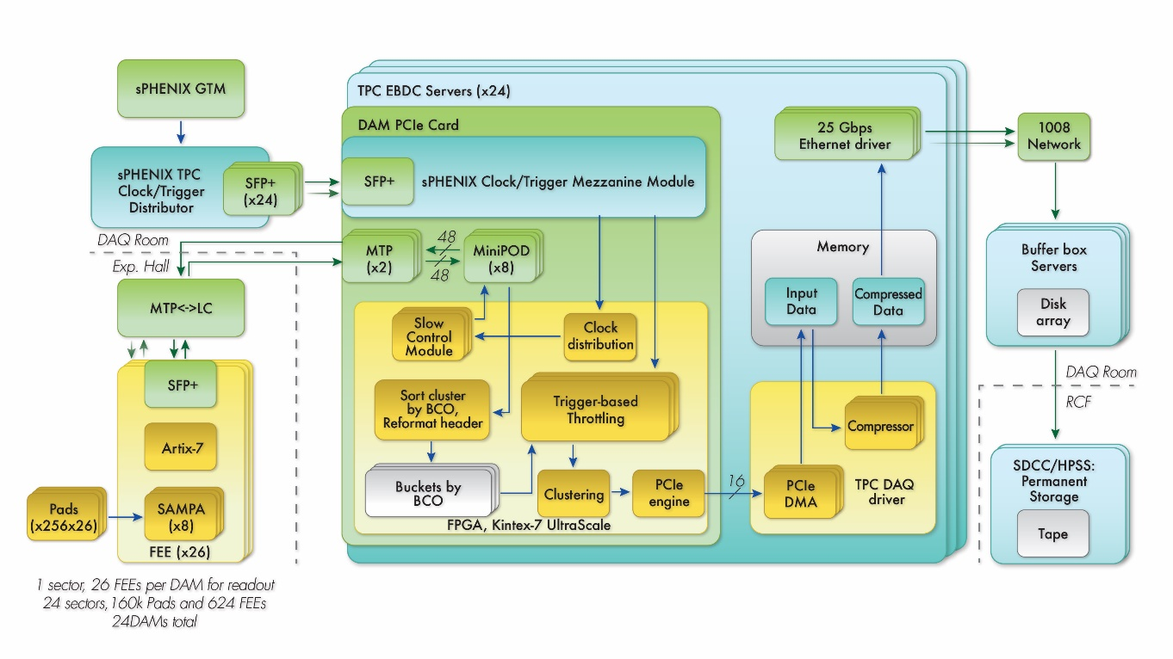
L3 Scope
DAM
sPHENIX production of FELIX
Two batches: 10 (OPC) + 20 (TEC) boards
Closely following the BNL ATLAS preproduction experience
Firmware development
EBDC
Procurement of 24 commodity servers
Running software interface to DAQ L2 1.6
Signal data fibers
Interface to the FEE L3 1.2.5

Slide 6
L3 Collaborators
Jin Huang (BNL/Physics, L3)
Associate Physicist, heavy-flavor topical group co-convener
Past projects highlight: commissioned DAQ for PHENIX forward silicon tracker, a successful upgrade @ RHIC featuring 2-Tbps continuous readout
John Kuczewski (BNL/Instrumentation Division)
Experienced digital developer. Expert in development for electronics, FPGA and drivers
Past projects highlight: LSST CCD readout electronics
Alfred DellaPenna (BNL/Instrumentation Division)
30 years of designing RF and Front End electronics. Analog receivers for high energy / electron /ION and Photon applications.
RHIC BPM front end electronics ,Current Monitors(1985-2011), SNS Beam position monitor/ High Current monitor (2002-2005),NSLSII BPM electronics ,Xray BPM front end electronics, Beam Top up electronics 2011-2015), LSST Raft tower module electronics 2016-present)
Joe Mead (BNL/NSLS-II), co-managing to FELIX production
Ivan Kotov (BNL/Instrumentation Division), QA, algorithm development
Joint development with TPC FEE (WBS 1.2.5) and DAQ (WBS 1.6)

Slide 7
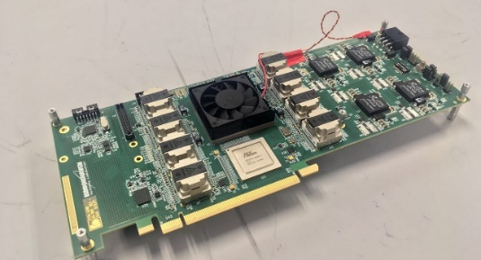
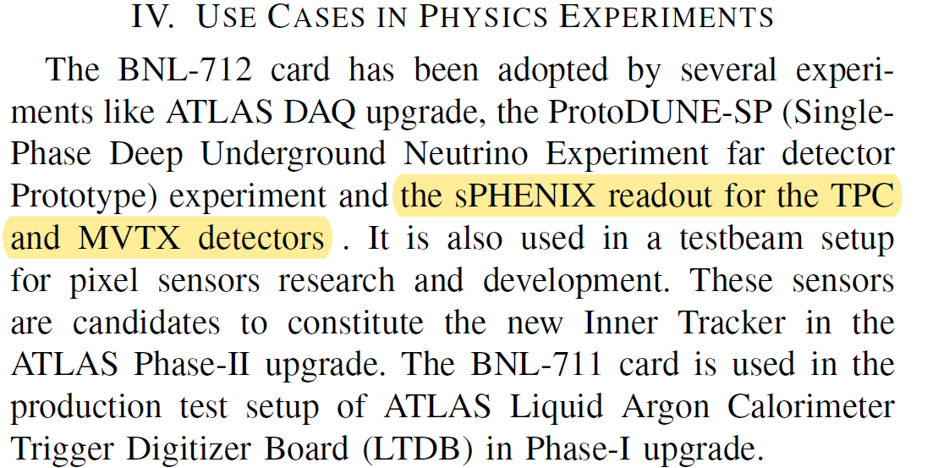
Synergistic collaboration
The critical development for sPHENIX TPC DAM is the FELIX DAQ interface, initially developed by Kai Chen and colleagues at Omega group in BNL Physics Department for the ATLAS phase-I upgrade
Sharing resource in FELIX development in BNL:
For sPHENIX prototyping: Omega group lent one FELIX v1.5→v2, produced one FELIX v2
Sharing firmware blocks and PCIe driver software
Consultation on FELIX production, coordinating on FELIX v2 timing mezzanine design
Joint LDRD 19-028 on FELIX application to multiple applications, funded by BNL
Submitted to IEEE TIM
FELIX v2.0 timing mezzanine and FPGA-PCIe card

Slide 8
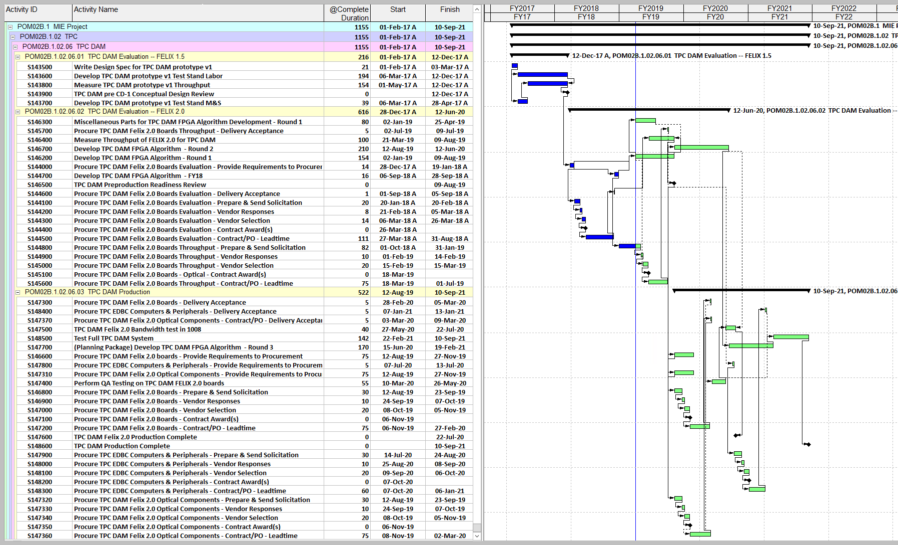
Schedule Drivers
207-day schedule float on the non-commodity components (FELIX).
NOT on critical path
Scheduling risk for FELIX production is low:
Already completed v1.5 test stand for the prototyping stage, 1.2.6.1
Closely follow BNL ATLAS pre-production experience
Scheduling risk for EBDC production is low:
Commodity computing, and benefits from massive parallelism in industry
Procurement scheduled at the latest stage of the production to take advantage of commercial computing development

Slide 9
Milestones
WBS Path | WBS Name | Activity ID | Activity Name | Milestone Level | Date | Completed?
1.02.06.01 | TPC DAM Evaluation -- FELIX 1.5 | S143900 | TPC DAM pre CD-1 Conceptual Design Review | L5 | 12-Dec-17 | yes
1.02.06.02 | TPC DAM Evaluation -- FELIX 2.0 | S144400 | Procure TPC DAM Felix 2.0 Boards Evaluation - Contract Award(s) | L5 | 26-Mar-18 | yes
1.02.06.02 | TPC DAM Evaluation -- FELIX 2.0 | S145100-S145500 | Procure TPC DAM Felix 2.0 Boards - Contract Award(s) | L5 | 18-Mar-19
1.02.06.02 | TPC DAM Evaluation -- FELIX 2.0 | S146500 | TPC DAM Preproduction Readiness Review | L2 | 9-Aug-19
1.02.06.03 | TPC DAM Production | S147100 | Procure TPC DAM Felix 2.0 Boards - Contract Award(s) | L5 | 6-Nov-19
1.02.06.03 | TPC DAM Production | S147350 | Procure TPC DAM Felix 2.0 Optical Components - Contract Award(s) | L5 | 6-Nov-19
1.02.06.03 | TPC DAM Production | S147600 | TPC DAM Felix 2.0 Production Complete | L2 | 22-Jul-20
1.02.06.03 | TPC DAM Production | S148200 | Procure TPC EDBC Computers & Peripherals - Contract Award(s) | L5 | 7-Oct-20
1.02.06.03 | TPC DAM Production | S148600 | TPC DAM Production Complete | L2 | 10-Sep-21
FPGA contract awarded 3-Apr-19
Other components: POs in preparation
Now

Slide 10
Cost Drivers
FELIX PCIe card: $74k (OPC) + $130k (TEC)
24 cards + 25% allowance for yield @ 8k / card
Driven by FPGA cost (maximized N_{10-Gbps-transceiver} / FPGA cost)
Received substantial price break (~50%) with multiple orders from BNL
Further supplemented by university contributions
Commodity server: 211k$
2U 24-core server supporting full size PCIe Gen3 x16 + SMBus
24 servers + 20% allowance for yield @ 6.5k / server
Cost uncertainty will reduce as prototyping, algorithm development and test with simulated FELIX output data.
Next leading cost – data fibers based on quote: 81k$

Slide 11
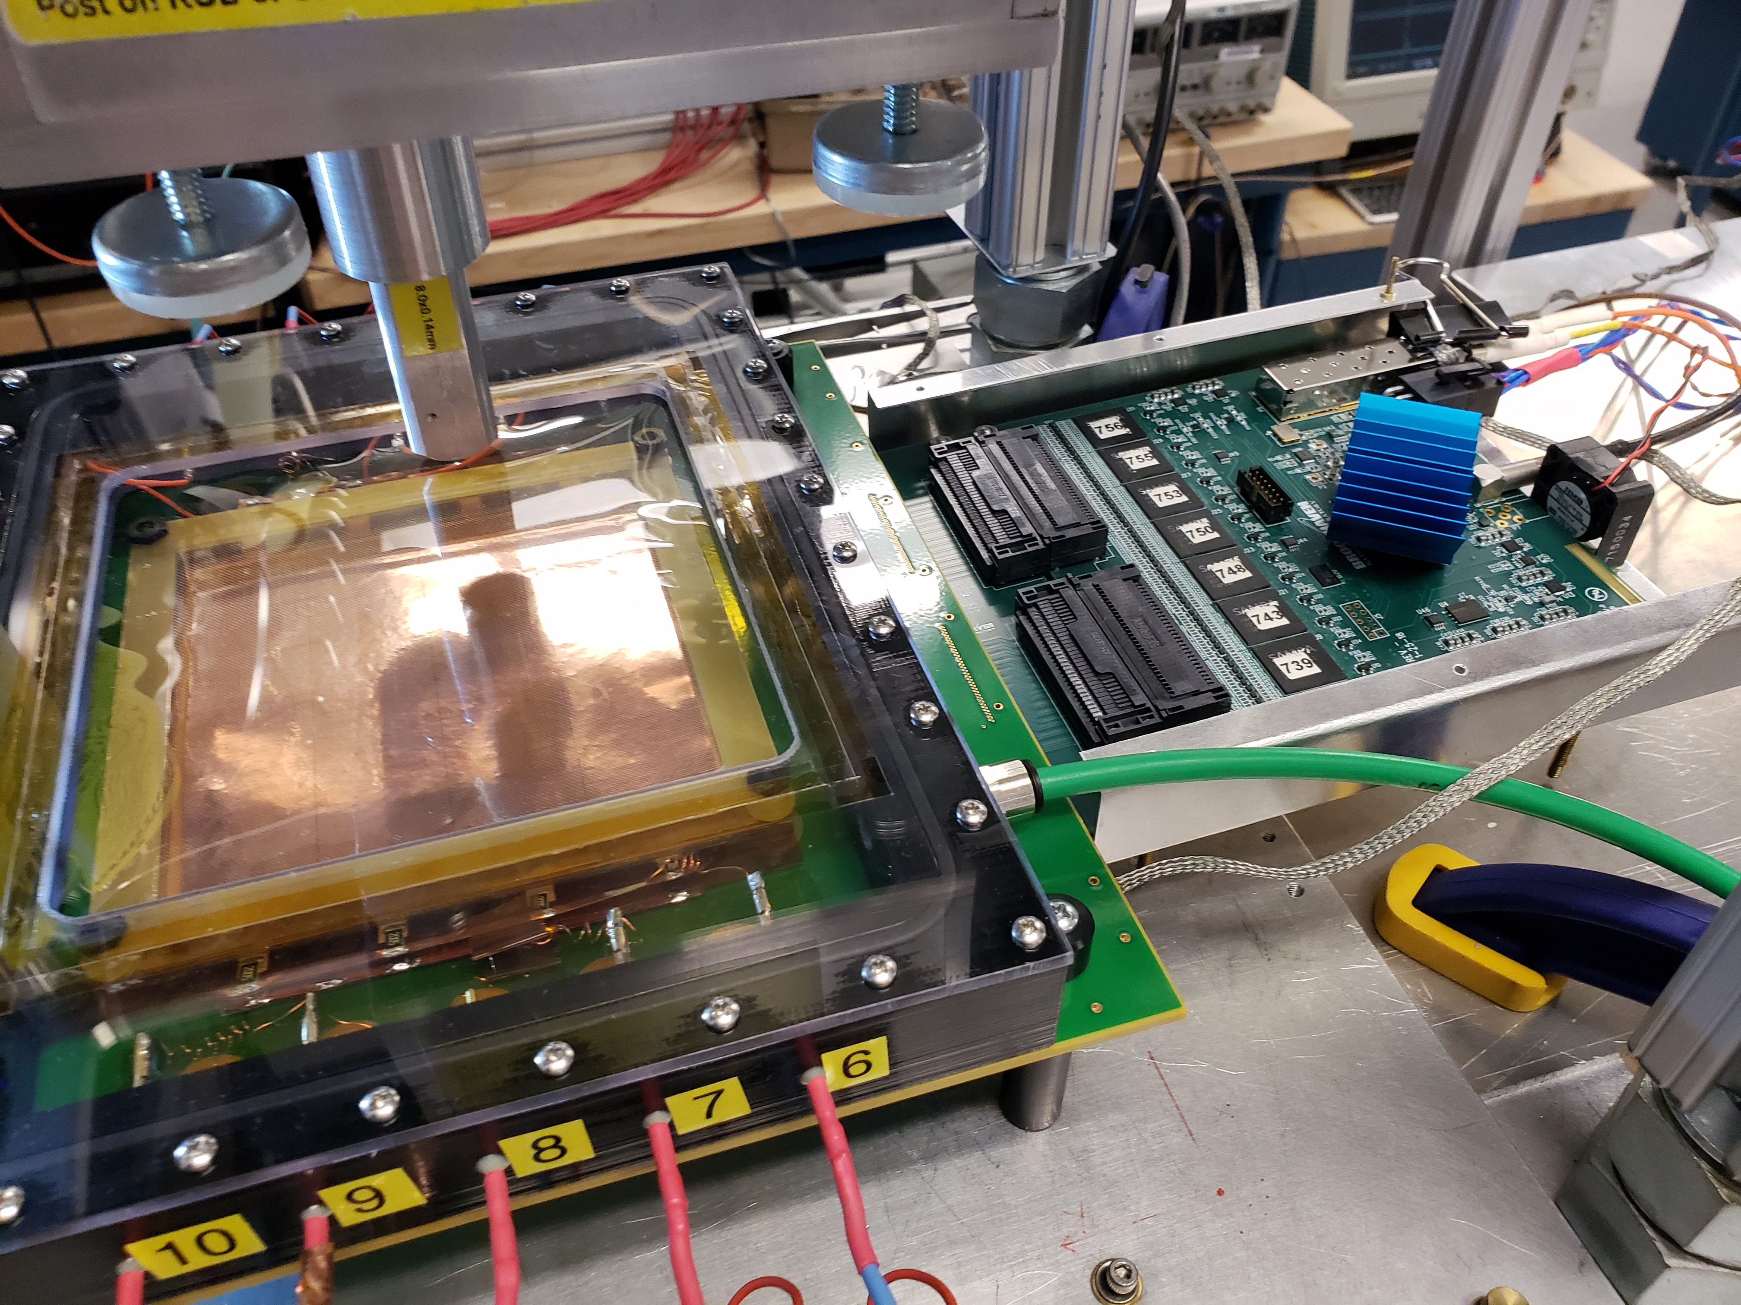
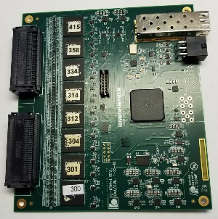
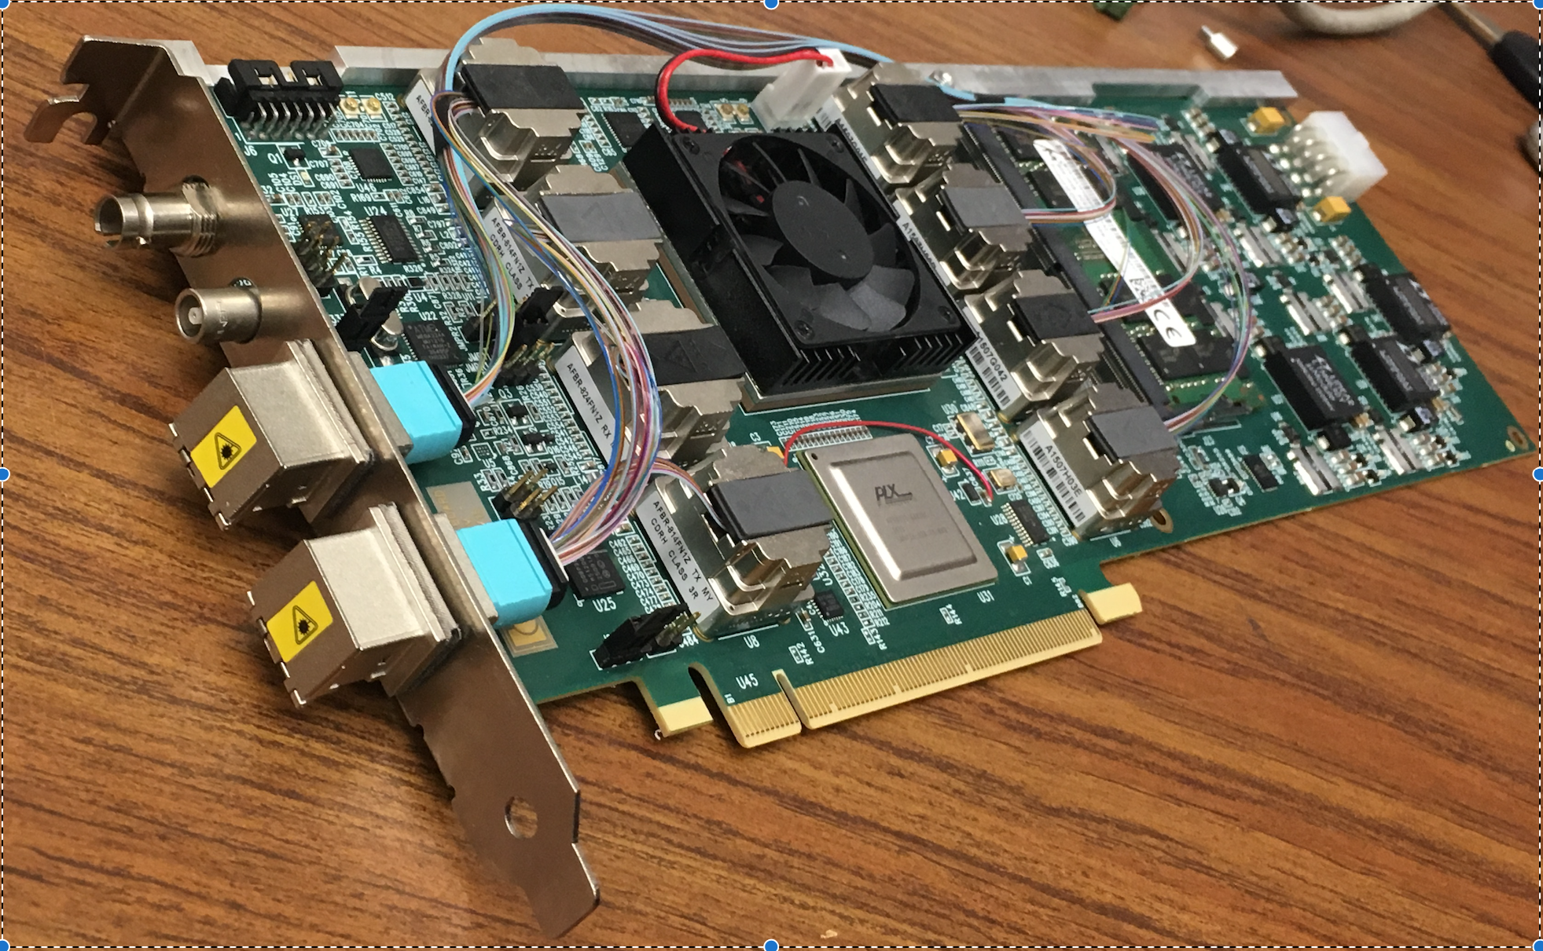
Status and Highlights
GEM readout test stand
Completed the v1.5 FELIX test stand 1.2.6.1
Continuing the development with two FELIX v2.1 test stands
Achieved 4x FEE simultaneous readout via FELIX v2.1
Demonstrated stable data link to FEE and GTM prototypes
GEM + Zigzag pads
FEE
Reconstructed hits
DAM: FELIX v1.5
EBDC

Slide 12
Issues and Concerns
FELIX components phase out before production
Producing 10x FELIX cards now in advanced R&D
Start final FELIX production promptly after PD-3 (as soon as fits in management plan)
TPC data rate may be higher than current expectation
FELIX IO bandwidth is 5-7 times higher than current estimated peak continuous data rate
Downstream to DAQ: addressed in DAQ-L2 WBS 1.6 Risk Registry
Improving estimation with TPC prototyping and testing
First two years of sPHENIX operation : expect lower data volume, which allows developing and qualifying clustering algorithms with real data
For later years: exploring possible on-FPGA clustering algorithm on FELIX, which would produce factor-of-two data reduction (based on ALICE/STAR offline experience)

Slide 13
Summary
DAM WBS 1.2.6: bridging custom front-end electronics and commodity computing with high-performance FPGA-based DAQ interface
Significantly reduced schedule and technical risks by using BNL-developed FELIX-DAQ interface card
Closely working with upstream 1.2.5 and downstream 1.6
Successfully completed FELIX v1.5 test stand WBS 1.2.6.1. Many progress in FELIX v2 test stands and productions.
The sPHENIX TPC DAM is ready for PD-2/3 approval.

Slide 14
Back Up

Slide 15
TPC Data Stream @ 170kHz AuAu
Continous-time simulation assuming cluster/layer = <dNch/deta>x2 and 3x5 sample / cluster
Largest reduction factor comes from triggering throttling, which reduce data by factor of ~4

Slide 16
As shown in the DAQ review, June 2018
Raw data size for single event
10Mbit for MB AuAu, and 130kbit for MB pp.
Associating with LVL-1 triggers (15kHz) reduces data size to be recorded.
Lossless data compression (LZO algorithm) gives a reduction to 60% of the original size
Final average per-event data sizes (TPC-only) are:
1.4MB/evt for MB AuAu in Year-1
2.0MB/evt for MB AuAu in Year-5
1.3MB/evt for MB pp
System | AuAu (Y-1) | AuAu (Y-5) | pp
Collision rate [kHz] | 100 | 170 | 12900
Raw data rate [Gbps] | 1100 | 1800 | 1700
After LVL-1 trigger [Gbps] | 290 | 400 | 260
After lossless compression (Gbps) | 170 | 240 | 160
Per-event size [MB/evt] | 1.4 | 2.0 | 1.3

Slide 17
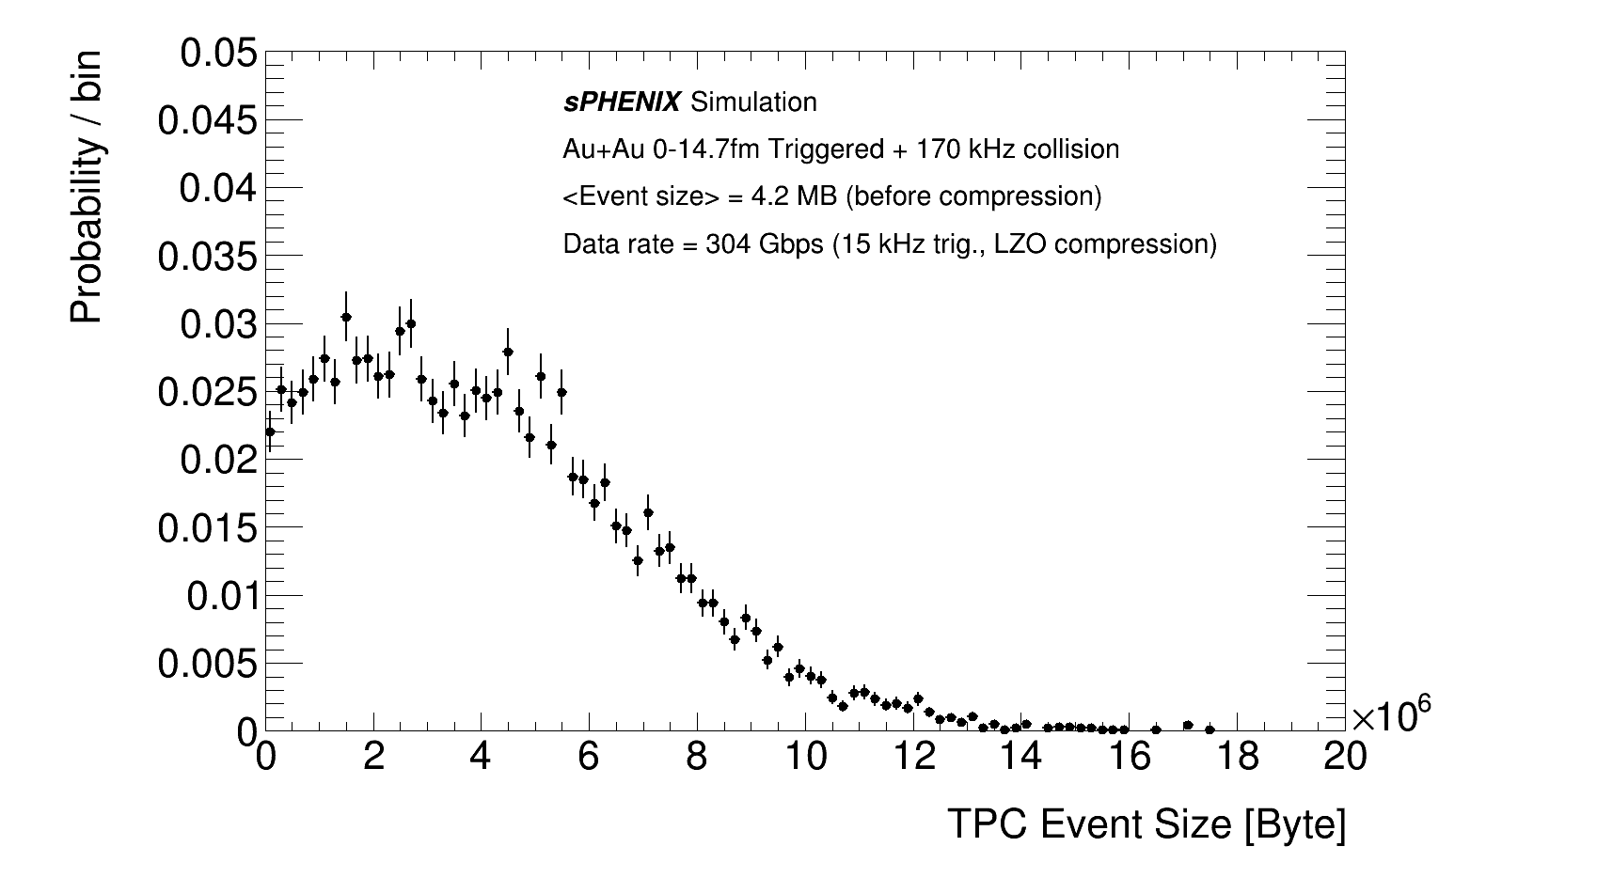
Followed up by Geant4 based simulation
After computing review, in July 2018, we improved the estimation in Geant4 based simulation: https://indico.bnl.gov/event/4024/
Mean channel occupancy in inner rings ~25% for triggered event @ 170kHz collision, 30% @ 200kHz
Average single MB event data rate consistent between <dNch/deta>x2 estimation and Geant4 simulation (15% smaller)
Full pile up simulation suggest 25% higher data rate than <dNch/deta>x2 estimation (from longer ionization trail of off-time tracks?)
FEE Occupancy, AuAu MB + 170kHz

Slide 18
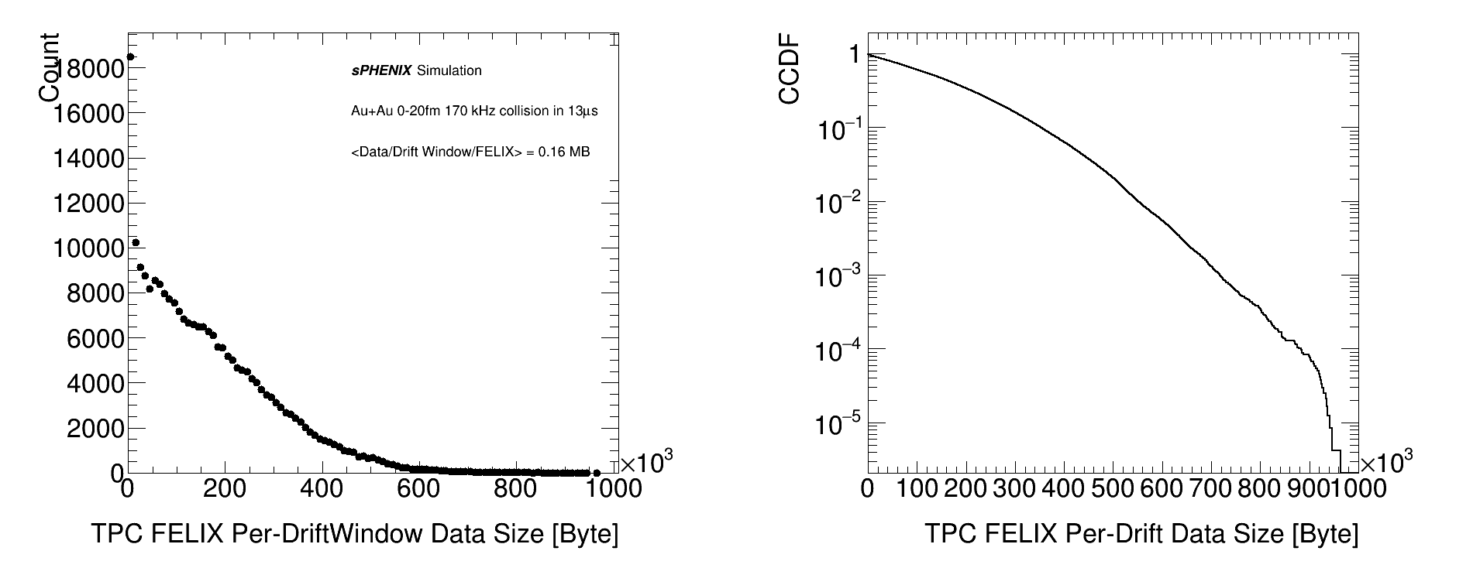
Geant4 simulation of Per-FELIX data
Estimating per-FELIX data at random time-window of 13us
Per FELIX data has mean of 0.16MB (100Gbps) and a very long tail
100Gbps * 13 us
100Gbps * 13 us

Slide 19
FELIX buffer usage
At ~100Gbps input and demonstrated FELIX output at a similar rate, transmitting all hits to the EBDC memory for trigger reduction is impractical.
However, if we throttle data on FELIX, we could dramatically reduce load on PCIe transmission
Required buffer depth ~ 70 Mb/9 MB
Guaranteed buffer for trigger delay = 16bit * 256 chan/FEE * 26 FEE * 20/us * 6.4us = 14 Mb / 1.7 MB
FIFO for DMA transmission, next slides ~ 2MB
Guaranteed buffer for taking the current trigger before generating a real-time busy signal = 16bit * 256 chan/FEE * 26 FEE * 20/us * 13us = 27 Mb/3.5 MB

Slide 20
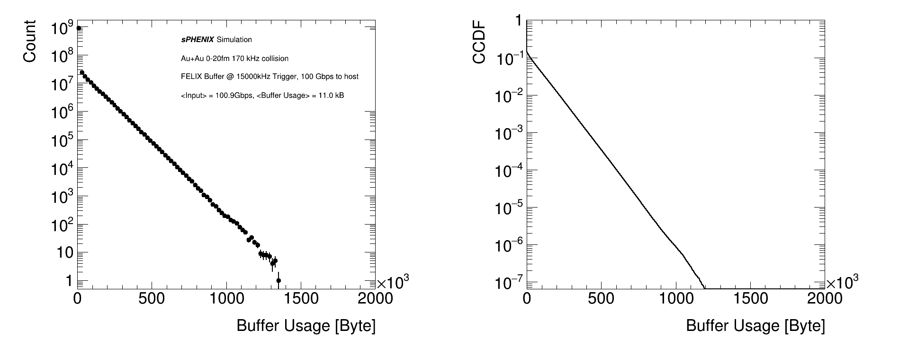
FELIX buffer usage in simulation
Using a leaky basket simulation to estimate buffer usage and probability of buffer full
At 100 Gbps DMA transfer (demonstrated throughput by ATLAS)
1MB buffer full once ~ 10s. 2MB buffer almost never get full

Slide 21
FELIX buffer usage in simulation
How about slower than expected DMA transfer? Say half speed, 50 Gbps
1 MB buffer would lead to 10⁻⁴ busy in any time frame. 2 MB would be quite comfortable.
100 Gbps DMA transfer (shown possible by ATLAS)
Much slower 50 Gbps DMA transfer

