Slide 1
sPHENIX Director’s Review
sPHENIX Intermediate Tracker (INTT) Overview/Management
WBS: 3.01
Rachid Nouicer, BNL
April 9-11, 2019

Slide 2
Strong Commitments of RIKEN/RBRC for INTT
INTT funded by RIKEN/RBRC

Slide 3
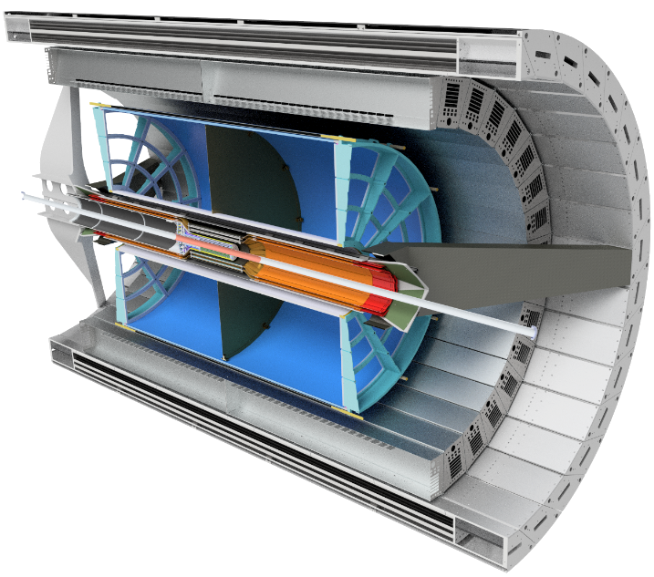
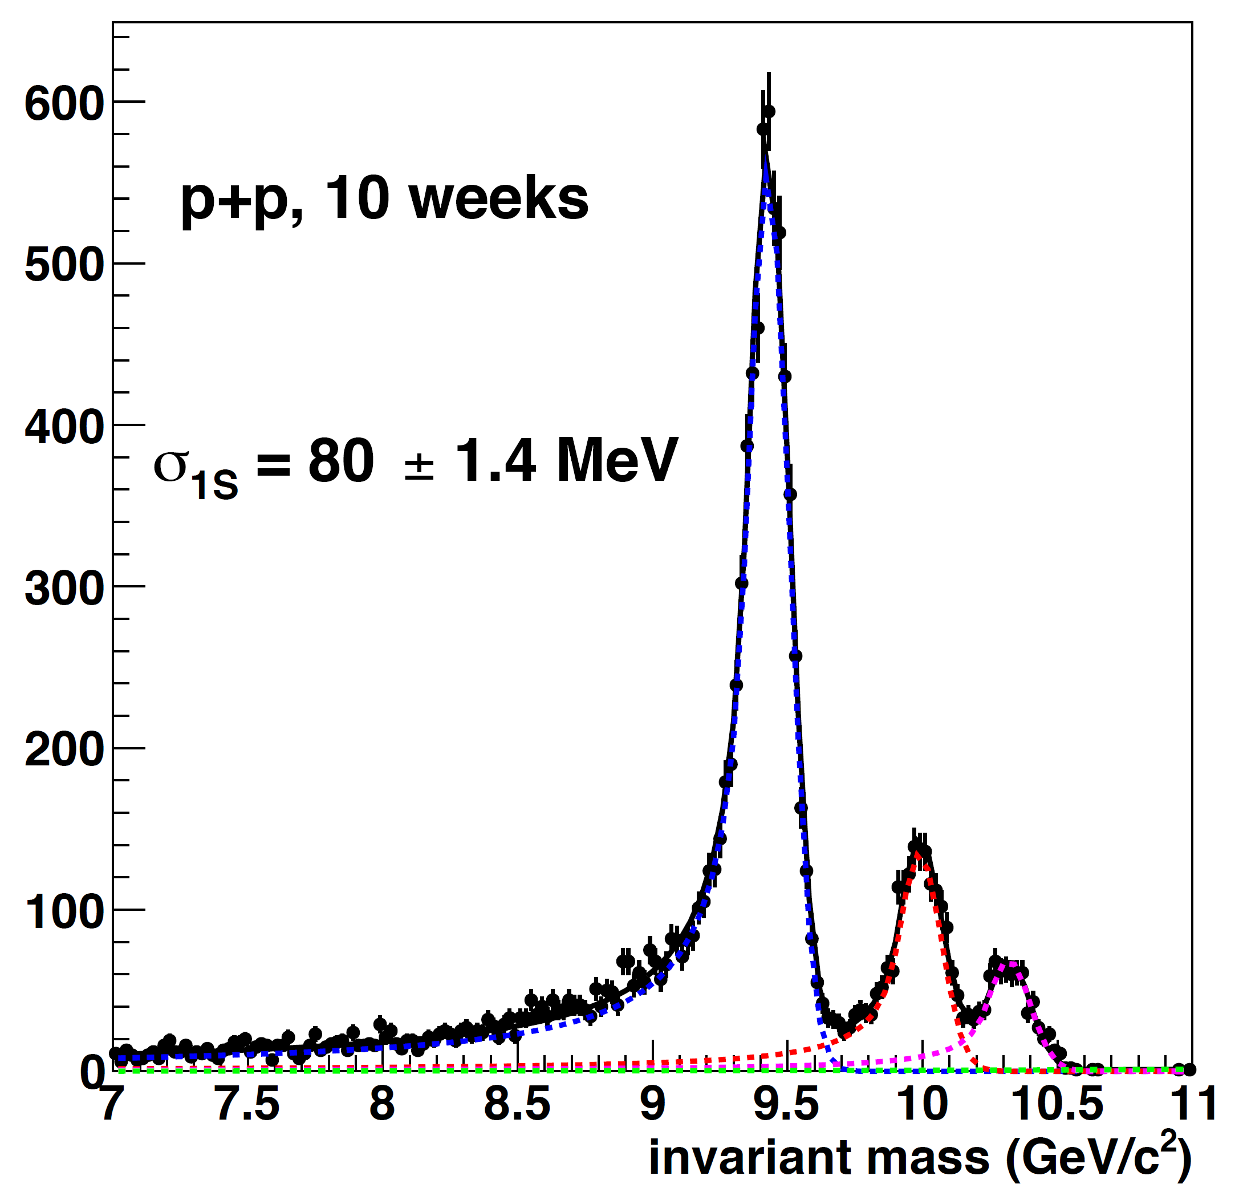
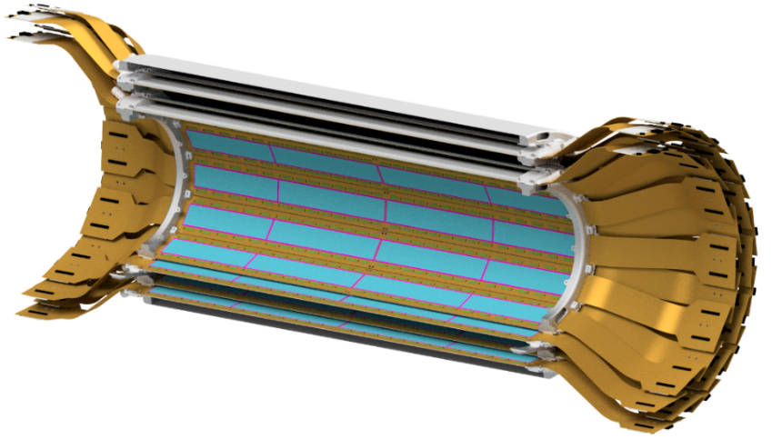
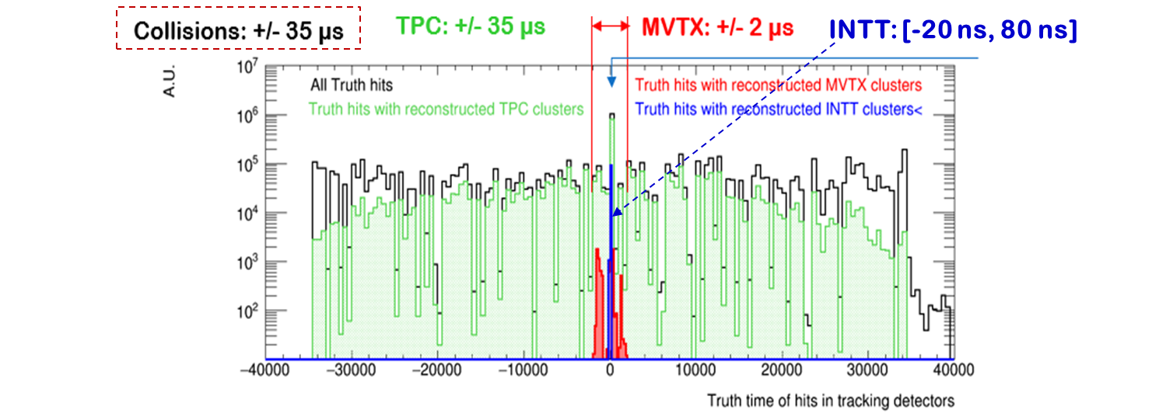
3.01 The sPHENIX INTT
Tracking System: MVTX+INTT+TPC
iHCAL
- Charged Tracking in sPHENIX:
MVTX provides vertexing
TPC provides p-resolution
INTT provides matching
Y(1S,2S,3S) → e⁺e⁻
EMCAL
- INTT has a unique role in the sPHENIX tracking system being the only detector with sufficiently fast time response to be able to associate individual tracks and events.
Mass Resolution
MVTX
TPC
INTT: Two Silicon Strip Barrels
Event generator (simulated data): event pile up

Slide 4
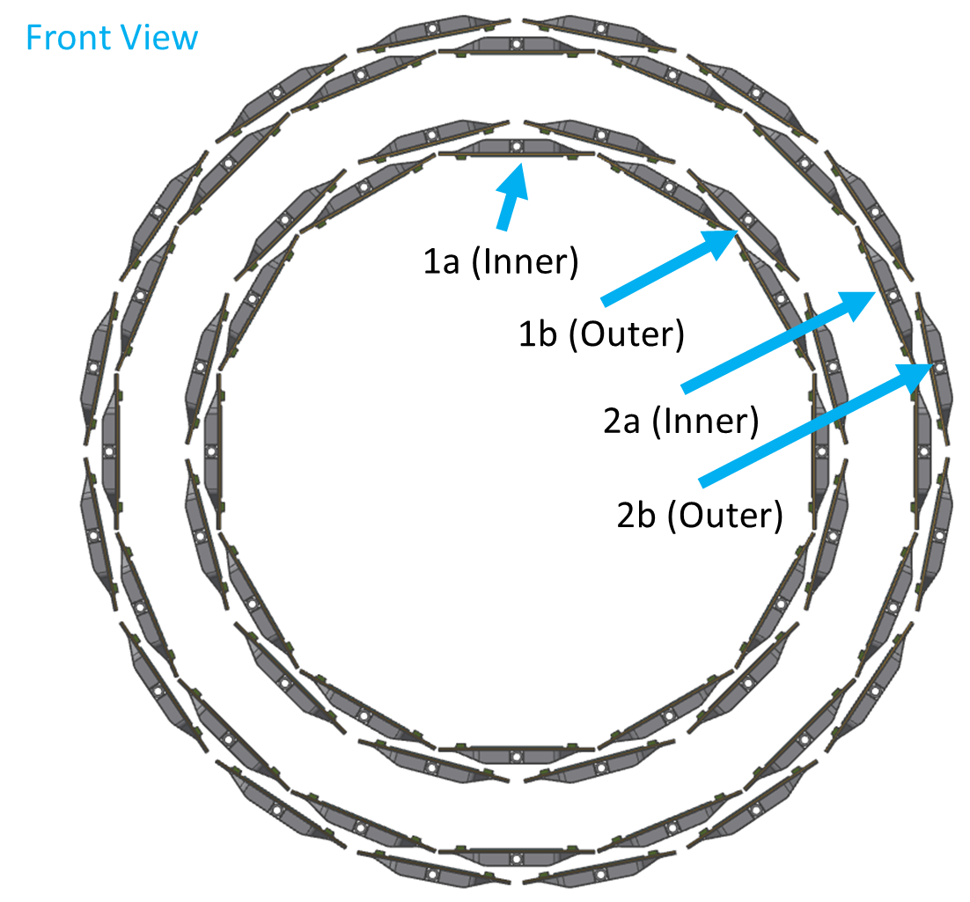
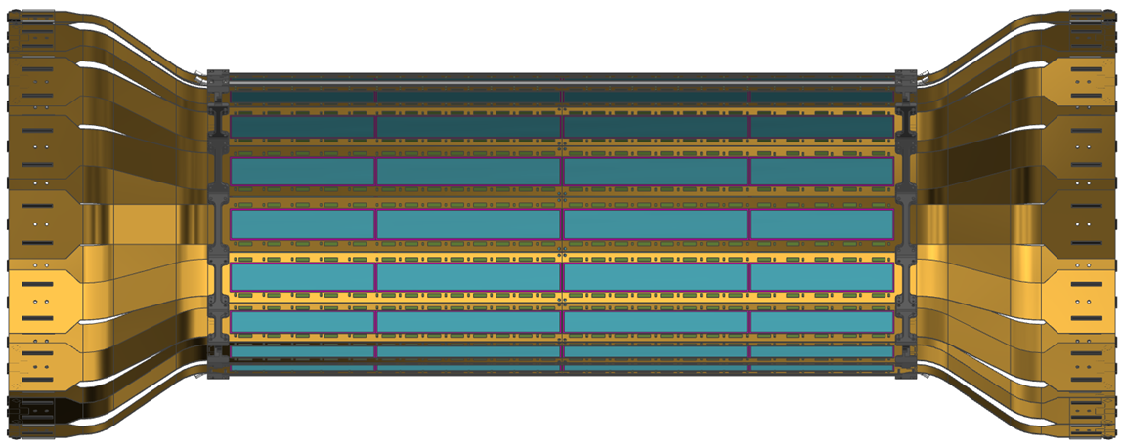
INTT Technical Overview: Two Barrels Specification
Two Barrels
Barrel | Center of Sensor Tangent Radius (mm) | Pseudo rapidity | QTY of Ladders | Angle (deg) | Coverage (PHI) (%) | Overlap (%) | Clearance (mm) | Chip Power Dissipation (W) | Stave Rad Length (%) | Barrel Rad Length (%)
1 | - | - | 24 | - | 100 | 1.8 | 2.0 | 79.88 | 0.50 | 2.16
1a (Inner) | 71.88 | 1.37 | 12 | 0 | 52.7 | 0 | 0.6 | 39.94 | 0.25 | 1.08
1b (Outer) | 77.32 | 1.31 | 12 | 0 | 49.4 | 0 | 3.4 | 39.94 | 0.25 | 1.08
2 | - | - | 32 | - | 100 | 1.8 | 2.0 | 106.50 | 0.50 | 2.16
2a (Inner) | 96.80 | 1.12 | 16 | 0 | 52.4 | 0 | 0.6 | 53.25 | 0.25 | 1.08
2b (Outer) | 102.62 | 1.07 | 16 | 0 | 49.4 | 0 | 2.8 | 53.25 | 0.25 | 1.08
Total | - | - | 56 | - | - | - | 11.88 | 186.38 | 1.00 | 4.32

Slide 5
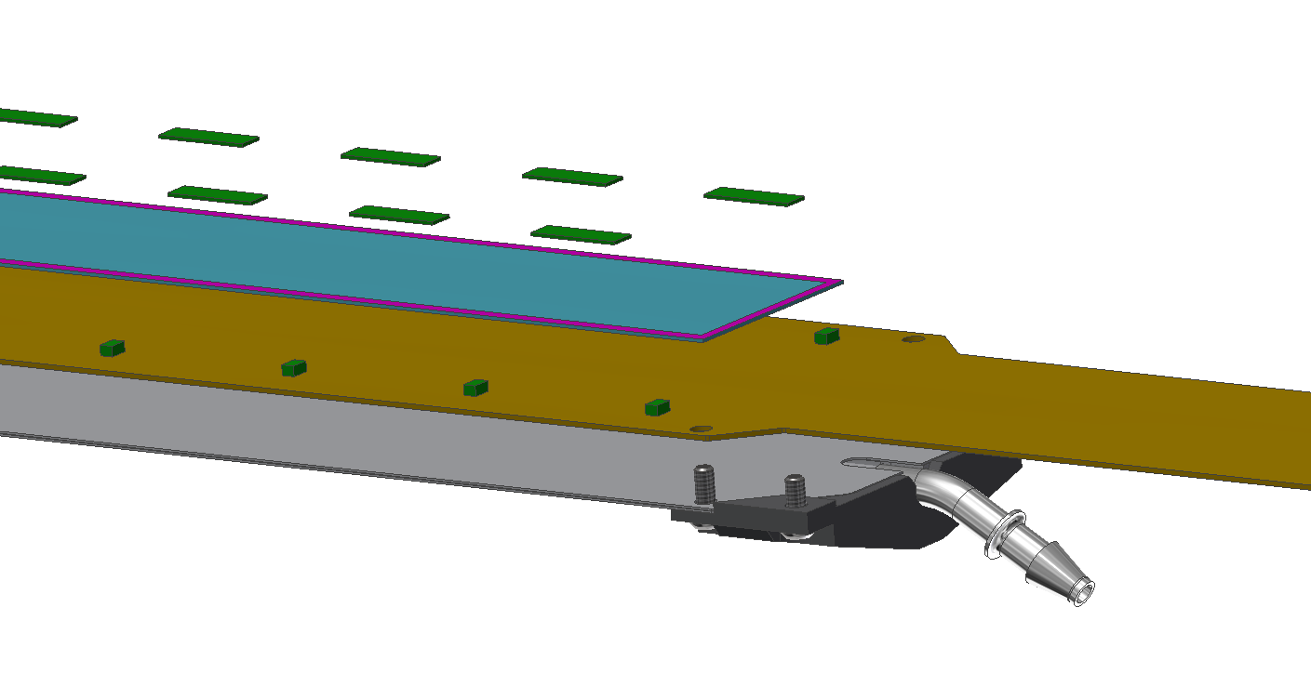
INTT Technical Overview – Ladder Components and Assembly
Ladder = 1 CFC Stave + 2 HDIs + 52 Chips + 4 Silicon Sensors
For Details See INTT Talks: Ladder/Det. Assembly
by Connor Miraval
Cross Section of Ladder
Chips (FVTX)
Silicon Sensors
CFC Stave
(M55J)
CFC-Stave
HDI
(High Density Interconnect)
Stave Endcap
(Carbon PEEK)
Cooling Barb
(304 Stainless Steel)

Slide 6
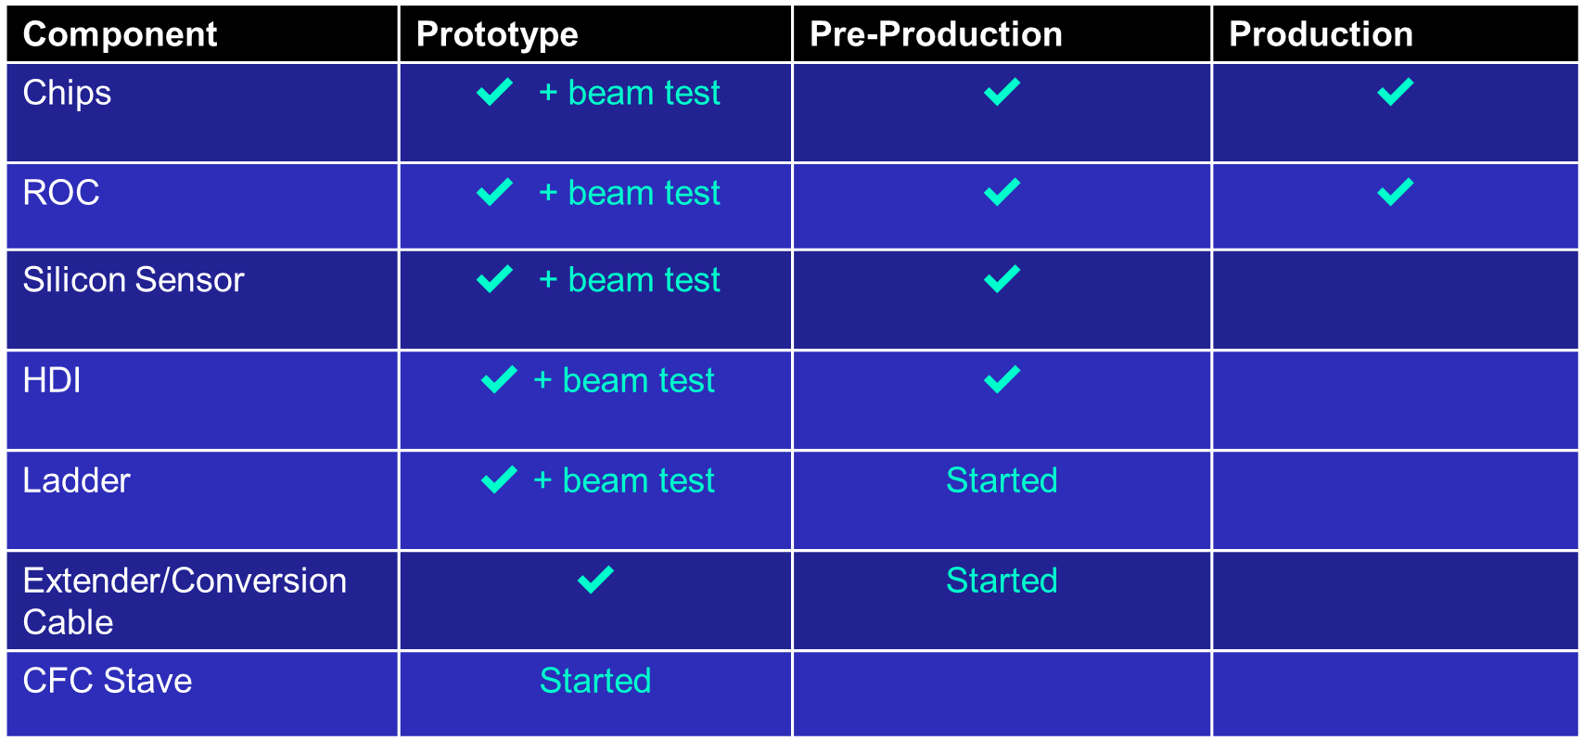
INTT Technical Overview
Ladder = 1 CFC-Stave + 2 HDIs + 4 Silicon sensors + 52 chips
For Details See INTT Talks: 1) Electronics
by Itaru’s Nakagaya
2) Ladder/Det. Assembly
by Connor Miraval
3) Mechanics/Integration & Infrastructure
By Dan Cacace
2019 Beam Test
Final Design and Safety Review (ladder)

Slide 7
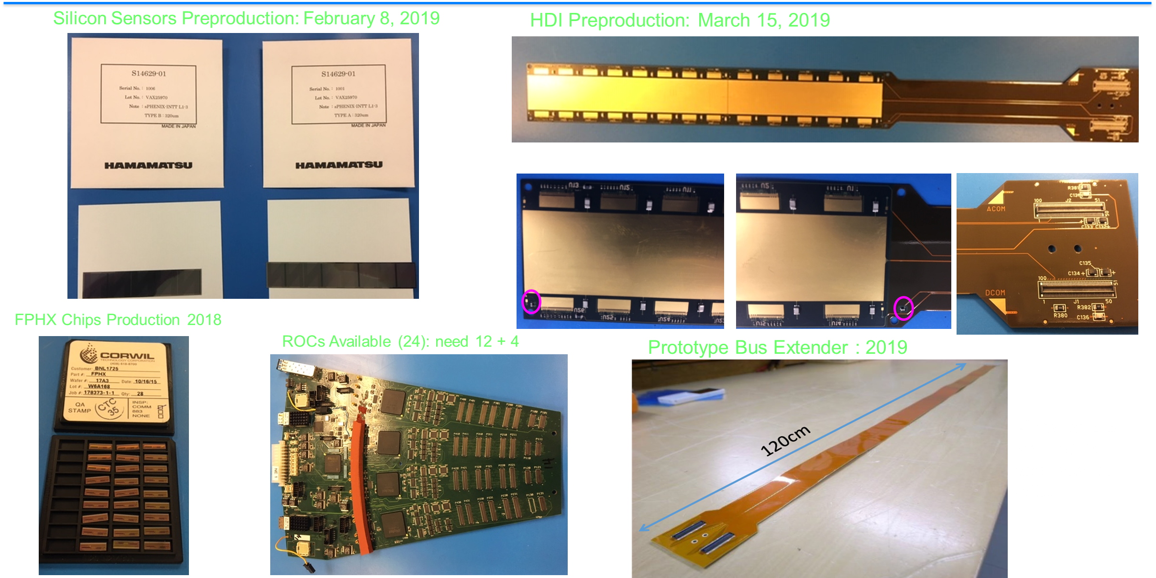
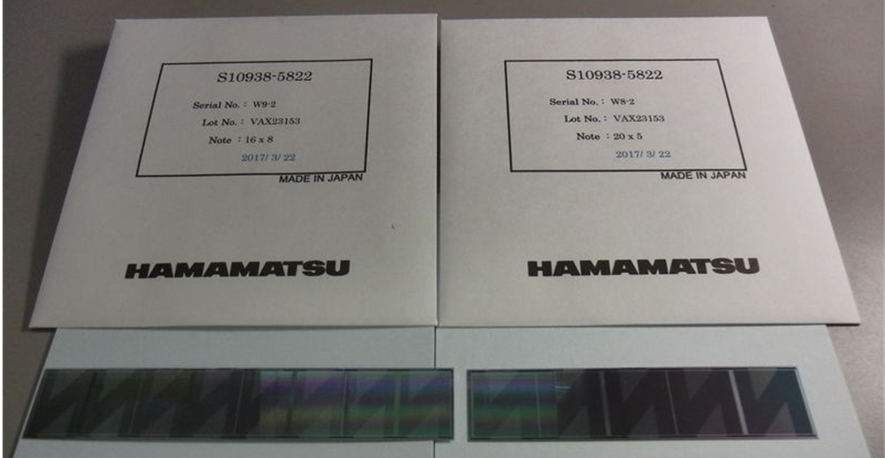
INTT Technical Overview (Components)
Silicon sensors Preproduction: February 2019
HDI Preproduction: March 2019
FVTX Chips Packaging 2018
ROC Available (24): need 12 + 4
Prototype Bus Extender: 2019

Slide 8
INTT Technical Overview: Silicon Sensors and Chip
Silicon Strip Sensor:
Very fine pitch (9.984/128 = 78 μm in φ), for good spatial resolution
High efficiency (>99%) and low noise for excellent tracking
Excellent time resolution [-20 ns, 60 ns], for no pileup
Thin-sensor/low mass, 320 μm (~0.34% X₀), for less multiple scattering
FVTX Chip:
Type A
Type B
Type A: Single sensor = 8 x 2 cells
Type B: single sensor = 5 x 2 cells
Photo FVTX chip
p-implant on n-bulk, Ac-coupled, 1.5 MΩ polysilicon resistors
Depletion voltage < 100V, Resistivity 3 to 5 kΩ-cm
Single cell geometry (active region):
128 strips (better resolution in φ-direction)
Strip width = 78 μm
φ-length = 78 μm x 128 strips x 2 cells =19.968 mm
z-length = A: 16 mmx 8=128 mm (B: 20 mm x5=100 mm)

Slide 9
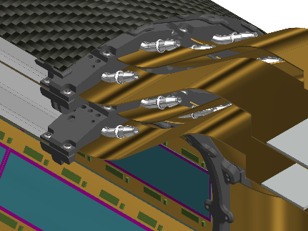
INTT Scope and Deliverables By RIKEN/RBRC
3 Half Ladders
3.01.01: INTT Construction
Ladder (Silicon Sensors + HDI + 52 Chips) Assembly: 100 Ladders
Endcap Rings (Carbon-Peek): 6 Support Structures to Build Barrels
Support Rails (Carbon-Fiber-Composite): 4 Support Rails Carrying Barrels
Barrels Assembly: 2 Barrels (4 sub-layers)
INTT Assembly: 2 Barrels + Extender/Conversion cables + ROCs + Survey
3.01.02: INTT Electronics
Design and Fabrication of Silicon Strip Sensors (Hamamatsu co.) : 400 Silicon Sensors
Testing and Evaluation of Silicon Sensors, and Implementation in Database
High Density Interconnect (HDI) Design and Fabrication (Yamashita co.) : 200 HDI Cables
Extender Cables (TAIYO-KOSAKUSHO co. ) and Conversion Cables: 200 Cables
FPHX Chips = 5,200 Chips
3.01.03: INTT Integration in sPHENIX
Temperature/Humidity Monitoring, Low and High Power Supplies, Optical Fibers, and Commissioning
Front View
Barrels

Slide 10
INTT Collaborators
Institutions:
BNL, RIKEN, RBRC, Purdue University,
Nara Woman’s University (NWU), and
National Central University (NCU)
Team:
Professors: Takashi Hachiya, Wei Xie, Chia-Ming Kuo
Physicists: Rachid Nouicer, Itaru Nakagawa, Yasuyuki Akiba, Jin Huang, John Haggerty, Martin Purschke, Eric Mannel
Physics Associates: Rob Pisani, Takahito Todoroki
Chief Engineer: Russ Feder
Mechanical Engineers:
Dan Cacace, Connor Miraval
Mechanical Technicians:
Mike Lenz, Bill Lenz
Designers: Rich Ruggiero
Electrical Engineer: Steve Boose
Electrical Technician: Sal Polizzo, Donald Pinelli
Edward O’Brien (BNL)
L1 Manager
Yasuyuki Akiba (RIKEN/RBRC)
Consultant
Dan Cacace (BNL)
L3 Manager
Connor Miraval (BNL)
L3 Manager
Takashi Hachiya (NWU)
L3 Manager
Rachid Noicer (BNL)
Itaru Nakagawa (RIKEN)
L2 Manager
Wei Xie (Purdue U.)
L3 Manager
Chia-Ming Kuo (NCU)
L3 Manager
Ayaka Suzuki
+Undergrads
L4 Manager
Mechanical Design
Assembly
Testing, Monitoring
Silicon Testing, Database
Bus Extender

Slide 11
INTT Schedule Drivers
Schedule is being driven by the funds RBRC/RIKEN (Japanese fiscal year) has available for purchasing the INTT components:
Silicon Sensors, HDIs, Extender Cables, and CFC Staves
Secondary driver, time of processing procurements (RIKEN/Japan) for the INTT components.
Need additional BNL engineering and technician FTEs to support delivery of INTT components which will be paid for by RIKEN/RBRC:
ROC (need electronic engineer, more details in Itaru’s Nakagaya talk):
Reuse of 5 years of operation, some broken function in some ROCs, many components are discontinued, original FPGA coder left the field long time ago.

Slide 12
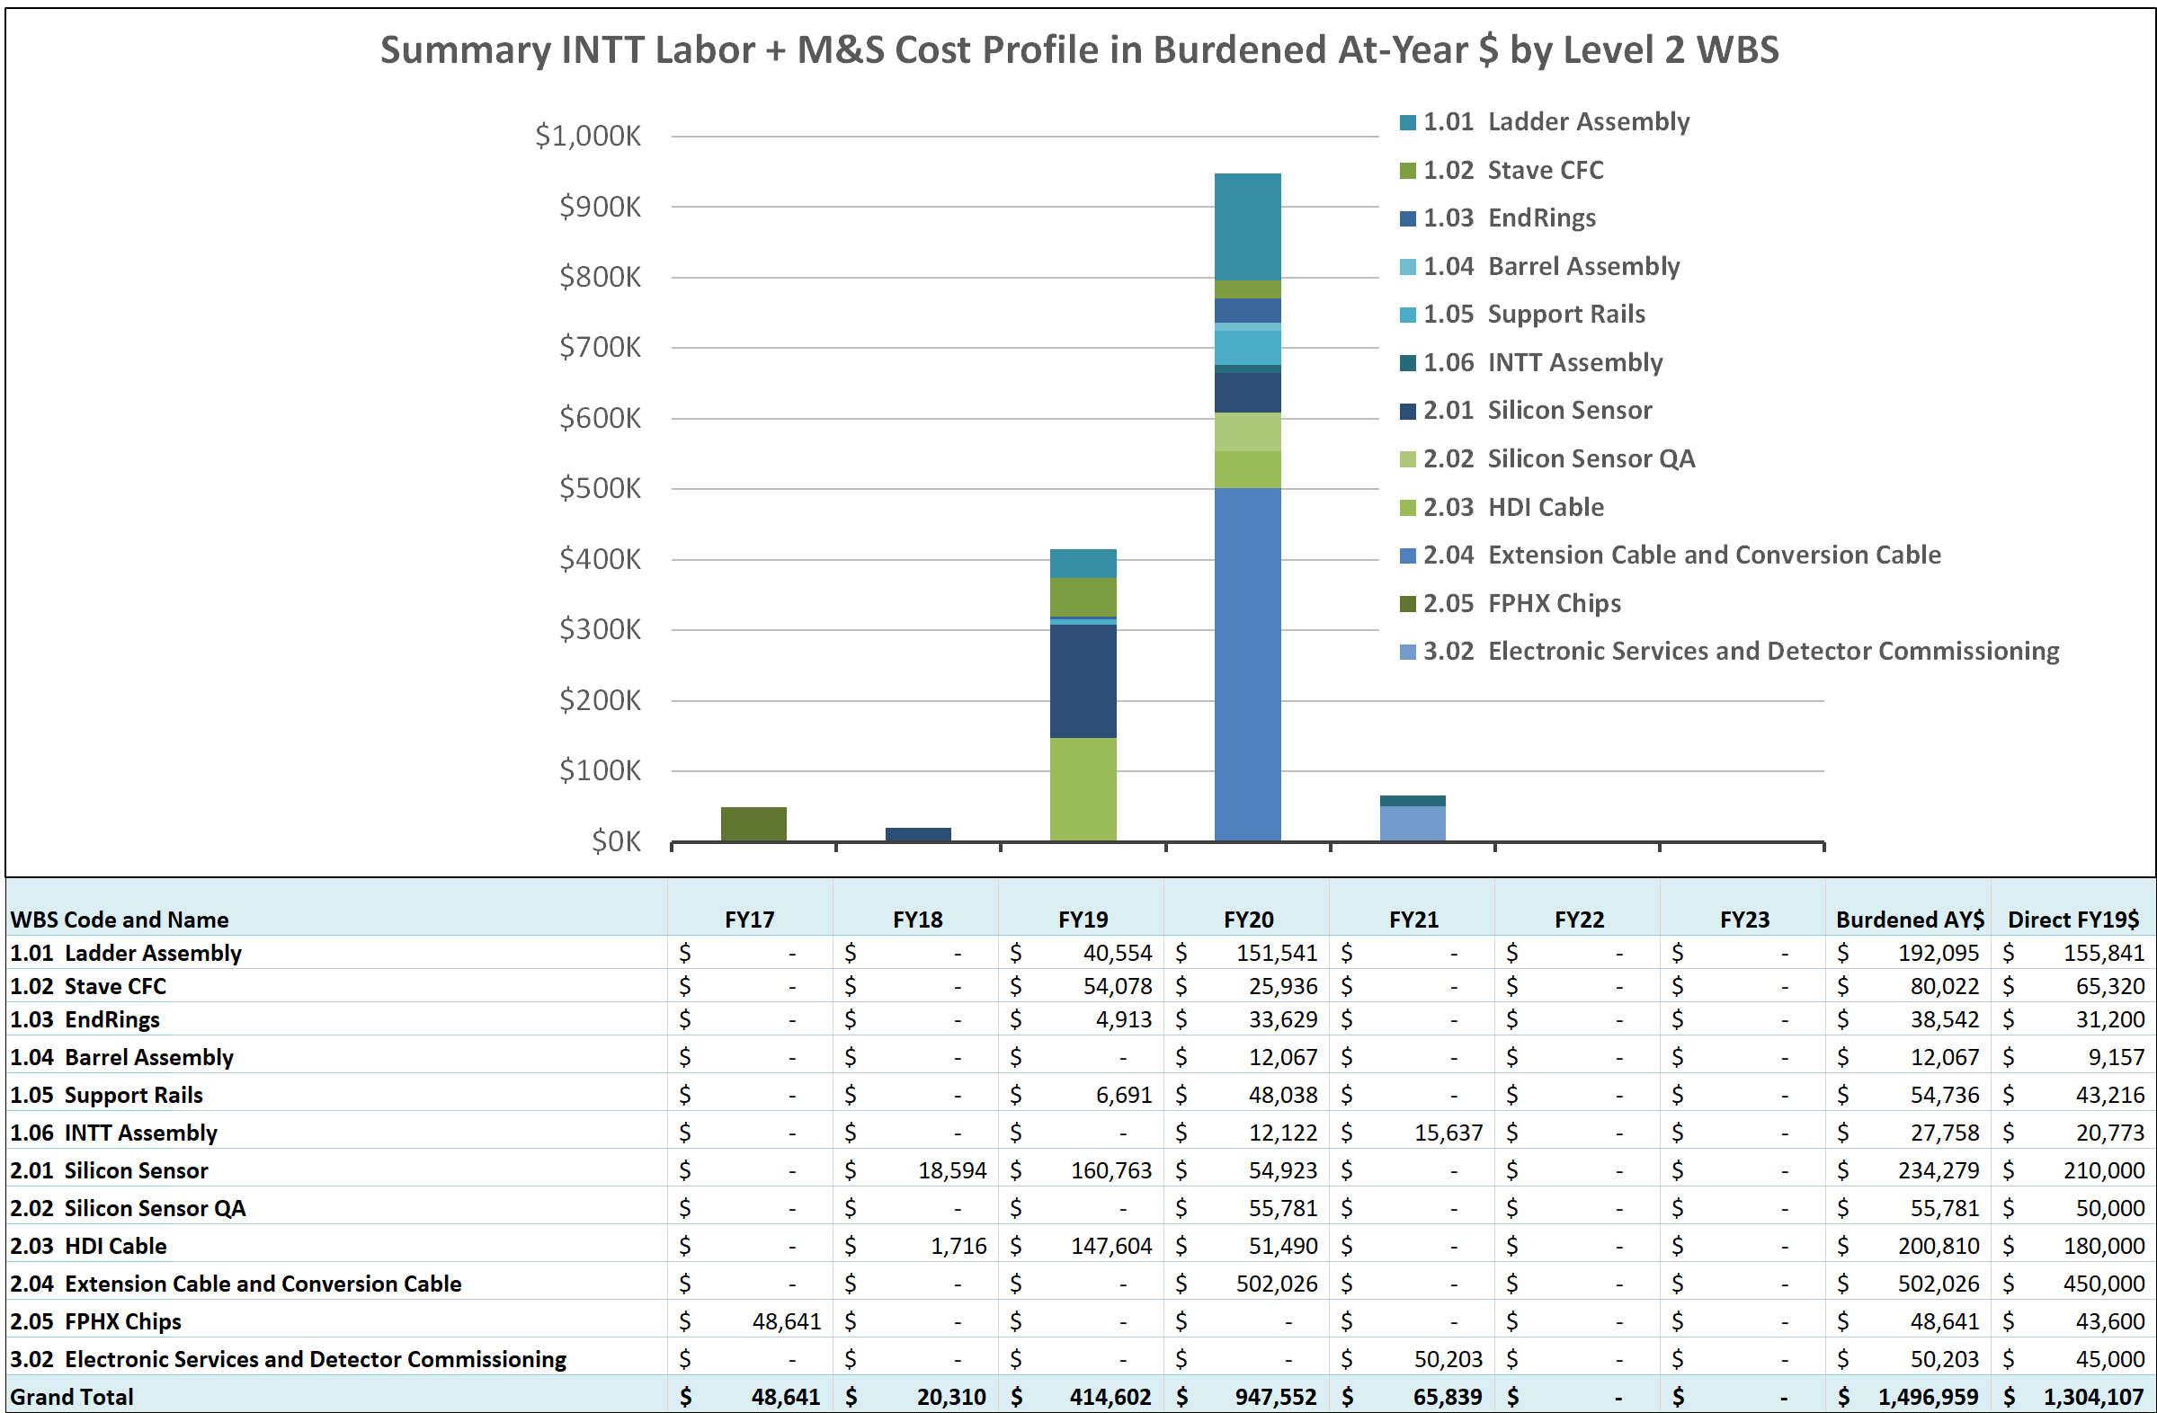
INTT Cost Drivers: RIKEN Funded

Slide 13
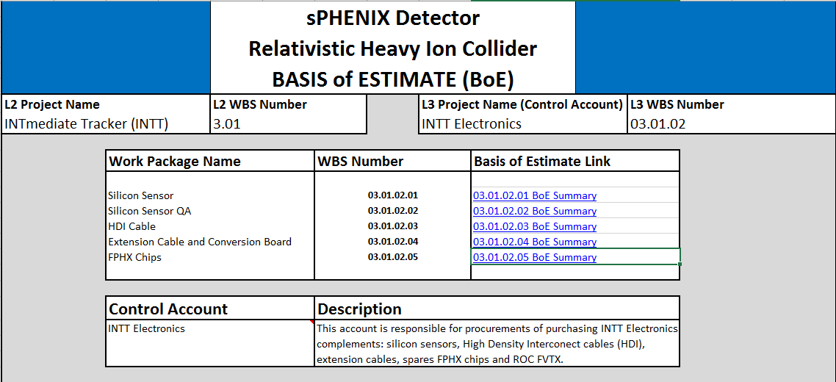
INTT Basis of Estimate & Resource-Loaded Schedule
One file per L3 (5 for 03.01.02 total for INTT)
One Summary/Details
Consistent w/ P6

Slide 14
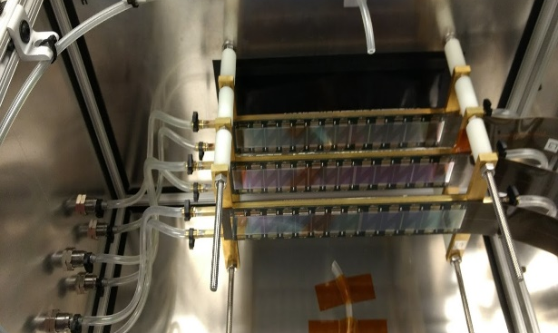
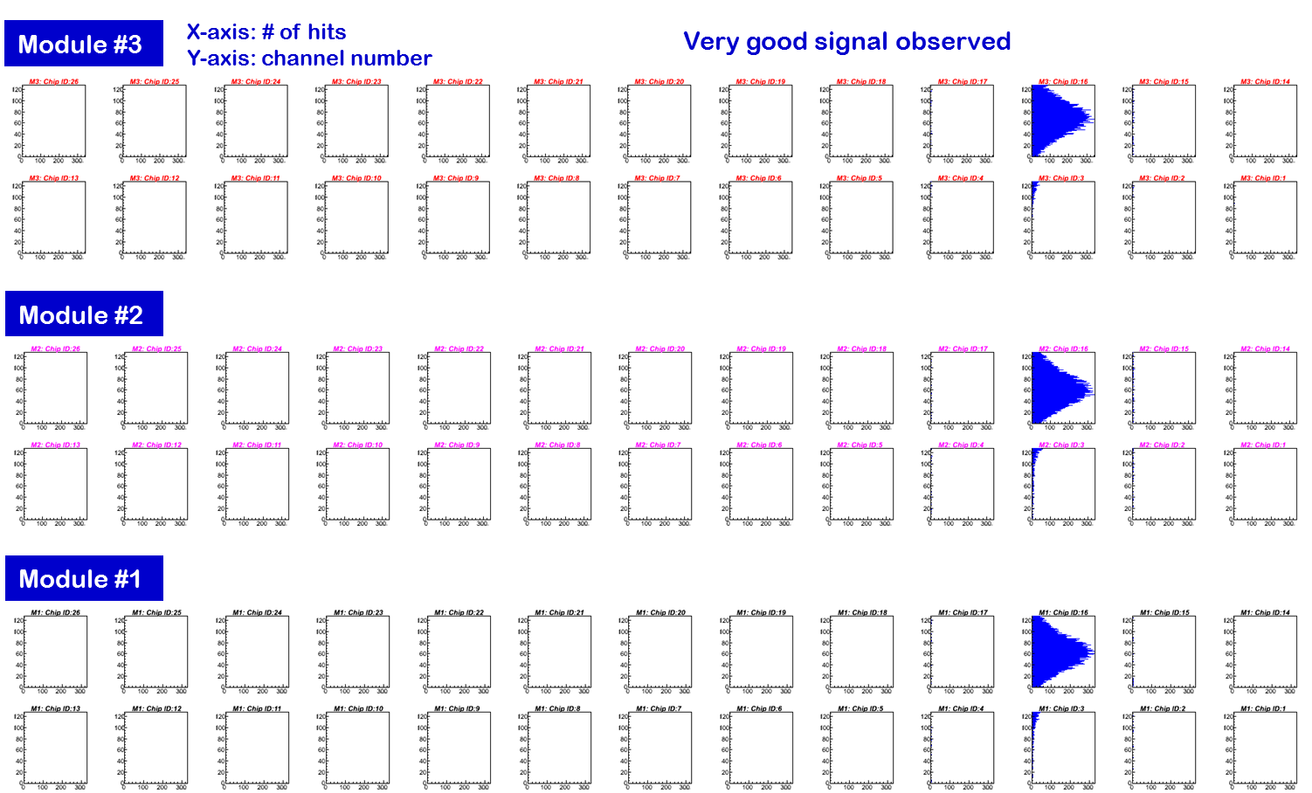
INTT Status and Highlights
Highlights from March 2018: INTT Telescope (Prototype Silicon Modules) Beam Test at FNAL Proton Beam 120 GeV
Successful Beam Test
Status: June 2019: 120 GeV Proton beam test at FNAL using Pre-production silicon modules
Full readout chain (including prototypes bus extender and conversion cable)
More detail study of the detector performance and tracking resolution.
Conversion Cable
Silicon Module
Bus extender

Slide 15
INTT Status and Highlights
Highlights from March 2018: INTT Telescope (Prototype Silicon Modules) Beam Test at FNAL Proton Beam 120 GeV
Status: 2018: - Prototype INTT components- silicon sensors + chips +HDI cable Successful tests (source test + beam test)
Plan:
2019: - Preproduction of INTT components (beam test)
→ Final Design and Safety Review Summer 2020: - Mass production of electronics components, and detector assembly.
Successful Beam Test
Status: June 2019: 120 GeV Proton beam test at FNAL using Pre-production silicon modules
Full readout chain (including prototypes bus extender and conversion cable)
More detail study of the detector performance and tracking resolution.
Conversion Cable
Silicon Module
Bus extender

Slide 16
INTT Issues and Concerns
There is a need for students/Post-docs for ladder and barrel tests, evaluation and data entry in the database during assembly.

Slide 17
3.01: INTT Environmental, Safety and Health (ES&H)
- The INTT detector assembly (ladders, barrels and testing) work is carried in the silicon lab room 2-211 in the physics department at BNL.
- The INTT Environment, Safety, and Health (ES&H) at the silicon lab (room 2-211) is handled by Brookhaven National Laboratory Integrated Safety Management System (ISMS) through the Silicon Lab Experimental Safety Review (ESR) Form: PO-035-2016.
- The Silicon Lab ESR Form describes all the works carried out by the INTT team and trainings required from each individual. The INTT individuals working in the silicon lab are registered in the Brookhaven National Laboratory Integrated Safety Management System (ISMS). The individuals are notified in case their training is expired or new trainings are required.
- All work associated with the INTT silicon lab will be conducted in a manner that ensures protection of the people (required trainings to achieve the work safely and effectively, glasses,…) , and the environment. Implementing procedures and additional guidance to ensure accomplishment of these expectations will be established as necessary and communicated to members of INTT team.
- All INTT components needed to meet mission requirements are fully defined and are designed, assembled, and operated in accordance with applicable Federal (including DOE) requirements.
- The INTT Environment, Safety, and Health (ES&H) follow sPHENIX ES&H at BNL. The work of INTT at the silicon at BNL is under the supervision of Achim Franz as its Experiment Review Coordinator (ERC).

Slide 18
Summary
• The INTT has a unique role in the sPHENIX tracking system being the only detector with
sufficiently fast time response to be able to associate individual tracks and events.
• The INTT has essential roles in the aspects of tracking pattern recognition, and in matching TPC tracks to MVTX hits.
• Excellent progress in many fronts:
- Prototype silicon sensors and HDI: design and fabrication achieved successfully (beam test)
- Preproduction underway and preparation for next beam test June 2019.
• INTT conceptual design meet the scientific objectives, near completion, and achieved in coordination within the sPHENIX integration task force (Office System Integration).
• RIKEN has committed to delivering the INTT.

Slide 19
Back Up

Slide 20
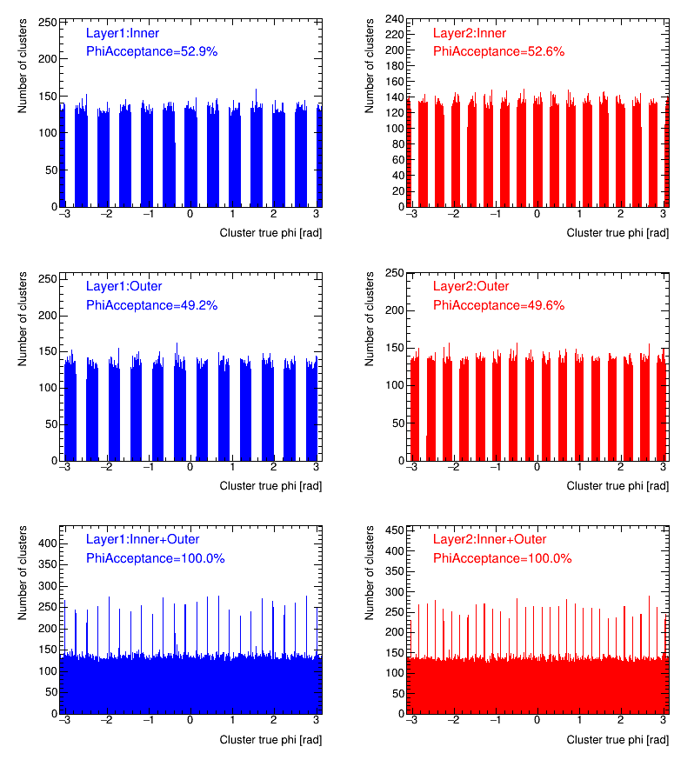
Outline
INTT Two Barrels Layout Active Area: Simulation
100% phi coverage: only silicon active area shown
Simulation set up
1.4T magnetic field
100 pi+ per event
Most recent INTT ladder configuration (sensor position)
INTT geometry update in Simulation
Stave: done
Carbon-Peek Endcap Rings: done
Rails: done
HDI outside Endcap Rings: in progress
Bus Extender: in progress
Notes:
20
Le titre de l’expose est:

